Slide 1
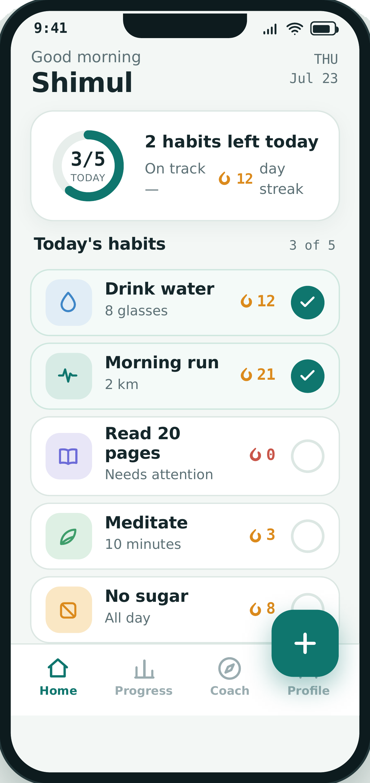
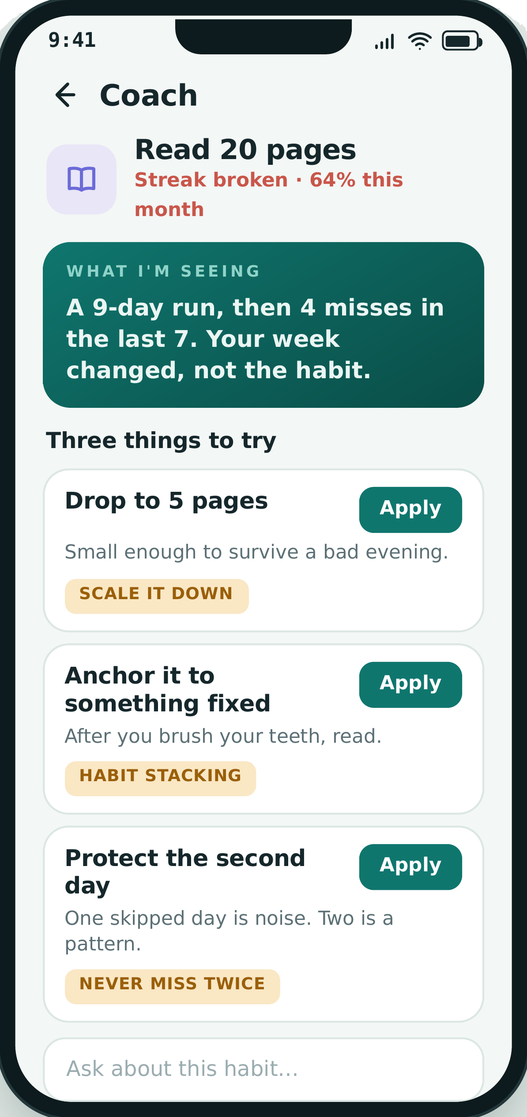
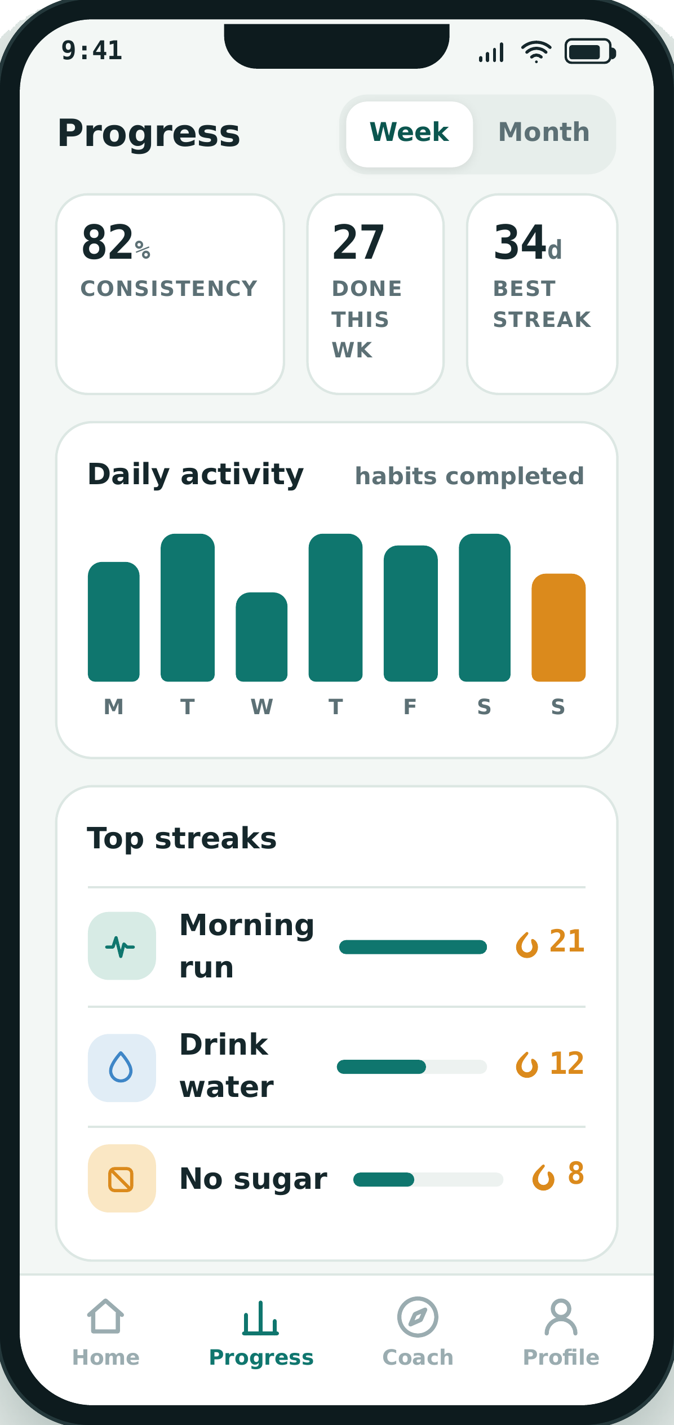
01 / 23
CSE-410 · PROJECT DOCUMENTATION · DOCUMENT 1 OF 2
HabitFlow
Screen Details
Fifteen screens specified to Jetpack Compose level — every element numbered, measured in dp and sp, named against a design token, and paired with the behaviour it triggers.
NAME
EXAM ROLL
ROLL
PLATFORM
THEME
Shimul Baidya
220419
359
Android · Kotlin
Lifestyle (Habits)
Habits stay on the device. The Coach is the one online call.

Slide 2
GUIDE
How to read this document
02 / 23
Six conventions hold across all fifteen screen slides.
1
Numbered badges
2
Colours are named, not hard-coded
Every callout on a mockup carries a number. The row with the same number in the table beside it is that element's full specification.
Specs reference tokens such as primary or on.surface. HabitFlow ships light and dark, so slide 3 is the only place a hex value appears — resolve every token there and nowhere else.
3
Units
4
Components are specified once
dp for anything measured, sp for anything typed, ms for motion. No pixel values appear in this document.
Slide 5 defines twelve reusable components. A row that reads C-01 inherits that entire specification; only the differences are restated.
5
Screen IDs are permanent
6
Footer strip
SCR-01 to SCR-15 are used again in the UI Flow document, so a node there points at exactly one slide here.
Purpose, where the screen is entered from, where it exits to, which Room entities feed it, and every state it must handle.
A row with no badge
Scope of this document
Numbers past the last badge describe behaviour with no single visual anchor — navigation rules, request scope, persistence. Those numbers appear in grey in the table and nowhere on the mockup.
Fifteen screens across five sections: Entry, Daily use, Habit management, AI Coach and Insight/Account. Screen-to-screen navigation is specified in Document 2, the UI Flow.

Slide 3
F-01
Foundations — colour
03 / 23
The only slide in this document that contains a hex value. Every screen specification names a token and resolves it here.
Token | Light | Dark | Used for
surface | #F3F7F5 | #0F1A1C | Screen background
surface.card | #FFFFFF | #162427 | Habit rows, stat cards, sheets
surface.sunken | #E7EEEB | #0A1416 | Chart tracks, progress rails
on.surface | #0D1B1E | #ECF3F1 | Habit names, headings, values
on.surface.muted | #5C7075 | #9DB0B3 | Sub-labels, units, helper text
on.surface.faint | #8A9B9E | #6E8285 | Placeholders, inactive nav
primary | #0F766E | #2DD4BF | Filled buttons, done rings, active nav
on.primary | #FFFFFF | #04201E | Text and icons on primary
primary.container | #D7EBE5 | #123A38 | Apply pills, coach callouts, chips
on.primary.container | #0B5A54 | #A7E8DF | Text on primary.container
danger | #C2410C | #F87171 | Broken streak, destructive actions
danger.container | #FBEBE8 | #33201E | Needs-attention banner background
outline | #E5ECE9 | #24363A | Card hairlines, dividers
scrim | #0D1B1E | #000000 | Behind bottom sheets, 55% alpha
Dark values are tuned for contrast, not inverted. primary lifts to 2DD4BF so a completion ring stays legible on a dark surface; danger lifts for the same reason.

Slide 4
F-02
Foundations — type, spacing and metrics
04 / 23
Nine type roles and nine layout rules. No value outside these appears on any screen slide.
Role | Size | Weight | Line | Used for
display | 32sp | Bold | 38sp | Greeting name, splash wordmark
headline | 26sp | Bold | 32sp | App bar titles, screen titles
title.lg | 22sp | Bold | 28sp | Section headings, empty-state titles
title | 20sp | Bold | 26sp | Habit names, card titles
stat | 32sp | Bold | 36sp | Streak and percentage figures
body | 16sp | Regular | 22sp | Coach prose, descriptions
caption | 14sp | Regular | 19sp | Sub-labels, goal text, units
label | 12sp | Bold | 16sp | ALL-CAPS section labels, +1.5sp tracking
micro | 11sp | Bold | 14sp | Strategy tags, nav labels
Layout rules
Design viewport
393 x 832 dp (Pixel-class); all values scale from this
Screen gutter
20dp left and right on every screen
Spacing scale
4 / 8 / 12 / 16 / 20 / 24 / 32 dp — no other values
Corner radius
sm 8dp · md 12dp · card 16dp · sheet 24dp · pill 50%
Elevation
Cards 0dp + 1dp outline · bottom sheet 8dp · dialog 12dp
Touch target
48 x 48dp minimum on every tappable element
Icon sizes
20dp inline · 24dp nav and app bar · 44dp empty-state
Motion
Ring fill 300ms · sheet 250ms · nav fade 150ms, all standard easing
Type face
Roboto — the Compose default; no font is bundled with the APK

Slide 5
F-03
Foundations — component library
05 / 23
Twelve reusable components. A screen row that reads C-01 inherits this entire specification; only differences are restated.
ID | Component | Composable | Specification | Appears on
C-01 | Habit row | Card + Row | 72dp tall, 16dp radius, surface.card, 1dp outline, 16dp inner padding | SCR-04, SCR-03
C-02 | Completion ring | Canvas + IconButton | 40dp outer, 4dp stroke, primary sweep on surface.sunken track, 300ms fill | SCR-04
C-03 | Streak chip | Row + Text | Flame icon 16dp + count in title/20sp primary; danger when streak is 0 | SCR-04, SCR-07, SCR-08
C-04 | Stat trio | Row of 3 Column | Equal weight, stat/32sp value + label/12sp caps, 24dp above and below | SCR-07, SCR-08, SCR-12, SCR-13
C-05 | Month grid | LazyVerticalGrid(7) | 28dp dot, 8dp gap; filled = done, sunken = missed, 2dp primary outline = today | SCR-07, SCR-08
C-06 | Suggestion card | Card + Column | 16dp radius, title/20sp, caption body, Apply pill right, micro tag beneath | SCR-06, SCR-09, SCR-10
C-07 | Apply pill | Button(shape = pill) | 78 x 32dp, primary.container fill, on.primary.container label at micro/11sp | SCR-06, SCR-09
C-08 | Primary button | Button | 56dp tall, full width minus gutters, pill shape, primary fill, title/20sp | SCR-02, SCR-03, SCR-05
C-09 | Bottom nav | NavigationBar | 72dp tall, 4 items, primary when selected, on.surface.faint when not | SCR-03, SCR-04, SCR-12, SCR-13, SCR-15
C-10 | Section label | Text | label/12sp caps, +1.5sp tracking, on.surface.muted, 12dp below the block above | All screens
C-11 | Coach input bar | OutlinedTextField + FAB | 44dp field, pill shape, 44dp send button; docked, keyboard-aware | SCR-06, SCR-09, SCR-10
C-12 | Bottom sheet | ModalBottomSheet | 24dp top radius, 8dp elevation, 32dp drag handle, 55% scrim behind | SCR-14

Slide 6
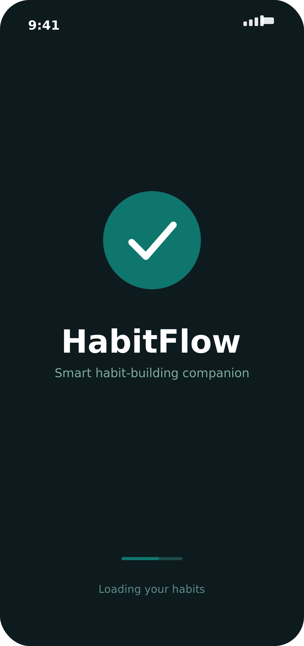
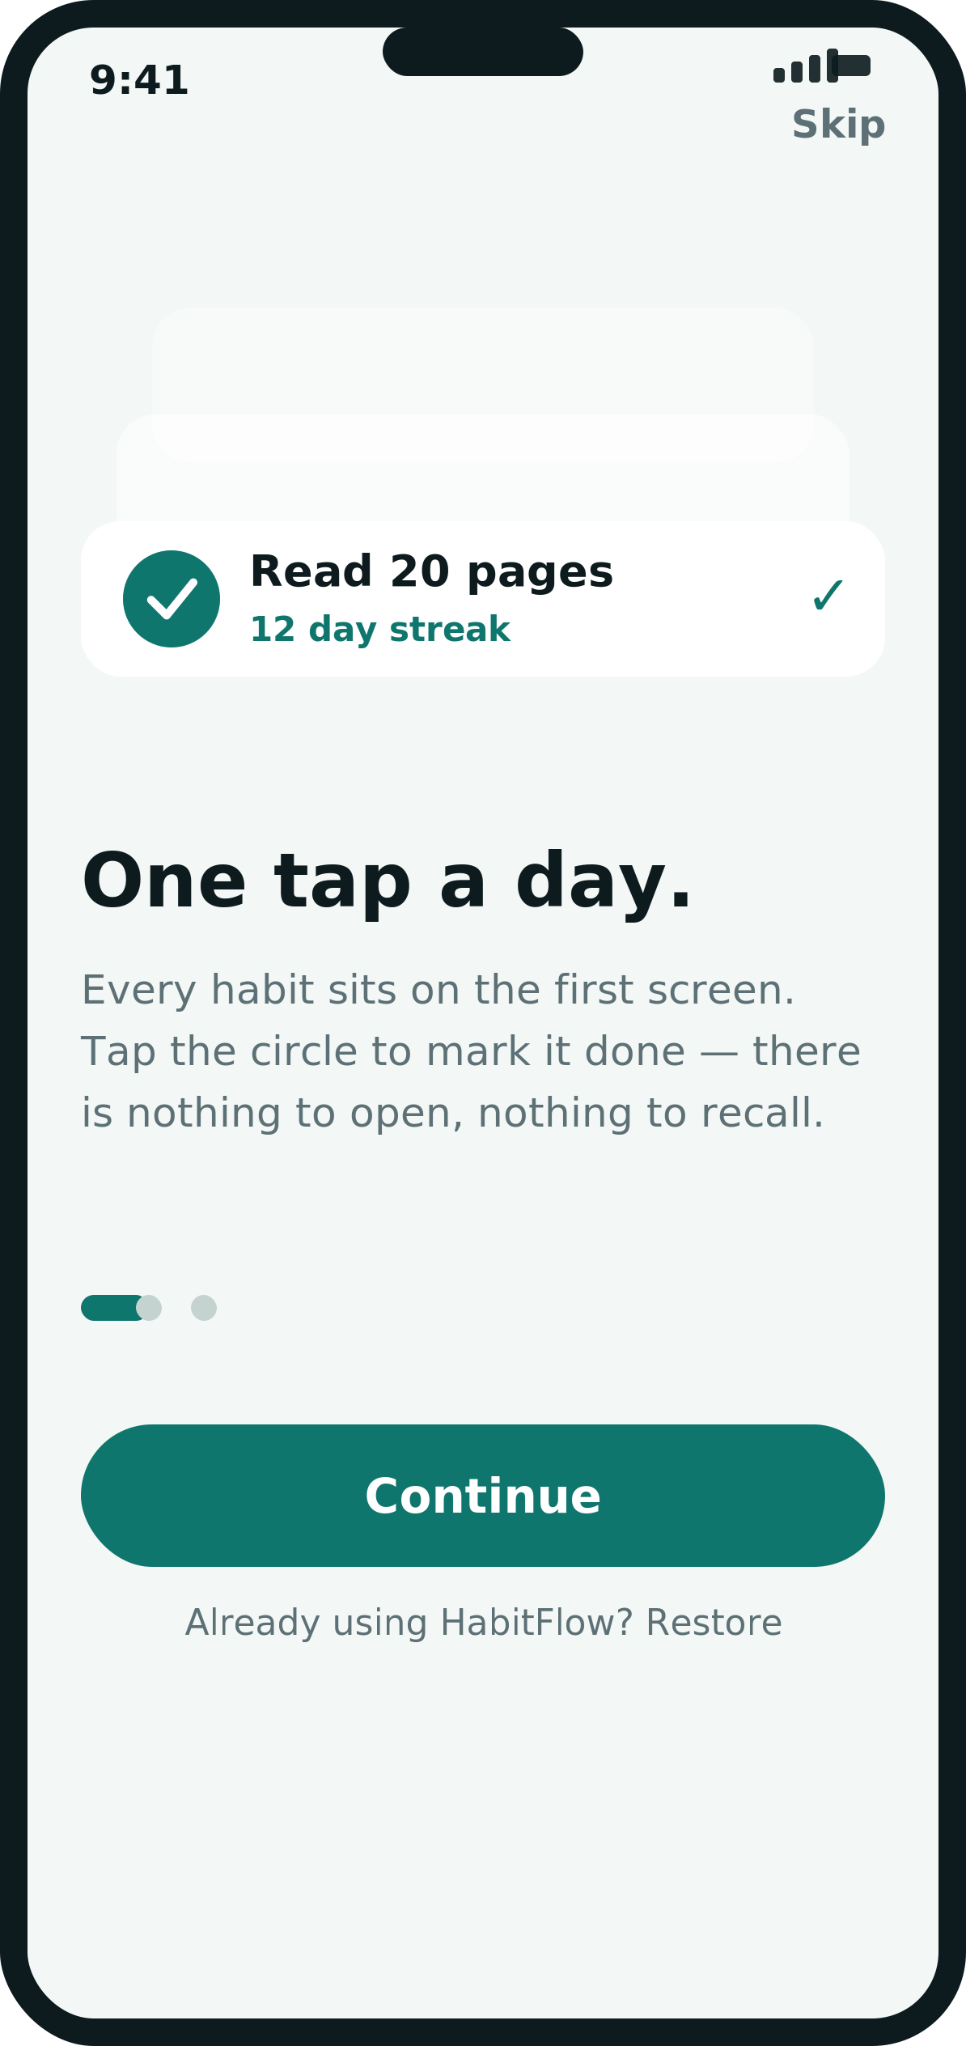
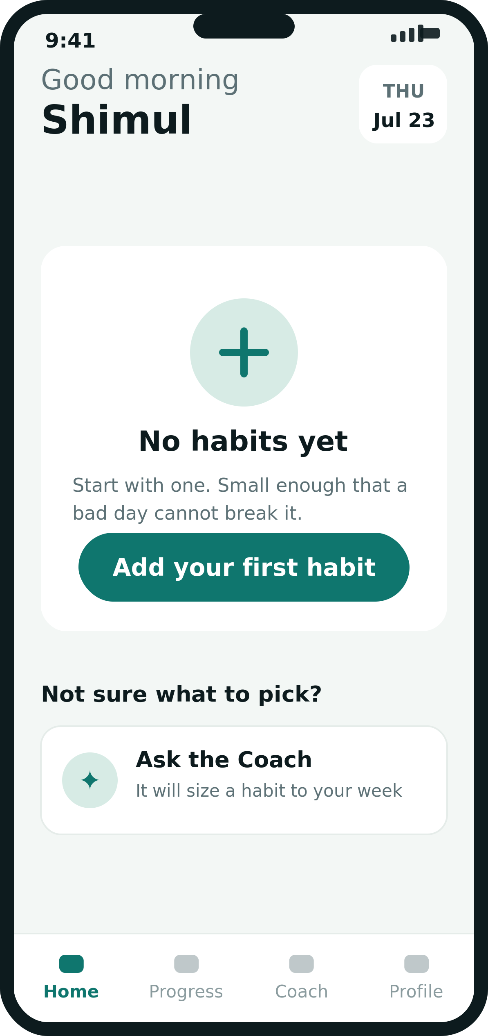
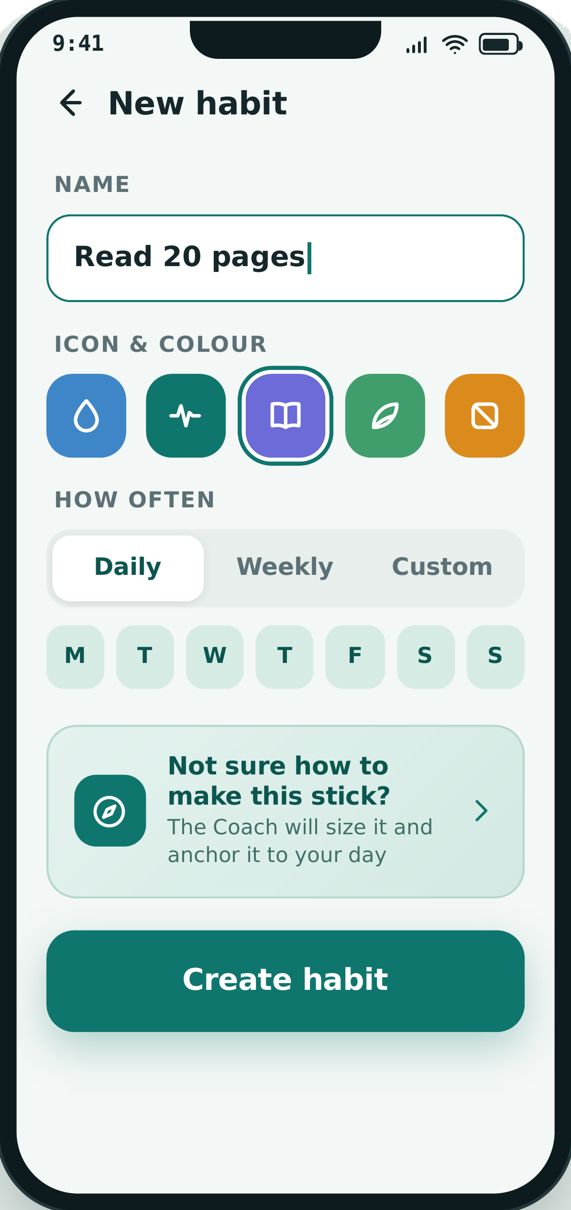
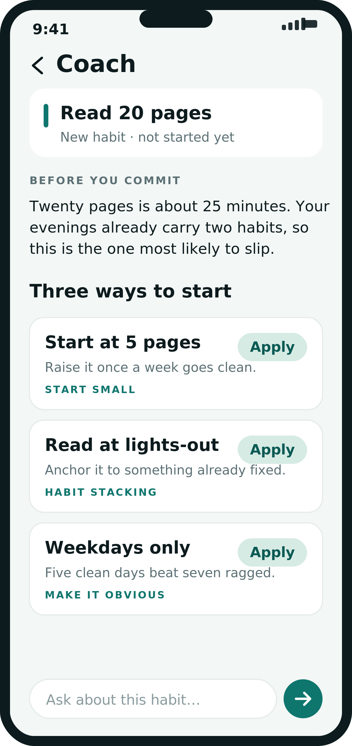
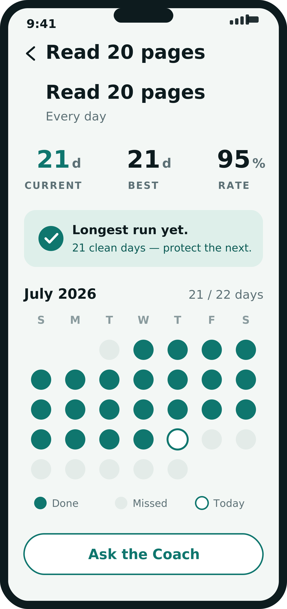
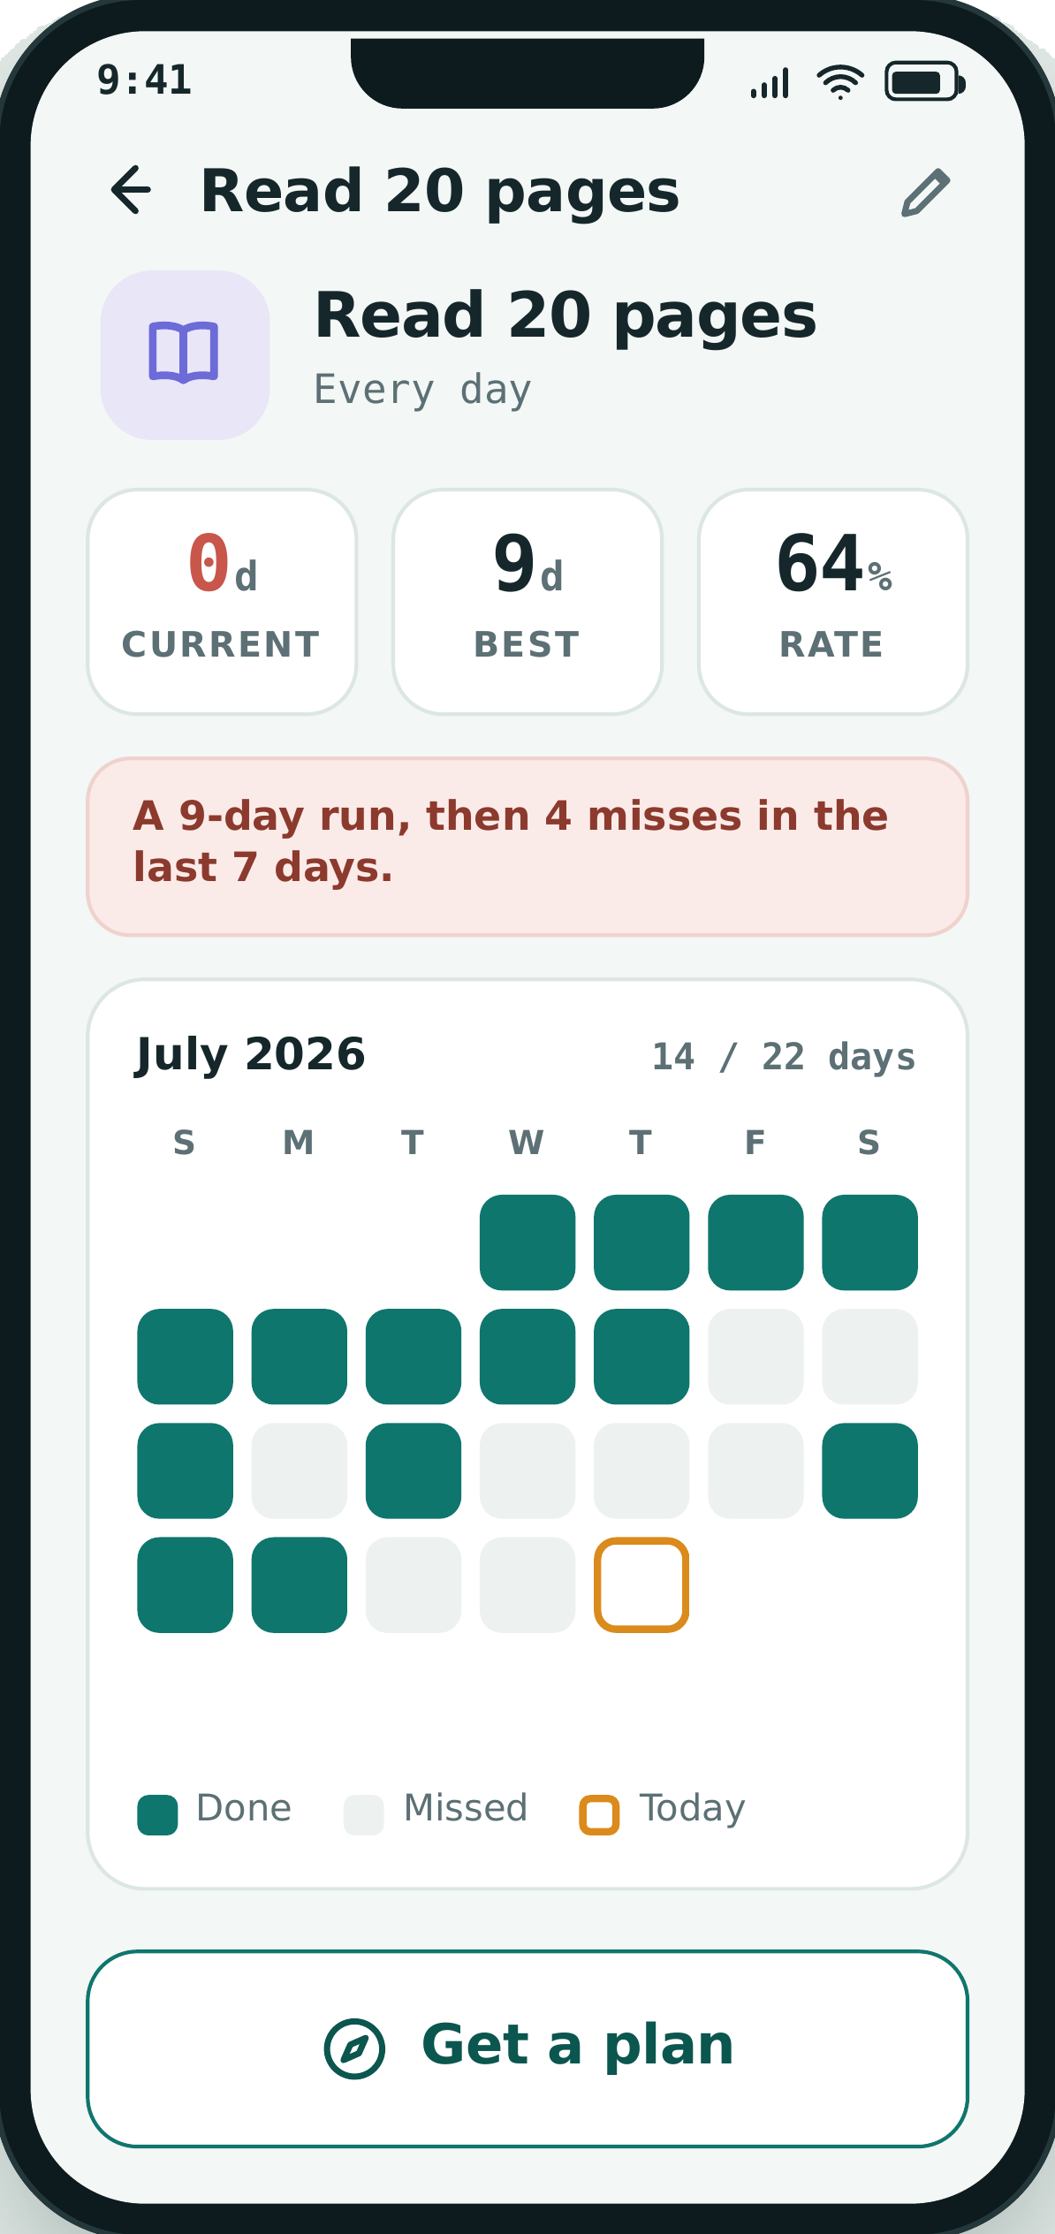
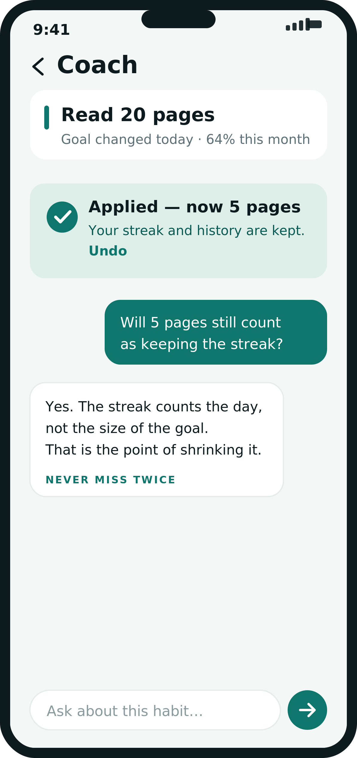
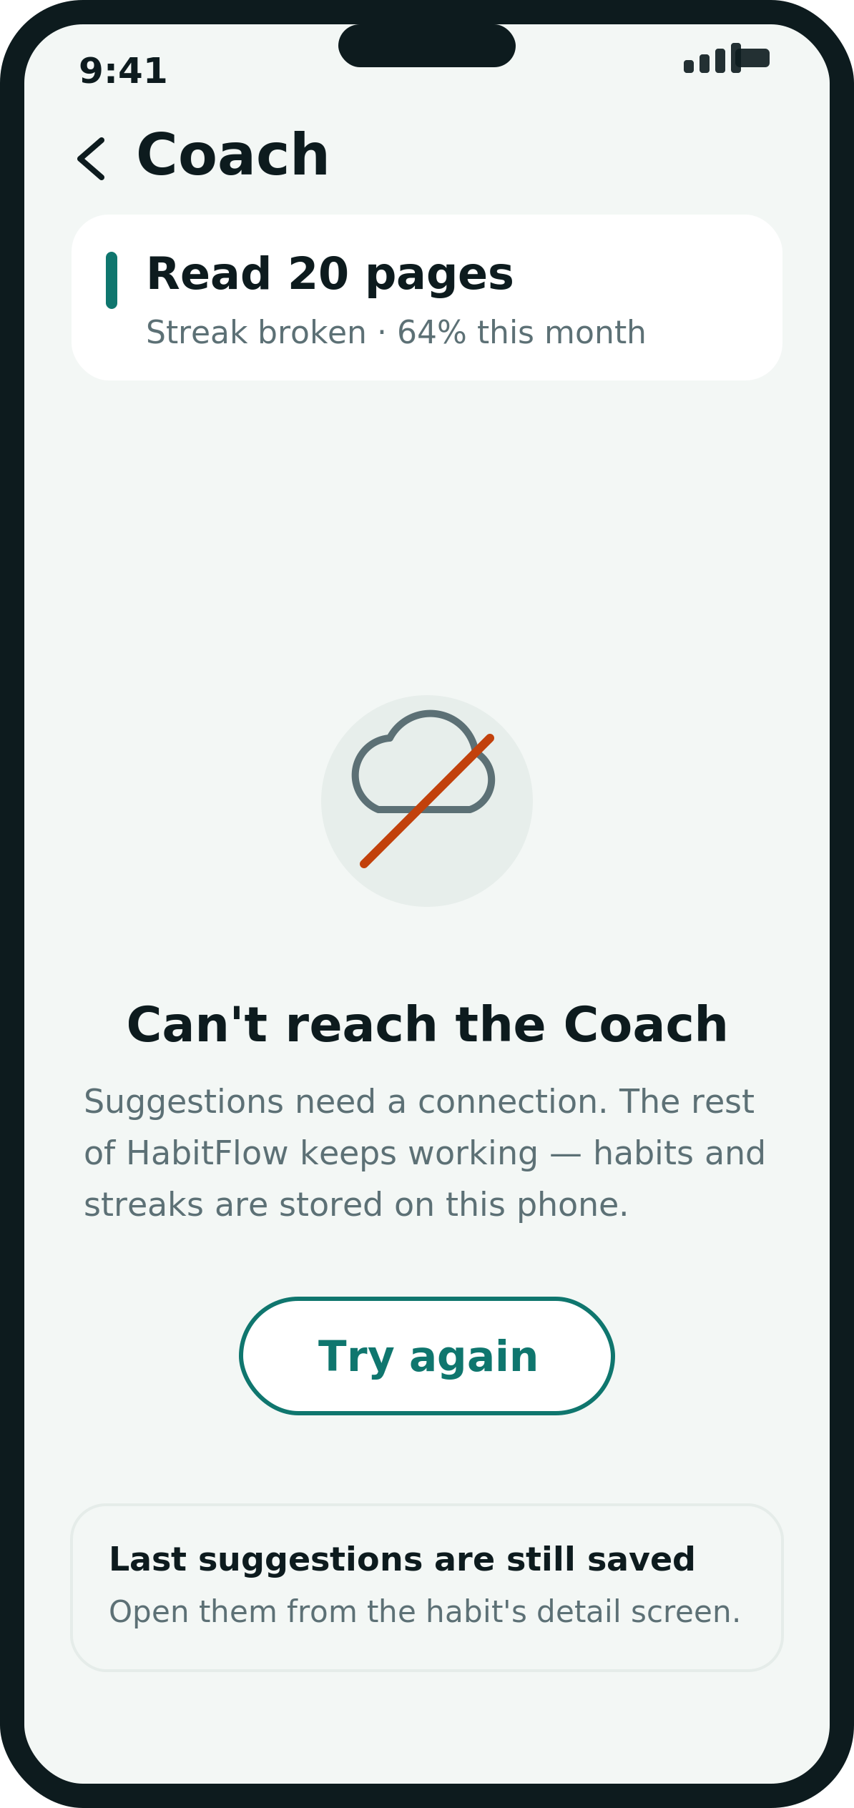
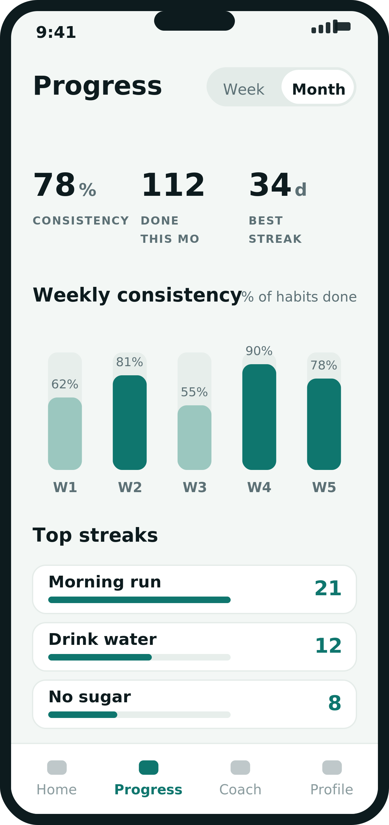
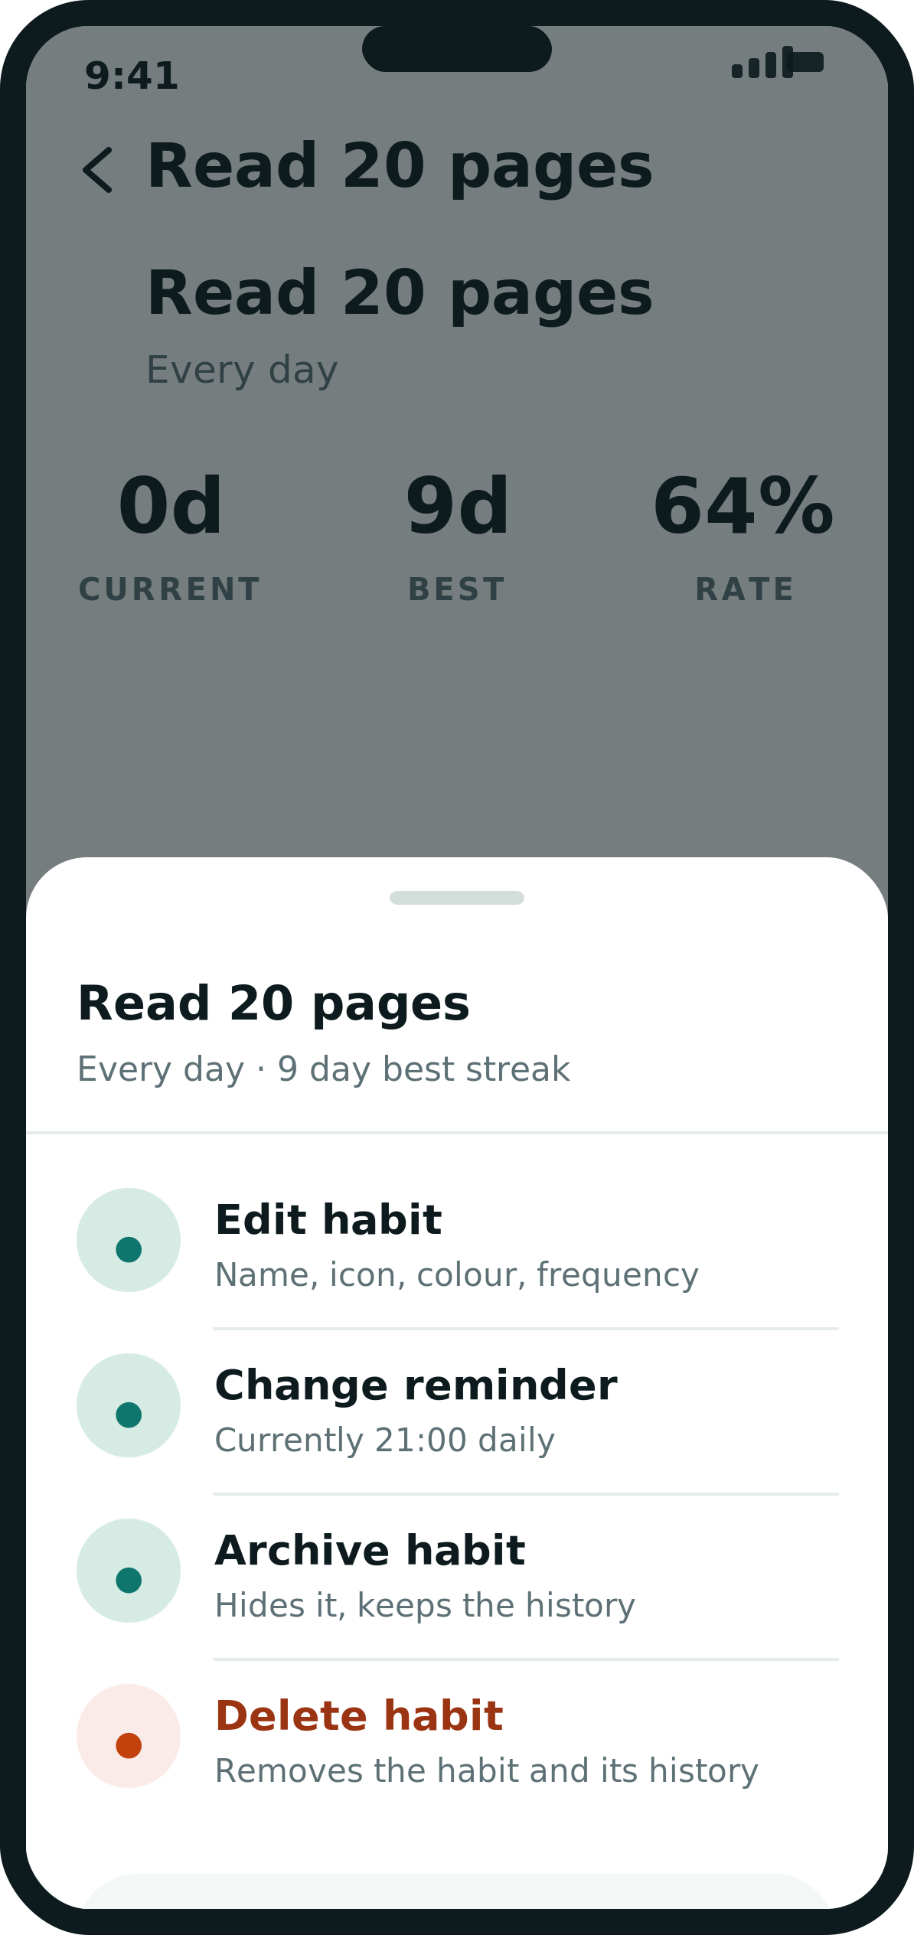
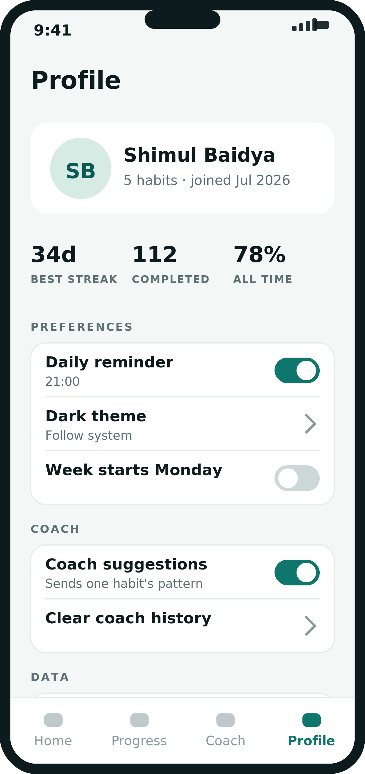
MAP
Screen map
06 / 23
Fifteen screens. These IDs are reused unchanged in Document 2, the UI Flow.
SCR-01
SCR-02
SCR-03
SCR-04
SCR-05
Splash
Onboarding
Home — empty state
Home — today
New habit
Entry
Entry
Daily use
Daily use
Habit management
SCR-06
SCR-07
SCR-08
SCR-09
SCR-10
Coach — plan a new habit
Habit detail — healthy
Habit detail — streak broken
Coach — suggestions
Coach — applied
AI Coach
Habit management
Habit management
AI Coach
AI Coach
SCR-11
SCR-12
SCR-13
SCR-14
SCR-15
Coach — offline
Progress — week
Progress — month
Edit and delete sheet
Profile and settings
AI Coach
Insight
Insight
Habit management
Account

Slide 7
SCR-01
Splash
07 / 23
Holds the first frame while Room opens and the habit list is read.
1
# | Element | Composable | Specification | Behaviour
1 | Status bar | WindowInsets | Light icons; window background = on.surface | Edge-to-edge, transparent
2 | Brand mark | Canvas | 192dp circle, 5dp primary ring, 24dp check glyph | Scales 0.92 to 1.0 over 220ms
3 | Wordmark | Text | display/32sp Bold, on.primary | Static
4 | Tagline | Text | caption/14sp, primary.container at 70% alpha | Static
5 | Load bar | LinearProgressIndicator | 80 x 4dp, pill, primary on 20% track | Indeterminate; hidden if ready under 400ms
6 | Screen background | Surface | Token on.surface in both themes — splash is always dark | No theme switch
7 | Route decision | LaunchedEffect | Minimum 600ms, maximum 3000ms on screen | Reads onboardingComplete, then navigates
8 | Failure path | Snackbar on SCR-04 | If Room throws, open an empty Home and surface a retry | Never blocks on the splash
2
3
4
5
PURPOSE
ENTERED FROM
EXITS TO
DATA SOURCE
STATES
Holds the first frame while Room opens and the habit list is read.
Cold launch (launcher icon)
SCR-02 first run · SCR-04 otherwise
SettingsDao.onboardingComplete · HabitDao.count()
Loading · DB migration · corrupt DB fallback

Slide 8
SCR-02
Onboarding
08 / 23
Three panes that explain the one interaction the app depends on: a daily tap.
1
# | Element | Composable | Specification | Behaviour
1 | Skip | TextButton | caption/14sp Bold, on.surface.muted, 20dp gutter, 48dp target | Writes onboardingComplete, jumps to SCR-03
2 | Illustration | Box + 3 Card | Stacked cards 60dp apart, alpha 0.35 / 0.6 / 1.0 | Top card animates in 400ms on pane change
3 | Headline | Text | headline/26sp Bold, on.surface, 20dp gutter | Changes per pane
4 | Body | Text | body/16sp, on.surface.muted, 24sp line height, max 3 lines | Changes per pane
5 | Pager dots | Row + Box | 8dp dots, active 28 x 8dp pill primary, 10dp gap | Reflects HorizontalPager state
6 | Continue | C-08 | Full width minus gutters, 56dp, primary | Advances pager; last pane finishes onboarding
7 | Restore | TextButton | caption/14sp, on.surface.muted, centred | Opens the import sheet — phase 2, disabled at v1
8 | Pager | HorizontalPager | 3 pages, swipe enabled both directions | Back on pane 1 exits the app
9 | Back handling | BackHandler | Pane 2 and 3 return to the previous pane | Never returns to SCR-01
2
3
4
5
6
7
PURPOSE
ENTERED FROM
EXITS TO
DATA SOURCE
STATES
Three panes that explain the one interaction the app depends on: a daily tap.
SCR-01 when onboardingComplete is false
SCR-03 empty Home after the last pane
SettingsEntity.onboardingComplete (write on finish)
Pane 1 of 3 · swipe back · skip

Slide 9
SCR-03
Home — empty state
09 / 23
First-run Home. The only job of this screen is to get one habit created.
# | Element | Composable | Specification | Behaviour
1 | Greeting | Column | title.lg/22sp muted over display/32sp Bold on.surface | Time-of-day string; name from settings
2 | Date chip | Card | 72 x 64dp, 12dp radius, surface.card | Static, no tap
3 | Empty card | Card | Full width minus gutters, 20dp radius, 32dp inner padding | Only shown when habit count is 0
4 | Empty icon | Box + Icon | 88dp circle primary.container, 36dp plus in primary | Decorative, not focusable
5 | Primary action | C-08 | 56dp, primary, label 'Add your first habit' | Navigates to SCR-05
6 | Coach shortcut | Card + Row | 88dp tall, 16dp radius, 1dp outline, 44dp leading circle | Opens SCR-06 with no habit pre-selected
7 | Bottom nav | C-09 | Home selected; Progress and Coach visible but disabled | Disabled tabs show a one-line explanation
8 | Screen scroll | Column + verticalScroll | Content is short — no LazyColumn until a habit exists | Scrolls only on small screens
9 | Transition | Crossfade | Empty to populated crossfades over 200ms | Triggered by the first insert
1
2
3
4
5
6
7
PURPOSE
ENTERED FROM
EXITS TO
DATA SOURCE
STATES
First-run Home. The only job of this screen is to get one habit created.
SCR-02 · SCR-04 when the last habit is deleted
SCR-05 create · SCR-06 coach · nav tabs
HabitDao.observeAll() returning an empty list
Empty (this screen) · loading skeleton · populated becomes SCR-04

Slide 10
SCR-04
Home — today
10 / 23
The daily hub. Every habit and its streak on the first screen, one tap to log.
1
# | Element | Composable | Specification | Behaviour
1 | Status bar | WindowInsets | Edge-to-edge; icons follow the theme | Content draws under it
2 | Greeting | Column | title.lg/22sp muted + display/32sp Bold on.surface, 20dp gutter | Morning / afternoon / evening by clock
3 | Date chip | Card | 72 x 64dp, 12dp radius, surface.card, weekday over date | Static
4 | Today ring | C-02 (large) | 64dp outer, 6dp stroke, primary sweep = done / total | Animates 300ms when a habit is checked
5 | Streak block | Column | stat/32sp Bold primary + label/12sp caps muted | Shows the longest active streak
6 | Section header | Row | title/20sp Bold + caption/14sp counter, 24dp above | Counter is done of total
7 | Habit row | C-01 | 72dp, 16dp radius, surface.card, 1dp outline, 8dp between rows | Tap opens SCR-07 or SCR-08
8 | Completion ring | C-02 | 40dp, 4dp stroke, 48dp touch target | Tap toggles today; 300ms fill; haptic on complete
2
3
4
5
6
7
8
9
10
11
12
13
PURPOSE
ENTERED FROM
EXITS TO
DATA SOURCE
STATES
The daily hub. Every habit and its streak on the first screen, one tap to log.
SCR-01 · SCR-02 · bottom nav from any tab
SCR-05 add · SCR-07 or SCR-08 detail · SCR-12 · SCR-09
HabitDao.observeAll() + CompletionDao.observeForDate(today)
Populated · empty is SCR-03 · loading skeleton · all-done celebration

Slide 11
SCR-04
Home — today (continued)
11 / 23
Specification continued — same screen, same numbering.
# | Element | Composable | Specification | Behaviour
9 | Streak counter | C-03 | 16dp flame + title/20sp primary | Danger token and a broken glyph when the count is 0
10 | At-risk row | C-01 variant | Same metrics; streak reads 0 in danger | Sorted under the Needs attention divider
11 | Needs attention | Row + Divider | label/12sp caps in danger, 20dp above and 12dp below | Only rendered when at least one habit is at risk
12 | Add habit | FloatingActionButton | 56dp, primary, 2dp elevation, 16dp from both edges | Opens SCR-05
13 | Bottom nav | C-09 | 72dp, Home selected | Tab switch is a fade, never a slide
PURPOSE
ENTERED FROM
EXITS TO
DATA SOURCE
STATES
The daily hub. Every habit and its streak on the first screen, one tap to log.
SCR-01 · SCR-02 · bottom nav from any tab
SCR-05 add · SCR-07 or SCR-08 detail · SCR-12 · SCR-09
HabitDao.observeAll() + CompletionDao.observeForDate(today)
Populated · empty is SCR-03 · loading skeleton · all-done celebration

Slide 12
SCR-05
New habit
12 / 23
Creates a habit. Coach entry sits directly above Create, where a plan is most useful.
1
# | Element | Composable | Specification | Behaviour
1 | Status bar | WindowInsets | Edge-to-edge | Content draws under it
2 | App bar | TopAppBar | 56dp, back chevron 24dp, headline/26sp Bold title | Back discards with a confirm if the form is dirty
3 | Field label | C-10 | label/12sp caps, +1.5sp tracking, on.surface.muted | Static
4 | Name field | OutlinedTextField | 60dp, 12dp radius, 2dp primary border when focused, title/20sp | Required; error state after an empty submit
5 | Icon and colour label | C-10 | label/12sp caps, 24dp above | Static
6 | Icon and colour | LazyRow | 56dp swatches, 8dp gap, 2dp primary ring on the selection | Single select; defaults to the first swatch
7 | Frequency label | C-10 | label/12sp caps, 24dp above | Static
8 | Frequency | SegmentedButtonRow | 52dp tall, pill, 3 options, selected fills surface.card | Custom reveals the day picker below
9 | Day picker | Row of 7 ToggleButton | 40dp circles, 8dp gap, primary.container when on | Only enabled for Weekly and Custom
10 | Coach card | Card + Row | 116dp, 16dp radius, primary.container, 48dp leading circle | Opens SCR-06 carrying the draft habit
11 | Create | C-08 | 56dp, primary, 20dp gutters, 24dp above the inset | Disabled until the name is non-blank
12 | Scroll | Column + verticalScroll | Create stays docked; the form scrolls behind it | Keyboard insets applied to the docked area
2
3
4
5
6
7
8
9
10
11
PURPOSE
ENTERED FROM
EXITS TO
DATA SOURCE
STATES
Creates a habit. Coach entry sits directly above Create, where a plan is most useful.
SCR-03 · SCR-04 FAB
SCR-06 coach · returns to SCR-04 on create
HabitDao.insert(HabitEntity) · icon and colour enums
Empty form · name required · duplicate name · custom-days validation

Slide 13
SCR-06
Coach — plan a new habit
13 / 23
Sizes a habit before it is created, so the first version is one that survives.
# | Element | Composable | Specification | Behaviour
1 | App bar | TopAppBar | 56dp, back chevron, headline/26sp Bold 'Coach' | Back returns without applying
2 | Habit chip | Card + Row | Leading 4dp primary bar, title/20sp name, caption sub-line | Read-only context, not tappable
3 | Section label | C-10 | label/12sp caps, on.surface.muted | Static
4 | Reading | Text | body/16sp on.surface, 24sp line height, max 4 lines | Model output; skeleton shimmer while loading
5 | Group header | Text | title/20sp Bold, 24dp above the first card | Count is always three
6 | Suggestion card | C-06 | 16dp radius, 1dp outline, 12dp between cards | Whole card is one tap target
7 | Apply pill | C-07 | 78 x 32dp, primary.container, micro/11sp Bold | Writes the value into the draft, then returns
8 | Strategy tag | Text | micro/11sp Bold caps, +1.5sp tracking, primary | The retrieved strategy shown as its source
9 | Supporting line | Text | caption/14sp on.surface.muted, max 2 lines | One sentence of why
10 | Input bar | C-11 | 44dp field + 44dp send, docked, 12dp above the inset | Keyboard-aware; send disabled when blank
11 | Request scope | CoachService | Sends the draft name, frequency and habit count only | No completion history exists yet for a draft
1
2
3
4
5
6
7
8
9
10
PURPOSE
ENTERED FROM
EXITS TO
DATA SOURCE
STATES
Sizes a habit before it is created, so the first version is one that survives.
SCR-05 coach card · SCR-03 coach shortcut
Back to SCR-05 with the applied values
Draft habit + HabitDao counts; strategy cards; model response
Loading · loaded · applied · offline is SCR-11 · rate limited

Slide 14
SCR-07
Habit detail — healthy
14 / 23
The reward view: an unbroken chain, made visible enough to be worth protecting.
# | Element | Composable | Specification | Behaviour
1 | App bar | TopAppBar | 56dp, back chevron, overflow opens SCR-14 | Title fades in on scroll
2 | Title block | Column | headline/26sp Bold + caption/14sp muted frequency | Frequency string built from the schedule
3 | Current streak | C-04 cell | stat/32sp Bold primary + label/12sp caps | Primary token while the streak is alive
4 | Best and rate | C-04 cells | stat/32sp Bold on.surface, equal thirds | Rate is completions over scheduled days this month
5 | Positive callout | Card + Row | 76dp, 16dp radius, primary.container, 36dp check circle | Shown when current equals best and best is 7 or more
6 | Month header | Row | title/20sp Bold month + caption/14sp muted ratio | Swipe the grid to change month
7 | Month grid | C-05 | 7 columns, 28dp dots, 8dp gap, 4 to 6 rows | Tap a past day to correct it; future days disabled
8 | Legend | Row | 18dp dots + caption/14sp, 20dp apart | Static
9 | Coach entry | OutlinedButton | 56dp, pill, 2dp primary border, primary label | Opens SCR-09; label reads 'Ask the Coach' when healthy
10 | Scroll | LazyColumn | Stats and callout scroll; app bar collapses | Button is docked, not in the scroll
1
2
3
4
5
6
7
8
9
PURPOSE
ENTERED FROM
EXITS TO
DATA SOURCE
STATES
The reward view: an unbroken chain, made visible enough to be worth protecting.
SCR-04 habit row · SCR-12 top streaks
SCR-06 or SCR-09 coach · SCR-14 sheet · back to SCR-04
HabitDao.byId + CompletionDao.observeMonth(habitId, month)
Healthy (this screen) · at risk is SCR-08 · new habit with no data

Slide 15
SCR-08
Habit detail — streak broken
15 / 23
The pair that carries the project. The app names the pattern instead of hiding it.
# | Element | Composable | Specification | Behaviour
1 | App bar | TopAppBar | 56dp, back chevron, overflow opens SCR-14 | Identical to SCR-07
2 | Title block | Column | headline/26sp Bold + caption/14sp muted | Identical to SCR-07
3 | Current streak | C-04 cell | stat/32sp Bold; reads 0d in on.surface, not danger | The number is neutral — the callout carries the tone
4 | Best and rate | C-04 cells | stat/32sp Bold on.surface | Best is preserved through a break, never reset
5 | Pattern callout | Card + Text | 76dp, 16dp radius, danger.container, body/16sp on.surface | Sentence generated by StreakCalculator, not the model
6 | Month header | Row | title/20sp Bold + caption/14sp ratio | Same as SCR-07
7 | Month grid | C-05 | Missed days use surface.sunken, not danger | Misses read as absence, not as failure
8 | Legend | Row | 18dp dots + caption/14sp | Static
9 | Get a plan | C-08 | 56dp, primary fill — filled here, outlined on SCR-07 | Opens SCR-09; the emphasis change is the whole point
10 | Entry rule | ViewModel | At risk when 2 or more misses fall in the last 7 scheduled days | Drives which of SCR-07 and SCR-08 renders
1
2
3
4
5
6
7
8
9
PURPOSE
ENTERED FROM
EXITS TO
DATA SOURCE
STATES
The pair that carries the project. The app names the pattern instead of hiding it.
SCR-04 at-risk row · SCR-12
SCR-09 coach · SCR-14 sheet · back to SCR-04
Same as SCR-07; StreakCalculator flags the at-risk state
At risk (this screen) · healthy is SCR-07 · recovered after two clean days

Slide 16
SCR-09
Coach — suggestions
16 / 23
The feature no other tracker has. Opens with what it noticed, not a blank chat box.
# | Element | Composable | Specification | Behaviour
1 | App bar | TopAppBar | 56dp, back chevron, headline/26sp Bold 'Coach' | Back returns to the detail screen
2 | Habit chip | Card + Row | 4dp leading primary bar, title/20sp name | Read-only context
3 | Status line | Text | caption/14sp on.surface.muted, mid-dot separated | Streak state and completion rate
4 | Section label | C-10 | label/12sp caps 'WHAT I'M SEEING' | Static
5 | Reading | Text | body/16sp on.surface, 24sp line height, max 4 lines | Model output; 3-line shimmer while loading
6 | Group header | Text | title/20sp Bold, 24dp above | Always exactly three suggestions
7 | Suggestion card | C-06 | 16dp radius, 1dp outline, 12dp gap | Whole card is tappable
8 | Apply pill | C-07 | 78 x 32dp, primary.container | One tap writes the change; moves to SCR-10
9 | Supporting line | Text | caption/14sp muted, max 2 lines | The reason, in one sentence
1
2
3
4
5
6
7
8
9
10
11
13
12
PURPOSE
ENTERED FROM
EXITS TO
DATA SOURCE
STATES
The feature no other tracker has. Opens with what it noticed, not a blank chat box.
SCR-08 Get a plan · SCR-07 Ask the Coach
SCR-10 after Apply · back to the detail screen
One habit's 30-day pattern + strategy knowledge base + model response
Loading · loaded · applied is SCR-10 · offline is SCR-11 · no pattern yet

Slide 17
SCR-09
Coach — suggestions (continued)
17 / 23
Specification continued — same screen, same numbering.
# | Element | Composable | Specification | Behaviour
10 | Strategy tag | Text | micro/11sp Bold caps primary | Names the retrieved strategy — the source, shown
11 | Cards 2 and 3 | C-06 | Same metrics; list is never longer than three | Scrolls under the docked input bar
12 | Input bar | C-11 | 44dp field + 44dp send, docked | Free-form follow-up about this habit only
13 | Send | FilledIconButton | 44dp circle, primary, 20dp glyph | Disabled while a request is in flight
14 | Privacy rule | CoachService | Sends the question and one habit's 30-day summary | Never the habit list, the name or any identifier
15 | Retrieval | StrategyRepository | About 50 local cards; top 3 by pattern match go in the prompt | Runs on device before the single network call
PURPOSE
ENTERED FROM
EXITS TO
DATA SOURCE
STATES
The feature no other tracker has. Opens with what it noticed, not a blank chat box.
SCR-08 Get a plan · SCR-07 Ask the Coach
SCR-10 after Apply · back to the detail screen
One habit's 30-day pattern + strategy knowledge base + model response
Loading · loaded · applied is SCR-10 · offline is SCR-11 · no pattern yet

Slide 18
SCR-10
Coach — applied
18 / 23
Confirms the change, keeps history intact, and leaves the conversation open.
# | Element | Composable | Specification | Behaviour
1 | Habit chip | Card + Row | Sub-line switches to 'Goal changed today' | Reflects the write immediately
2 | Applied card | Card + Row | 104dp, 16dp radius, primary.container, 36dp check circle | Inserted at the top of the thread
3 | Undo | TextButton | caption/14sp Bold primary, 48dp target | Live for 10s, then the row is committed
4 | User message | Card | Right aligned, max 76% width, 16dp radius, primary fill | on.primary text; 12dp between bubbles
5 | Coach reply | Card | Left aligned, max 76% width, 1dp outline, surface.card | Carries the strategy tag when one applies
6 | Input bar | C-11 | Docked, 44dp field + 44dp send | Scrolls the thread to the bottom on send
7 | Thread | LazyColumn(reverseLayout) | 12dp between items, 20dp gutters | New messages append at the bottom
8 | Write path | HabitManager | Goal is updated; completions and streak rows are untouched | A shrunk goal never resets a streak
9 | Persistence | CoachMessageDao | Thread is stored per habit, capped at 50 messages | Cleared from SCR-15
1
2
3
4
5
6
PURPOSE
ENTERED FROM
EXITS TO
DATA SOURCE
STATES
Confirms the change, keeps history intact, and leaves the conversation open.
SCR-09 after an Apply
Back to SCR-07 or SCR-08 with the new goal
HabitDao.update(goal) · CoachMessageDao for the thread
Applied · undo window · follow-up in flight · offline is SCR-11

Slide 19
SCR-11
Coach — offline
19 / 23
The Coach is the only online piece, so its failure has to be a designed state.
# | Element | Composable | Specification | Behaviour
1 | Habit chip | Card + Row | Unchanged from SCR-09 — context survives the failure | Read-only
2 | State icon | Box + Icon | 148dp circle surface.sunken, 56dp glyph, danger slash | Decorative, not focusable
3 | Headline | Text | title.lg/22sp Bold on.surface, centred | Copy varies by error type
4 | Explanation | Text | body/16sp on.surface.muted, centred, max 3 lines | Names what still works — habits are local
5 | Retry | OutlinedButton | 52dp, pill, 2dp primary border | Exponential backoff; disabled 3s after a tap
6 | Cached note | Card | 72dp, 16dp radius, surface, 1dp outline | Only shown when a stored suggestion exists
7 | Detection | ConnectivityManager | Checked before the call; no spinner when already offline | Fails fast rather than timing out
8 | Data safety | Copy rule | Every error state states that local data is unaffected | Removes the fear the failure implies
1
2
3
4
5
6
PURPOSE
ENTERED FROM
EXITS TO
DATA SOURCE
STATES
The Coach is the only online piece, so its failure has to be a designed state.
SCR-06 · SCR-09 · SCR-10 when the request fails
Retry stays here · back to the detail screen
No network call; cached suggestions from CoachSuggestionDao
No connection · timeout · rate limited · server error — same layout, different copy

Slide 20
SCR-12
Progress — week
20 / 23
Rolls daily check-offs into weekly consistency, so movement survives a bad day.
# | Element | Composable | Specification | Behaviour
1 | Screen title | Text | headline/26sp Bold on.surface, 20dp gutter | No back — this is a nav root
2 | Range toggle | SegmentedButtonRow | 116 x 36dp, pill, surface.sunken track, selected on surface.card | Week and Month; switches to SCR-13
3 | Consistency | C-04 cell | stat/32sp Bold + label/12sp caps, left aligned | Scheduled days completed this week
4 | Done and best | C-04 cells | Equal thirds across the content width | Best streak is all-time, not weekly
5 | Stat labels | C-10 | label/12sp caps, wraps to two lines | Wrapping is expected — 12sp holds two lines
6 | Chart header | Row | title/20sp Bold + caption/14sp muted unit | Static
7 | Bar chart | Canvas | 7 bars, 24dp wide, 8dp radius, primary on surface.sunken track | Bars animate up over 400ms, staggered 40ms
8 | Day axis | Row | caption/14sp muted, one letter per bar, today is Bold | Week starts per the SCR-15 setting
9 | Top streaks | Text | title/20sp Bold, 24dp above the list | Hidden when no habit has a streak
10 | Streak row | Card + Row | 48dp, 12dp radius, 1dp outline, 8dp gap | Tap opens that habit's detail screen
11 | Streak value | Text | title/20sp Bold primary, right aligned | Rail width is the value over the top streak
12 | Bottom nav | C-09 | Progress selected | Fade between tabs
1
2
3
4
5
6
7
8
9
10
11
12
PURPOSE
ENTERED FROM
EXITS TO
DATA SOURCE
STATES
Rolls daily check-offs into weekly consistency, so movement survives a bad day.
Bottom nav from any tab
SCR-13 month toggle · SCR-07 or SCR-08 from a streak row
StatsAggregator over CompletionDao.observeRange(week)
Populated · fewer than 7 days of data · no habits yet

Slide 21
SCR-13
Progress — month
21 / 23
Same screen, wider window. Five weekly bars replace seven daily ones.
# | Element | Composable | Specification | Behaviour
1 | Range toggle | SegmentedButtonRow | Month selected; identical metrics to SCR-12 | Toggling re-queries, it does not navigate
2 | Consistency | C-04 cell | stat/32sp Bold; value is monthly, not weekly | Recomputed on range change
3 | Done and best | C-04 cells | Label reads THIS MO rather than THIS WK | Only the label string differs
4 | Chart header | Row | title/20sp Bold 'Weekly consistency' | Static
5 | Bar chart | Canvas | 5 bars, 34dp wide, 8dp radius; under 75% uses a lighter primary | Same 400ms stagger as SCR-12
6 | Bar values | Text | micro/11sp muted above each bar | Omitted when a bar is under 10%
7 | Streak row | Card + Row | 48dp, 12dp radius, 1dp outline | Identical component to SCR-12
8 | Streak value | Text | title/20sp Bold primary | Identical to SCR-12
9 | Bottom nav | C-09 | Progress selected | Unchanged
10 | Shared screen | ProgressScreen(range) | SCR-12 and SCR-13 are one composable with a range parameter | Build once, not twice
1
2
3
4
5
6
7
8
9
PURPOSE
ENTERED FROM
EXITS TO
DATA SOURCE
STATES
Same screen, wider window. Five weekly bars replace seven daily ones.
SCR-12 range toggle
SCR-12 · SCR-07 or SCR-08 from a streak row
StatsAggregator over CompletionDao.observeRange(month)
Populated · partial month · month with no completions

Slide 22
SCR-14
Edit and delete sheet
22 / 23
Every destructive path on one surface, with delete visually separated from the rest.
# | Element | Composable | Specification | Behaviour
1 | Scrim | Scrim | on.surface at 55% alpha, 250ms fade | Tap outside dismisses
2 | Drag handle | Box | 32 x 4dp, pill, on.surface.faint, 12dp from the top | Drag down dismisses
3 | Sheet header | Column | title/20sp Bold name + caption/14sp muted summary | Divider 1dp outline beneath
4 | Action row | Row | 72dp, 44dp leading circle primary.container, title/20sp label | Full-width ripple; 48dp minimum target
5 | Delete | Row (danger) | Same metrics; label and circle use the danger tokens | Opens a confirm dialog naming the streak that is lost
6 | Cancel | Button(tonal) | 52dp, pill, surface, on.surface.muted label | Same as dismissing the sheet
7 | Sheet | C-12 | 24dp top radius, 8dp elevation, wraps content | Never full height — the habit stays visible above
8 | Archive | HabitManager | Sets archivedAt; the row leaves Home, history is kept | Snackbar with a 5s undo
9 | Delete cascade | Room | onDelete = CASCADE from habit to completions | Irreversible; the dialog says so explicitly
1
2
3
4
5
6
PURPOSE
ENTERED FROM
EXITS TO
DATA SOURCE
STATES
Every destructive path on one surface, with delete visually separated from the rest.
SCR-07 or SCR-08 overflow · long-press a row on SCR-04
SCR-05 in edit mode · back to the detail screen
HabitDao.update / archive / delete (cascades completions)
Open · delete confirmation dialog · archive undo snackbar

Slide 23
SCR-15
Profile and settings
23 / 23
Owns the fourth nav tab, the theme switch, and every Coach privacy control.
# | Element | Composable | Specification | Behaviour
1 | Avatar | Box + Text | 100dp circle primary.container, initials in title.lg/22sp | Local only; no account, no sign-in
2 | Identity | Column | title/20sp Bold name + caption/14sp muted summary | Name is editable inline
3 | Lifetime stats | C-04 | Three cells, stat/32sp reduced to 24sp, label/12sp caps | All-time, not windowed
4 | Section label | C-10 | label/12sp caps, 24dp above each group | Preferences, Coach, Data
5 | Toggle row | Row + Switch | 56dp, title/20sp label over caption/14sp value | Writes on change; no save button
6 | Theme row | Row + chevron | 56dp; value reads Light, Dark or Follow system | Opens a 3-option dialog — this is the theme switch
7 | Coach controls | Rows | Suggestions toggle plus Clear coach history | Toggle off hides every Coach entry point
8 | Destructive | Row (danger) | Label and helper use the danger tokens | Type-to-confirm dialog before wiping
9 | Bottom nav | C-09 | Profile selected | Unchanged
10 | Persistence | DataStore + Room | Preferences in DataStore, counts from Room | Theme applies without a restart
1
2
3
4
5
6
7
8
9
PURPOSE
ENTERED FROM
EXITS TO
DATA SOURCE
STATES
Owns the fourth nav tab, the theme switch, and every Coach privacy control.
Bottom nav
Stays in tab; export opens the system file picker
SettingsEntity · aggregate counts · CoachMessageDao.clear()
Default · toggles pending write · destructive confirm

