Slide 1
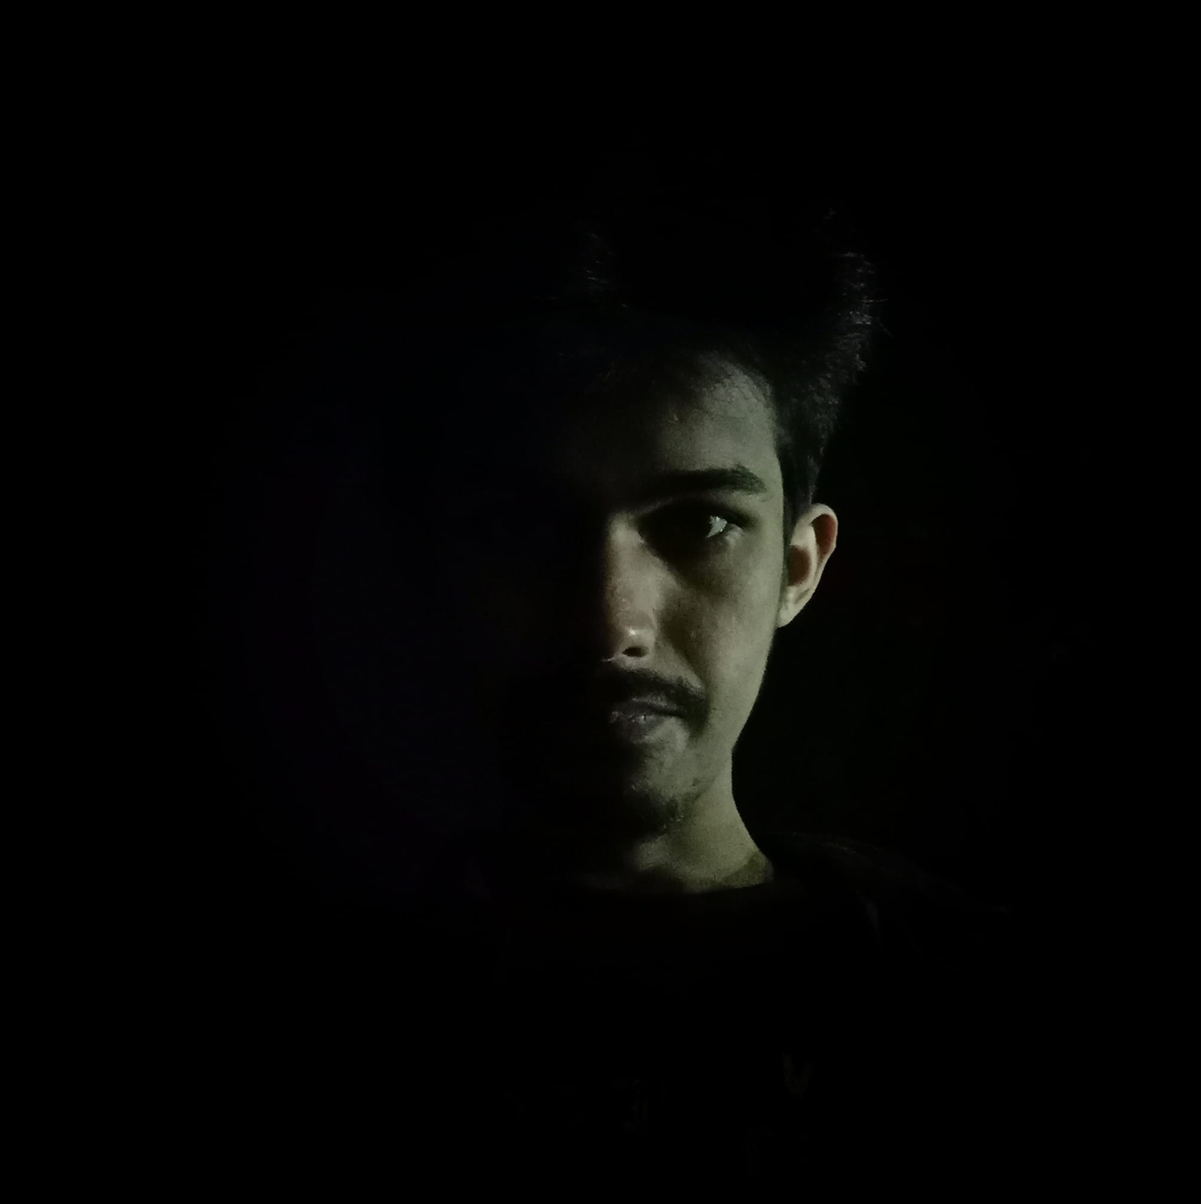
Personal Information
NAME: Md Shimul Hasan
Father’s Name: Fulu Moral
Mother’s Name: Khadija Begum
Present Address: Second Hall, SUST
Permanent Address: Chupair, kaliganj, Gazipur
Date of Barth: 07-08-2001
Nationality: Bangladeshi
Religion: Islam
01782282120
mdshimul49@student.sust.edu
Second Hall, SUST
SUMMARY
I am an enthusiastic, self-motivated, reliable, responsible and hard-working person. I am a mature team worker and adaptable to all challenging situations. I am able to work well both in a team environment as well as using own initiative. I am able to work well under pressure and adhere to strict deadlines.
LANGUAGES
Bangla
English
EDUCATION
HOBBIES
Bachelor of Science: Forestry and Environmental Science
Shahjalal University of Science & Technology, Sylhet
HSC | 2019
Dhaka City College | Result 5.00
Travelling
Playing
Photography
Reading
SSC | 2017
Jamalpur R M Bidyapith, Gazipur | Result 5.00
SKILLS
MS Word
MS Excel
PowerPoint
REFERENCE
Mahfuzur Rahman Khan
Advocate, Supreme Court of Bangladesh
Notes:
Copyright © www.free-cv-design.com

