Slide 1
An Introduction to Blender
12-11-2019
Michael Waters

Slide 2

What is Blender?
Wikipedia has the full description:
“ Blender is a free and open-source 3D computer graphics software toolset used for creating animated films, visual effects, art, 3D printed models, motion graphics, interactive 3D applications, and computer games. Blender's features include 3D modeling, UV unwrapping, texturing, raster graphics editing, rigging and skinning, fluid and smoke simulation, particle simulation, soft body simulation, sculpting, animating, match moving, rendering, motion graphics, video editing, and compositing. “
Blender’s power is flexibility and it can link with many rendering engines, simulation engines, texture/sculpting tools.
It comes with 2 rendering engines
Eevee: essentially a modern video game graphics engine with high performance and good realism
Cycles: A simulation engine of light scattering physics (path/ray tracing) that produces photorealist images at greater computational cost <- This tutorial

Slide 3
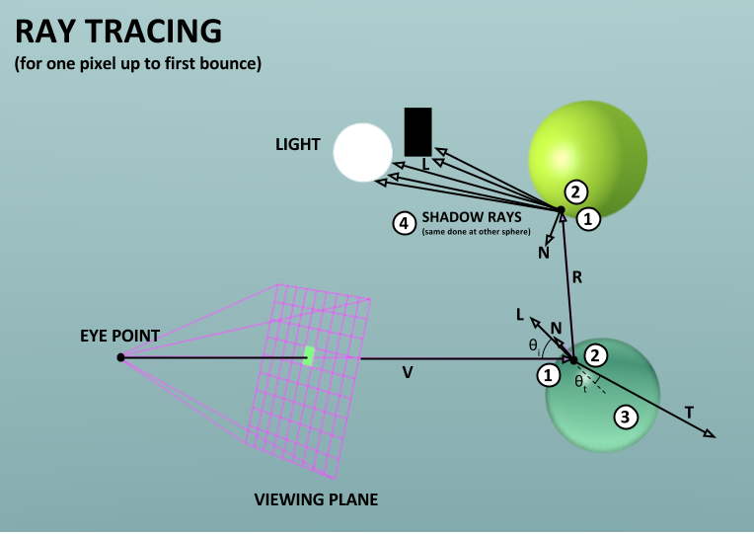
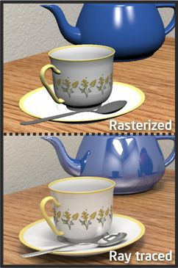
Ray tracing
Treats light as rays that travel in straight line until it scatters off of or is absorbed by an object
Can be traced forwards or backwards from light sources
Needs materials properties*
Each pixel is sampled on a viewing plane to become an image
Much more realistic than checking intersections and colors in rasterization
Nikolaus Leopold
https://www.online-tech-tips.com/computer-tips/what-is-path-tracing-and-ray-tracing-and-why-do-they-improve-graphics/
*Not in the MatSci sense

Slide 4
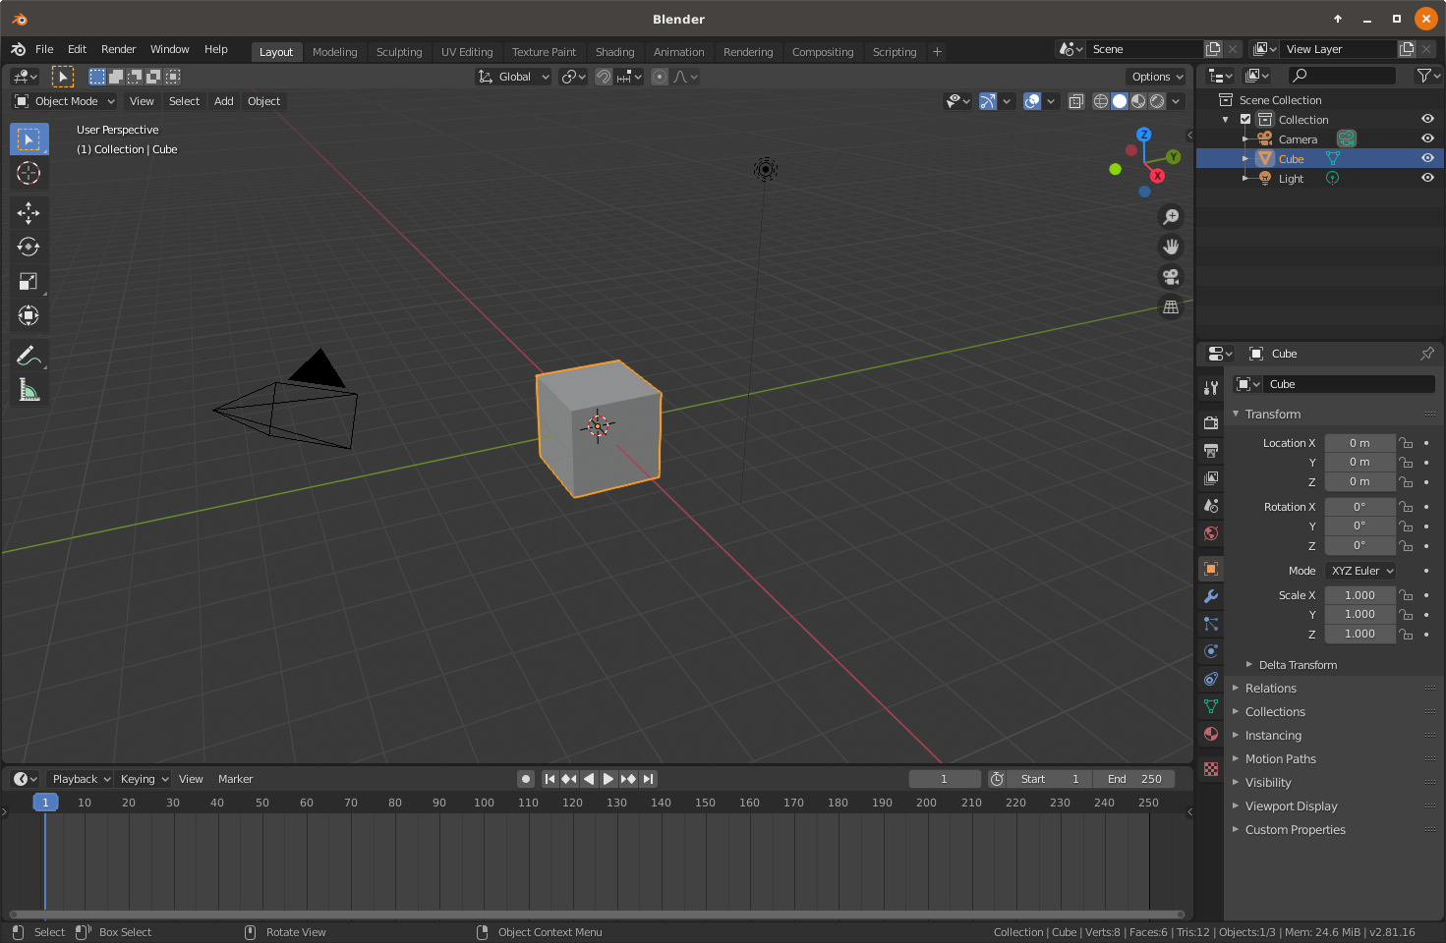
The Blender GUI
Panels!
3D Viewport
Outliner
Properties
Timeline
Reconfigurable!
Panels can be resized, added, subtracted, or switched to another type!
Let’s switch timeline to 3D viewport
Render at any time with the render button on top!

Slide 5
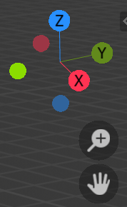

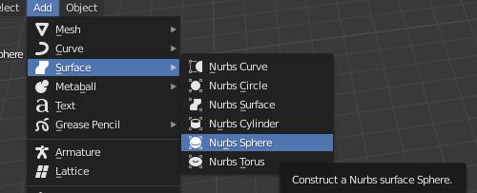
Editing in 3D viewport
Navigation
Rotate: center click or click+drag on corner axes
Pan: shift+center click or click+drag on hand
Zoom: scroll like on web page or click+drag on magnifying glass
Object mode lets you create, move, and rotate things
Buttons on the left move and rotate Create a sphere Add -> Surface -> Nurbs Sphere
Please leave them overlapping somewhat for later
You can add more lights and cameras too!
Useful keyboard shortcuts for later: (g, r, s) + (x, y, z) for axial constraints

Slide 6
Editing in 3D viewport Cont.
Edit mode lets you change vertices and curves
Move a cube vertex!
Go back to object mode when done
The shading buttons let you see wire frames, solids, or live rendering views
Use the lower 3D Viewport to always have the camera’s view by:
View -> Cameras -> Active Camera
Very handy for fine adjustments!

Slide 7
The Properties Panel
Lets you tweak anything you select or general properties
Many tabs, mouse over to see names!
Key tabs:
Render Properties -> How the render engine runs
Output Properties -> Picture size, color depth, color balance
Object Properties -> Affine transformations
Material Properties -> What things look like
World Properties -> Set background color or ambient light
Change rendering engine: Render Properties -> Render Engine -> Cycles
Change Sampling -> Viewport from 32 to 8

Slide 8

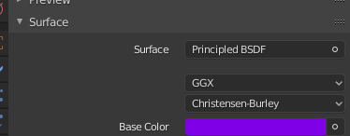
The Properties Panel: Creating a material
In Object Mode, select your sphere then click material property tab
Click the materials tab and then create new material
Rename the material ‘NW’
Open the preview section
Set Base Color to your favorite purple
Can change surface type for more materials properties!
Try Glossy or Glass BSDF
Try the Roughness slider
Please leave on Principled BSDF for next step

Slide 9
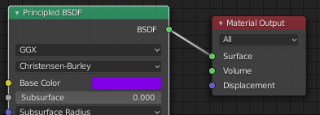
How Materials Properties work
Switch Outliner panel to Shader Editor
Surface shader and/or volume shader
Surface shaders only interact with light at surfaces
E.g. reflection, refraction, scattering
Volume shader affect throughout
Volumetric absorption in tinted glass, volumetric scattering in smoke
You need at least one!
Procedural Shaders for many looks can be made
Mixed shaders, textures, functions, normal vectors, etc. are combined in the Material Output
This is a graphical representation of programming procedural materials!

Slide 10
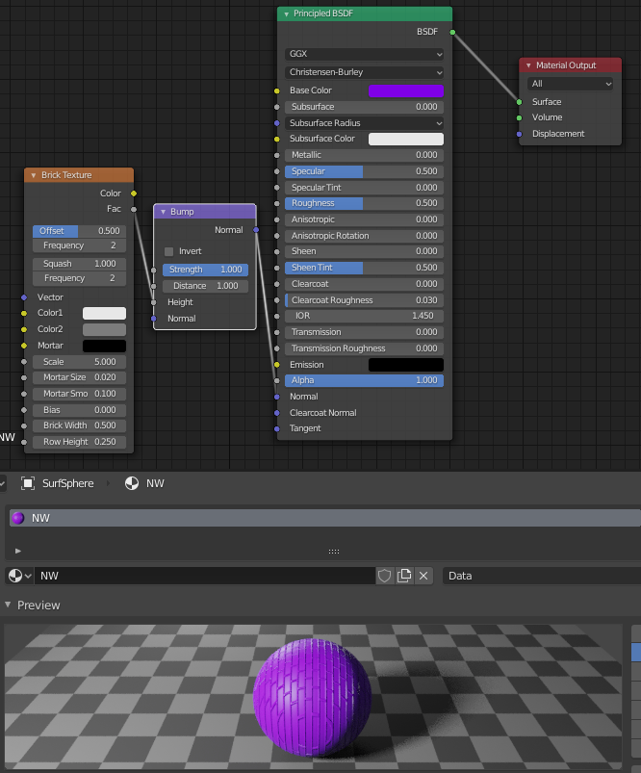
Example Shader
Adding a Brick Texture to a Bump map for the Normal vectors
Add -> Vector -> Bump
Add -> Texture -> Brick
Lines connect function outputs to inputs

Slide 11
Tips
Lighting and camera setup are key because we are doing simulated photography
You can even simulate IPhone Cameras!
Surface shaders are the most important for good materials
Cycles uses Monte Carlo pixel sampling (path tracing) which often requires the increasing the number of sample to not have a grainy image
Avoiding transparency and refractive surfaces to reduces the number of samples required

Slide 12
How I get data into Blender with the Python API
Blender uses it’s own internal python copy
Your scripts are run by Blender
Prerequisites
Conda
Installation:
Create conda environment with Python version matching Blender’s
conda create -n blender-env python=3.7
conda activate blender-env
conda install scikit-image
conda install -c conda-forge ase
To run from command line
blender -–python my_script.py

Slide 13
Blender API
The API is not aimed at our uses
It can be awkward to use
I have provided an example

