Slide 1
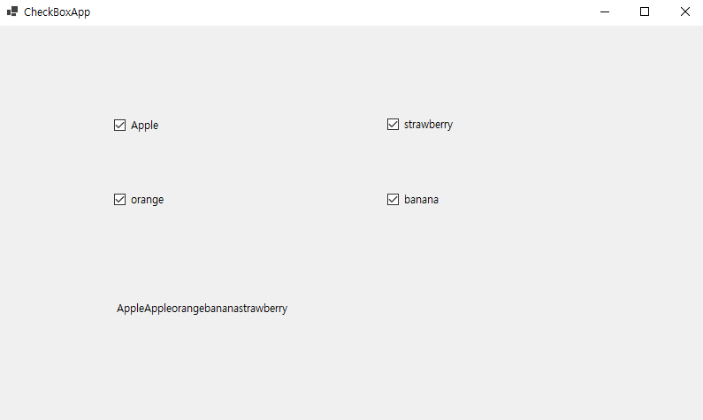
public partial class Form1 : Form
{
public Form1()
{
InitializeComponent();
}
private void UpdateLabel(string s, bool b)
{
if (b)
{
label1.Text += s; // label1의 Text 프로퍼티에 문자열 추가
}
else
{
string strTemp = label1.Text;
int i = strTemp.IndexOf(s);
label1.Text = strTemp.Remove(i, s.Length);
}
}
private void checkBox1_CheckedChanged(object sender, EventArgs e)
{
UpdateLabel(checkBox1.Text, checkBox1.Checked);
}
private void checkBox2_CheckedChanged(object sender, EventArgs e)
{
UpdateLabel(checkBox2.Text, checkBox2.Checked);
}
private void checkBox3_CheckedChanged(object sender, EventArgs e)
{
UpdateLabel(checkBox3.Text, checkBox3.Checked);
}
private void checkBox4_CheckedChanged(object sender, EventArgs e)
{
UpdateLabel(checkBox4.Text, checkBox4.Checked);
}
}

Slide 2
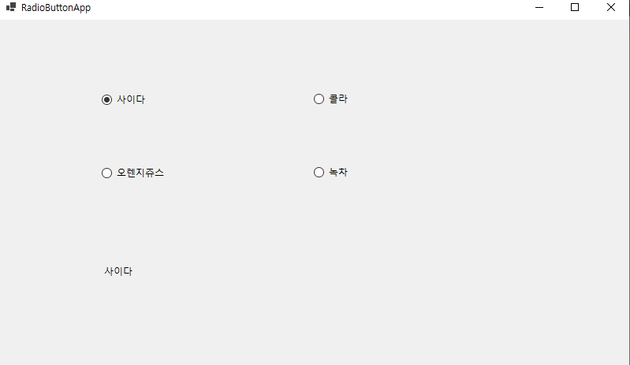
public partial class Form1 : Form
{
public Form1()
{
InitializeComponent();
}
private void radioButton1_CheckedChanged(object sender, EventArgs e)
{
label1.Text = radioButton1.Text;
}
private void radioButton2_CheckedChanged(object sender, EventArgs e)
{
label1.Text = radioButton2.Text;
}
private void radioButton3_CheckedChanged(object sender, EventArgs e)
{
label1.Text = radioButton3.Text;
}
private void radioButton4_CheckedChanged(object sender, EventArgs e)
{
label1.Text = radioButton4.Text;
}
}

Slide 3
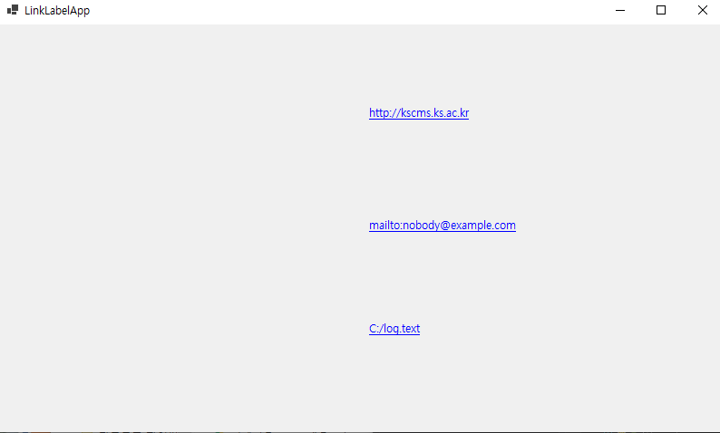
using System;
using System.Windows.Forms;
using System.Diagnostics;
namespace WinFormsApp2
{
public partial class Form4 : Form
{
public Form4()
{
InitializeComponent();
}
private void label1_Click(object sender, EventArgs e)
{
Process.Start(label1.Text);
}
private void label2_Click(object sender, EventArgs e)
{
Process.Start(label2.Text);
}
private void label3_Click(object sender, EventArgs e)
{
Process.Start(label3.Text);
}
}
}

Slide 4
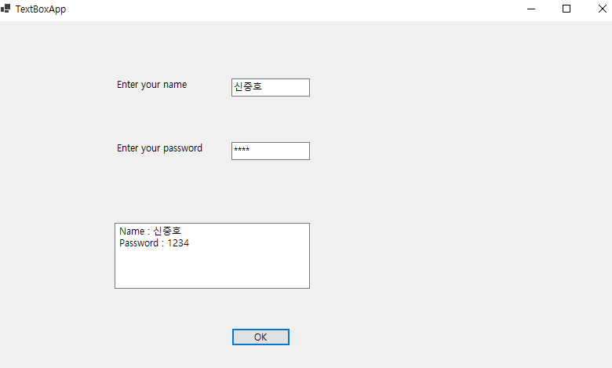
namespace WinFormsApp1
{
public partial class Form2 : Form
{
public Form2()
{
InitializeComponent();
}
private void button1_Click(object sender, EventArgs e)
{
textBox3.Text = "Name : " + textBox1.Text +
"\r\nPassword : " + textBox2.Text;
}
}
}

Slide 5
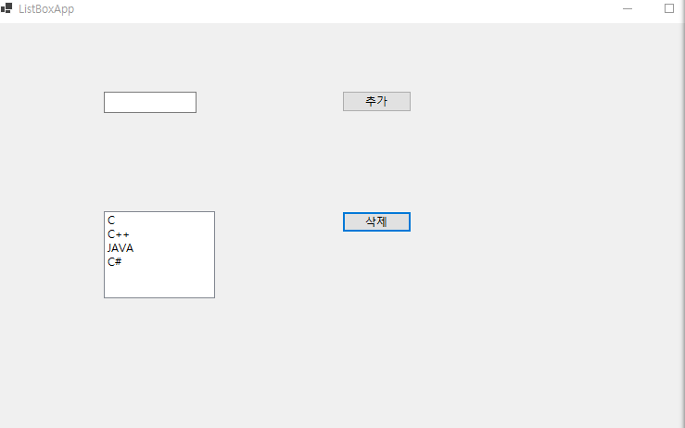
public partial class Form3 : Form
{
public Form3()
{
InitializeComponent();
}
private void button1_Click(object sender, EventArgs e)
{
if (textBox1.Text != "")
{
listBox1.Items.Add(textBox1.Text);
textBox1.Text = "";
}
}
private void button2_Click(object sender, EventArgs e)
{
if (listBox1.SelectedIndex > -1)
listBox1.Items.RemoveAt(listBox1.SelectedIndex);
}
}

Slide 6
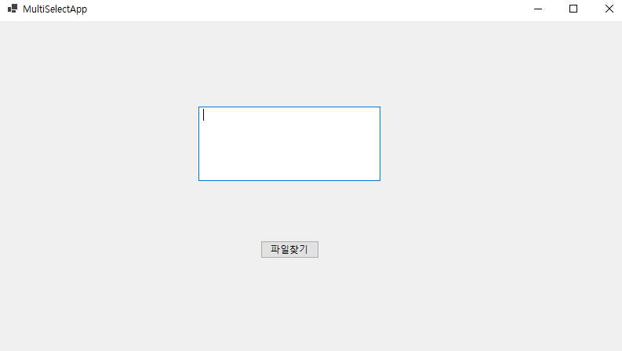
public partial class Form3 : Form
{
public Form3()
{
InitializeComponent();
}
private void button1_Click(object sender, EventArgs e)
{
openFileDialog1.InitialDirectory = @"C:\";
openFileDialog1.Filter
= "텍스트 파일(*.txt)|*.txt|모든 파일(*.*)|*.*";
openFileDialog1.FilterIndex = 1; // "텍스트 파일(*.txt)|*.txt“
openFileDialog1.RestoreDirectory = true;
openFileDialog1.ShowDialog();
textBox1.Text = openFileDialog1.FileName;
}
}

Slide 7
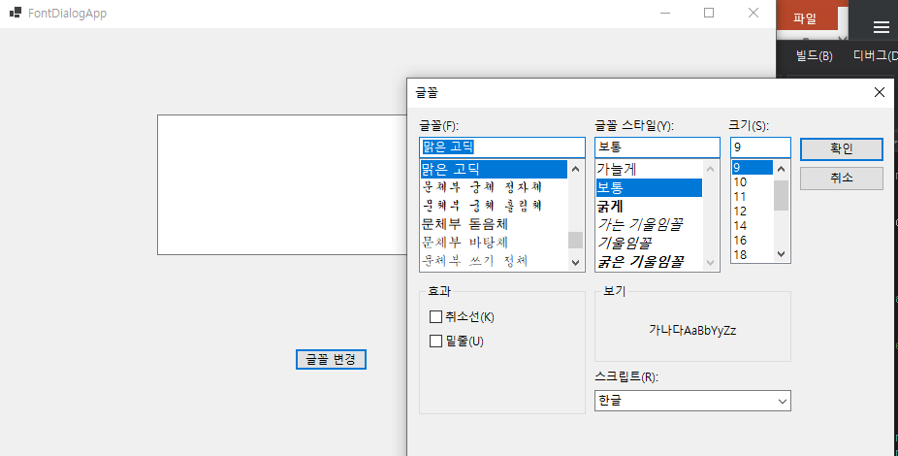
public partial class Form4 : Form
{
public Form4()
{
InitializeComponent();
}
private void button1_Click(object sender, EventArgs e)
{
fontDialog1.ShowDialog();
textBox1.Font = fontDialog1.Font;
textBox1.ForeColor = fontDialog1.Color;
}
}

