Slide 1
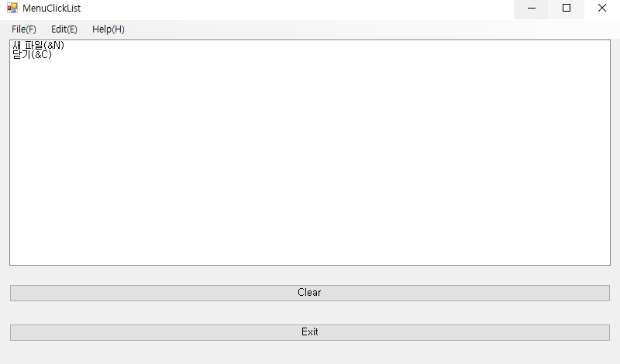
using System;
using System.Windows.Forms;
namespace WindowsFormsApp1
{
public partial class Form1 : Form
{
public Form1()
{
InitializeComponent();
}
private void button1_Click(object sender, EventArgs e)
{
listBox1.Items.Clear();
}
private void button2_Click(object sender, EventArgs e)
{
Application.Exit();
}
private void 새파ToolStripMenuItem_Click(object sender, EventArgs e)
{
listBox1.Items.Add(((ToolStripMenuItem)sender).Text);
}
private void 열기ToolStripMenuItem_Click(object sender, EventArgs e)
{
listBox1.Items.Add(((ToolStripMenuItem)sender).Text);
}
private void 닫기CToolStripMenuItem_Click(object sender, EventArgs e)
{
listBox1.Items.Add(((ToolStripMenuItem)sender).Text);
}
}
}

Slide 2
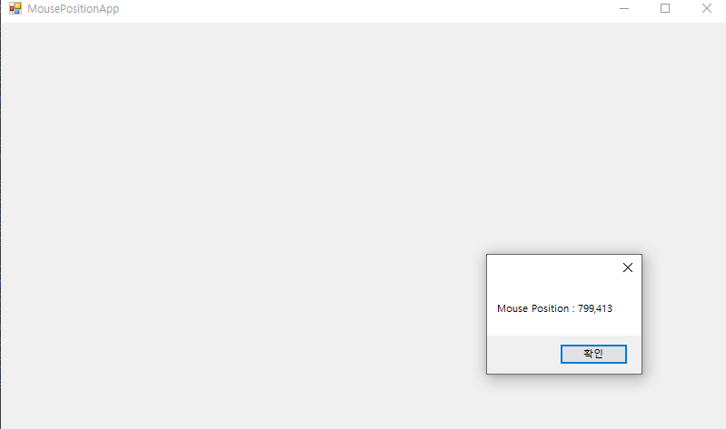
using System;
using System.Drawing;
using System.Windows.Forms;
namespace WindowsFormsApp1
{
public partial class Form3 : Form
{
public Form3()
{
InitializeComponent();
}
private void Form3_MouseEnter(object sender, EventArgs e)
{
Point mousePoint = PointToClient(MousePosition);
string msg = "Mouse Position : " + mousePoint.X + "," + mousePoint.Y;
MessageBox.Show(msg);
}
}
}

Slide 3
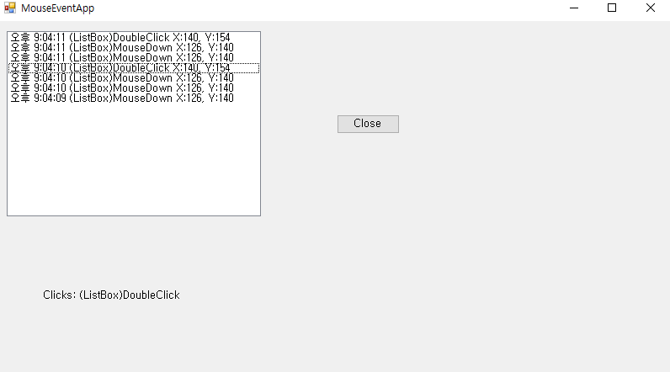
using System;
using System.Drawing;
using System.Windows.Forms;
namespace WindowsFormsApp1
{
public partial class Form4 : Form
{
public Form4()
{
InitializeComponent();
}
private void UpdateEventlabels(string msg, int x, int y, MouseEventArgs e)
{
string message = string.Format("{0} X:{1}, Y:{2}", msg, x, y);
string eventMsg = DateTime.Now.ToLongTimeString();
eventMsg += " " + message;
listBox1.Items.Insert(0, eventMsg);
listBox1.TopIndex = 0;
string mouseInfo;
if (e != null)
{
mouseInfo = string.Format("Clicks: {0}, Delta: {1}," + "Buttons: {2},",e.Clicks, e.Delta, e.Button.ToString());
}
else
{
mouseInfo = string.Format("Clicks: {0}", msg);
}
label1.Text = mouseInfo;
}
private void listBox1_MouseDown(object sender, MouseEventArgs e)
{
UpdateEventlabels("(ListBox)MouseDown", e.X, e.Y, e);
}
private void listBox1_MouseDoubleClick(object sender, MouseEventArgs e)
{
Point mousePoint = PointToClient(MousePosition);
UpdateEventlabels("(ListBox)DoubleClick", mousePoint.X, mousePoint.Y, null);
}
private void button1_Click(object sender, EventArgs e)
{
Application.Exit();
}
}
}

Slide 4
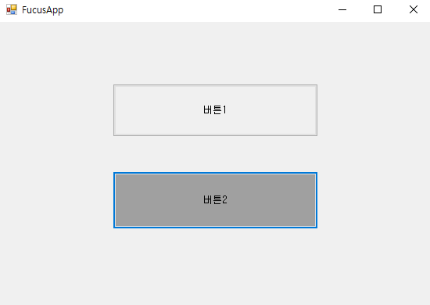
using System;
using System.Drawing;
using System.Windows.Forms;
namespace WindowsFormsApp1
{
public partial class Form5 : Form
{
public Form5()
{
InitializeComponent();
}
private void button1_Click(object sender, EventArgs e)
{
this.button1.BackColor = SystemColors.Control;
this.button2.Focus();
if (this.button2.Focused)
this.button2.BackColor = SystemColors.ControlDark;
}
private void button2_Click(object sender, EventArgs e)
{
this.button2.BackColor = SystemColors.Control;
this.button1.Focus();
if (this.button1.Focused)
this.button1.BackColor = SystemColors.ControlDark;
}
}
}

Slide 5
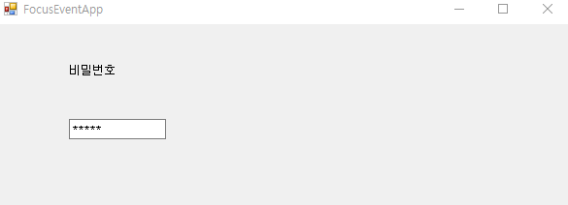
using System;
using System.Windows.Forms;
namespace WindowsFormsApp1
{
public partial class Form6 : Form
{
public Form6()
{
InitializeComponent();
}
private void textBox1_Enter(object sender, EventArgs e)
{
}
}
}

Slide 6
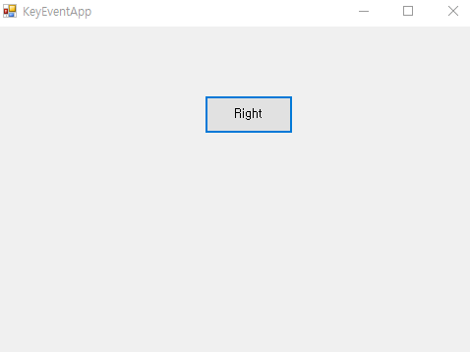
using System.Drawing;
using System.Windows.Forms;
namespace WindowsFormsApp1
{
public partial class Form7 : Form
{
public Form7()
{
InitializeComponent();
}
public int xPt, yPt;
public static readonly int Move = 10;
private void button1_KeyUp(object sender, KeyEventArgs e)
{
this.xPt = this.button1.Location.X;
this.yPt = this.button1.Location.Y;
switch (e.KeyCode)
{
case Keys.Left:
xPt -= Move;
break;
case Keys.Right:
xPt += Move;
break;
case Keys.Up:
yPt -= Move;
break;
case Keys.Down:
yPt += Move;
break;
}
this.button1.Text = e.KeyCode.ToString();
this.button1.Location = new Point(xPt, yPt);
}
}
}

Slide 7
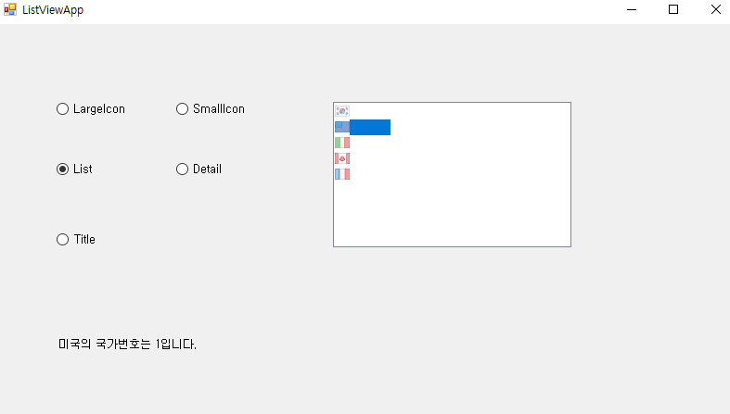
using System;
using System.Windows.Forms;
namespace WindowsFormsApp1
{
public partial class Form8 : Form
{
public Form8()
{
InitializeComponent();
}
private void radioButton1_CheckedChanged(object sender, EventArgs e)
{
if (radioButton1.Checked)
listView1.View = View.LargeIcon;
}
private void radioButton2_CheckedChanged(object sender, EventArgs e)
{
if (radioButton2.Checked)
listView1.View = View.SmallIcon;
}
private void radioButton3_CheckedChanged(object sender, EventArgs e)
{
if (radioButton3.Checked)
listView1.View = View.List;
}
private void radioButton4_CheckedChanged(object sender, EventArgs e)
{
if (radioButton4.Checked)
listView1.View = View.Details;
}
private void radioButton5_CheckedChanged(object sender, EventArgs e)
{
if (radioButton5.Checked)
listView1.View = View.Tile;
}
private void listView1_Click(object sender, EventArgs e)
{
foreach (ListViewItem item in listView1.SelectedItems)
{
ListViewItem.ListViewSubItemCollection subItem = item.SubItems;
label1.Text = subItem[1].Text + "의 국가번호는 " + subItem[2].Text + "입니다.";
}
}
}
}

Slide 8
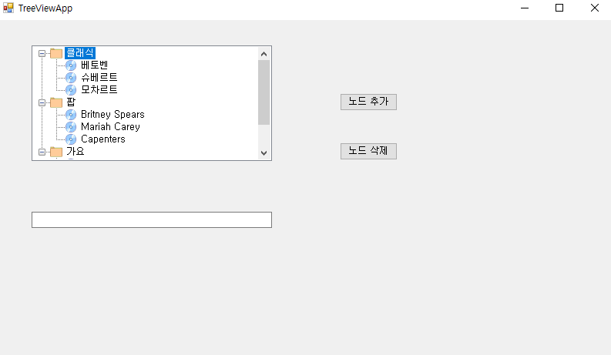
using System;
using System.Windows.Forms;
namespace WindowsFormsApp1
{
public partial class Form9 : Form
{
public Form9()
{
InitializeComponent();
}
private void treeView1_AfterSelect(object sender, TreeViewEventArgs e)
{
}
private void Form9_Load(object sender, EventArgs e)
{
treeView1.ExpandAll();
}
private void button1_Click(object sender, EventArgs e)
{
if (textBox1.Text != "" && treeView1.SelectedNode != null)
{
treeView1.SelectedNode.Nodes.Add(
new TreeNode(textBox1.Text, 1, 1));
textBox1.Text = "";
textBox1.Focus();
}
}
private void button2_Click(object sender, EventArgs e)
{
treeView1.Nodes.Remove(treeView1.SelectedNode);
}
}
}

Slide 9
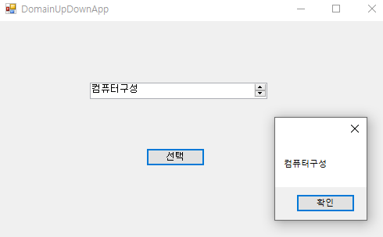
using System;
using System.Windows.Forms;
namespace WindowsFormsApp1
{
public partial class Form10 : Form
{
public Form10()
{
InitializeComponent();
}
private void button1_Click(object sender, EventArgs e)
{
MessageBox.Show(domainUpDown1.SelectedItem.ToString());
}
}
}

Slide 10
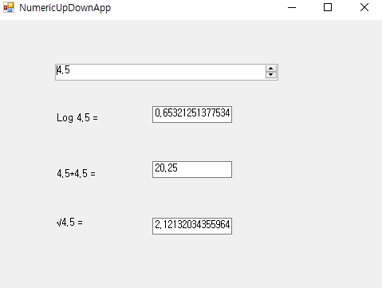
using System;
using System.Windows.Forms;
namespace WindowsFormsApp1
{
public partial class Form11 : Form
{
public Form11()
{
InitializeComponent();
}
private void numericUpDown1_ValueChanged(object sender, EventArgs e)
{
decimal d = numericUpDown1.Value;
label1.Text = "Log " + d + " = ";
textBox1.Text = System.Math.Log10((double)d).ToString();
label2.Text = d + "*" + d + " = ";
textBox2.Text = System.Math.Pow((double)d, 2).ToString();
label3.Text = "√" + d + " = ";
textBox3.Text = System.Math.Sqrt((double)d).ToString();
}
}
}

Slide 11
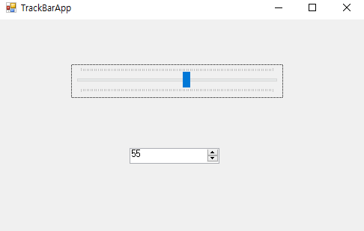
using System;
using System.Windows.Forms;
namespace WindowsFormsApp1
{
public partial class Form12 : Form
{
public Form12()
{
InitializeComponent();
}
private void trackBar1_Scroll(object sender, EventArgs e)
{
numericUpDown1.Value = trackBar1.Value;
}
private void numericUpDown1_ValueChanged(object sender, EventArgs e)
{
trackBar1.Value = (int)numericUpDown1.Value;
}
}
}

Slide 12
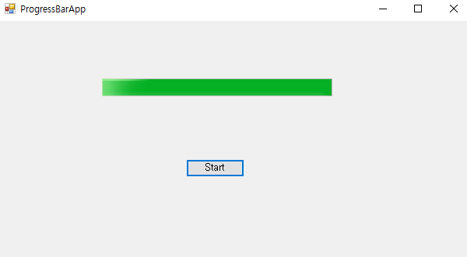
using System;
using System.Windows.Forms;
namespace WindowsFormsApp1
{
public partial class Form13 : Form
{
public Form13()
{
InitializeComponent();
}
private void button1_Click(object sender, EventArgs e)
{
for (int i = progressBar1.Minimum; i < progressBar1.Maximum; i++)
progressBar1.Value = i;
}
}
}

Slide 13
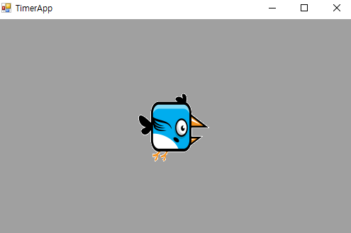
using System;
using System.Windows.Forms;
namespace WindowsFormsApp1
{
public partial class Form14 : Form
{
public Form14()
{
InitializeComponent();
}
private int index = 0;
private void timer1_Tick_1(object sender, EventArgs e)
{
index %= imageList1.Images.Count;
label1.Image = imageList1.Images[index++];
}
}
}

