Slide 1
Introduction:
In this project, I explored the relationship between the following:
Quantity of a product in an order and discount level.
Price’s effect on quantity ordered in a product
Units In Stock’s impact on Units On Order
Reorder Level’s impact on Units on Order
Methods employed were:
Creating a hypothesis about the data
Comparing the differences in values within the dataset
Determining whether these differences were statistically significant

Slide 2
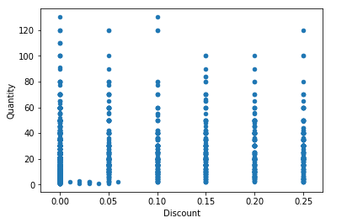
Does Discount Amount have an effect on the quantity of a product in an order?
Hypothesis: The greater the discount is, the more units of that good people will buy in general.
There was a general upward in the quantity ordered
A Product sold at a discount will have an order quantity that is 21.5% higher on average
Products that were sold at 5% increments tended to be ordered
Products sold at a 5% discount were on average ordered 21% more than products sold at 10% discounts
Caveats- We aren’t controlling for any other variables so we cant say that having the discount will necessarily cause that outcome, just that the two occur together.

Slide 3
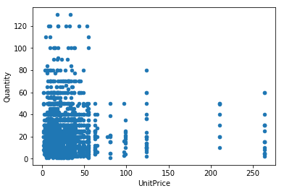
Does Price have an effect on the quantity of a product in an order?
Hypothesis: The price will have an impact on the quantity of a product that is ordered.
We cant clearly say beforehand whether it will increase because more expensive products may be perceived as more valuable and ordered in greater quantities or whether cheaper products will be ordered in larger quantities because they are cheaper.
No statistically significant relation seems to exist between a product’s price and the quantity it is ordered.

Slide 4
Does Units in Stock have an effect on Units on Order?
Hypothesis: Units in stock has a statistically significant relationship with Units in order and the more units in stock there are, in general, the fewer units in order there will be.
It makes Sense considering that stores wouldn’t want to hold too many units of a product, as keeping too much inventory has opportunity costs and maintenance costs.
Interestingly, any product that had more than the median Units in stock actually had zero units on order.
Finding: Units in stock does have a statistically significant impact on units on order.
With this knowledge, we may be able to create predictive model that helps order exactly how much/many of a product we’d need.
We can also simplify our ordering system to automatically take out goods that are above the median level so that they do not get accidentally ordered when not needed.
We can actually see that when a product has Units In Stock that is greater than the median, it basically has no units being ordered for it.

Slide 5
Does Reorder Level Impact Units in Order?
Hypothesis: Reorder Level My have a positive or negative impact on units on order however we cant really say specifically which one yet.
Price may increase units on order as selling more expensive goods increase the money make preselling each unit.
Price may also reduce the units on order as more expensive units require a larger investment and may cost more to maintain over time.
Unit Price does have a statistically significant impact on Units in Order.
Like the relationship, we see that unit price also has a statistically significant impact so we would benefit by including it in the model.
Furthermore, we can see that the mean units on order from units that have a reorder level below the median of 15 is a paltry 1.93 whereas Units In Order above the median is almost 10 times bigger at 20.71.

Slide 6

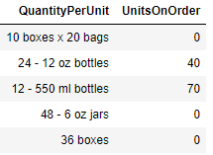
Future Recommendations
Analyzing just Units on Order, Reorder Level, and Discontinued, we were able to measure 32 percent of the variance within the dataset. Further investigation could help develop predictive model that can automate the item ordering process completely.
Cleaning up the Quantity Per Unit is critical to this, but that comes with it’s own challenges

