Slide 1
ICTS 2026 · GRADUATE LECTURE
Simulation-Based Inference
Bayesian inference when you can simulate your data
but cannot write down its likelihood
forward: easy
parameters
simulator
data
θ
run the physics
x
inverse: which θ could have produced the one x we observed?
A first course for PhD students in astronomy and cosmology
Simulation-Based Inference · Introduction
1
Notes:
Open with the inverse problem, not with neural networks. SBI is a family of Bayesian computational methods, not one algorithm. Sources: Deistler et al. 2025 (arXiv:2508.12939); Thiele 2026 (arXiv:2605.10719); Anau Montel 2025 (MPA lecture notes).

Slide 2
HOW THIS LECTURE IS ORGANISED
Five questions, in order
Why can a simulator be easy to run but impossible to score?
Part I
1
What does ABC do — and why does it stop working?
Part II
2
What do NPE, NLE and NRE actually learn?
Part III
3
What does “amortised” buy you?
Part III
4
How do you know the posterior is not nonsense?
Part IV
5
By the end you should be able to answer each of these in plain language, and to say which method you would use on your own data.
Simulation-Based Inference · Introduction
2
Notes:
Use these as checkpoints. Come back to them at the end.

Slide 3
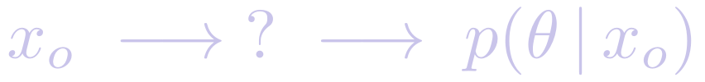
PART I
Why simulation-based inference?
The inverse problem, and the two different ways a likelihood can fail you.
Simulation-Based Inference · Part I — Motivation
3
Notes:
Frame the whole of Part I as: what exactly is missing when we say the likelihood is intractable?

Slide 4
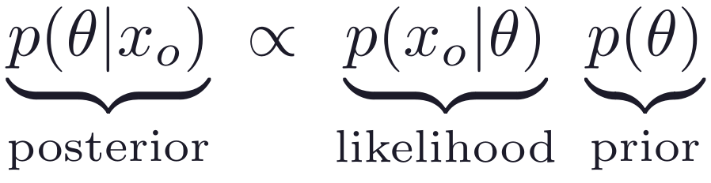
THE INVERSE PROBLEM
Every model can be run in two directions
Forward — the simulator
Inverse — inference
You choose θ; the code returns a possible dataset x.
This is exactly what your simulator already does.
It is stochastic: the same θ gives a different x every run.
You have one dataset xₒ. Which θ could have produced it?
The answer is a distribution, not a single best fit.
Degeneracies and uncertainty are part of the answer.
The prior and the likelihood are physics choices; the posterior is what the data plus those choices imply.
The target is the whole distribution p(θ | xₒ) — every parameter compatible with the data and the prior.
Simulation-Based Inference · Part I — Motivation
4
Notes:
Stress that a point estimate plus an error bar is a summary of the posterior, and often a bad one (see the bimodal example later).

Slide 5
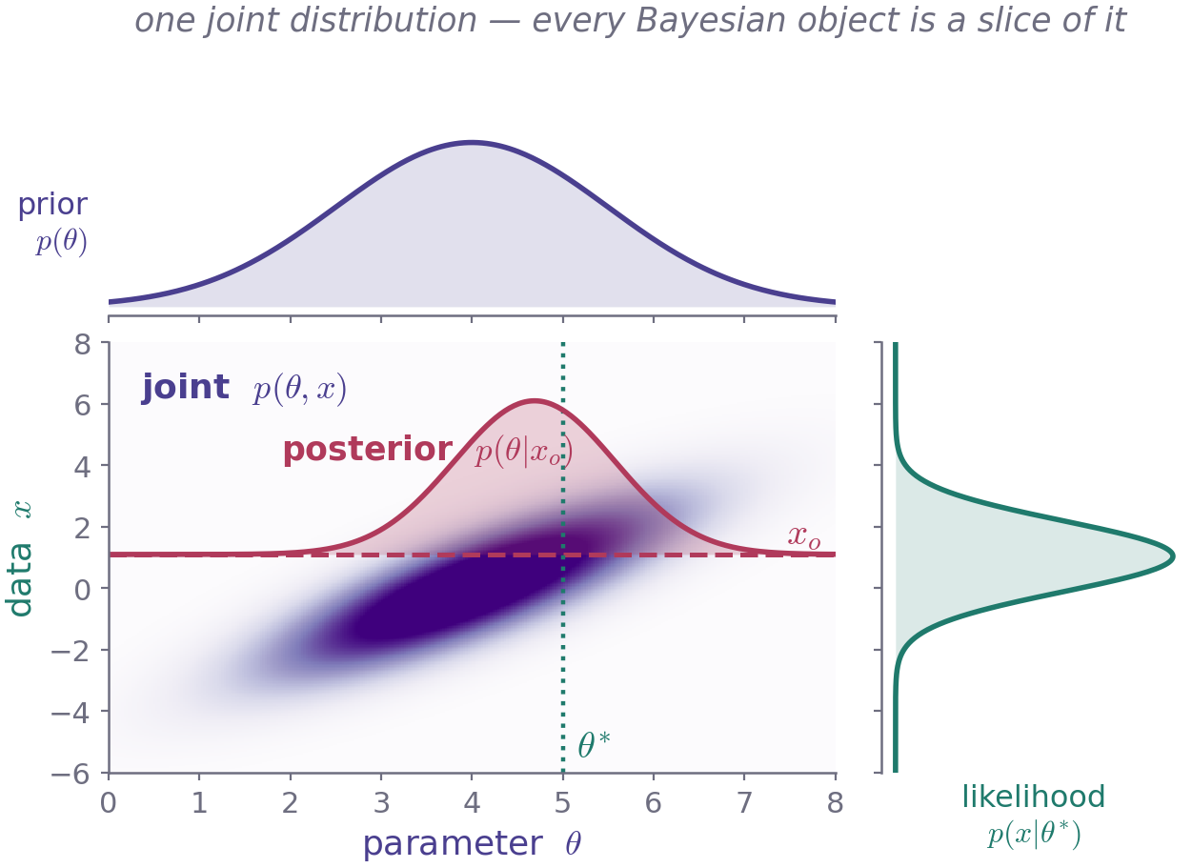
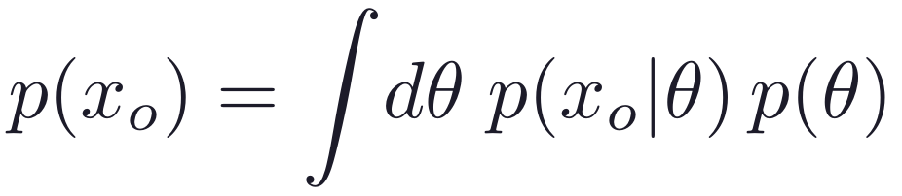
ANATOMY OF BAYES' THEOREM
Every Bayesian object is a slice of one density
How to read it
The joint p(θ, x) = p(θ) p(x | θ) contains everything.
Fix a parameter θ*: the vertical slice is the likelihood.
Fix the data at xₒ: the horizontal slice is the posterior.
Integrate over θ: the evidence p(xₒ), a normalisation.
Figure computed for a linear-Gaussian model; layout after Anau Montel (2025), Fig. 1.
If you can draw the joint distribution, you have already done Bayesian inference. The rest is computation.
Simulation-Based Inference · Part I — Motivation
5
Notes:
Ask the room: which of these five objects does your simulator give you access to? Answer: only samples from the joint.

Slide 6
WHAT EACH METHOD DEMANDS OF YOUR MODEL
SBI is the only row that never evaluates a likelihood
method | sample (θ, x) ~ p(θ, x) | evaluate p(xₒ | θ) | evaluate ∇θ log p(xₒ | θ)
Markov chain Monte Carlo | no | yes | no
Nested sampling | no | yes | no
Hamiltonian Monte Carlo | no | yes | yes
Variational inference | no | yes | yes
Simulation-based inference | yes | no | no
Every classical method needs a program that returns a number for p(xₒ | θ). SBI needs a program that returns a random dataset. That single substitution is the whole idea — and it is why SBI works on black-box code, in any language, with no gradients.
After Anau Montel (2025), Table 1.
Ask of your own model: can I sample from it? Can I score it? The answers select your method.
Simulation-Based Inference · Part I — Motivation
6
Notes:
MCMC and nested sampling need likelihood values; HMC and VI also need gradients with respect to the parameters. SBI needs neither, only the forward program.

Slide 7
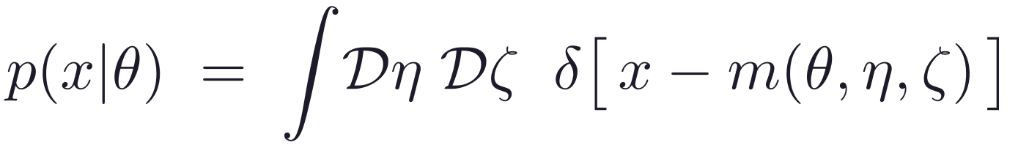
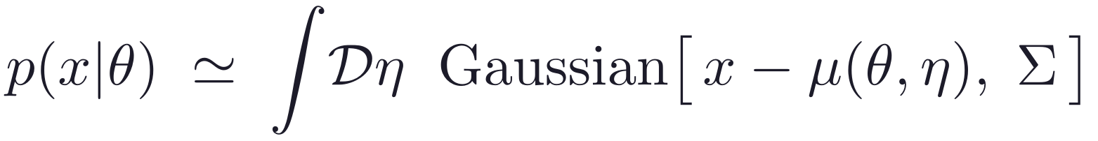
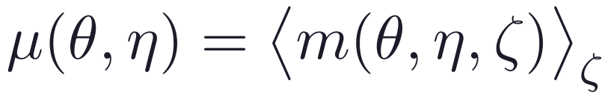
WHY LIKELIHOODS BECOME INTRACTABLE
The Gaussian likelihood is a lucky special case
What a likelihood actually is
When the shortcut fails
Nonlinear structure formation: the field is not Gaussian.
Masks, selection functions and survey geometry.
Noise that is not Gaussian and not stationary.
Branching or black-box code with no analytic mean.
Latent variables numbering in the millions.
A sum over every latent path that could have produced x: nuisance parameters η, and initial conditions and noise ζ.
if the ζ integral can be done analytically
What a standard analysis assumes instead
SBI keeps this expression and never attempts the shortcut — it replaces the integral with samples.
Now η is low-dimensional and MCMC works.
Following Thiele (2026), Eqs. 2–3.
“Intractable likelihood” means: I can draw from p(x | θ), but I cannot put a number on it.
Simulation-Based Inference · Part I — Motivation
7
Notes:
Emphasise that Eq. 3 is an approximation people make for tractability, not a law. SBI removes the need for it.

Slide 8
WHERE THIS BITES IN ASTRONOMY
Four places the likelihood is simply not available
Field-level galaxy clustering
Weak-lensing map statistics
The likelihood of a 3-D density field after nonlinear growth, galaxy bias, redshift-space distortions and masking has no closed form.
Peak counts, wavelet and scattering coefficients are strongly non-Gaussian; only mocks give their sampling distribution.
Strong-lens substructure
Galactic-centre γ-ray excess
The dark-matter subhalo population enters through a high-dimensional latent field that must be marginalised over.
Unresolved point sources below the detection threshold make the photon-count likelihood intractable.
Application areas as surveyed in Thiele (2026), §4.
In every case we can generate mocks all day. We just cannot score the one dataset we actually have.
Simulation-Based Inference · Part I — Motivation
8
Notes:
Invite examples from the audience's own projects here — it is worth two minutes.

Slide 9
TWO REASONS TO REACH FOR SBI
Intractable, or merely unaffordable
1
The likelihood does not exist
in closed form
2
The likelihood exists, but you
need the posterior fast, often
You cannot write down p(x | θ), so MCMC has nothing to sample. The only honest access to the model is running it forwards.
Rerunning a sampler per object is the bottleneck. Train once, then infer in milliseconds — amortisation.
Typical of cosmology
Typical of astrophysics
field-level and higher-order lensing statistics
intractable selection and systematics models
gravitational-wave events, minutes after the alert
photometric redshifts and spectra, catalogue-scale
The cosmology / astrophysics split follows Thiele (2026), §1 and §6.
Same machinery either way — but the motivation changes which method you should pick.
Motivation 1 forces SBI. Motivation 2 chooses it — which means you can often validate against the answer you already trust.
Simulation-Based Inference · Part I — Motivation
9
Notes:
Motivation 2 is the friendlier case: a ground-truth posterior exists, so the SBI result can be validated directly.

Slide 10
A CONCRETE FORWARD MODEL
Easy to run forwards, hopeless to marginalise
cosmology θ
+ nuisance η
initial
conditions
gravity
(N-body)
halos +
galaxies
survey
realism
mock field
or catalogue
10⁶–10⁹ random phases
HOD scatter
mask, selection, noise
latent variables injected at each stage
The ζ integral runs over every random number the chain ever drew. There is no closed form, and no sampler can march through it.
One run of this chain is a sample from p(x | θ). Nothing in it ever gives you the value of p(xₒ | θ).
Hierarchical simulators like this also let you reuse one expensive gravity run with many cheap galaxy realisations — Thiele (2026), §2.
Simulation-Based Inference · Part I — Motivation
10
Notes:
Separate cosmological parameters (wanted) from nuisance parameters (tolerated) from latent variables (never wanted, but unavoidable).

Slide 11
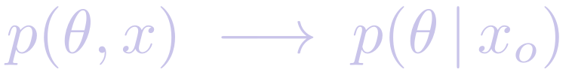
PART II
One table of simulations
Every SBI method starts from the same thing. The classical one throws most of it away.
Simulation-Based Inference · Part II — From the joint to ABC
11
Notes:
Part II builds the intuition: posterior = conditional slice of the joint; ABC = the crudest way to take that slice.

Slide 12
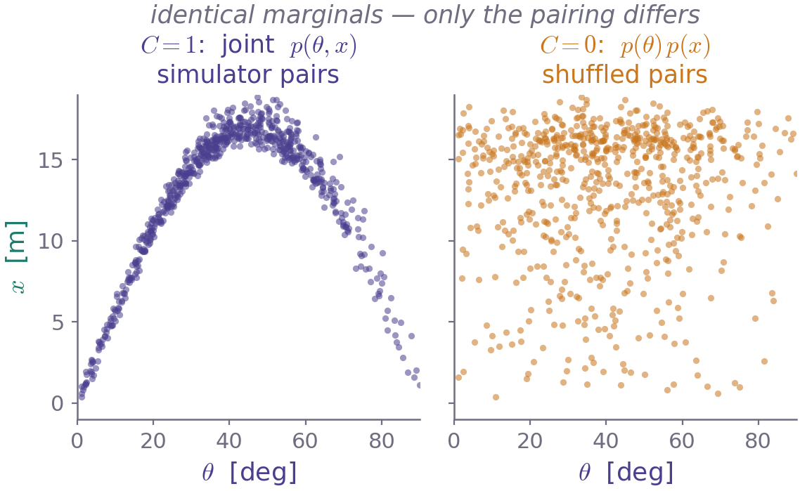
THE ONE INGREDIENT EVERY METHOD SHARES
Simulate a table of parameter–data pairs
1
Draw parameters from the prior
θᵢ ~ p(θ)
2
Run the simulator once for each
xᵢ ~ p(x | θᵢ)
3
Keep the pair
(θᵢ , xᵢ)
A table of 900 pairs, plotted. Structure in this cloud is the only information any method has about θ.
These pairs are draws from the joint distribution p(θ, x) = p(θ) p(x | θ). That table is the only thing any SBI method ever sees.
The draws need not be i.i.d. from the prior: quasi-random sequences (Latin hypercube, Sobol) give lower-variance loss estimates, and one expensive gravity run can carry many cheap galaxy realisations.
Thiele (2026), §2.
ABC, NPE, NLE and NRE all consume this same table. They differ only in what they do with it.
Simulation-Based Inference · Part II — From the joint to ABC
12
Notes:
Because simulation and training are decoupled, the bank can be generated offline, fully in parallel, in any language — then reused across methods and architectures for free.

Slide 13
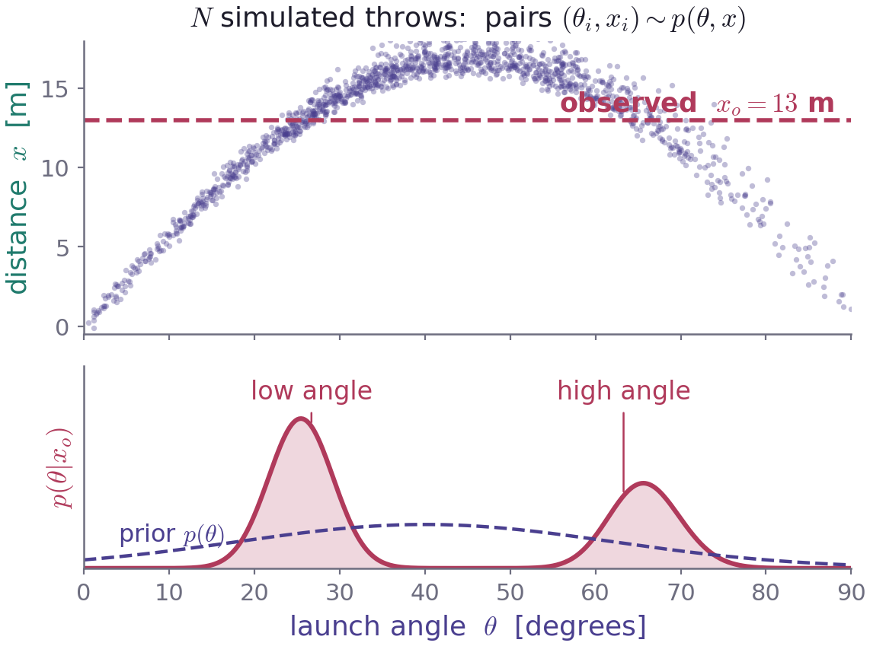
THE KEY PICTURE
The posterior is a horizontal cut through the joint
A simulator you can hold in your head
Throw a ball at angle θ with a fixed force. A random tailwind and measurement error make it stochastic. Record only the distance x.
Simulate a few thousand throws.
Keep the ones that landed at xₒ = 13 m.
The angles of those throws are the posterior.
It is bimodal: a low flat throw and a high lofted throw both travel 13 m.
Ball-throw example after Deistler et al. (2025), Fig. 2; figure computed here from 4 million simulated throws.
A best-fit angle with a Gaussian error bar would have been simply wrong. The shape of the posterior is the result.
Simulation-Based Inference · Part II — From the joint to ABC
13
Notes:
This is the single most useful mental image in the lecture. Conditioning = slicing. Everything that follows is a way of estimating that slice without literally having to hit xₒ.

Slide 14
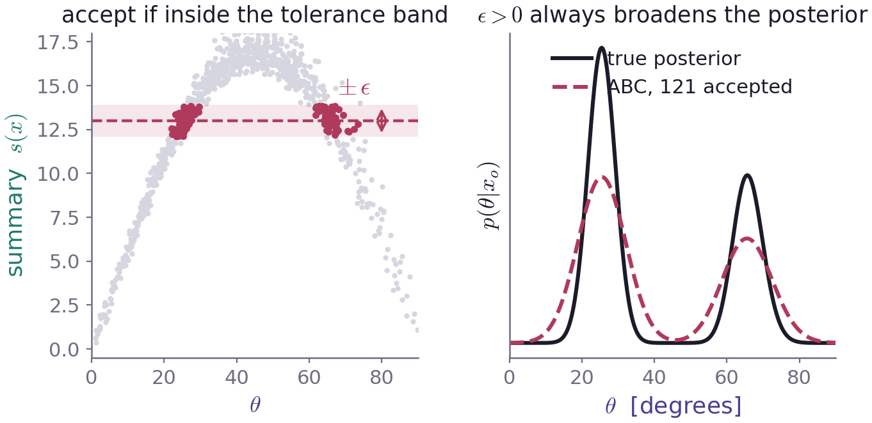
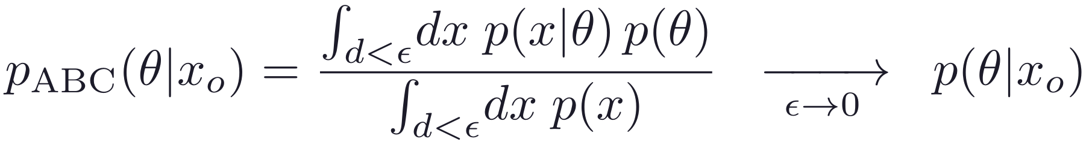
APPROXIMATE BAYESIAN COMPUTATION
No simulation lands exactly on xₒ — so widen the cut
The algorithm
1
draw θ from the prior
2
run the simulator to get x
3
compress both to a summary s(·)
4
keep θ if s(x) is within ε of s(xₒ)
After Anau Montel (2025), Eq. 3 and Fig. 2; accepted count from this bank.
exact as ε → 0
Any ε > 0 broadens the posterior. ABC is therefore conservative — but only if your summary is informative.
Simulation-Based Inference · Part II — From the joint to ABC
14
Notes:
ABC is Rubin's idea from the 1980s, and it was the whole of SBI for decades. It is still the clearest way to see what SBI is doing.

Slide 15
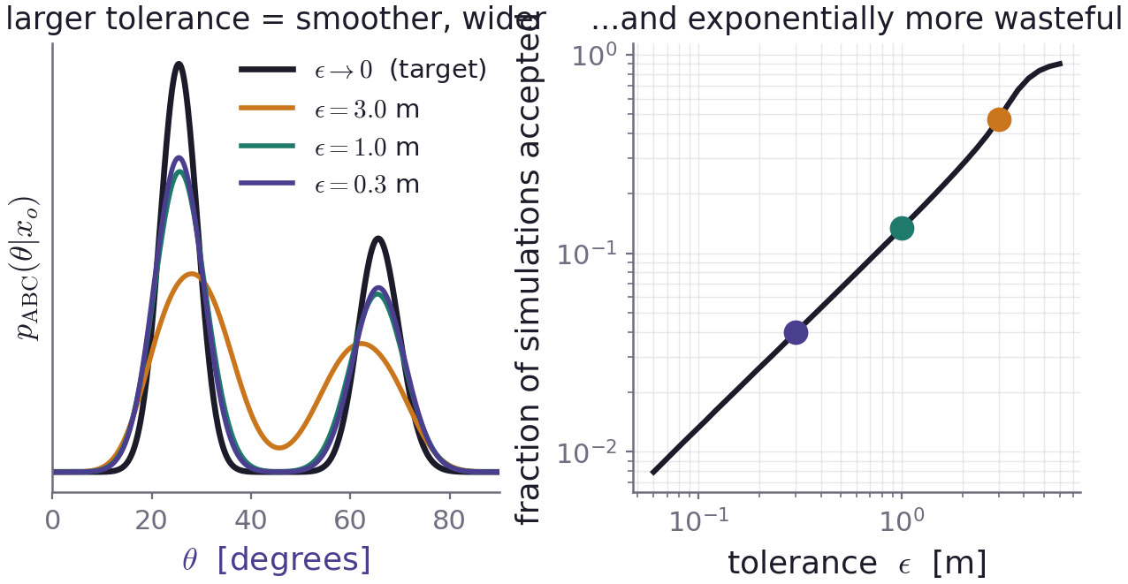
THE TOLERANCE TRADE-OFF
Accuracy and cost pull in opposite directions
Numbers from the BayesFlow tutorial “From ABC to BayesFlow” (pyABC chemical-reaction example).
ABC pays the full price again for every new observation. Nothing is reusable.
Simulation-Based Inference · Part II — From the joint to ABC
15
Notes:
Left: as ε shrinks the ABC posterior converges onto the target. Right: the acceptance rate falls like a power law. You cannot have both, and the cost is per-observation.

Slide 16
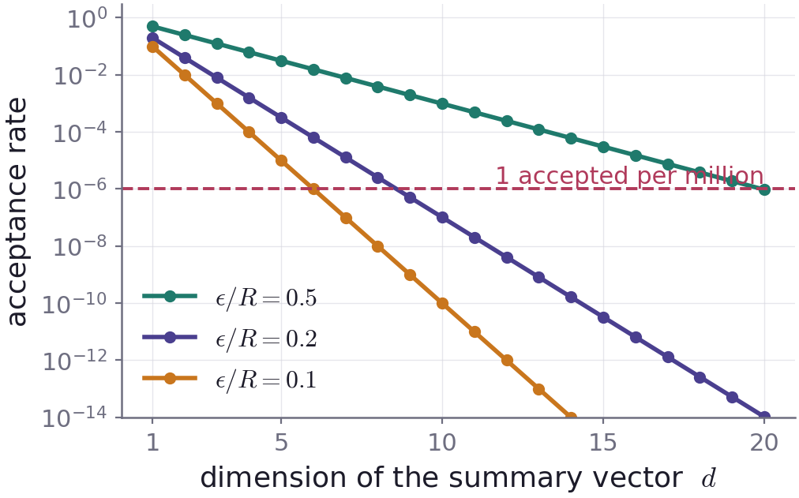
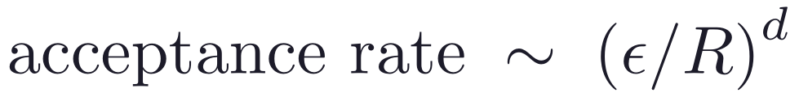
WHY ABC STOPS SCALING
Two problems you cannot tune away
1
2
The curse of dimensionality
You must hand-craft the distance
ABC never compares x to xₒ. It compares summaries s(x). Whatever information about θ your summary discards is gone — it caps the posterior you can ever recover, and you usually cannot tell how much you lost.
In cosmology this is the familiar question of which statistic to measure — except here it is also a hard ceiling on the inference.
Both problems come from throwing simulations away. Neural SBI keeps every single one.
Simulation-Based Inference · Part II — From the joint to ABC
16
Notes:
At ε/R = 0.2 and a 10-dimensional summary you accept roughly one simulation in ten million. This is exactly why ABC was confined to low-dimensional summaries for thirty years.

Slide 17
PART III
Neural simulation-based inference
Stop rejecting simulations. Fit a flexible model to all of them.
Simulation-Based Inference · Part III — Neural SBI
17
Notes:
The conceptual jump: ABC is nearest-neighbour estimation with a hand-made metric. Neural SBI is regression over the whole bank.

Slide 18
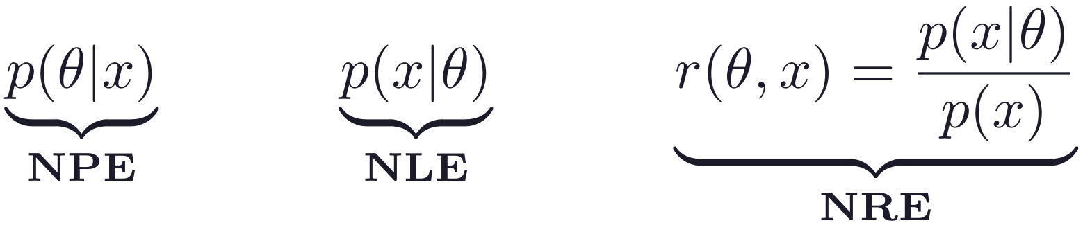
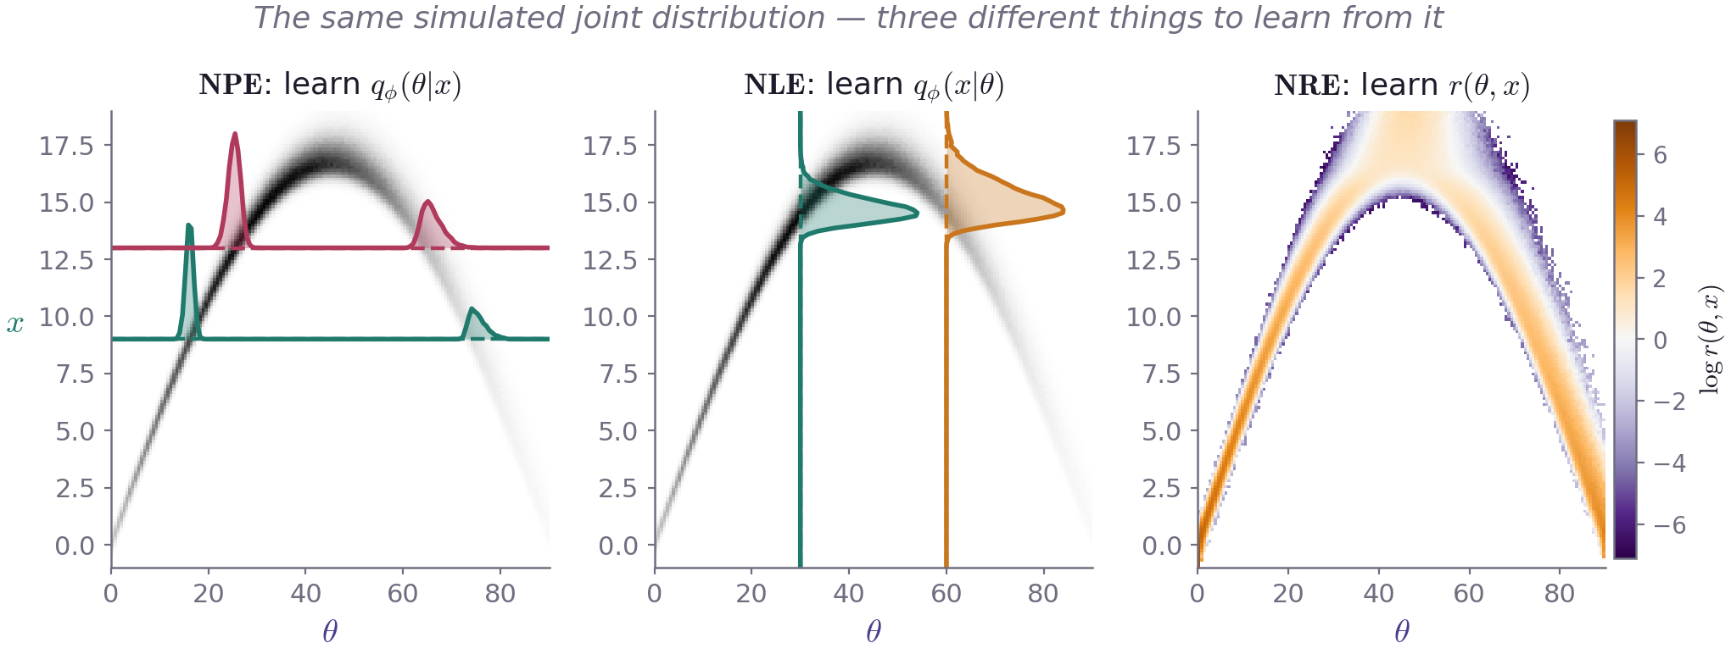
READING BAYES' THEOREM AS A MENU
Three quantities you can learn from the same table
All three panels computed from one bank of ball-throw simulations. Scheme after Thiele (2026), Figs. 2–4.
Simulation-Based Inference · Part III — Neural SBI
18
Notes:
Left: NPE reads off horizontal cuts and needs nothing further. Middle: NLE reads off vertical cuts — those are likelihoods, so a sampler must still turn them into a posterior. Right: NRE learns a single surface over the whole plane; positive where parameters and data belong together.

Slide 19
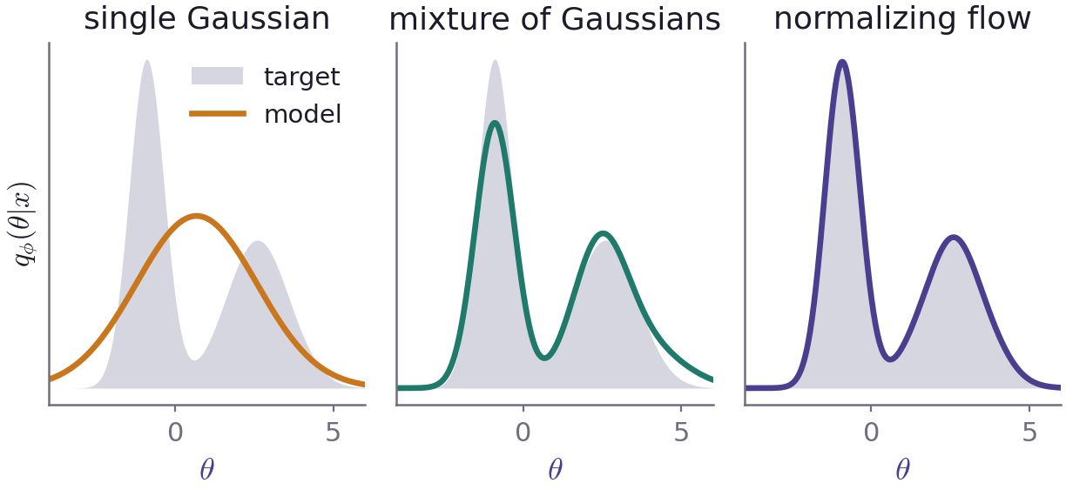
THE TOOL: CONDITIONAL DENSITY ESTIMATION
A network that outputs a distribution, not a number
What the network returns
Not a point estimate — the shape of a whole density.
It must be normalised and cheap to sample from.
Mixture density networks: a Gaussian mixture.
Normalising flows: the modern default.
Expressive is not the same as correct. Flexibility lets the model represent a complicated posterior; it is never evidence that the model found the right one.
Anau Montel (2025), §3.1.1.
The model class decides what shapes are reachable. The loss decides which shape you actually get.
Simulation-Based Inference · Part III — Neural SBI
19
Notes:
A single Gaussian cannot represent the bimodal ball-throw posterior no matter how well it is trained. That is a model-class failure, not a training failure.

Slide 20
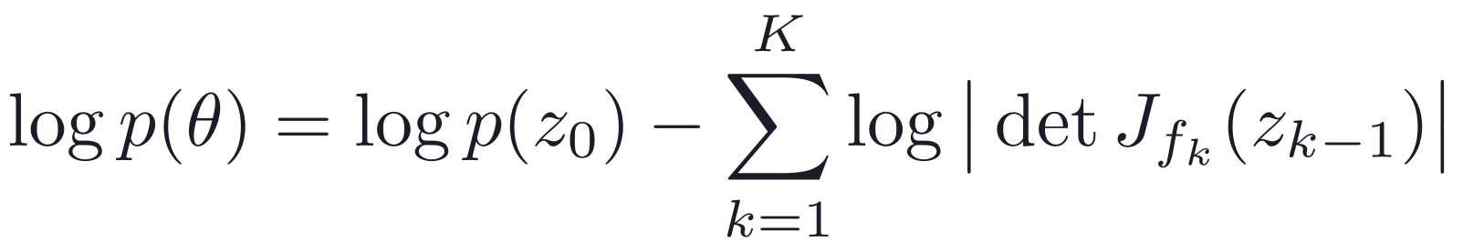
NORMALISING FLOWS IN ONE SLIDE
Deform a Gaussian until it fits
Why flows dominate
Chain invertible maps with cheap Jacobian determinants.
To sample: draw z₀ and push it forward.
To evaluate the density: push back, track the volume change.
Both directions exact — that is what NPE and NLE need.
Figure computed from an explicit two-map flow; scheme after Anau Montel (2025), Fig. 4.
A flow is only a flexible shape. What makes it a posterior is the objective it is trained on.
Simulation-Based Inference · Part III — Neural SBI
20
Notes:
Masked autoregressive flows and neural spline flows are the workhorses. Continuous-time alternatives (flow matching, diffusion) are more expressive but slower to evaluate — and cosmological posteriors are usually not that complicated.

Slide 21
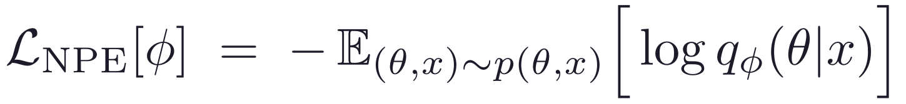
NEURAL POSTERIOR ESTIMATION
NPE learns the posterior directly
The pipeline
Why that loss gives the posterior
simulated pairs
(θ, x)
conditional density
qϕ(θ | x)
samples at
x = xₒ
Add and subtract the entropy of the true posterior:
The constant does not depend on ϕ. So minimising the loss minimises the expected KL divergence between the true posterior and the model, and at the optimum
In words: make the model assign high probability to the parameters that actually produced each simulated dataset.
for every x — not only for the one you happen to have observed. That is amortisation, and it falls out of the loss for free.
No likelihood is ever evaluated. The simulator enters only through the pairs sitting in the training set.
Derivation as in Anau Montel (2025), §3.1 and Thiele (2026), Eq. 7.
One objective, one training run, and the likelihood is never touched.
Simulation-Based Inference · Part III — Neural SBI
21
Notes:
Worth doing slowly on the board: the KL decomposition is the reason this works, and it is two lines of algebra. The expectation is over x ~ p(x), which is why the result holds for all x simultaneously.

Slide 22
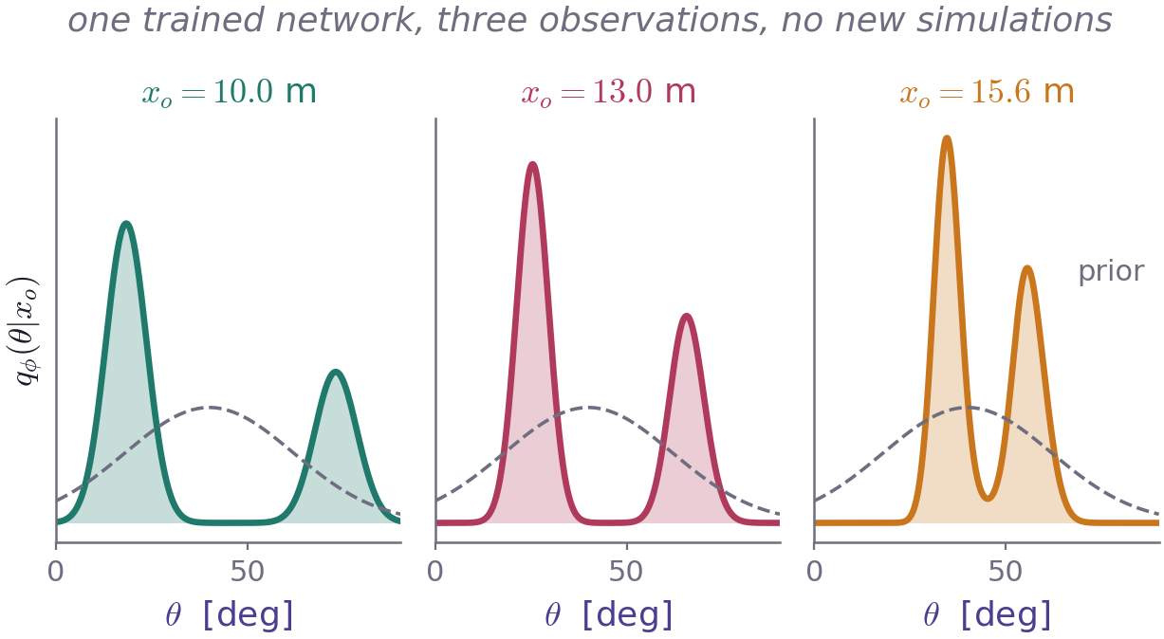
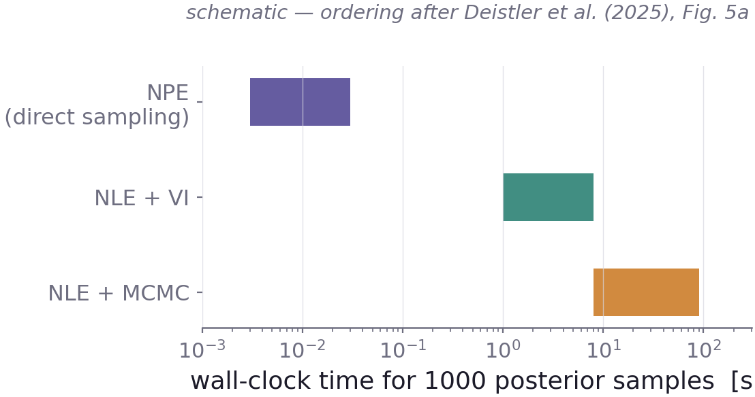
AMORTISED INFERENCE
Pay once in training, then infer in milliseconds
NPE draws posterior samples with a single forward pass. NLE and NRE must run a sampler for every observation — seconds to minutes, with convergence to check each time.
Posteriors computed by conditioning the same simulation bank on three different observations.
once
training run — then the network is frozen
ms
per new observation, per posterior
10³
calibration inferences become affordable
Amortisation is not only convenience: it is what makes thorough validation affordable at all.
Simulation-Based Inference · Part III — Neural SBI
22
Notes:
The third callout is the important one. Coverage tests need hundreds to thousands of inferences on held-out simulations. With a per-observation MCMC that is often simply out of reach.

Slide 23
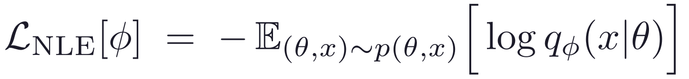
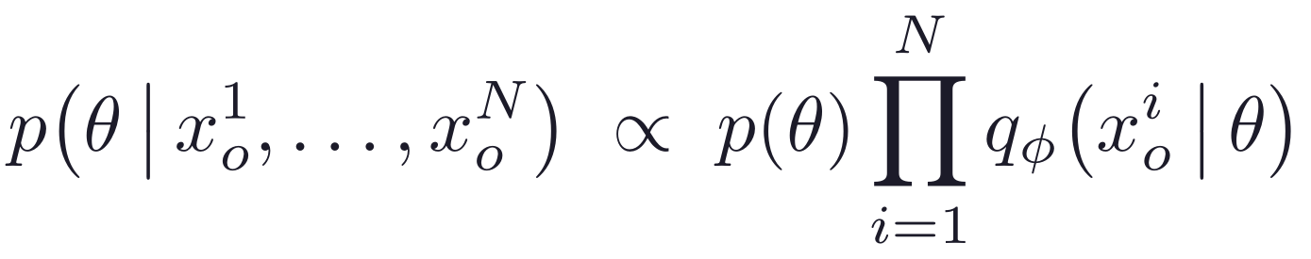
NEURAL LIKELIHOOD ESTIMATION
NLE learns the simulator's likelihood instead
What it learns
Where NLE clearly wins
Many independent measurements of the same kind:
The same objective as NPE, with θ and x exchanged.
Then there is still work to do
Train on single trials, then infer from any number of them — the likelihood simply factorises. NPE would have to be trained on N-observation inputs, needing N simulations per parameter set.
Multiply by the prior and run MCMC or variational inference — separately for every observation.
Anau Montel (2025), §3.2; Deistler et al. (2025), §3.2.
The price: a sampler runs for every observation, and it brings its own failure modes. A perfectly trained network still returns a wrong posterior if the chain has not converged.
Choose NLE when your data are many independent measurements — not because it sounds more principled.
Simulation-Based Inference · Part III — Neural SBI
23
Notes:
Also prefer NLE in the rarer case where the parameter vector is high-dimensional relative to the data: networks map high-dimensional inputs to low-dimensional outputs far more easily than the reverse.

Slide 24
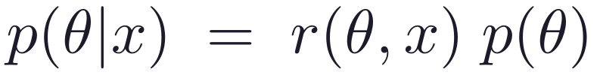
NEURAL RATIO ESTIMATION
Turn inference into a classification problem
The likelihood-ratio trick
Label real simulator pairs C = 1 and shuffled pairs C = 0.
Train a binary classifier with cross-entropy loss.
The Bayes-optimal classifier is the sigmoid of the log ratio, so the ratio comes straight out of it.
Shuffling the table breaks the link between parameters and data while leaving both marginals untouched. A classifier that can tell the two apart has learned that link.
No flow is needed, so any architecture will do. It still needs MCMC or prior reweighting to produce samples.
Anau Montel (2025), §3.3; Thiele (2026), §2.3.
The classifier's probability is not the posterior. The ratio built from it is.
Simulation-Based Inference · Part III — Neural SBI
24
Notes:
Shuffling to build the negative class is the whole trick, and it costs nothing: the marginal samples are already in the table.

Slide 25
NPE VS NLE VS NRE
What you learn decides what you pay for later
 | NPE | NLE | NRE
learns | qϕ(θ | x) | qϕ(x | θ) | r(θ, x)
posterior samples | one forward pass, ms | MCMC or VI, per observation | MCMC or reweighting
high-dimensional x | natural, via embedding net | awkward — x is the output | natural, via embedding net
many i.i.d. observations | must retrain for N | factorises for free | factorises for free
embedding trained end-to-end | yes | no | yes
typical failure mode | silently miscalibrated density | sampler failure on top of density error | poorly calibrated ratio
Synthesised from Anau Montel (2025), §8.2; Thiele (2026), §2.7; Deistler et al. (2025), §3.
All three are amortised. They differ in what happens after training — and that is usually what decides the project.
Simulation-Based Inference · Part III — Neural SBI
25
Notes:
Read the 'posterior samples' row aloud: it is the single most practical difference between the methods.

Slide 26
A FIRST-PASS DECISION GUIDE
Start with NPE; deviate only for a stated reason
No special structure; you want speed and simplicity
NPE
Many independent observations of the same kind per object
NLE or NRE — they factorise
Parameter vector larger than the data vector
NLE
A normalising flow is awkward or too expensive
NRE
One target observation, posterior far tighter than the prior
sequential — at the cost of the standard checks
One trap worth naming: do not multiply NPE posteriors over i.i.d. observations. NPE already contains the prior, so the factors do not combine correctly — and small approximation errors near sharp prior edges compound with every factor you add.
These are heuristics. Diagnostics, not method labels, decide whether an analysis is sound.
Guidance after Thiele (2026), §2.7 and Fig. 5; Anau Montel (2025), §8.2.
Simulation-Based Inference · Part III — Neural SBI
26
Notes:
The i.i.d. trap is subtle and has bitten real analyses: with a uniform prior the network cannot represent the sharp edge exactly, and multiplying N posteriors multiplies that error N times.

Slide 27
DATA COMPRESSION
You will almost always have to compress x first
1
Hand-crafted summaries
2
Information-theoretic
3
Learned embeddings
Power spectra, peak counts, correlation functions. Interpretable and physically motivated — and lossy unless they happen to be sufficient.
MOPED, score compression, information-maximising neural networks. Near-optimal for the Fisher information; needs derivatives at a fiducial point.
A CNN for fields, a permutation-invariant set network for catalogues — trained end-to-end with the inference network, so the features are chosen for the inference.
NLE cannot train an embedding end-to-end: its density lives in data space and has to stay invertible. NPE and NRE can — which is often the deciding argument for field-level analyses.
Thiele (2026), §2.6; Anau Montel (2025), §4.
Compression is where information is lost — and where most of the physics judgement lives.
Simulation-Based Inference · Part III — Neural SBI
27
Notes:
Practical advice from both reviews: for tabular summaries start with something simple like MOPED and only reach for neural compression if you can show it helps. For fields and images, respect the symmetries in the architecture.

Slide 28
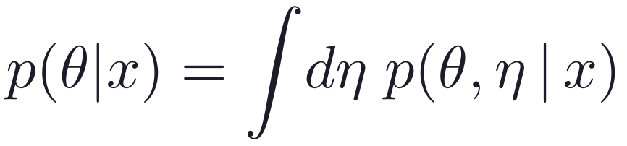
NUISANCE PARAMETERS
SBI marginalises them for free
The integral you usually dread
The SBI recipe
1
Draw both θ and η from the joint prior.
In likelihood-based inference this is the bottleneck. Every extra nuisance parameter added for realism is another sampler dimension, and the cost grows fast enough to limit how realistic your model is allowed to be.
2
Simulate — η leaves its imprint on x.
3
Train the network on (θ, x) pairs only.
The network learns the marginal p(θ | x) directly. The integral was carried out by the training set.
θ₁
θ₂
η₁
η₂
η₃
η₄
η₅
η₆
η₇
η₈
network sees (θ, x)
θ₁
θ₂
simulate with all of them
marginal posterior
Anau Montel (2025), §5.
You can add nuisance parameters for realism without paying for them at inference time.
Simulation-Based Inference · Part III — Neural SBI
28
Notes:
This is genuinely one of SBI's structural advantages over likelihood-based inference, and it is under-appreciated. It is also why marginal-first methods like truncated marginal NRE scale to models with very many nuisance parameters.

Slide 29
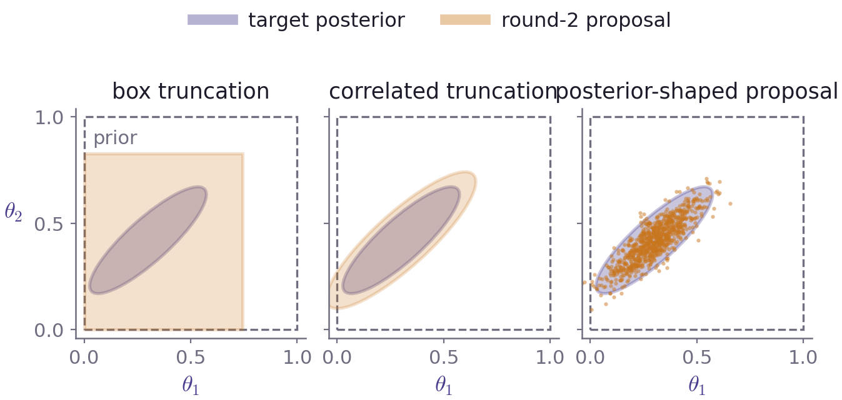
SEQUENTIAL AND TRUNCATED SBI
Spend simulations where the posterior actually is
The idea
Round 1: simulate from the prior and fit.
Narrow the proposal to where the posterior lives.
Repeat. Large savings when the posterior is far tighter than the prior.
Cost: the training prior is no longer the prior, so SBC and coverage tests no longer apply directly.
Truncation keeps local amortisation inside the truncated region, so you can still test there. Proposals shaped like the posterior do not.
Proposal strategies after Anau Montel (2025), Fig. 6 and §6.
In cosmology the gain over an explicit-likelihood analysis is often modest — keeping the checks is usually worth more.
Simulation-Based Inference · Part III — Neural SBI
29
Notes:
Thiele's judgement is worth quoting: when SBI buys you order-unity improvement rather than a transformation, the extra consistency checks that amortised methods allow are the better trade.

Slide 30
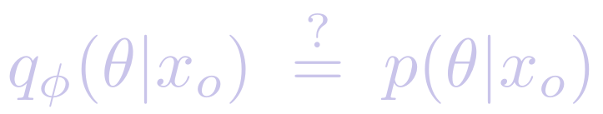
PART IV
Is the posterior trustworthy?
A posterior is a claim about the world. Diagnostics are the evidence for it.
Simulation-Based Inference · Part IV — Diagnostics
30
Notes:
The central message of Part IV: neural networks fail silently. Unlike MCMC there is no chain to inspect, so the tests have to be built into the workflow from the start.

Slide 31
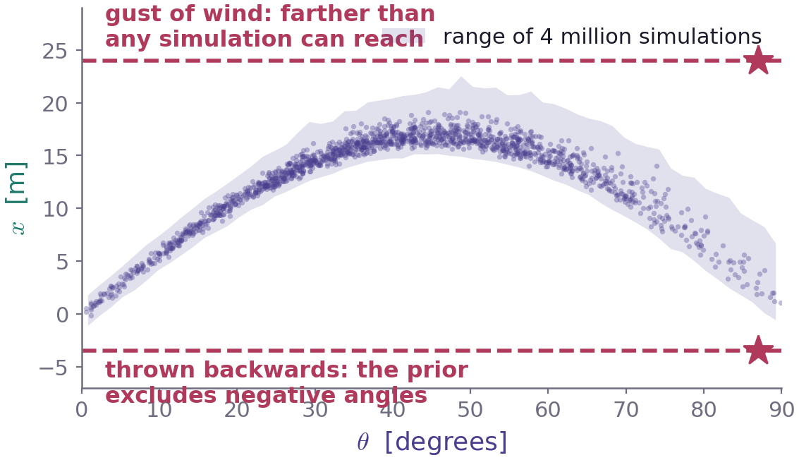
TWO WAYS AN SBI RESULT GOES WRONG
Wrong physics, or a wrong network
1
Model misspecification
xₒ lies outside anything your simulator and prior can produce. SBI does not politely widen the posterior in response — it can return a confident, meaningless answer.
2
An undertrained network
The physics is fine, but the learned density is miscalibrated: too few simulations, poor hyperparameters. Silent — the loss curve can look perfectly converged.
The horizontal cut at xₒ is empty: no parameter in the prior, with any noise realisation, reproduces the data.
Misspecification framing after Deistler et al. (2025), §3.1; Thiele (2026), §3. Envelope computed from 4 million simulations.
The first is a physics problem, the second a machine-learning problem. Different tests find them.
Simulation-Based Inference · Part IV — Diagnostics
31
Notes:
Point at the star markers. Ask: what should a good method return here? Arguably a loud complaint, not a posterior. This is why the prior predictive check comes first.

Slide 32
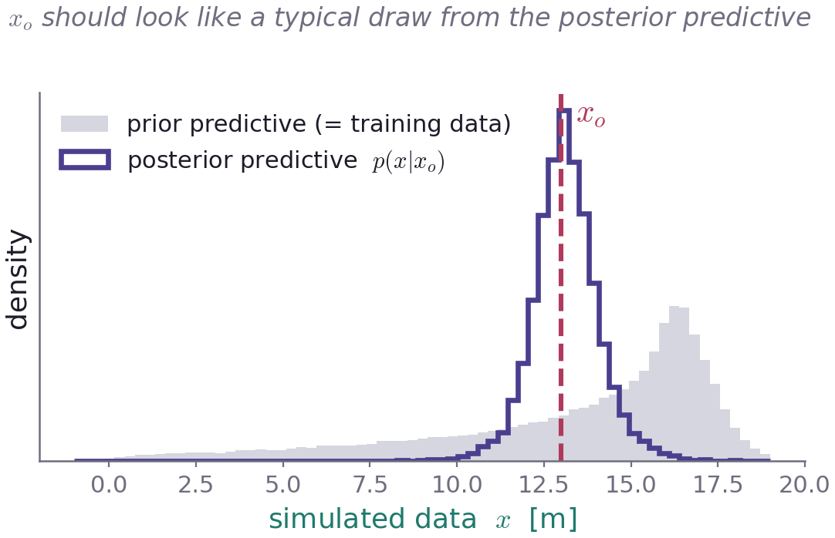
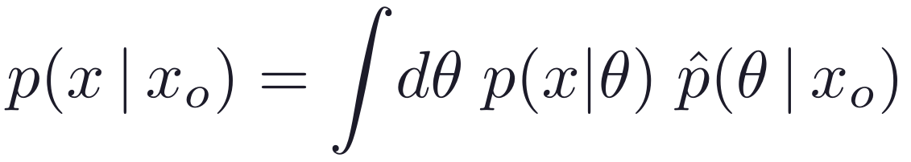
CHECKS THAT COST ALMOST NOTHING
Run these before you trust anything
1
Prior predictive check
Is xₒ inside the cloud of simulated data? Do this before you train anything at all — it is the cheapest test in the whole workflow.
2
Data censoring
Cut small scales, mask sky patches, drop a band. Does the posterior move the way physics says it should? Compare the response on real and mock data.
3
Posterior predictive check
Draw parameters from the posterior, simulate, and check that xₒ looks like a typical member of the resulting ensemble.
Re-simulated from the ball-throw posterior at xₒ = 13 m.
A posterior predictive check is necessary but not sufficient: an uninformative posterior equal to the prior can pass one.
Simulation-Based Inference · Part IV — Diagnostics
32
Notes:
Data censoring is the test practitioners are already best at, because they have strong physical expectations for how the posterior should respond to a scale cut. Use that intuition.

Slide 33
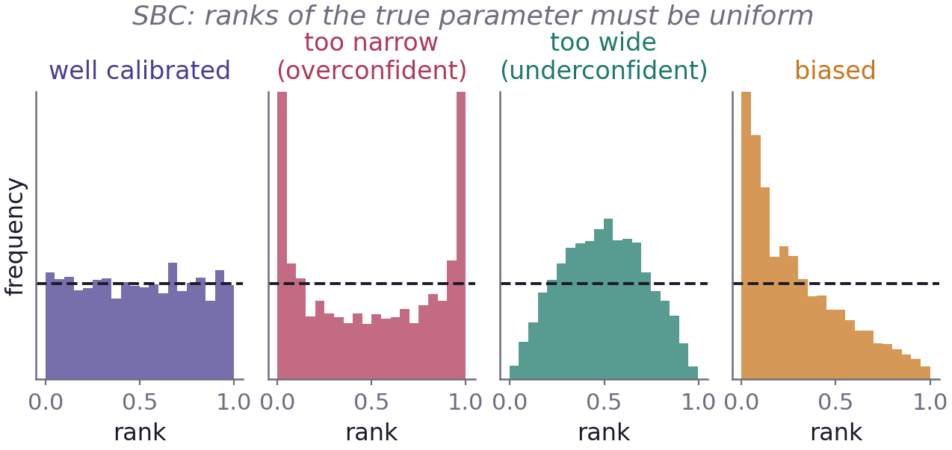
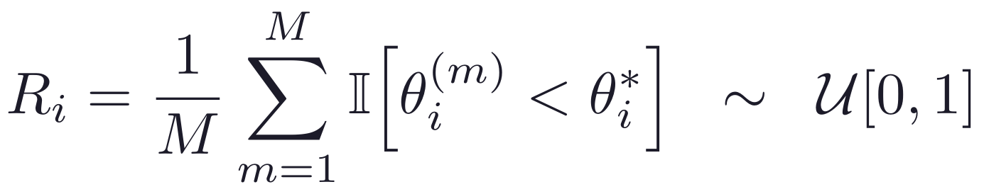
SIMULATION-BASED CALIBRATION
The ranks of the true parameter must be uniform
For each of L held-out pairs (θ*, x): run inference, rank the true value among M posterior draws, then histogram those ranks over the whole calibration set. Uniform means calibrated — and the shape of any deviation names the failure for you.
Ranks test of Talts et al. (2018); failure-mode taxonomy after Anau Montel (2025), Fig. 7. Histograms computed from a linear-Gaussian calibration set.
SBC tests one parameter at a time: all marginals can be perfect while the correlations between them are wrong.
Simulation-Based Inference · Part IV — Diagnostics
33
Notes:
Note what SBC needs: a test set drawn from the same joint as the training set. That requirement is exactly what sequential methods violate.

Slide 34
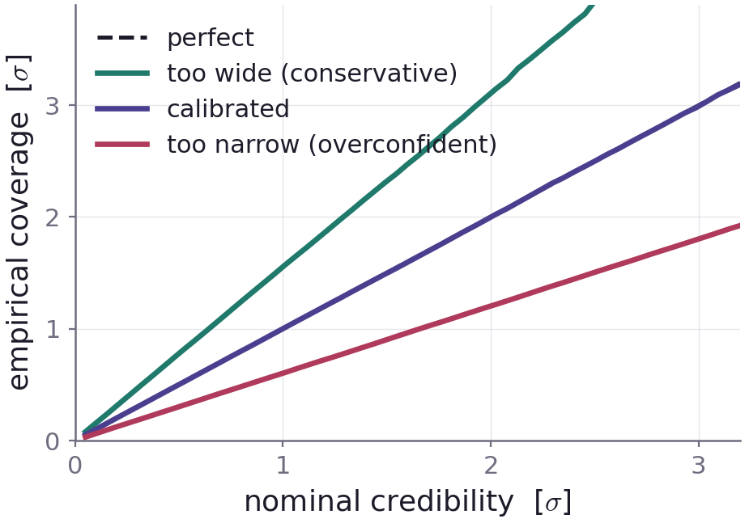
EXPECTED COVERAGE AND TARP
Do 68% intervals contain the truth 68% of the time?
Two ways to rank
HPD coverage — rank by posterior density. Tests the joint distribution, so it can see wrong parameter correlations, and handles multimodal posteriors.
TARP — rank by distance from a randomly chosen reference point. Works even when you cannot evaluate the density, only sample from it.
Above the diagonal = conservative, intervals too wide. Below = overconfident. Below the diagonal is the dangerous side, and the one that gets papers corrected.
Computed by Monte Carlo for rescaled and biased posteriors.
Necessary, not sufficient: a posterior that simply returns the prior has perfect coverage and tells you nothing.
Simulation-Based Inference · Part IV — Diagnostics
34
Notes:
HPD coverage from Hermans et al. (2022); TARP from Lemos et al. (2023). Both are ranking procedures — that is the unifying idea behind every calibration test in this lecture.

Slide 35
READING THE DIAGNOSTICS HONESTLY
What a passing test does and does not prove
Global tests average over the prior
The prior always passes
Some regions of parameter space can be over-covered and others under-covered while the average sits exactly on the diagonal.
Calibration tests check consistency, not precision. An uninformative posterior is perfectly calibrated and perfectly useless.
Local tests are sharper and dearer
Sequential methods break the premise
Local C2ST and local coverage find region-specific failures, but they need far more calibration simulations than you may be able to afford.
These tests need a test set from the training prior. A narrowed proposal no longer satisfies that, so the standard tests do not apply.
When a ground-truth posterior does exist — SBI replacing a working explicit-likelihood analysis — compare the two sets of samples directly: classifier two-sample tests, maximum mean discrepancy, PQMass.
Thiele (2026), §3.2–3.3; Anau Montel (2025), §7.3.
No single test certifies a posterior. Run several, report them, and say plainly which ones you could not run.
Simulation-Based Inference · Part IV — Diagnostics
35
Notes:
The last card is the strongest position an SBI paper can be in, and it is available whenever SBI is chosen for speed rather than forced by an intractable likelihood.

Slide 36
SBI ON REAL DATA
Where it is already doing science
Cosmology
Astrophysics
Galaxy clustering — BOSS, with the SimBIG framework, both at the field level and from summary statistics.
Weak lensing — every Stage-III survey: DES, KiDS and HSC, using higher-order and map-level statistics.
Cosmic voids — neutrino-mass constraints from BOSS void statistics.
Gravitational waves — real-time parameter estimation for compact-binary mergers.
Type Ia supernovae — hierarchical dust-extinction population analysis.
Photometric redshifts and stellar spectra — amortised fitting at catalogue scale.
Galactic-centre γ-ray excess — intractable point-source likelihood.
Mostly motivated by intractable likelihoods.
Mostly motivated by speed.
Real-data applications as catalogued in Thiele (2026), §4 — that review lists the primary references for each.
The field has moved from method papers to published measurements. The bar now is the diagnostics, not the novelty.
Simulation-Based Inference · Part V — Practice
36
Notes:
Worth stressing: these are analyses of real data, not just forecasts. The methodology is past the proof-of-concept stage.

Slide 37
THE OPEN PROBLEM
Faithful posteriors on a finite simulation budget
The uncomfortable finding
What is being done about it
With limited simulation budgets, neural posteriors can be confidently wrong — and the global checks do not always catch it. Cosmological simulations are expensive, and we have exactly one universe to compare against.
ensembling independently trained networks
objectives that target coverage directly
hybrid analytic + SBI likelihoods
multi-fidelity training, cheap plus accurate
cheap simulations with a small correction set
Survey of current directions: Thiele (2026), §5. The parameter-count finding is from Deistler et al. (2025), Fig. 6.
Architecture choice is rarely the bottleneck. The simulation budget is.
Simulation-Based Inference · Part V — Practice
37
Notes:
If asked 'how many simulations do I need?', the honest answer is that nobody can tell you a priori — which is precisely why the diagnostics in Part IV are not optional.

Slide 38
THE WORKFLOW
Five stages, and a loop you should expect to use
1
Define
2
Choose
3
Run
4
Validate
5
Analyse
simulator, prior,
what counts as data
compression,
algorithm, network
simulate, train,
infer
PPC, SBC,
coverage
marginals,
science
Failed checks send you back — and in this order of suspicion: the simulator, then the prior, then the compression, then the inference network. Reaching straight for a bigger network is usually the wrong first move.
Workflow after Deistler et al. (2025), Fig. 3 and Anau Montel (2025), Fig. 8.
Reserve simulations for validation from the very start: diagnostics need their own held-out calibration set.
Simulation-Based Inference · Part V — Practice
38
Notes:
Emphasise the loop. Nobody gets this right on the first pass, and a paper that reports only the final pass is hiding information.

Slide 39
TAKING IT TO YOUR OWN PROBLEM
A checklist, and where the code already lives
1
Can you sample your model without evaluating its likelihood? If you can evaluate it, use MCMC — SBI is not an upgrade.
Software
Write the prior down explicitly and be ready to defend its width.
sbi
the broadest toolkit; NPE, NLE, NRE and diagnostics
2
BayesFlow
amortised workflows, strong on validation plots
3
Prior predictive check against the real data, before any training.
swyft
truncated marginal ratio estimation
4
Hold out simulations for validation and calibration from the start.
lampe
lightweight, close to raw PyTorch
5
Start with NPE and a normalising flow. Keep the simulation bank so you can swap methods later for free.
pydelfi
density estimation with learned compression
6
Run SBC and expected coverage. Put them in the paper.
LtU-ILI
an astronomy-facing wrapper over several of the above
7
Only then interpret the posterior as a measurement.
The simulation bank is the expensive asset. Every other choice is cheap to redo — so keep it, and document it.
Simulation-Based Inference · Part V — Practice
39
Notes:
Item 1 deserves emphasis. SBI is a tool for when you have no alternative or when speed genuinely matters, not a default modernisation of a working analysis.

Slide 40
TAKEAWAYS
Five things worth keeping
1
SBI trades “evaluate the likelihood” for “run the model.” That single substitution is the whole idea.
2
Every method starts from the same table of (θ, x) pairs. They differ only in what they learn from it.
3
NPE by default; NLE or NRE when the data are many independent measurements; sequential only when you can justify losing the checks.
4
Amortisation is not just speed — it is what makes thorough calibration testing affordable.
5
An SBI posterior without diagnostics is not a measurement. Report the tests you ran, and the ones you could not.
Simulation-Based Inference · Part V — Practice
40
Notes:
Close by walking back through the five questions from slide 2.

Slide 41
REFERENCES
Where to read further
Deistler, Boelts, Steinbach, Moss et al. (2025)
The most practical of the four: workflow, pitfalls, and the ball-throw example used in this lecture.
Simulation-Based Inference: A Practical Guide. arXiv:2508.12939
L. Thiele (2026)
Concise, astronomy-facing review: derivations for NPE, NLE and NRE, diagnostics, real-data applications, and the simulation-budget frontier.
Machine Learning Techniques for Astrophysics and Cosmology: Simulation-Based Inference. arXiv:2605.10719
N. Anau Montel (2025)
Lecture notes with the fullest treatment of the KL derivations, marginal inference, sequential schemes and coverage diagnostics.
Basics of Simulation-Based Inference. MPA Postdoc/Staff Lecture Series on Cosmology, 27 November 2025
J. Arruda / BayesFlow developers
A worked notebook taking one problem from ABC to amortised neural inference; the simulation-count comparison on slide 15 comes from here.
From ABC to BayesFlow. BayesFlow documentation, example 6
Also cited: Talts et al. (2018) for simulation-based calibration; Hermans et al. (2022) for expected coverage; Lemos et al. (2023) for TARP. Software: sbi, BayesFlow, swyft, lampe, pydelfi, LtU-ILI.
Simulation-Based Inference · Part V — Practice
41
Notes:
All four sources are freely available online.

