Slide 1
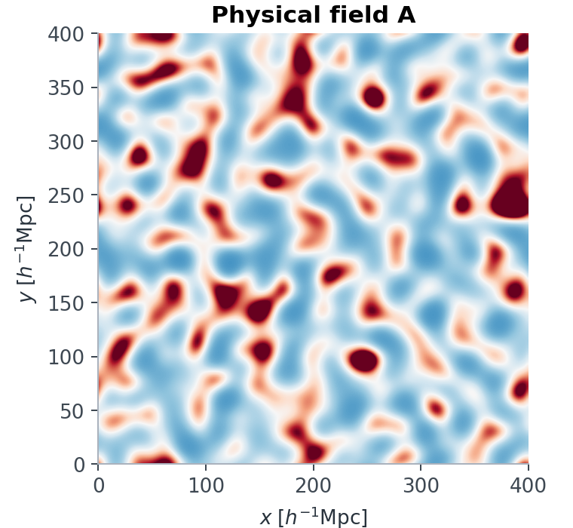
ICTS 2026 • DAY 1
From fields
to information
Forward models, field statistics, wavelets and the art of compression
A field is not a picture. It is a probability-bearing data object.
01
Notes:
Slide 1 of 35: Day 1: from fields to information
Start with the scientific object, not with a list of methods. The central question is what information in a field matters for an inference target.
Tell students that today they will calculate summaries, audit what each one keeps, and connect classical, learned, and field-level approaches.
The visual is an analytic fixture generated from the Day 1 course notebooks; it is not observational data.
Sources and provenance:
Local analytic fixture: day1/outputs/00_opening_mystery.png

Slide 2
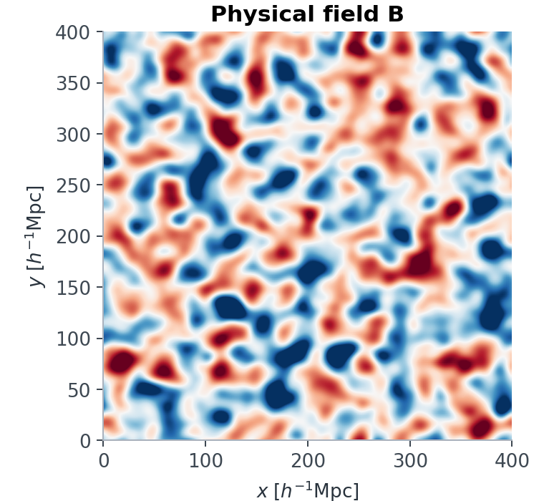
02
Two fields. Same power spectrum. Same cosmology?
FIELD A
FIELD B
Blind vote: indistinguishable for Ωm and σ8 — or not?
ICTS 2026 • forward models, fields & inference
analytic fixture • reveal on slide 10
Notes:
Slide 2 of 35: Two fields. Same power spectrum. Same cosmology?
Run this as a true blind vote. Do not reveal how the pair was made.
Ask for a reason, not only an answer: which visible structures might affect a parameter posterior, and which might be irrelevant nuisance detail?
The pair has matched Fourier amplitudes and different phase organization. The power-spectrum equality is revealed later.
Sources and provenance:
Local analytic fixture: day1/outputs/00_opening_mystery.png

Slide 3
03
A forward model predicts an ensemble, not one map
parameters
θ
forward model
F(θ, z)
latent variables
z
x ∼ p(x | θ)
Changing the seed is intended variation; numerical error is not.
ICTS 2026 • forward models, fields & inference
Notes:
Slide 3 of 35: A forward model predicts an ensemble, not one map
Even at fixed cosmological parameters, initial phases, galaxy formation, selection, and measurement noise generate a distribution of possible data.
The simulator therefore defines p(x|theta), not a single correct realization.
Keep aleatoric variation separate from solver or surrogate error; they require different validation strategies.

Slide 4
04
One field contains structure across cosmic time and scale
The same volume can be read as morphology, modes, objects, topology or likelihood evidence.
What would you keep if the inference code could only accept 100 numbers?
Credit NASA GSFC
ICTS 2026 • forward models, fields & inference
Notes:
Slide 4 of 35: One field contains structure across cosmic time and scale
Let the GIF play once without narration. It is a concrete reminder that a field carries coherent structure across both time and scale.
The high-resolution MP4 is packaged beside the deck for reliable local playback. The GIF remains embedded in the PPTX.
Use the prompt to make compression feel like a scientific design choice rather than an implementation afterthought.
Sources and provenance:
NASA Scientific Visualization Studio: https://svs.gsfc.nasa.gov/14297/
Credit: NASA's Goddard Space Flight Center / A. Yung

Slide 5
05
The forward chain changes mathematical objects
initial field
δ(q)
particles
{xᵢ, vᵢ}
catalog
{xᵢ, marksᵢ}
map / survey
selection + noise
data object
x
units + grid
mass + periodicity
marks + ordering
mask + response
likelihood support
A change of representation is a change of assumptions—not merely a file format.
ICTS 2026 • forward models, fields & inference
Notes:
Slide 5 of 35: The forward chain changes mathematical objects
Name the object contract at every arrow: domain, units, boundary conditions, stochastic variables, selection, and noise.
A catalog is a marked point process; its row ordering is not physical. A map has a pixel response and a mask. A summary has an explicitly chosen invariance.
These contracts make later statistics reproducible and prevent silent mismatches between simulator and observation.

Slide 6
06
Why compress? The arithmetic becomes unforgiving
512³ = 134,217,728 voxels
Finite simulations impose a rank ceiling
≈ 512 MiB for one float32 field
rank(C) ≤ Nsim − 1
Covariance entries = p(p+1)/2
So adding bins can make a summary longer while making its likelihood estimate less reliable.
p = 20
210
p = 100
5,050
p = 1,000
500,500
ICTS 2026 • forward models, fields & inference
Notes:
Slide 6 of 35: Why compress? The arithmetic becomes unforgiving
Separate storage, likelihood, and simulation costs. A modern survey field can be vast even before multiple tracers, redshift bins, and systematics are included.
Sample covariance has rank at most Nsim-1. Stable inversion and parameter-dependent covariance require still more simulation support.
A longer summary is not automatically more informative once covariance noise, density-estimation error, and model mismatch are included.

Slide 7
07
Data volume is not parameter information
Entropy of the data
Information about θ
H(X)
I(θ; X)
How many states the data can occupy
Only the variation that changes the parameter evidence
bits about everything
bits about the question
I(θ; T(X)) ≤ I(θ; X)
data-processing inequality
ICTS 2026 • forward models, fields & inference
Notes:
Slide 7 of 35: Data volume is not parameter information
A huge field may contain abundant randomness, foregrounds, nuisance physics, and repeated modes while carrying modest information about a chosen parameter.
A deterministic summary cannot create mutual information about theta. Its goal is to discard detail that is irrelevant or too expensive while retaining the likelihood geometry needed for the task.
In finite-compute practice, a smaller summary can improve posterior calibration even though ideal information cannot increase.

Slide 8
08
Sufficiency is always relative to a model and a question
p(x | θ) = h(x) · g(T(x), θ)
Factorization criterion
T₁(x) for
{Ωm, σ8}
same data x
different retained
features
T₂(x) for
primordial fNL
Change the likelihood family, nuisance model or parameter target—and sufficiency can disappear.
ICTS 2026 • forward models, fields & inference
Notes:
Slide 8 of 35: Sufficiency is always relative to a model and a question
Use the Neyman-Fisher factorization theorem as the precise meaning of a sufficient statistic for a dominated likelihood family.
The statement is conditional on the full model. Adding survey masks, non-Gaussian noise, baryons, or new parameters can invalidate a previously sufficient compression.
In cosmology we often seek approximately sufficient, locally optimal, or decision-optimal summaries rather than a global finite-dimensional sufficient statistic.
Sources and provenance:
Generalized score compression: https://arxiv.org/abs/1712.00012

Slide 9
THE GAUSSIAN EXCEPTION
09
Power is exact only inside a special Gaussian idealization
statistically homogeneous Gaussian field
independent complex Gaussians on a nonredundant half-space
with δ̃(−k) = δ̃(k)*
all connected correlators above second order vanish
the covariance — equivalently P(k) — fixes the ensemble
Caveat: isotropic binned P(k) also assumes the relevant symmetries and a modeled window/noise response.
ICTS 2026 • forward models, fields & inference
Notes:
Slide 9 of 35: Power is exact only inside a special Gaussian idealization
Be precise: the full covariance is sufficient for a zero-mean Gaussian field. Replacing it by an isotropic P(k) additionally uses homogeneity and isotropy and assumes the observation operator is handled.
Finite windows mix modes; anisotropic physics or redshift-space distortions can make angular information important; non-Gaussian evolution creates connected higher-order correlations.
Power is indispensable, but its sufficiency is a likelihood statement—not a universal property of fields.

Slide 10
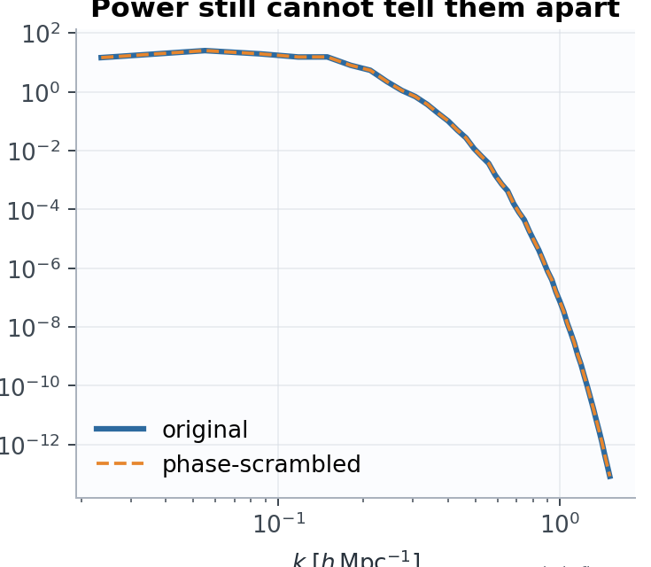
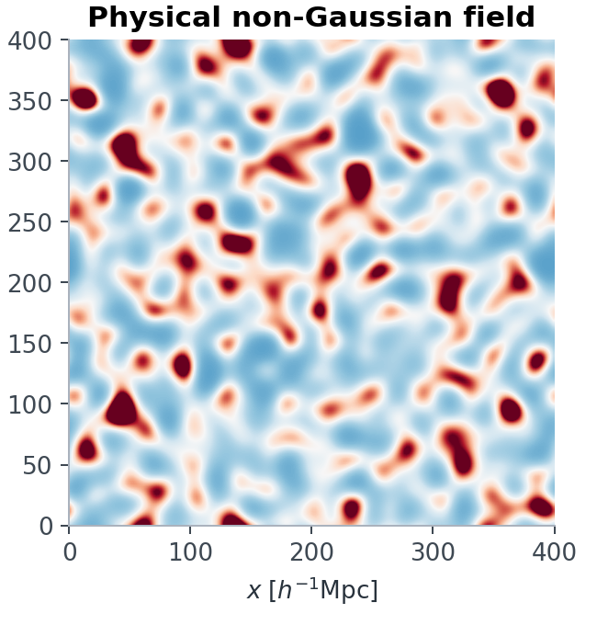
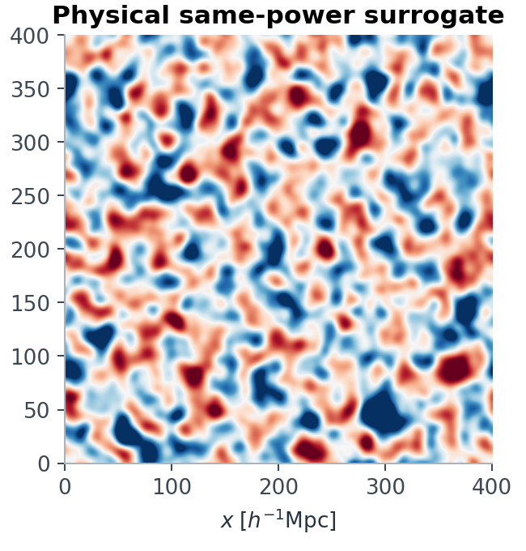
MYSTERY REVEALED
10
Gravity moves information into phase correlations
|δ̃ₐ(k)| = |δ̃ᵦ(k)| ⇒ Pₐ(k) = Pᵦ(k)
Same amplitudes. Different phases. Different morphology.
Power sees amplitude by scale; it does not remember where structures occur.
ICTS 2026 • forward models, fields & inference
analytic fixture • same Fourier amplitudes, altered phases
Notes:
Slide 10 of 35: Gravity moves information into phase correlations
Reveal that the fields were made with the same Fourier amplitudes and different phase organization.
Nonlinear gravity couples modes, so phase correlations encode morphology and higher-order dependence that is absent from the power spectrum.
Do not claim that every phase difference is cosmologically informative. The point is that power cannot decide; task-specific validation must.
Sources and provenance:
Local analytic fixture: day1/outputs/02_same_power_mystery.png
Nonlinear power-spectrum information saturation: https://arxiv.org/abs/astro-ph/0502081

Slide 11
VALIDATION GEOMETRY
11
Model error is dangerous when it mimics a parameter shift
∂μ/∂θ
bθ ≈ F⁻¹ (∂μ/∂θ)ᵀ C⁻¹ Δμmodel
A visually obvious error can be harmless if orthogonal to the score.
A subtle error can be fatal if aligned with it.
Δμmodel
summary space
validate in the inference metric
ICTS 2026 • forward models, fields & inference
Notes:
Slide 11 of 35: Model error is dangerous when it mimics a parameter shift
Parameter bias depends on the covariance-weighted projection of model error onto parameter-response directions.
This is why matched-phase field comparison, summary residuals, coverage, and posterior predictive checks complement visual inspection.
The displayed linearized bias expression is schematic; nuisance parameters and nonlinearity modify the exact result.

Slide 12
MAP OF THE DAY
12
There is no universal compressor
symmetry-based
P(k), ξ(r), multipoles
morphology-based
peaks, PDF, topology, wavelets
field x
model-aware
MOPED, score
learned / field-level
IMNNs, neural estimators
For every branch: what is retained? what is invariant? how is the posterior validated?
ICTS 2026 • forward models, fields & inference
Notes:
Slide 12 of 35: There is no universal compressor
Use this as the handoff to Lecture 2. The branches are not a quality ranking; they encode different inductive biases and computational contracts.
Field-level inference still performs internal representation learning or marginalization. It avoids a fixed handcrafted summary, not compression in the broad information-processing sense.
The common validation target is held-out posterior performance under realistic observation and nuisance models.

Slide 13
DAY 1 • LECTURE 2
How we calculate—
and what survives
Power, bispectrum and directional wavelets as explicit operations on a field
Every statistic is an algorithm plus a claim about what may be forgotten.
13
Notes:
Slide 13 of 35: Lecture 2: how we calculate—and what survives
Reset the room: the goal is now operational. Students should be able to write each estimator, state its normalization, and identify its invariances.
Keep connecting code operations to scientific claims. An FFT convention, shell average, mask correction, or modulus is never merely a software detail.

Slide 14
FOURIER CONTRACT
14
An FFT becomes a physical statistic only after four choices
01
02
03
04
coordinate
transform
normalization
support
box L; grid N
FFT sign + ordering
Δxᵈ and volume V
zero mode; Nyquist; mask
δ̃(k) = Δxᵈ Σₓ δ(x) exp(−i k·x)
P(k) has units of volume when δ is dimensionless
A unit test on dimensions catches many 'correct-looking' spectra.
ICTS 2026 • forward models, fields & inference
Notes:
Slide 14 of 35: An FFT becomes a physical statistic only after four choices
Write the continuous and discrete conventions together. If delta is dimensionless, the Fourier transform carries volume and P(k) carries volume.
Make the zero-mode convention explicit: a mean-subtracted overdensity has delta-tilde(0)=0 up to numerical precision.
State the supported k range before plotting. The grid Nyquist is a sampling ceiling, not evidence that every bin below it is trustworthy.

Slide 15
CALCULATING P(k)
15
The isotropic power estimator is a sequence of reductions
1
2
3
4
mean subtract
Fourier transform
mode power
shell average
δ ← δ − ⟨δ⟩
δ̃ = FFT(δ) Δxᵈ
Pmode = |δ̃|² / V
P̂(kb) = Σ wₖPmode / Σwₖ
Store Nmodes(kb) beside P̂(kb). It controls variance, weighting and whether a bin is supported.
estimator output = {k, P, Nmodes, convention metadata}
ICTS 2026 • forward models, fields & inference
Notes:
Slide 15 of 35: The isotropic power estimator is a sequence of reductions
Walk through the estimator as executable pseudocode. The shell average is a weighted reduction over supported Fourier cells, not a plotting operation.
Weights must account for the chosen real-to-complex FFT storage and any analysis weighting. Always return the number of represented modes.
For a survey, window convolution and shot/noise terms enter the model; a periodic-box estimator is not automatically an observational estimator.

Slide 16
HERMITIAN SYMMETRY
16
A real field stores only half of Fourier space
δ̃(−k) = δ̃(k)*
rFFT truncates one axis; interior stored cells represent ± partners.
−k
+k
Along the truncated FFT axis: interior modes get weight 2; the k = 0 and even-grid Nyquist boundary planes get weight 1.
Wrong multiplicities bias shell averages and Parseval checks.
ICTS 2026 • forward models, fields & inference
Notes:
Slide 16 of 35: A real field stores only half of Fourier space
For a real-valued field, Fourier coefficients obey Hermitian symmetry. Real-to-complex storage omits redundant conjugate modes.
Along the truncated FFT axis, an interior stored mode represents the omitted negative-axis partner and gets multiplicity two. The zero plane, and the Nyquist plane for an even grid, get multiplicity one because both in-plane conjugate partners remain stored.
Do not call an entire boundary plane self-conjugate: only special grid points whose coordinates are all zero or Nyquist are individually self-conjugate.
Use a Parseval identity and direct comparison with a full complex FFT as implementation tests.

Slide 17
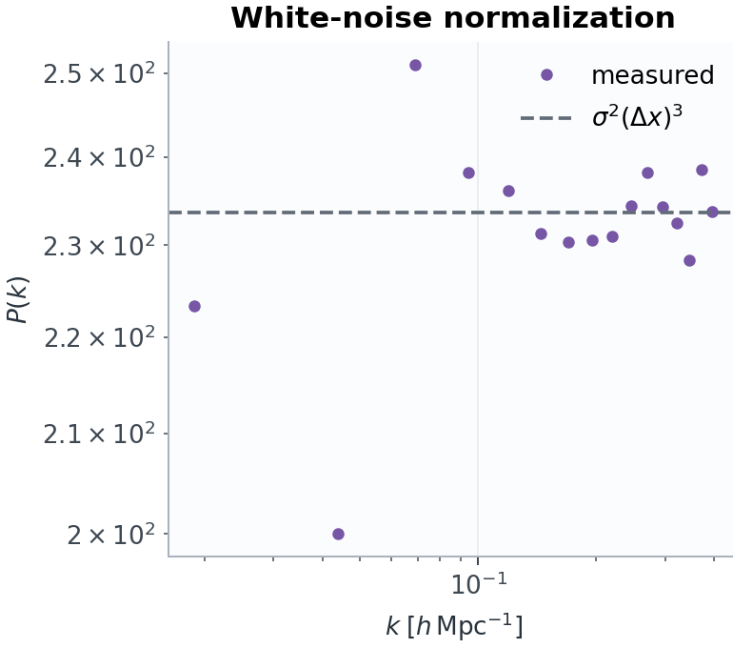
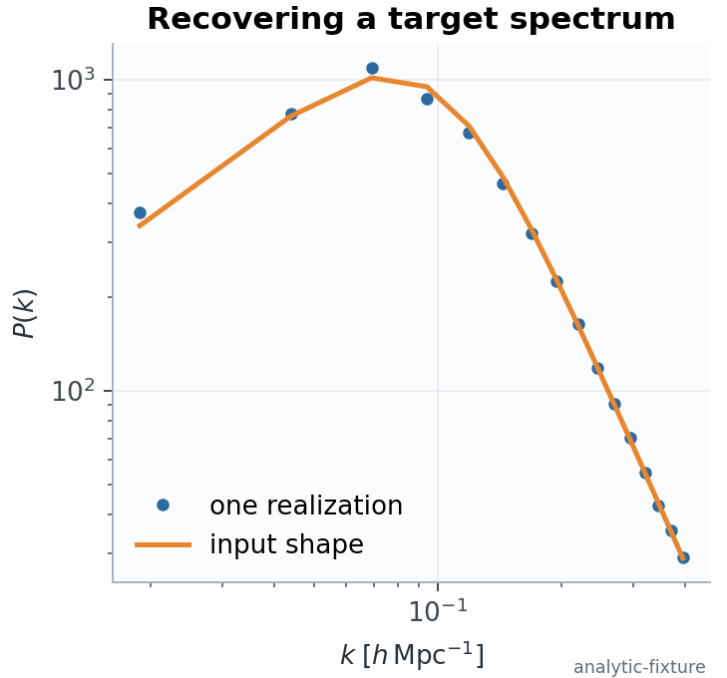
VALIDATION ORACLES
17
Limiting cases make the estimator earn your trust
white noise → flat P(k)
target spectrum → shape recovered
ICTS 2026 • forward models, fields & inference
analytic fixtures • Day 1 notebook validation
Notes:
Slide 17 of 35: Limiting cases make the estimator earn your trust
Use four oracles: constant field after mean subtraction, a single sinusoid, white noise, and a known target spectrum.
The sinusoid tests k-grid placement and normalization. White noise tests flatness. Parseval tests total variance. A target spectrum tests the full generator-estimator loop.
These are analytic fixtures generated for teaching; do not label them as survey measurements.
Sources and provenance:
Local analytic fixture: day1/outputs/01_power_validation.png

Slide 18
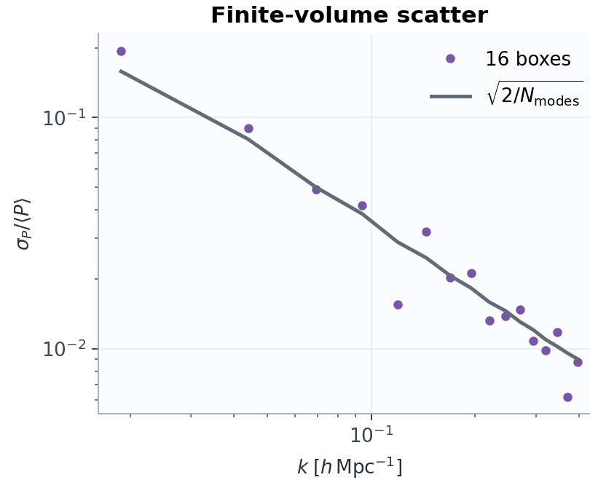
SAMPLE VARIANCE
18
Finite volume gives every spectrum an uncertainty floor
Var[P̂(k)] ≈ 2 P(k)² / Nmodes(k)
for a Gaussian field and a narrow bin
low k: few modes, large scatter
wide bins: lower variance, poorer resolution
non-Gaussianity couples bins through the trispectrum
ICTS 2026 • forward models, fields & inference
analytic fixture • Gaussian covariance is a baseline, not the last word
Notes:
Slide 18 of 35: Finite volume gives every spectrum an uncertainty floor
Derive the approximate Gaussian variance from independent mode powers. Emphasize the assumptions: narrow bins, weak window coupling, and Gaussian statistics.
At nonlinear scales the connected four-point function adds covariance and bin-to-bin correlation.
Finite volume is not a bug in the estimator. It is uncertainty in the particular realization and must be propagated.
Sources and provenance:
Local analytic fixture: day1/outputs/01_variance_window_cross.png

Slide 19
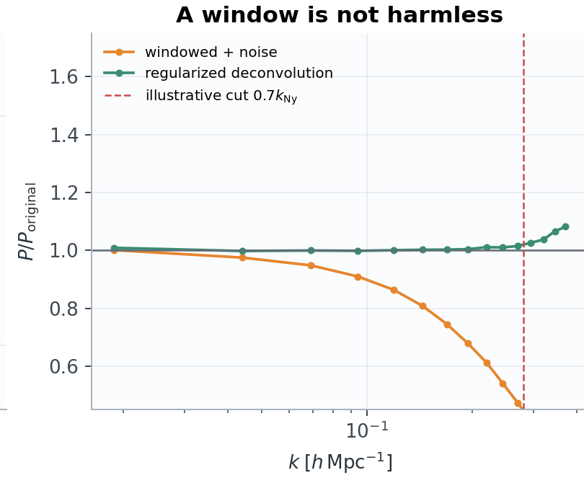
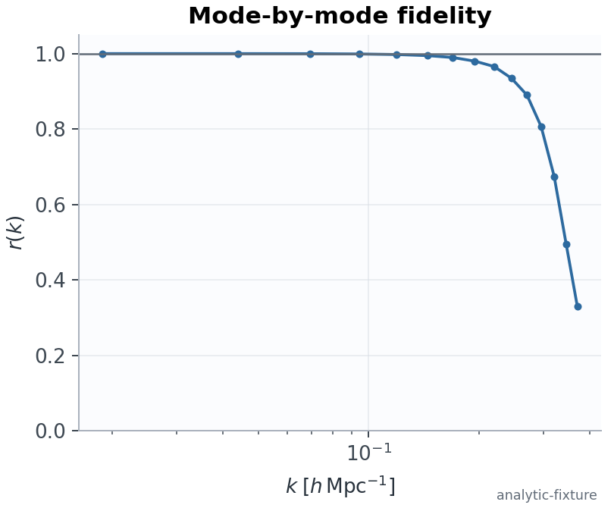
WINDOWS & CROSS-SPECTRA
19
Window response and mode fidelity are separate tests
window response
amplitude vs identity
T(k)=√(Papp/Pref) r(k)=Pcross/√(Papp Pref)
ICTS 2026 • forward models, fields & inference
analytic fixtures • identical binning and support required
Notes:
Slide 19 of 35: Window response and mode fidelity are separate tests
A mass-assignment or instrument window suppresses and mixes modes. Deconvolution is safe only where the response is controlled and nonzero.
Transfer T measures amplitude agreement. Cross-correlation r measures coherent agreement of a paired realization. They answer different questions.
Be careful: r=1 is stronger than merely similar phases; under the bin weights it corresponds to positively proportional mode collections. Compare auto- and cross-spectra with identical support and normalization.
Sources and provenance:
Local analytic fixture: day1/outputs/01_variance_window_cross.png

Slide 20
A SUMMARY AUDIT
20
Different statistics ask different questions of the field
summary
calculation
remembers
usually forgets
PDF / moments
histogram δ(x)
one-point amplitudes
where values occur
P(k)
average |δ̃|² in shells
variance by scale
phase organization
bispectrum
triangle-mode product
selected phase coupling
most configurations
wavelet S₁
local filter → modulus → mean
scale + direction response
absolute location
peaks / topology
objects or excursion sets
morphology + connectivity
some metric detail
No row is 'best'. The retained distinctions must match the inference target.
ICTS 2026 • forward models, fields & inference
Notes:
Slide 20 of 35: Different statistics ask different questions of the field
Use the table as an audit template: calculation, retained structure, discarded structure, and expected nuisance sensitivity.
A summary family can be expanded: anisotropic power, marked statistics, Minkowski functionals, persistent homology, phase harmonics, and learned summaries all make different compromises.
Avoid a one-dimensional ladder from simple to advanced. Finite-simulation performance and robustness can reverse the apparent ranking.

Slide 21
CALCULATING B(k₁,k₂,k₃)
21
The bispectrum measures closed-triangle phase coupling
⟨δ̃(k₁) δ̃(k₂) δ̃(k₃)⟩ = (2π)ᵈ δD(k₁+k₂+k₃) B(k₁,k₂,k₃)
1
band-pass
keep shells k₁,k₂,k₃
k₁
k₂
2
multiply
δ₁(x) δ₂(x) δ₃(x)
k₃
3
average
sum over x and normalize
FFT-based shell filtering makes selected triangle families tractable.
ICTS 2026 • forward models, fields & inference
Notes:
Slide 21 of 35: The bispectrum measures closed-triangle phase coupling
Translation invariance imposes triangle closure: only mode triplets summing to zero contribute to the ensemble bispectrum.
The practical filtered-field estimator is: isolate three shells, inverse transform, multiply the real-space filtered fields, average, and apply the declared normalization.
The notebook's plotted quantity is a normalized selected-shell response, not a literal exhaustive bispectrum measurement. Say this explicitly.

Slide 22
HIGHER-ORDER RESPONSE
22
Selected triangles distinguish the same-power pair
normalized response × 100
The sign and amplitude of a chosen response change when phase coupling changes.
But five triangle families are still a deliberate compression of the full bispectrum configuration space.
ICTS 2026 • forward models, fields & inference
normalized selected-shell teaching response • not a survey measurement
Notes:
Slide 22 of 35: Selected triangles distinguish the same-power pair
The bars reproduce the selected-shell normalized response used in the Day 1 teaching material.
Use them to demonstrate the job of a higher-order statistic, not to claim a calibrated cosmological result.
Configuration choice is itself compression. The estimator can be sensitive to normalization, bin width, masks, and shot/noise corrections.
Sources and provenance:
Local analytic fixture values from the Day 1 field-statistics notebook

Slide 23
WAVELETS 1/7
23
A wavelet is a localized Fourier band
real space
Fourier space
localized oscillation
bands around ±k₀ for this real wavelet
Wλ(x) = (δ * ψλ)(x)
ICTS 2026 • forward models, fields & inference
Notes:
Slide 23 of 35: A wavelet is a localized Fourier band
The sketch is a real cosine-Gaussian wavelet, so its Fourier magnitude has equal bands around plus and minus k0. A complex Morlet wavelet can emphasize one lobe, with the opposite direction supplied by its conjugate partner.
A wavelet is localized in position and concentrated in a Fourier band. The uncertainty principle prevents exact localization in both domains.
The convolution coefficient W_lambda(x) is complex for a complex Morlet wavelet and retains spatial location before any averaging.
Use 'central wavenumber k0' for the Fourier center. Calling k0 a scale reverses the physical interpretation; real-space scale is roughly proportional to 1/k0.
Sources and provenance:
Mallat, group-invariant scattering: https://arxiv.org/abs/1101.2286

Slide 24
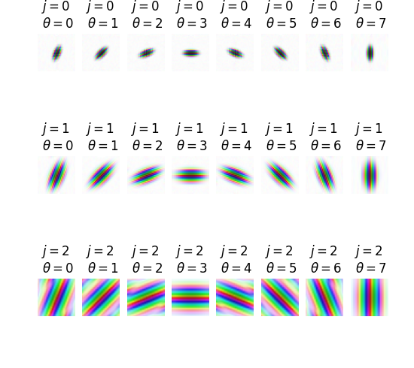
WAVELETS 2/7
24
Scale and direction form a wavelet bank
j chooses a radial band
|k| ≈ k₀ · 2⁻ʲ
α chooses a direction
k̂α = (cos α, sin α)
Together λ=(j,α) gives a bank of local, oriented band-pass measurements.
Shown: spatial-domain real parts. Kymatio writes θ; here we use α.
ICTS 2026 • forward models, fields & inference
Kymatio documentation • BSD-3-Clause
Notes:
Slide 24 of 35: Scale and direction form a wavelet bank
The Kymatio gallery shown here displays spatial-domain real parts obtained from directional filters; it is not a plot of Fourier-plane tiling.
In Fourier space, the bank covers bands with dilated and rotated copies of a mother wavelet plus a low-pass filter.
Index j controls the radial frequency band. Index alpha controls the direction of the central Fourier wavevector.
Coverage, overlap, angular resolution L, and maximum scale J determine both the represented morphology and the coefficient count.
Sources and provenance:
Kymatio 2D filter visualization: https://www.kymat.io/gallery_2d/plot_filters.html
Kymatio license: BSD-3-Clause

Slide 25
WAVELETS 3/7
25
The direction label belongs to a wavevector
ridge / filament direction
central wavevector kα
A plane wave is constant along its ridges, so kα is perpendicular to the stripe direction.
kα
The 90° distinction prevents a common interpretation error.
ICTS 2026 • forward models, fields & inference
Notes:
Slide 25 of 35: The direction label belongs to a wavevector
For a complex Morlet filter, alpha labels the central Fourier wavevector, not necessarily the visible ridge direction of a responding filament.
A plane wave varies along k and is constant perpendicular to k. Therefore a filter centered on k_alpha often responds to ridges or filaments perpendicular to that vector.
State the convention used by the software; packages may display filter angle or spatial ridge orientation differently.

Slide 26
WAVELETS 4/7
26
Opposite directions are conjugate partners
same axial orientation
kα
kα+π = −kα
ψα+π(x) = ψα(x)* ⇒ Wα+π(x) = Wα(x)*
|Wα+π(x)| = |Wα(x)|
For a real field and conjugate-paired filters, α and α+π become redundant after modulus.
ICTS 2026 • forward models, fields & inference
Notes:
Slide 26 of 35: Opposite directions are conjugate partners
For a real input and a filter bank with psi_(alpha+pi)=psi_alpha conjugate, opposite-direction coefficients are complex conjugates.
Taking the modulus removes the sign of the wavevector direction, leaving axial orientations on [0,pi). This halves the nonredundant angular domain.
If signed or complex phase-sensitive coefficients are retained, the relation must be handled explicitly rather than assuming orientation redundancy.

Slide 27
WAVELETS 5/7
27
Invariance is made by averaging—and paid for with information
coefficient map
Wj,α(x)
modulus map
|Wj,α(x)|
spatial mean
S₁(j,α)
translation shifts x
complex phase removed
location removed
rotation: α → α + β
average over α
rotation invariance—but anisotropy is gone
Keep directional channels whenever redshift-space distortions, shear, filaments or survey geometry matter.
ICTS 2026 • forward models, fields & inference
Notes:
Slide 27 of 35: Invariance is made by averaging—and paid for with information
A translated field translates the coefficient maps. Spatial averaging produces translation invariance by discarding absolute location.
A rotation permutes angular channels. Averaging over alpha produces rotation invariance, but also removes anisotropy that may be scientifically important.
For second-order coefficients, rotationally invariant reductions can be expressed through relative angle Delta alpha. Equality of plus and minus Delta alpha additionally needs parity symmetry or explicit averaging.

Slide 28
WAVELETS 6/7
28
The notebook computes first-order scattering
S₁(j,α) = ⟨ | δ * ψj,α | ⟩x
field
δ(x)
band-pass
δ * ψj,α
modulus
|δ * ψj,α|
average
S₁(j,α)
512² pixels → J×L = 4×8 = 32 coefficients
A dramatic compression: useful only if those 32 numbers retain the parameter distinctions we need.
ICTS 2026 • forward models, fields & inference
Notes:
Slide 28 of 35: The notebook computes first-order scattering
The Day 1 notebook computes first-order scattering: filter, complex modulus, then spatial average.
Before the final average, the modulus map remains localized and covariant to translations. After averaging, location is removed.
With J=4 scales and L=8 stored directions, the first-order vector has 32 entries. This count assumes all channels are kept; antipodal or rotational reductions can lower it.
Sources and provenance:
Mallat, group-invariant scattering: https://arxiv.org/abs/1101.2286
Cosmological WST example: https://arxiv.org/abs/2108.07821

Slide 29
WAVELETS 7/7
29
Second order measures modulation across scales
fine-scale response
|δ * ψλ₁|
filter the envelope
|δ * ψλ₁| * ψλ₂
modulus + mean
S₂(λ₁,λ₂)
S₂(λ₁,λ₂) = ⟨ ||δ*ψλ₁| * ψλ₂| ⟩x
It asks whether small-scale power is spatially modulated by a larger-scale pattern.
J=4, L=8, j₂>j₁ ⇒ C(4,2)×8² = 384 channels
before symmetry reductions
ICTS 2026 • forward models, fields & inference
Notes:
Slide 29 of 35: Second order measures modulation across scales
The first modulus creates a positive envelope of fine-scale activity. A second wavelet measures how that activity is organized over a coarser scale and direction.
Second-order scattering captures cross-scale modulation and non-Gaussian coupling while remaining more structured and data-efficient than a generic learned representation.
The displayed 384 count uses four scales, eight directions, and ordered scale pairs j2>j1 before antipodal, rotational, parity, or coefficient-selection reductions.
Sources and provenance:
Mallat, group-invariant scattering: https://arxiv.org/abs/1101.2286
Cheng et al., scattering statistics for cosmology: https://arxiv.org/abs/2006.08561
Wavelet phase harmonics: https://arxiv.org/abs/2006.06298

Slide 30
MODEL-AWARE COMPRESSION
30
Optimal summaries use the model's parameter directions
PCA / KL
MOPED
score compression
retains high-variance directions
unsupervised unless covariance is signal/noise weighted
tα = bαᵀ x
t(x)=∇θ log p(x|θ)|θ*
one covariance-weighted linear summary per parameter near a fiducial model
the local likelihood gradient; dimension ≈ number of parameters
'Optimal' is local: it depends on a fiducial model, derivatives, covariance and the nuisance treatment.
nuisance hardening projects away declared nuisance-score directions
ICTS 2026 • forward models, fields & inference
Notes:
Slide 30 of 35: Optimal summaries use the model's parameter directions
PCA preserves variance, not necessarily parameter information. KL methods can become signal-to-noise aware when built from a declared covariance model.
MOPED constructs one covariance-weighted linear compression per parameter for Gaussian data under regularity assumptions. General score compression extends the local-likelihood idea.
The score is locally Fisher-information preserving around the expansion point, not globally sufficient by default. Model error in derivatives or covariance can damage the compression.
Sources and provenance:
MOPED: https://arxiv.org/abs/astro-ph/9911102
Generalized score compression: https://arxiv.org/abs/1712.00012

Slide 31
LEARNED COMPRESSION
31
Learned summaries optimize a declared task
simulated field
x
network
fφ(x)
low-dimensional
summary t
posterior /
likelihood ratio
Fisher objective
IMNN-style: make summaries respond to θ
ratio / posterior objective
learn features useful for a neural estimator
reconstruction objective
preserve field detail—but not necessarily θ information
The loss function defines what 'information' means to the network.
ICTS 2026 • forward models, fields & inference
Notes:
Slide 31 of 35: Learned summaries optimize a declared task
Learned compression is not one method. Architectures and losses can target Fisher information, likelihood ratios, posteriors, reconstruction, or downstream decisions.
An Information Maximizing Neural Network learns summaries from simulations by maximizing a Fisher-information proxy near fiducial points.
Validate simulation coverage, calibration, nuisance robustness, out-of-distribution behavior, and whether the learned representation uses artifacts unavailable in real data.
Sources and provenance:
Information Maximizing Neural Networks: https://arxiv.org/abs/1802.03537
Massive optimal data compression for likelihood-free inference: https://arxiv.org/abs/1801.01497

Slide 32
FULL-FIELD INFERENCE
32
Field-level inference keeps phases—and moves the hard work
gravity + bias +
observation model
initial field
δinit
observed field
d
p(θ, δinit, nuisance | d) ∝ p(d | F(θ,δinit,nuisance)) p(δinit|θ) p(θ,nuisance)
retains phase
and locality
high-dimensional
latent posterior
expensive
gradients / sampling
strong model
checking required
Field-level is not 'compression-free': it replaces a fixed summary with a hierarchical generative representation.
ICTS 2026 • forward models, fields & inference
Notes:
Slide 32 of 35: Field-level inference keeps phases—and moves the hard work
Field-level inference conditions on the observed map while jointly inferring cosmological parameters, latent initial conditions, and nuisance variables through a forward model.
It preserves phase and local structure that fixed low-dimensional summaries may discard, but it shifts complexity into the simulator, observation model, differentiation, and high-dimensional posterior sampling.
The method is not free of compression in a broad sense: the generative model, priors, discretization, and numerical posterior representation still determine what information is accessible.
Sources and provenance:
BORG field-level inference: https://arxiv.org/abs/1203.3639
Recent field-level cosmology review: https://arxiv.org/abs/2509.13435

Slide 33
DECISION FRAMEWORK
33
Choose a compressor by held-out inference performance
method
dimension
simulator demand
interpretability
main failure mode
P(k) + low-order
small
low–moderate
high
missed non-Gaussian info
wavelet / morphology
medium
moderate
medium–high
chosen invariance is wrong
score / MOPED
≈ Nθ
derivatives + covariance
high
local/model mismatch
learned summary
chosen
high
variable
simulation shortcut / shift
field-level
latent field
very high
model-explicit
forward-model misspecification
Decide with coverage, bias, posterior width, simulation cost and robustness—not with vector length alone.
ICTS 2026 • forward models, fields & inference
Notes:
Slide 33 of 35: Choose a compressor by held-out inference performance
This table is a decision aid, not a ranking. Hybrid pipelines are common: physics-informed wavelets plus score compression, or field-level inference with internal learned surrogates.
Use held-out simulations and realistic systematics to assess coverage, bias, posterior volume, robustness, and compute. Compare against a simple baseline.
A larger summary can perform worse when covariance or density estimation is simulation-limited; a sophisticated learned method can fail under domain shift.

Slide 34
PRIMARY ANCHORS
34
A short reading trail
Heavens, Jimenez & Lahav (2000)
Mallat (2012)
MOPED: parameter-aware linear compression
invariant scattering representation
open paper ↗
open paper ↗
Alsing & Wandelt (2018)
Cheng et al. (2020)
generalized score compression
scattering statistics for cosmology
open paper ↗
open paper ↗
Charnock, Lavaux & Wandelt (2018)
Jasche & Wandelt (2013)
information-maximizing neural summaries
Bayesian field-level reconstruction
open paper ↗
open paper ↗
Use these as starting points; the speaker notes contain the narrower caveats used today.
ICTS 2026 • forward models, fields & inference
Notes:
Slide 34 of 35: A short reading trail
This slide intentionally uses a small set of primary anchors rather than a comprehensive bibliography.
Encourage students to read method papers alongside applications and validation studies. Claimed optimality always inherits assumptions from the likelihood, simulator, and nuisance model.
Sources and provenance:
MOPED: https://arxiv.org/abs/astro-ph/9911102
Score compression: https://arxiv.org/abs/1712.00012
IMNN: https://arxiv.org/abs/1802.03537
Scattering: https://arxiv.org/abs/1101.2286
Cosmological scattering: https://arxiv.org/abs/2006.08561
BORG: https://arxiv.org/abs/1203.3639

Slide 35
DAY 1 • CLOSING CONTRACT
What should survive
the compression?
The distinctions that move the posterior—plus enough diagnostics to know when the model is wrong.
calculate
interpret
validate
normalization • support • weights
retained structure • imposed symmetry
oracles • held-out coverage • model shift
35
Notes:
Slide 35 of 35: What should survive the compression?
Close by asking three students to name one calculation detail, one discarded distinction, and one validation test for a summary discussed today.
The intended takeaway is not that wavelets or field-level inference always win. It is that compression is an explicit scientific contract connecting the field, the model, the computation, and the posterior.
Preview the next day: forward-simulation accuracy must be judged on the scales and summaries that the inference will actually use.

