Slide 1
OpenDial Framework
Svetlana Stoyanchev
SDS seminar
3/23

Slide 2
OpenDial modules
Rule-structured components
Collection of probabilistic rules with a trigger variable
External components: monitor dialog state and update it when relevant changes are detected

Slide 3
Open Dial
Defines dialogue in terms of utterances and dialogue acts
U_u - user utterance
U_m – machine utterance
A_u – user dialog act
A_m – machine dialog act
Define dialogue rules using ‘triggers’ and ‘effects’ (if-then-else) using XML representation
Allows probabilistic rules

Slide 4
Formalization
Represent distribution with the help of if...then...else construction
Condition on particular state variables
Distribution over possible effects

Slide 5
Probabilistic rules
The DM applies probability/utility rules
What is the difference between probability & utility?
Probability rules - express probability over effects
Utility rules – express utility distribution

Slide 6
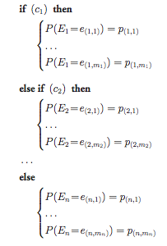
Probability rules
Form: If … then … else …
condition
effect

Slide 7
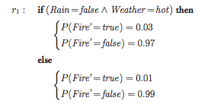
Probability rules
Conditions can be arbitrarily complex logical formulae
Effect: define probability (of each possible effect) cumulative effect of a condition sum to 1

Slide 8
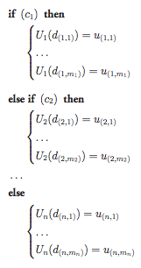
Utility rules
Assign utility values to particular system decisions
Same form as probability rules
BUT Probabilistic effects are replaced by utility distribution

Slide 9
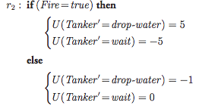
Utility rule

Slide 10
When are utility rules useful?
Utility
most utility rules only include one single decision variable
the possibility to integrate multiple decision variables where the system can execute multiple actions in parallel
communicate through both verbal and non-verbal channels
Dealing with uncertainty of ASR/NLU

Slide 11
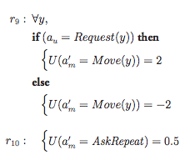

Example Rules
y is a direction (left, right, up, down, forward, backward)
If system’s previous DA was AskRepeat, there is 90% chance that the user will repeat

Slide 12
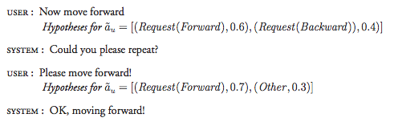
Example

Slide 13
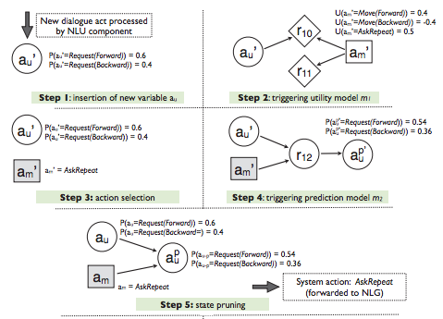
Example (1)
.4 = .6*2 -.4*.2
-.4 = -.6*2 +.4*.2
.5 (defined by r10, i.e. threshold)
Best Action: AskRepeat
Prob. Dist. For next DA
.54 = .6*.9
.36 = .4*.9

Slide 14
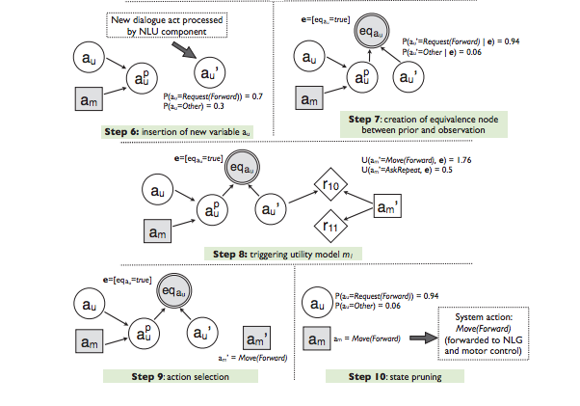
Example (2)
Combining predicted and actual user response

Slide 15
Framework allows DM to prime the recognition hypotheses of the user’s DA based on previous DAs
Utilities and Probabilities can be learned from data

Slide 16
Questions
How to plug in a probabilistic NLU, trained on data? e.g. to understand all cities in a database?

