Slide 1

The Contribution of Data and Information to Business Strategy and Operations
In today's rapidly evolving business landscape, data has become an indispensable asset. It provides the insights that fuel strategic decision-making, optimize operational processes, enhance customer experiences, and drive innovation. This presentation explores the multifaceted role of data in shaping the future of modern businesses.

Slide 2
Strategic Decisions
Market Trend Analysis: Track industry growth, competitors, and new opportunities to stay competitive.
Customer Needs Identification: Track industry growth, competitors, and new opportunities to stay competitive.
Opportunity Identification: Identify underserved markets and new products for expansion.
Informed Decisions: Rely on data-driven insights for effective strategies and reduced risks.

Slide 3
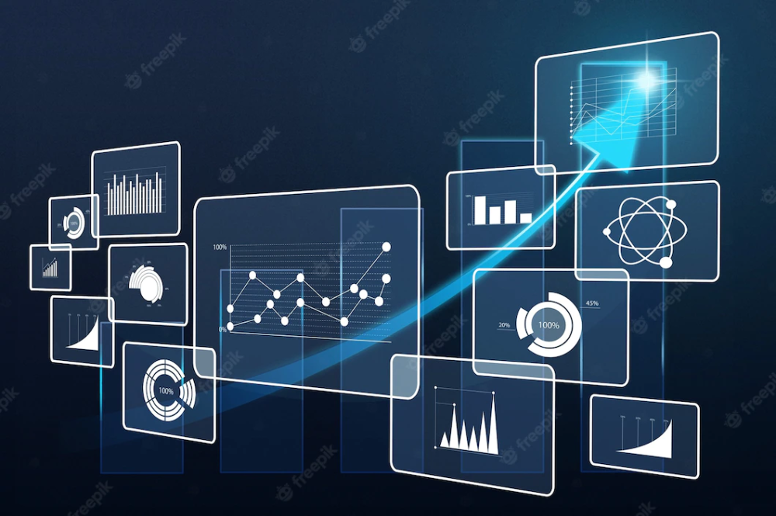
Operational Process Optimization
Process Mapping
Visually document activities to identify and improve bottlenecks and inefficiencies.
2. Cost Reduction
Use data to find opportunities for automation and resource optimization to cut costs.
3. Efficiency Improvement
Automate tasks, optimize workflows, and enhance communication to improve efficiency.

Slide 4
Enhanced Customer Experience
Customized Marketing
Using data helps businesses categorize customers and engage them with personalized messages and offers. By understanding customer preferences, behaviors, and purchase histories, companies can provide tailored experiences that meet individual needs.
Enhanced Customer Support
Data analysis of customer interactions helps identify common issues and train customer service representatives more effectively. This leads to quicker problem resolution and increased customer satisfaction.
Product Innovation
Insights from customer feedback, surveys, and social media analysis inform product development, ensuring new products meet customer expectations.
Operational Efficiency
Data analytics streamline operations, optimize inventory, reduce waste, improve delivery times, and enhance workforce management, leading to more efficient and cost-effective operations.

Slide 5

Supply chain management
Adopt cutting-edge technology: Use ERP (Enterprise Resource Planning), IoT (Internet of Things), and Big Data Analytics to track, manage, and optimize the entire supply chain, from manufacturing to distribution.
Work closely with partners: Build strategic partnerships with suppliers and other partners in the supply chain, share information and data transparently to improve performance and reduce risks.
Supply chain risk management: Assess and identify potential risks, develop contingency plans, and diversify supply sources to minimize the risk of relying on a single source.
Optimize inventory management: Use inventory management methods such as Just-in-Time (JIT), apply modern management tools such as warehouse management systems (WMS), and analyze data to predict demand and adjust inventory levels accordingly.

Slide 6
Data generation tools
Power BI: Microsoft tool, helps create reports and charts from big data, integrates well with other Microsoft products.
Tableau: Powerful data visualization tool, creates corresponding expressions and reports from multiple data sources.
Datapine: All-in-one tool, provides dashboards, automated reports and data analysis.
Zoho Analytics: Tool for small businesses and individuals, easy to use and integrates well with other Zoho products.

Slide 7

Creating and using data in a business platform
Information is a core resource or a factor that helps organizations manage their performance, make good choices, and improve clients’ satisfaction. This presentation discusses the creation and use of data in an organization, as well its business procedures, materials, equipment, and techniques in data processing and analysis.

Slide 8
Create data
Transactional Data: Includes details of sales, purchases, and financial transactions, such as customer names, product details (name, quantity, unit price), and transaction times.
Operational Data: Originates from internal systems and equipment, including performance metrics, inventory data, manufacturing process data, and sensor data. It helps monitor current performance and resource consumption.
Customer Data: Collected from website visits, social media, questionnaires, and feedback, including customer attributes, preferences, behavior, and transactions.
Market Data: Gathered from external sources like industry reports, market research, and competitive information, providing insights into competition, markets, and consumer behavior.

Slide 9

Using data creating and making decisions
Market Trends: Data identifies market trends and customer preferences, aiding in pricing, product development, and resource allocation.
Performance Monitoring: Data tracks KPIs, highlighting areas for improvement and measuring strategy effectiveness.
Predictive Analytics: Historical data and predictive models forecast trends, demand, and optimize inventory for proactive planning.
Customer Experience: Analyzing customer data helps tailor offerings, personalize marketing, and enhance customer satisfaction and loyalty.

Slide 10
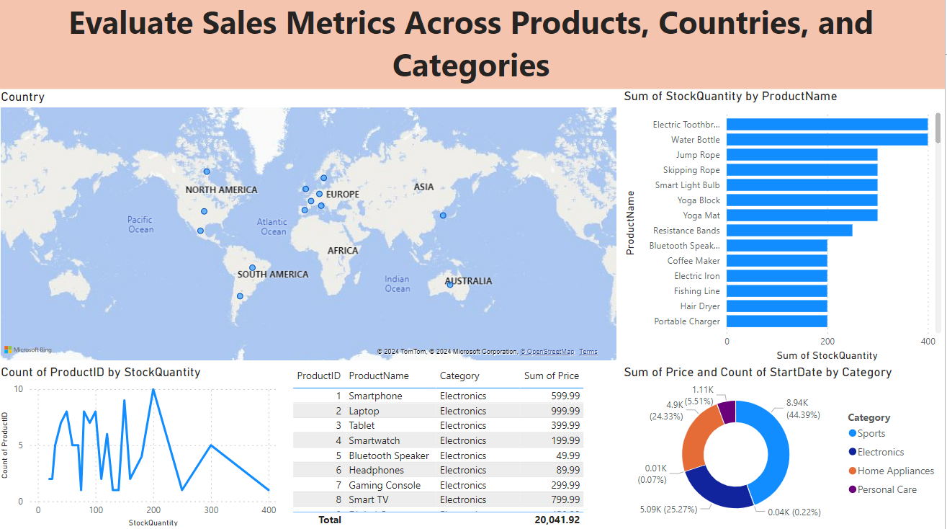
Power BI Project: Data Table and Value Analysis

Slide 11
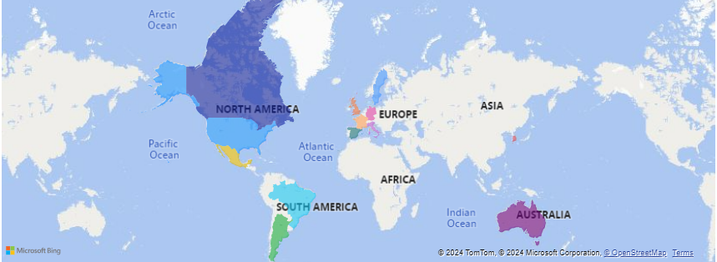
National sales analysis
Country Analysis
World Map: On the map, all sales activities are presented by country while different regions appear in distinct colors. Such color variations make it easy for viewers to differentiate between different regions.
Insights: Based on this map, the organization can identify locations that could be potential markets, and therefore have sales potential. Also, there are regions where sales efforts may need to be increased.

Slide 12
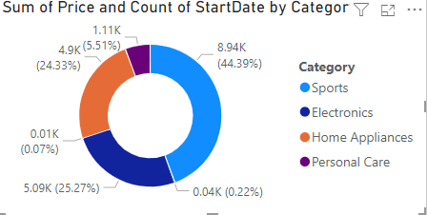
Sales and Category Products (Donut Chart)
Pie Chart: The pie chart breaks the annual product sales by categories such as sports, Electroncs, Home appliances and Personal Care. It is designed in a way that each segment highlights the percentage as well as the value of the sale.
Insights: This chart also allows for the determination of the products that yield most of the sales, hence, the appropriate way to mix and market the products.

Slide 13
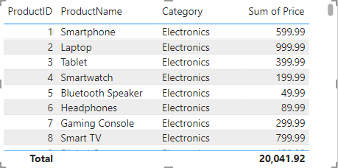
Product Data Sheet (Table)
This table provides detailed information on the sales performance of each product, including product name, first sale date, total sales volume, and overall revenue. Hello, businesses can:
Identify "hot" products: Find best-selling products to focus on strategy.
Evaluate revenue of each product: Choose products to develop effectively.
Manage inventory smartly: Avoid shortage/excess of products.

Slide 14
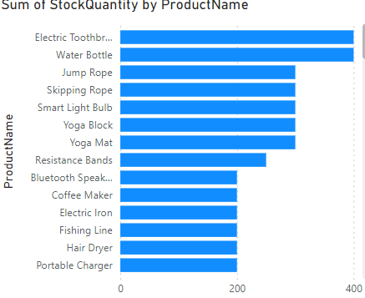
Chart of total best-selling products by name (Stacker bar chart)
The chart shows sales trends for different products. This data can be used to:
Identify which products are selling well and which ones need improvement.
Plan production and inventory accordingly
Develop targeted marketing campaigns.

Slide 15

Data information is the key to business success
Apart from what I have illustrated using Power BI in the classification above, below are other useful analysis that would help the business make the right decisions: Hence, organizations can use the rich analytics and visualization tools that are integrated with the software solution to unearth critical trends and thus grow strategically while leaving the competition behind.

Slide 16
Delivering insights based on Power BI data
Informed Insights: It is specifically useful in giving detailed report on business performance hence enabling the businesses truly understand the market, customers and competitors.
Customer analytics: From the point above, it is clear that Power BI assists companies to arrive at decisions that are vital in matters regarding the attraction and satisfaction of customers.
Competitive advantage: It also shows how through the use of Power BI one can be able to uncover competitors and even come up with the right strategies that may be used to counter competitors.
Real-time reporting: Power BI also has functions of building real time reports and charts which means businesses can always be on top of the action and can answer to what is going on.
Data integration: Power BI is the best tool that gathers data from multiple sources; it provides a general vision of business activities and decision making.

Slide 17

Effectiveness
Process Optimization: Sales tracking enable enhancement of right strategies and delivering of products on the right time.
Resource Allocation: Enterprise data also assist in the concentration of scarce resources where they will deliver the highest returns; on the highest-margin products and regions.
Risk Mitigation: Both business monitoring and targeting in digital platforms enable one to pin point risks and prevent them.
Performance Benchmarking: Thus, benchmarking can make a major contribution to the enhancement of the business performance by comparing product and region results.
Customer Segmentation: Segmenting of customers for better understand and creating of new advertising strategies.
Trend Analysis: Forecasting to have a foresight of the amount of demand that is expected so as to produce and market the product appropriately.
Financial Planning: Budgeting that involves processing of enterprise data for financial resources.

Slide 18
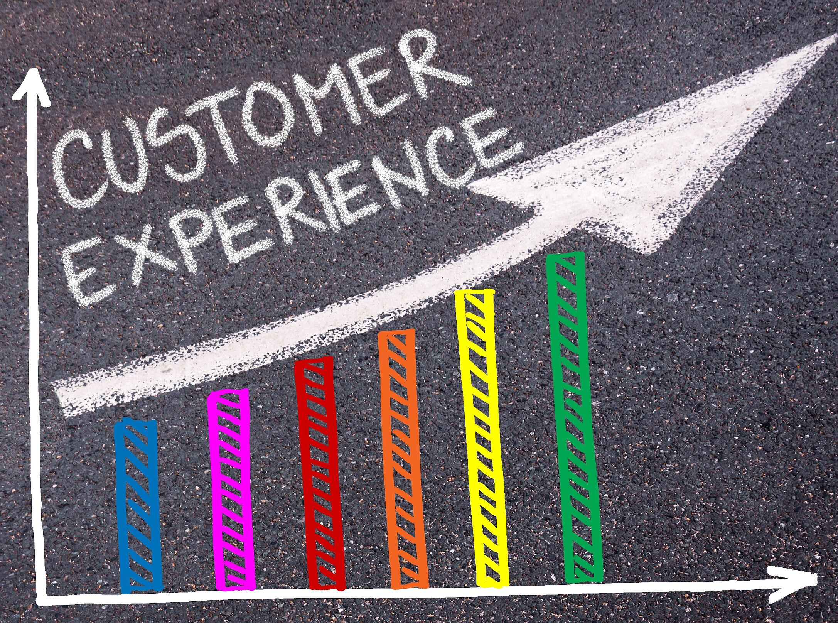
Customer Experience
Customer Satisfaction: Data analysis improves service and product quality, leading to higher customer satisfaction by meeting or exceeding expectations.
Targeted Marketing: Leveraging customer data enables more focused marketing campaigns, delivering promotions that resonate with specific audiences.
Operational Efficiency: Data analysis enhances operational efficiency by identifying improvements in supply chain and inventory management, resulting in a better overall customer experience.

Slide 19

End
Analytics is becoming a popular tool for making business decisions because it offers information, efficiency, and improvement of customers’ satisfaction. This important strategy assists business organisations to operate effectively in volatile environments by managing issues and opportunities in pursuit of the organisations’ objectives.

