Slide 1
GigStop Web App
Team AlphaDragon Design Presentation

Slide 2
What We’re trying to Solve…
Got some free time one evening, want to go see some live music.
Have to go to venue websites to see what’s going on.
Find a band, go to YouTube to see if they’re any good…
Go to ticket websites to get the tickets.
Accessing several websites at once to get this information is tiresome.
Would be awesome if all these problems were solved in a single space…
A SINGLE INTERFACE WHERE THE USER CAN QUICKLY SHOP FOR LIVE MUSIC EVENTS

Slide 3
How we plan to solve this
Coalesce all this information in a single web application
Give local bands a space to promote and get interested people to their gigs.
Users will be able to get relevant information about events happening in their area on a given date and future dates.
Bands will be able to upload their music to the application from a source (i.e. YouTube) – Gives users an idea of their style etc.
If bands have access to their tickets, app may provide functionality for users to directly purchase tickets from the band (Allows bands to become their own TicketMaster).

Slide 4
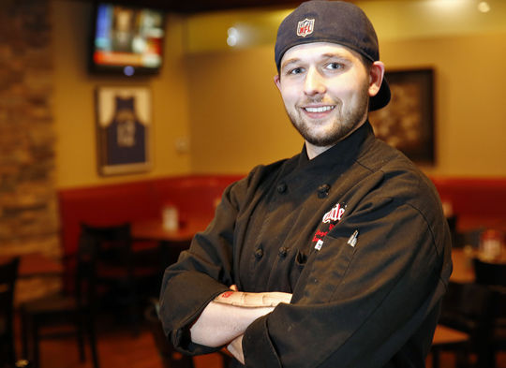
User Persona: Bill Braskin
Name Bill Braskin
Age 28
Location Glasgow
Motivations
Have a good time
Discover new bands
Save money
Goals
Find out which bands are playing this weekend
Attend good gigs
Get discount on pricing
Frustrations
Wasting time researching who is playing where
Getting ripped off
Watching a band he doesn’t like
Attending an event with a poor atmosphere
Behavioral Considerations
Attends gigs 3-4 times a month
Has a short attention span and is easily distracted
Impulsive
Expectations
Check out which bands are playing
Buy tickets at a discount
Rate the gigs he has attended
“ Nothing beats being there as a crowd goes wild”
Bill currently works as a chef in a restaurant in Glasgow. He is very social and has a wide circle of friends. Bill is an audiophile and has an eclectic taste in music. He loves catching bands before they hit the mainstream so that he can make statements like “ I was into them before they were famous”.

Slide 5
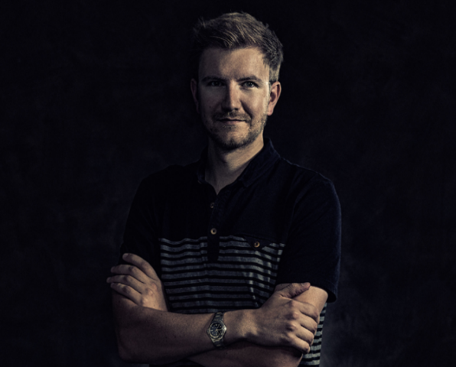
Performer Persona: Jamie Wright
Name Jamie Wright
Age 33
Location Livingston
Motivations
Become a better musican
Achieve fame
Save time
Goals
Increase the number of people attending his gigs
Sell tickets
Get his music heard by a wider audience
Reduce the amount of time he spends on administration
Frustrations
Playing to an empty house
Wasting time dealing with selling tickets
Not being able promote his band effectively
Behavioral Considerations
Time constrained
Not particularly tech savvy
Expectations
Attract new fans
Manage his ticket distribution
Communicate with fans
“ Seeing people enjoying my music makes it all worthwhile ”
Jamie is the drummer for the Band “Heavy Plant Movement” and also works fulltime as construction worker. He views his job as a means of paying the bills. He can’t wait for the weekend so that he can indulge his main passion which is music.
Jamie is an avid supporter of Livingston FC

Slide 6
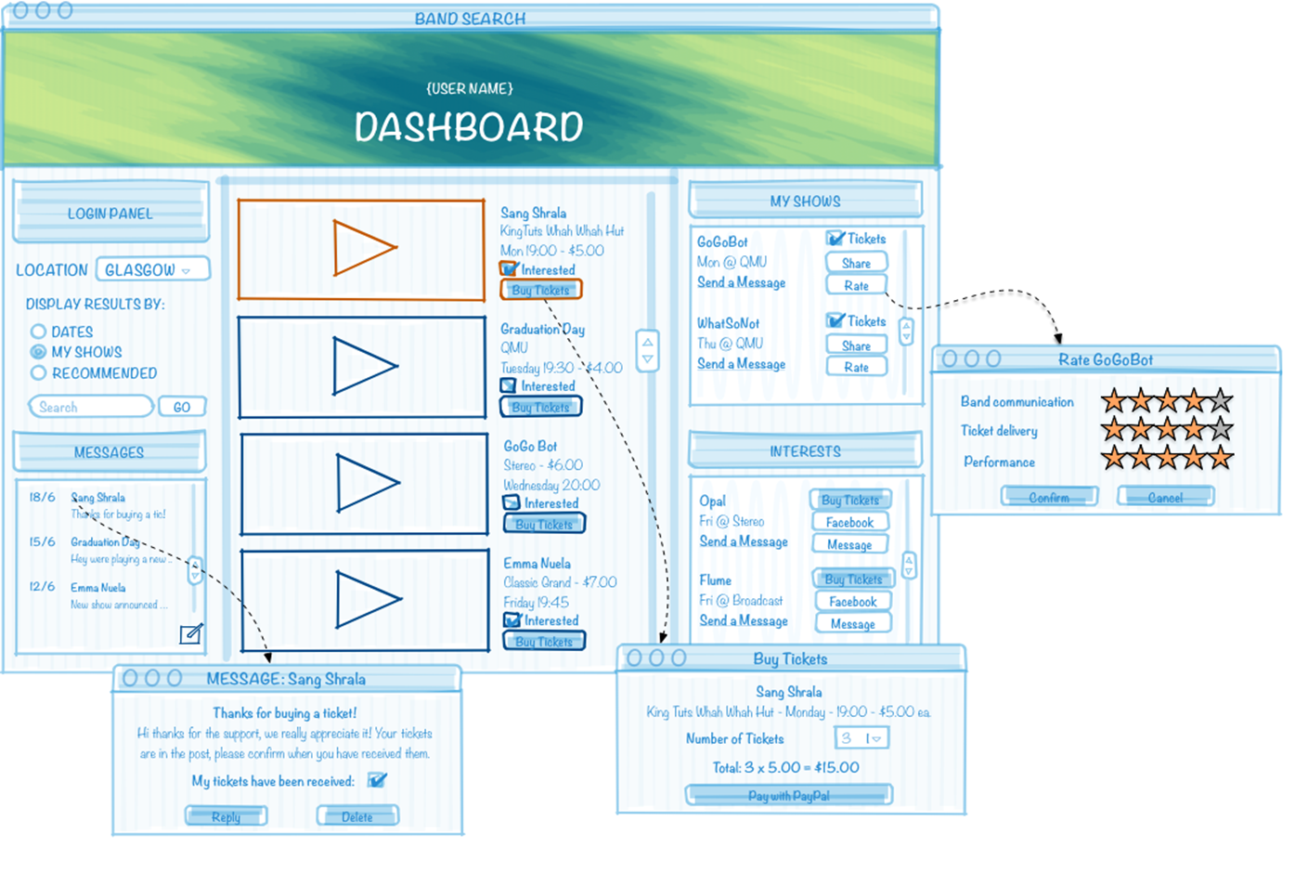
Wireframe: User Perspective

Slide 7
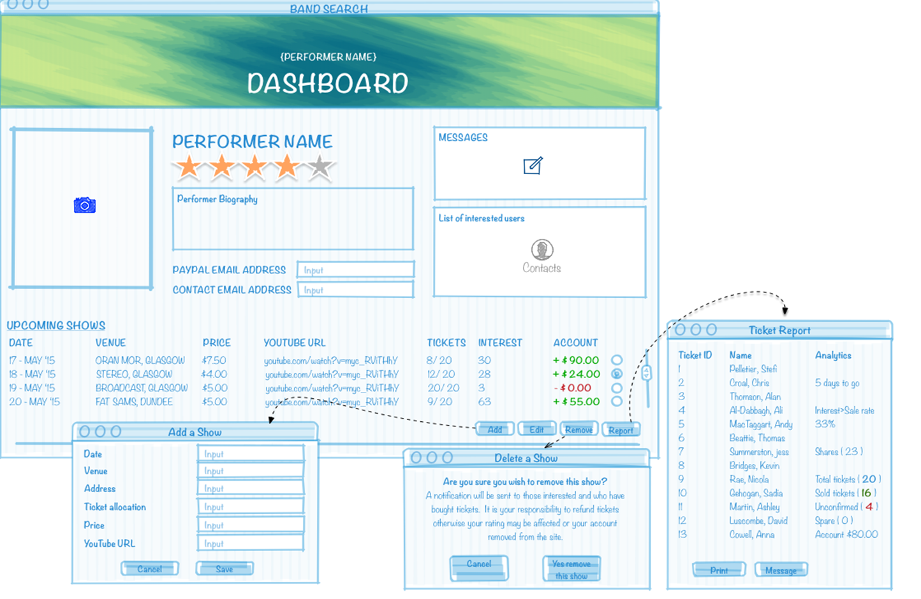
Wireframe: Performer Perspective

Slide 8
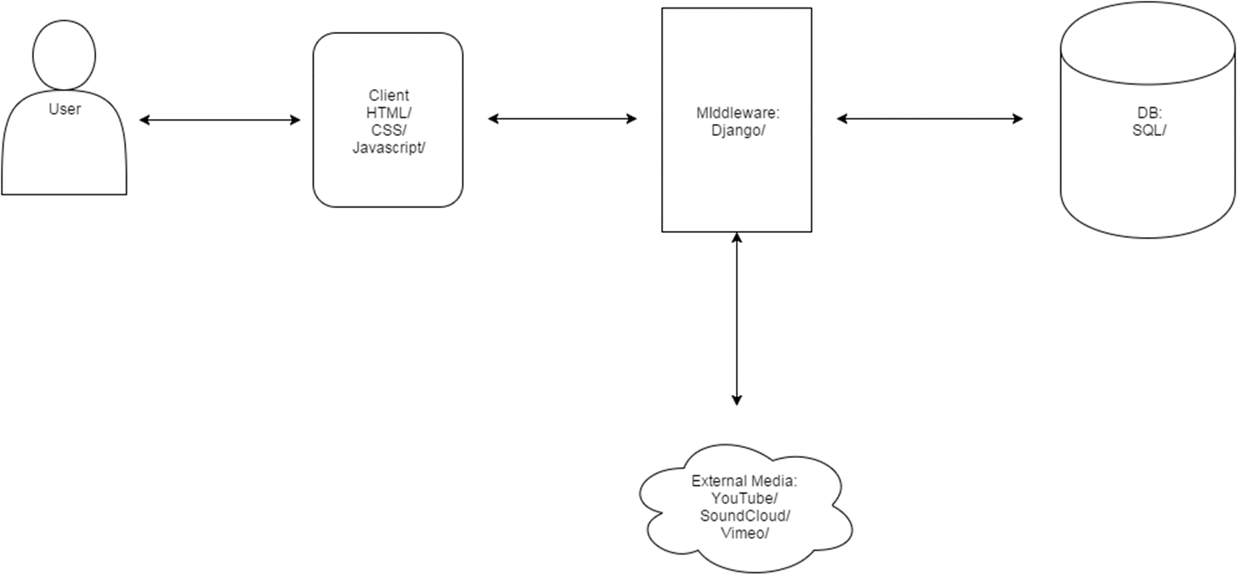
System Architecture

Slide 9
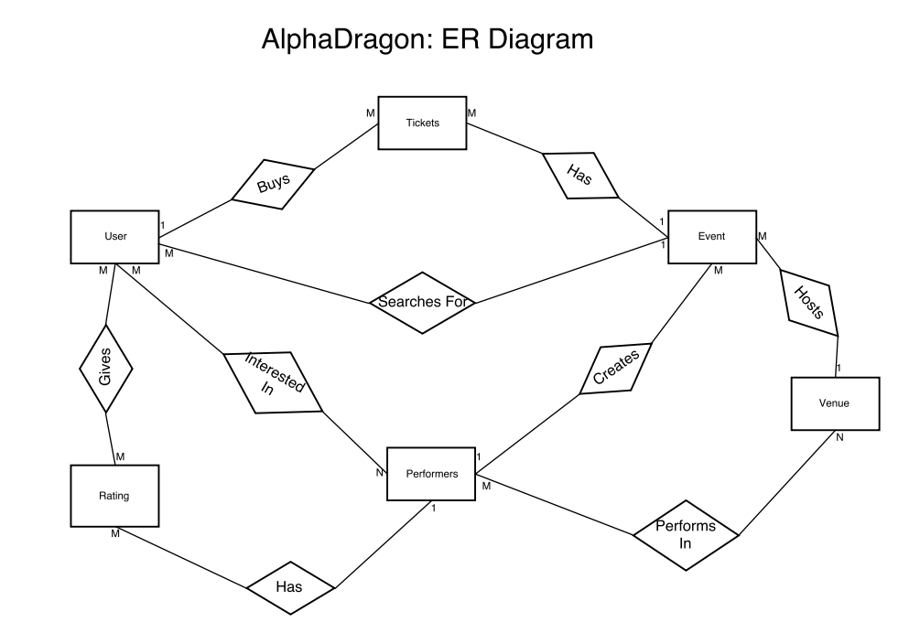
E-R Diagram

Slide 10
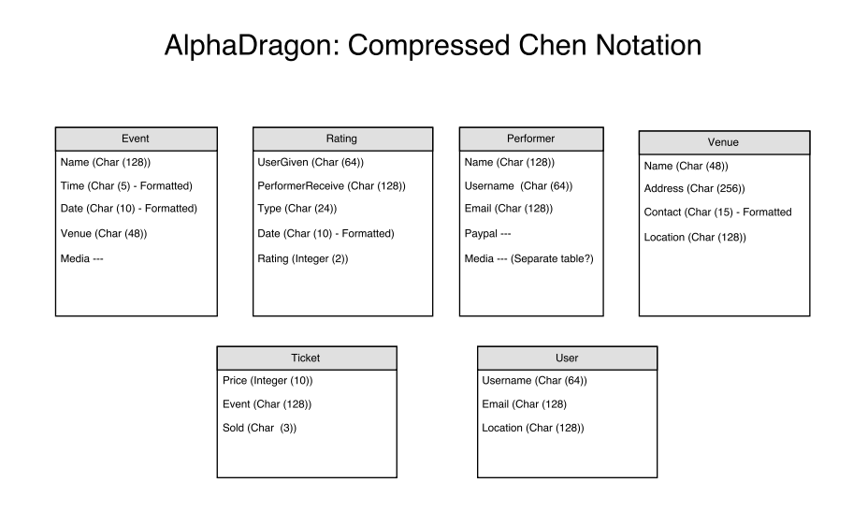
Compressed Chen

