Slide 1
Image Warping

Slide 2
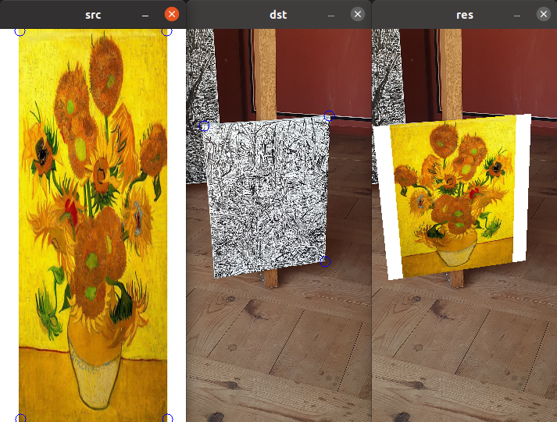
Result

Slide 3
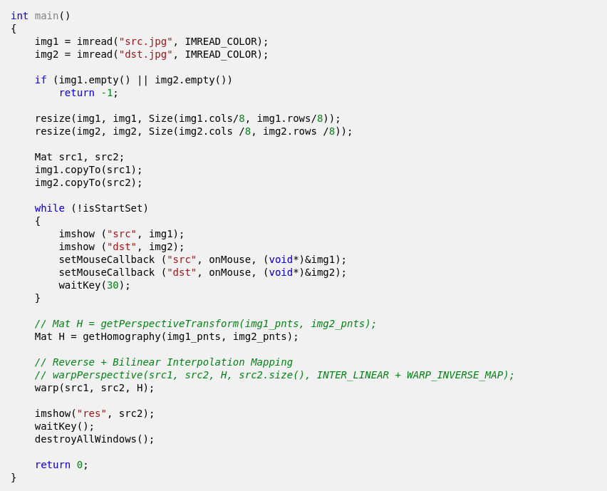
Overview
영상 2개를 받아 각 영상마다 4개의 점을 클릭
총 8개의 포인트로부터 호모그래피를 계산한 후
호모그래피를 이용해 와핑하여 영상 합성

Slide 4
Overview
영상 2개를 받아 각 영상마다 4개의 점을 클릭
총 8개의 포인트로부터 호모그래피를 계산한 후
호모그래피를 이용해 와핑하여 영상 합성

Slide 5
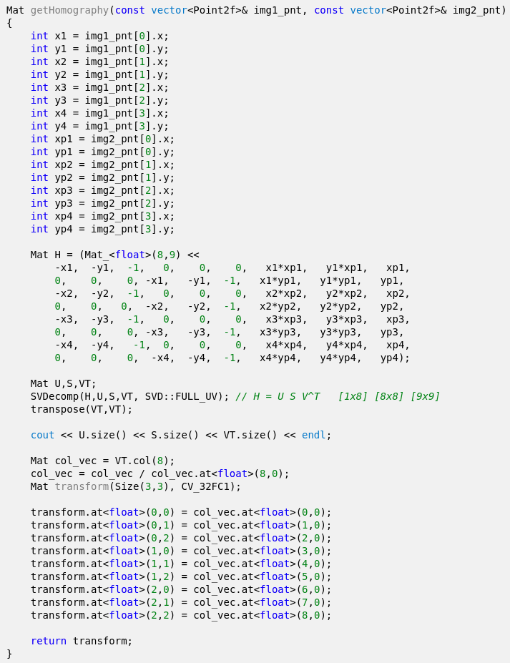
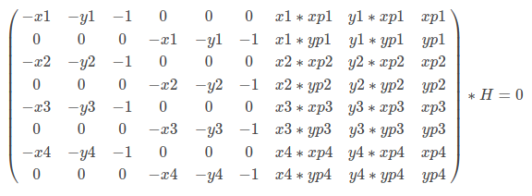
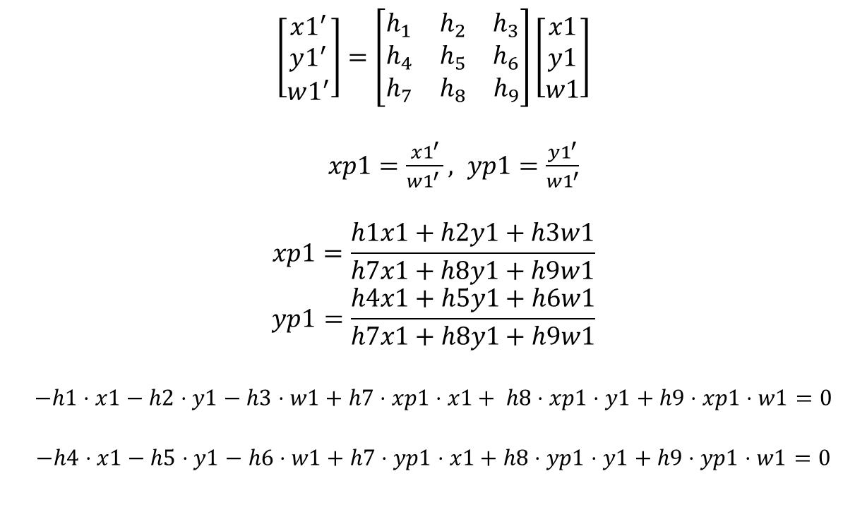
getHomography
$$\left[\begin{aligned}x1^{′} \\ y1^{′} \\ w1^{′}\end{aligned}\right]=\left[\begin{matrix}h_{1} & h_{2} & h_{3} \\ h_{4} & h_{5} & h_{6} \\ h_{7} & h_{8} & h_{9}\end{matrix}\right]\left[\begin{aligned}x1 \\ y1 \\ w1\end{aligned}\right]$$
$xp1=\frac{x1^{′}}{w1^{′} }, yp1=\frac{y1^{′}}{w1^{′}}$
$$xp1=\frac{h1x1+h2y1+h3w1}{h7x1+h8y1+h9w1}$$
$$yp1=\frac{h4x1+h5y1+h6w1}{h7x1+h8y1+h9w1}$$
$$−h1⋅x1−h2⋅y1−h3⋅w1+h7⋅xp1⋅x1+ h8⋅xp1⋅y1+h9⋅xp1⋅w1=0$$
$$−h4⋅x1−h5⋅y1−h6⋅w1+h7⋅yp1⋅x1+h8⋅yp1⋅y1+h9⋅yp1⋅w1=0$$

Slide 6

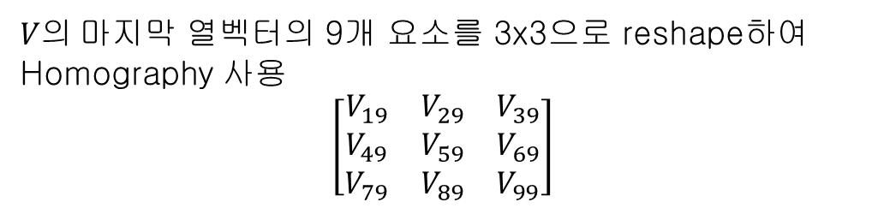
getHomography
고유값이 0일때 고유벡터가 x가 된다.
$$H= USV^{T}$$
$$V^{T}=\left[9×9\right]$$
$=\left[\begin{matrix}V_{11} & ⋯ & V_{91} \\ ⋮ & ⋱ & ⋮ \\ V_{19} & ⋯ & V_{99}\end{matrix}\right]$
$V의$마지막 열벡터의 9개 요소를 3x3으로 reshape하여 Homography 사용
$$\left[\begin{matrix}V_{19} & V_{29} & V_{39} \\ V_{49} & V_{59} & V_{69} \\ V_{79} & V_{89} & V_{99}\end{matrix}\right]$$
Notes:
If you want to compute a condition number of a matrix or an absolute value of its determinant, you do not need u and vt.
You can pass flags=SVD::NO_UV|... . Another flag SVD::FULL_UV indicates that full-size u and vt must be computed, which is not necessary most of the time.
[SVD::FULL_UV]
when the matrix is not square, by default the algorithm produces u and vt matrices of sufficiently large size for the further A reconstruction;
if, however, FULL_UV flag is specified, u and vt will be full-size square orthogonal matrices.

Slide 7
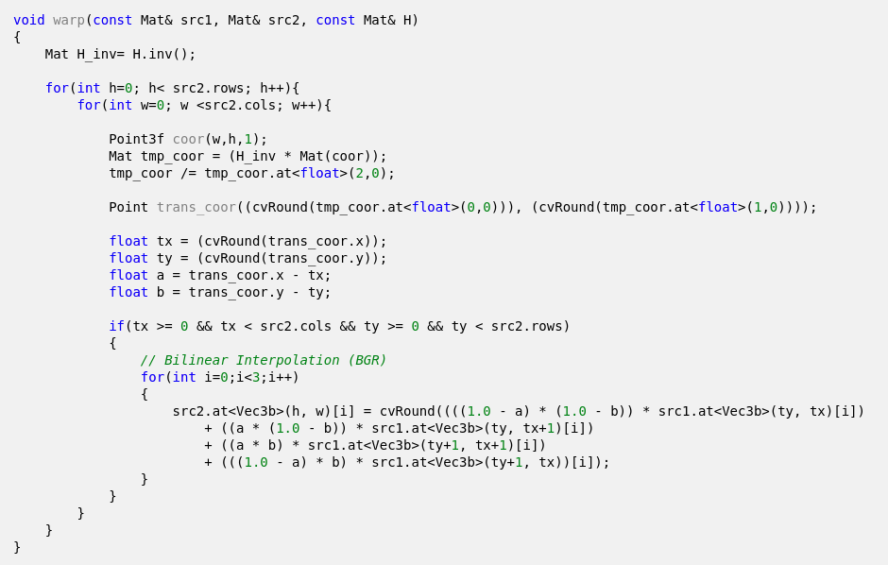
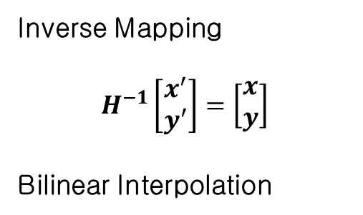
warpingPerspective
Inverse Mapping
$$H^{−1}\left[\begin{aligned}x^{′} \\ y^{′}\end{aligned}\right]=\left[\begin{aligned}x \\ y\end{aligned}\right]$$
Bilinear Interpolation

Slide 8
Overview

Slide 9
Result

