Slide 1
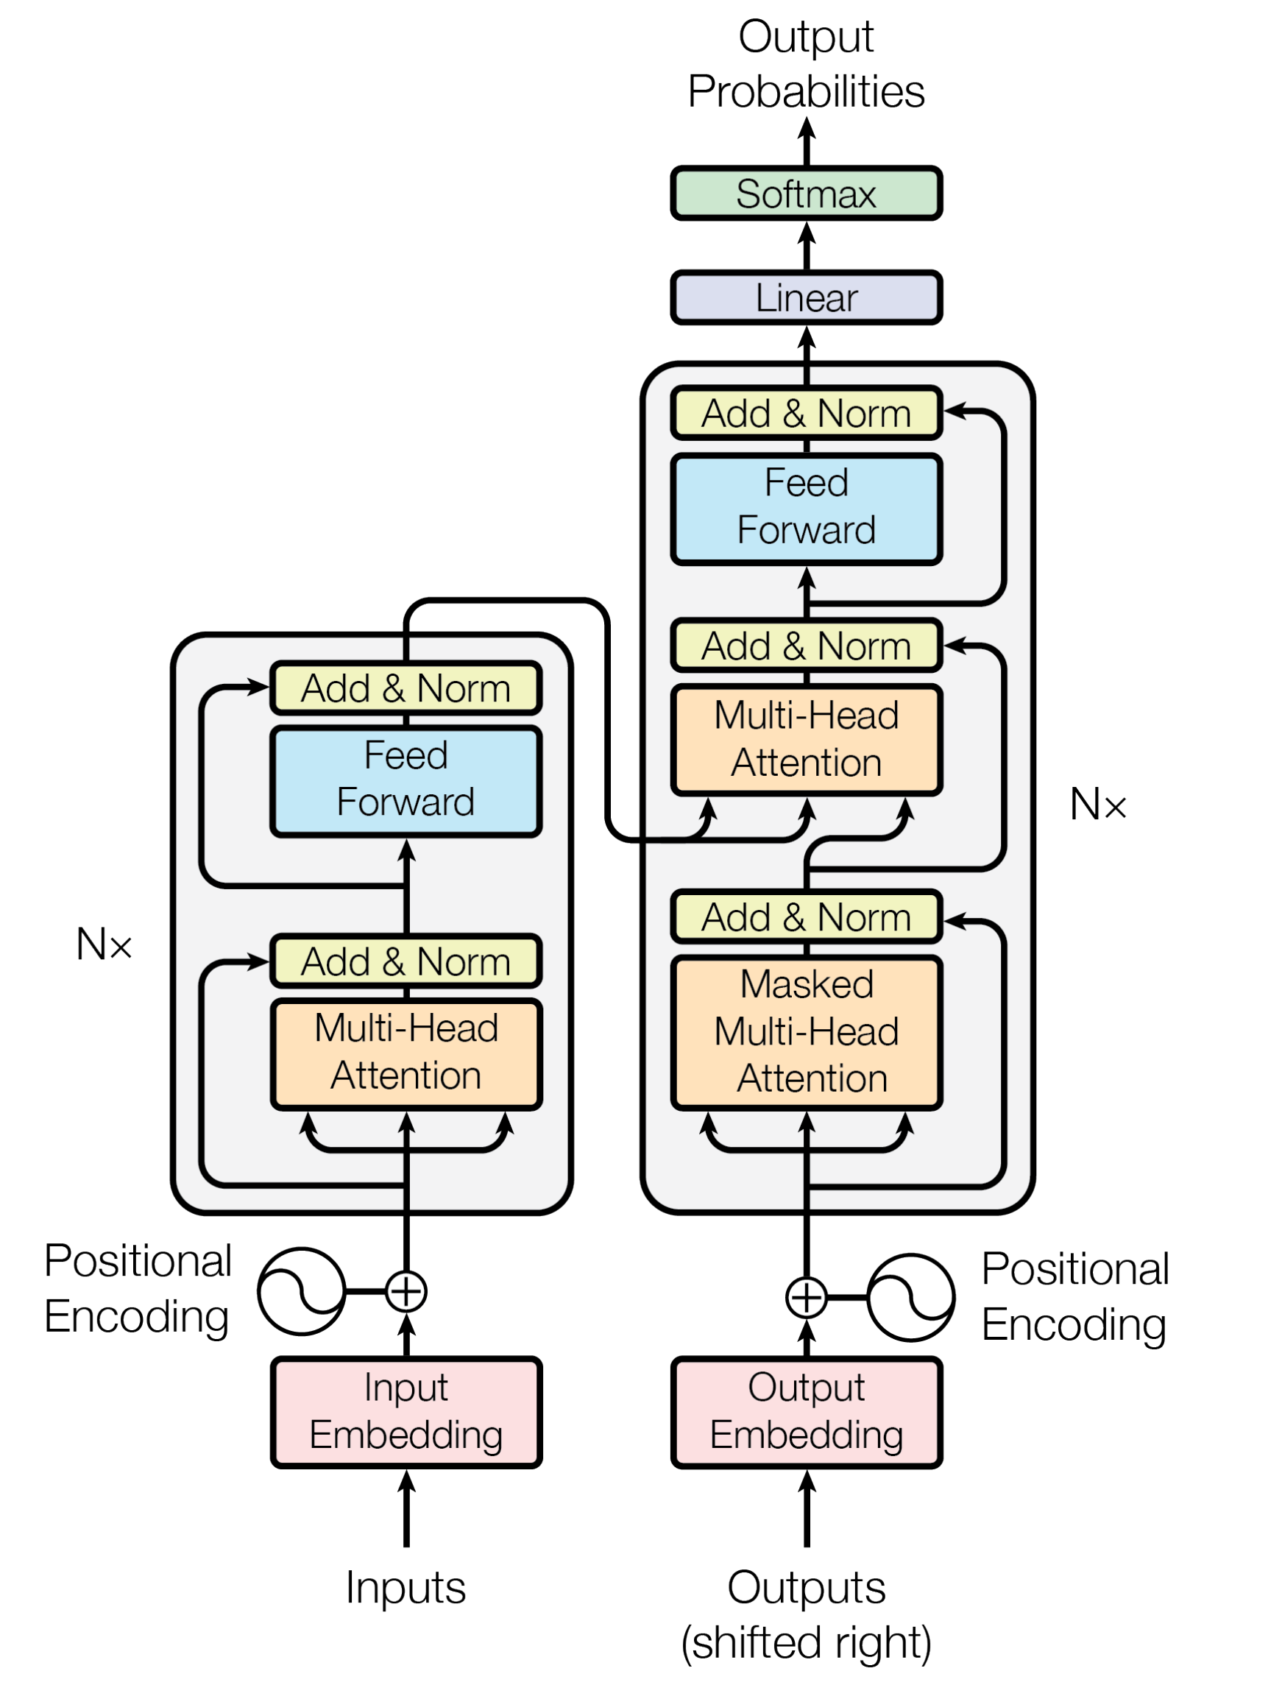
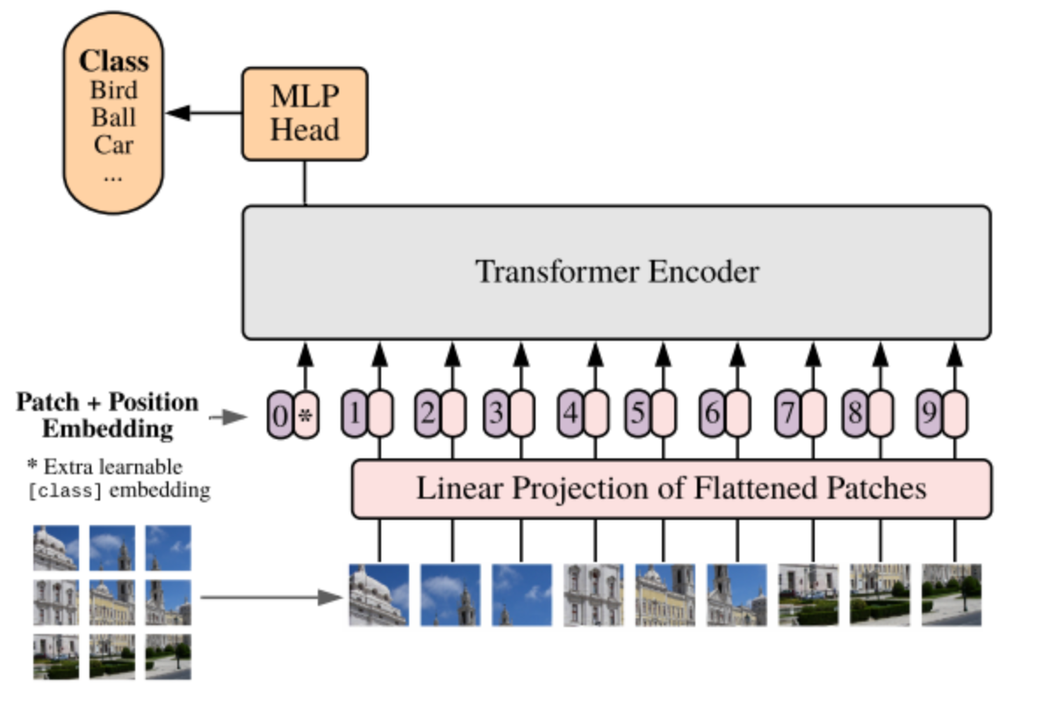
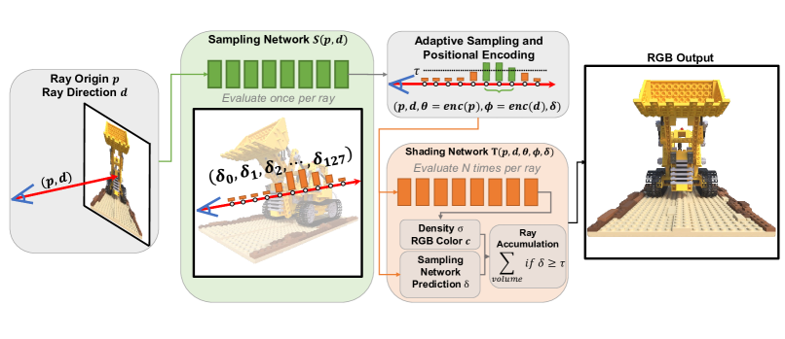
(1) PE in a language model
(2) PE in a vision model
(3) PE in a NeRF based model

Slide 2
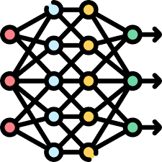
Input
I | am | going | to | post | something
Embedding
Vector
0.12 | 0.87 | 0.45 | 0.78 | 0.34 | 0.56
0.23 | 0.57 | 0.89 | 0.12 | 0.91 | 0.38
0.34 | 0.76 | 0.54 | 0.43 | 0.65 | 0.29
0.88 | 0.47 | 0.31 | 0.38 | 0.72 | 0.59
0.63 | 0.85 | 0.49 | 0.11 | 0.92 | 0.74
Positional
Encoding

Slide 3
Index 0
Index 1
Index 2
…
Index 99
Index 100
Input
I | am | going | … | Best | Regards
Positional
Encoding
0 | 1 | 2 | … | 99 | 100
0 | 1 | 2 | … | 99 | 100
0 | 1 | 2 | … | 99 | 100
0 | 1 | 2 | … | 99 | 100
0 | 1 | 2 | … | 99 | 100

Slide 4
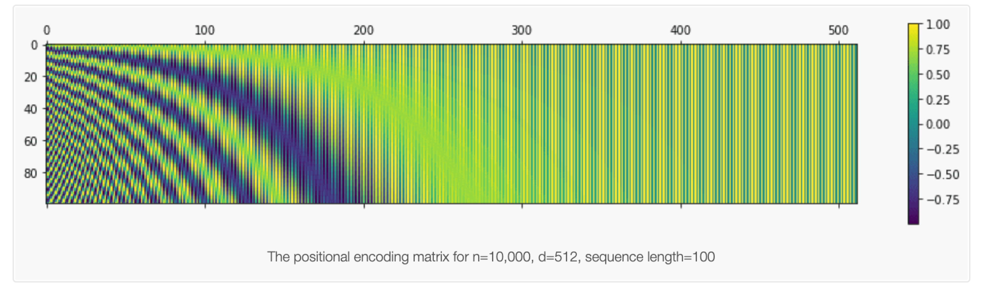
Index 0
Index 1
Index 2
Index 3
Index 4
Index 5
Input 1
I | am | going | to | post | something
Positional
Encoding
1/6 | 2/6 | 3/6 | 4/6 | 5/6 | 1
Index 0
Index 1
Index 2
Input 2
You | are | here
Positional
Encoding
1/3 | 2/3 | 1

Slide 5
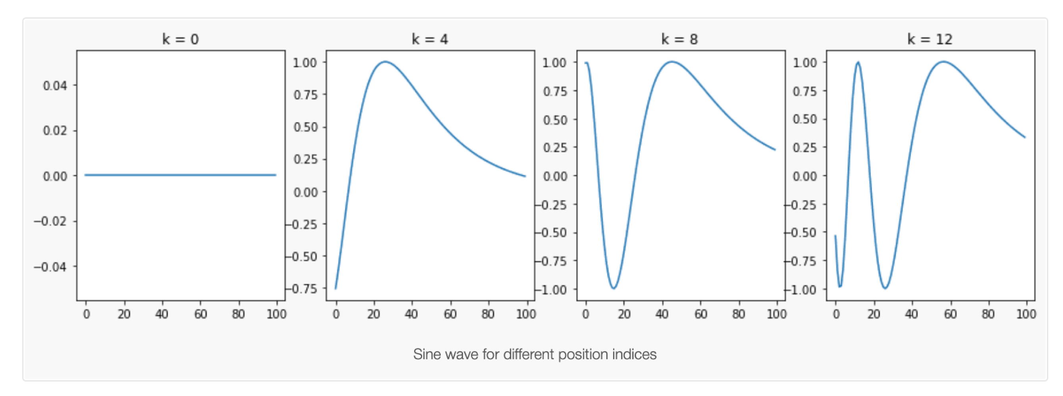





Index 0
Index 1
Index 2
Index3
Index 4
Index 5
Input
I | am | going | to | post | something
Positional
Encoding
$$2^{4}$$
0 | 0 | 0 | 0 | 0 | 0
0 | 0 | 0 | 0 | 0 | 0
0 | 0 | 0 | 0 | 1 | 1
0 | 0 | 1 | 1 | 0 | 0
0 | 1 | 0 | 1 | 0 | 1
$$2^{3}$$
$$2^{2}$$
$$2^{1}$$
$$2^{0}$$
j = 0
j = 4
j = 8
j = 12

