Slide 1
Hospital Emergency Room Dashboard
Power BI analysis of ER patient flow, wait times and satisfaction
April 2023 – October 2024

Slide 2
ER performance at a glance
9,216
35.3 min
4.99 / 10
40.7%
unique patients over 19 months
average wait before being seen
average patient satisfaction
of patients seen within 30 minutes
Patients by day of week
Seen within 30 minutes

Slide 3
How the dashboard was built
Understand
Prepare
Build and explain
1
Requirement gathering / business requirements
3
Data connection
8
Dashboard layouting
2
Data walkthrough
4
Data cleaning / quality check
9
Charts development and formatting
5
Data modeling
10
Dashboard / report development
6
Data processing
11
Insights generation
7
DAX calculations

Slide 4
Four KPIs, each tracked daily with a sparkline
1
Number of patients
2
Average wait time
Total patients visiting the ER each day. The area sparkline shows peak days and seasonal patterns.
Average time before a medical professional sees the patient. The sparkline flags days with long waits that need operational changes.
3
Patient satisfaction score
4
Patients referred
Daily average satisfaction to judge service quality. The sparkline shows dips that can be matched to busy periods.
Patients referred from the ER to specific departments each day. The sparkline points to departments needing extra resources.

Slide 5
Four dashboard pages, from summary to detail
1
2
3
4
Monthly View
Consolidated View
Patient Details
Key Takeaways
Track KPIs and patterns month by month.
Summarize performance over any chosen date range.
Patient-level data for detailed checks.
Turn findings into actions for stakeholders.
Admission status, age groups, referrals, 30-minute timeliness, gender, race, day and hour
The same metrics as the monthly view, aggregated across the range
A grid of ID, name, gender, age, admission date, race, wait time, referral and status
Descriptive analysis of each metric: patterns, anomalies and recommendations

Slide 6
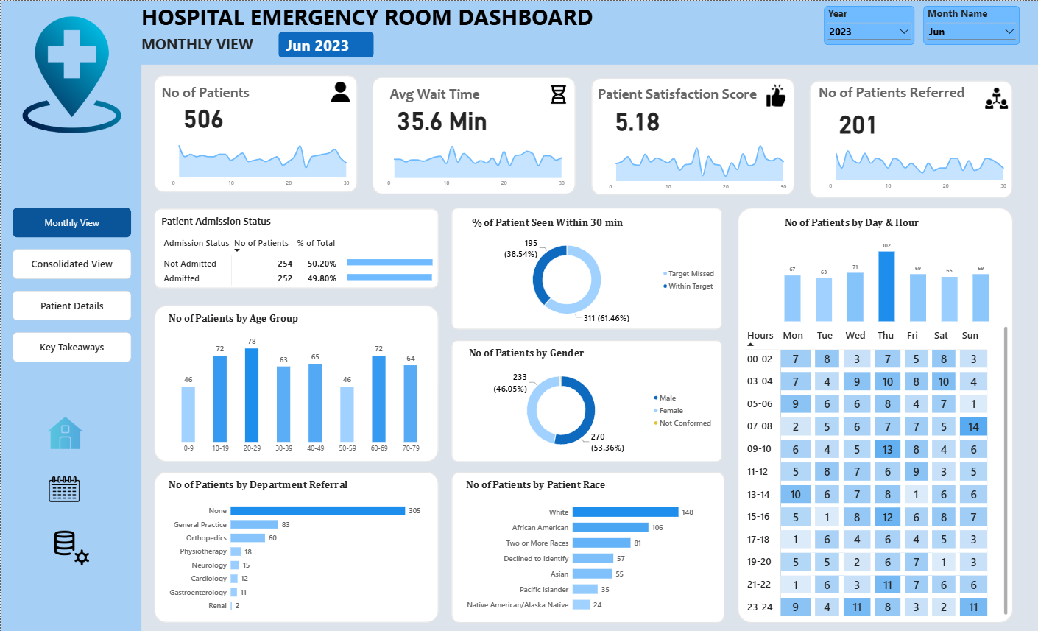
Monthly view: June 2023
What June 2023 shows
506 patients
Average wait 35.6 min, satisfaction 5.18, and 201 patients referred.
38.5% seen in 30 min
195 patients met the target; 311 (61.5%) missed it.
Thursday peak
102 patients, the highest of any weekday that month.

Slide 7
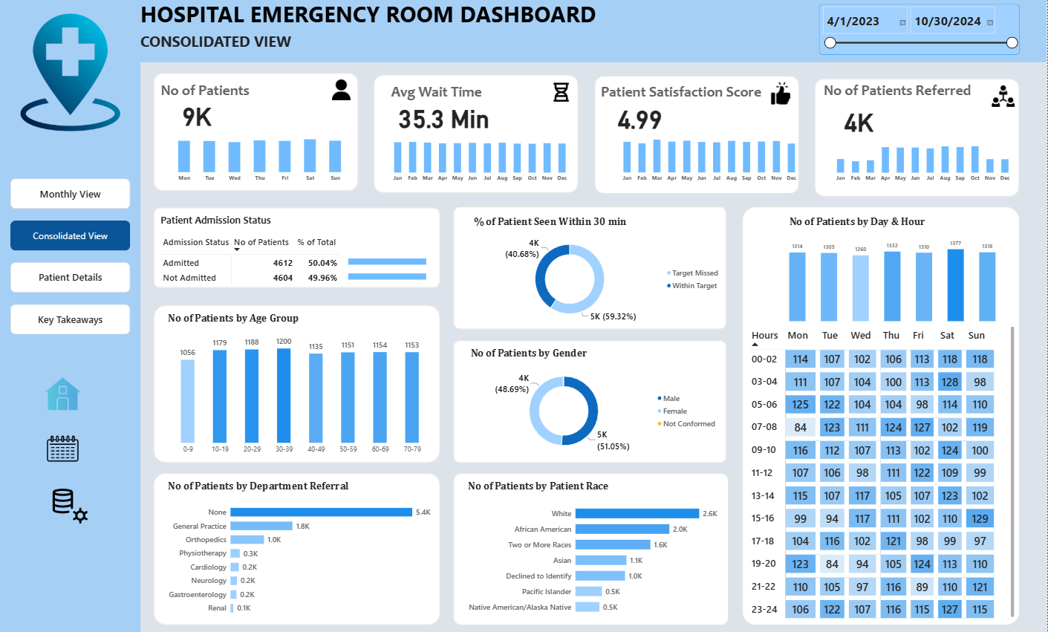
Consolidated view: Apr 2023 – Oct 2024
Across 19 months
9,216 patients
Average wait 35.3 min and satisfaction 4.99.
Even split
4,612 admitted (50.04%) and 4,604 not admitted (49.96%).
Saturday busiest
1,377 patients; weekday volumes range 1,260 to 1,332.

Slide 8
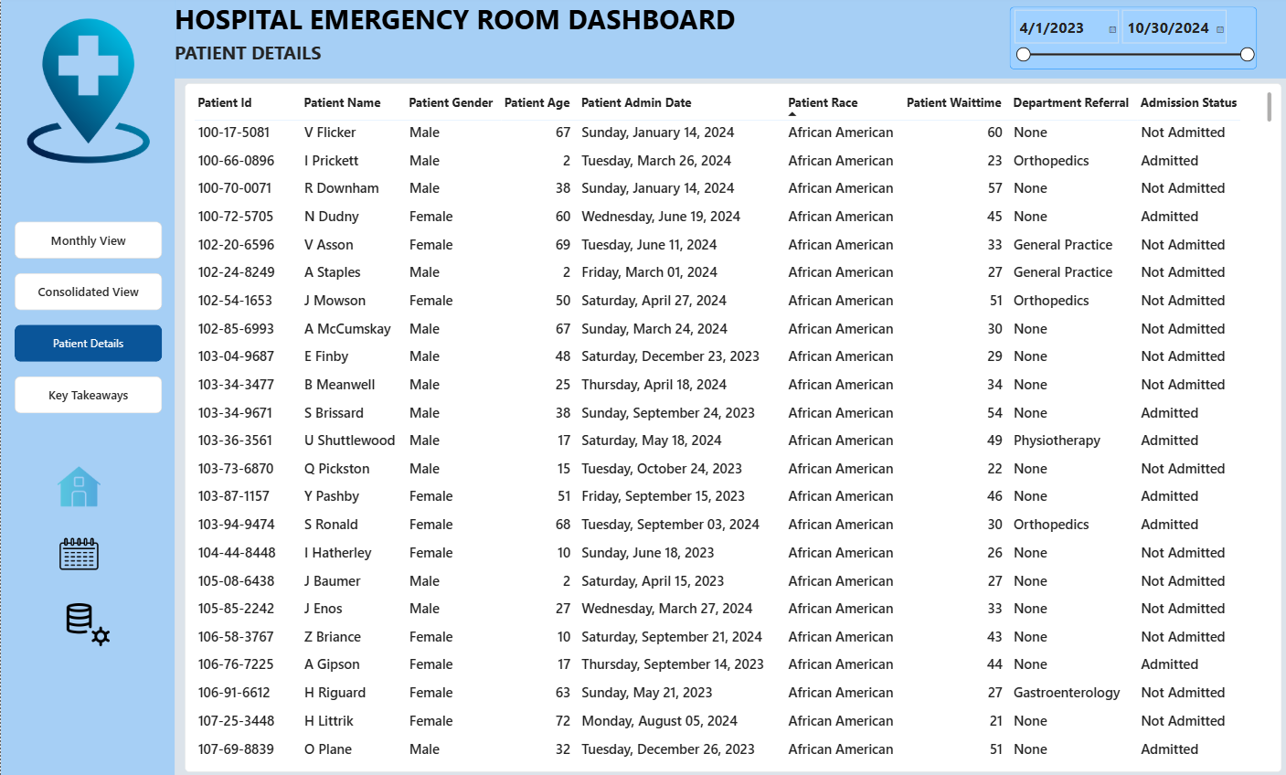
Patient details
Patient-level grid
9 fields per patient
ID, name, gender, age, admission date, race, wait time, referral, status.
Date-range filter
The same date slider as the consolidated view limits the rows shown.
Troubleshooting
Lets analysts trace any KPI back to the individual visits behind it.

Slide 9
Key insights, April 2023 – October 2024
Waits and satisfaction
Referrals
Busy periods
Average wait is 35.3 min and satisfaction is 4.99 out of 10, so there is room to improve patient flow.
About 5,400 patients needed no referral. General Practice (1,840) and Orthopedics (995) lead, then Physiotherapy (276) and Cardiology (248).
Saturday is busiest (1,377), then Thursday (1,332). Hourly volume is steady, from 737 to 808 per time band.
Age
Race
Admission
Ages 30–39 are the largest group (1,200), followed by ages 20–29 (1,188). Ages 0–9 are the smallest (1,056).
White 2,571, African American 1,951, multiracial 1,557 and Asian 1,060. About 1,030 patients declined to identify.
Nearly half were admitted (4,612); the other 4,604 were treated and released.

