Slide 1

VR ATTENDANCE
Presented by:
Rohit Gangshettiwar : 176
Rutu Shinde : 181
of
SYMCA, C
Under Guidance of
Dr.Balasaheb Bhamangol Sir
01

Slide 2
VR ATTENDANCE
Presented by:
Rohit Gangshettiwar : 176
Rutu Shinde : 181
of
SYMCA, C
Under Guidance of
Dr.Balasaheb Bhamangol Sir
01

Slide 3

INTRODUCTION
Voice Recognition and attendance marker, detect voice and mark attendance accordingly,Voice check detect specific voice.
Speech Recognition (SR) is the ability to translate a dictation or spoken word to text.
Speech Recognition known as “automatic speech recognition“ (ASR),or speech to text(STT) .
Speech recognition is the process of converting an acoustic signal, captured by a microphone or any peripherals , to a set of words.
To achieve speech understanding we can use linguistic processing •The recognized words can be an end in themselves, as for applications such as commands & control data entry and document preparation.
02

Slide 4

EXISTING SYSTEM
SINCE : 1940.
The first speech recognition program was appeared in 1953 at the bell labs, that was about recognition of a digit in a noise free environment.
1940S AND 1950S
Considered as the foundational period of the speech recognition technology, in this period work was done on the of the speech recognition that is automation and information theoretic models.
03

Slide 5
NEED FOR SYSTEM
Virtual attendance systems are becoming increasingly popular in today's digital age, and there are several reasons why they are important.
CONVENIENCE:
With virtual attendance systems, employees can easily mark their attendance from anywhere with an internet connection, making it more convenient for them to work remotely or from home.
ACCURACY:
Virtual attendance systems are highly accurate and reliable, as they use advanced technology such as biometric scanners, facial recognition software, or GPS tracking to ensure that the right person is marking their attendance at the right time.
COST-
EFFECTIVE:
Implementing a virtual attendance system can help organizations save on costs associated with traditional attendance systems such as paper-based systems or manual time-tracking, as well as the cost of employing staff to maintain such systems.
COMPLIANCE:
Virtual attendance systems can help organizations comply with labor laws and regulations related to attendance tracking and payment of wages, by providing accurate and auditable records of employee attendance.
REAL-TIME MONITORING:
Virtual attendance systems can provide real-time monitoring of employee attendance, allowing managers to quickly identify any attendance issues and take corrective actions as needed.
04

Slide 6
SCOPE OF WORK
This project has the speech recognizing and speech synthesizing capabilities and voice can be transform & use in many ways .
Though it is not a complete replacement of what we call a notepad but still a good text editor to be used through voice this software also can open windows based software such as notepad , google chrome and etc..
Its application work in different areas
Its implementation as a desktop Application
This application as software that can be use for :
Speech Recognition ,convert the voice to text
Speech Generation , convert the text to voice .
Voice identification
05

Slide 7

SCOPE OF WORK
SPEECH RECOGNIZING
Has the speech recognizing capabilities a
SPEECH SYNTHESIZING
Has the sspeech synthesizing capabilities and voice can be transform & use in many ways .
NOT A COMPLETE REPLACEMENT OF A NOTEPAD
Though it is not a complete replacement of what we call a notepad but still a good text editor to be used through voice this software also can open windows based software such as notepad , google chrome and etc..
06

Slide 8

OPERATING ENVIRONMENT - SOFTWARE & HARDWARE SPECIFICATION
Hardware
Component Minimum Recommended
CPU 1.6 GHz 2.53GHz
RAM 2 GB 4gb
Microphone Mic High quality microphones
Sound card Sound card Sound cards with very clear signals
Software
OS : Windows
Web Browser: Chrome, Mozilla, Firefox
Front Ends: Tkinter
Back Ends: Tenserflow and python
Database: MySql
other supporting tools used : Vs studio, mySql terminal.
07

Slide 9
DESCRIPTION OF TECHNOLOGY USED
ARTIFICIAL INTELLIGENCE
Artificial Intelligence (AI) refers to the development of computer systems that can perform tasks that typically require human intelligence, such as visual perception, speech recognition, decision-making, and natural language processing. AI involves the use of algorithms and statistical models to enable machines to learn from data, recognize patterns, and make predictions or decisions.
PYTHON
Python is a popular programming language that is widely used in the development of AI systems. Python provides a rich set of libraries and tools for machine learning, deep learning, natural language processing, and computer vision. It has a simple and easy-to-learn syntax that makes it accessible for beginners, as well as powerful features that enable experienced programmers to develop complex AI systems. Python's flexibility, ease of use, and community support make it an excellent choice for developing AI applications.
VOICE RECOGNITION
A voice recognition system, also known as speech recognition, refers to the technology that enables a computer or device to recognize and interpret human speech. It involves converting spoken words into text or commands that can be processed by the computer or device.
08

Slide 10
PROPOSED SYSTEMS
Attendance system using voice recognition and speech recogniton to avoid proxy. Speech automation , speech to text, Verification using speech.
Speech Recognition (SR) is the ability to translate a dictation or spoken word to text. Speech Recognition known as “automatic speech recognition“ (ASR),or speech to text(STT)
This Smart Attendance System is the combination of a Python and a Web Application. Speech Recognizer is used to recognize the voice inputs, capture the input records, and then we log them into a database.
09

Slide 11
OBJECTIVES OF SYSTEM
Its application work in different areas
This application as software can be used for :
- Speech Recognition (convert the voice to text)
- Speech Generation , (convert the text to voice )
- Text Editing (copy ,past ,select )
Developing software for speech recognition (speech to text conversion)
Developing advanced technology incorporating these ideas
10

Slide 12
ANALYSIS & DESIGN
11

Slide 13
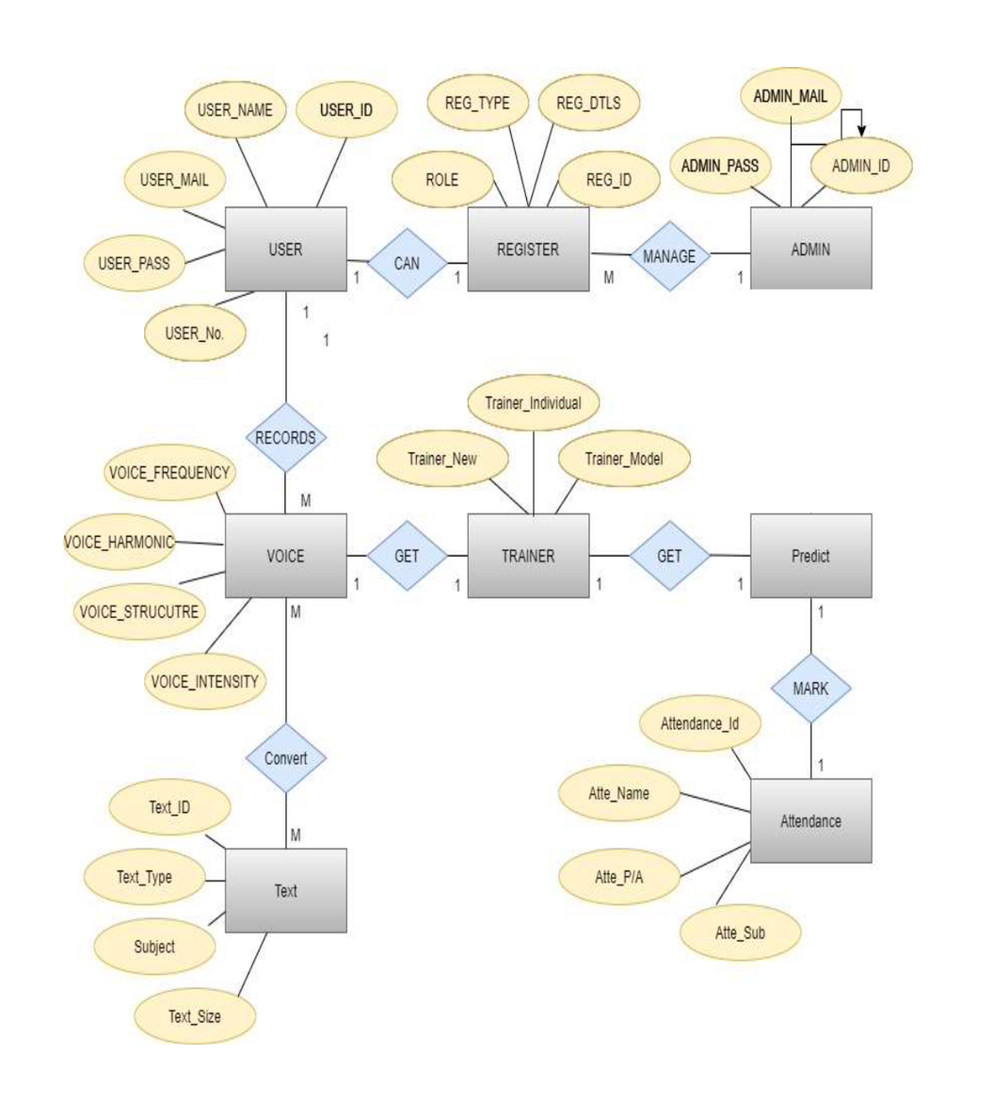
ERD
12

Slide 14
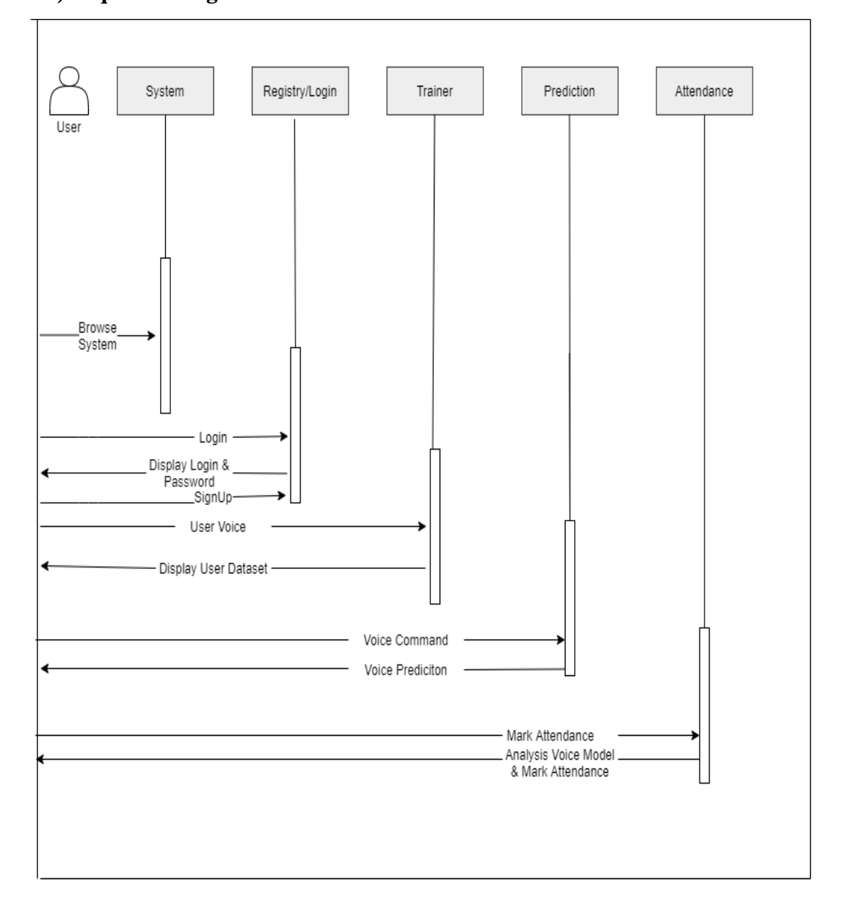
Sequence
Diagram
13

Slide 15
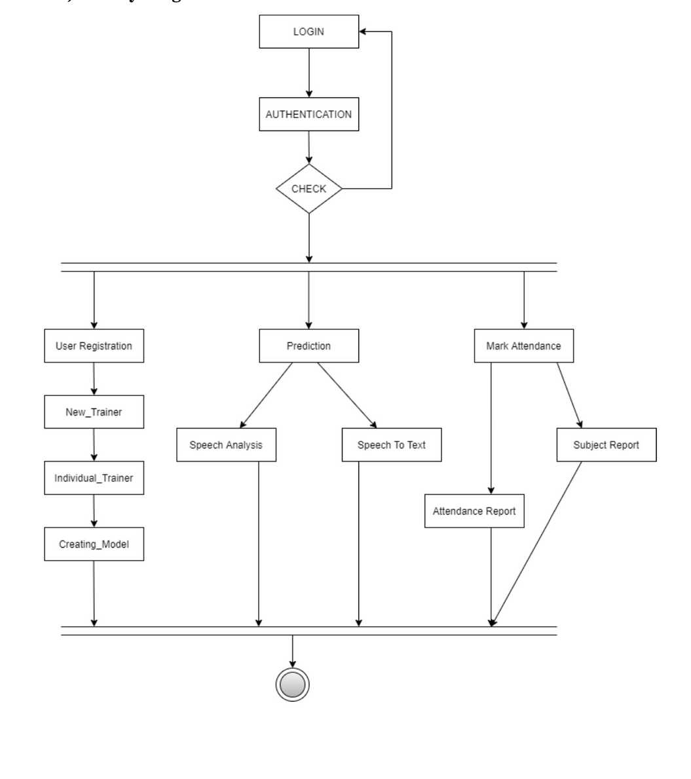
ACTIVITY DIAGRAM
14

Slide 16
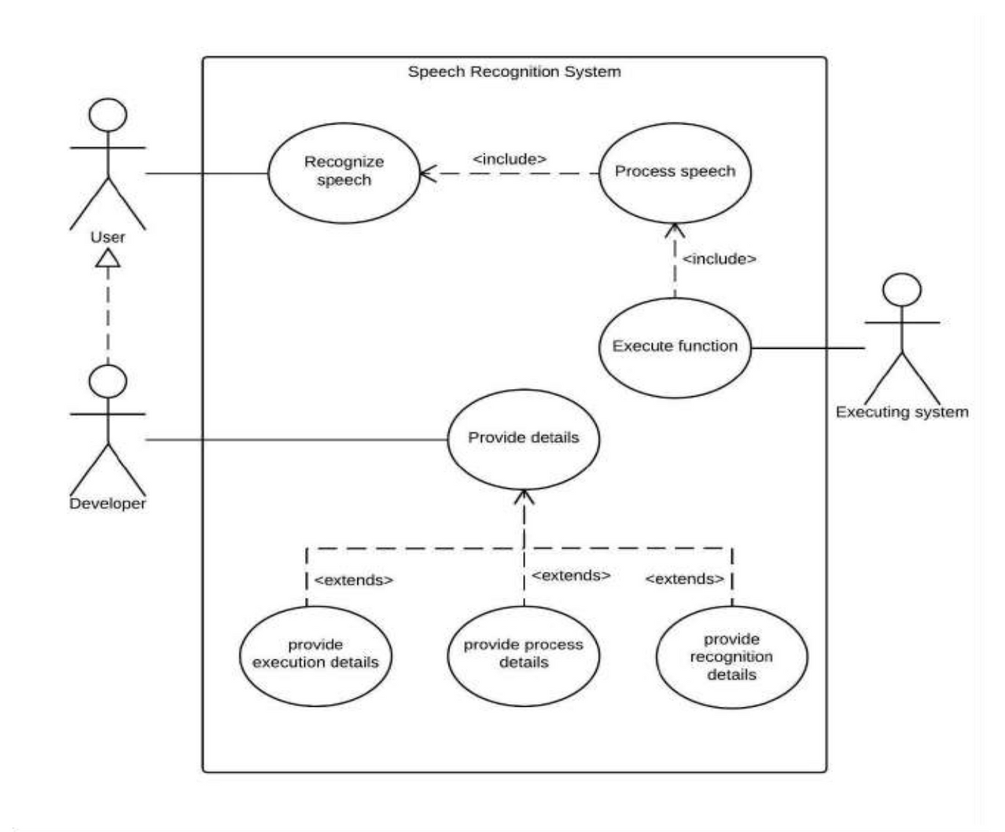
USE CASE
DIAGRAM
15

Slide 17
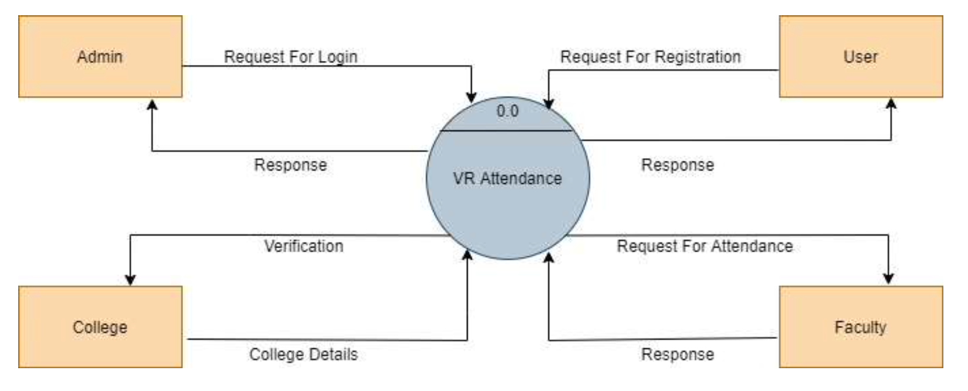
DFD
Level (Context-
Level)
16

Slide 18
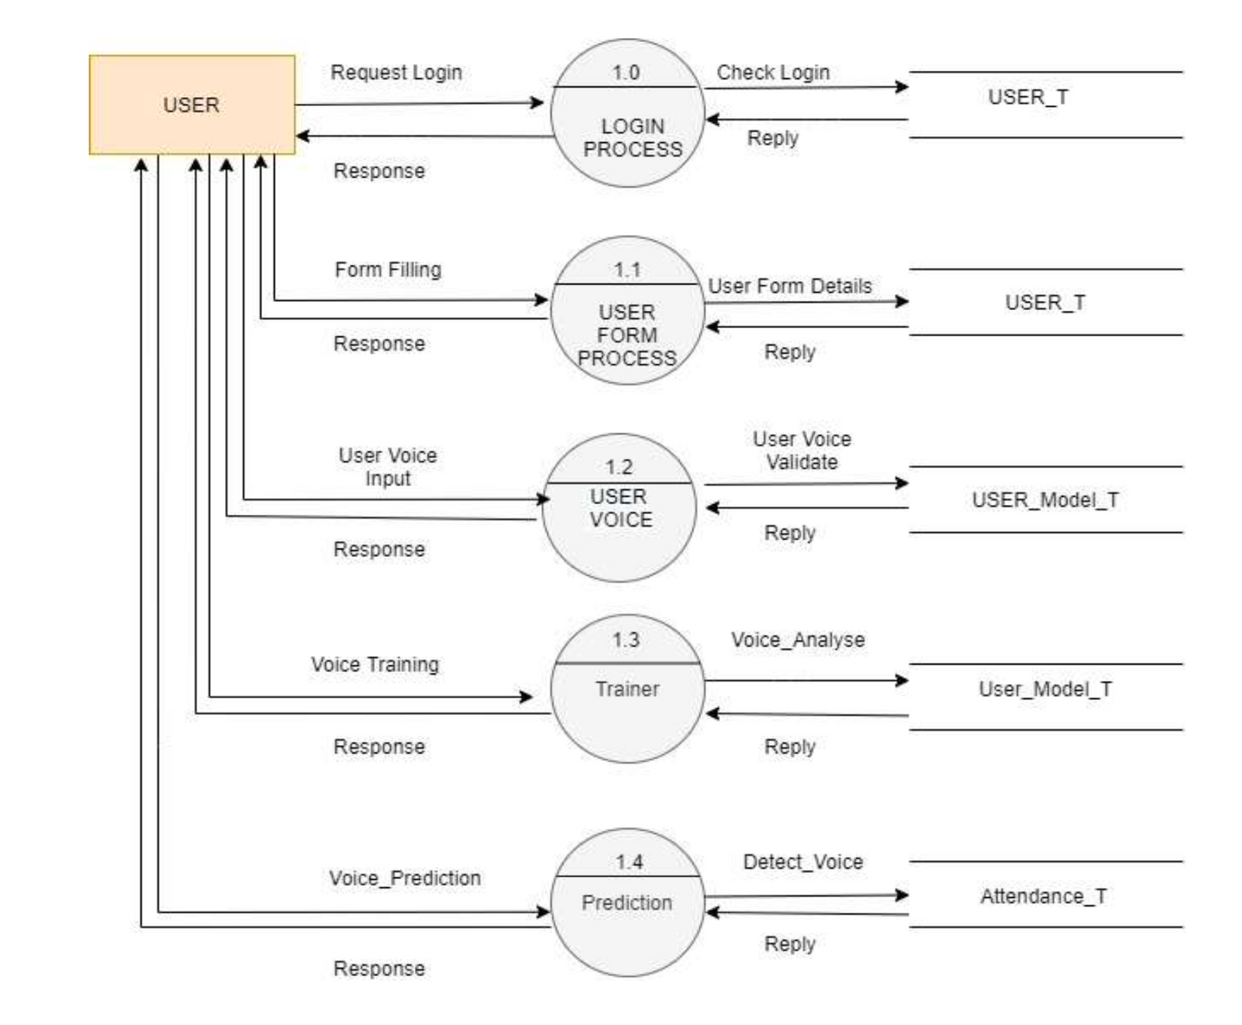
1st level DFD
Level
17

Slide 19
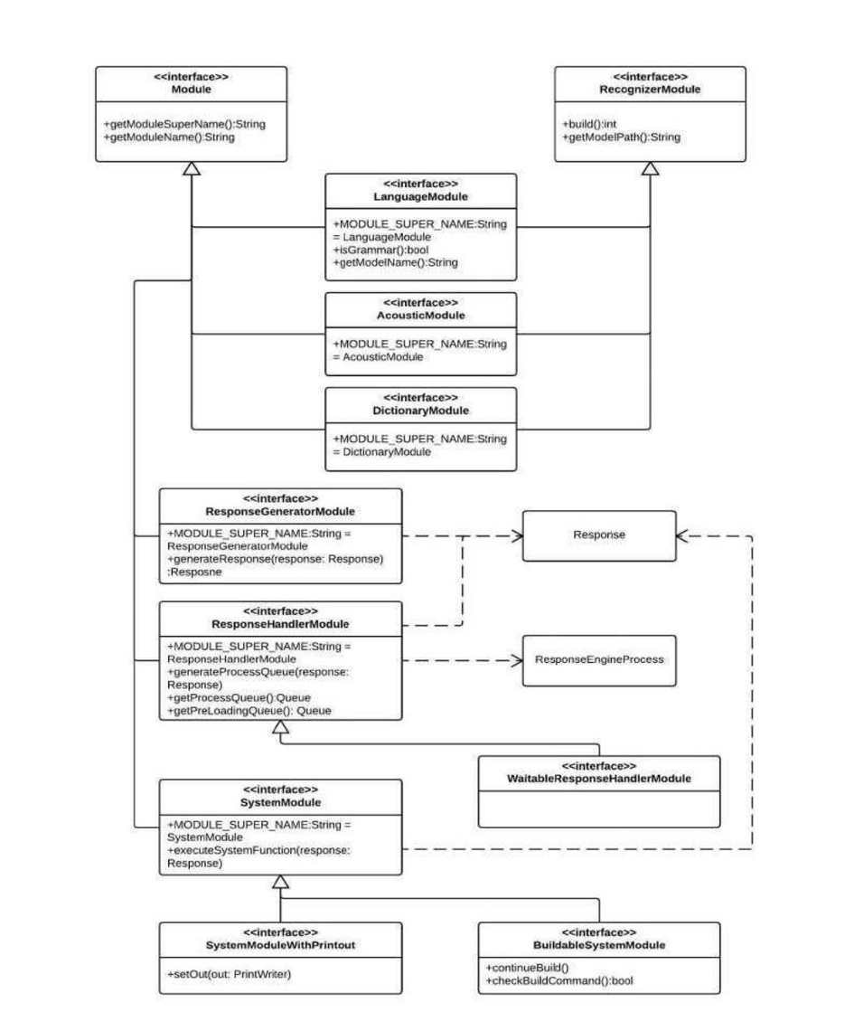
Class Diagram
18

Slide 20






MODULES
Admin
Attendance
VR model
Trainer
User
19

Slide 21
DRWABACKS AND LIMITATION
Accuracy Of prediction
The features maybe respond according to enviorment.
20

Slide 22
FUTURE ENHANCEMENTS
We will be able to create mobile smartphone application in the future.
More Accuracy Rate can be created.
Prediction can be improved
Its capacity to individually identify each person based on their voice input can be expanded further, making the process of granting secure access easy, faster, and more secure than the traditional technique. This can be expanded and utilized in a variety of departments. It would be beneficial to management, for example, in determining professor compensation based on attendance. It could also be beneficial in government workplaces with many elderly staff. They can utilize this model for attendance even when they have lost their fingerprints.
21

Slide 23
CONCLUSION
This project is developed successfully and the performance is found to be satisfactory.
It has been developed in Python and the database built in Excel keeping in mind the specifications of the system.
Manually taking attendance is the traditional way. It takes a long time and is insecure, making it inefficient. Instead of taking student attendance manually, Smart Attendance employing a speech recognition technology is a more efficient way that saves time for teachers. Its ability to take attendance for each person based on their vocal input simplifies and speeds up the procedure when compared to the traditional way. Students must provide voice as input; if any invalid input is recognized, attendance will not be recorded due to authentication failure. As a result, we were able to achieve our desired outcomes with the help of an automatic attendance system, saving a significant amount of productive time. We don't even need any unusual hardware to carry out this procedure. This strategy simplifies attendance management and ensures that attendance is taken accurately. Students, faculty, and administrators can use the website we built to view student attendance based on numerous filters such as a specific class, a specific subject, a certain date, a specific student, and so on. The website allows for simple attendance tracking as well as less paperwork, which saves time and money. It generates several forms of class or student attendance reports automatically. It protects users’ privacy by giving them permissions based on their role.
22

Slide 24

Thank you

