Slide 1
ABC Call Volume Trend
By Yash Shinde
Excel Worksheet :- Click Here to Download
Video Presentation:- Click Here to Watch Video Presentation

Slide 2
Project Description!
In this CX analytics project, we will delve into the world of customer experience by analyzing a dataset spanning 23 days, focusing on the inbound calling team of a company. The dataset contains essential details such as agent information, queue times, call timestamps, call durations, and call statuses. Specifically, we'll spotlight the pivotal role of customer service representatives in managing inbound customer support, aiming to engage and delight customers and foster their loyalty to the business.

Slide 3
Table of Contents
1
2
3
4
Introduction
Analysis
Project description and Tech Stack Used
A. Average Call Duration
B. Call Volume Analysis
C. Manpower Planning
D. Night Shift Manpower Planning
Insights
Conclusion
Summarize the insights and knowledge gained during the project.
Described what I have achieved through the project

Slide 4
-> Excel -> PowerPoint -> Github -> Google Drive
Tech Stack Used :-

Slide 5
A
Average Call Duration
Determine the average duration of all incoming calls received by agents.

Slide 6
Average Call Duration
To find the Average Call Duration first I created a new pivot table using the raw data.
Then, I added Time_Bucket to the rows.
I used Call_Status as a filter for filtering data. Since we have only asked for the call that are answered.
And in values area I have added Call_seconds. And calculated the Average value of Call seconds.
Then finally I got the Average Call Duration of all incoming calls received by agents.
This duration is calculated for each time bucket.

Slide 7
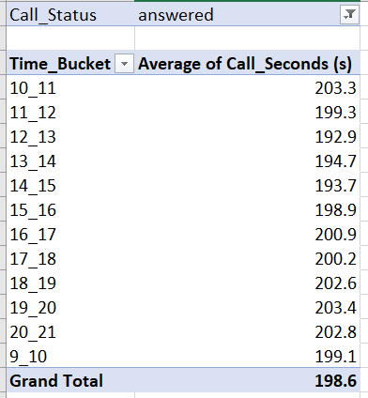
Thus, we have calculated the duration of calls for each time bucket.
Bar Graph of the result table is given below
Average duration of calls between 9am – 21pm is 198.6 seconds.

Slide 8
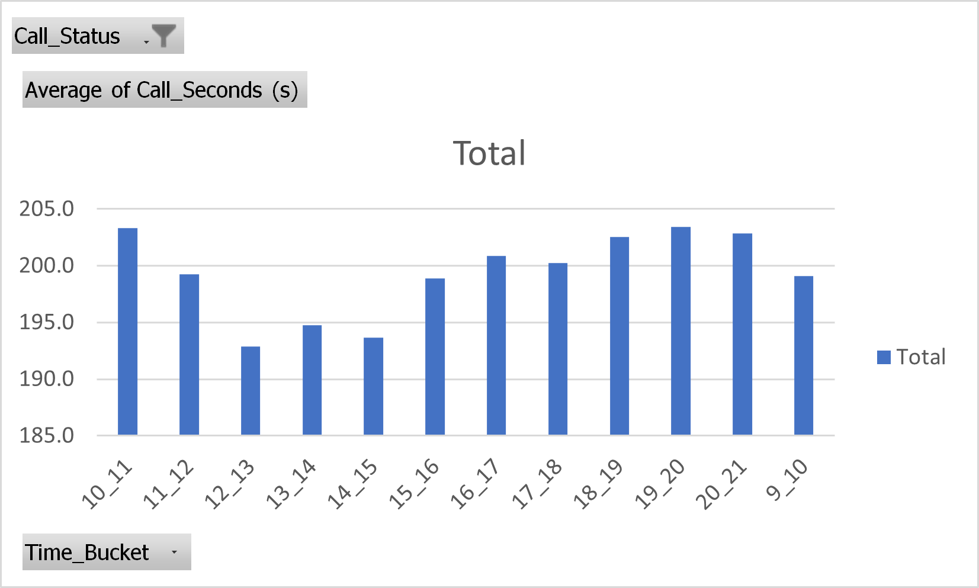
Bar Graph of Average Call Duration

Slide 9
B
Call Volume Analysis
Visualize the total number of calls received.

Slide 10
Call Volume Analysis
To perform Call Volume Analysis first I created a new pivot table using the raw data.
Then, I added Time_Bucket to the rows.
For columns I used Values of Time and Customer_Phone_No.
And in the values area, I have added Time and Customer_Phone_No. And calculated the Count of those variables.
Then finally I got how many calls I made for each time_bucket and what percentage it represents.
This duration is calculated for each time bucket.
Lastly, I have represented the result in the form of Bar Chart.

Slide 11
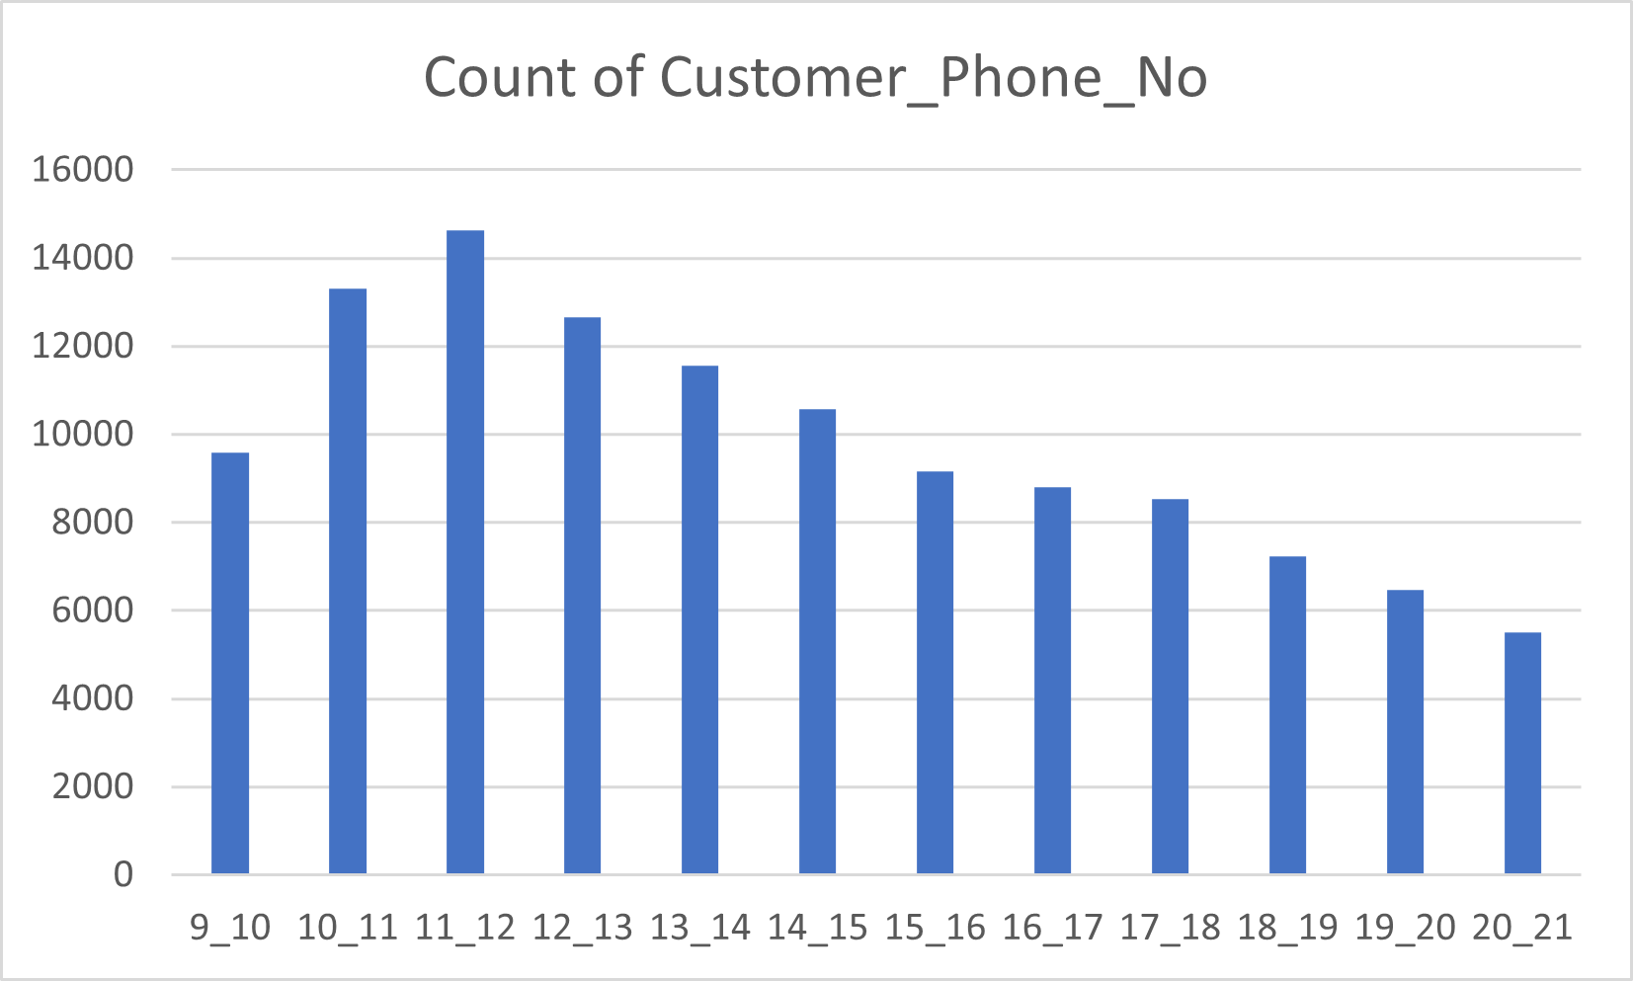
Highest number of calls (i.e., 14626) are received between 11 am – 12 p.m.

Slide 12
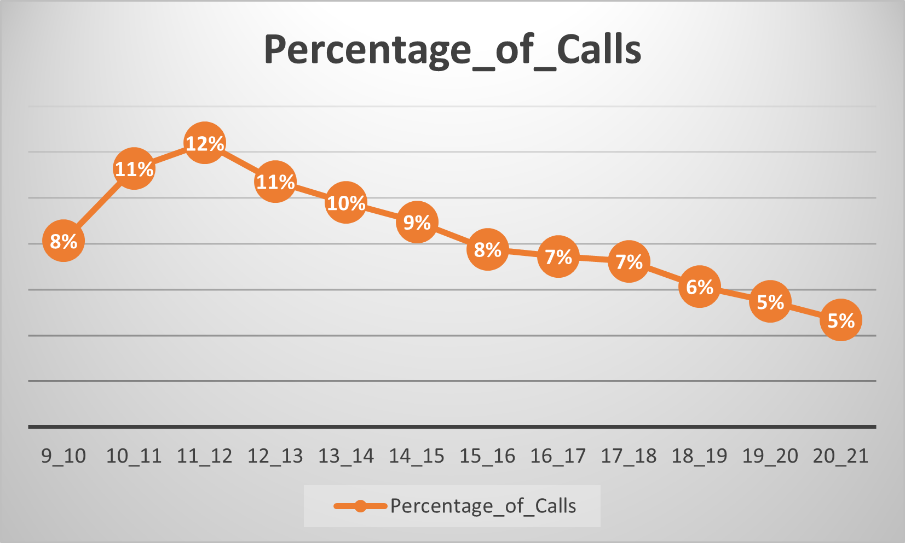
Line Graph of Percentage of Calls
Thus, we have calculated the percentage of calls received in each time bucket.
Here, we can easily see the highest percentage(12%) of calls received between 11am – 12 p.m.

Slide 13
C
Manpower Planning
To calculate the minimum number of agents required in each time bucket to ensure that at least 90 out of 100 calls are answered.

Slide 14
Manpower Planning
First, I have calculated how many hours an agent works on Average daily.
I got that an agent on average works 4.5 hours daily. And they work for a minimum of 20 days in a month.
Then, I created a new pivot table by selecting all the raw data.
Then, I added Time_Bucket to the rows.
For columns I used Values of Sum_of_Queue_Time and Sum_of_Call_Seconds.
Then I calculated the Total_Average_Call_Time by taking addition of Sum_of_Queue_Time and Sum_of_Call_Seconds.
Then I calculated the Agents_Required to Answer 90% of the call using the following formula.
=ROUND(J36*0.9/1800, 0)
Lastly, to find the total number of working persons required per day. I divided the total working hours into two shifts 9am and 12pm
Then total number of agents required to answer 90% of the calls is calculated by finding the max agents needed in between each shift.

Slide 15
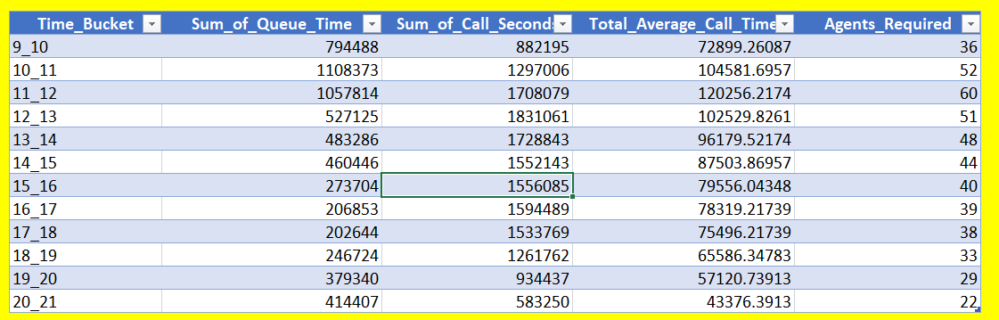
Number of agents needed in each time bucket.

Slide 16
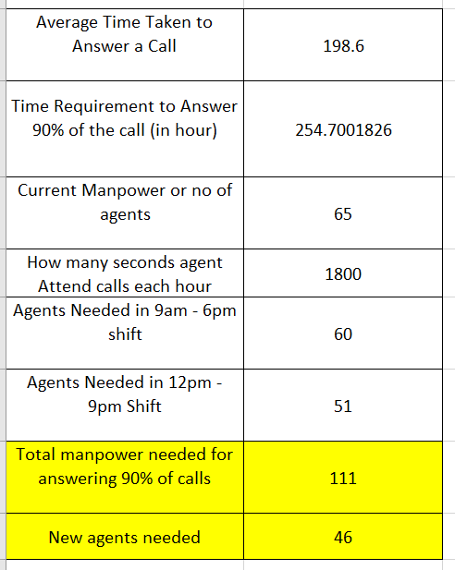
Result
Thus, we have calculated the total manpower needed for answering 90% of calls. i.e., 111
Here, I have calculated the current manpower using the unique function of excel. i.e., 65
Thus, we need to add 46 new agents to answer 90% of the calls.

Slide 17
D
Night Shift Man power Planning
Creating a manpower plan for each time bucket throughout the day, keeping the maximum abandon rate at 10%.

Slide 18
Night Shift Manpower Planning
This is the extended question to the previous question.
Thus, I duplicated the previous sheet and calculated the Night Shift manpower planning.
Then, as we know about 30% of calls are Call Volume at Night(9 PM – 9 AM).
I calculated it by taking 30% of total calls daily.
Then I calculated the Additional Hours Required using the following formula.
=B69*198.6*0.9/3600
Lastly, to find the total number of working persons required for the Night Shift. I divided the additional hours required to answer the calls by the total hours of calls attended by the agents.
Then by using the total calls distribution table given in the question by time_buckets. I calculated the Total_Additional_hours using the following formula.
=$B$70*B81/30
And Lastly calculated the Required_Agents using =D81/0.6 as each agent can be active on call only for 60% of time.

Slide 19
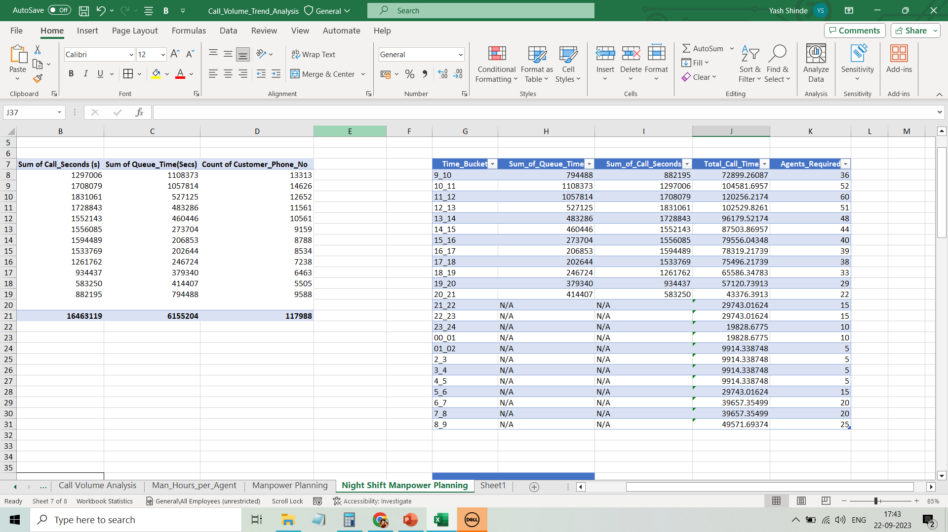
Distribution of Required_Agents across each Time_Bucket

Slide 20
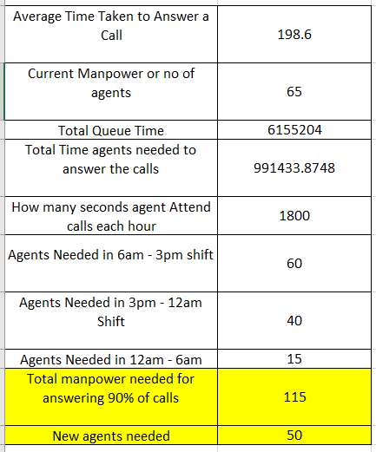
Result
Here I have performed Night Shift Manpower Planning.
Thus, I have calculated the total manpower needed for answering 90% of calls. for all 24 hours. i.e., 115
Here, I have calculated the current manpower using the unique function of excel. i.e., 65
Thus, we need to add 50 new agents to answer 90% of the calls.

Slide 21
Conclusion

Slide 22
Thus, I have completed a Call Volume Trend Analysis.
Given key findings and all meaningful trends or patterns I have discovered.
I have learned to use Excel formulas and Pivot tables to analyze the dataset.
GitHub Repository and drive links are given as follows.
GitHub Repository:- https://github.com/ShindeYash/ABC_Call_Volume_Trend.git
Excel Worksheet:-https://docs.google.com/spreadsheets/d/1hWG8c6Sn37MUcVyXZuUwGw8Fmu5qy9PS/edit?usp=sharing&ouid=104957742252162470359&rtpof=true&sd=true
Drive Link:-https://drive.google.com/drive/folders/1JyZV5MwtrUY1I9D_W0g3Z9wZqXSnaz4G?usp=sharing
Video Presentation:-https://www.loom.com/share/4eaf16e829744f149b0a6bcca5ee9f47?sid=4e1f71fa-4cab-4cc9-8576-3501fcc95af4

Slide 23
Thanks!
Do you have any questions?
yashpradeepshinde@gmail.com
Yash Shinde

