Slide 1
ABC Call Volume Trend
By Yash Shinde
Excel Worksheet :- Click Here to Download
Video Presentation:- Click Here to Watch Video Presentation

Slide 2
Project Description!
In this CX analytics project, we will delve into the world of customer experience by analyzing a dataset spanning 23 days, focusing on the inbound calling team of a company. The dataset contains essential details such as agent information, queue times, call timestamps, call durations, and call statuses. Specifically, we'll spotlight the pivotal role of customer service representatives in managing inbound customer support, aiming to engage and delight customers and foster their loyalty to the business.

Slide 3
Table of Contents
1
2
3
4
Introduction
Analysis
Project description and Tech Stack Used
A. Average Call Duration
B. Call Volume Analysis
C. Manpower Planning
D. Night Shift Manpower Planning
Insights
Conclusion
Summarize the insights and knowledge gained during the project.
Described what I have achieved through the project

Slide 4
-> Excel -> PowerPoint -> Github -> Google Drive
Tech Stack Used :-

Slide 5
A
Average Call Duration
Determine the average duration of all incoming calls received by agents.

Slide 6
Average Call Duration
To find the Average Call Duration first I created a new pivot table using the raw data.
Then, I added Time_Bucket to the rows.
I used Call_Status as a filter for filtering data. Since we have only asked for the call that are answered.
And in values area I have added Call_seconds. And calculated the Average value of Call seconds.
Then finally I got the Average Call Duration of all incoming calls received by agents.
This duration is calculated for each time bucket.

Slide 7
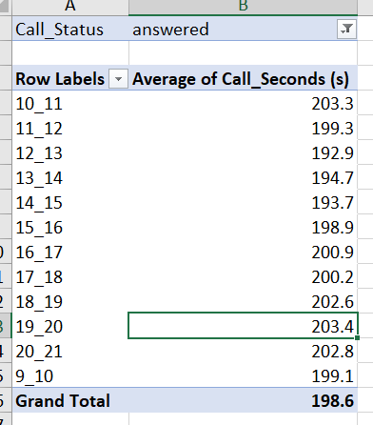

Slide 8
B
Call Volume Analysis
Visualize the total number of calls received.

Slide 9
Call Volume Analysis
To perform Call Volume Analysis first I created a new pivot table using the raw data.
Then, I added Time_Bucket to the rows.
For columns I used Values of Time and Customer_Phone_No.
And in the values area, I have added Time and Customer_Phone_No. And calculated the Count of those variables.
Then finally I got how many calls I made for each time_bucket and what percentage it represents.
This duration is calculated for each time bucket.
Lastly, I have represented the result in the form of Bar Chart.

Slide 10
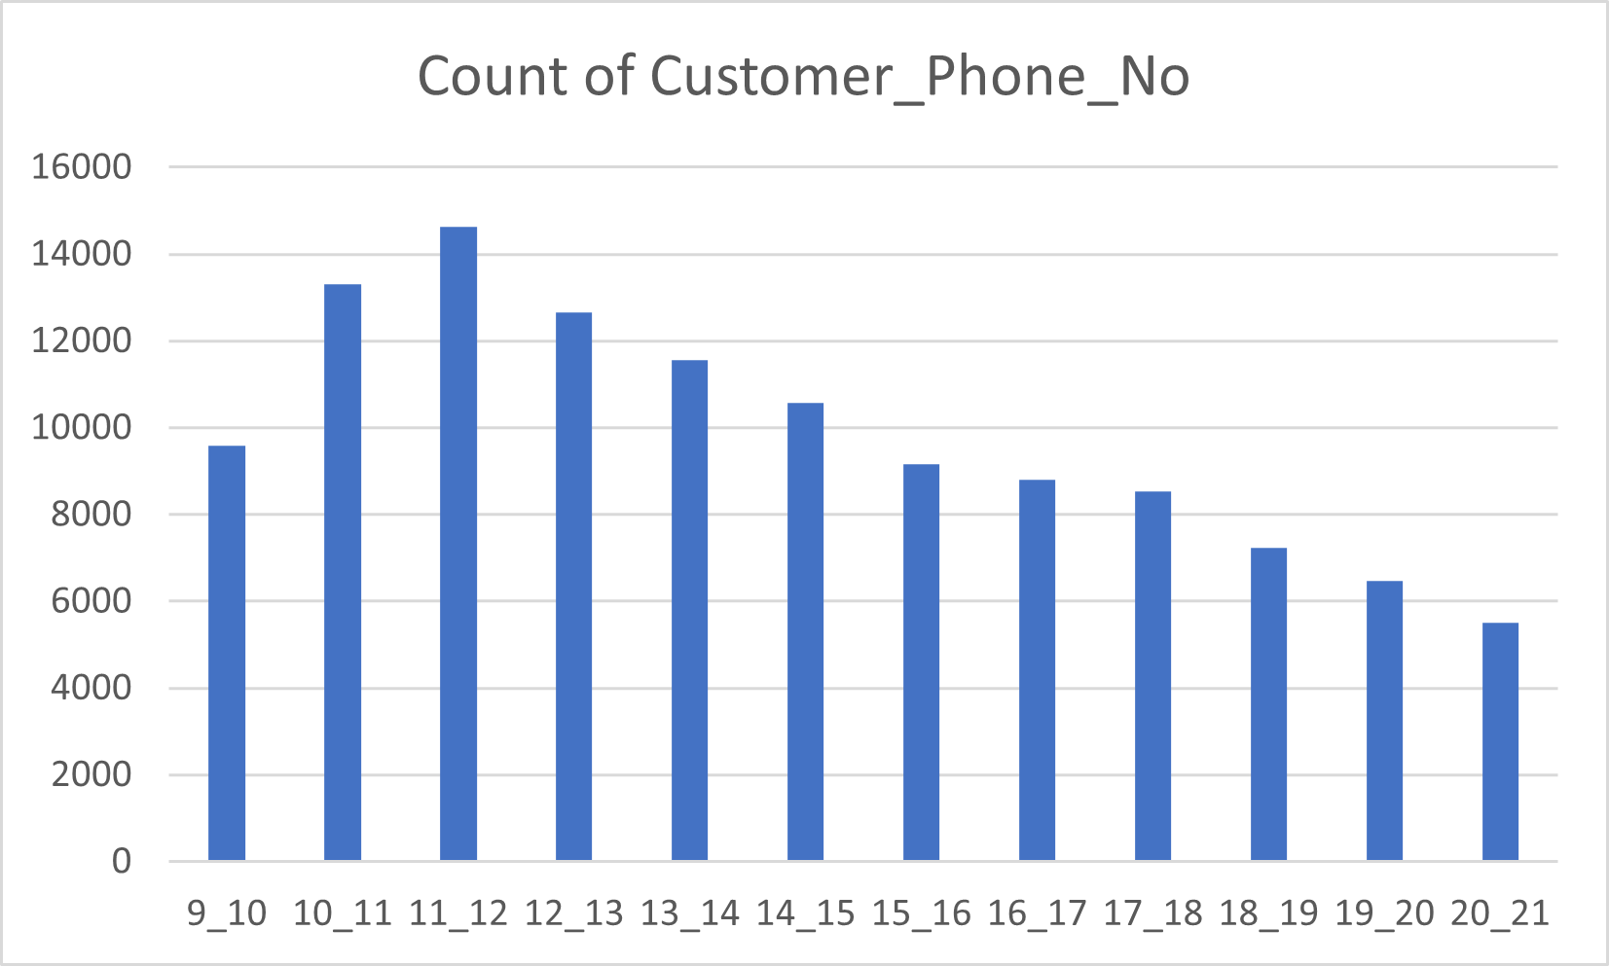

Slide 11
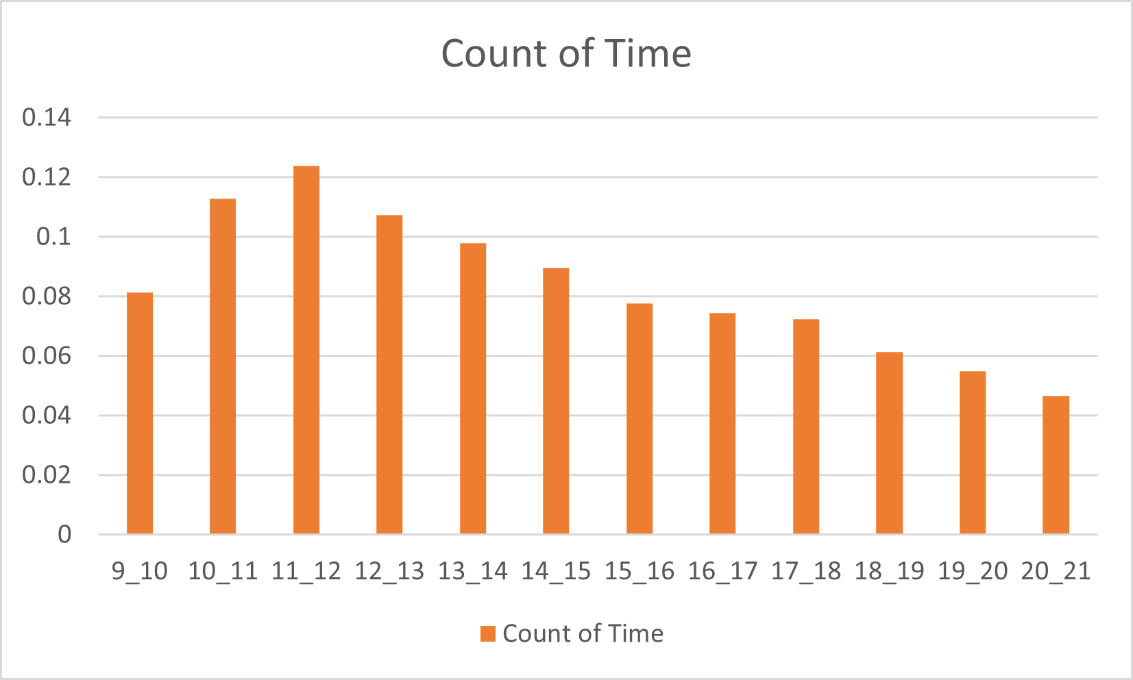

Slide 12
C
Manpower Planning
To calculate the minimum number of agents required in each time bucket to ensure that at least 90 out of 100 calls are answered.

Slide 13
Manpower Planning
First, I have calculated how many hours an agent works on Average daily.
I got that an agent on average works 4.5 hours daily. And they work for a minimum of 20 days in a month.
Then, I created a new pivot table by selecting all the raw data.
Then, I added Date_&_Time to the rows.
For columns I used Values of Duration(hh:mm:ss).
Then I calculated the Average call on a daily basis for all Call_Status types.
Then I calculated the Time Requirement to Answer 90% of the call using the following formula.
=E59*198.6*0.9/3600
Lastly, to find the total number of working persons required per day. I divided the time required to answer 90% of the calls by the total hour calls attended by the agents.

Slide 14
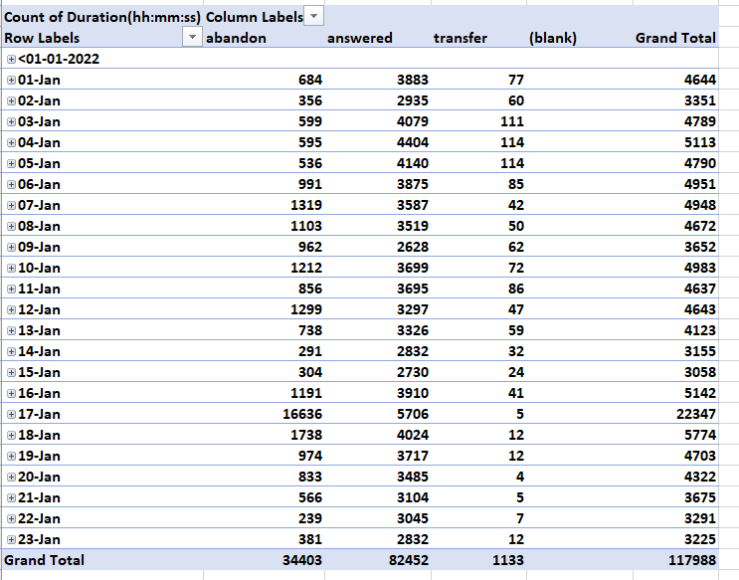

Slide 15
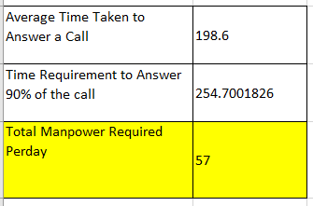
Result

Slide 16
D
Night Shift Man power Planning
Creating a manpower plan for each time bucket throughout the day, keeping the maximum abandon rate at 10%.

Slide 17
Night Shift Manpower Planning
This is the extended question to the previous question.
Thus, I duplicated the previous sheet and calculated the Night Shift manpower planning.
Then, as we know about 30% of calls are Call Volume at Night(9 PM – 9 AM).
I calculated it by taking 30% of total calls daily.
Then I calculated the Additional Hours Required using the following formula.
=B69*198.6*0.9/3600
Lastly, to find the total number of working persons required for the Night Shift. I divided the additional hours required to answer the calls by the total hours of calls attended by the agents.
Then by using the total calls distribution table given in the question by time_buckets. I calculated the Total_Additional_hours using the following formula.
=$B$70*B81/30
And Lastly calculated the Required_Agents using =D81/0.6 as each agent can be active on call only for 60% of time.

Slide 18
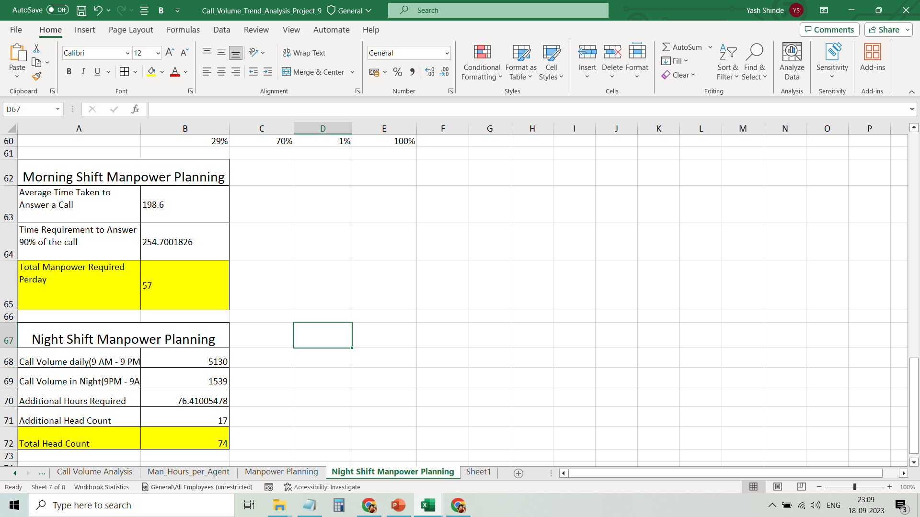

Slide 19
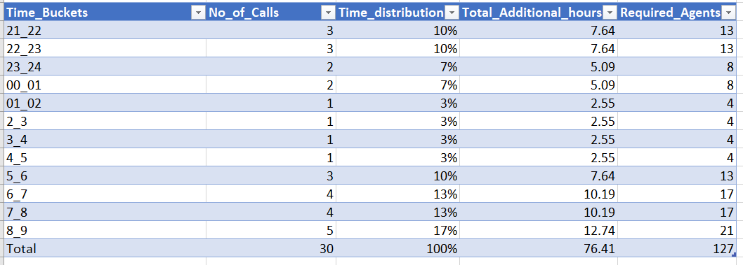
Distribution of Required_Agents across each Time_Bucket

Slide 20
Conclusion

Slide 21
Thus, I have completed a Call Volume Trend Analysis.
Given key findings and all meaningful trends or patterns I have discovered.
I have learned to use Excel formulas and Pivot tables to analyze the dataset.
GitHub Repository and drive links are given as follows.
GitHub Repository:- https://github.com/ShindeYash/ABC_Call_Volume_Trend.git
Excel Worksheet:- https://docs.google.com/spreadsheets/d/1tZ8Ac_lgpyuS8OM-dpL6ROi267wYDAEG/edit?usp=sharing&ouid=104957742252162470359&rtpof=true&sd=true
Drive Link:-https://drive.google.com/drive/folders/1JyZV5MwtrUY1I9D_W0g3Z9wZqXSnaz4G?usp=sharing
Video Presentation:-https://www.loom.com/share/5d2280b814304e439ec37c61cc287731?sid=b3ea99be-43c2-4cd6-88a4-bca75f389587

Slide 22
Thanks!
Do you have any questions?
yashpradeepshinde@gmail.com
Yash Shinde

