Slide 1
Bank Loan Case Study Report
By Yash Shinde
Excel Sheet:- Click Here to Download
Video Presentation:- Click Here to Watch Video Presentation

Slide 2
Project Description!
In this data analytics project, as a data analyst at a finance company specializing in urban loans, my goal is to tackle the challenge of loan default among customers with limited credit history. Through Exploratory Data Analysis (EDA), I will explore the dataset to identify missing data and apply appropriate methods to handle it effectively. My comprehensive EDA will play an important role in enhancing lending decisions and reducing default risks for the company.

Slide 3
Table of Contents
2
1
3
4
Analysis
Introduction
Project description and Tech Stack Used
A. Managing Missing Data
B. Detecting Data Outliers
C. Analyze Data Imbalance
D. Univariate, Segmented Univariate, and Bivariate Analysis
E. Top Correlations for Different Scenarios
Insights
Conclusion
Summarize the insights and knowledge gained during the project.
Described what I have achieved through the project

Slide 4
"Unveiling insights through data analysis to enhance lending decisions and mitigate loan default risks."

Slide 5
A
Managing Missing Data
for each genre, calculated descriptive statistics

Slide 6
Movie Genre Analysis
First I created a new sheet and copied IMDb rating and genre column.
Then I used “Text-to-Columns” feature to make a separate column for the genre.
Then by Using the “UNIQUE” formula selected distinct genres.
Then in the next sheet created a table of those genres as a row & having columns as Average, Median, Mode, Max, Min, Variance and StdDev using the following formulas, respectively.
=AVERAGEIFS('Movie Genre Analysis'!$K$2:$K$5044, 'Movie Genre Analysis'!$J$2:$J$5044, "*" & B6 & "*")
=MEDIAN(IF(ISNUMBER(FIND(B6,'Movie Genre Analysis'!$J$2:$J$5044)),'Movie Genre Analysis'!$K$2:$K$5044))
=MODE(IF(ISNUMBER(FIND(B6,'Movie Genre Analysis'!$J$2:$J$5044)),'Movie Genre Analysis'!$K$2:$K$5044))
=MAX(IF(ISNUMBER(FIND(B6,'Movie Genre Analysis'!$J$2:$J$5044)),'Movie Genre Analysis'!$K$2:$K$5044))
=MIN(IF(ISNUMBER(FIND(B6,'Movie Genre Analysis'!$J$2:$J$5044)),'Movie Genre Analysis'!$K$2:$K$5044))
=VAR.P(IF(ISNUMBER(FIND(B6,'Movie Genre Analysis'!$J$2:$J$5044)),'Movie Genre Analysis'!$K$2:$K$5044))
=STDEV.P(IF(ISNUMBER(FIND(B6,'Movie Genre Analysis'!$J$2:$J$5044)),'Movie Genre Analysis'!$K$2:$K$5044))

Slide 7
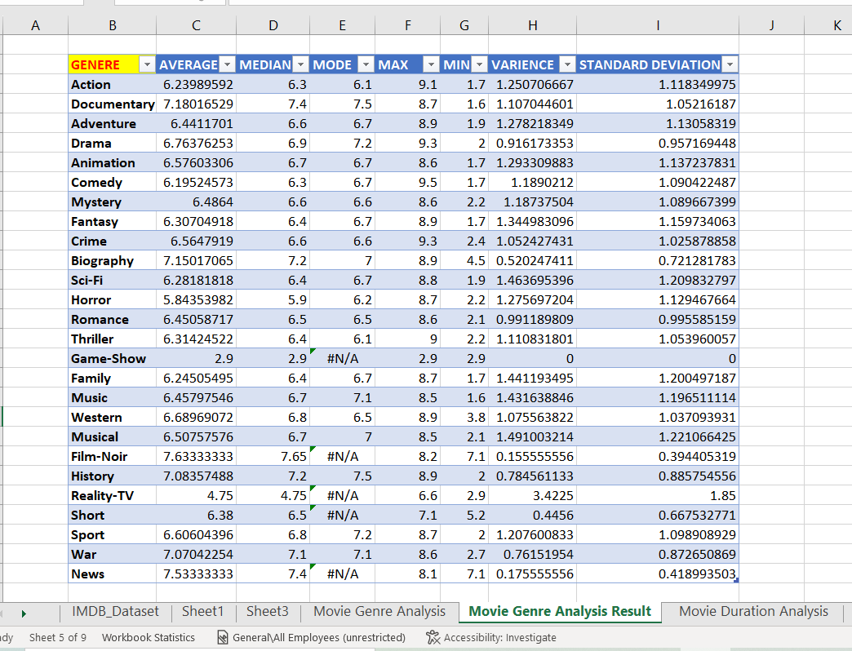
Result Table

Slide 8
B
Detecting Data Outliers
Analyze the distribution of movie durations and its impact on the IMDB score.

Slide 9
Movie Duration Analysis
First I created a new sheet and copied IMDb rating and duration column.
Then by Using the “UNIQUE” formula selected distinct duration as follows.
=SORT(UNIQUE(A2:A5029))
Then I created a table of those durations as a row & having columns as Average, Median and Standard Deviation using the following formulas, respectively.
=AVERAGEIFS($B$2:$B$5029,$A$2:$A$5029, E5)
=MEDIAN(IF($A$2:$A$5029=E5,B2:B5029))
=STDEV.P(IF($A$2:$A$5029=E5,B2:B5029))
Then I created scatter plot named “'AVERAGE', 'MEDIAN', 'STANDARD DEVIATION' by 'DURATION’” in which I also included trend lines.
Scatter Plot is given in the next slide
Trend line shows that

Slide 10
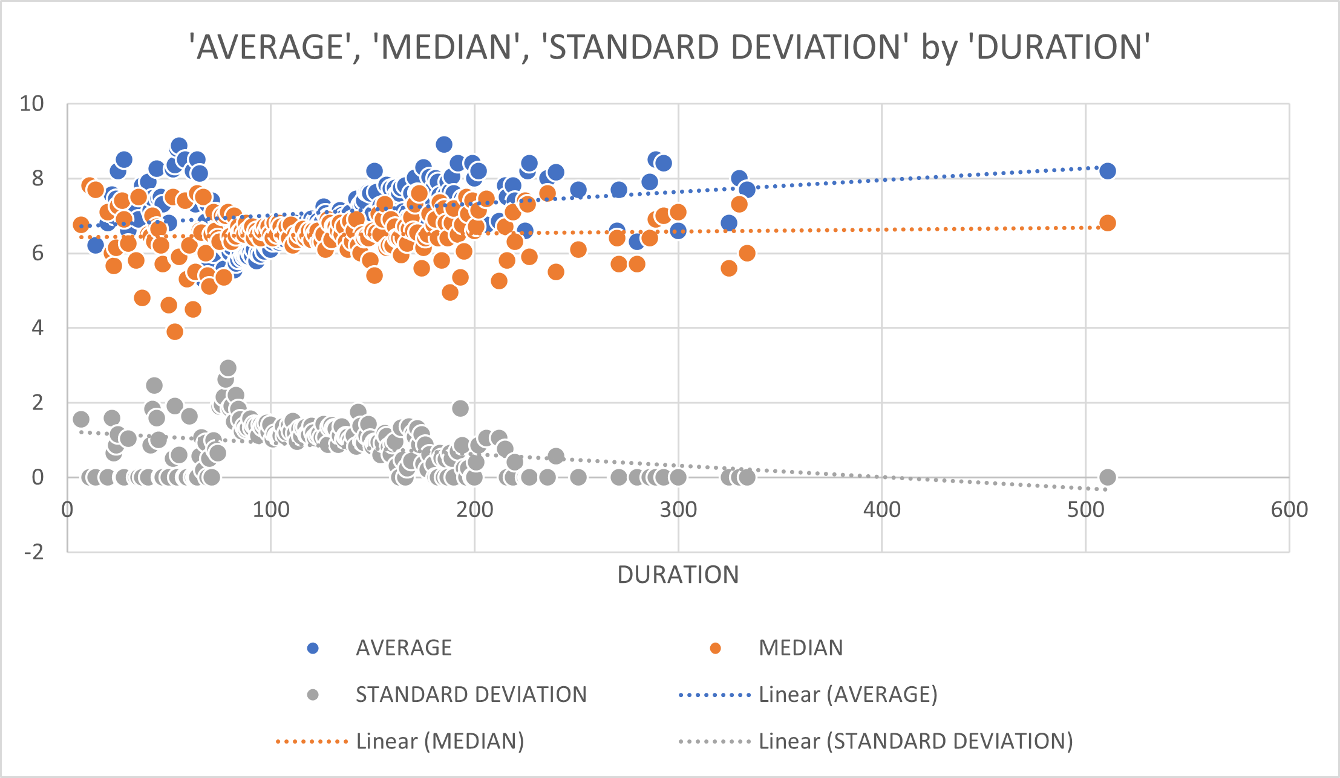
Scatter Plot
Trendline and ScatterPlot show that movies having a duration between 25-200 have more and consistent IMDB score.

Slide 11
C
Analyze Data Imbalance
Determined the most common languages used in movies and analyzed their impact on the IMDB score using descriptive statistics.

Slide 12
Language Analysis
First I created a new sheet and copied IMDb rating and Language column.
Then by Using the “UNIQUE” formula selected distinct Languages as follows.
=UNIQUE(A2:A5032)
Then by using count function I have counted total count of each movie.
=COUNT(IF(A2:A5032=D5,1))
Then I created a table of top 10 languages as a row & having columns as Count, Mean, Median and Standard Deviation using the following formulas, respectively.
=AVERAGE(IF($A$2:$A$5032=[@Language],$B$2:$B$5032))=MEDIAN(IF($A$2:$A$5029=E5,B2:B5029))
=MEDIAN(IF($A$2:$A$5032=[@Language],$B$2:$B$5032))
=STDEV(IF($A$2:$A$5032=[@Language],$B$2:$B$5032))
Then created following graphs which shows that Mean and Median are correlated.
Table and graph is given below.

Slide 13
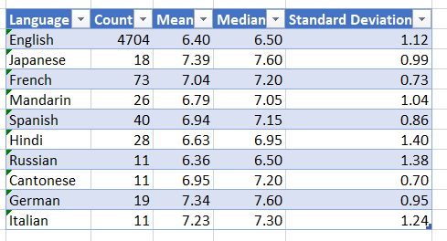
Result Table

Slide 14
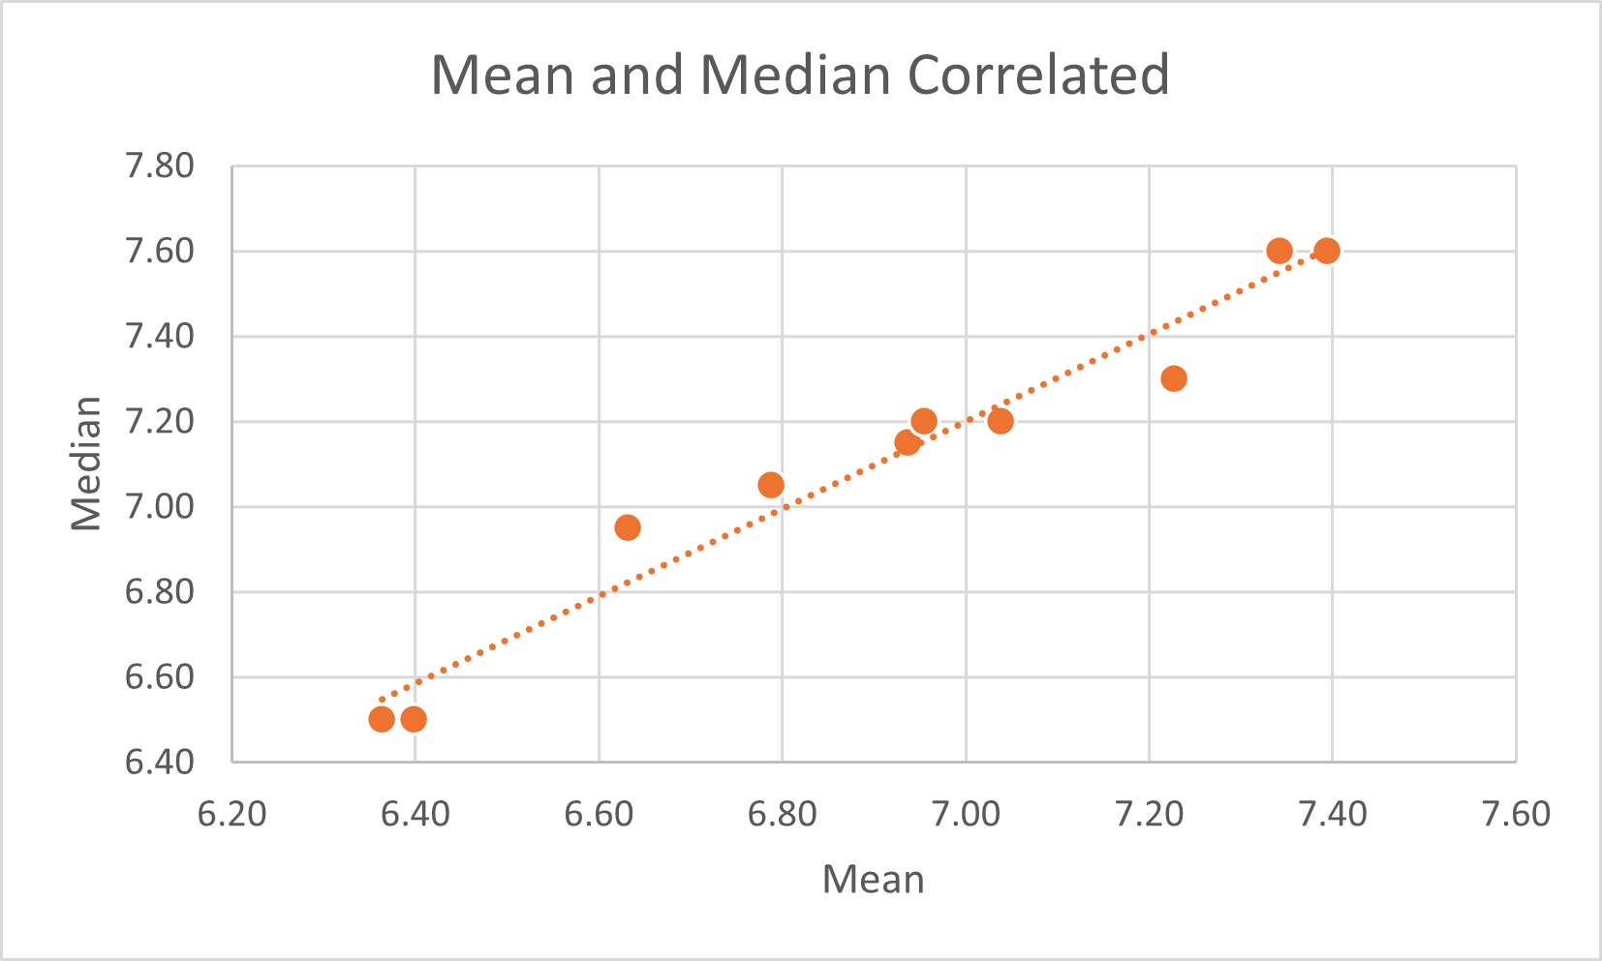
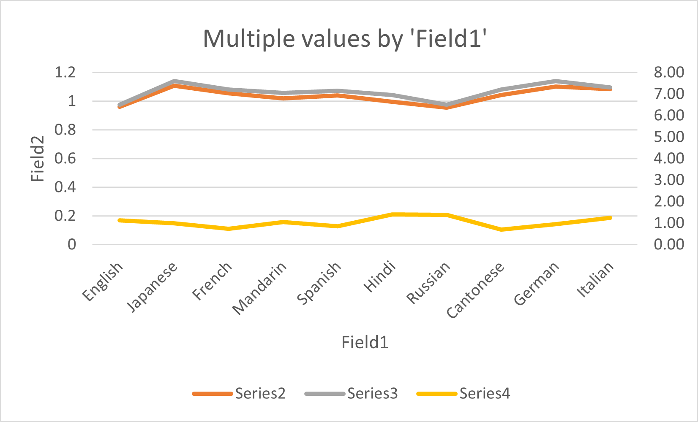
Graphs
Above graphs shows that mean and median are correlated.

Slide 15
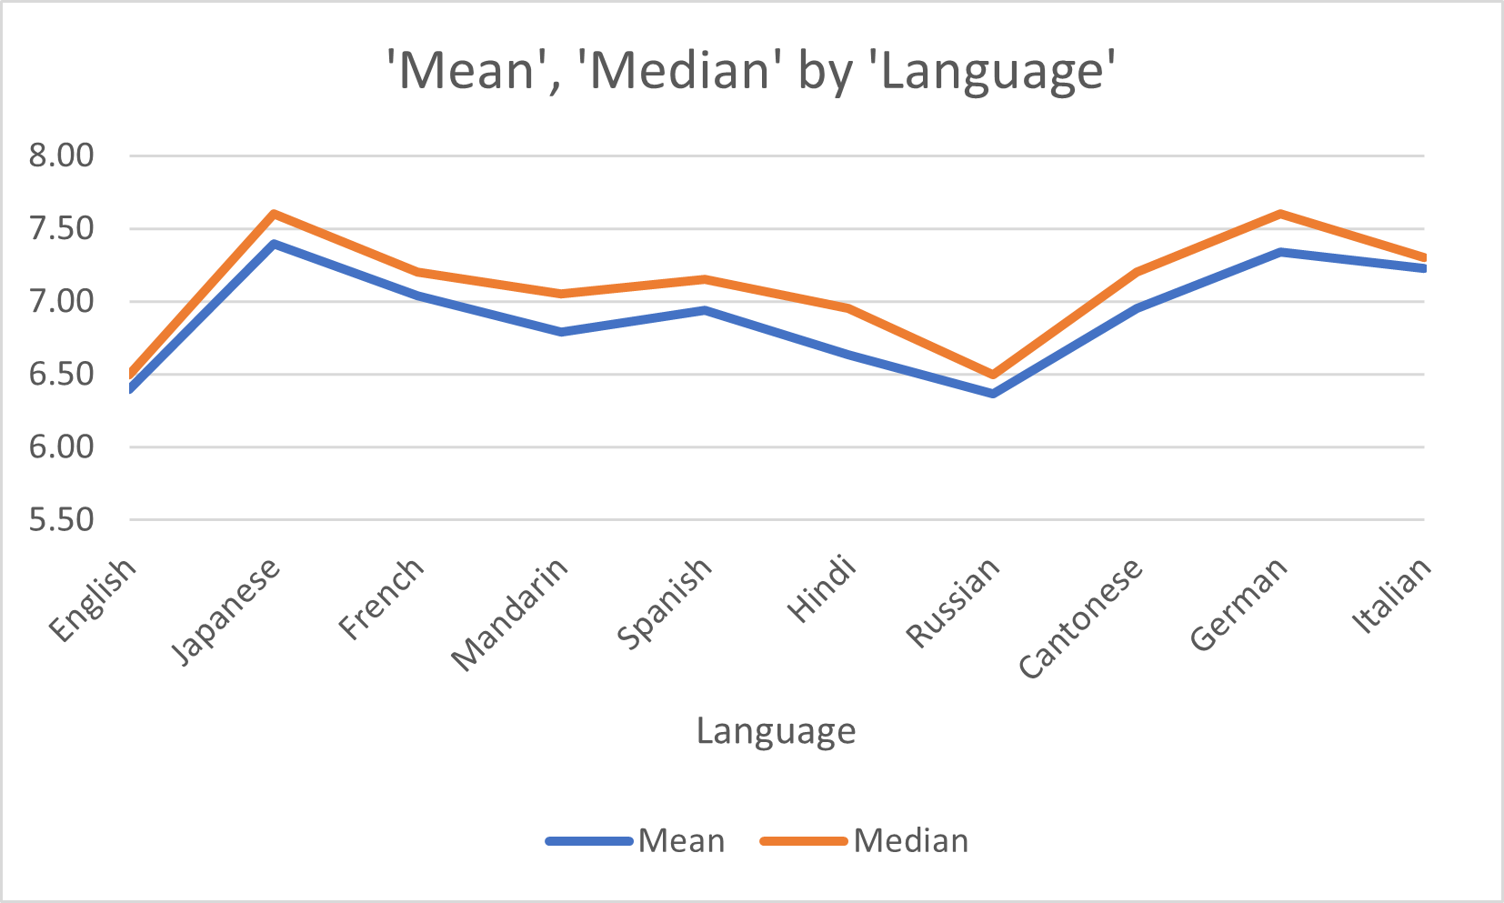
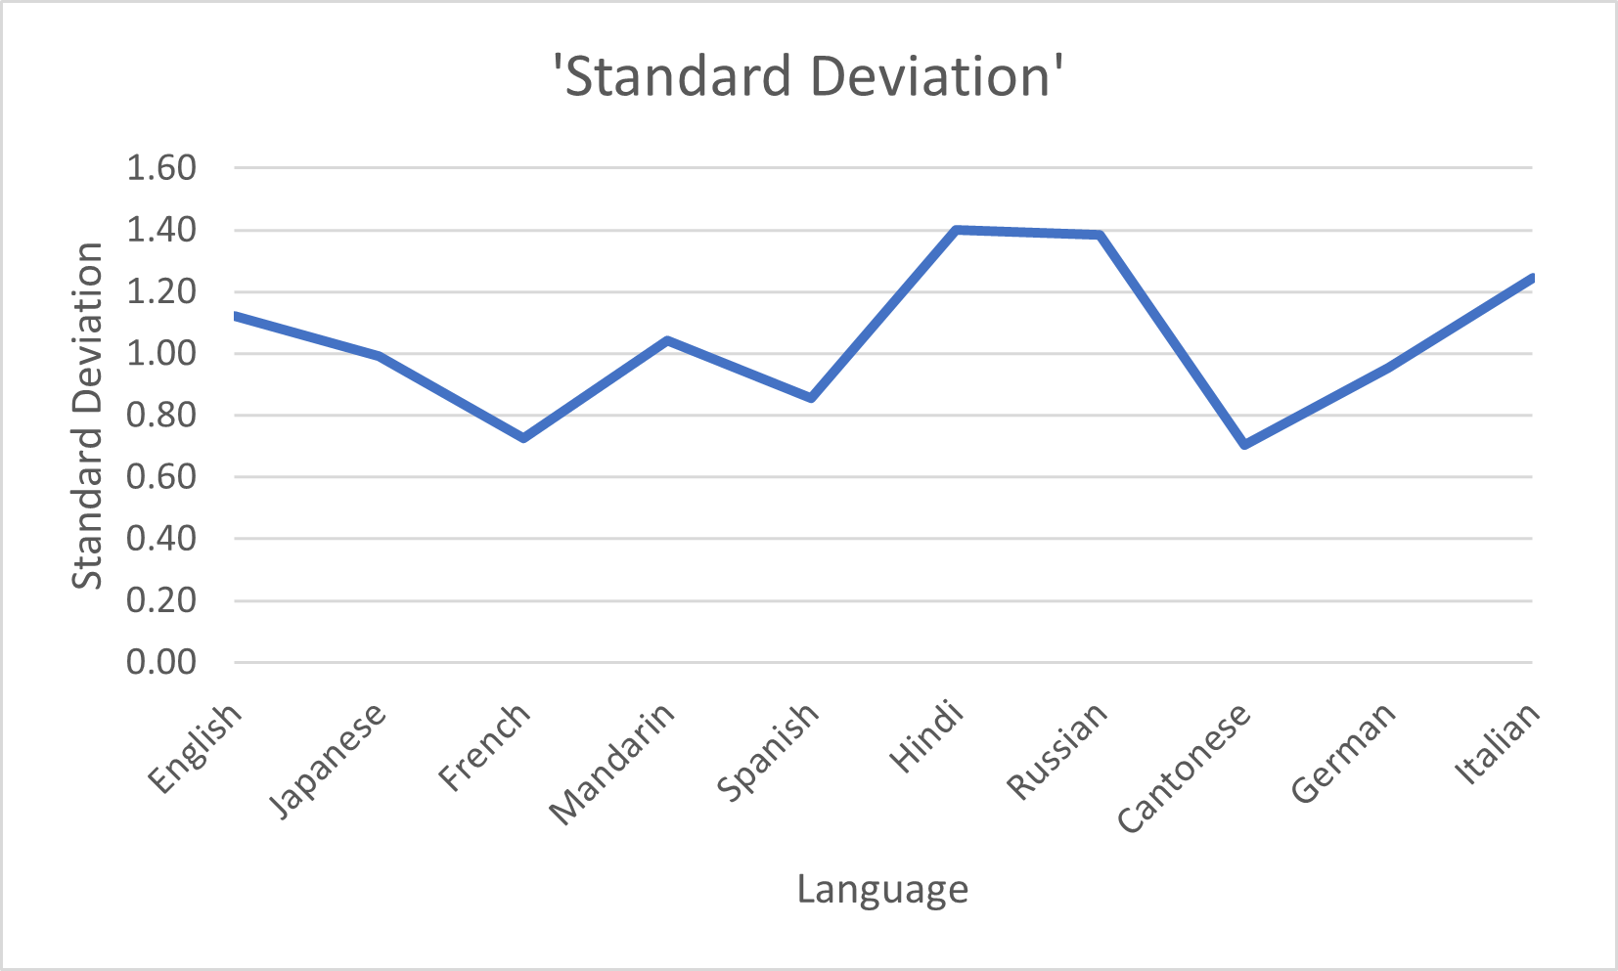
Graphs
Above graph shows that Hindi and Russian language movies have most standard deviation. i.e. IMDB score of Movies in this language are vary too much .

Slide 16
D
Univariate, Segmented Univariate, and Bivariate Analysis
Influence of directors on movie ratings.

Slide 17
Director Analysis
First I created a new sheet and copied IMDb rating and Director name column.
Then by Using the “UNIQUE” formula selected distinct Director Name as follows.
=UNIQUE(A2:A5044)
Then by using AverageIf function I calculated the average IMDB score of each director.
=AVERAGE(IF($A$2:$A$5044=E4,$B$2:$B$5044))
Then I created a table of directors who have at least 3 movies as a row & having columns as Count_of_directors, Rank and Percentile using the following formulas, respectively.
=COUNT(IF($A$2:$A$5044=E4,1))
Then by using Analysis Toolpack in the options founded rank and percentile
Then created following graphs which shows that Mean and Median are correlated.
Table and graph is given below.

Slide 18
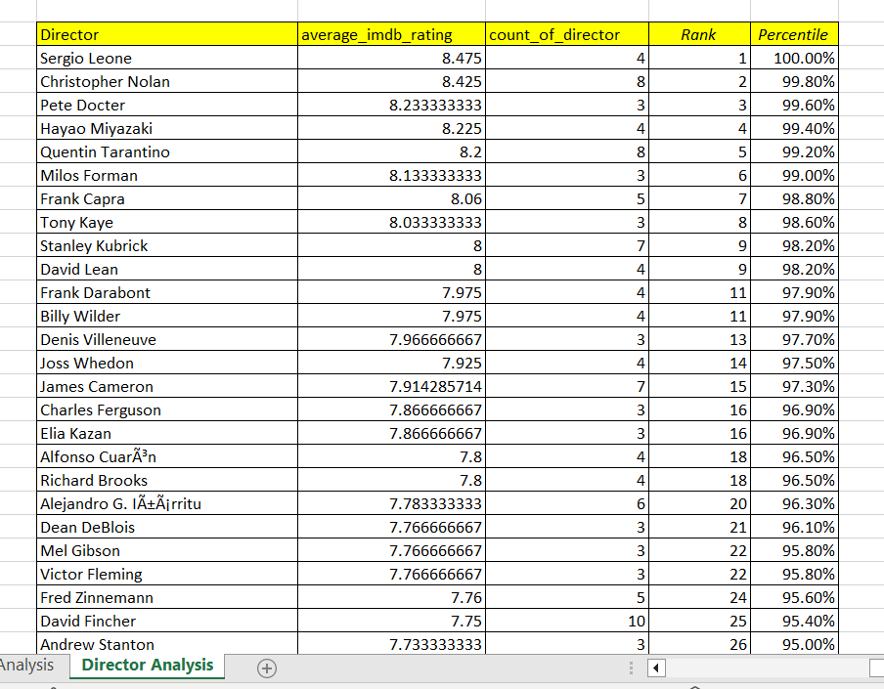
Result Table
Full table Drive Link :- https://docs.google.com/spreadsheets/d/1ipGyTLqC435WaC7R35tTVDKJv3OlgmX2/edit?usp=drive_link&ouid=104957742252162470359&rtpof=true&sd=true

Slide 19
E
Top Correlations for Different Scenarios
The relationship between movie budgets and their financial success

Slide 20
Budget Analysis
First I created a new sheet and copied Budget, Director name and Gross column.
Then I removed the blank entries in the table and performed the following steps.
Then by Using the “CORREL” formula selected calculated the correlation between budget and gross.
=CORREL(Table2[budget],Table2[gross])
Then by using the “=[@gross]-[@budget]” formula I calculated the profit margin of each movie.
Then by using the Max function I calculated the maximum Profit Margin.
=MAX(Table2[profit margin])

Slide 21
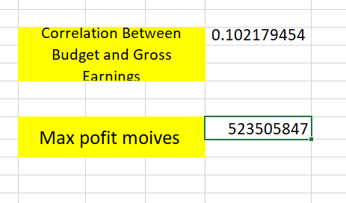
Result
A correlation coefficient close to 0 i.e. 0.102 indicates a weak or no linear relationship between the
budget and Gross Earnings.
Highest profit margin is 523505847 for James Cameron’s movie “AVATAR”.

Slide 22
Conclusion

Slide 23
Thus, I have explored provided IMDB movies Dataset.
Given key findings and all meaningful trends or patterns I have discovered.
I have learned to use Excel to analyze the dataset.
I have learned to gain insights by using Excel Formulas.
All the respective Charts and their output is attached to this report.
GitHub Repository and drive links are given as follows.
GitHub Repository:- https://github.com/ShindeYash/IMDB_Movie_Analysis
Excel Sheet:- https://docs.google.com/spreadsheets/d/1-Z8DUqb3e9oM1rhaQFGrWpMst9T6jaRQ/edit?usp=sharing&ouid=104957742252162470359&rtpof=true&sd=true
Drive Link:- https://drive.google.com/drive/folders/1LL-qQYuRnCb_QW8dXle5u4_k-9tU_jJS?usp=drive_link
Video Presentation:-https://www.loom.com/share/b798e2adfd6b4e20a75ebe48ac3739f4?sid=0a9dd469-1fa9-481a-a394-6198a1c28c42

Slide 24
Thanks!
Do you have any questions?
yashpradeepshinde@gmail.com
Yash Shinde

