Slide 1
Community Benefits Navigator
Indian Government Welfare Schemes AI Assistant
Built with NVIDIA Nemotron-3-Super + Multi-Query RAG
Vinayak Rao Patil Shinde
GitHub: @shindevrp
Track 1: Community Benefits Navigator NVIDIA + DataHack Summit 2026
Notes:
Welcome everyone. Today I'm presenting the Community Benefits Navigator — an AI assistant for Indian government welfare schemes built with NVIDIA Nemotron-3-Super.
This app helps farmers, students, women, and low-income families discover what welfare schemes they qualify for, how to apply, and compare options — all in their preferred language.

Slide 2
The Problem
▸ 60+ central welfare schemes — each with different eligibility, documents, and application process
▸ Farmers, women, students, and low-income families struggle to discover what they qualify for
▸ Scheme information is spread across multiple government portals in different formats
▸ AI assistants hallucinate or give generic answers — no source confidence
▸ Language barrier: most information is English-only, excluding Hindi/bilingual users
Notes:
The problem: India has 60+ central welfare schemes spread across different portals. Each has different eligibility criteria, required documents, and application processes. Most information is English-only. People don't know what they qualify for or where to start.

Slide 3
The Solution
▸ Multi-Query RAG: decomposes broad questions into sub-queries for complete coverage
▸ Nemotron-3-Super (via OpenRouter) handles 6 distinct roles: answer, explain, compare, summarize, FAQ, recommend
▸ Data-driven JSON rule engine — new schemes require zero code changes
▸ Self-rated confidence scores via embedded JSON extraction
▸ Full i18n: English + Hindi (Telugu/Tamil/Bengali/Marathi fallback)
▸ Voice input, dark mode, session history, PDF download
Notes:
Our solution: A multi-query RAG system using Nemotron-3-Super. The app decomposes broad questions into targeted sub-queries, retrieves relevant documents from ChromaDB, and generates responses with confidence scores.
Key features: 6 LLM roles, data-driven rule engine, full i18n, voice input, dark mode.

Slide 4
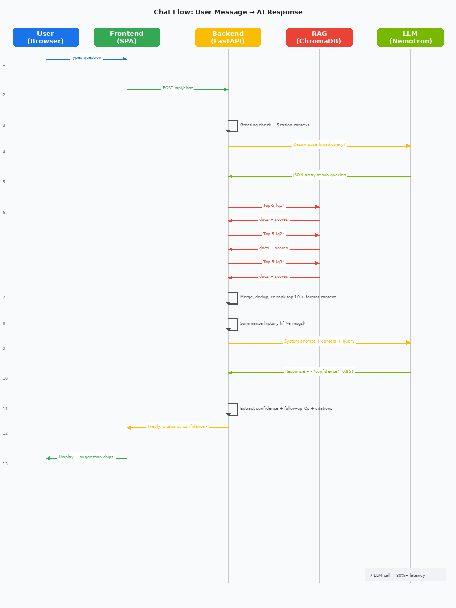
Architecture
User → FastAPI Backend → Query Decomposition → Multi-Query ChromaDB Retrieval | → Merge & Deduplicate → Nemotron-3-Super (OpenRouter) → Response + Confidence
Notes:
Here's the architecture. User sends a query → FastAPI backend → query decomposition (2-4 sub-questions) → multi-query ChromaDB retrieval → merge & deduplicate → Nemotron generates final answer with confidence score.
The LLM has 6 distinct roles via different prompts: answering, eligibility checking, comparison, recommendation, FAQ, and summarization.

Slide 5
Key Features
Chat
Eligibility
Schemes
Compare
Multi-turn conversation with query decomposition Suggested question chips, voice input Session history sidebar
Age + income + demographics form Rule-engine matching + AI explanation PDF download of results
Browse/search all 60+ welfare schemes Click for full details (benefits, docs, portal) Multi-language names
Side-by-side table compare AI Compare with Nemotron recommendations Joint-applicability check
+ CSC Locator (Leaflet map) | Dark Mode | Multi-Language (6 languages) | PDF Reports | One-Click Docker Deploy
Notes:
Let me walk through the key features. Chat tab for conversation, Eligibility tab with form + AI explanation, Schemes browser with search, Compare tab with both table and AI comparison, and CSC Locator for finding help centers.
Plus dark mode, 6 languages, voice input, PDF download, and Docker one-click deploy.

Slide 6
Live Demo Walkthrough
1. Chat Tab — Ask "What schemes am I eligible for?" — see multi-query decomposition in action
2. Eligibility Tab — Enter age 35, income 1.2L — see matched schemes + AI explanation button
3. Schemes Tab — Browse/search, click any scheme for full details (benefits, docs, helpline)
4. Compare Tab — Pick two schemes, click Compare (table) then AI Compare (Nemotron)
5. Language — Switch to Hindi → all UI + responses translate instantly
6. CSC Locator — Search "Pune" → see nearby Common Service Centres on Leaflet map
7. Extra — Toggle dark mode, use voice input, download eligibility PDF, view session history
Notes:
Now let me show you the live demo. I'll start with a chat query, show eligibility checking, browse schemes, compare two schemes, switch to Hindi to show i18n, and finally search for a CSC on the map.
I'll also toggle dark mode and show voice input briefly.

Slide 7
Tech Stack
Backend
Frontend
Infra
• FastAPI
• ChromaDB (vector store)
• Sentence Transformers (E5-small)
• OpenRouter (Nemotron-3-Super)
• Vanilla JS + CSS
• Leaflet.js (CSC map)
• html2pdf.js (PDF export)
• Web Speech API (voice input)
• Python 3.11 + Uvicorn
• Docker + Docker Compose
• Setup.sh auto-configure
• CORS + session middleware
Why Vanilla JS: app under 1300 lines, framework overhead not justified. One model handles 6 roles via different prompts.
Notes:
Tech stack: FastAPI backend with ChromaDB vector store, Sentence Transformers for embeddings, OpenRouter for Nemotron-3-Super access. Frontend is vanilla JS under 1300 lines.
Docker Compose for one-command deployment. Setup.sh for auto-configuration.

Slide 8
Key Highlights
★ Query Decomposition: "What am I eligible for?" → 4 sub-queries → full coverage
★ Multi-Role LLM: Same Nemotron model answers, explains, compares, recommends, summarizes
★ Self-Rated Confidence: JSON regex extraction, no separate API call, transparent to user
★ Data-Driven: Add a new scheme JSON → zero code changes needed anywhere
★ OpenRouter Free Tier: ~$0/month during dev, switch to direct NIM for production
★ SVG Mic Icons: Open-source, respects dark/light mode via currentColor
★ Full i18n: 90+ UI strings translated, data-i18n attributes on all static HTML
★ One-Click Deploy: Docker Compose with persistent ChromaDB volume
Notes:
Key highlights: The same LLM handles 6 roles via different prompts. Query decomposition ensures complete coverage. Self-rated confidence is transparent. Adding a new scheme requires zero code changes.
OpenRouter free tier saved ~$100/month during development. For production, switch to direct NVIDIA NIM deployment.

Slide 9
Links & Submission
GitHub Repository
https://github.com/shindevrp/meetup-nvidia-nemotron-3-super
Submission Directory
track_1_community_benefits_navigator/shinde_vinayak_rao_patil/
Quick Start
git clone ... → cd backend && cp .env.example .env && bash setup.sh → uvicorn main:app Or: docker compose up --build
YouTube Demo | Blog Post | LinkedIn — (links in README)
Notes:
Here are the links to the GitHub repository and submission directory. The README has full documentation including the architecture diagram.
Quick start: clone the repo, run setup.sh, and start with uvicorn. Or use Docker Compose for a fully containerized setup.

Slide 10
Thank You
Questions? Feedback?
Vinayak Rao Patil Shinde | @shindevrp | NVIDIA + DataHack Summit 2026
Notes:
Thank you for watching! Happy to answer any questions. This project was built for the NVIDIA + DataHack Summit 2026 hackathon.

