Slide 1
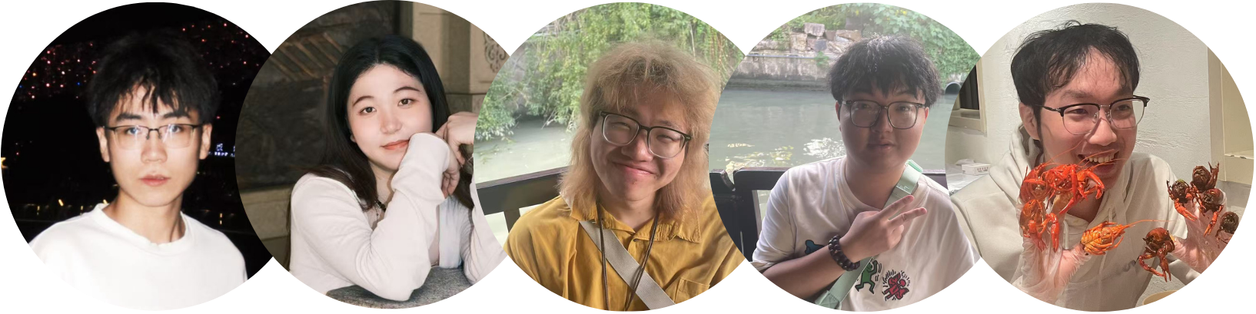
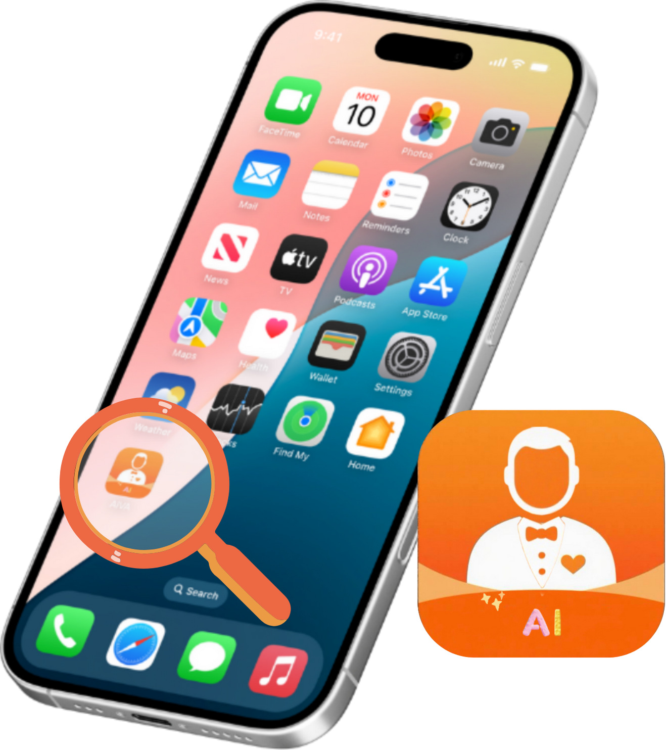
Generatiive Al in life steward –– AIVA
Project Members: Kejie Ren (2254448), Mengxuan Shen (2252176),
Haiqi Shen (2254119),Changbo Wang (2251958), Jinghao Zhang (2257366)
Group Number: 62 Module Name: CPT208 Human-Centric Computing
Submission Date: 2025/5/9
Reporter：Mengxuan Shen 2252176

Slide 2
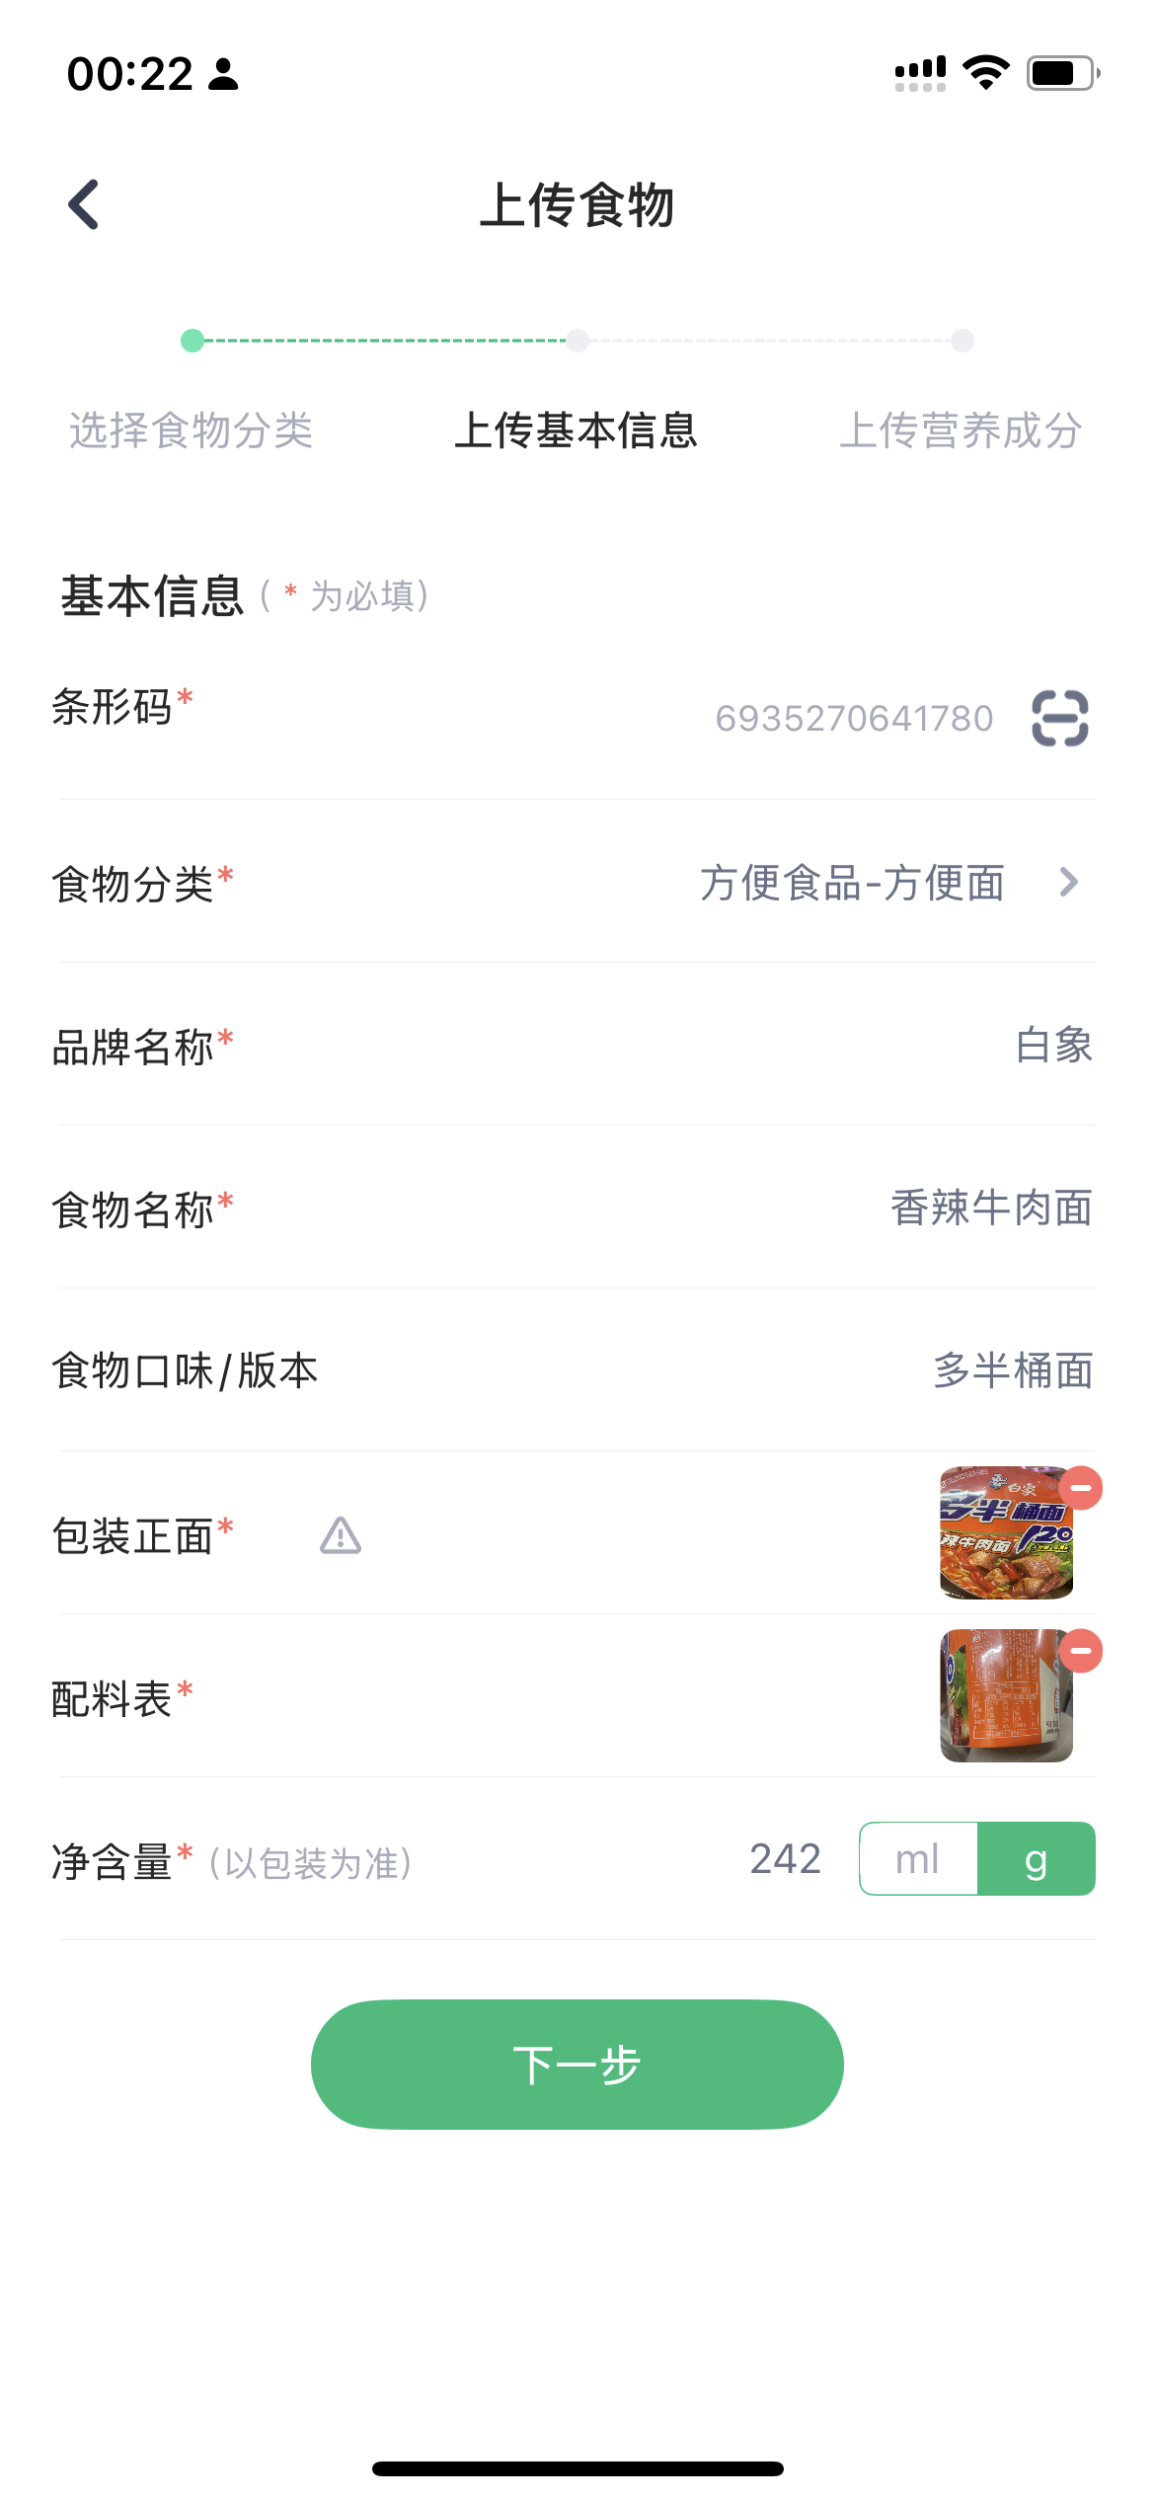
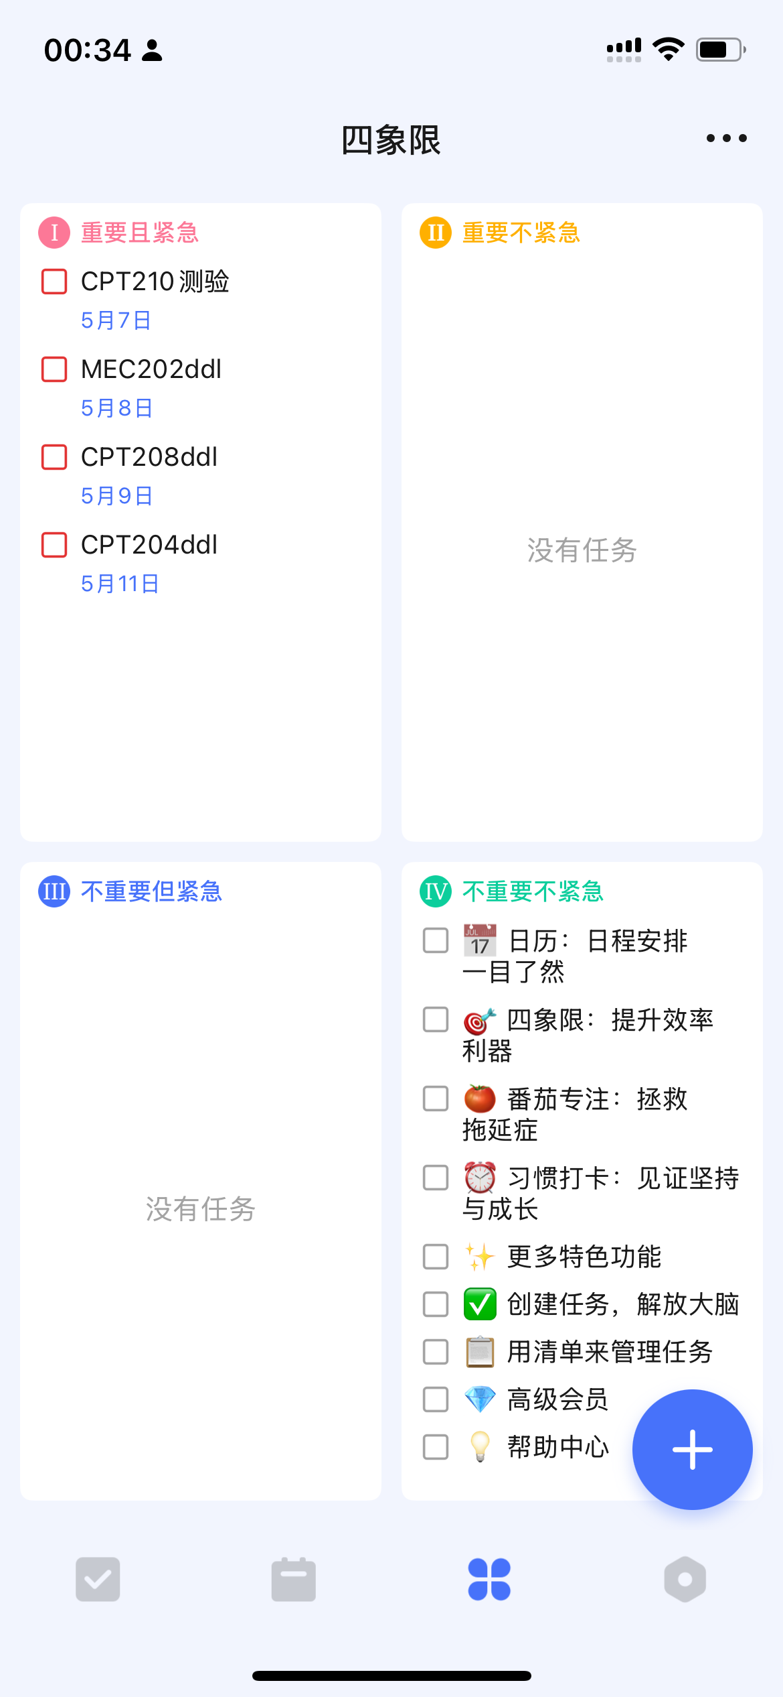
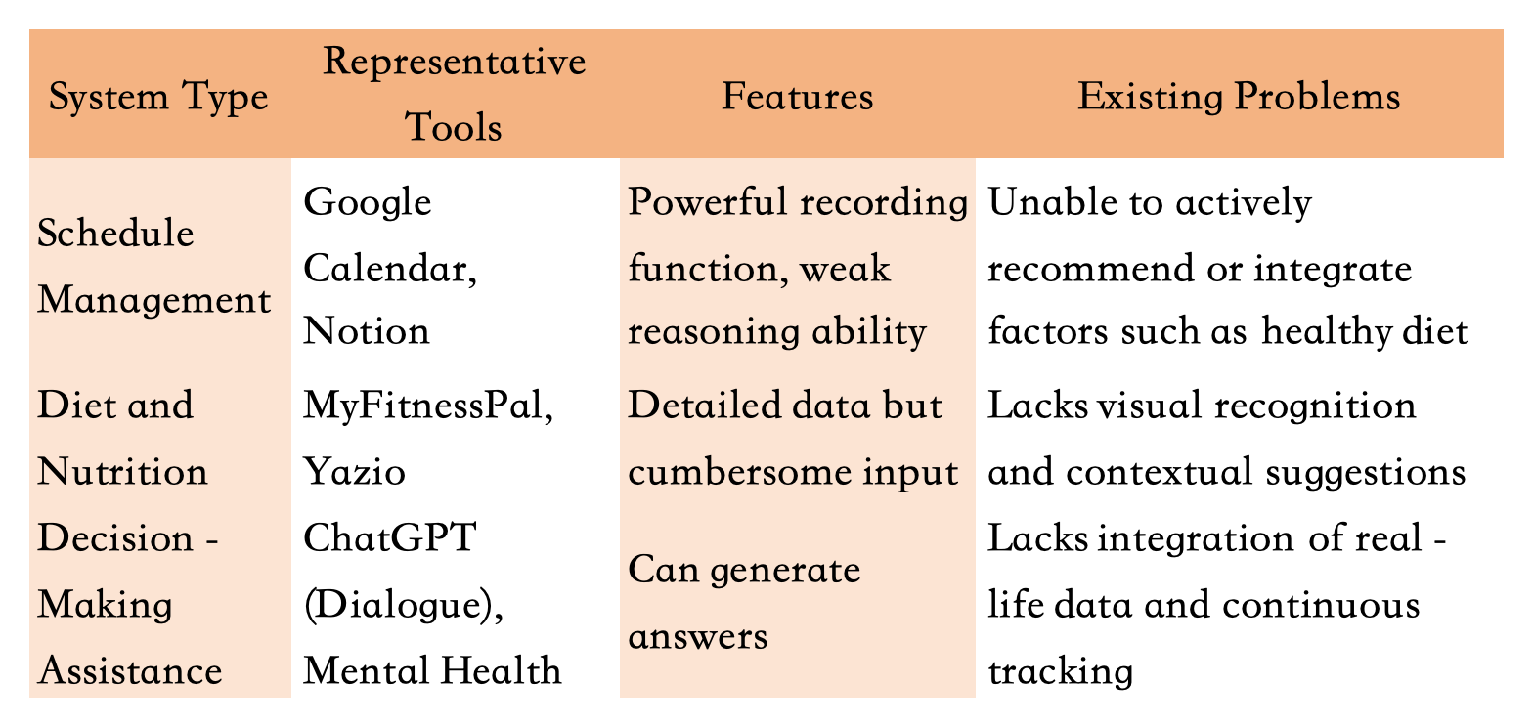
Background and Introduction
Integrated solutions to avoid fragmentation
Modern life management faces key challenges: traditional tools (such as ordinary calendar apps and static diet plans) cannot adapt to dynamic personal needs, real-time scenarios and overall health goals.
Human-centered computing: Integration and Personalization
People increasingly want personalized help for health, efficiency, and decision - making. Yet current solutions are fragmented and context - unaware. AIVA, an AI life assistant, simplifies daily tasks via adaptive nutrition tracking, smart scheduling, proactive decision - making and so on. It merges real - time data analysis with human - centric design, swapping rigid tools for personalized support to foster habits, optimize tasks, and encourage healthier, more intentional choices.
Example

Slide 3
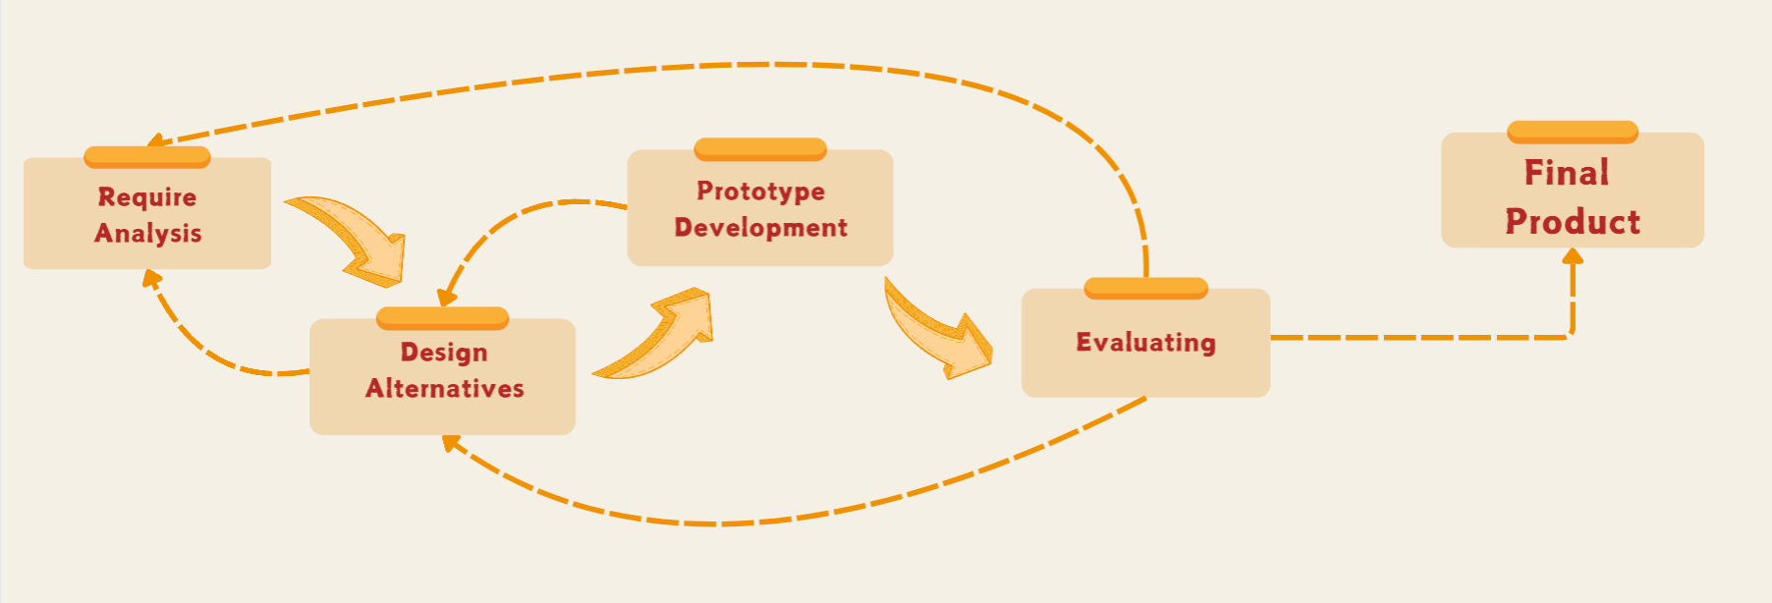
Design and Methodology
Target Users
College students and middle-aged groups lacking self-discipline
Workflow
Requirement analysis serves as the starting point. By conducting research, it clarifies user needs and pain points, thus anchoring the direction for product development. Designing alternatives, prototype development, and evaluation form a coherent chain. Exploring multiple solutions, building prototypes, and conducting comprehensive evaluations help identify and solve problems continuously. The results of evaluation are fed back to the previous stages for cyclic optimization. This enables the product to be refined step by step, resulting in a final product that meets the needs of the market and users.

Slide 4
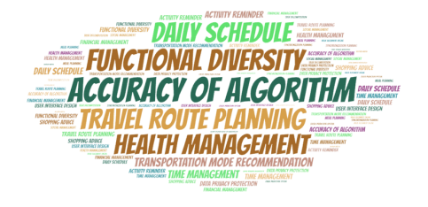
Require Analysis
An online survey with both open-end and closed-end questions and received 70 valid results.
In trip planning, the bar chart shows high demand for daily schedule and travel route planning, indicating users want smart Butlers to help organize travel efficiently.
The bar chart on decision support reveals a strong need for health management, highlighting users' eagerness for professional health - related advice.
The word cloud emphasizes terms like "DAILY SCHEDULE", "FUNCTIONAL DIVERSITY", and "ACCURACY OF ALGORITHM", suggesting users expect smart Butlers with diverse, accurate-performing features for good service.

Slide 5
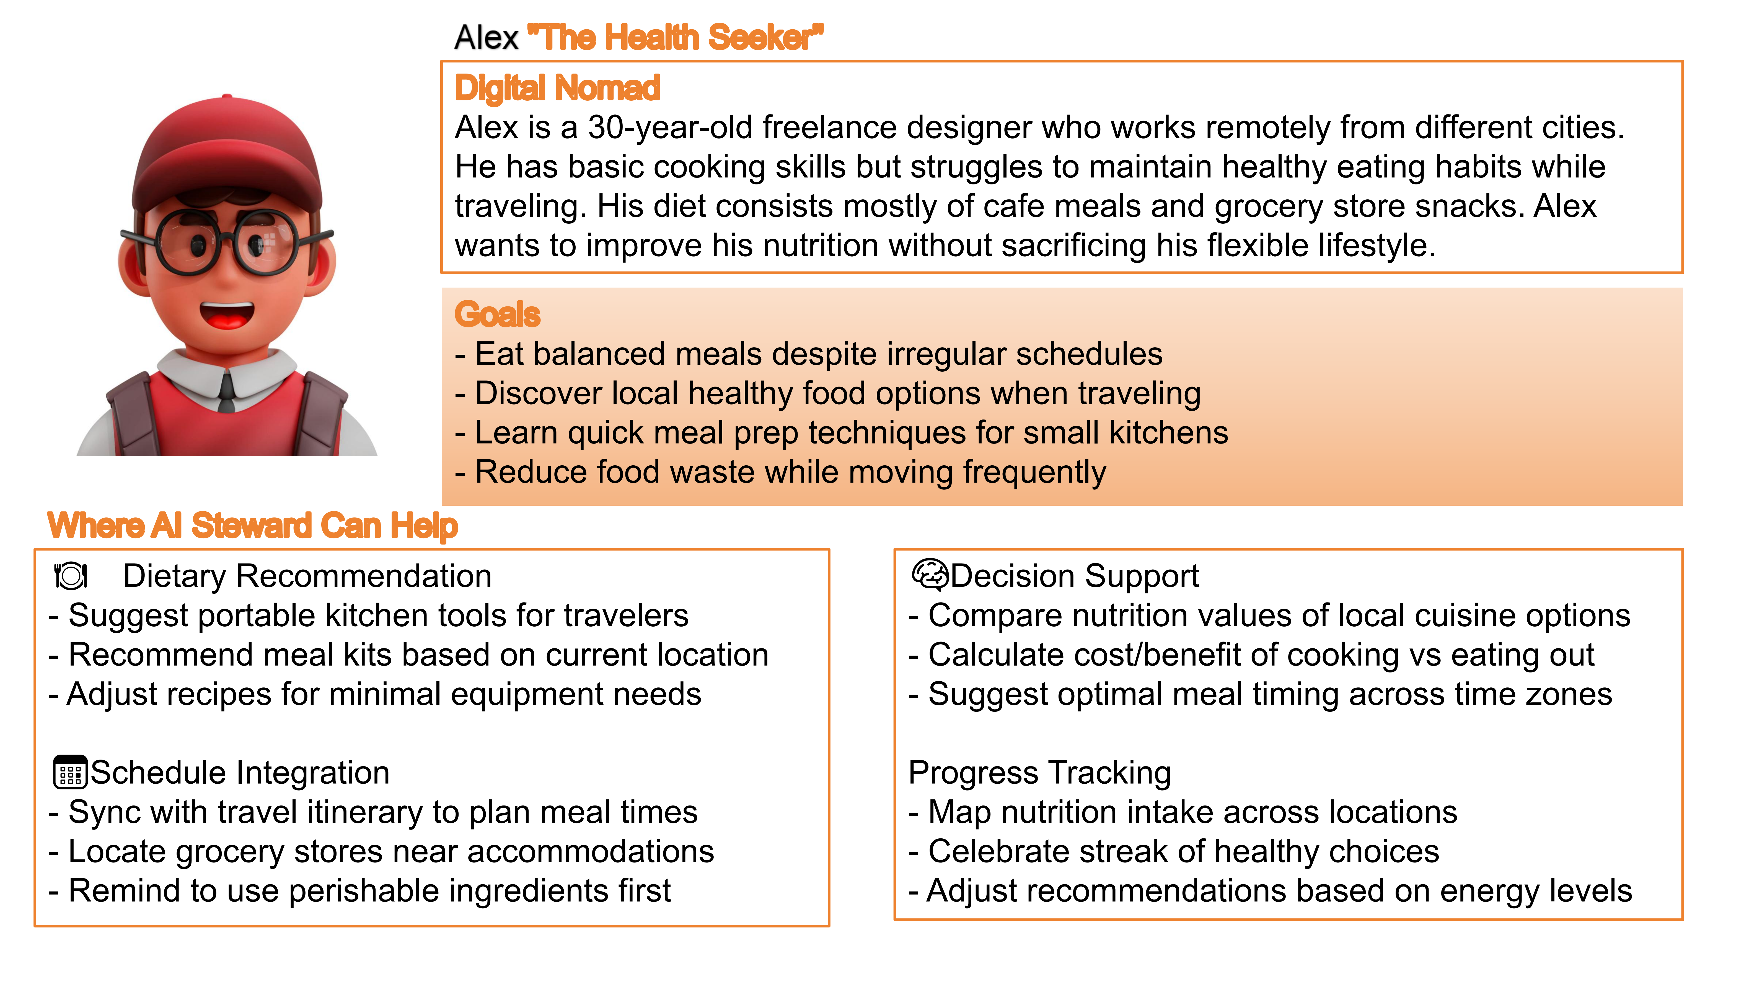
Require Analysis
An online survey with both open-end and closed-end questions and received 70 valid results.
As a digital nomad, Alex can't maintain healthy eating while traveling. His need for better nutrition without sacrificing flexibility shows the demand for Aiva app's personalized diets.
Alex wants balanced meals and local healthy food. Aiva app's dietary recs and schedule integration can meet his healthy - eating needs in various situations.
Facing challenges, Alex can benefit from Aiva app's decision - support and progress - tracking to make healthy choices, proving the app's importance.
The pie charts show that over half care about healthy diets, most need occasional help with daily decisions, and the majority either often or occasionally plan their daily itineraries, indicating varied yet significant demands for health - related attention and organizational assistance in daily life.

Slide 6
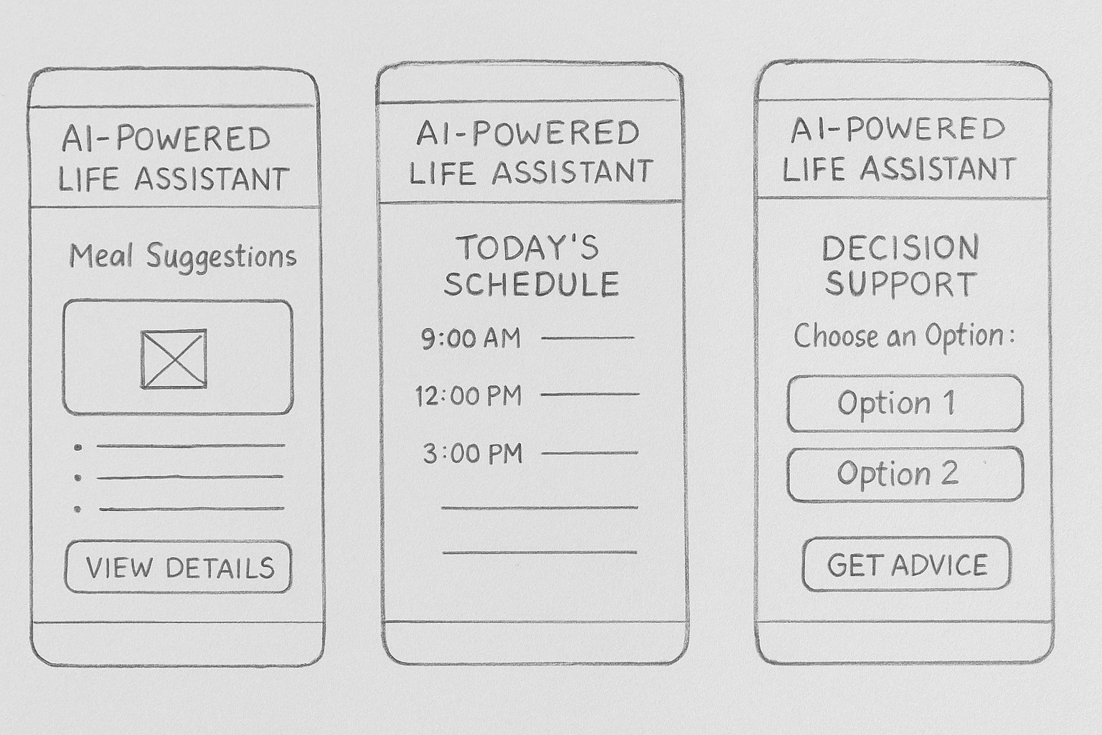
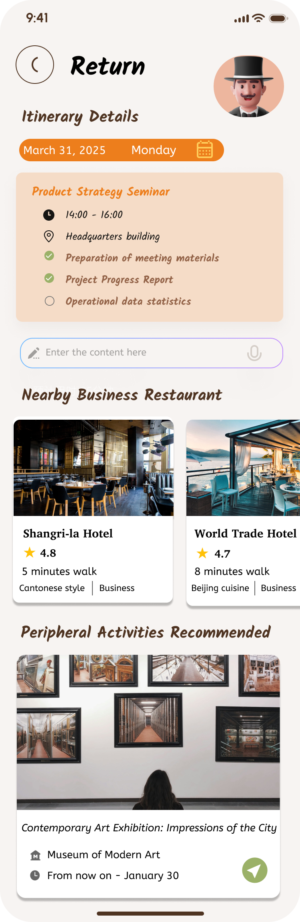
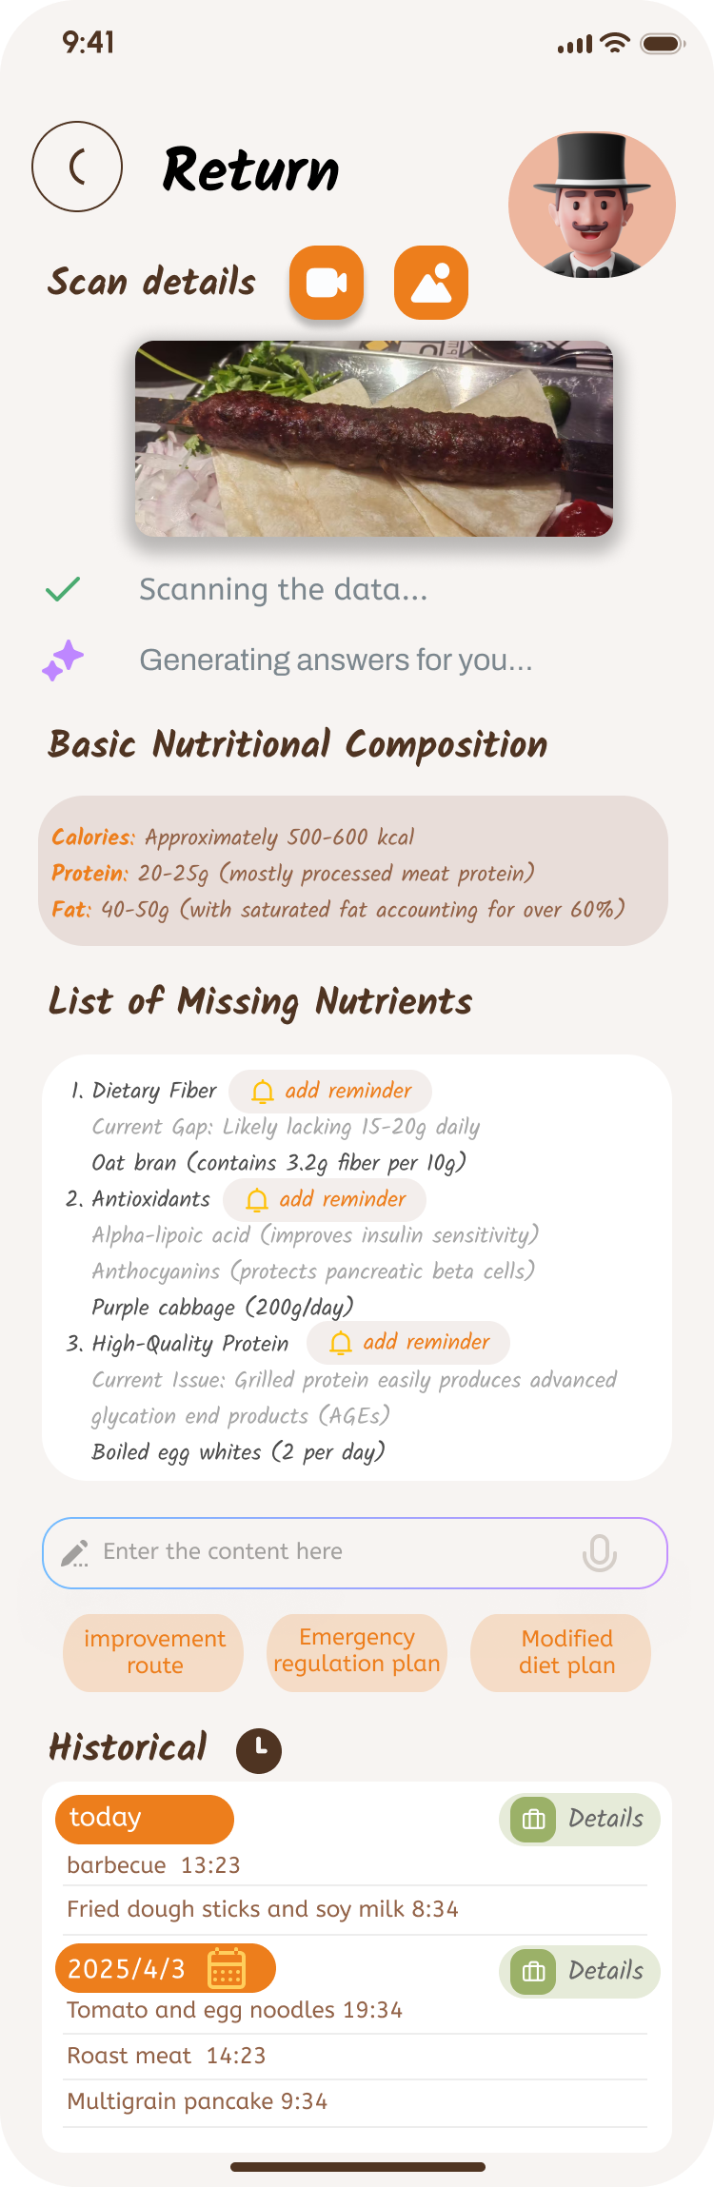

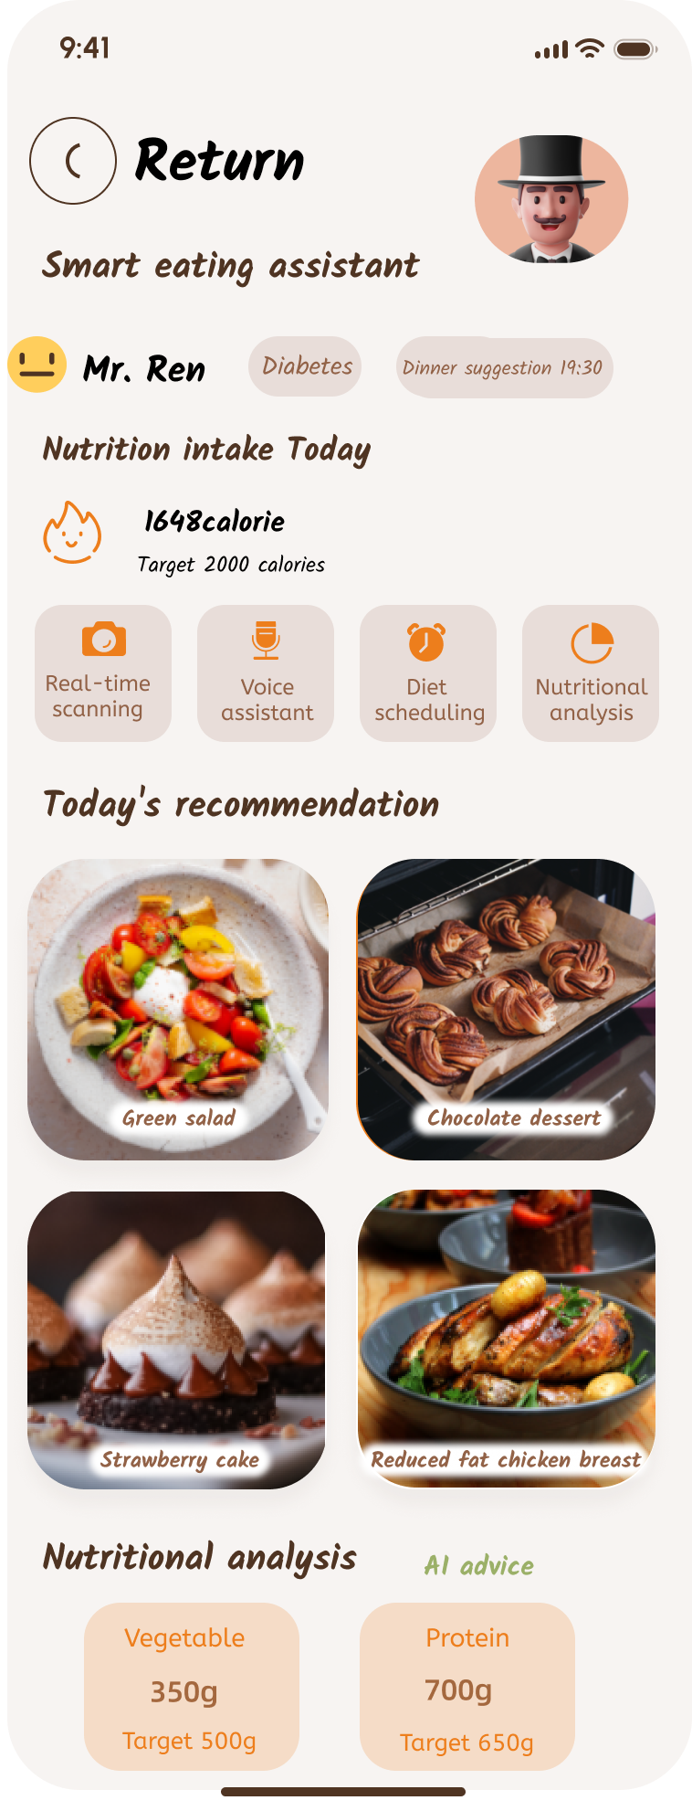
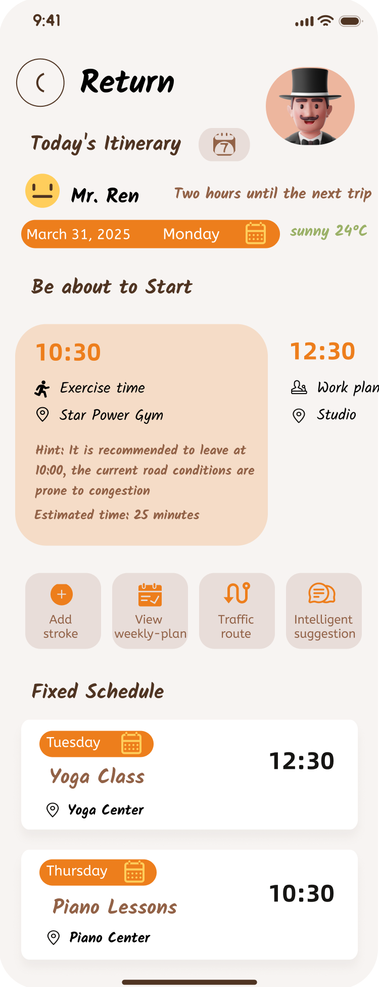
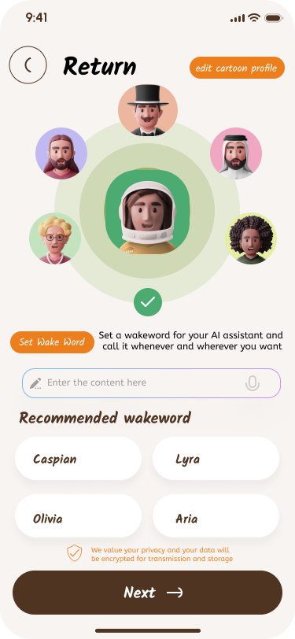
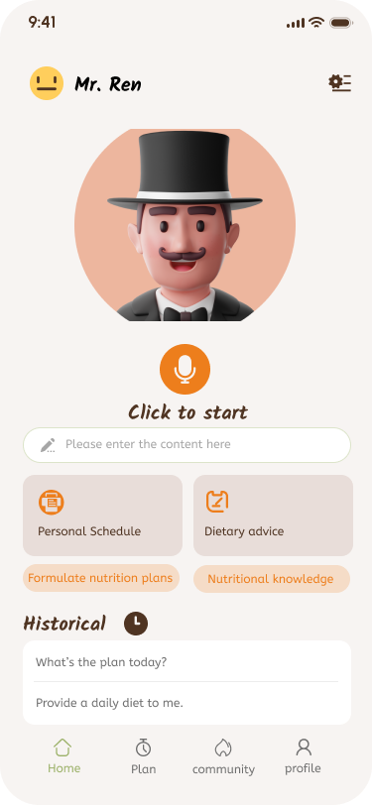
Prototype Implement
From the setting of cartoon characters and wake words, to the intelligent decision-making function on the main page and the entry points of the other two major functions (personal schedule and diet advice, and then to the separate application of AI to realize each function.

Slide 7
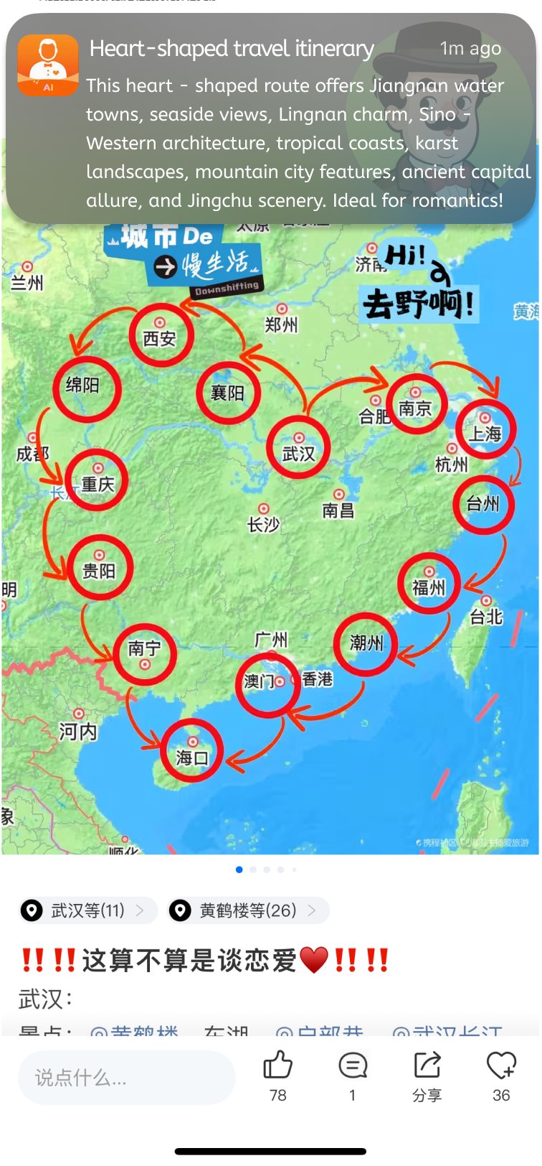
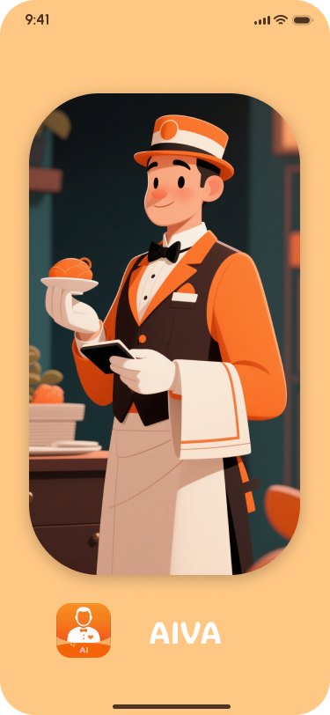
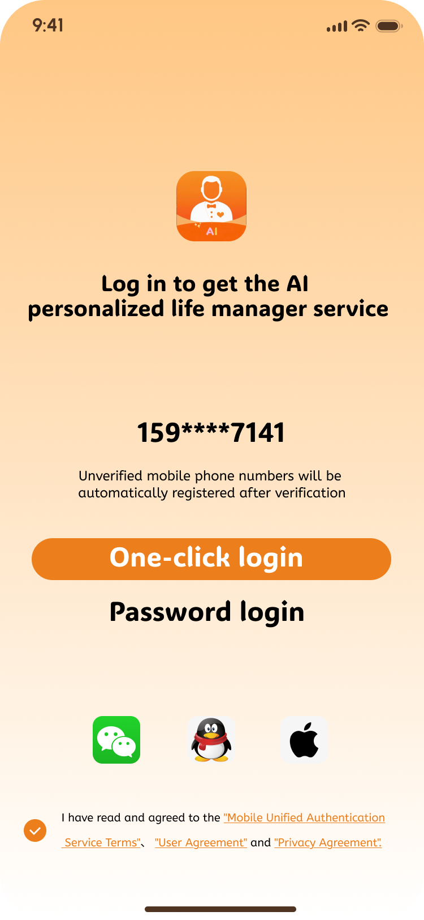
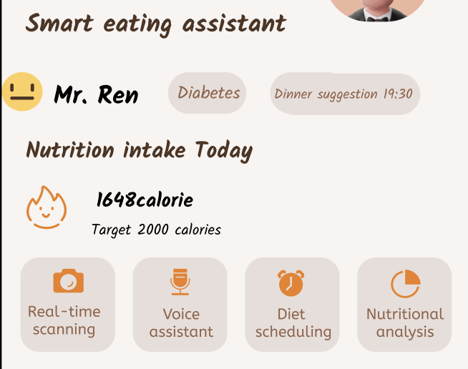
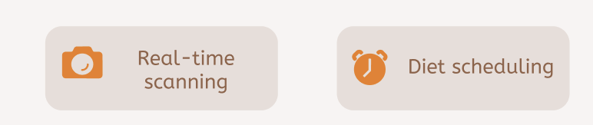

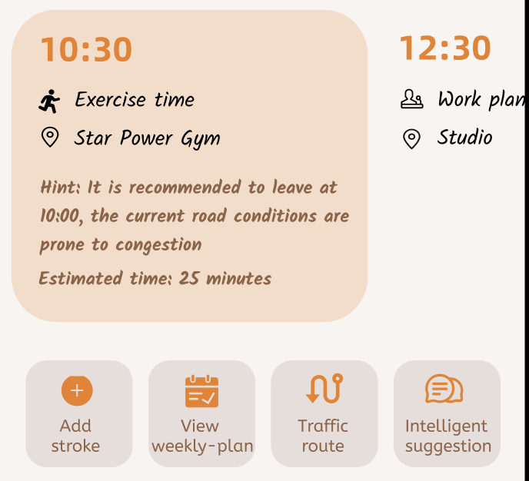

①
Iteration 1
Prototype Implemention
Require Analysis
①
The lack of login and pop-up pages makes the image of the butler not deeply rooted in people's minds
②
Some buttons with extra functions are duplicated with the previous page functions
When users browse the heart-fluttering routes on the Ctrip Travel app, AIVA will introduce relevant information such as the scenery along the way to users in the form of pop-up Windows with the users' permission. On the jump page, an image of a butler is given, allowing users to better experience the feeling of a butler. The default one-click login on the mobile phone is convenient for users to operate

Slide 8
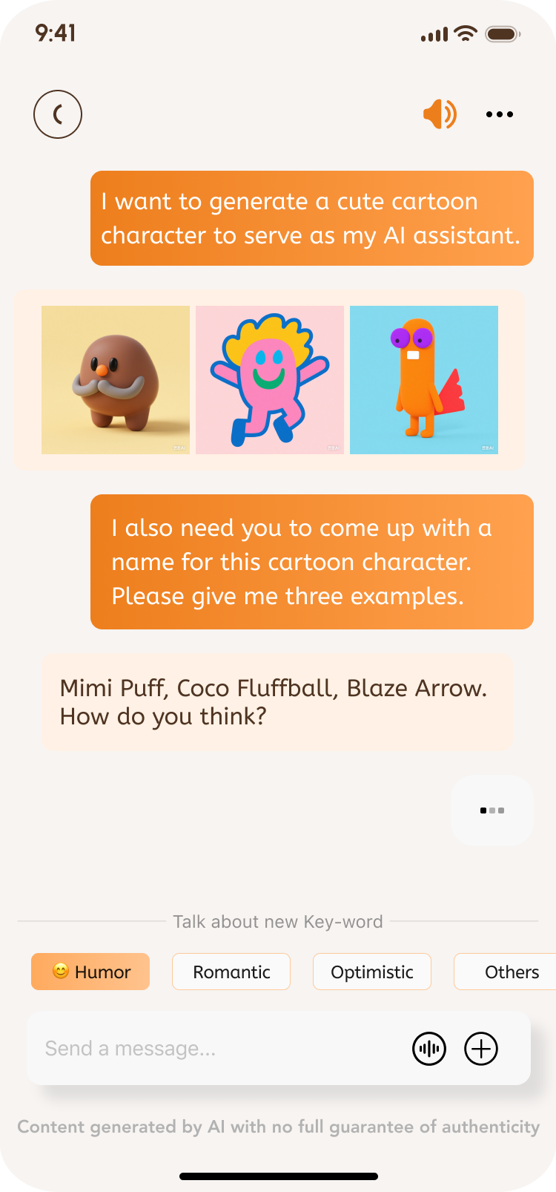
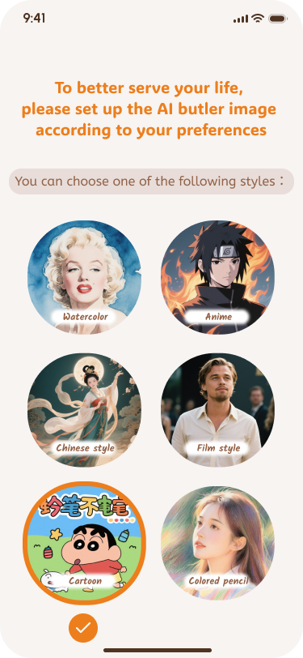
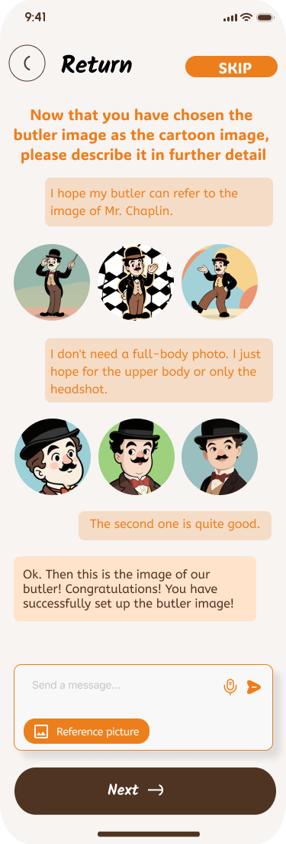
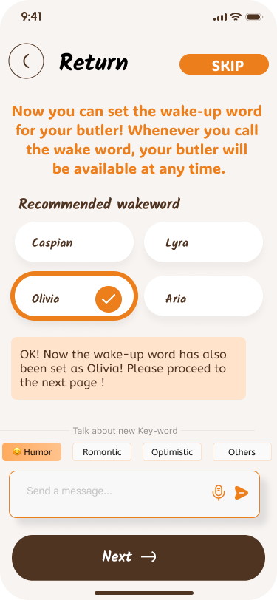


Iteration 2
Prototype Implemention
Require Analysis
The current settings of cartoon characters cannot well reflect AI-generated images, and their self-creativity is not that strong.
①
The pages featuring cartoon characters and wake words are rather mixed together, not very intuitive and aesthetically pleasing.
②
The sense of companionship of the butler needs to be enhanced.
The generated butler image will frequently appear on subsequent pages and can also accompany users in the form of pop-up Windows or floating Windows
Ultimately, users can first select the image style of the butler, and then adjust the AI-generated butler image and wake-up words through dialogue

Slide 9
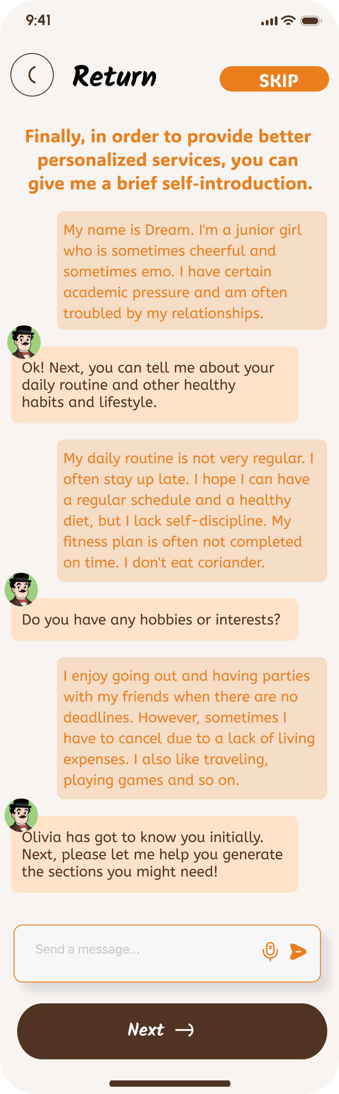
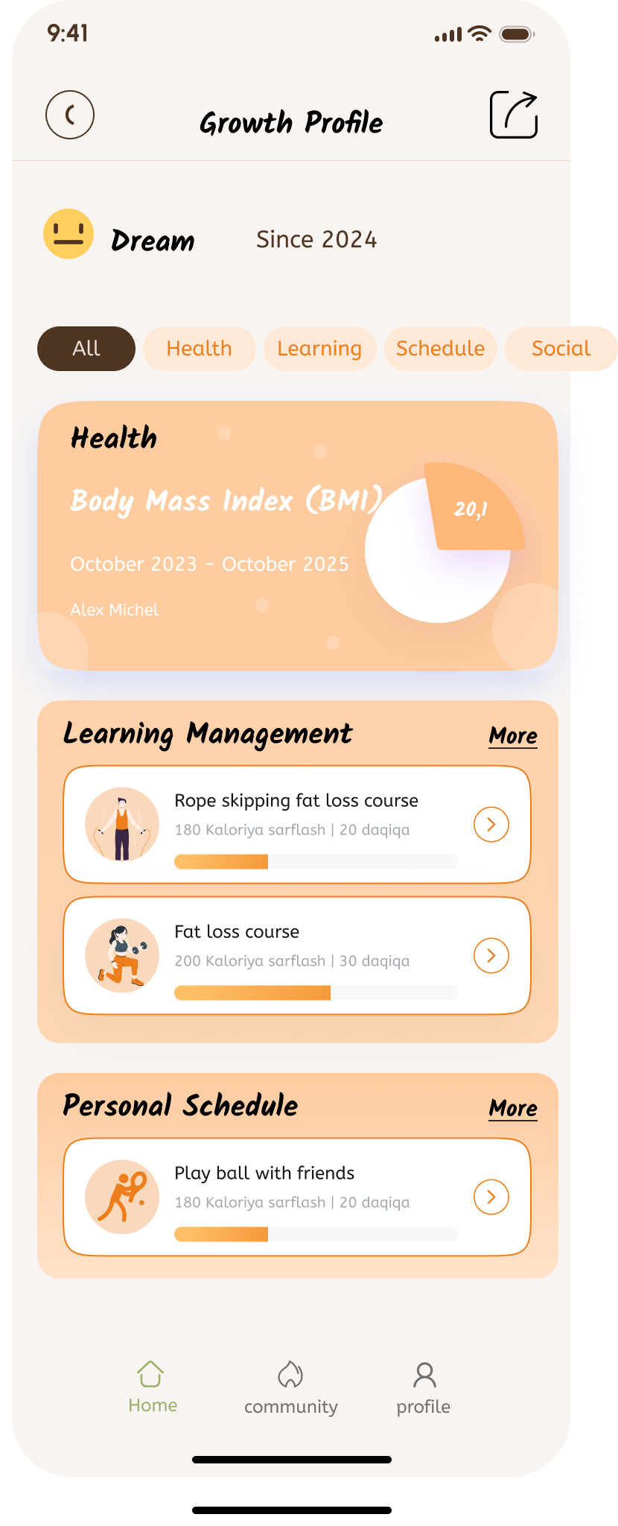
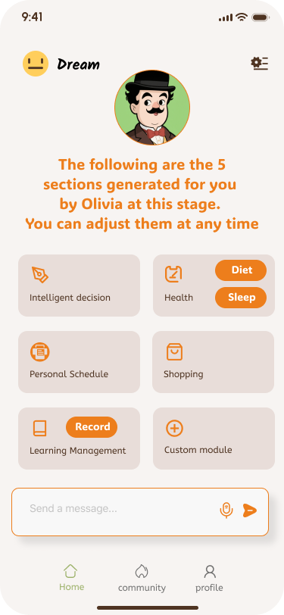
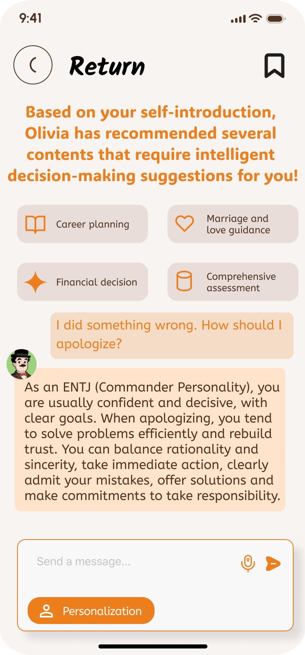
Iteration 3
Prototype Implemention
Require Analysis
Diet, schedule and decision-making are just preset sections that are relatively fixed. As a life manager, one cannot comprehensively manage the user's life.
①
The current intelligent decision-making is not personalized enough and fails to reflect users' behavioral logic, thinking patterns, etc.
②
On pages lacking a personal growth page, users cannot get an overview of their recent lives.
③
AIVA can learn more about user information through guided Q&A, such as MBTI, living habits, daily activities, etc. Based on the analysis of users, it generates the sections that users need. Users can also customize the sections.
On the decision-making page, users can also make personalized decisions by choosing the decision-making mode and behavioral logic that consider their personal habits.

Slide 10
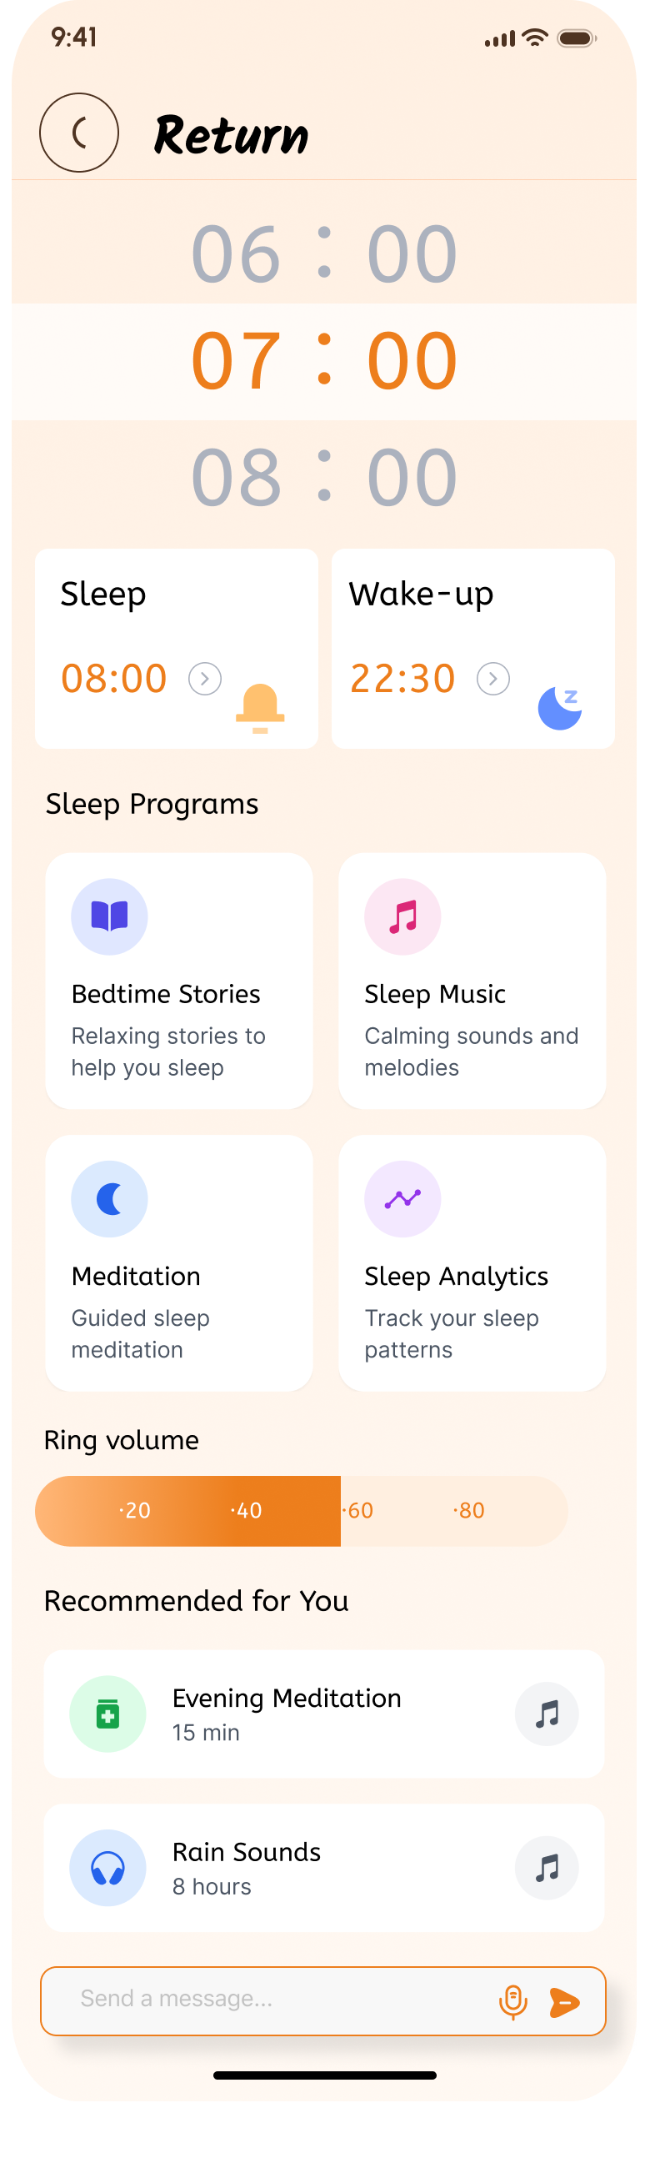
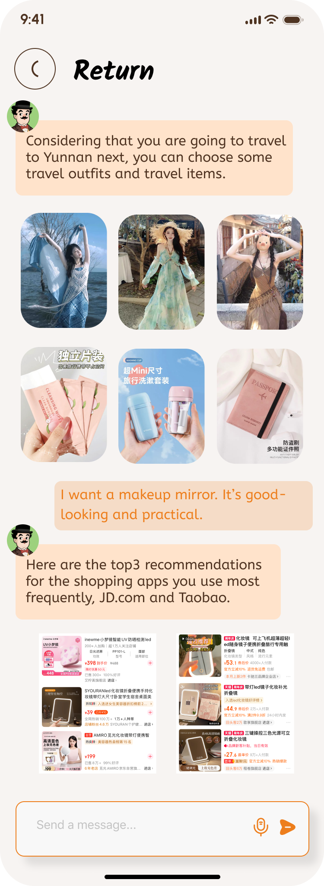
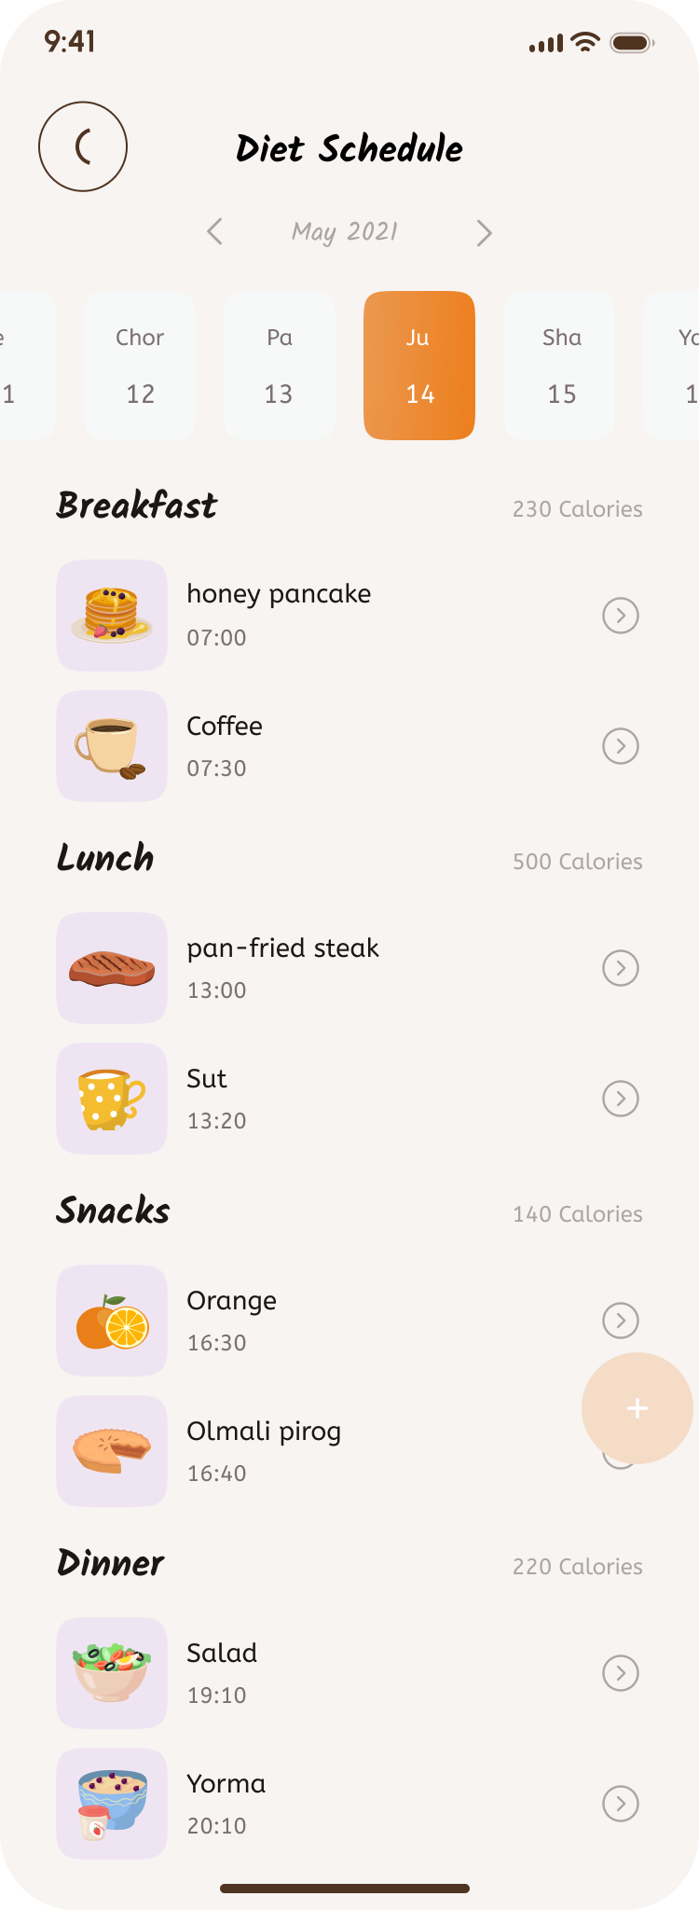
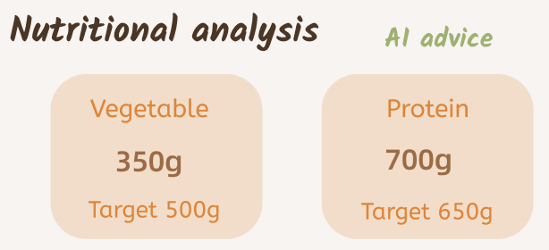
Iteration 4
Prototype Implemention
Require Analysis
In sleep management, AIVA can analyze users' sleep and provide suitable lullabies for them. In the shopping section, AIVA can recommend good products based on users' schedules and make intelligent comparisons.
For the majority of AIVA users, the sleep and shopping sections are also very important. Therefore, users hope that AIVA can also present these pages as preset sections with specific pages.
①
On the diet page, after giving suggestions based on the analysis of nutritional components, the suggestions only provide the amount of nutrients but no specific food recommendations. Users cannot know exactly what to eat.
②
Based on the analysis of nutritional components and the dietary plan recommendations on how to consume specific nutrients, users can obtain healthy diet advice more intuitively.

Slide 11
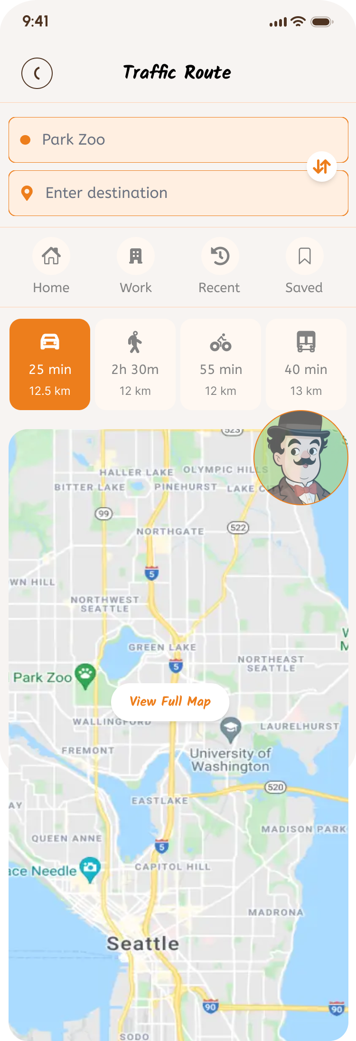
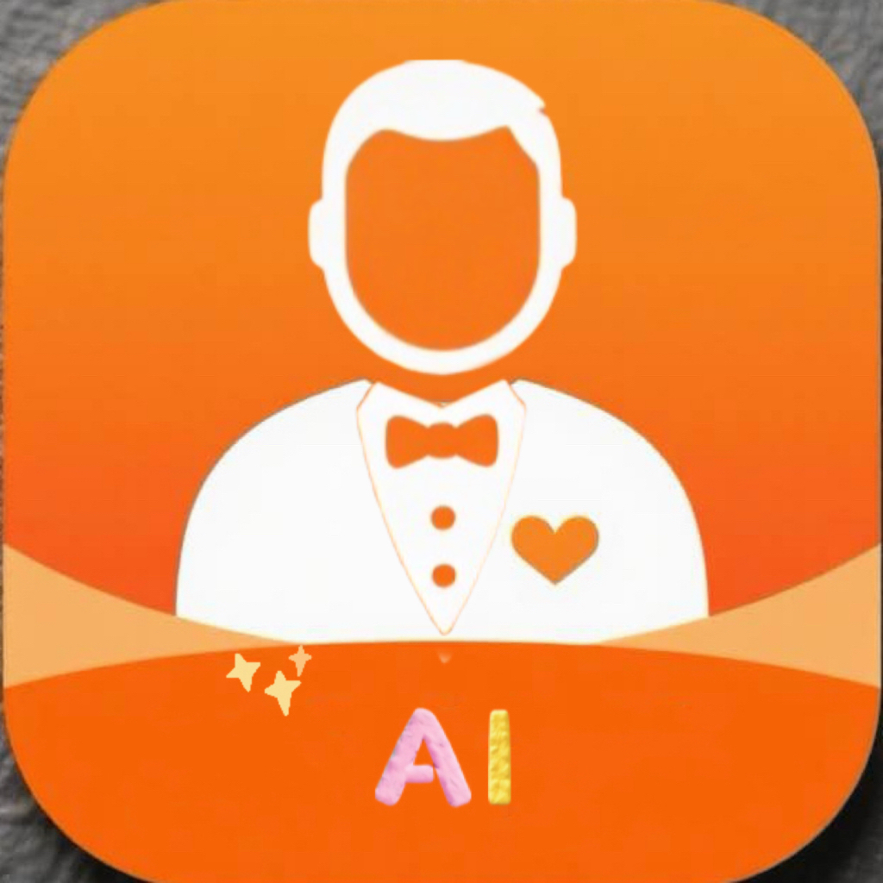
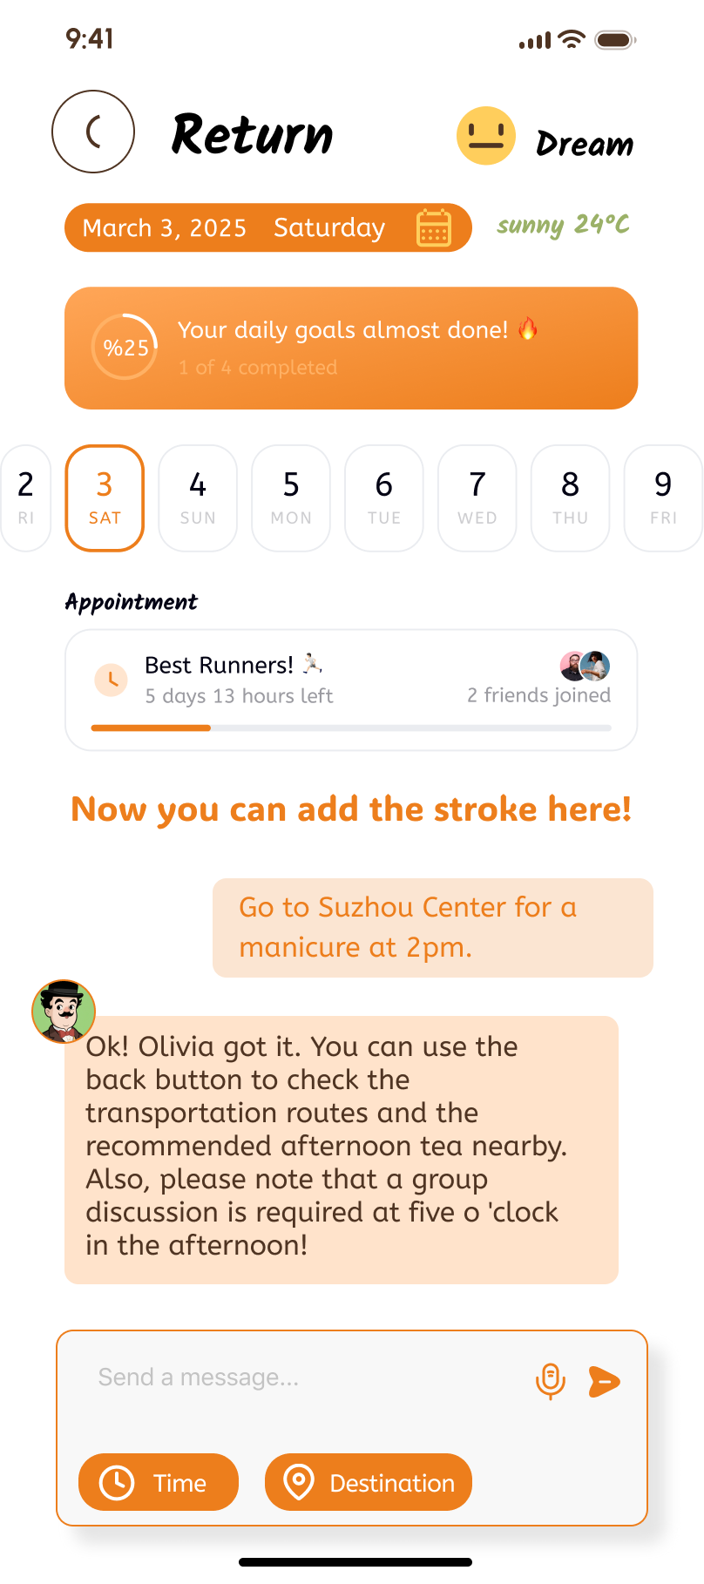

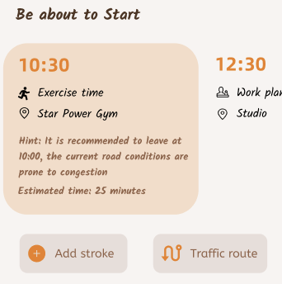
Iteration 5
Prototype Implemention
Require Analysis
①
The icon of the app is not warm enough and has a robot-like feel.
②
The specific pages of add stroke and traffic route are lacking
The new APP avatar can better reflect a sense of a butler, with a more intimate and warm feeling
AIVA can proactively provide transportation routes when users have relevant itineraries. Users can also simply and conveniently modify their itineraries through interaction with the butler.

Slide 12
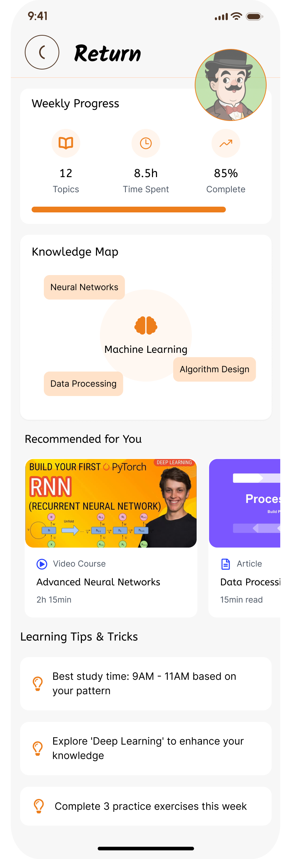
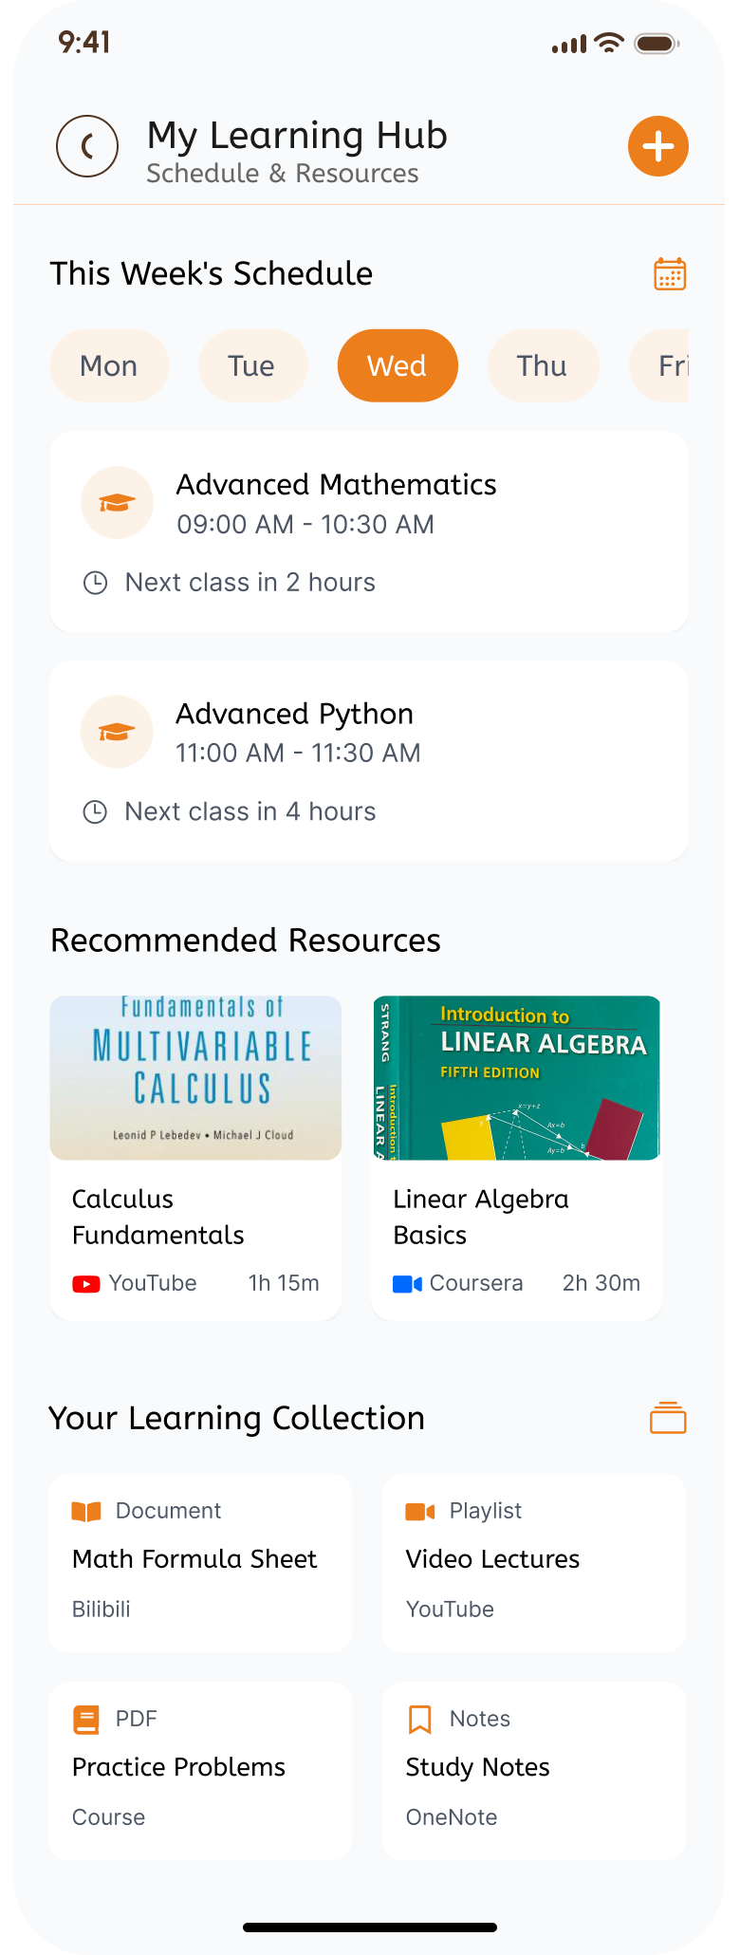
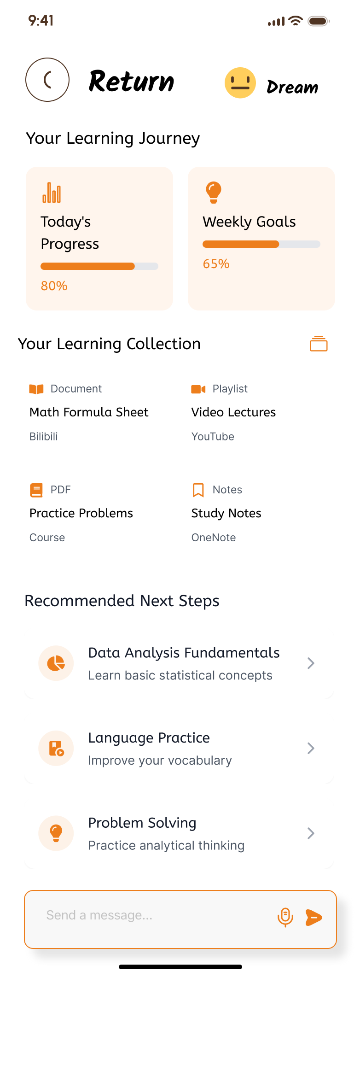
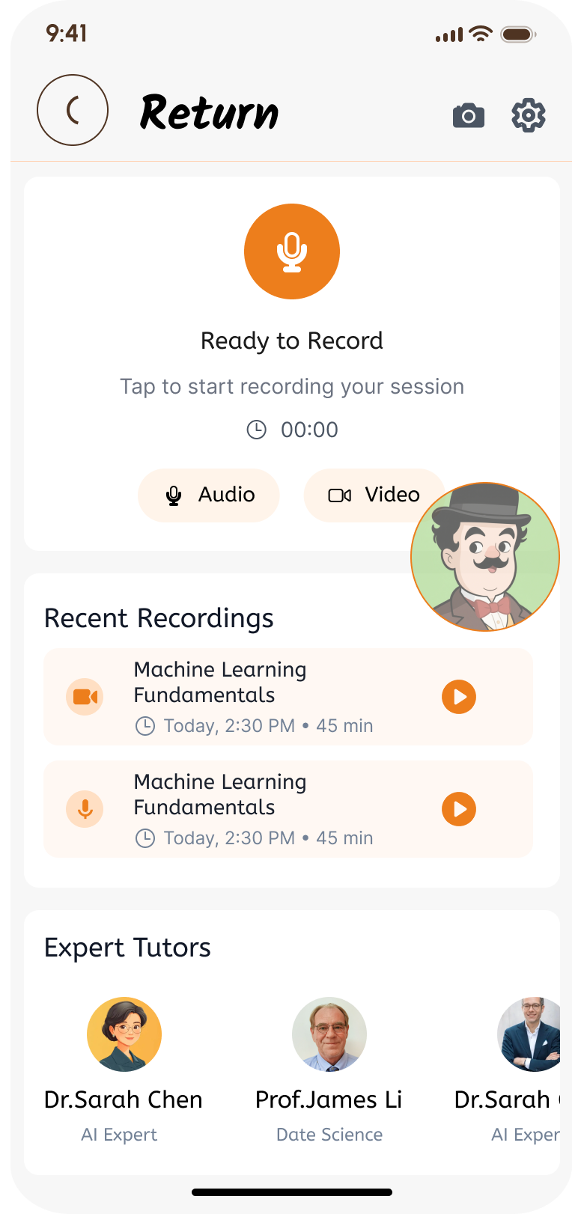
Iteration 6
Prototype Implemention
Require Analysis
As one of the main user groups of AIVA, the student group also has a very important aspect of learning. Users have reported that another function of the camera can be utilized: intelligent recording of class time, recording key points of the class, and after class, plans can be made and relevant textbooks recommended to improve the academic performance of users as students.
If the class schedule is written here again, it will conflict with the schedule arrangement, so this page is omitted.

Slide 13
Evaluation and Results
Evaluation
method
Heuristic evaluation: Based on the principle of usability, self-check whether the application interface and functions are easy to use.
Usability test: Recruit 100 users from different backgrounds, including students, professionals, etc.
Data analysis: Integrate tools in the application to collect indicators such as the number of daily active users, the frequency of function usage, and user retention rate.
Evaluation
result
Quantitative result User activity: The average daily active users were 500 in the first month of launch, increased to 800 in the second month, and reached 1,000 in March.
Function usage: The diet decision function is used most frequently, accounting for 35% of the function visits. The schedule function accounts for 25%. Sleep management and learning functions account for 20% and 15% respectively.
To compare the efficiency of users in completing tasks before and after the iteration of AIVA, three typical tasks, namely formulating a diet plan, arranging a weekly schedule and purchasing goods, were selected for testing. Draw a line graph with the iterative version as the abscissa and the average time to complete the task as the ordinate. Data shows that before the iteration, the average time for users to complete the formulation of a diet plan was 15 minutes. After three iterations, it was shortened to 8 minutes. The average time for arranging a weekly schedule has decreased from 12 minutes to 6 minutes. The average time for purchasing goods has decreased from 20 minutes to 10 minutes, clearly demonstrating the significant improvement in users' task completion efficiency after the iteration of AIVA.

Slide 14
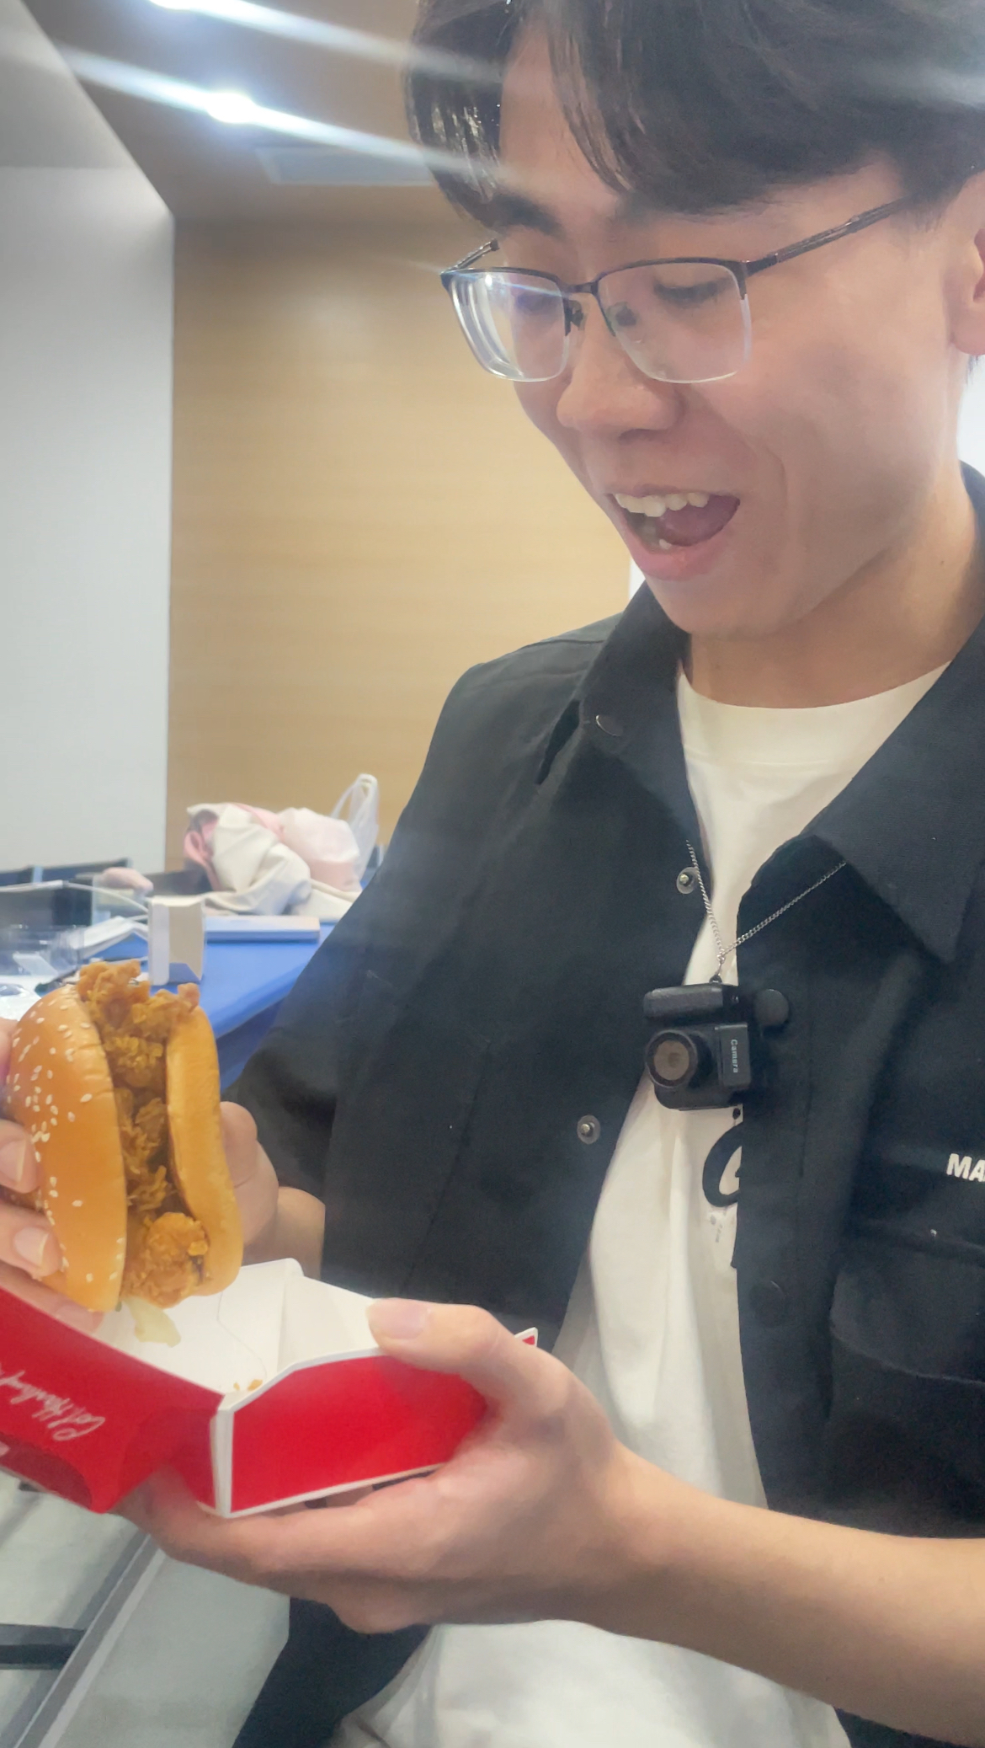


Evaluation and Results
Qualitative feedback Positive: Users love the personalized features of applications, especially the ability to customize AI butlers. The functional integration is convenient. Managing multiple aspects of life in one application can save time.
Negative: Some users feel confused when switching between different functional sections and are also concerned about data privacy, hoping for more transparent data usage.
Evaluation
result
Humanistic
influence
Improving health management level: Take Alex as an example. After using AIVA for three months, his weight dropped from 75 kilograms to 70 kilograms and his body fat percentage decreased from 25% to 22%.
Improving life efficiency: A survey of 50 users found that they saved an average of 5 to 8 hours per week after using AIVA.
Social impact: AIVA is expected to drive the development of AI life management apps.

Slide 15
Discussion and Reflections
Project outcomes and Objectives
Advantages: Personalized customization (customizing AI butlers, exclusive services, making decisions based on user behavior patterns) Diverse functions (covering all aspects of life)
Deficiency: Reliance on data; The functions are complex and difficult to master
Compare with the existing schemes: It is highly personalized and integrated, outperforming most single-function applications. However, mature applications may have an advantage in terms of the number of users and interface
Team and individual reflection
Team Advantages: Smooth communication and complementary expertise among members
Improvement: Strengthen early user testing and optimize resource allocation
Individual Gain: Knowledge of AI integration; The design process of figma User-centered design concept (I was mainly responsible for the functional realization of figma, page production and the overall framework design of the poster)
Improvement: Enhance the ability to coordinate resources in complex projects and be more proactive in participating in the early testing planning
Ethics and Principles
Protect data; Privacy Avoid AI bias

Slide 16
Acknowledgment
I'm deeply grateful to my CPT208 instructors, Li Yue and Ma Teng, for their guidance on human - centric design principles. Their feedback on ethical AI implementation during the project evaluation was invaluable.
I also thank my TA, Shuhao Zhang, for his support.
Thanks to the testers for their participation in line with participatory design.
Appreciation to my team members for our early - stage collaboration.
Finally, kudos to the developers of open - source tools (TensorFlow, ARCore) for facilitating AIVA's technical realization.
Reference
[1] CPT208 Lecture Notes, "Human-Centered Design Methods," University of Xi’an Jiaotong-Liverpool, 2025.
[2] Group 62, "Generative AI in Life Steward – AIVA Project Poster," CPT208, 2025.

