Slide 1
Kubernetes in
30 minutes
Mar 5, 2019

Slide 2

Kubernetes

Slide 3
k8s

Slide 4
“Something to do with containers…?

Slide 5
Assumptions
You know about containers
You know about orchestration
You know about the painful art of deploying stuff

Slide 6

Docker

Slide 7

“Random containers doing their own sh*t”

Slide 8
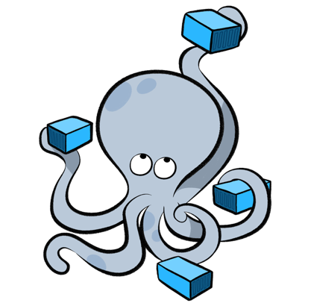
Compose

Slide 9
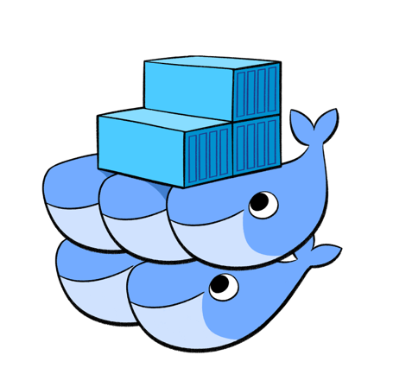
Swarm

Slide 10

“Clustering an Discovery”
(hey, we’re getting somewhere!)

Slide 11
=

Slide 12
“Batteries Sold Separately”

Slide 13
“Batteries Included”

Slide 14



K8s on Cloud
TKE
TencentHub
Networking
…and others

Slide 15
Basic Concepts

Slide 16
Node

Slide 17
Hosts running k8s daemons

Slide 18
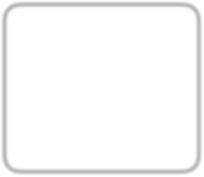


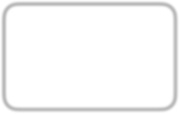
Master
API
Scheduler etc..
N de
kubelet
N de
kubelet
N de
kubelet

Slide 19
Pod

Slide 20
基本
Basic unit of deployment in k8s

Slide 21
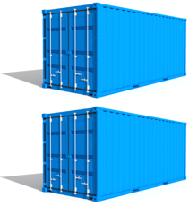
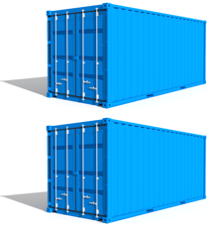
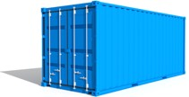

Group of Containers

Slide 22
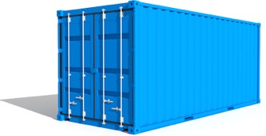


Container configurations

Slide 23

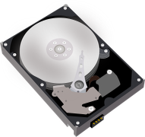
Shared storage

Slide 24




c ntainer
P d

Slide 25
P d
c ntainer
c ntainer

Slide 26
P d
c ntainer
c ntainer c ntainer

Slide 27
P d
e.g.
c ntainer
nginx
c ntainer
app
c ntainer
redis/cache

Slide 28
Scheduled together
(“co-scheduled”)

Slide 29
Guaranteed to be on the same node
(“co-located”)

Slide 30

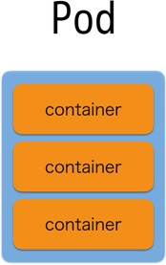
N de
N de
N de

Slide 31
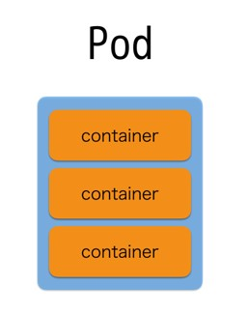
N de
N de
N de
Depends on each node’s resource availability and each pod’s resource requirements

Slide 32




N de
N de
c ntainer
c ntainer
c ntainer

Slide 33





N de N de
This will NEVER happen
c ntainer
cntainer
c ntainer

Slide 34
Miscellaneous
Each pod has its own IP address
Pods are expected to be stateless

Slide 35
Replica Set

Slide 36
Keeps track of Pod replicas

Slide 37
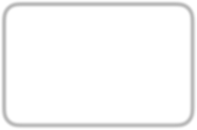
Replica Set
replicas: 3 template:

Slide 38
Replica Set
replicas: 3 template:
A

Slide 39
Replica Set
replicas: 3 template:
A
B

Slide 40
Replica Set
replicas: 3 template:
A
B
C

Slide 41

Replica Set
replicas: 3 template:
A
B
C

Slide 42
Replica Set
replicas: 3 template:
A
B

Slide 43
Replica Set
replicas: 3 template:
A
B
D

Slide 44
Deployment

Slide 45
Manages Replica Set state transitions

Slide 46
Depl yment
replicas: 3 template:

Slide 47
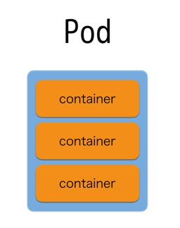
Depl yment
replicas: 3 template:
Replica Set A
replicas: 3 template:

Slide 48
Depl yment
replicas: 3 template:
Change s me settings, please!
Replica Set A
replicas: 3 template:

Slide 49
Depl yment
replicas: template:
2
3
Change s me settings, please!
Replica Set A
replicas: 3 template:

Slide 50

Depl yment
replicas: template:
2
3
Change s me settings, please!
Replica Set A
replicas: 3 template:
Replica Set B
replicas: 2 template:

Slide 51

Depl yment
replicas: template:
2
3
Change s me settings, please!
Replica Set A
Replica Set B
replicas: 2 template:
replicas: 3
template:

Slide 52
Depl yment
replicas: template:
2
3
Change s me settings, please!
Replica Set B
replicas: 2 template:

Slide 53
Keeps track of state change history

Slide 54
Depl yment
replicas: 3 template:

Slide 55
Depl yment
replicas: 3 template:
A
replicas: 3 template:

Slide 56
Depl yment
replicas: 3 template:
Change s me settings, please!
A
replicas: 3 template:

Slide 57
Depl yment
replicas: template:
2
3
Change s me settings, please!
A
replicas: 3 template:

Slide 58
Depl yment
replicas: template:
2
3
Change s me settings, please!
A
replicas: 3 template:
B
replicas: 2 template:

Slide 59
Depl yment
replicas: template:
2
3
Change s me settings, please!
A
B
replicas: 2 template:
replicas: 3
template:

Slide 60
Depl yment
replicas: template:
2
3
Change s me settings, please!
B
replicas: 2 template:

Slide 61
Depl yment
replicas: template:
2
3
Oh wait, I actually didn’t want t d that…
B
replicas: 2 template:

Slide 62
Depl yment
replicas: template:
3
2
3
Oh wait, I actually didn’t want t d that…
B
replicas: 2 template:

Slide 63


Depl yment
replicas: template:
3
2
3
Oh wait, I actually didn’t want t d that…
B
replicas: 2 template:
r llback

Slide 64

Depl yment
replicas: template:
3
2
3
Oh wait, I actually didn’t want t d that…
A
replicas: 3 template:
B
replicas: 2 template:
r llback

Slide 65

Depl yment
replicas: template:
3
2
3
Oh wait, I actually didn’t want t d that…
A
replicas: 3 template:
B
r llback
replicas: 2
template:

Slide 66
Depl yment
replicas: template:
3
2
3
Oh wait, I actually didn’t want t d that…
A
replicas: 3 template:

Slide 67
Services

Slide 68
Logical set of Pods
(and ways to access them)

Slide 69
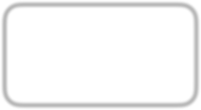


Raw Pod Access
P d
10.0.96.2
P d
10.0.96.3
P d
10.0.96.3

Slide 70
Raw Pod Access
P d
10.0.96.2
P d
10.0.96.3
P d
10.0.96.3

Slide 71
Raw Pod Access
P d
10.0.96.2
_{Pd} 10.0.96.3
P d
10.0.96.3

Slide 72
Raw Pod Access
P d
10.0.96.2
P d
10.0.96.3

Slide 73
Raw Pod Access
P d
10.0.96.2
P d
10.0.96.3

Slide 74

Access Via Service
P d
10.0.96.2
r le=web
Service
match r le=web
P d
10.0.96.3
r le=web
P d
10.0.96.4
r le=web
P d
10.0.96.5
r le=db

Slide 75
Access Via Service
P d
10.0.96.2
r le=web
Service
match r le=web
P d
10.0.96.3
r le=web
P d
10.0.96.4
r le=web
P d
10.0.96.5
r le=db

Slide 76
Access Via Service
P d
10.0.96.2
r le=web
Service
match r le=web
P d
10.0.96.3
r le=web
P d
10.0.96.4
r le=web
P d
10.0.96.5
r le=db

Slide 77
Access Via Service
P d
10.0.96.2
r le=web
Service
match r le=web
_{Pd} 10.0.96.3
rle=w
eb
P d
10.0.96.4
r le=web
P d
10.0.96.5
r le=db

Slide 78
Access Via Service
P d
10.0.96.2
r le=web
Service
match r le=web
P d
10.0.96.4
r le=web
P d
10.0.96.5
r le=db

Slide 79
Access Via Service
P d
10.0.96.2
r le=web
Service
match r le=web
P d
10.0.96.4
r le=web
P d
10.0.96.5
r le=db

Slide 80
Access Via Service
P d
10.0.96.2
r le=web
Service
match r le=web
P d
10.0.96.6
r le=web
P d
10.0.96.4
r le=web
P d
10.0.96.5
r le=db

Slide 81
Access Via Service
P d
10.0.96.2
r le=web
Service
match r le=web
P d
10.0.96.6
r le=web
P d
10.0.96.4
r le=web
P d
10.0.96.5
r le=db

Slide 82
Secrets

Slide 83
Store pieces of data in k8s

Slide 84
e.g. Identity Information

Slide 85
(securely)

Slide 86
(…in the future)

Slide 87

Secret
key1 → base64 value
key2 → base64 value
key3 → base64 value

Slide 88


P d
c ntainer:
v lumeM unts:
- name: certificates
m untPath: /etc/ssl/certs
c ntainer
v lumes:
- name: certificates secret:
secretName: ca-certificates
v lumes

Slide 89
P d
env:
- name: foo-secret valueFrom: secretKeyRef:
name: f
value: secret-value
c ntainer
v lumes

Slide 90
ConfigMaps

Slide 91
Same as Secrets (Unprotected)

Slide 92
Ingress

Slide 93
Services are for within the cluster only
(external IPs allowed, but don’ use that to serve external requests)

Slide 94
Inbound connections to internal cluster services
(New since 1.2)

Slide 95
DaemonSets

Slide 96



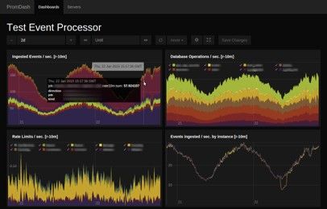
Ensure nodes run a copy of a Pod
N de N de N de
pr metheus-exp rter
pr metheus-exp rter
pr metheus-exp rter

Slide 97
Sh*tSets

Slide 98
StatefulSets
Sh*tSets

Slide 99
Use only when *really* needed

Slide 100
…and with *really* I mean never

Slide 101
Keeps unique IDs in replicas (x-0, x-1, x-2,…)

Slide 102
Questions?

