Slide 1
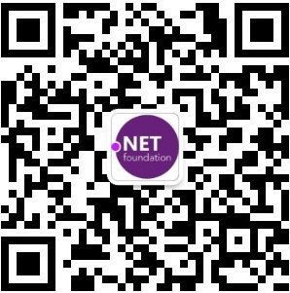
ASP.NET Core & Docker & K8s
From 0 to Cloud
张善友
MVP / TVP
geffzhang@weyhd.com

Slide 2
Agenda
Principles of Microservices
.NET Core
What’s Docker and why should I care
ASP.NET Core & Docker
Let’s port a non-trivial project to Docker and AKS

Slide 3
Definition
A microservices architecture consists of a collection of small, autonomous services. Each service is self-contained and should implement a single business capability.

Slide 4
Characteristics of a Microservice
Services are small, independent, and loosely coupled.
Each service is a separate codebase.
Services can be deployed independently.
Services are responsible for persisting their own data or external state.
Services communicate with each other by using well-defined APIs.
Services don't need to share the same technology stack, libraries, or frameworks.
Notes:
In a microservices architecture, services are small, independent, and loosely coupled.
Each service is a separate codebase, which can be managed by a small development team.
Services can be deployed independently. A team can update an existing service without rebuilding and redeploying the entire application.
Services are responsible for persisting their own data or external state. This differs from the traditional model, where a separate data layer handles data persistence.
Services communicate with each other by using well-defined APIs. Internal implementation details of each service are hidden from other services.
Services don't need to share the same technology stack, libraries, or frameworks.

Slide 5
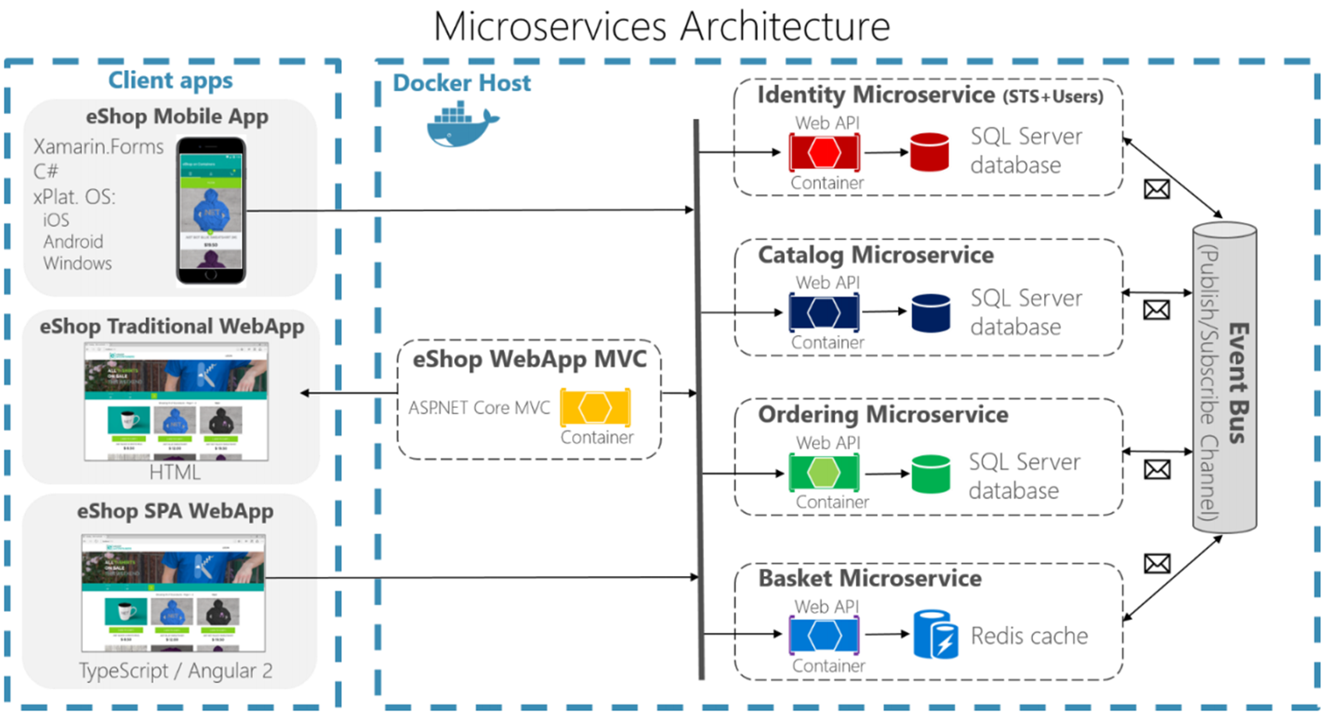
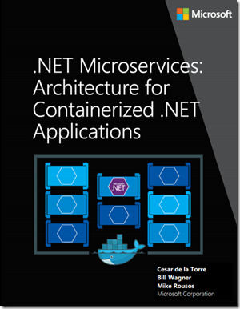
.NET Microservices - Architecture for Containerized .NET Applications
http://aka.ms/MicroservicesEbook

Slide 6
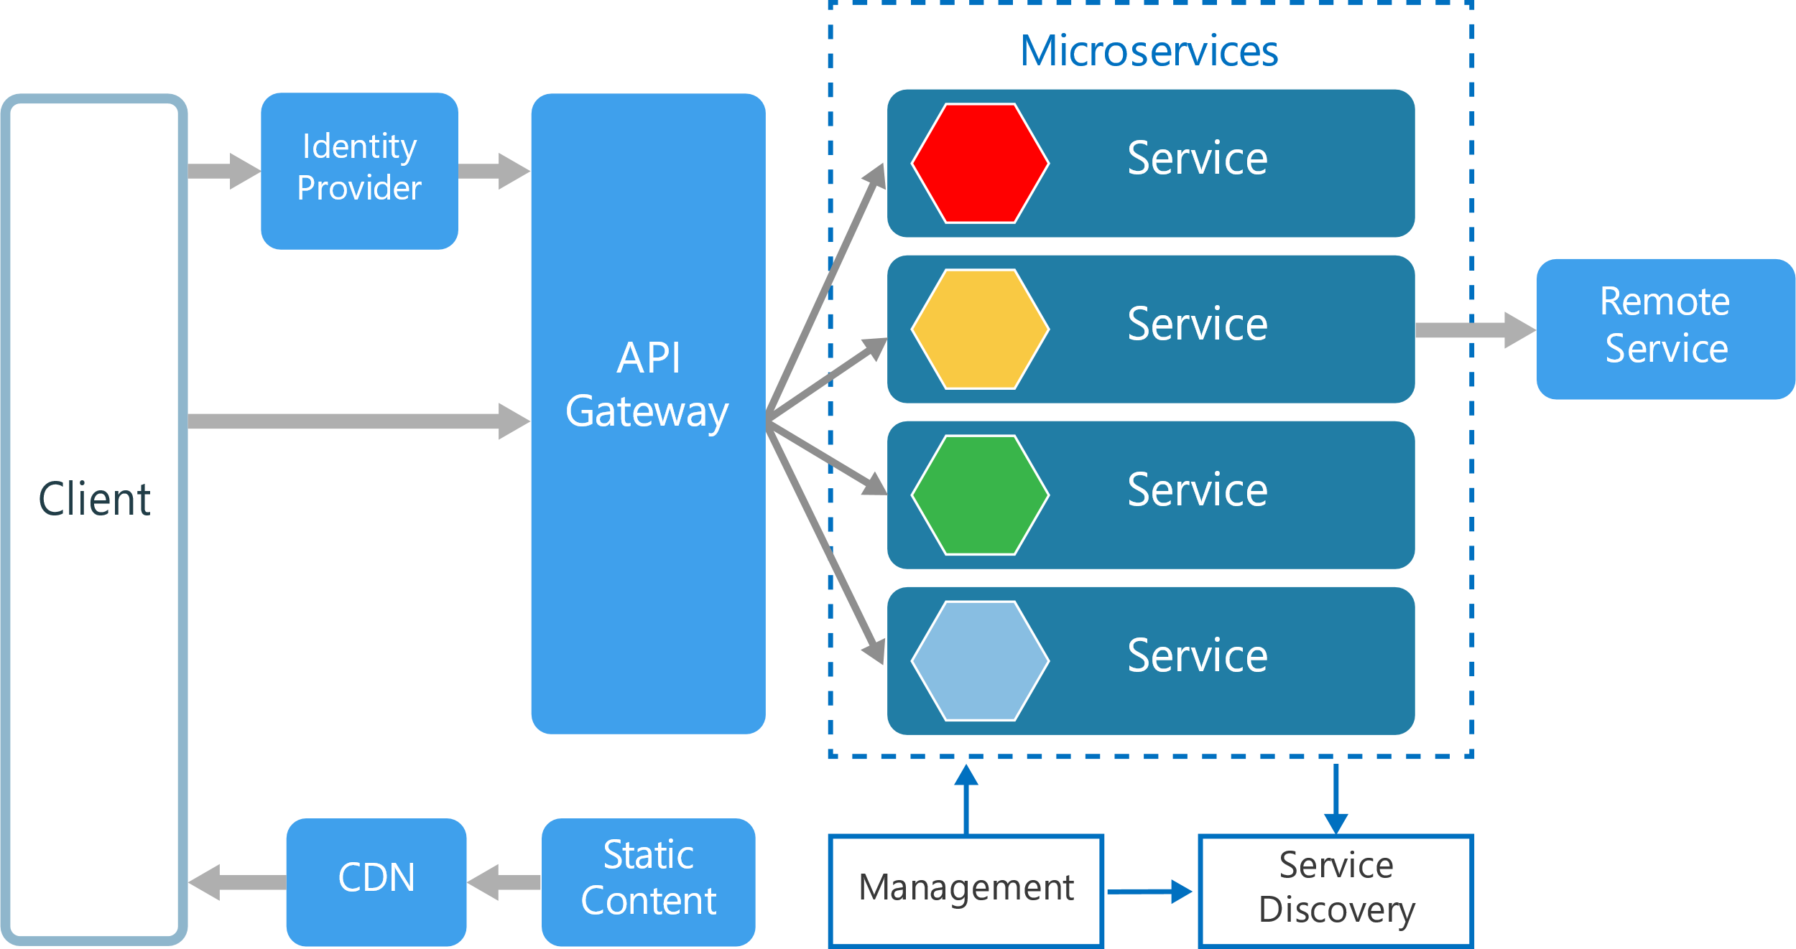
Microservices Overview

Slide 7
Other Components in a Typical Microservices Architecture
Management
Service Discovery
API Gateway
Notes:
Management. The management component is responsible for placing services on nodes, identifying failures, rebalancing services across nodes, and so forth.+
Service Discovery. Maintains a list of services and which nodes they are located on. Enables service lookup to find the endpoint for a service.
API Gateway. The API gateway is the entry point for clients. Clients don't call services directly. Instead, they call the API gateway, which forwards the call to the appropriate services on the back end. The API gateway might aggregate the responses from several services and return the aggregated response.

Slide 8










A platform and build everything
DESKTOP
WEB
CLOUD
MOBILE
JEUX
IoT
IA
.NET
Notes:
You can build anything with .NET. From desktop apps to cloud-native services, iPhone and Android mobile apps to artificial intelligence, you can build almost anything with the .NET platform.

Slide 9

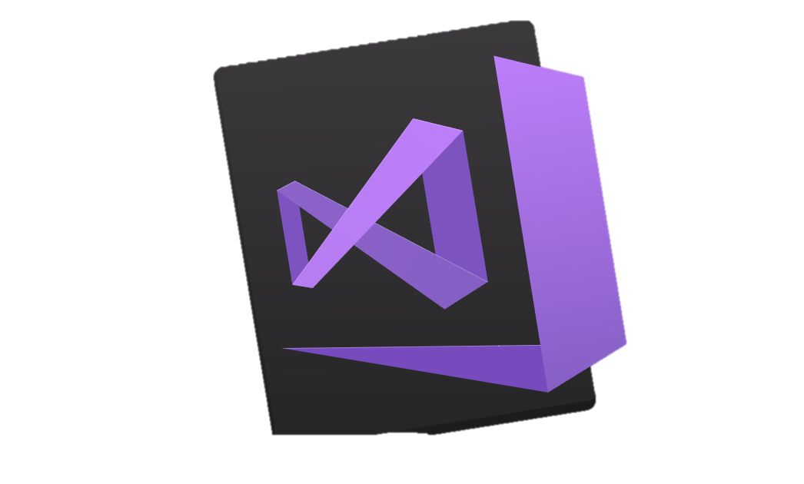

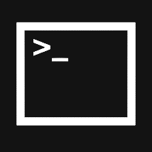
.NET - Software development platform
TOOLS
DESKTOP
WEB
CLOUD
MOBILE
Games
IoT
IA
VISUAL STUDIO
.NET STANDARD
VISUAL STUDIO FOR MAC
LIBRAIRIES
VISUAL STUDIO CODE
INFRASTRUCTURE
RUNTIME COMPONENTS
COMPILERS
LANGUAGES
COMMAND LINE INTERFACE
Notes:
.NET is an entire software development platform that takes care of a lot of the heavy lifting for you when you want to build an application. Applications frameworks help you build the specific types of apps or workloads and enable you to literally build any app for any platform with any operating system. Each .NET workload shares a common infrastructure and .NET Standard library. This means not only are your .NET skills portable, but your actual code is portable no matter what you’re building. This makes it easy to share reusable components (called libraries) across the breadth of applications people build.
Additionally, there are a broad set of development tools that makes it really productive to write, debug, build and manage code bases.
See: www.dot.net

Slide 10
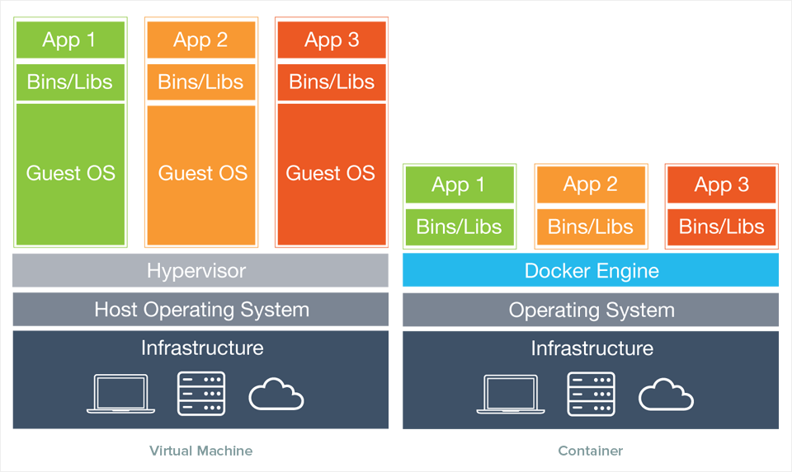
What’s Docker
Service density++ ☺

Slide 11
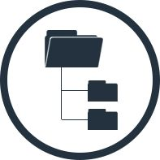
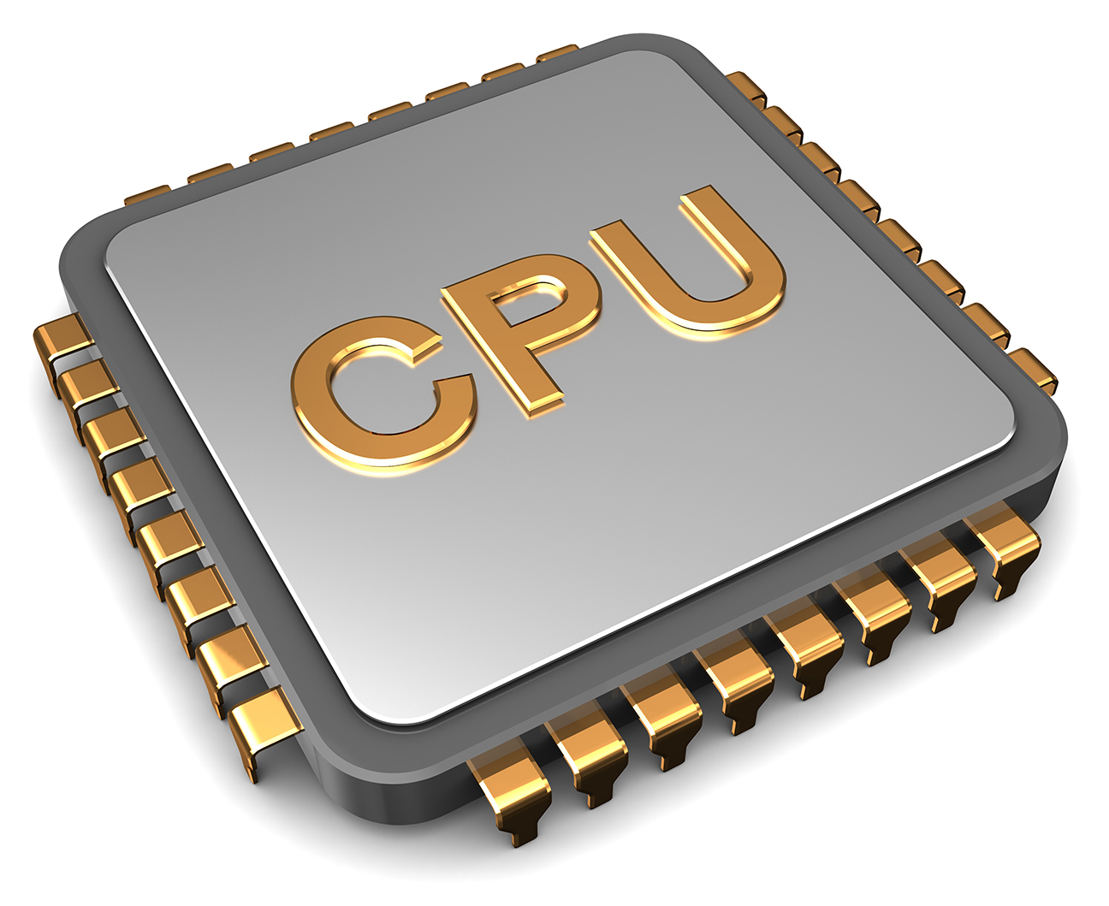
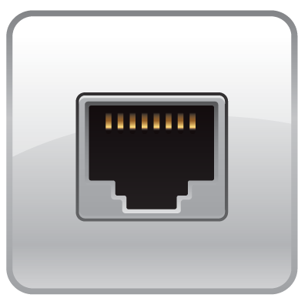
Containers == Virtualized Operating System
Kernel namespaces (Linux and Windows)
Virtual File System
Virtual Process Tree
Virtual Network

Slide 12
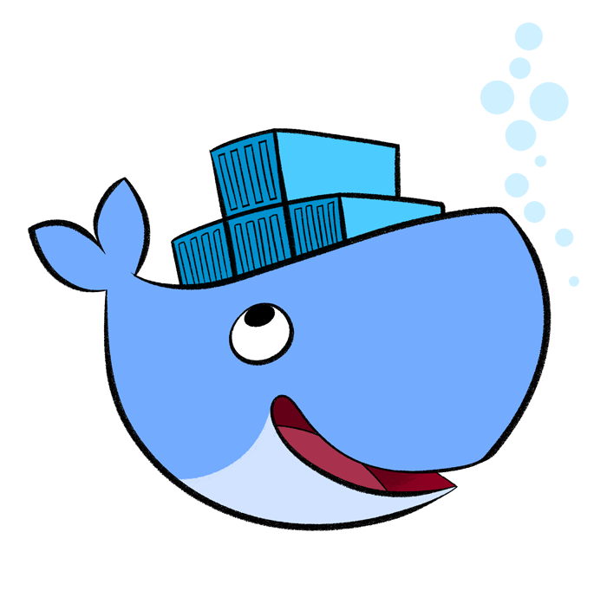
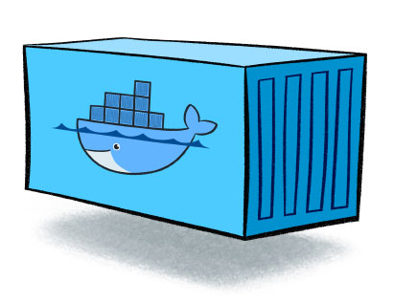
Docker is a (the) container engine
Image
Docker (aka Moby project) is free and open source, no limitations
There’s an enterprise edition (hosting, support, certification...)
It’s the de-facto standard for container-based applications

Slide 13
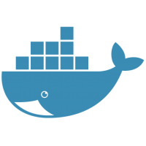
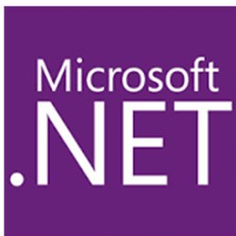
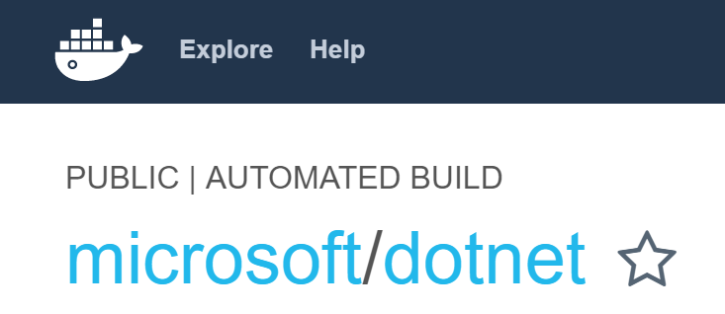
Docker and .NET
.NET Core Docker images
xPlat. (Linux & Windows)
.NET Framework images
Windows only
See at Docker Hub

Slide 14
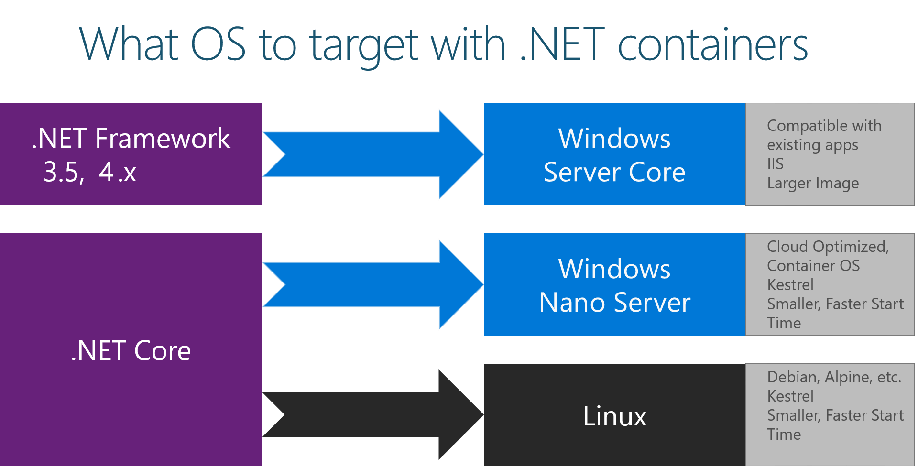

Slide 15
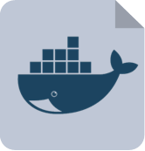
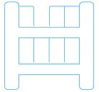
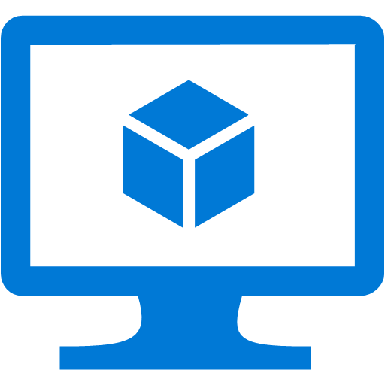
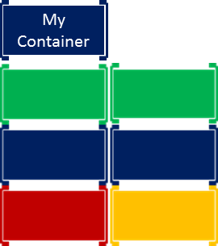






Inner-Loop development workflow for Docker apps
1.
2.
3.
4. (opt)
5.
6.
Write
Dockerfile/s
Create Images defined at Dockerfile/s
Define apps
by writing
Run Containers / Compose app
Code
your app
Test
your app or
microservices
docker-compose.yml
My Containers
My Images
My Containers
docker build
docker run /
Docker-compose up
http
access…
VM
Base Images
My Images
1
2
Remote
Docker Registry
(i.e. Docker Hub)
Local
Docker Repos
7.
git push
Push or
Continue
developing
docker push
to private registry
(*) If not using CI/CD

Slide 16

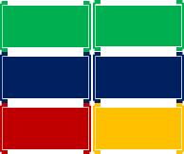
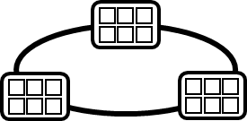

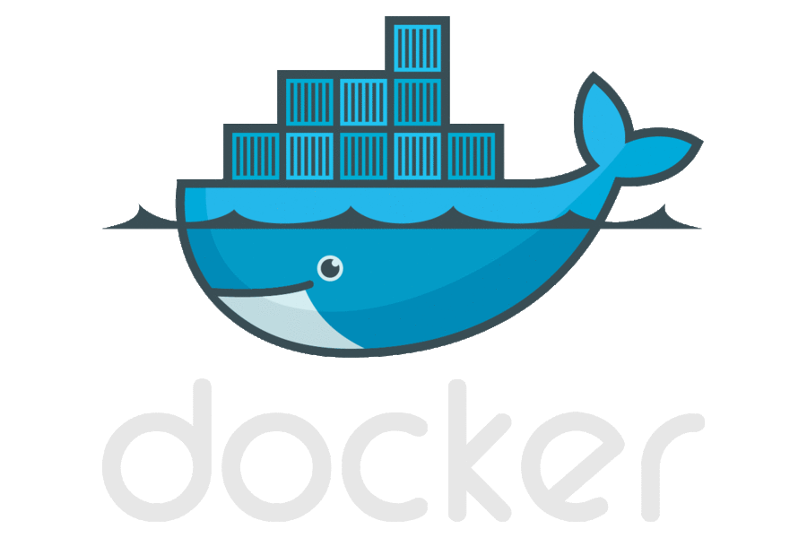

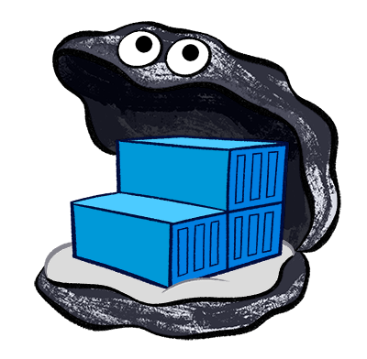
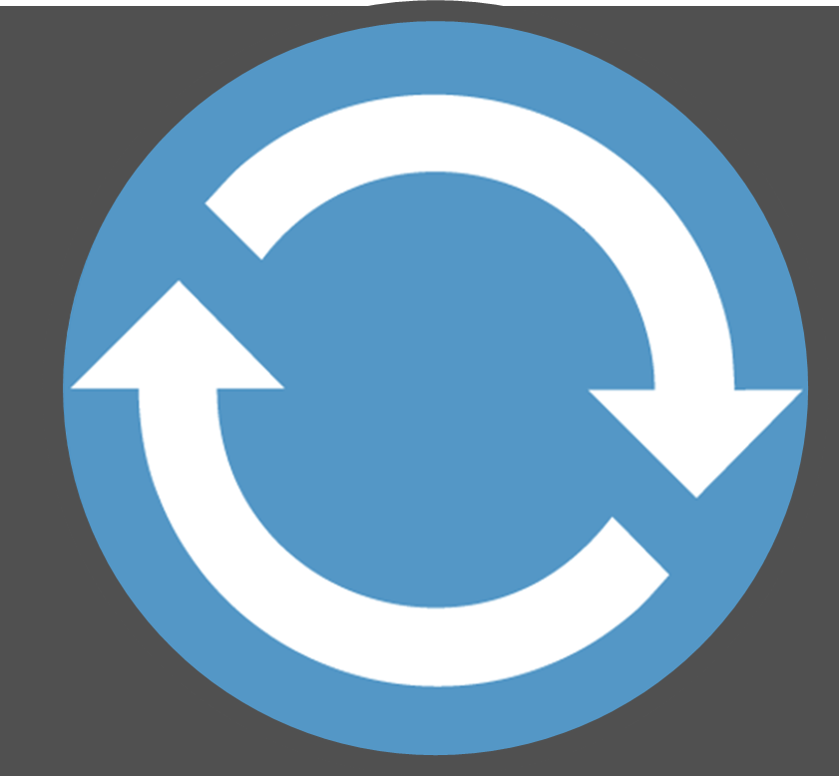
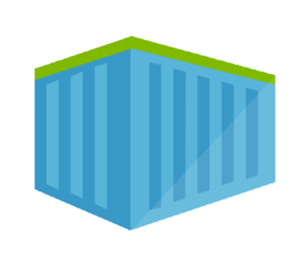
DevOps Workflow using containers
Visual Studio Team Services
AKS
2.
3.
4.
5.
Source Code Control
(SCC)
Build/CI,
Integrate,
Test
Run, Manage
Service Fabric
CD, Deploy
Production
environments
App Services
Azure Container Registry
Push
Code
Azure Key Vault
Inner-Loop
6.
1.
Monitor and Diagnose
Run
Code
Validate
Debug
Outer-Loop
Notes:
http://docs.devopshub.cn/

Slide 17
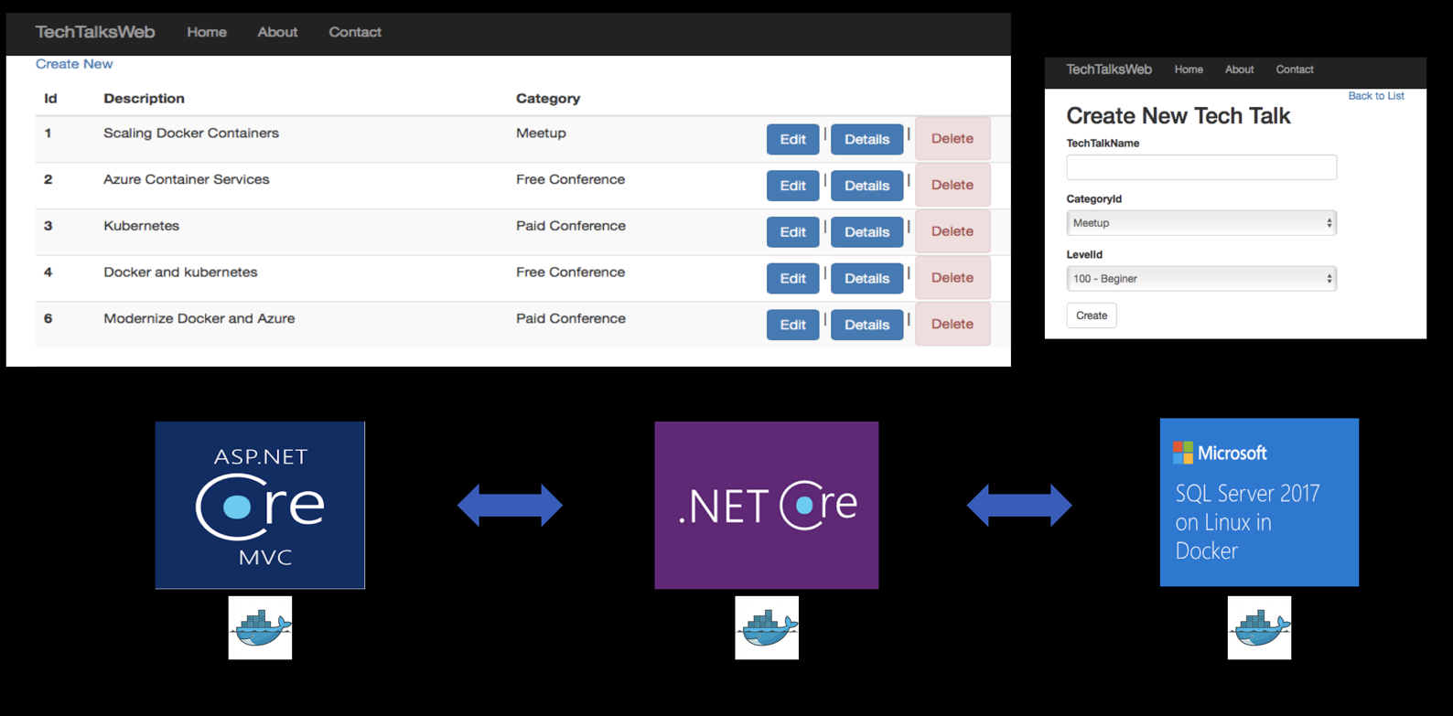

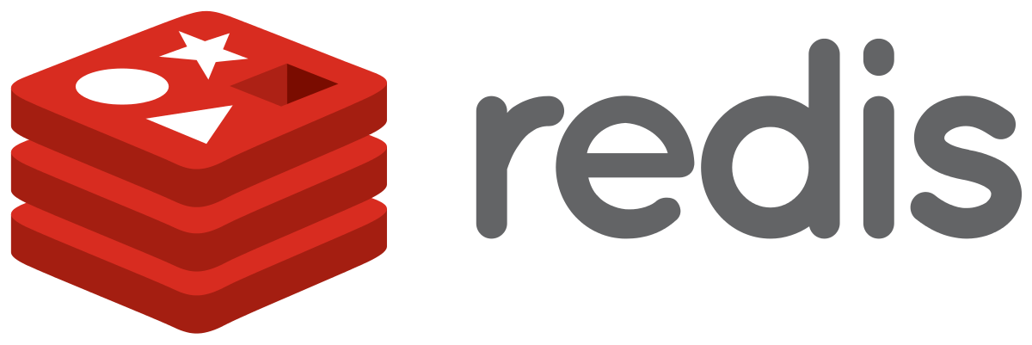


What we are going to build
Front end
ASP.NET Core MVC
Back end
ASP.NET Core MVC
Notes:
https://docs.microsoft.com/zh-cn/dotnet/standard/containerized-lifecycle-architecture/design-develop-containerized-apps/visual-studio-tools-for-docker

Slide 18
Dockerfile explained
Host machine
base
aspnetcore:2.1
80
/app
FROM microsoft/dotnet:2.1-aspnetcore-runtime AS base
WORKDIR /app
EXPOSE 80
FROM microsoft/dotnet:2.1-sdk AS build
WORKDIR /src
COPY *.sln ./
COPY backend/backend.csproj backend/
RUN dotnet restore
COPY . .
WORKDIR /src/backend
RUN dotnet build -c Release -o /app
FROM build AS publish
RUN dotnet publish -c Release -o /app
FROM base AS final
WORKDIR /app
COPY --from=publish /app .
ENTRYPOINT ["dotnet", "backend.dll"]
build
dotnet-build:2.1
/src
Compose.sln
Backend.csproj
Compose.sln
Backend.csproj
Packages
program.cs
start.cs, …
program.cs
start.cs, …
/app
backend.dll
publish
dotnet-build:2.1
/src
*.sln, *.csproj, *.cs…
Pkgs
/app
.dll
Pkgs
/views
final
aspnetcore:2.1
/app
/app
.dll
Pkgs
/views
80
$: dotnet backend.dll

Slide 19

Dockerfile explained
Host machine
base
aspnetcore:2.1
80
/app
FROM microsoft/dotnet:2.1-aspnetcore-runtime AS base
WORKDIR /app
EXPOSE 80
FROM microsoft/dotnet:2.1-sdk AS build
WORKDIR /src
COPY *.sln ./
COPY backend/backend.csproj backend/
RUN dotnet restore
COPY . .
WORKDIR /src/backend
RUN dotnet build -c Release -o /app
FROM build AS publish
RUN dotnet publish -c Release -o /app
FROM base AS final
WORKDIR /app
COPY --from=publish /app .
ENTRYPOINT ["dotnet", "backend.dll"]
build
dotnet-build:2.1
/src
Compose.sln
Backend.csproj
Compose.sln
Backend.csproj
Packages
program.cs
start.cs, …
program.cs
start.cs, …
/app
backend.dll
publish
dotnet-build:2.1
/src
*.sln, *.csproj, *.cs…
Pkgs
/app
.dll
Pkgs
/views
final
aspnetcore:2.1
/app
/app
.dll
Pkgs
/views
80
$: dotnet backend.dll

Slide 20
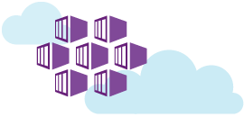
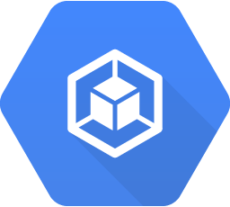
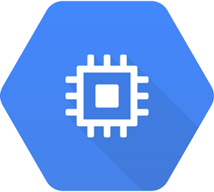
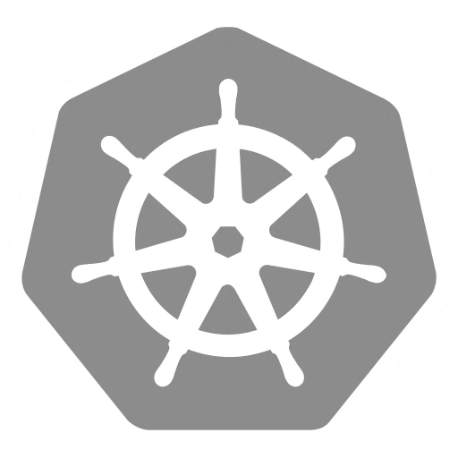
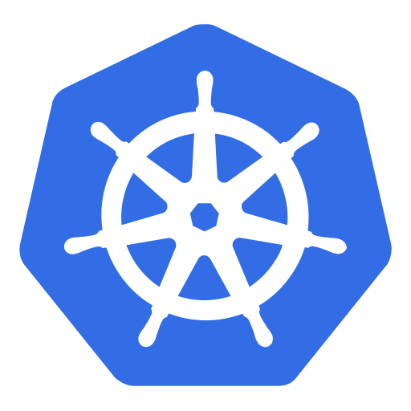

We need an orchestrator: enter Kubernetes and AKS
Running Pods
(~containers)
Agent
nodes
Master
nodes
Kubectl
CLI

Slide 21
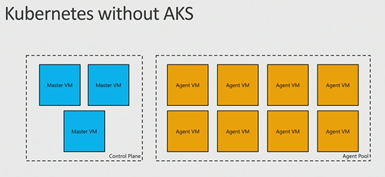
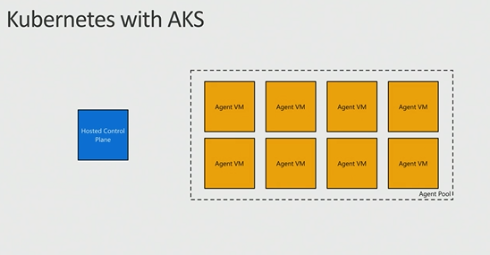
AKS: Managed Kubernetes
Azure-hosted control plane
No master nodes to manage or pay for
Automated upgrades and patching
Easily upgrade control plane and worker nodes to new versions of Kubernetes
Scale agent pool to increase or decrease capacity
Notes:
Automatic binpacking
Self-healing
Horizontal scaling
Service discovery and load balancing
Automated rollouts and rollbacks
Secret and configuration management
Storage orchestration
Batch execution

Slide 22
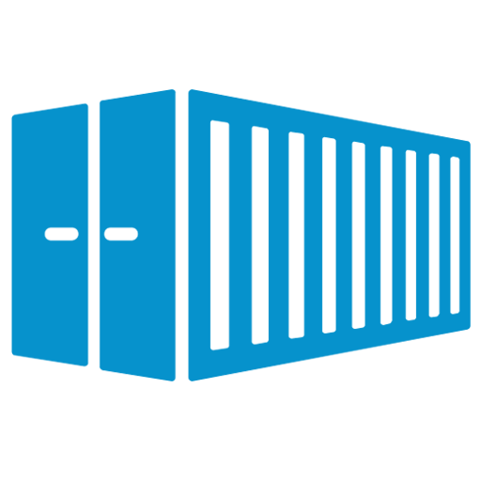
Ok... What’s a “Pod” now?!
Atomic unit of deployment in Kubernetes
It has its own IP Address
It’s short lived and replaceable
Don’t get too attached to it ☺
It runs one or more containers
All the containers share storage and network
We almost never manage pods directly
There are higher level objects
frontend
10.1.0.11
frontend
Log spooler
/var/logs
10.1.0.11

Slide 23
Kubernetes objects are created through its REST API
Service
apiVersion: v1
kind: Service
metadata:
name: frontend-svc
spec:
ports:
- port: 80
selector:
app: frontend
Deployment
HOST: frontend-svc
apiVersion: apps/v1beta1
kind: Deployment
metadata:
name: frontend-dpy
spec:
replicas: 3
template:
metadata:
labels:
app: frontend
spec:
containers:
- name: frontend
image: myreg/frontend:latest
ports:
- containerPort: 80
app: frontend
ReplicaSet
Upgrade policy
Pod
frontend
frontend
frontend
10.1.0.11:80
10.1.0.19:80
10.1.0.47:80
app: frontend
app: frontend
app: frontend

Slide 24
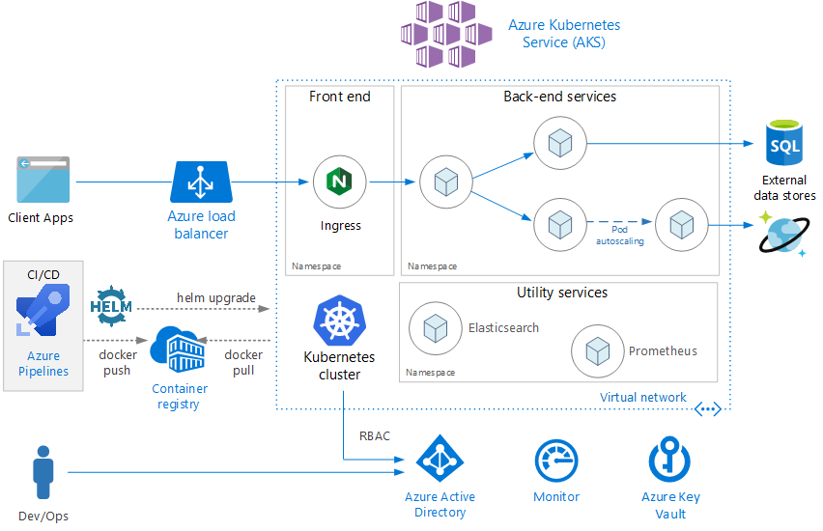
Microservice architecture on AKS
Notes:
https://docs.microsoft.com/zh-cn/azure/architecture/reference-architectures/microservices/aks
https://github.com/mspnp/microservices-reference-implementation

Slide 25
Recap
Run Mongo & Redis as Docker containers
Dockerised frontend and backend
Added nginx
Described the whole system on docker-compose
Run all of it on our laptop
Saved the images on Azure Container Registry
Configured a CI/CD pipeline for them
Deployed on a Kubernetes cluster in Azure Kubernetes Service (AKS)
Set up a dashboard and an alert in Log Analytics

Slide 26
Recap - Commands
docker run –p 8080:80 wordpress | Starts a container from an image, exponing it on 8080
docker ps | Lists of all running containers (-a includes stopped ones)
docker start containerName | Starts (and stops) a container
docker rm -f $(docker ps -q) | Removes all running containers
docker images | Lists all images
docker rmi imageName | Removes an image
docker login myregistry.azurecr.io | Logs in Azure Container Registry
docker tag frontend myregistry.azurecr.io/frontend | Tags an image for Azure Container Registry
docker push myregistry.azurecr.io/frontend | Pushes an image to Azure Container Registry
kubectl apply -f filename | Creates the kubectl objects specified in the file
kubectl get deployments/services/pods | Lists all the deployments/services/pods in the cluster
kubectl proxy --address="0.0.0.0" | Tunnels the cluster’s dashboard to localhost

Slide 27
Recap – On Azure
Azure Container Registry
Our private repository where we can store Docker images
docker login myregistry.azurecr.io
Azure Web App for Containers
They can run only one container at a time
Sort of CD supported via Azure Container Registry and web hooks
Azure Container Service (AKS)
Fully managed orchestrator
Based on Kubernetes
https://docs.microsoft.com/en-us/azure/aks/
Container monitoring solution
Based on Azure LogAnalytics
Uses a DaemonSet to track cluster events
https://docs.microsoft.com/en-us/azure/log-analytics/log-analytics-containers

Slide 28
Thank you!
@geffzhang
geffzhang@weyhd.com
Get the code at https://github.com/geffzhang/DockerStarted

