Slide 1
OFFICE AUTOMATION SYSTEM

Slide 2
GOVERMENT POLYTECHNIC DHARASHIV
PROJECT NAME - OFFICE AUTOMATION SYSTEM
PRESENTED BY – Om Shingare, Prerana Kupade

Slide 3
CONTENTS
Introduction
Pain Point Of College
Aim
Project Outcomes
Requirements
System Design
Actual Result
Application
Future Scope
Conclusion

Slide 4
INTRODUCTION
Welcome to the presentation on the transformation journey of Government Polytechnic College, Dharashiv.
In today's digital age, technology has become an integral part of our daily lives, revolutionizing the way we work, communicate, and learn. Educational institutions, too, have embraced this digital transformation, leveraging technology to enhance administrative efficiency, communication, and overall student experiences.
We aim to implement a centralized Office Automation System (OAS) to manage letter creation, printing, tracking.

Slide 5
Pain Point Of College
Manual Administrative Processes: Many administrative tasks, such as handling letters, managing student records, and processing payments, may still be done manually, leading to inefficiencies and delays.
Lack of Transparency: The lack of transparent processes can lead to confusion among students, faculty, and staff regarding policies, procedures, and decision-making.
Limited Communication Channels: Inadequate communication channels between different departments, faculty, and students may result in misunderstandings, missed deadlines, and decreased collaboration.

Slide 6
Pain Point Of College
Outdated Technology Infrastructure: Colleges may struggle with outdated technology infrastructure, including outdated software systems, slow internet connections, and insufficient hardware resources, hindering productivity and innovation.
Difficulty in Accessing Information: Difficulty in accessing important information, such as course schedules, academic resources, and campus announcements, can impede students' academic progress and faculty/staff efficiency.

Slide 7
KEY FEATURES
Streamline the process of creating, printing, and tracking letters within a centralized system.
Eliminate manual administrative tasks and ensure efficient handling of correspondence.
Track the status of document requests and streamline approval processes.
Design the OAS with a user-friendly interface to enhance accessibility and usability for all users.
Allow for future enhancements and updates to accommodate changing requirements and technological advancements.

Slide 8
AIM
The primary aim of the Office Automation System (OAS) project is to create a user-friendly and efficient web-based platform centralized system to manage various administrative tasks, including letter creation, printing, tracking, document requests, feedback mechanisms, and information dissemination.
We aim to demonstrate how the OAS aligns with the institution's objectives of efficiency, transparency, and student engagement, ultimately enhancing the overall operational effectiveness of Government Polytechnic College, Dharashiv.

Slide 9
PROJECT OUTCOMES
Streamlined administrative tasks such as letter management, document requests, and feedback mechanisms.
Centralized system for managing and tracking letters, documents, and feedback submissions.
Provision of user-friendly interfaces and timely information for students.
Reduction in paper usage, printing costs, and administrative overhead.
Design of the Office Automation System (OAS) to be scalable and adaptable to meet evolving needs.

Slide 10
REQUIREMENTS
Functional Requirements:
User Authentication
Document Request
User Interface
Non-Functional Requirements:
Security
Performance
Reliability
Scalability

Slide 11
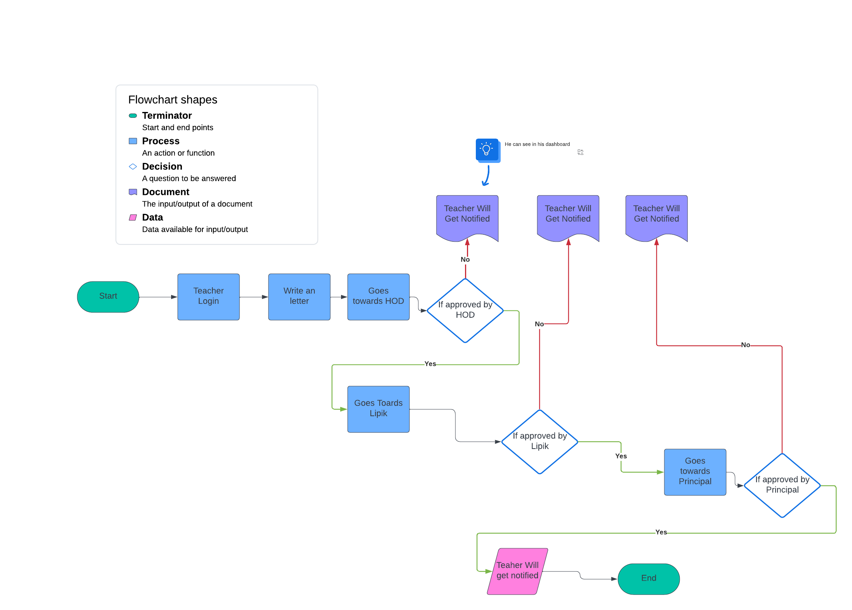
SYSTEM DESIGN

Slide 12
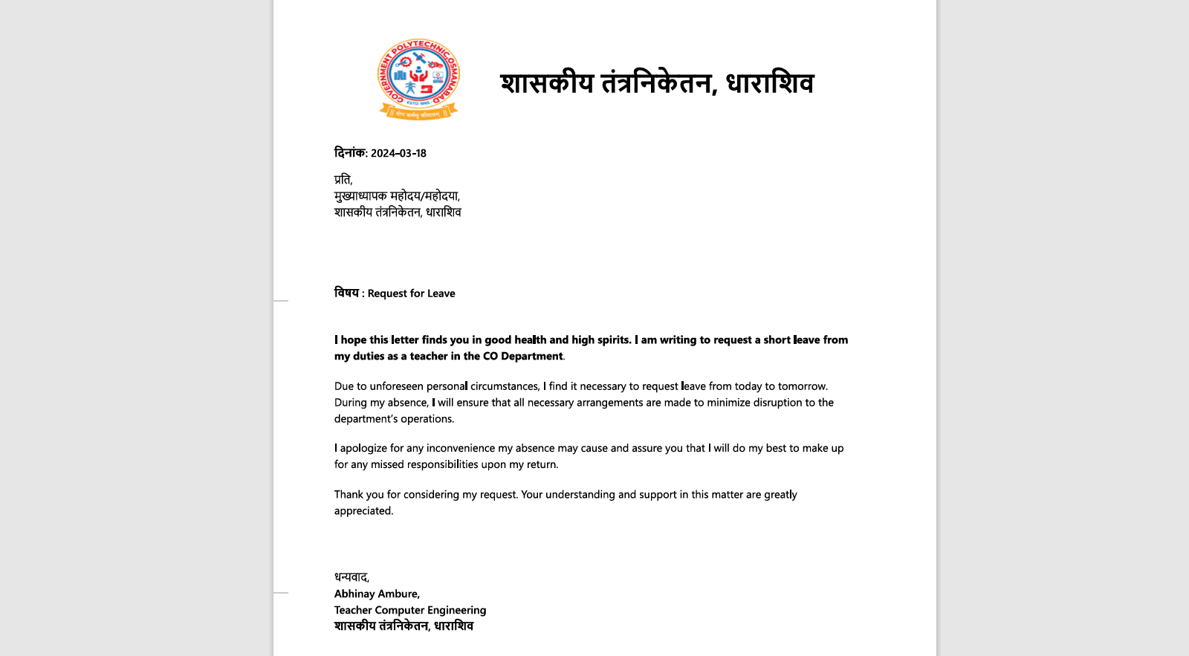
Actual Result

Slide 13
APPLICATIONS
Letter Submission and Approval: The primary application of your system would be to automate the process of letter submission and approval within the college. This includes letters such as leave requests, permissions, and other administrative documents.
Real-Time Tracking: Your system can provide real-time tracking of the status of each letter, allowing teachers and administrators to monitor the progress of their submissions at any given time.
Role-Based Access Control: Implementing role-based access control ensures that only authorized users have access to specific functions and information within the system, enhancing security and confidentiality.
Automated Notifications: Your system can send automated notifications to users at various stages of the approval process, keeping them informed about any updates or actions required on their part.

Slide 14
FUTURE SCOPE
Enhanced Communication Features: In the future, the Office Automation System could be expanded to include additional communication features such as chat functionalities, discussion forums, and announcements to facilitate seamless collaboration and information sharing among users.
Integration with External Systems: The system could be enhanced to integrate with external systems such as email servers, student information systems, and calendar applications to streamline data exchange and improve interoperability with other college systems.
Advanced Analytics and Reporting: Implementing advanced analytics and reporting capabilities can provide deeper insights into administrative processes, letter approval trends, and user behavior, enabling informed decision-making and continuous process improvement.
Artificial Intelligence (AI) Integration: Integration of AI technologies such as natural language processing (NLP) and machine learning (ML) can automate routine tasks, provide personalized recommendations, and enhance the efficiency and effectiveness of the Office Automation System.

Slide 15
CONCLUSION
The Office Automation System has not only simplified administrative tasks but has also empowered teachers, Heads of Departments (HODs), and administrative staff to focus their time and energy on more value-added activities. Through real-time tracking, automated notifications, and role-based access control, we have created a user-friendly platform that enhances communication, collaboration, and decision-making across the college.

