Slide 1
SceneIQ
AI-Powered Visual Accessibility Assistant
Final Team Presentation
Prachi & Shingirai
CSCI 5030-01: Real-World Web Application Development
github.com/ShingiraiBhengesa/SceneIQ
Notes:
Welcome, we're Prachi and Shingirai presenting SceneIQ — our AI-powered visual accessibility assistant. This is a web platform that helps visually impaired users understand their surroundings through image analysis, scene descriptions, and audio output.

Slide 2



Problem Statement
285 million people worldwide live with visual impairments. They rely on sighted assistance, guide dogs, or limited assistive tools to navigate and understand their environment. Most existing solutions are expensive, require specialized hardware, or don’t provide real-time contextual understanding.
Limited Awareness
No Context
No Audio Output
No way to understand unfamiliar
environments independently
Can’t ask questions about
what’s around them
Most tools are visual-only,
not accessible to blind users
Notes:
285 million people worldwide have visual impairments. They face three key challenges: limited environmental awareness, no way to ask contextual questions about their surroundings, and most tools are visual-only without audio output. SceneIQ addresses all three.

Slide 3

Target Users & Project Goals
Target Users
Project Goals
Blind and visually impaired individuals
Real-time scene description via AI
Low-vision users who need scene context
Object detection with labels
Visual Q&A for contextual questions
Caregivers and accessibility advocates
Text-to-speech for hands-free use
Educators working with VI students
WCAG 2.1 AA accessible interface
Notes:
Our target users are blind and visually impaired individuals, low-vision users, caregivers, and educators. Our goals: real-time scene description, object detection, visual Q&A, text-to-speech, and full WCAG 2.1 AA accessibility.

Slide 4


What Makes SceneIQ Different
AI-Powered
Understanding
Interactive
Q&A
Audio-First
Design
Accessible
by Default
Not just object lists — natural language scene descriptions that explain what’s happening
Ask follow-up questions about any image and get contextual AI answers
Every result can be read aloud with customizable speech rate and voice
Built WCAG 2.1 AA compliant from day one — keyboard nav, screen readers, ARIA
Notes:
Four things make SceneIQ unique: AI-powered natural language understanding not just object lists, interactive Q&A, audio-first design with customizable TTS, and built accessible from the ground up.

Slide 5
Complete Tech Stack
Frontend
Backend
AI / ML
Infrastructure
React.js 18.2
Python FastAPI
Groq Cloud API
PostgreSQL 16
Tailwind CSS 3.4
SQLAlchemy ORM
Llama 4 Scout 17B
Redis 7
React Router 6.22
Alembic migrations
Vision-language model
Docker Compose
Web Speech API
Pydantic validation
Pillow (image processing)
Render (deployment)
Notes:
Our tech stack: React with Tailwind CSS frontend, Python FastAPI backend with SQLAlchemy and Alembic. For AI we pivoted from local YOLOv8 plus BLIP models to the Groq Cloud API with Llama 4 Scout — a 17 billion parameter vision-language model. This was necessary because the YoloV8 were too large to deploy on Render's free tier. Infrastructure is PostgreSQL, Redis, Docker Compose, deployed on Render.

Slide 6






System Architecture
FastAPI
Groq Cloud API
POST /auth/register
Llama 4 Scout 17B
Vision-Language Model
React
Frontend
POST /auth/login
Scene captioning
Object detection
Visual Q&A
Render
Deployment
GET /users/profile
Tailwind CSS
Web Speech API
React Router
WCAG 2.1 AA
PUT /users/profile
Docker container
Static site hosting
PostgreSQL add-on
Env vars managed
POST /images/analyze
PostgreSQL
POST /images/ask
users table
analysis_history (JSONB)
GET /images/history
Notes:
Our architecture flows left to right. The React frontend communicates with a FastAPI backend over REST. The backend calls the Groq Cloud API for all AI features — scene captioning, object detection, and visual Q&A — using the Llama 4 Scout vision-language model. Results are stored in PostgreSQL. Everything is deployed on Render with Docker.

Slide 7


AI / ML Architecture
Deployment Pivot: Local YOLOv8 + BLIP models (2.5GB RAM) were too large for Render’s free tier. We switched to Groq Cloud API with Llama 4 Scout — a single vision-language model that handles all three tasks (detection, captioning, Q&A) via API calls, eliminating local model overhead.
Object Detection
Scene Captioning
Visual Q&A
detect_objects()
generate_caption()
answer_question()
Prompt:
Prompt:
Prompt:
List objects as JSON array
with labels and confidence
Describe this image in one
clear sentence for VI users
User’s custom question
passed directly to model
→ [{label, confidence}]
→ natural language text
→ contextual answer
Model: meta-llama/llama-4-scout-17b-16e-instruct | API: Groq Cloud | No local GPU needed
Notes:
We pivoted from local YOLOv8 plus BLIP to Groq Cloud API with Llama 4 Scout because the local models required 2.5GB RAM which exceeded Render's free tier.
Llama 4 Scout is a single vision-language model that handles all three tasks via different prompts: object detection returns JSON with labels and confidence, captioning generates a natural language sentence, and Q&A answers user questions.
This eliminated the need for local GPU and reduced our deployment footprint to near zero.

Slide 8


Database Schema
users
analysis_history
id
UUID
PK
id
UUID
PK
name
VARCHAR(100)
NOT NULL
1 : N
user_id
UUID
FK → users.id
email
VARCHAR(255)
UNIQUE, INDEX
image_filename
VARCHAR(255)
password_hash
VARCHAR(255)
NOT NULL
caption
TEXT
speech_rate
FLOAT
DEFAULT 1.0
objects_detected
JSONB
high_contrast
BOOLEAN
DEFAULT FALSE
created_at
TIMESTAMP
WITH TZ
created_at
TIMESTAMP
WITH TZ
updated_at
TIMESTAMP
WITH TZ
Notes:
Two tables: users stores account info plus accessibility preferences like speech rate and high contrast. analysis_history stores each image analysis with the caption as text and detected objects as JSONB.
They have a one-to-many relationship via user_id foreign key with CASCADE delete. Both tables use UUID primary keys and timezone-aware timestamps.

Slide 9
Frontend Component Structure
App.jsx (React Router)
Shared Components
Services / Context
Navbar.jsx
Footer.jsx
ProtectedRoute.jsx
api.js (real API)
Pages (routes)
AuthContext.jsx
LandingPage
/
LoginPage
/login
RegisterPage
/register
DashboardPage
/dashboard
UploadPage
/upload
ProfilePage
/profile
PrivacyPolicy
/privacy
Terms
/terms
Accessibility
/access...
Notes:
The frontend has 9 pages routed through React Router. Shared components include Navbar, Footer, and ProtectedRoute for auth guards.
Services include api.js with real fetch calls to the backend, and AuthContext for JWT token state management.
Pages include the main 6 plus Privacy Policy, Terms of Service, and Accessibility Statement pages added in Sprint 3.

Slide 10
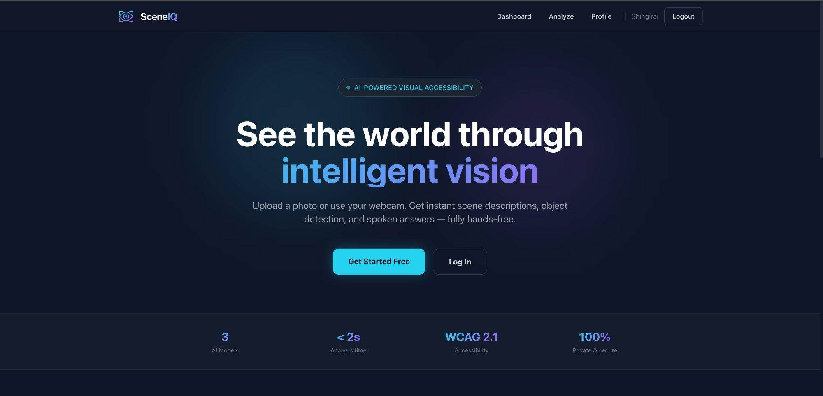
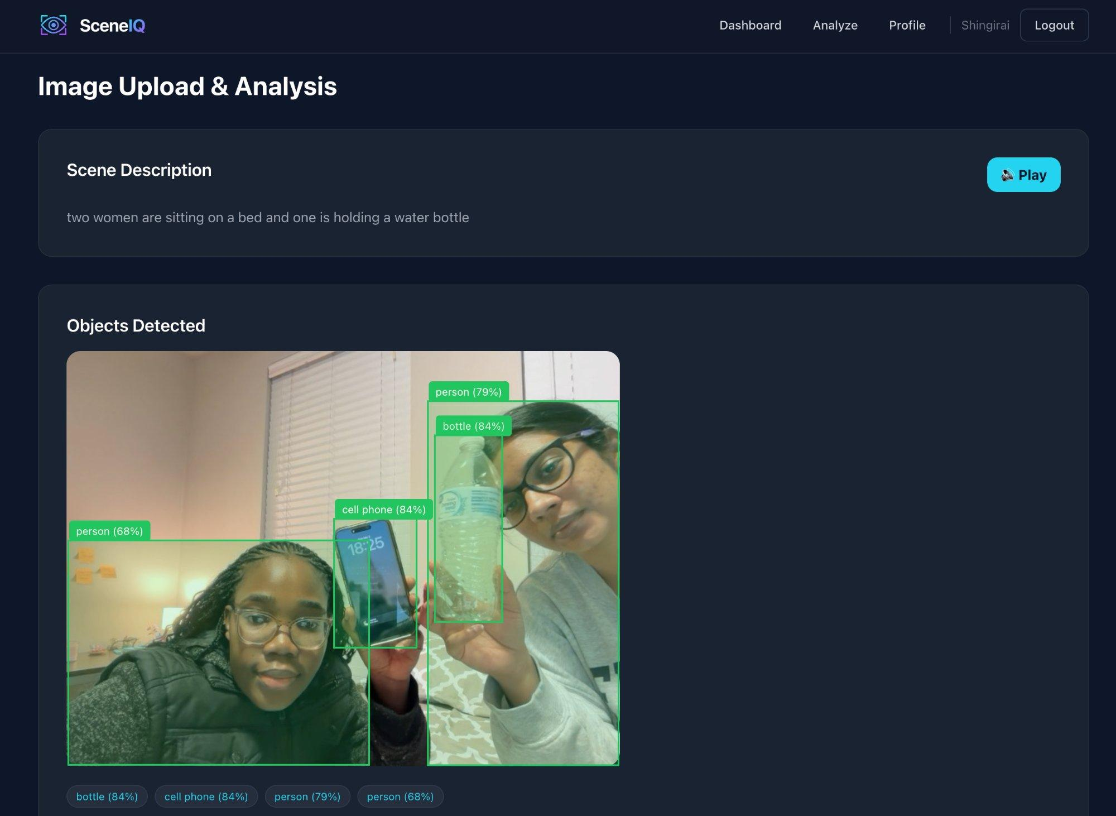
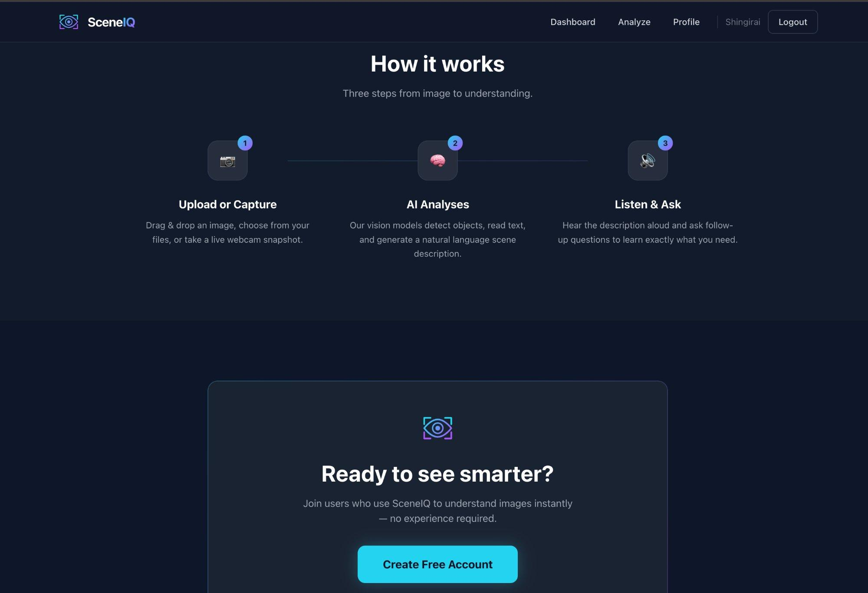
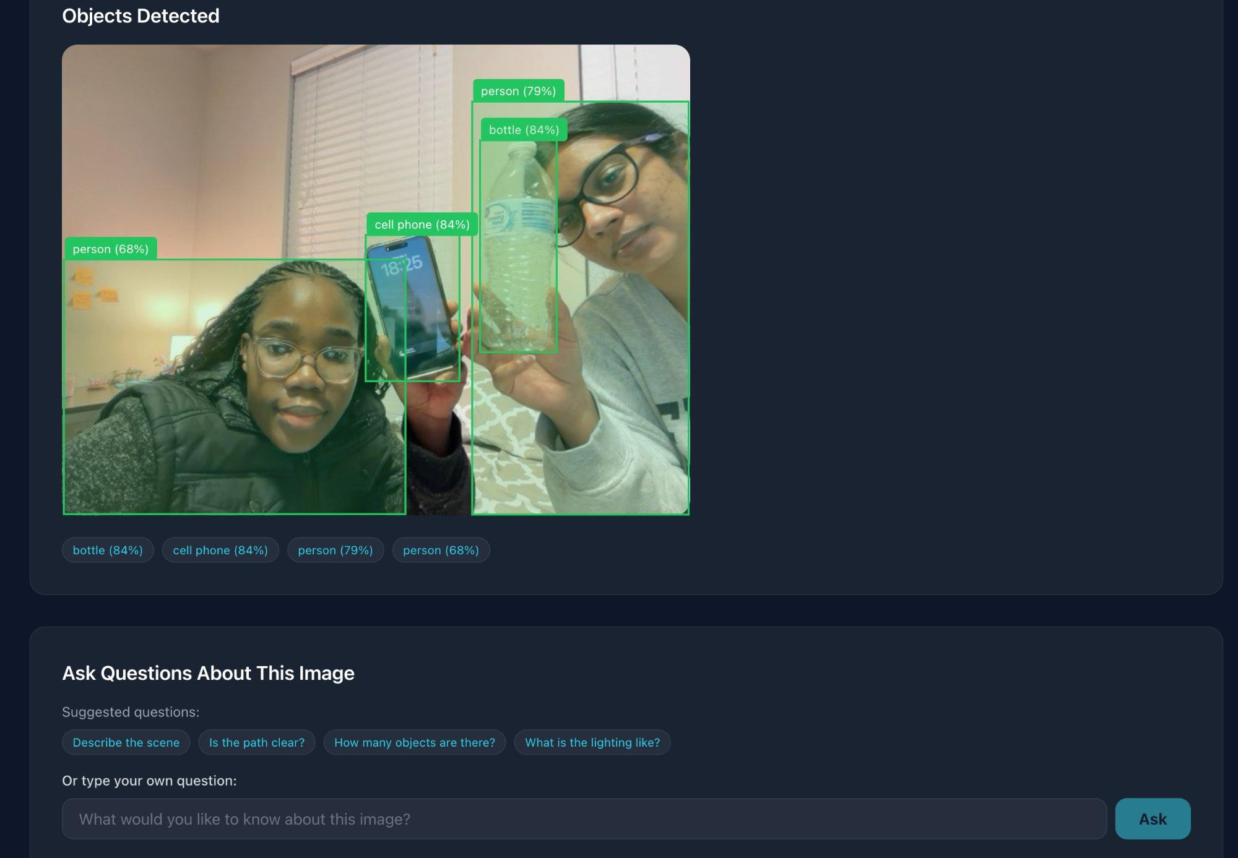
Live Demo
Notes:
Here are four key screenshots. Top left: the landing page. Top right: object detection and scene captioning with real AI results. Bottom left: the How It Works section. Bottom right: the Visual Q&A interface. Let me do a live demo now...

Slide 11
External Libraries & Services
Backend Libraries
Frontend & Services
groq
Groq Cloud API client
react-router-dom
Client-side routing
Pillow
Image processing (PIL)
tailwindcss
Utility-first CSS
python-jose
JWT token creation/verification
Web Speech API
Browser TTS (built-in)
bcrypt
Password hashing
Groq Cloud
AI inference API
python-multipart
File upload handling
Render.com
Deployment platform
pydantic[email]
Request/response validation
Docker
Containerization
redis
Session cache (configured)
PostgreSQL
Managed database
python-dotenv
Environment variable loading
Alembic
DB schema migrations
Notes:
On the backend: groq for the API client, Pillow for image processing, python-jose and bcrypt for auth, pydantic for validation.
On the frontend: React Router, Tailwind, and the built-in Web Speech API for text-to-speech.
External services: Groq Cloud for AI inference, Render for deployment, PostgreSQL as a managed database, Docker for containerization, and Alembic for database migrations.

Slide 12
Future Vision: Beyond the Browser
SceneIQ’s API-first architecture makes it easy to expand to new devices, modalities, and use cases.
Live Video
Captioning
Smart Walking
Stick
Wearable
Devices
Advanced
AI Features
• Stream webcam frames continuously
• Embed camera + speaker in cane
• Smart glasses with bone conduction
• OCR for reading text and signs
• Real-time narration of surroundings
• Raspberry Pi or ESP32 hardware
• Clip-on camera for clothing
• Face recognition for known people
• Alert on scene changes or hazards
• Hit SceneIQ API over Wi-Fi/LTE
• Smartwatch companion app
• Navigation and wayfinding
• WebSocket for low-latency updates
• Haptic feedback for obstacles
• Bluetooth earpiece audio output
• Multi-language scene descriptions
Notes:
This slide shows where SceneIQ can go next.
First, live video captioning — instead of uploading a single photo, we stream webcam frames continuously and narrate the surroundings in real-time, alerting users when the scene changes or hazards appear. This could use WebSockets for low-latency updates.
Second, smart walking sticks — we embed a small camera and speaker into a walking cane with a Raspberry Pi or ESP32 microcontroller. It connects to the SceneIQ API over Wi-Fi or cellular data and provides spoken descriptions plus haptic vibration feedback for obstacles.
Third, wearable devices — smart glasses with bone conduction audio, clip-on cameras, smartwatch companion apps, or simple Bluetooth earpieces. Our API-first design means any device with a camera and internet connection can use SceneIQ.
Fourth, advanced AI features for future development — OCR for reading signs and text, face recognition to identify known people, navigation and wayfinding assistance, and multi-language support for scene descriptions.
The key point is that because SceneIQ uses a cloud API for AI inference, all these devices just need to send an image and receive text back — the intelligence lives in the cloud, not on the device.

Slide 13
Thank You
Questions & Live Demo
Prachi & Shingirai
github.com/ShingiraiBhengesa/SceneIQ
Notes:
That wraps up our technical overview of SceneIQ. We've shown the problem, our solution, the complete tech stack including our pivot from local models to Groq Cloud API, the system architecture, database schema, frontend structure, and all external libraries.
Happy to do a live demo and take questions. Thank you!

