Slide 1
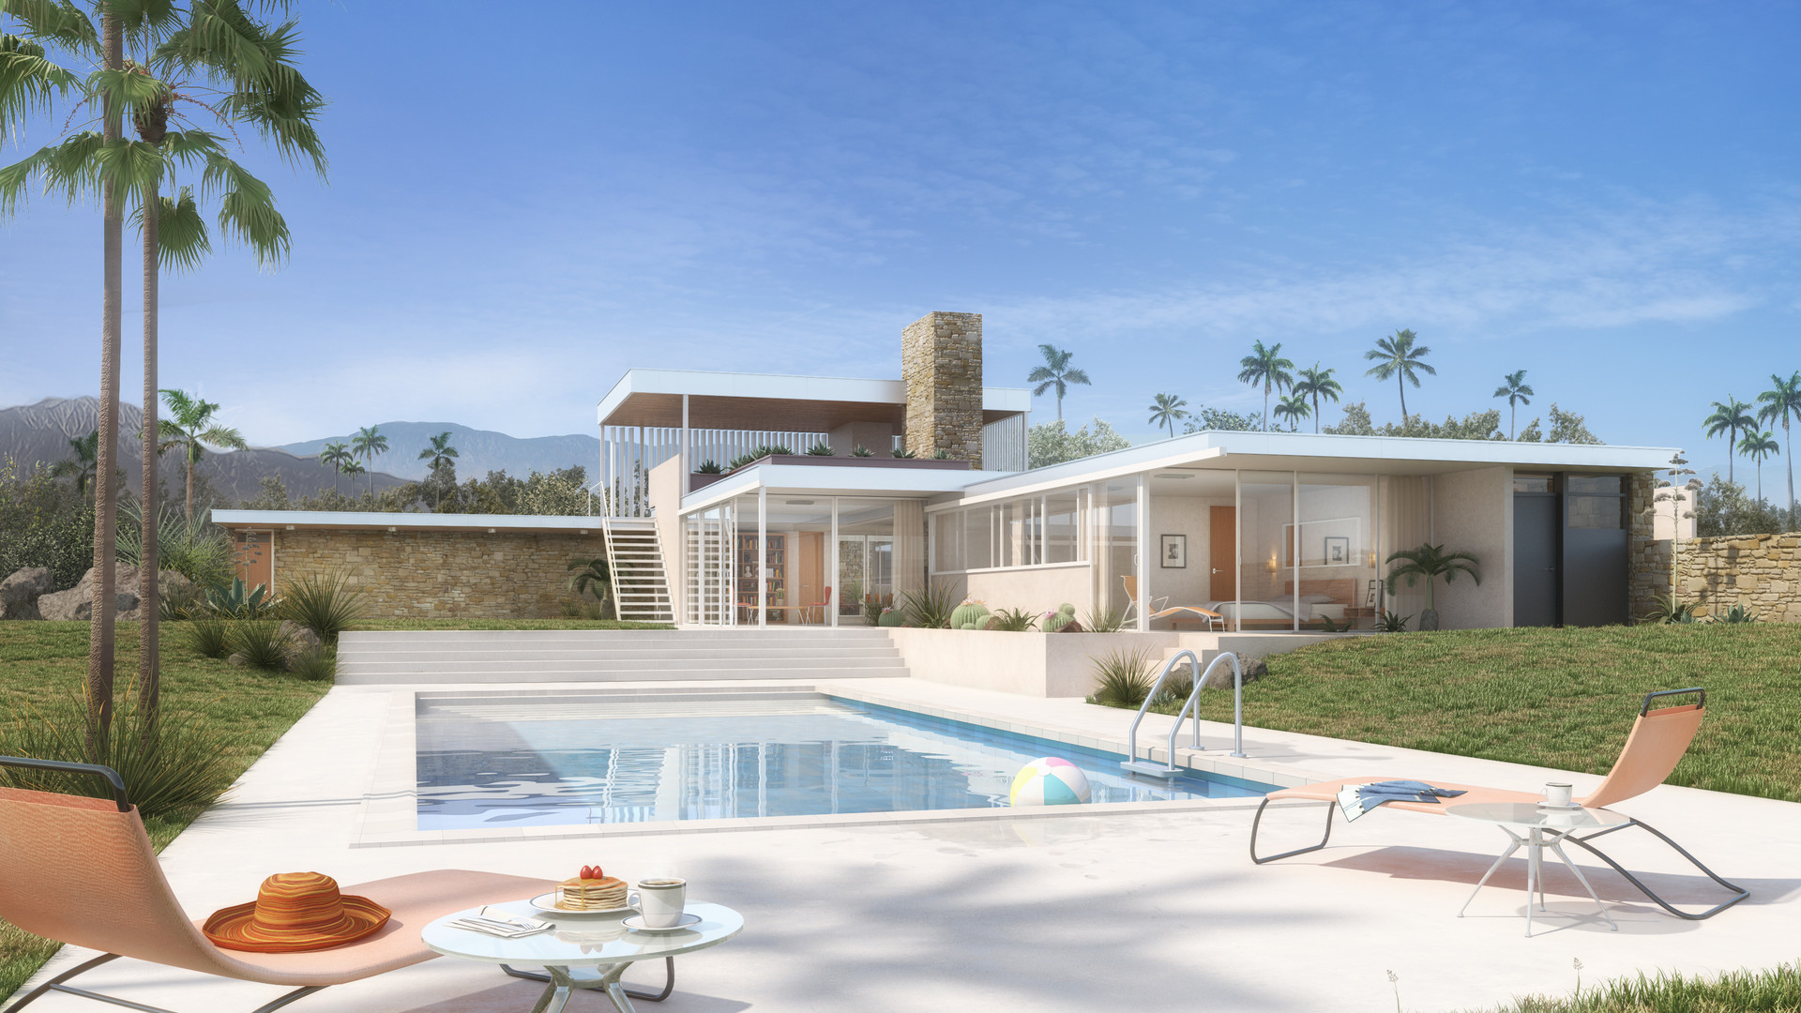
Kaufman Desert House
Chris DeChamplain

Slide 2
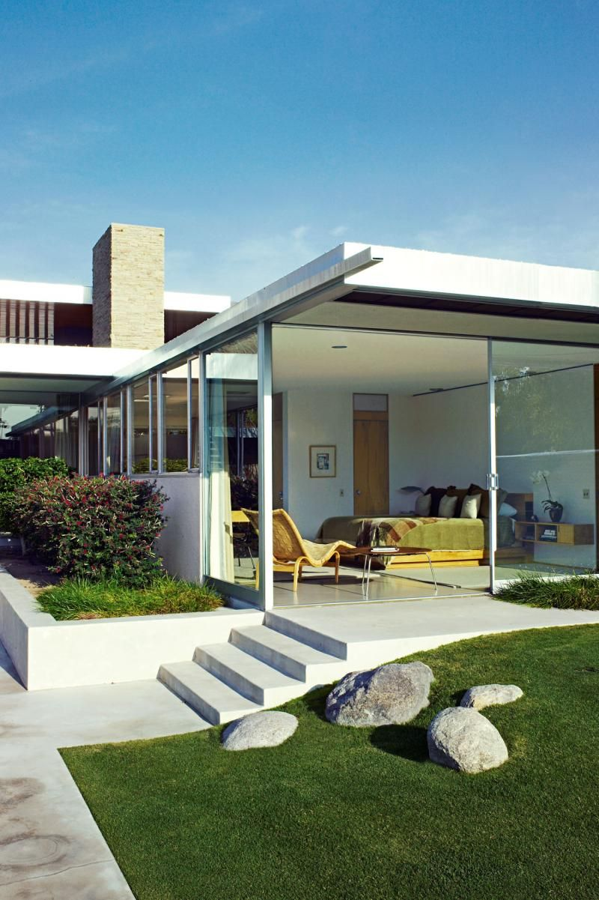
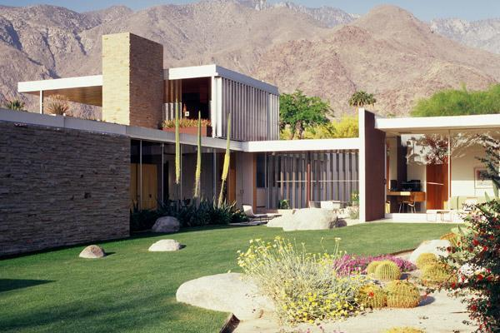
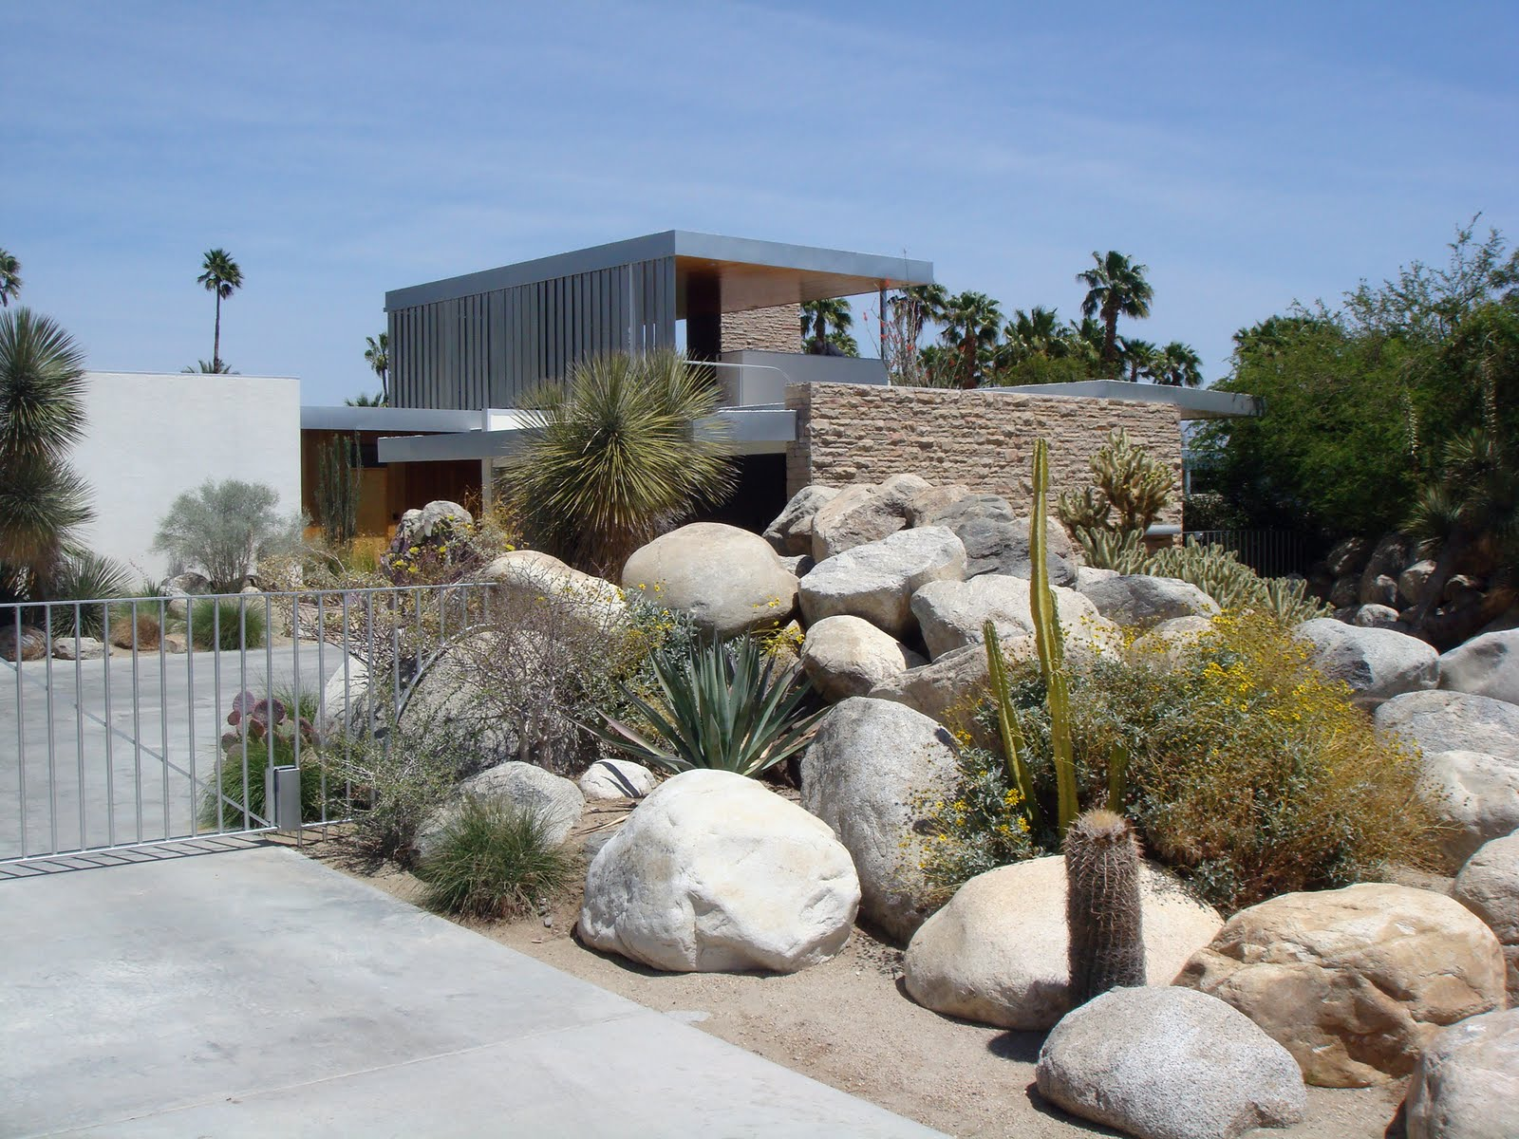
Style
Built in 1946 as a vacation home for Edgar J. Kaufmann Sr, this 2.6 acre site was constructed in an isolated region near the foot of Mt. San Jacinto by Richard J. Neutra.
The terrain, rough and rugged desert, made for a truly unique location for a home. The goal of the design was to fashion a home that didn’t completely blend into nature yet still took advantage of the surrounding terrain and ecology.
Opting for an object-in-space approach not unlike those used in classical European villas, Neutra used materials that speak directly to the Modernist style: Glass, steel, stone and concrete.
This home helped to define the style now referred to as Desert Modernism.
Exterior photos of Kaufman Desert House

Slide 3
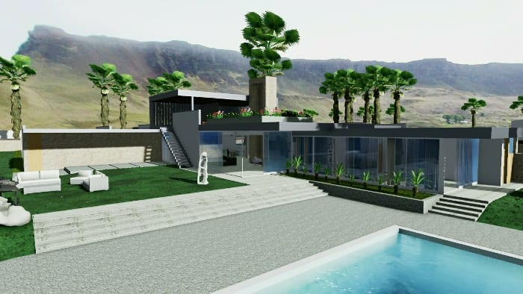
Form
The design Neutra utilized for this home was highly dependent on a mix of private and public, built and unbuilt spaces. Every piece serves a specific need, and is organised to flow naturally and intuitively.
Floating Effect
Through clever blending of glass doors and interesting overhangs, Neutra was able to skew perception on what was indoors and outdoors within the home.
Cantilevers allowed him to remove the need for corner posts in various rooms (such as the master bedroom) and create a floating effect to the entire structure.
3D rendering of the structure

Slide 4
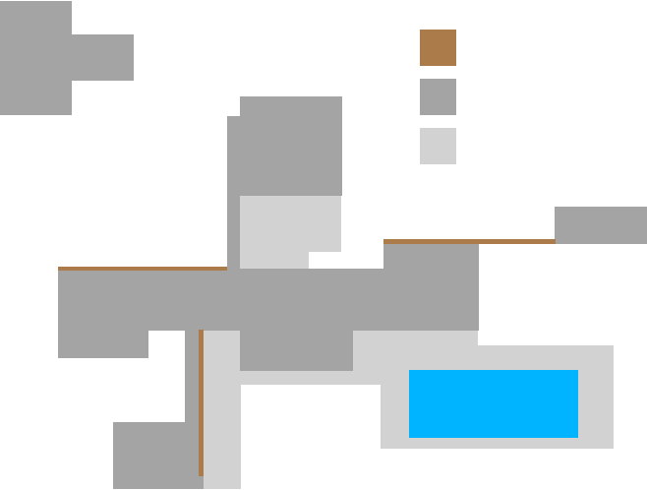
Form
The Pinwheel
Neutra utilized another unusual feature to bring style and uniqueness to the structure: a pinwheel formation.
Various wings extend from a core central branch, with each wing serving a different and specific purpose (a common theme in Modernism.) Each is connected to the central hub through the use of airflow, leading lines, hallways and materials.
Stone Wall
Interior Space
Exterior Space
“The architect who really designs for a human being has to know a great deal more than just the Five Canons of Vitruvius.” - Neutra
Form diagram showing interior, exterior and stone walls

Slide 5
Space
The structure itself is purposely designed to look man-made to stand out from the natural setting. Through this stark contrast to the surrounding terrain the home gains an aspect of power over it, and seems to take ownership over the desert.
The hills, valleys, trees and mountains around the home creates a juxtaposition to this claiming, however, and grant it the ability to still blend into the region and seem as if it belongs.
Through varying ceiling heights in one space to the next, inhabitants get a sense of where they are in the home compared to other areas thanks to the differing form of each section.
Northern Elevation
Southern Elevation
Western Elevation

Slide 6
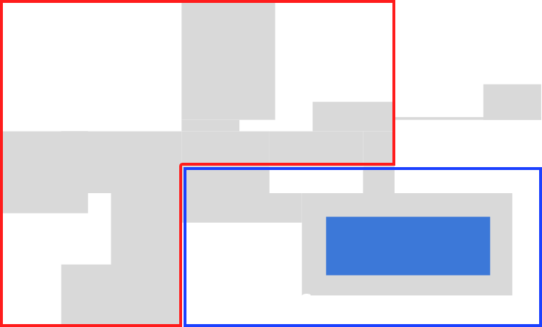
Space
The design Neutra utilized for this home was highly dependent on a mix of private and public, built and unbuilt spaces.
Built Spaces
The west wing houses a kitchen, service areas and rooms for staff, accessible via a breezy deck area.
The south wing connects to the primary public sphere and contains two long covered walkways as well as a marquee.
The lounge and dining area are situated in the center of the house, forming an accessible social area.
A patio is connected to the northern gallery, and also connects to a bedroom suite.
Large sliding windows lead into a spacious and open living room and master bedroom. These also open to the swimming pool.
Built and Unbuilt space create disparate elements that seamlessly blend together.

Slide 7
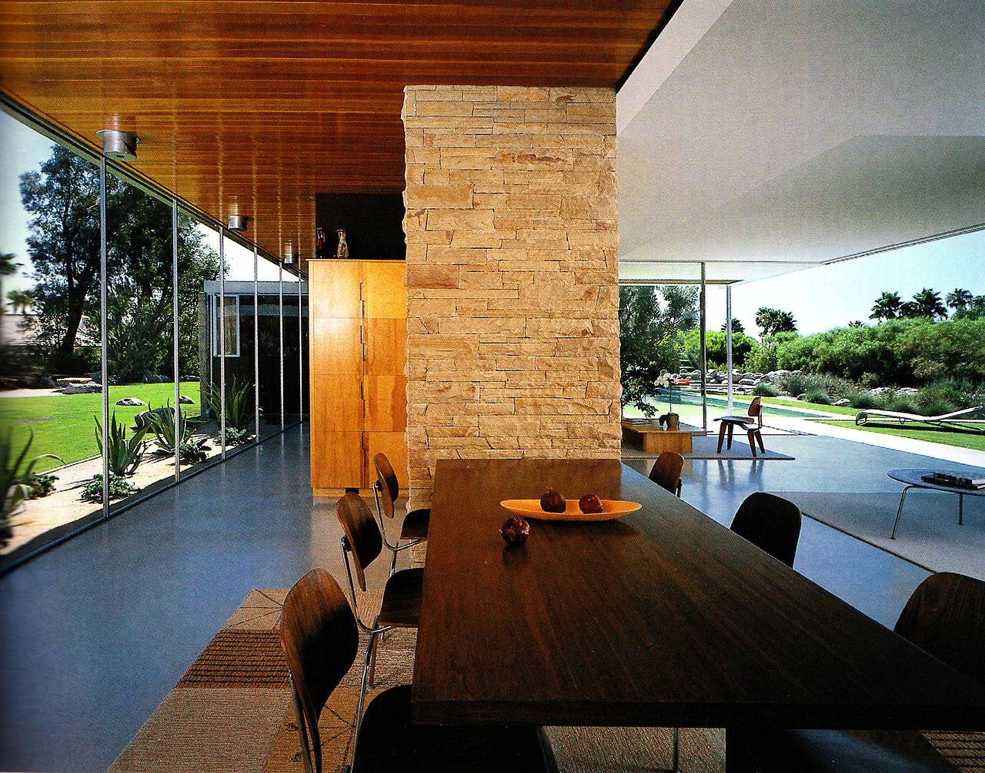
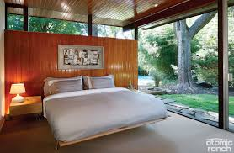
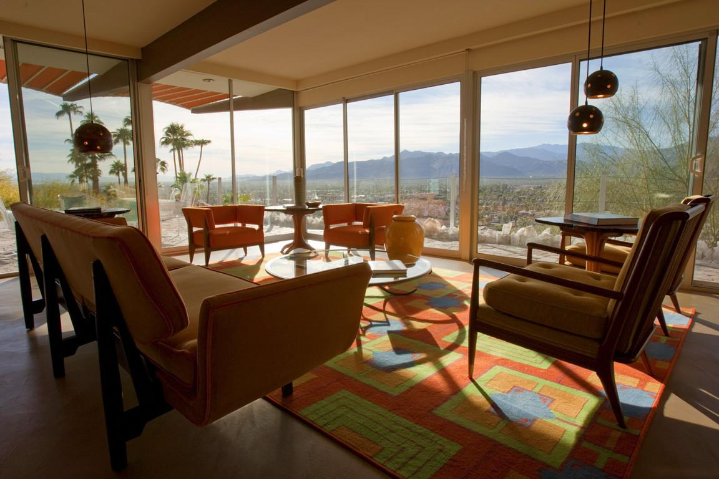
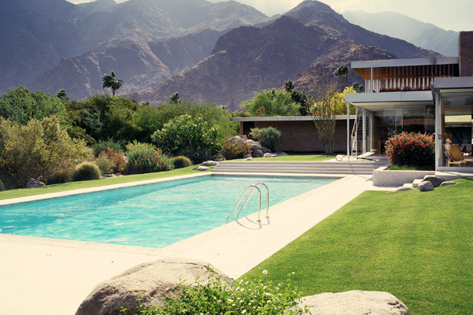
Space
Unbuilt Spaces
A wisely positioned swimming pool in the south east side of the property is the key feature of the unbuilt area of the structure.
It serves as the focal point of the home, and acts as a composite balance to the entire house by creating harmony. This was necessary due to the unusual pinwheel structure that is otherwise of unequal proportions.
It helps to calm the design and ground it with the natural landscape around it, and merges well into the build spaces which helps to maintain a visual balance.
The interior Built spaces are bright and airy, while the Unbuilt space blends the home into the surrounding landscape.

Slide 8
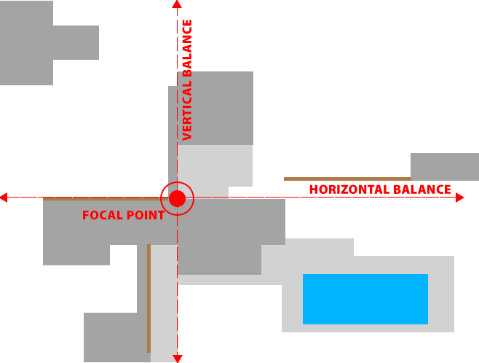
Organization
Every part of the structure is carefully placed, with the central hub acting as the balance of the structure.
Note the northwest quadrant, where the guesthouse would otherwise break the visual balance. The southeastern quadrant features the pool, providing an counterbalance that brings harmony to the design through bilateral symmetry.
This creates a strong focal point directly in the center of the property, and helps to bring order to an otherwise unusual placement of features.
Vertical and Horizontal balance of the structure

Slide 9
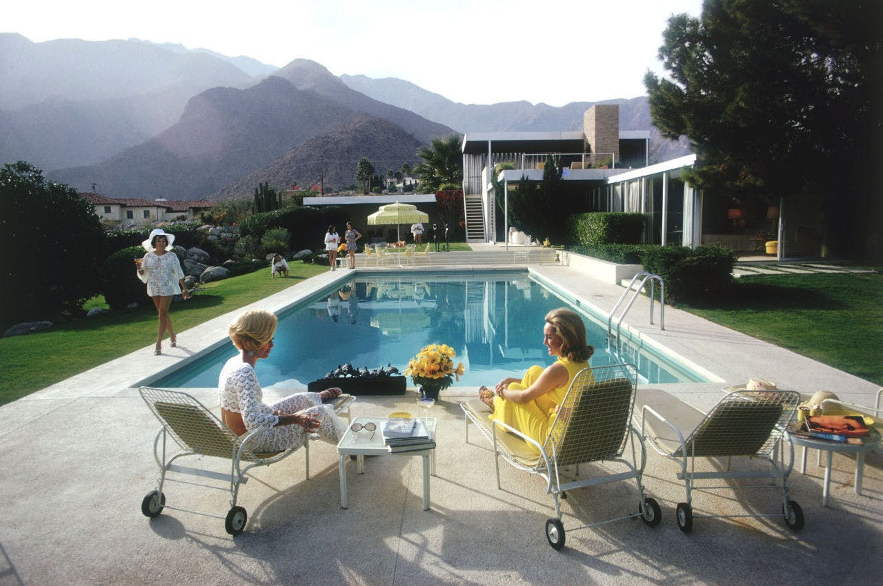
Geography
Desert landscape surrounds the structure, providing a link between it and the terrain that is both pleasant and natural. The various elements used in the home take advantage of the region and are designed to make the most from it.
Winds come primarily from the northwest and can often lead to dust storms, so thick stone walls were very carefully placed to mitigate this problem.
Sunlight bathes the house from a southern direction, and Neutra used this to his advantage: The swimming pool located on the south-east side of the building allows it to reflect the entire structure like a mirror while simultaneously creating a microclimate that is calm and inviting, and feels as if the house is a part of the surrounding landscape.
Calm, inviting space. Awful 60’s haircuts.

Slide 10
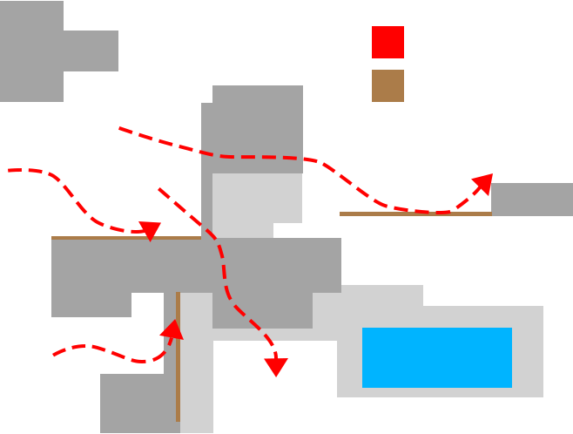
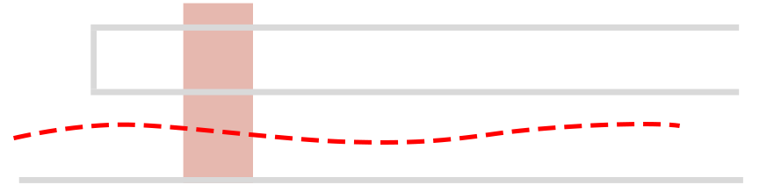
Circulation
Natural ventilation and intelligent use of materials with high thermal mass makes for efficient heating and cooling and reduces the need for air conditioning.
Apertures are placed in the walls to accommodate the northwestern flow of wind. With these apertures at both ends of rooms, air can flow in and through without needing to rebound off of surfaces, maintaining a fresh and breathable atmosphere at all times.
Meanwhile, stone walls placed in strategic locations completely block these same winds, preventing unwanted airflow in living areas such as bedrooms.
The main living room, located on the southern side of the structure, has no shading or overhangs to speak of. This results in a wide open, friendly and inviting space for inhabitants to enjoy, socialize and relax.
Air Flow
Stone Wall
Home ventilation, top view
Hallway ventilation, side view

Slide 11
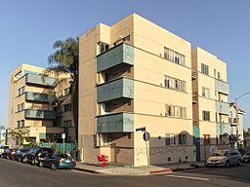
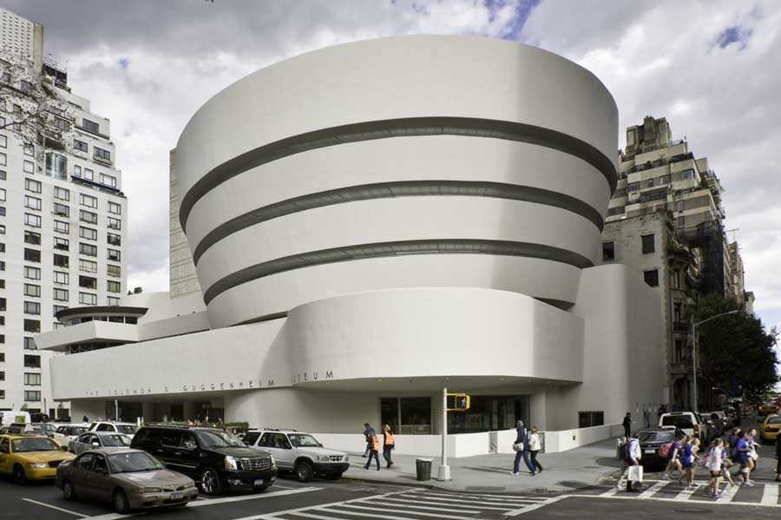
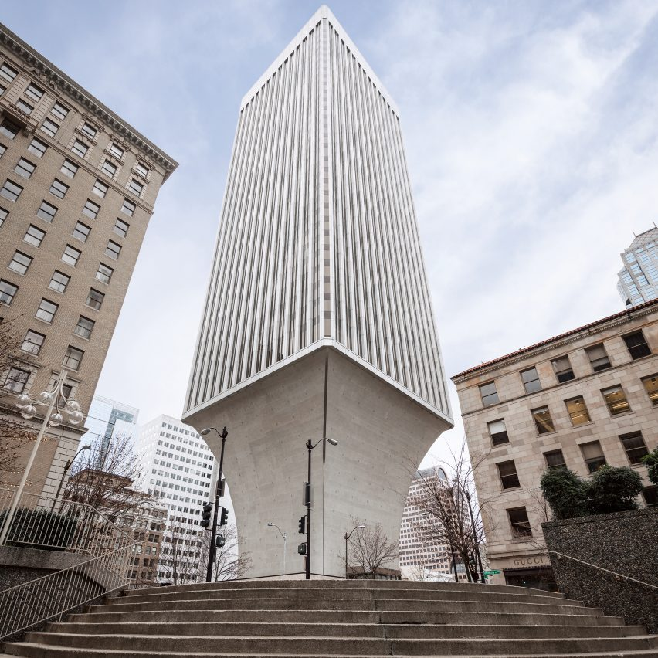
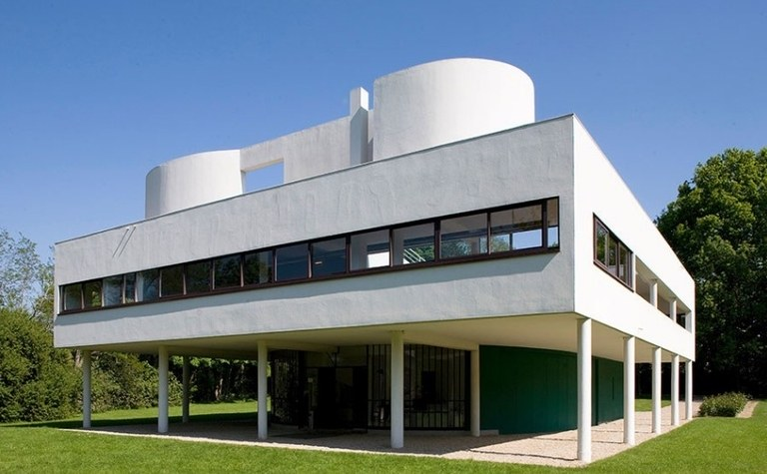
Modernist Style
Modernist architectural style first started appearing in the early 1900s, but didn’t become commonplace until shortly after the second World War, and was popular until the 1980s.
Made popular by Frank Lloyd Wright, Rudolph Schindler and Neutra himself, Modernism is defined by the use of man-made materials such as glass, steel and concrete in structures as well as the idea that form should follow function in architectural designs.
Linear lines play a large part in structures built in this style, and most modernist structures have a clearly defined form as a result.
Minimalism is a key factor as well, with buildings created in the style featuring little to no ornamentation on facades. Carvings and embellishments are effectively absent, bringing focus instead to their architectural elements.
Jardinette Apartments, The Guggenheim, Villa Savoye, Rainier Tower.

Slide 12
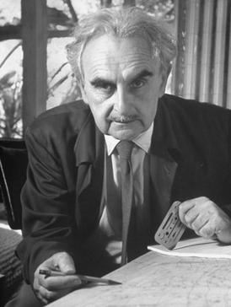
Architect
Richard J. Neutra (April 8, 1892 - April 16 1970) was an architect of Austrian-American descent. For the majority of his career he lived and built in southern California. He is considered among the most important and influential modernist architects.
Before his architecture career he served as an artillery lieutenant during World War 1. Afterwards he worked in Switzerland with landscape architect Gustav Ammann, and moved to the United States in 1923 where he eventually worked with Frank Lloyd Wright and Rudolf Schindler. His first works in America were in landscape architecture, but eventually he went on to open his own practice in 1930 and designed numerous buildings in the International style. Twelve of these are designated as Historic Cultural Monuments.
He became celebrated for his airy and geometric structures, symbolizing a West Coast variation on mid-century modern residence.

Slide 13
Citations
Study.com :
https://study.com/academy/lesson/richard-neutra-biography-quotes.html
azquotes.com :
https://www.azquotes.com/author/24971-Richard_Neutra
Wikipedia.org :
https://en.wikipedia.org/wiki/Richard_Neutra
https://en.wikipedia.org/wiki/Modern_architecture#American_modernism_-_Frank_Lloyd_Wright,_Rudolph_Schindler,_Richard_Neutra_(1919%E2%80%931939)
https://en.wikipedia.org/wiki/Kaufmann_Desert_House
Other:
https://www.dezeen.com/2018/02/16/richard-neutra-kaufmann-house-desert-architecture-palm-springs-modernism-week/
https://www.archdaily.com/104112/ad-classics-kaufmann-house-richard-neutra
https://www.mcmdaily.com/the-kaufmann-desert-house/
https://www.slideshare.net/swapnilkahar1/richard-neutra-palm-spring-house

