Slide 1


Project A: Feature Engineering and Selection
Group F
JIALU.XU, ZHENGYU.WANG, XINJI. WANG, SHUXING.ZHOU

Slide 2




Square company:
Group F
1
Our dataset is provided by Square.inc
which is a financial services, mobile payment and merchant services aggregator company
Project introduction:
2
To investigate whether a customer has the potential to paid plan on the platform using a high dimension data.
Group F
SCC460
Page1

Slide 3
Focus:
1
1.Feature engineering and selection
2.Probability of customer behavior estimate
Objective:
2
1.Investigate high dimensional dataset and determine composite features.
2.Test whether traditional feature selection heuristics are enough to optimize model accuracy.
Group F
SCC460
Page2

Slide 4
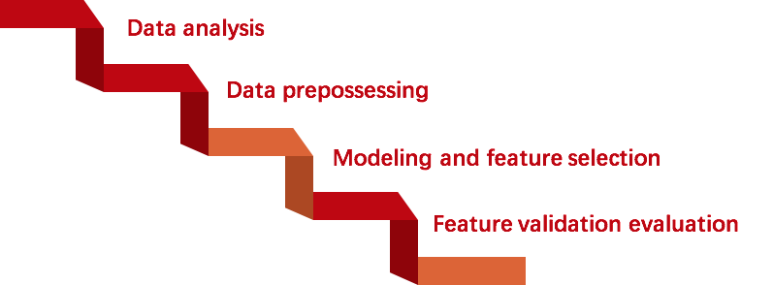
Research pipeline
Task: Find the best representation of the high dimension dataset
Process:
Group F
SCC460
Page3

Slide 5

Data analysis
Response
dataset
Incidence
dataset
Dimension
1818 * 100279
100279
responses
Attributes
Observations
(with no column description)
Group F
SCC460
Page4

Slide 6


Data preprocessing
1
Missing value
Data
Cleaning
Duplicate data
2
3
Constant feature
Result:
Dataset with 1318*42079
Group F
SCC460
Page5

Slide 7

Data balance
Introducing new, non-replicated minority class examples from the line segments that join the five minority class nearest neighbors[1](1:0.7 nearly balanced data with around 14k observations)
Removing some
of the majority
of class (1:1 balanced data with 472 observations)
Under-
sampling
Smote
Over-
sampling
Adding more of the minority class (1:1 balanced data with around 90k observations)
Group F
SCC460
Page6

Slide 8


Modeling and feature selection
Random forest is an ensemble of unpruned regression or
classification trees which is created by using bootstrap samples
of the training data and random feature selection in tree induction.
Random forest:
Model selection criteria:
Purity function:
(1)
Mean Decrease Gini function:
(2)
Group F
SCC460
Page7

Slide 9
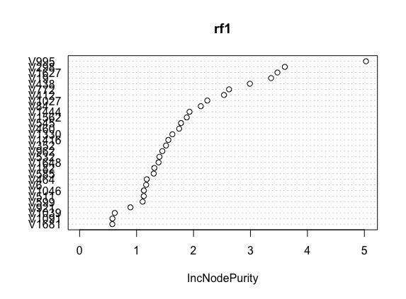

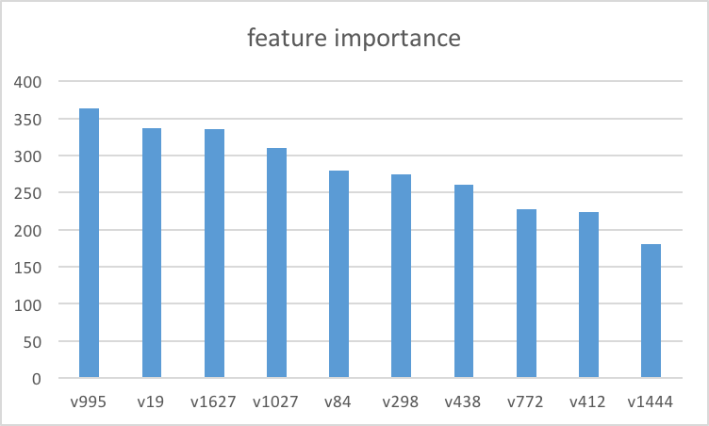
Modeling and feature selection
Figure 1 shows importance of attributes from a certain forest using
incNodepurity (1)
Figure 2 indicates the weighted feature importance from several random forest. (If V995 is most important one among all features, then multiply it by 20. Second one multiply by 19, etc.)
Group F
SCC460
Page8

Slide 10

Feature validation evaluation
Using different machining learning model to process different dataset we create.
Evaluating training model and testing result using f1-score, precision, recall, roc.
Compare all the result in one table and get to conclusion.
Group F
SCC460
Page9

Slide 11

SVM
Definition:
SVM is a supervised learning model with associated learning algorithms that analyze data used for classification and regression analysis.
An SVM model is to construct a good hyperplane which will maximum the distance to the nearest training data points in a high dimensional space.
Group F
SCC460
Page10

Slide 12

KNN
Theorem:
K-nearest neighbor does not evaluate each observation until classification. A object is assigned to the k-nearest neighbor by a majority of votes. So in each object classification, the algorithm will traverse the whole dataset to find the k-nearest neighbor(where k is usually a positive integer) and assign the observation to the majority.This lead to KNN a time consuming algorithm.
Group F
SCC460
Page11

Slide 13
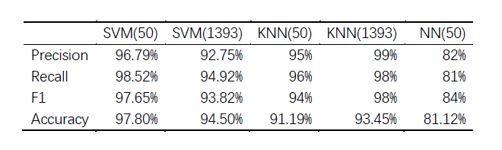
Model Result
The result table
Group F
SCC460
Page12

Slide 14
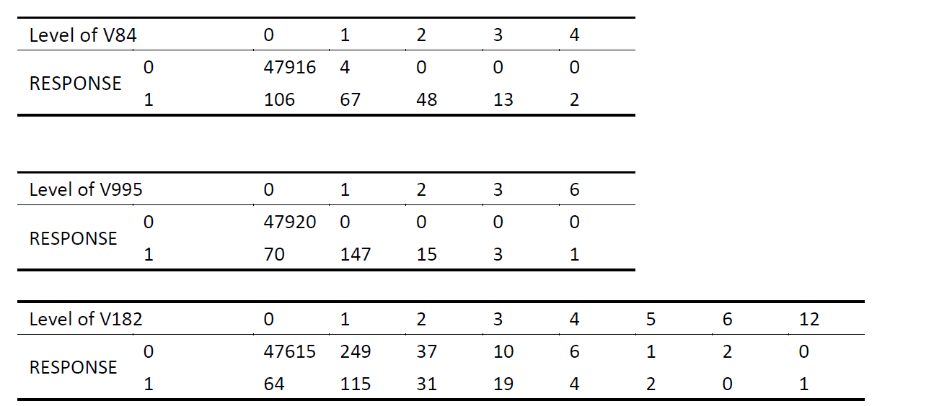

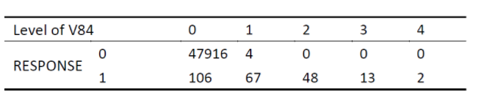
Result
Three most important features
V995 is the
best feature
Group F
SCC460
Page13

Slide 15
Conclusion
By using random forest in high dimension dataset, we selected about 50 features as our primary result.
By applying both original dataset and dimension-reduced dataset in different models, we use evaluation criteria to compare and believe that the features selected are a good representation of the original dataset.
Group F
SCC460
Page14

Slide 16
Reference
[1] N. Chawla, K. Bowyer, L. Hall, and W. Kegelmeyer, “SMOTE: Synthetic minority over-sampling technique,” Journal of Artificial Intelligence Research, vol. 16,pp. 321–357, 2002.)
[2] Svetnik V, Liaw A, Tong C, et al. Random forest: a classification and regression tool for compound classification and QSAR modeling[J]. Journal of chemical information and computer sciences, 2003, 43(6): 1947-1958.
Group F
SCC460
Page15

Slide 17
Q&A
Thank you!

