Slide 1
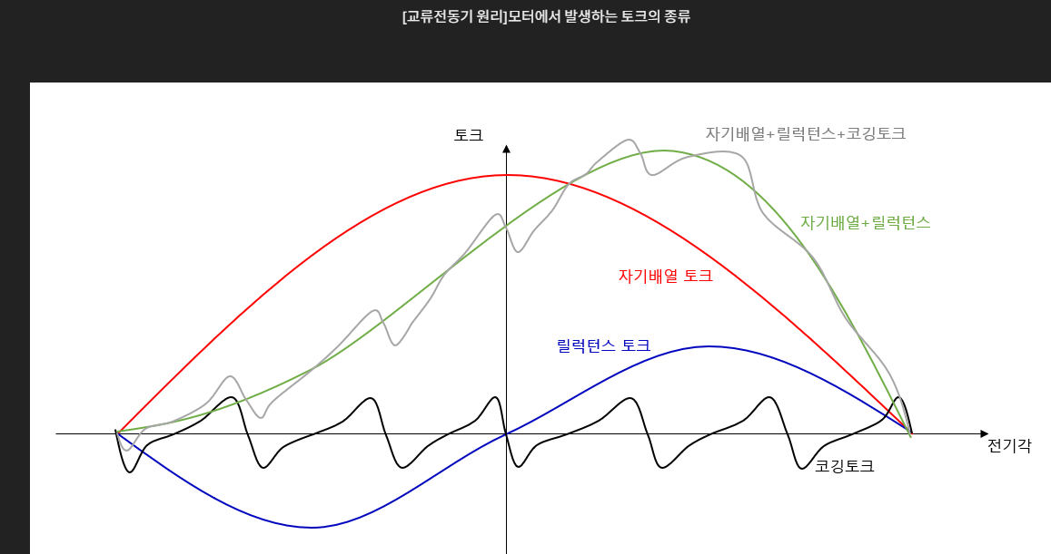

Slide 2
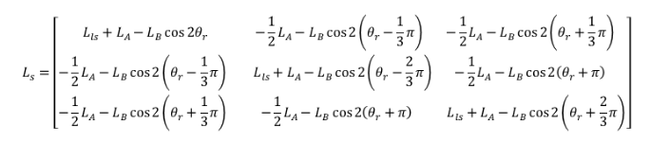
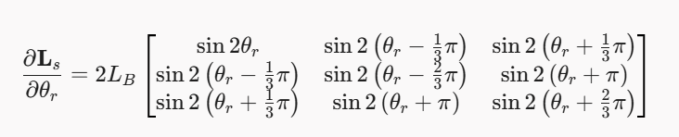
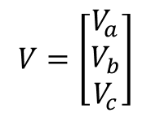
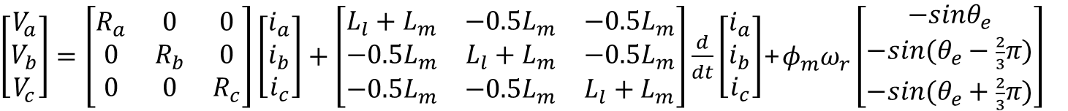
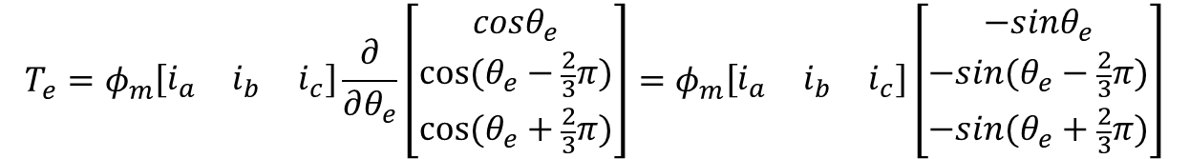
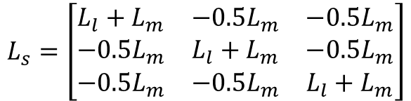





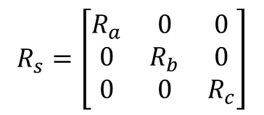

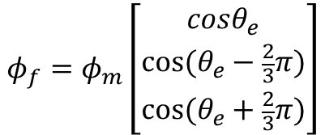

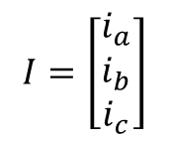
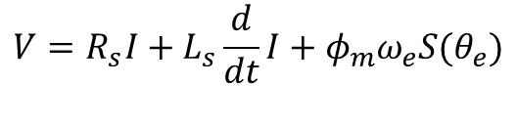
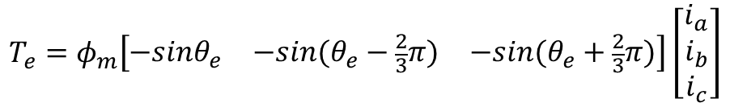
$$L_{s}=\left[\begin{matrix}L_{l}+L_{m} & −0.5L_{m} & −0.5L_{m} \\ −0.5L_{m} & L_{l}+L_{m} & −0.5L_{m} \\ −0.5L_{m} & −0.5L_{m} & L_{l}+L_{m}\end{matrix}\right]$$
$$φ_{f}=φ_{m}\left[\begin{matrix}cosθ_{e} \\ cos⁡(θ_{e}−\frac{2}{3}π) \\ cos⁡(θ_{e}+\frac{2}{3}π)\end{matrix}\right]$$
$$λ=L_{s}I+φ_{f}$$
$$V=R_{s}I+\frac{d}{dt}λ$$
$$V=R_{s}I+L_{s}\frac{d}{dt}I+φ_{m}ω_{e}S(θ_{e})$$
$$\dot{I}={−L}_{s}^{−1}R_{s}I+L_{s}^{−1}V{−L}_{s}^{−1}φ_{m}ω_{e}S(θ_{e})$$
$$T_{e}=φ_{m}S^{T}\left(θ_{e}\right)I$$
$$J\dot{ω}=PT_{e}−T_{load}−T_{fric}$$
$$W=\frac{1}{2}i^{T}L_{s}i+i^{T}φ_{f}$$
$T_{e}=\frac{∂}{∂θ_{e}}W=\frac{1}{2}i^{T}\frac{∂L_{s}}{∂θ_{e}}i+\frac{∂}{∂θ_{e}}(i^{T}φ_{f}$)
$$T_{e}=φ_{m}\left[\begin{matrix}i_{a} & i_{b} & i_{c}\end{matrix}\right]\frac{∂}{∂θ_{e}}\left[\begin{matrix}cosθ_{e} \\ cos⁡(θ_{e}−\frac{2}{3}π) \\ cos⁡(θ_{e}+\frac{2}{3}π)\end{matrix}\right]=φ_{m}\left[\begin{matrix}i_{a} & i_{b} & i_{c}\end{matrix}\right]\left[\begin{matrix}−{sinθ}_{e} \\ −sin⁡(θ_{e}−\frac{2}{3}π) \\ −sin⁡(θ_{e}+\frac{2}{3}π)\end{matrix}\right]$$
$$V=\left[\begin{matrix}V_{a} \\ V_{b} \\ V_{c}\end{matrix}\right]$$
$$I=\left[\begin{matrix}i_{a} \\ i_{b} \\ i_{c}\end{matrix}\right]$$
$$T_{e}=φ_{m}\left[\begin{matrix}{−sinθ}_{e} & −sin⁡(θ_{e}−\frac{2}{3}π) & −sin⁡(θ_{e}+\frac{2}{3}π)\end{matrix}\right]\left[\begin{matrix}i_{a} \\ i_{b} \\ i_{c}\end{matrix}\right]$$
$$R_{s}=\left[\begin{matrix}R_{a} & 0 & 0 \\ 0 & R_{b} & 0 \\ 0 & 0 & R_{c}\end{matrix}\right]$$
$\left[\begin{matrix}V_{a} \\ V_{b} \\ V_{c}\end{matrix}\right]=\left[\begin{matrix}R_{a} & 0 & 0 \\ 0 & R_{b} & 0 \\ 0 & 0 & R_{c}\end{matrix}\right]\left[\begin{matrix}i_{a} \\ i_{b} \\ i_{c}\end{matrix}\right]+\left[\begin{matrix}L_{l}+L_{m} & −0.5L_{m} & −0.5L_{m} \\ −0.5L_{m} & L_{l}+L_{m} & −0.5L_{m} \\ −0.5L_{m} & −0.5L_{m} & L_{l}+L_{m}\end{matrix}\right]\frac{d}{dt}\left[\begin{matrix}i_{a} \\ i_{b} \\ i_{c}\end{matrix}\right]$+$φ_{m}ω_{r}\left[\begin{matrix}−sinθ_{e} \\ −sin⁡(θ_{e}−\frac{2}{3}π) \\ −sin⁡(θ_{e}+\frac{2}{3}π)\end{matrix}\right]$
영구자석 동기 전동기 모델링 (IPMSM, SPMSM)
https://m.blog.naver.com/lagrange0115/221576091271
https://m.blog.naver.com/lagrange0115/221579157897

Slide 3






















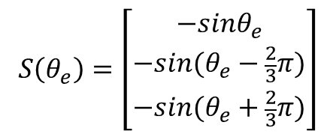



$$\dot{I}={−L}_{s}^{−1}R_{s}I+L_{s}^{−1}V{−L}_{s}^{−1}φ_{m}ω_{e}S(θ_{e})$$
$$S\left(θ_{e}\right)=\left[\begin{matrix}−{sinθ}_{e} \\ −sin⁡(θ_{e}−\frac{2}{3}π) \\ −sin⁡(θ_{e}+\frac{2}{3}π)\end{matrix}\right]$$
$$T_{e}=φ_{m}S^{T}\left(θ_{e}\right)I$$
$$J{\dot{ω}}_{r}={PT}_{e}−T_{load}−T_{fric}$$
$$P:Pole Pair$$
+
$$ω_{e}$$
$${−L}_{s}^{−1}φ_{m}S\left(θ_{e}\right)$$
$$P$$
$$ω_{r}$$
$$\dot{I}$$
$$I$$
$$T_{e}$$
$${\dot{ω}}_{r}$$
$$θ_{r}$$
$$V$$
$$L_{s}^{−1}$$
+
$$\frac{1}{s}$$
$$φ_{m}S^{T}(θ_{e})$$
$$P$$
+
$$\frac{1}{J}$$
$$\frac{1}{s}$$
$$\frac{1}{s}$$
$${−L}_{s}^{−1}R_{s}$$
$$−T_{load}−T_{fric}$$
$$θ_{e}$$
$$P$$

