Slide 1
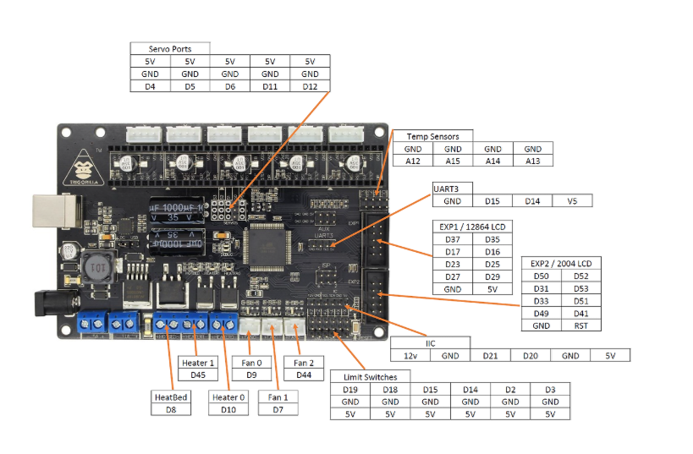
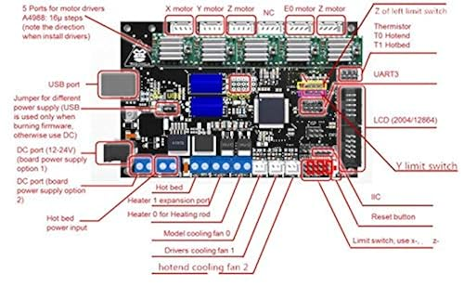
3D Printer ANYCUBIC TriGorilla Integrated Main board Compatible Mega2560 & RAMPS1.4 Combo

Slide 2
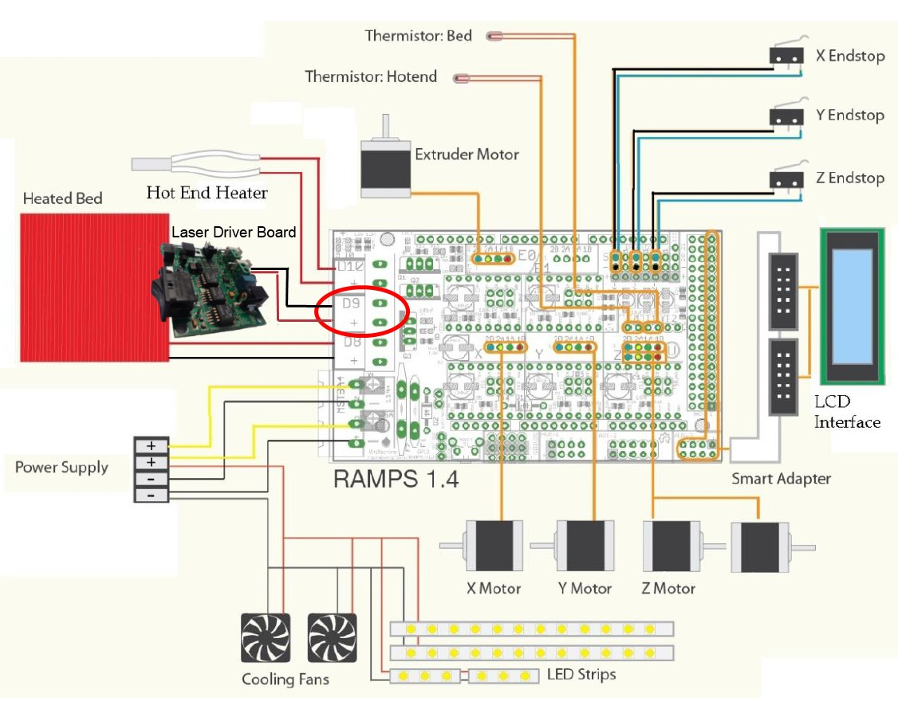
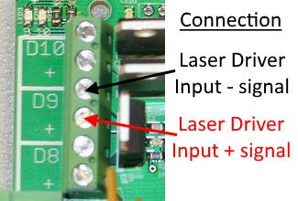
Software
The software is the same for all of the upgrades here. The commands to turn on and off the laser are:
LASER ON: M106
LASER OFF: M107
Using PWM to control the laser
You can have power control as well with the RAMPS1.4 board. Simply use “M106 Sxxx” command to turn on the laser where “xxx” is a number between 0 and 255. 255 is full power and 0 is off.
M106 S255 = Turns the laser on at full power
M106 S0 = Turns the laser off
M106 S127 = Turns the laser on at 50% power
M107 = Turns the laser off as well

Slide 3
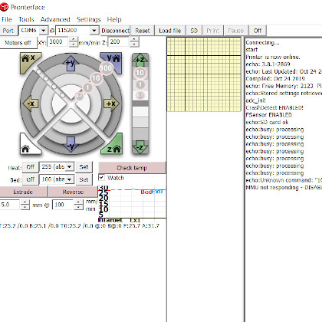
Pronterface

Slide 4
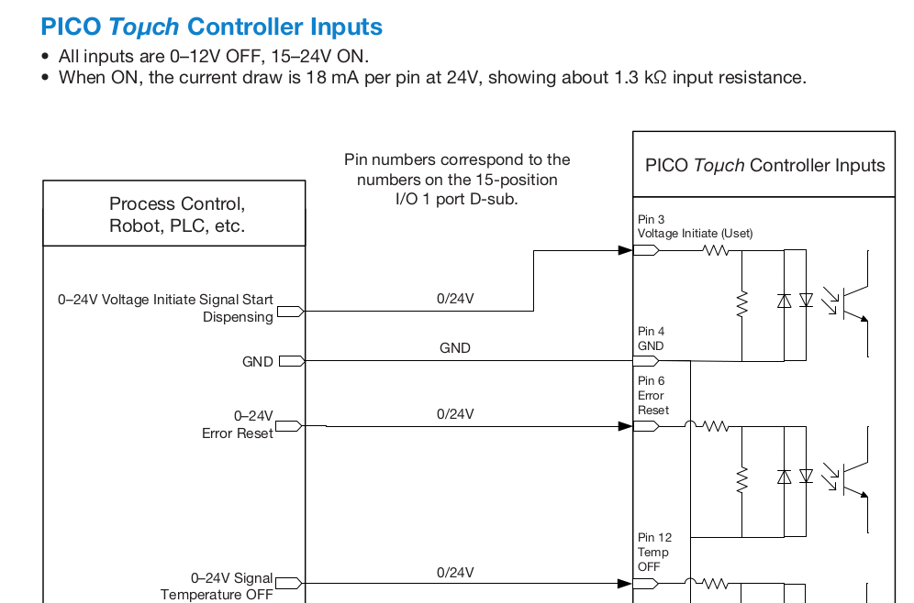
PICO Toμch Controller Inputs

Slide 5
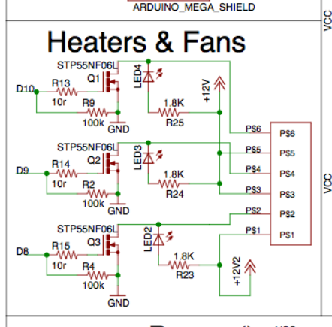

Slide 6
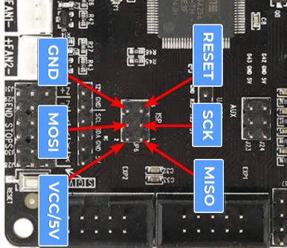

Slide 7
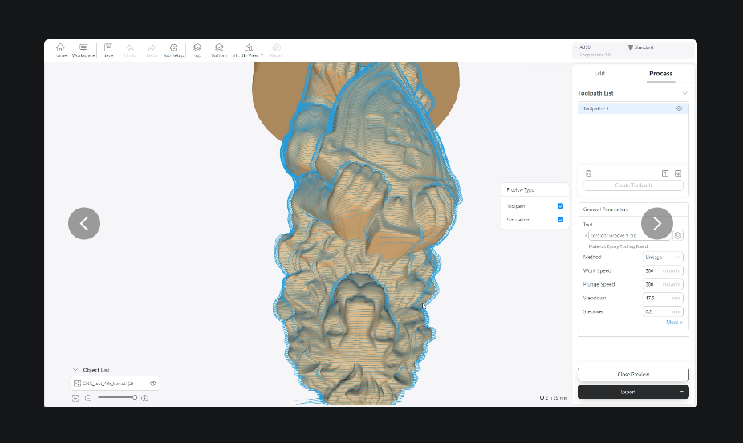
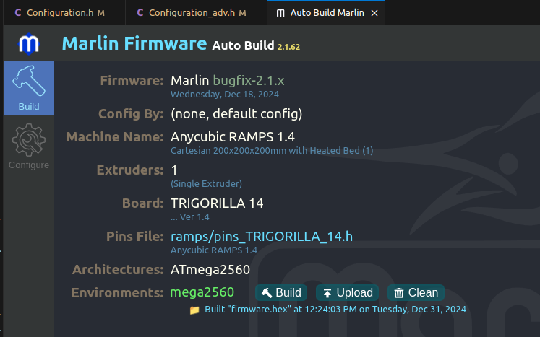
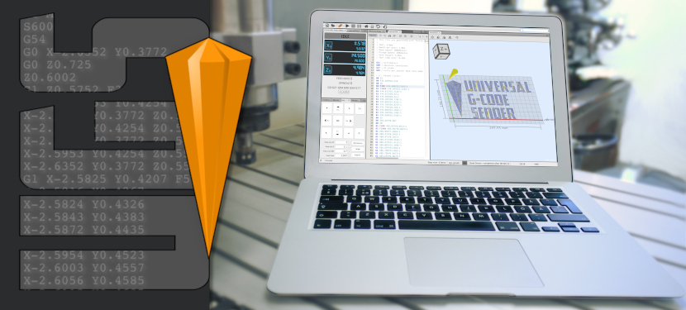
M4 pin4 OFF
M5 pin4 ON
M3 S100 pin6 pwm width
5v | 5v | 5v | 5v | 5v
g | g | g | gnd | gnd
 |  | pwm |  | on/off
Snapmaker Luban
https://www.snapmaker.com/en-US/snapmaker-luban
Universal G-Code Sender is a Java based, cross platform G-Code sender, compatible with GRBL, TinyG, g2core and Smoothieware.
#define LASER_FEATURE

