Slide 1
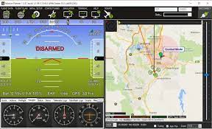
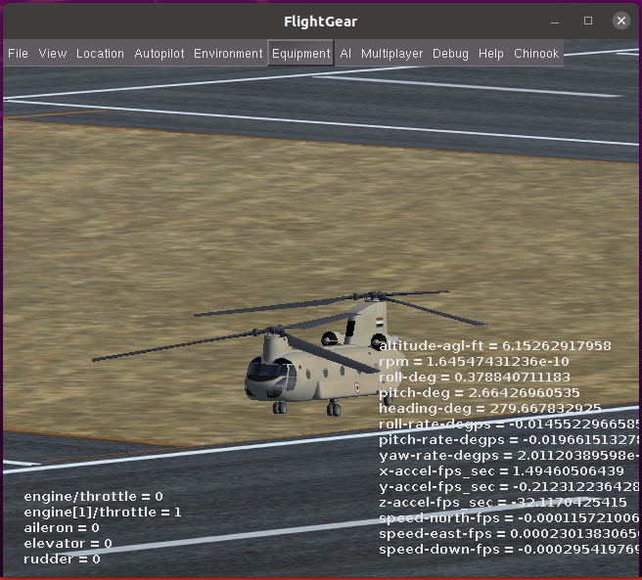
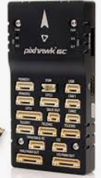
HILS with FlightGear
MissionPlanner
(GCS 1)
MissionPlanner
(GCS 2)
UDP(localhost)
usb2Serial
(telem1)
FlightGear Bridge
(Extenal AHRS & GPS)
usb2Serial
(telem1)
UAVCAN
Serial
(telem2)
Serial(telem2)
Primary FC
FlightGear(Open Source Simulator
Model: CH47d
Secondary FC

