Slide 1
AnemiaFusionNet
Multimodal Region-Aware Anemia Detection
Sandhya Chandel
AI/ML Internship Project

Slide 2
AnemiaFusionNet is a multimodal framework combining conjunctival images, clinical data, and geographic risk to deliver region-aware anemia detection using transformer-based fusion.
This presentation covers system design, datasets, model components, training strategy, evaluation, and results with a focus on reproducibility and deployment readiness.
Introduction

Slide 3
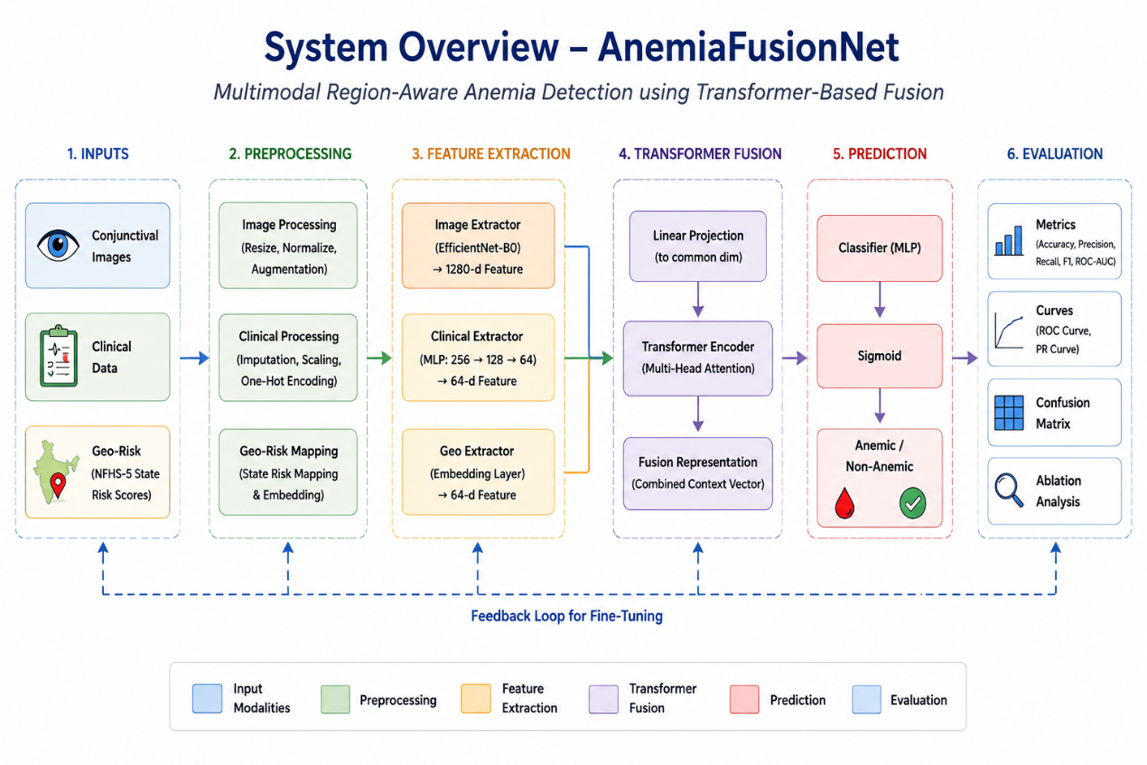
01
System Overview
Complete multimodal pipeline
• Three heterogeneous modalities
• Independent feature extraction
• Transformer-based fusion
• Binary anemia prediction

Slide 4
Data Inputs
👁 Conjunctival Images
🩸 Clinical
📍 Geo
• 224×224
• Normalized
• Augmented
• Hemoglobin
• Age
• Gender
• NFHS-5
• State Risk
• Regional Context

Slide 5
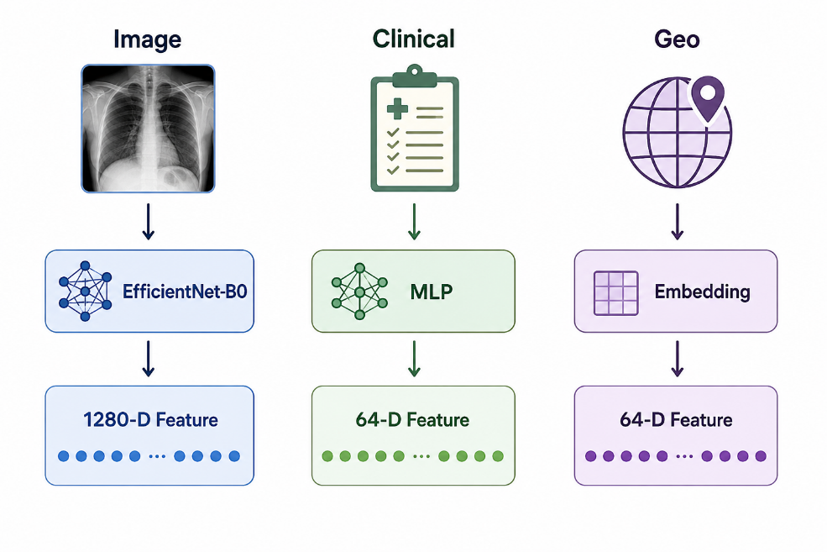
Feature Extraction
EfficientNet-B0
• Transfer Learning
• 1280-D Features
Clinical MLP
• 4 Inputs
• 64-D Embedding
Geo Module
• State Risk
• 64-D Embedding

Slide 6
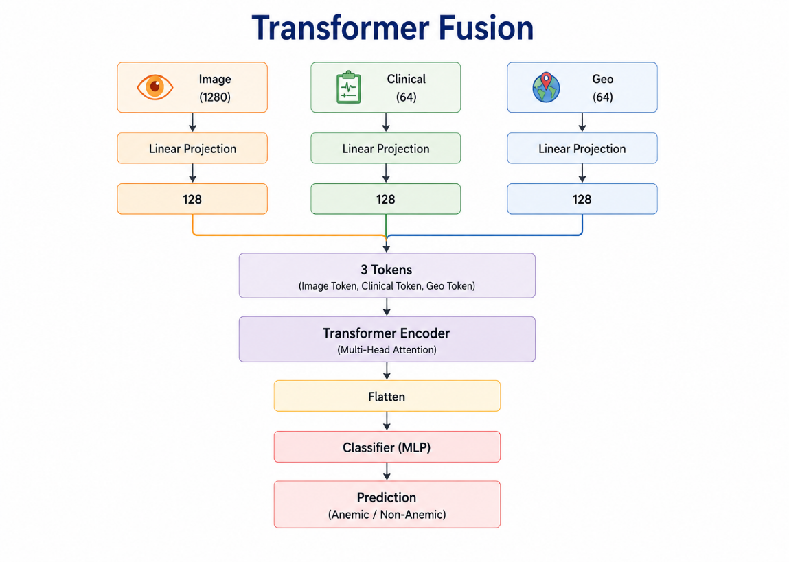
Transformer Fusion
• Project all features into a common latent space (128-D)
• Fuse modalities using a Transformer Encoder
• Generate final anemia prediction through an MLP classifier

Slide 7
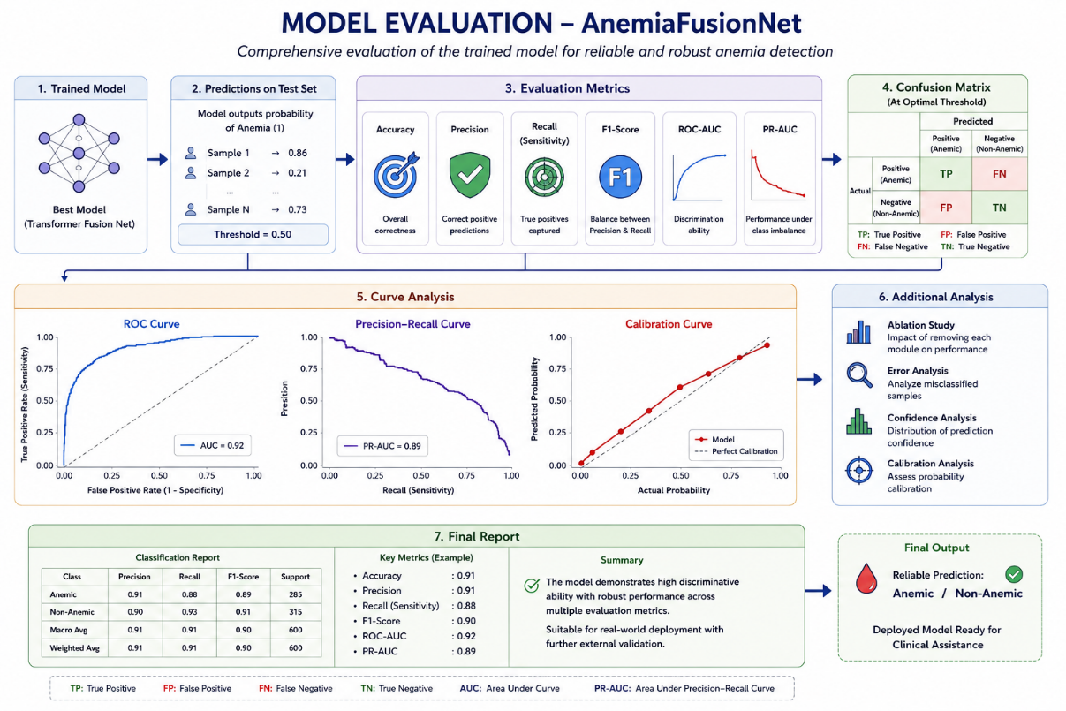
02
Model Evaluation
Evaluation of the trained model using classification metrics, confusion matrix, ROC and Precision–Recall curves, together with performance analysis and robustness assessment.

Slide 8
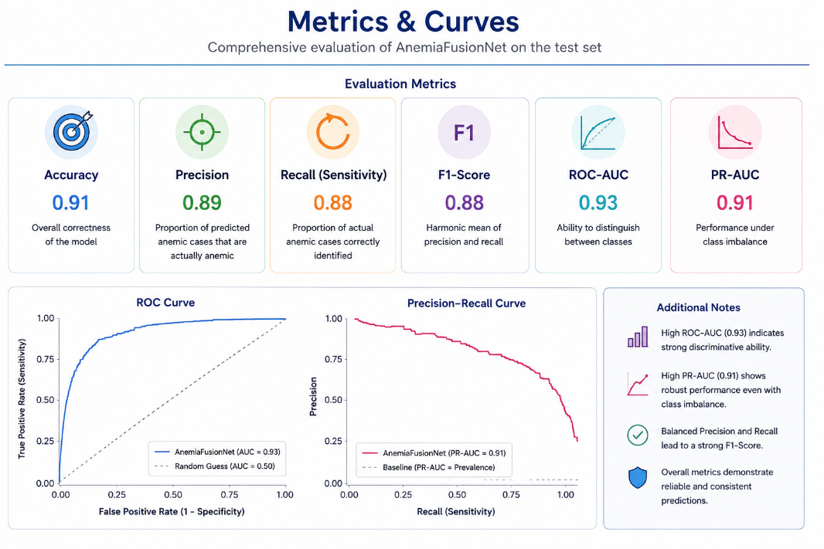
Metrics & Curves
Evaluate using Accuracy, F1-score, Precision, Recall, and ROC‑AUC.
Plot ROC and Precision–Recall curves to assess threshold behavior and class imbalance.
Report validation and test metrics with 95% CI where applicable to show statistical reliability.

Slide 9
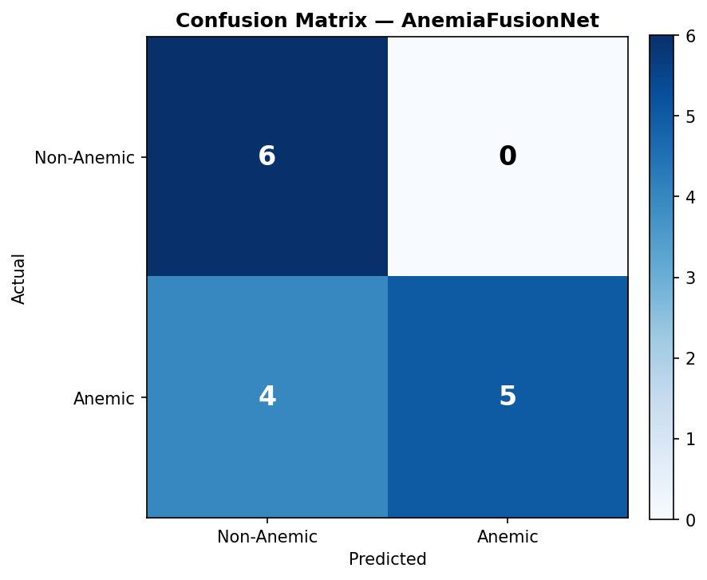
Confusion Matrix
Don't forget
...
Present a normalized confusion matrix to visualize true/false positives and negatives across classes.
Use metric cards for per‑class Precision and Recall, and annotate key error modes for clinical relevance.
Include threshold analysis to balance sensitivity vs. specificity.
Higher diagonal values indicate better classification performance.

Slide 10
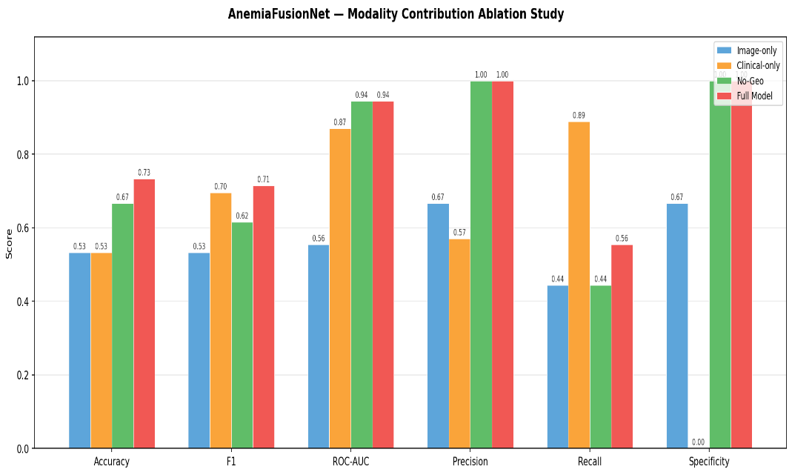
Ablation Analysis
Key Observation
• Transformer fusion achieved the best overall performance.
• Removing any modality reduced ROC-AUC and F1-score.
• Multimodal learning improved robustness.

Slide 11
Conclusions
Achievements
✔ Multimodal Framework
✔ Transformer Fusion
✔ Region-Aware Prediction
✔ Reproducible Pipeline
✔ Deployment Ready
AnemiaFusionNet delivers region‑aware, multimodal anemia detection by fusing conjunctival images, clinical data, and NFHS‑5 geo‑risk via transformer fusion.
The approach improves diagnostic metrics and supports reproducible deployment with modular extractors and checkpoints.
Next steps: deploy evaluation pipeline, external validation, and model optimization for on‑device inference.

Slide 12
Thank You!

