Slide 1
C++ Final Project McGill University
Multiple Regression using Machine Learning Algorithms
Christian Both

Slide 2

Project Task
Perform a regression analysis on the
“Ames Housing Dataset”₁
Broken down in:
Data import and conversion
Implementation of regression algorithms by use of machine learning library
Feature selection and calibration of parameters
Validation of predictions and output of results
₁ Taken from: https://www.kaggle.com/c/house-prices-advanced-regression-techniques

Slide 3
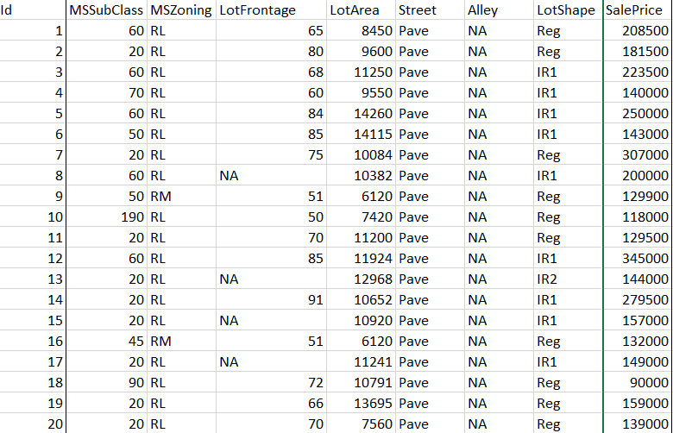
Ames Housing Dataset
Objective:
Predict Sale Prices
of properties based
on housing features
79 Features
1460 Samples
Train.csv
Test.csv
Sale Price included in training file only

Slide 4
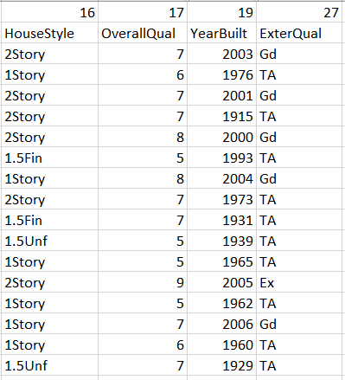
Ames Housing Dataset
Features
23 nominal
23 ordinal
14 discrete
20 continuous

Slide 5
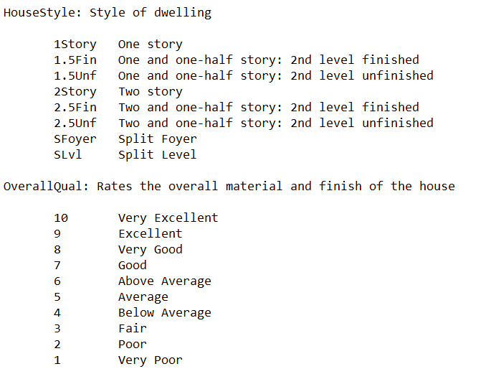
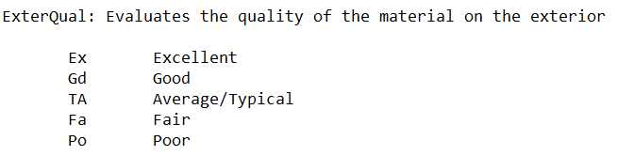
Ames Housing Dataset
Features
23 nominal
23 ordinal
14 discrete
20 continuous

Slide 6
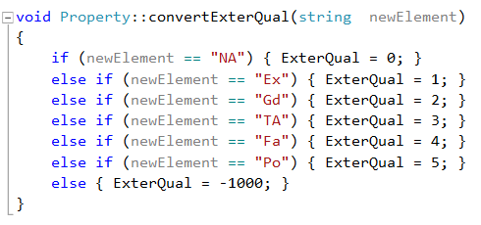
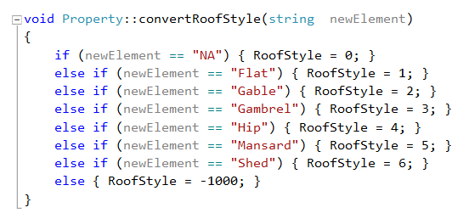
Reading the Data Set & Conversion
Class “Property” including 81 int member variables
Discrete/ continuous features converted normally to int
Stoi Function
Ordinal values converted to int by member function in increasing/ decreasing order
Nominal values converted to int by member function in random order
else Statement included to catch exceptions/ typing errors
Iterative process in order to read complete data set correctly
Notes:
Function writeDataSet to output

Slide 7
Feature Engineering
Property Features | Pearson coefficient
OverallQual | 0.7904
GrLivArea | 0.7087
ExterQual | -0.6830
KitchenQual | -0.6625
GarageCars | 0.6407
GarageArea | 0.6235
TotalBsmtSF | 0.6134
1stFlrSF | 0.6059
FullBath | 0.5596
TotRmsAbvGrd | 0.5331
YearBuilt | 0.5258
YearRemodAdd | 0.5088
BsmtQual | -0.4795
MasVnrArea | 0.4724
Fireplaces | 0.4649
HeatingQC | -0.4295
BsmtFinSF1 | 0.3877
Foundation | 0.3822
FireplaceQu | 0.3399
WoodDeckSF | 0.3316
2ndFlrSF | 0.3197
OpenPorchSF | 0.3163
GarageFinish | -0.2988
SaleCondition | 0.2917
HalfBath | 0.2889
LotShape | 0.2678
LotArea | 0.2645

Slide 8
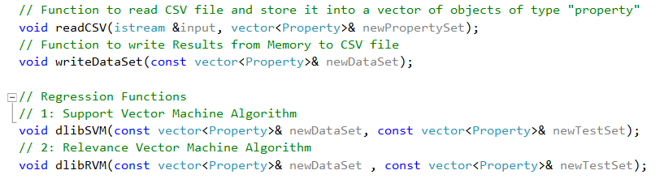
Functions in code
Using dlib c++ Library for Machine Learning Algorithms: http://dlib.net/ml.html
Support Vector Machine
Example: http://dlib.net/svr_ex.cpp.html
Relevance Vector Machine
Example: http://dlib.net/rvm_regression_ex.cpp.html

Slide 9


Validation Method
5-fold cross-validation as a member function of regression classes
Mean Squared Error (MSE)
Coefficient of determination (R²)
$$MSE=\frac{1}{S}\sum_{i=1}^{S}{{(y − y_{i})}^{2}}$$

Slide 10
Feature Selection
Features are tested independently in the order of Pearson coefficient (>0.5) and validated by R²
Best combination of Features is tested on same parameters
 | Property Features | R² Value by independent test | Pearson coefficient
1 | OverallQual | 0.71 | 0.7904
2 | GarageCars | 0.56 | 0.6407
3 | GrLivArea | 0.54 | 0.7087
4 | KitchenQual | 0.5 | -0.6625
5 | ExterQual | 0.47 | -0.6830
6 | GarageArea | 0.46 | 0.6235
7 | YearBuilt | 0.36 | 0.5258
8 | TotalBsmtSF | 0.34 | 0.6134
9 | FullBath | 0.32 | 0.5596
10 | TotRmsAbvGrd | 0.32 | 0.5331
11 | 1stFlrSF | 0.31 | 0.6059
SVM: Top 10 Features favorable
R² = 0.833
RVM: Top 3 Features favorable
R² = 0.825
Notes:
Take all is not an option, very bad MSE 4 * 10^9 , R² = 0.25
Which parameters?

Slide 11
Parameters
Number of Samples
Customized entry of sample numbers possible
Maximum 1460 (all Samples)
Kernel
Radial Basis Kernel
Linear Kernel
Polynomial Kernel
Gamma: Parameter to set for radial basis kernel
default Gamma performs best, option in code to calculate Gamma depending on spread of samples
Show worse results by adding more than one feature
Notes:
All samples makes always sense, but sometimes long computing time. 24 min SVR 10 features,
Manual check of performance: split necessary so that not all samples can be used

Slide 12
Parameters
Normalize sample data
Subtract mean and divide by standard deviation for every sample
Support Vector Machine
C-Value: allowance of training error, large c encourages exact fitting
Optimal value found by for loop and set to default: 110.000
Customized entry possible in code
SVM/RVM
Epsilon: Accuracy fit of training data
Can be set higher if computing time too long (esp. RVM + many features)
Notes:
(esp. RVM + many features

Slide 13
Visualization of Results
RVM Regression
Radial basis kernel
400 Samples
Top 3 Features
Overall Quality
Gross living Area
Garage Cars
Default Gamma
Epsilon: 0.001
Prediction for rest 1060 known Sale prices of training set
R² = 0.77
Upload of test data on kaggle (R² = 0.835): RMSE = 0.159

Slide 14
Future Work
Support Vector Machine/ Relevance Vector Machine
Limitations of regression function for nominal features eg. Roof type/ Neighborhood
Implementation of regression algorithm capable of taking all styles of features into account possibly:
Artificial Neural Networks
Decision/Regression Trees

Slide 15
Questions?
Thank you!

