Slide 1
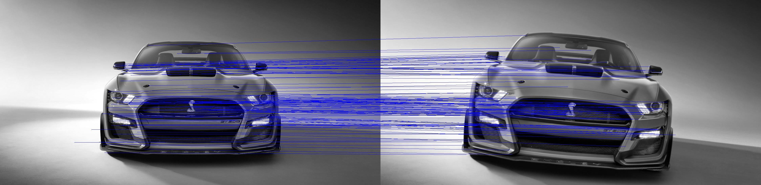
A SIFT Descriptor for Feature Matching
Advanced Systems Lab
Nicolas Hafner, Costanza Improta, Zsombor Kalotay, Jan Leutwyler

Slide 2

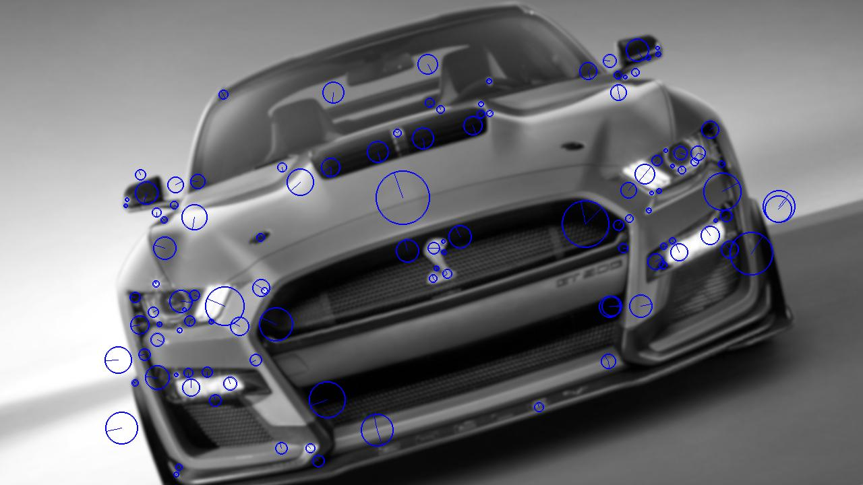
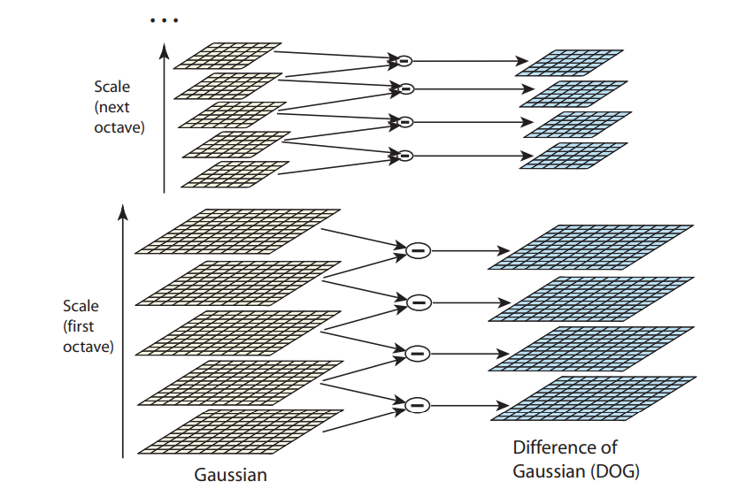
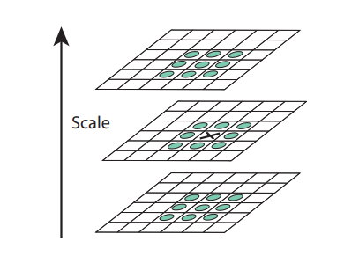
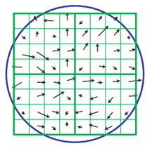
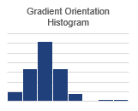
Rough Visualization of our Algorithm
Generate Gradient/Rotation Pyramid
Localize Extrema in DoG Pyramid
Refine Extrema location and assign Orientation
Extract Descriptor around keypoint from image
Generate Gaussian Pyramid
Generate DoG Pyramid

Slide 3
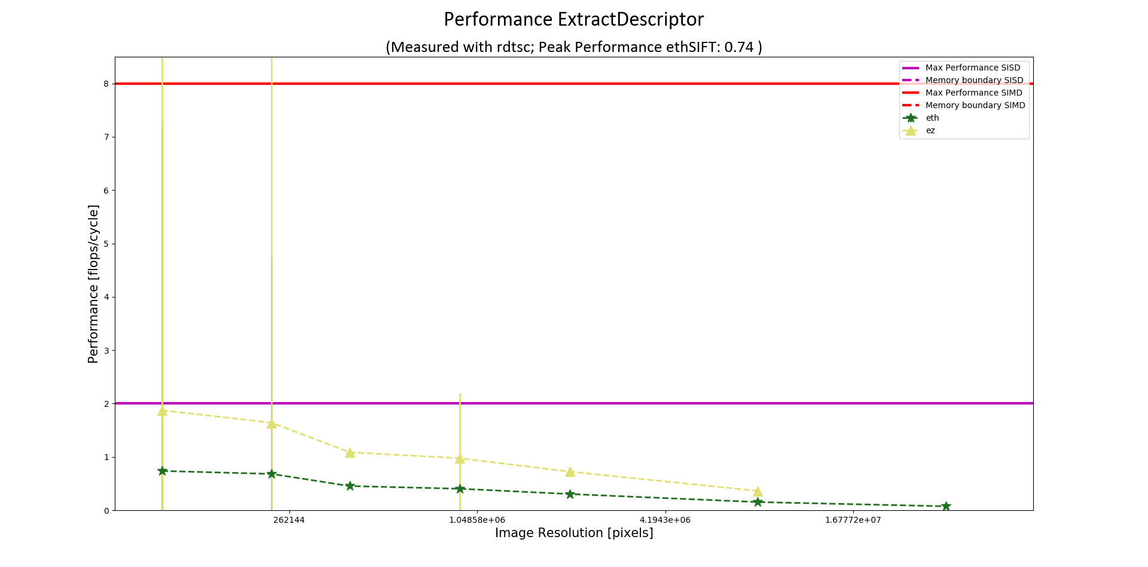
Performance Plot of straightforward Code

Slide 4
Plan on how to move forward
For each of these building blocks of our algorithm
Apply C optimization techniques
Try to use AVX2 techniques whenever possible
Do all time measurements on the same Intel Machine
Generate Performance Plots
Write detailed Report

Slide 5
Preliminary Work Split
Nicolas:
Descriptor Extraction
Keypoint Detection
Costanza
DoG Pyramid
Rotation/Gradient Pyramid
Jan
Convolution
Extrema Refinement
Zsombor
Gaussian Pyramid and Kernel Generation
Histograms

Slide 6
Questions
Flop counts for std-c methods (exp, floor, ceil, sqrt, pow, sin, cos, min, max)
Flop counts for loop depending on keypoint scale
Flop counts for mem alloc and mem copy
Is it necessary to count flops for reference library (ezSift)?
How to treat casting to floats?

Slide 7
Appendix

Slide 8
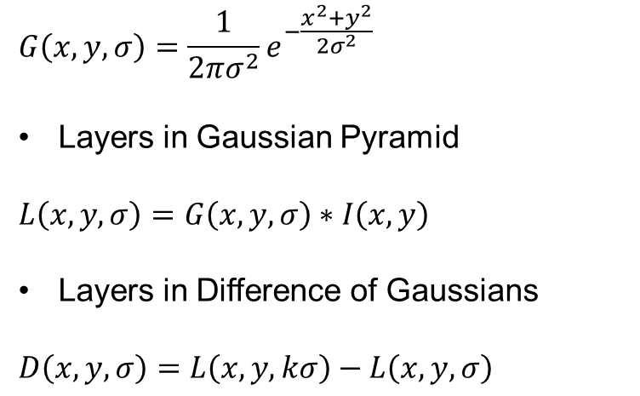
1. Scale-space Extrema Detection
Overview of Algorithm
After each octave, image is downsampled by a factor of 2
$$G\left(x, y, σ\right)=\frac{1}{2πσ^{2}}e^{−\frac{x^{2}+y^{2}}{2σ^{2}}}$$
Layers in Gaussian Pyramid
$$L\left(x,y,σ\right)=G\left(x,y,σ\right)∗I\left(x,y\right)$$
Layers in Difference of Gaussians
$$D\left(x,y,σ\right)=L\left(x, y,kσ\right)−L\left(x,y,σ\right)$$
Repeatedly convolved with Gaussians
Constant multiplicative factor k

Slide 9
1. Scale-space Extrema Detection
Overview of Algorithm
Find local extrema in DoG pyramid by comparing a pixel to its 8 neighbour pixels in the same scale, as well as to the 9 pixels in each of the adjacent scales.
It is only selected if it is either larger or smaller than all of these other pixel values.

Slide 10
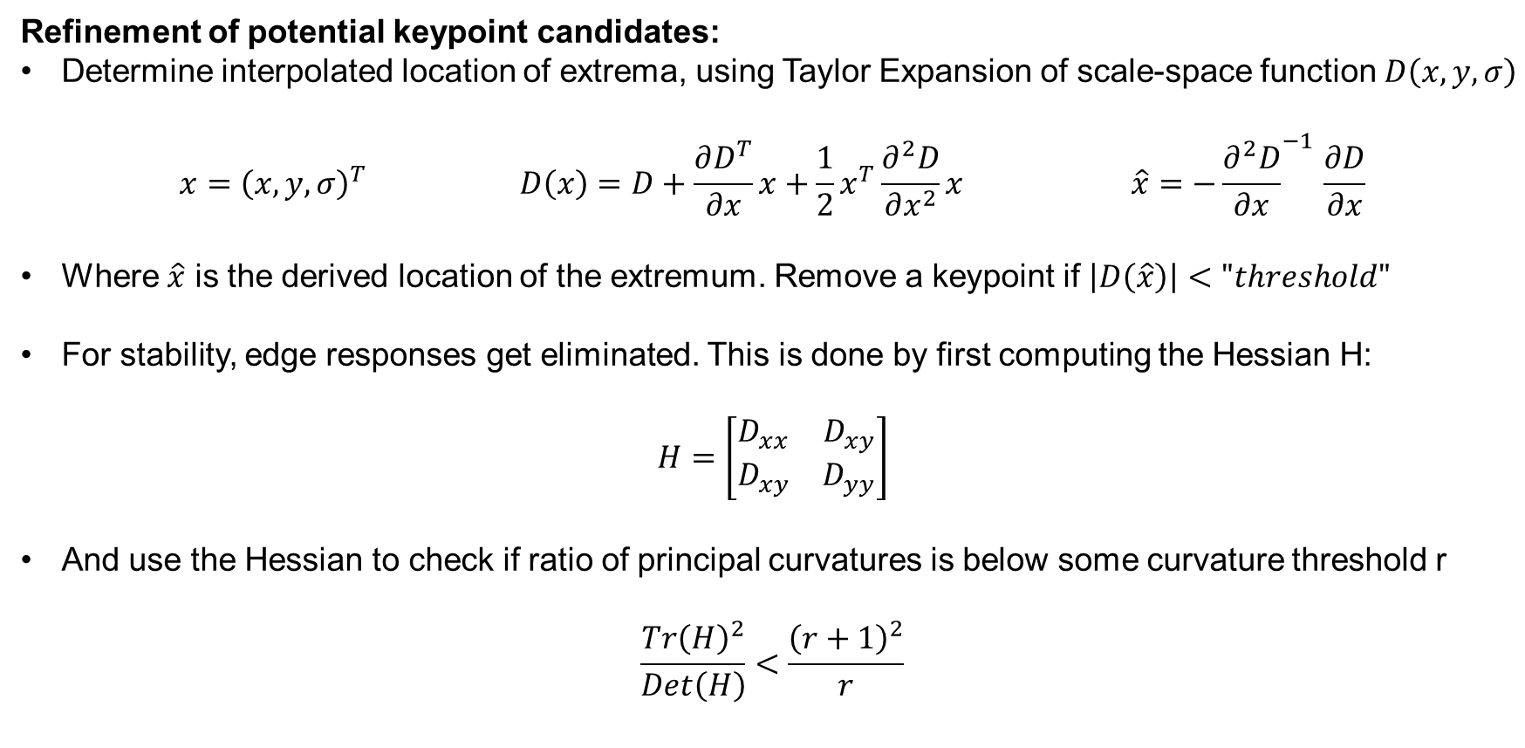
2. Keypoint Localization
Overview of Algorithm
Refinement of potential keypoint candidates:
Determine interpolated location of extrema, using Taylor Expansion of scale-space function $D\left(x, y, σ\right)$
$$x={\left(x,y,σ\right)}^{T} D\left(x\right)=D+\frac{∂D^{T}}{∂x}x+\frac{1}{2}x^{T}\frac{∂^{2}D}{∂x^{2}}x \hat{x}=−{\frac{∂^{2}D}{∂x}}^{−1 }\frac{∂D}{∂x}$$
Where $\hat{x}$ is the derived location of the extremum. Remove a keypoint if $\left|D\left(\hat{x}\right)\right|<"threshold"$
For stability, edge responses get eliminated. This is done by first computing the Hessian H:
$H=\left[\begin{matrix}D_{xx} & D_{xy} \\ D_{xy} & D_{yy}\end{matrix}\right]$
And use the Hessian to check if ratio of principal curvatures is below some curvature threshold r
$$\frac{Tr{\left(H\right)}^{2}}{Det\left(H\right)}<\frac{{\left(r+1\right)}^{2}}{r}$$

Slide 11
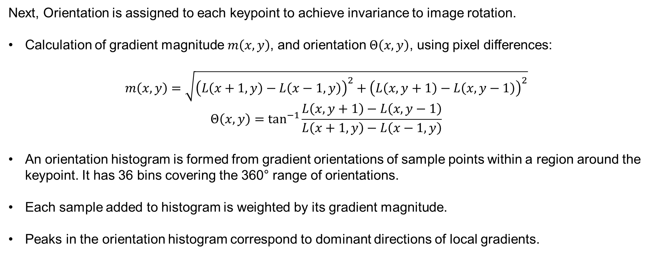
3. Orientation Assignment
Overview of Algorithm
Next, Orientation is assigned to each keypoint to achieve invariance to image rotation.
Calculation of gradient magnitude $m\left(x, y\right)$, and orientation $Θ\left(x, y\right)$, using pixel differences:
$$m\left(x,y\right)=\sqrt{{\left(L\left(x+1,y\right)−L\left(x−1,y\right)\right)}^{2}+{\left(L\left(x, y+1\right)−L\left(x, y−1\right)\right)}^{2}}$$
$$Θ\left(x,y\right)=\tan^{−1}{\frac{L\left(x, y+1\right)−L\left(x,y−1\right)}{L\left(x+1,y\right)−L\left(x−1,y\right)}}$$
An orientation histogram is formed from gradient orientations of sample points within a region around the keypoint. It has 36 bins covering the 360° range of orientations.
Each sample added to histogram is weighted by its gradient magnitude.
Peaks in the orientation histogram correspond to dominant directions of local gradients.

Slide 12
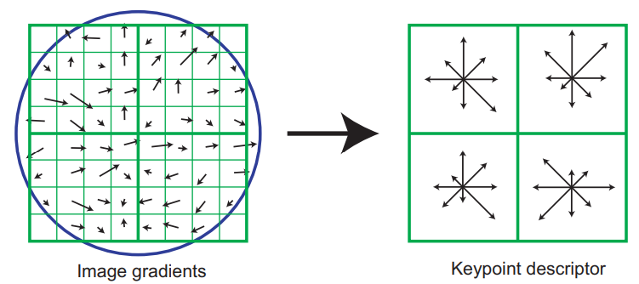
4. Extraction of Keypoint Descriptor
Overview of Algorithm
Last step is to create a descriptor for the local image region:
We consider a 16x16 pixel patch around the keypoint
The patch is subdivided in 16 blocks of size 4x4, for each of these blocks an 8 bin orientation histogram is created
This gives us a total of 128 bin values. These values are represented as a vector to form the keypoint descriptor
Figure: Shows a 2x2 descriptor array computed from an 8x8 set of samples

Slide 13
References
Distinctive Image Features from Scale-Invariant Keypoints [Lowe, 2004]
Guohui Wang, ezSIFT: an easy-to-use standalone SIFT library, 2013

