Slide 1
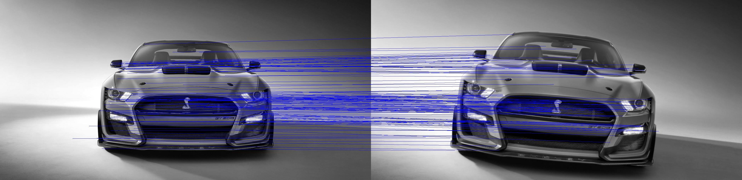
A SIFT Descriptor for Feature Matching
Advanced Systems Lab
Nicolas Hafner, Costanza Maria Improta, Zsombor Kalotay, Jan Leutwyler

Slide 2
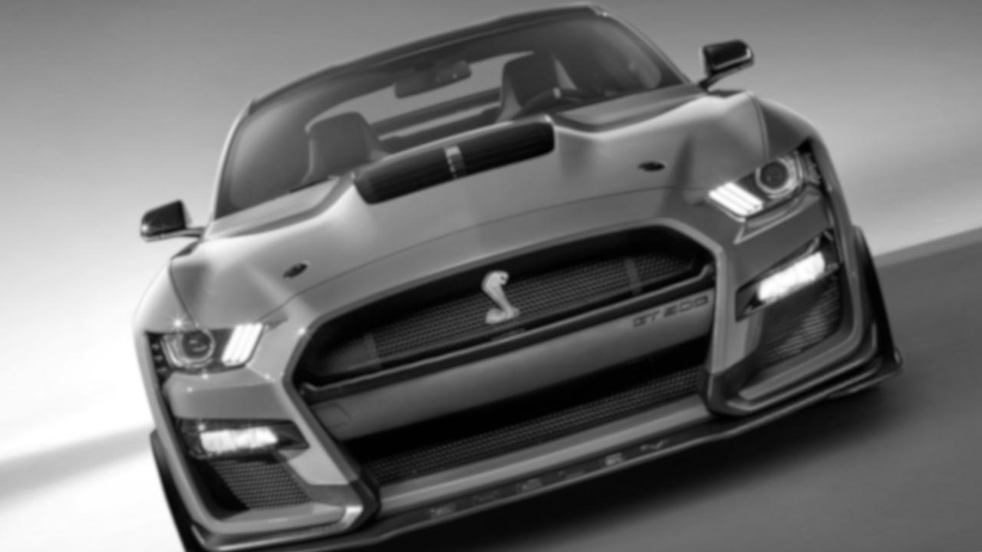
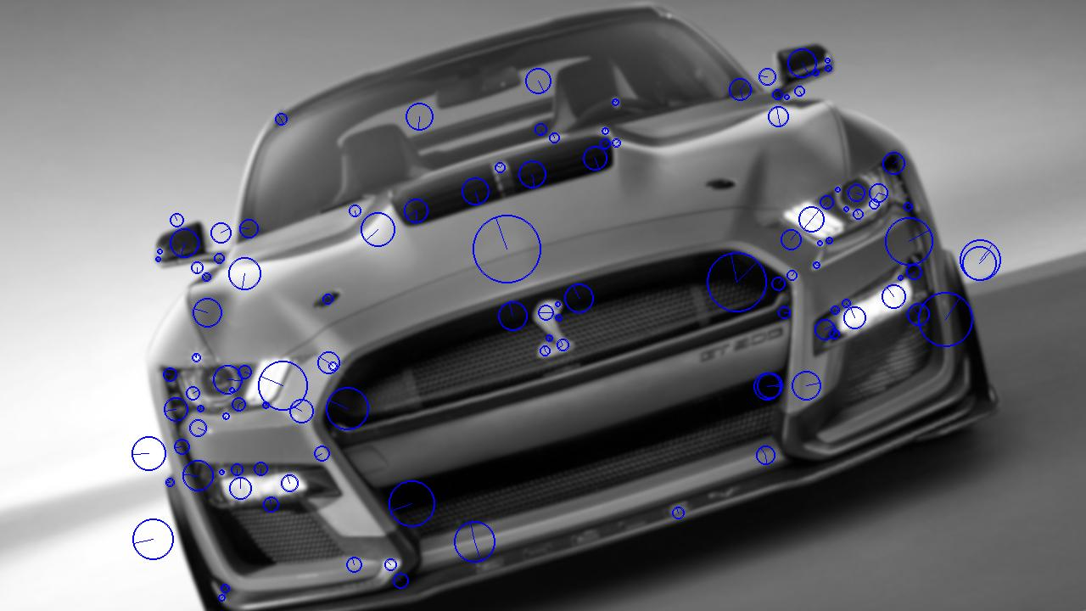
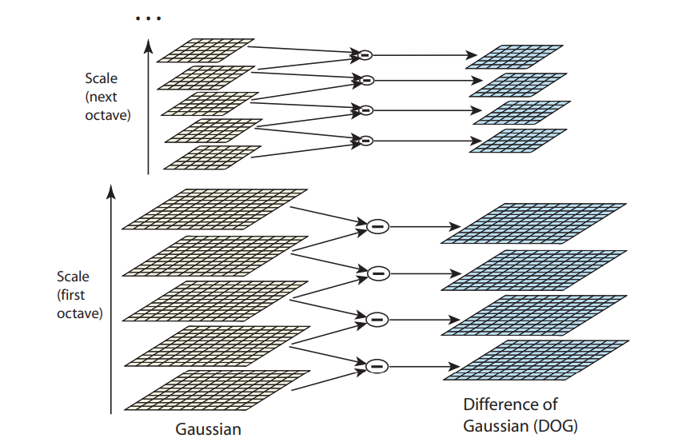
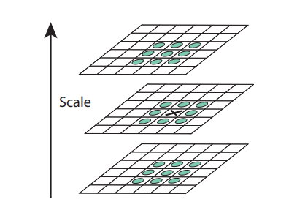
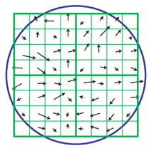
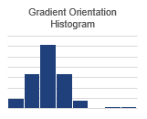
Rough Visualization of our Algorithm
Generate Gradient/Rotation Pyramid
Localize Extrema in DoG Pyramid
Refine Extrema location and assign Orientation
Extract Descriptor around keypoint from image
Generate Gaussian Pyramid
Generate DoG Pyramid

