Slide 1

A SIFT Descriptor for Feature Matching Advanced Systems Lab
Nicolas Hafner, Costanza Maria Improta, Zsombor Kalotay, Jan Leutwyler

Slide 2

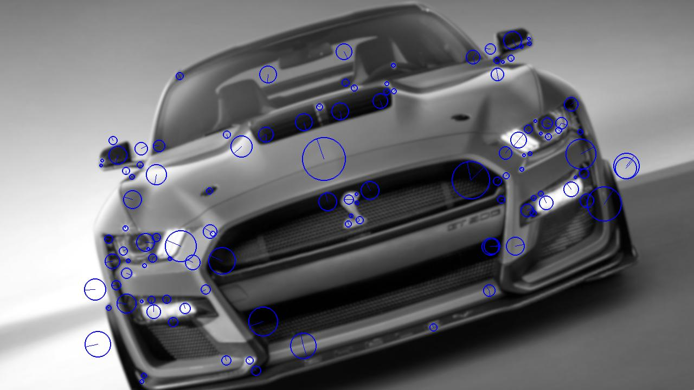
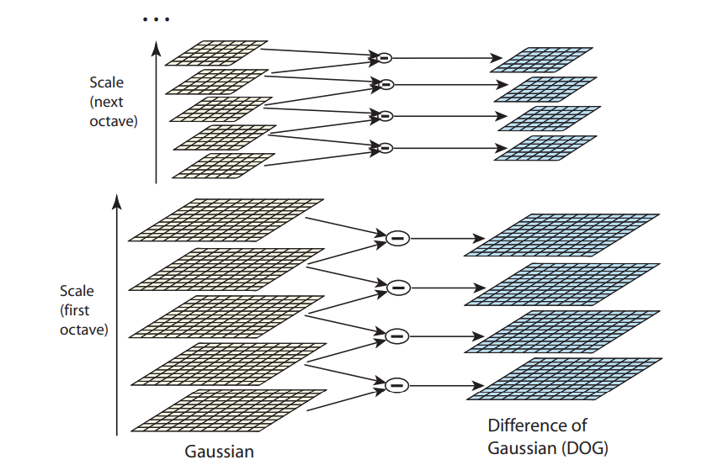
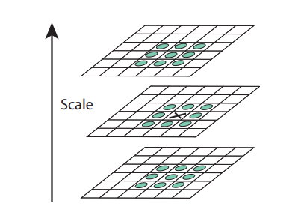
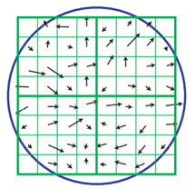
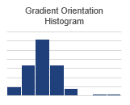
Our Algorithm
Asymptotic runtime: O(xxx)
Generate Gradient/Rotation Pyramid
Localize Extrema in DoG Pyramid
Refine Extrema location and assign Orientation
Extract Descriptor around keypoint from image
Generate Gaussian Pyramid
Generate DoG Pyramid
Notes:
Algorithm that you consider:
State problem that it solves (input:…, output: …)
Visualize how it works
State asymptotic runtime

Slide 3
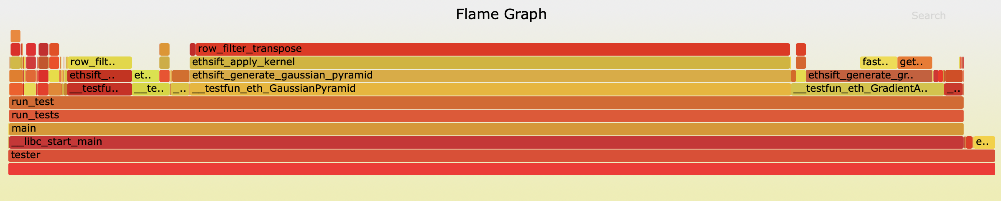
Cost Analysis and Profiling
Flop count and memory accesses
Bottlenecks: row_filter_transpose, ethsift_apply_kernel, ethsift_generate_gaussian_pyramid
Notes:
Cost Measures
Exact Count

Slide 4
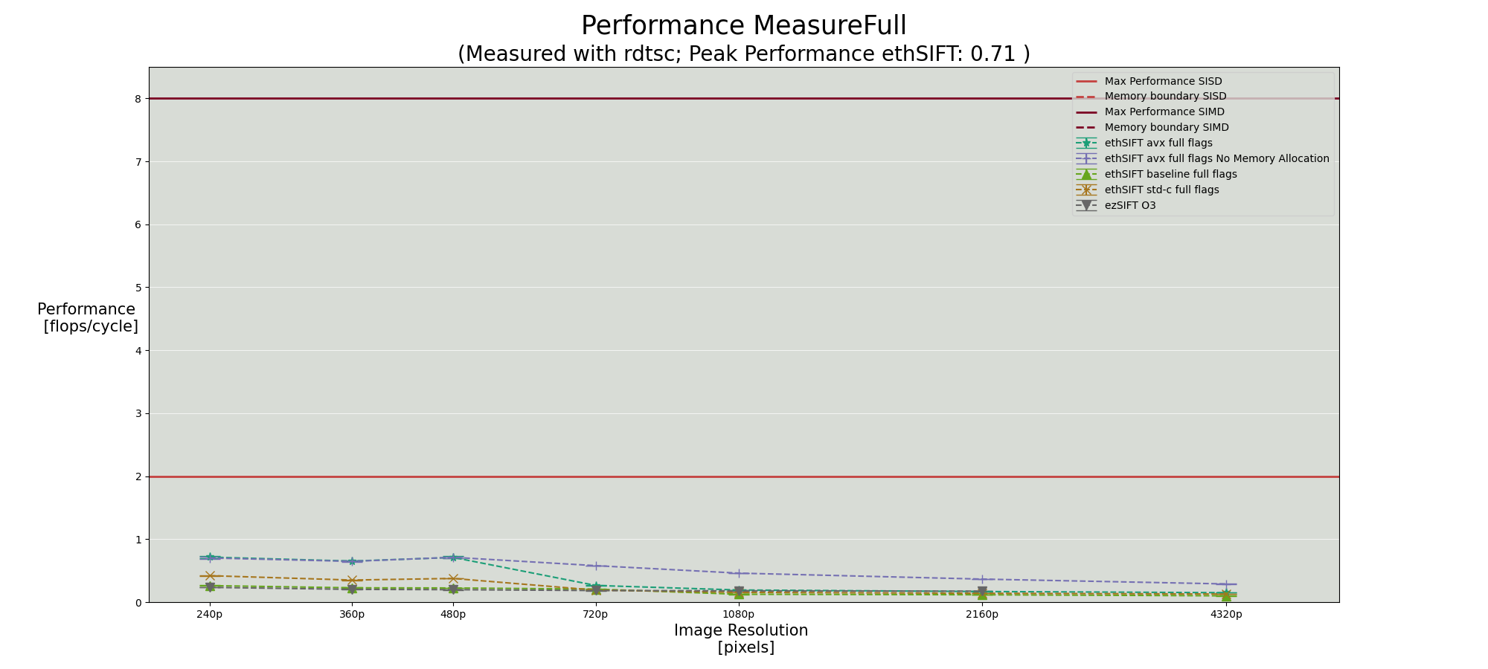
Experimental Results (Intel i7-7820HQ @ 2.9GHz)
Overall Speedup:
x x.xx
Notes:
Experimental setup – platform, compiler
Performance plot over a range of sizes with different code versions
Push input size to the limit in the experiments
Overall Speedup

Slide 5
Baseline Implementation
ezSIFT as benchmarking

Slide 6
Standard C optimisations

Slide 7
AVX optimisations

Slide 8
Additional Observations
ezSIFT leaks memory
Helped performance:
Variable declarations close to point of use
Declaring const
Worsened performance:
size_t instead of int
Forcing memory to be paged in at allocation time
Prefetching memory can be hurtful
Without optimisations
GCC
Clang
ICC
With optimisations
ICC
Clang
GCC

