Slide 1
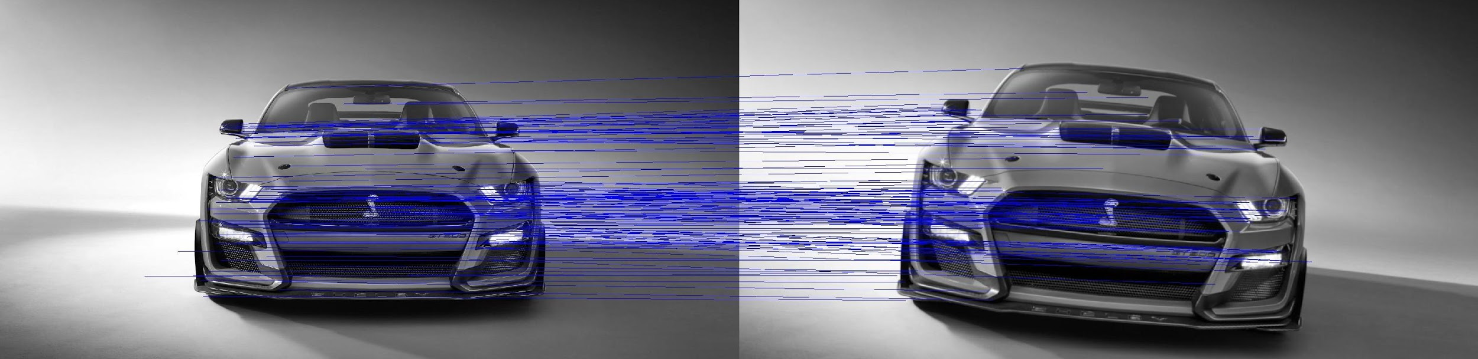
A SIFT Descriptor for Feature Matching Advanced Systems Lab
Nicolas Hafner, Costanza Maria Improta, Zsombor Kalotay, Jan Leutwyler

Slide 2

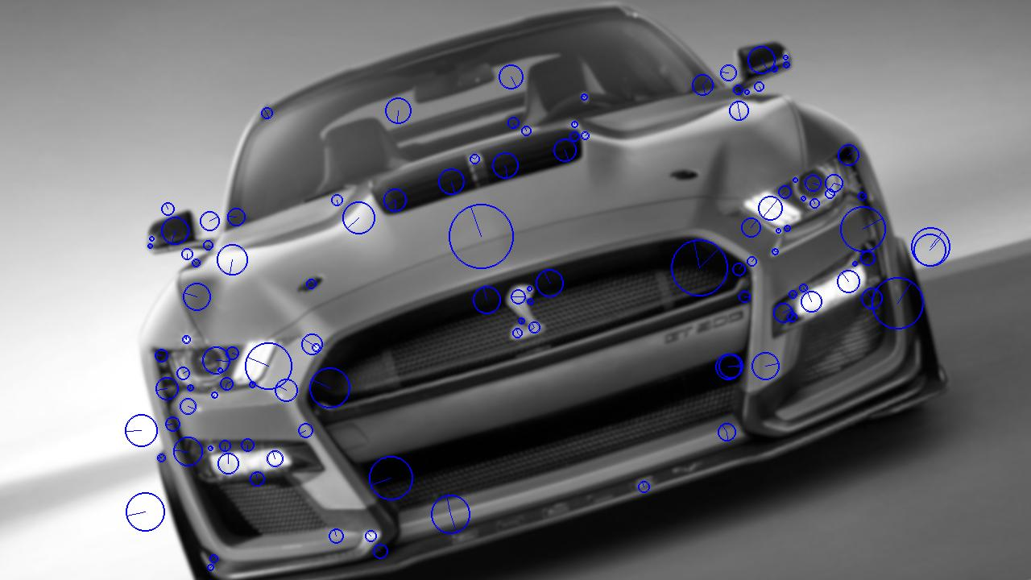
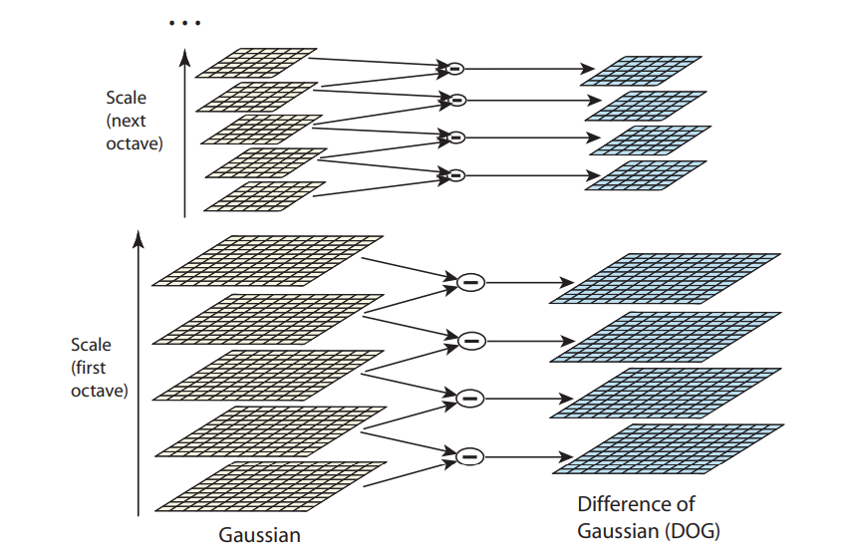
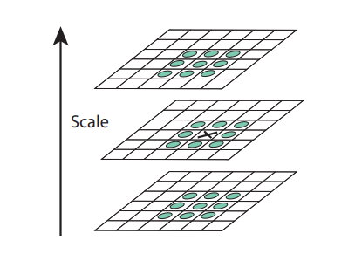
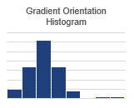
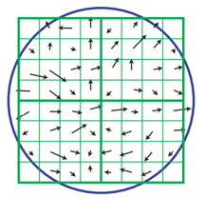
Our Algorithm
Generate Gradient/Rotation Pyramid
Localize Extrema in DoG Pyramid
Refine Extrema location and assign Orientation
Extract Descriptor around keypoint from image
Generate Gaussian Pyramid
Generate DoG Pyramid
Notes:
Algorithm that you consider:
State problem that it solves (input:…, output: …)
Visualize how it works
State asymptotic runtime

Slide 3
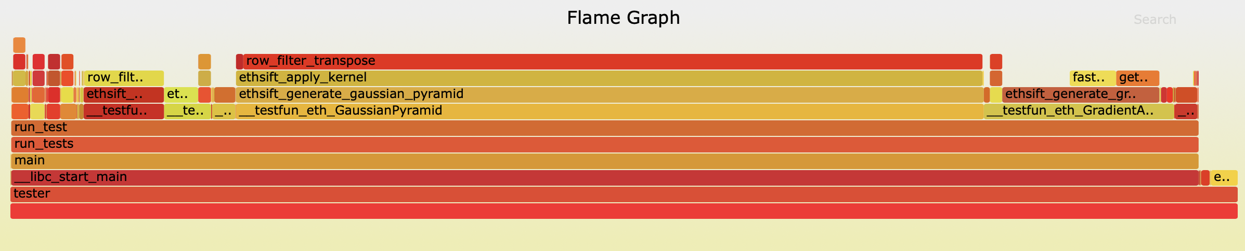
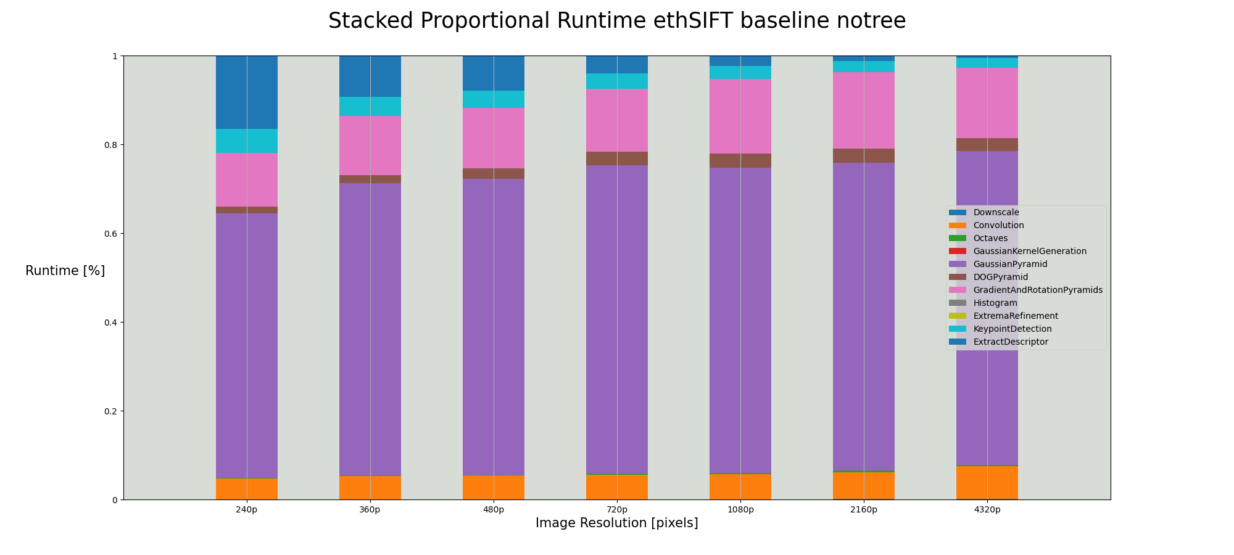
Cost Analysis and Profiling
Flop count and memory accesses
Runtime (proportional)
Bottlenecks:
Gaussian Pyramid
Gradient and Rotation Pyramids
Reference Implementation:
ezSIFT
Notes:
Cost Measures
Exact Count

Slide 4
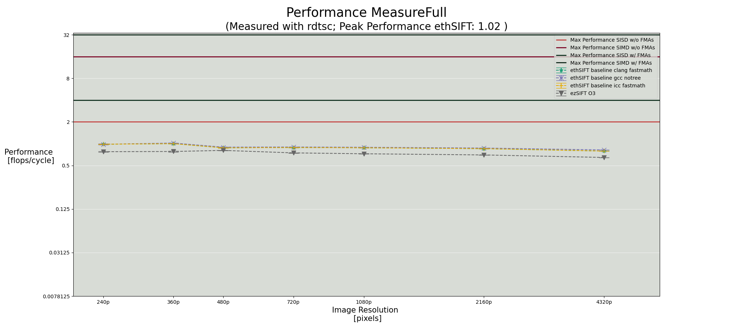
Baseline Implementation (Intel i7-8700K @ 4.4GHz)

Slide 5
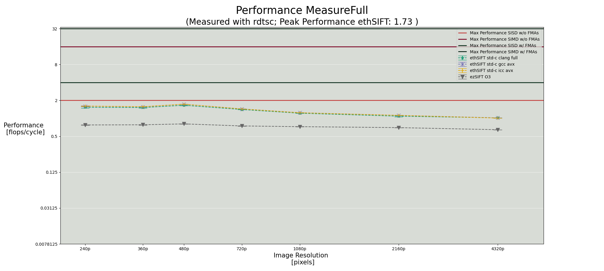
Standard C optimisations (Intel i7-8700K @ 4.4GHz)

Slide 6
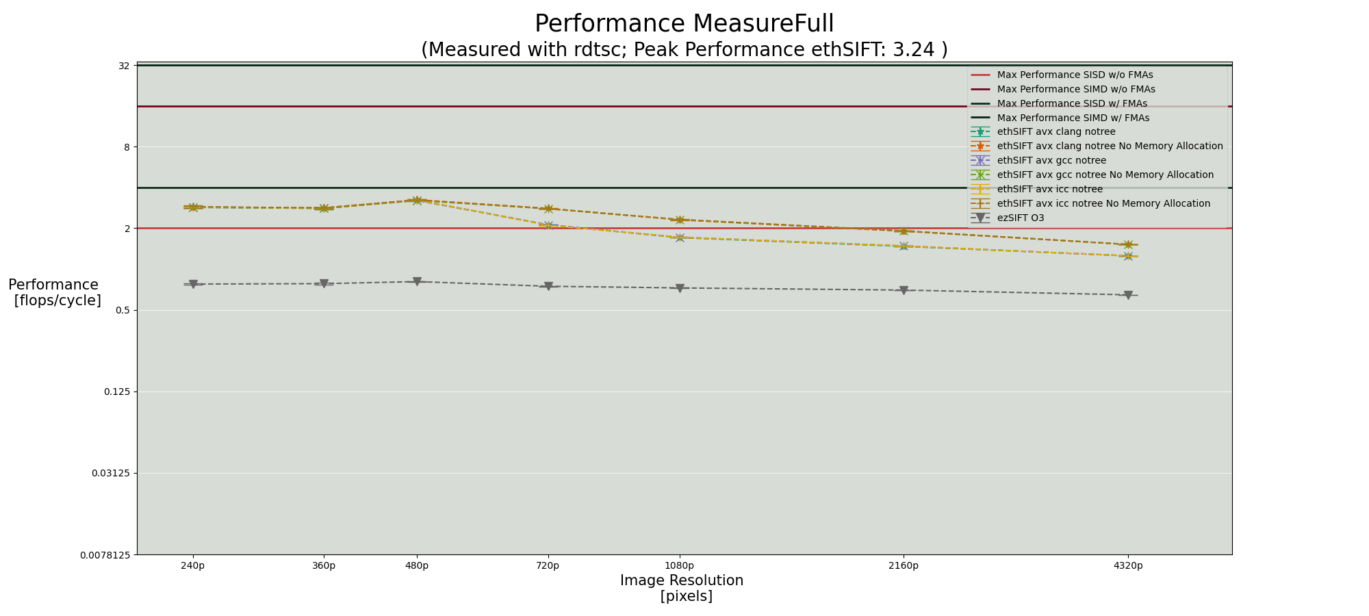
AVX optimisations (Intel i7-8700K @ 4.4GHz)

Slide 7
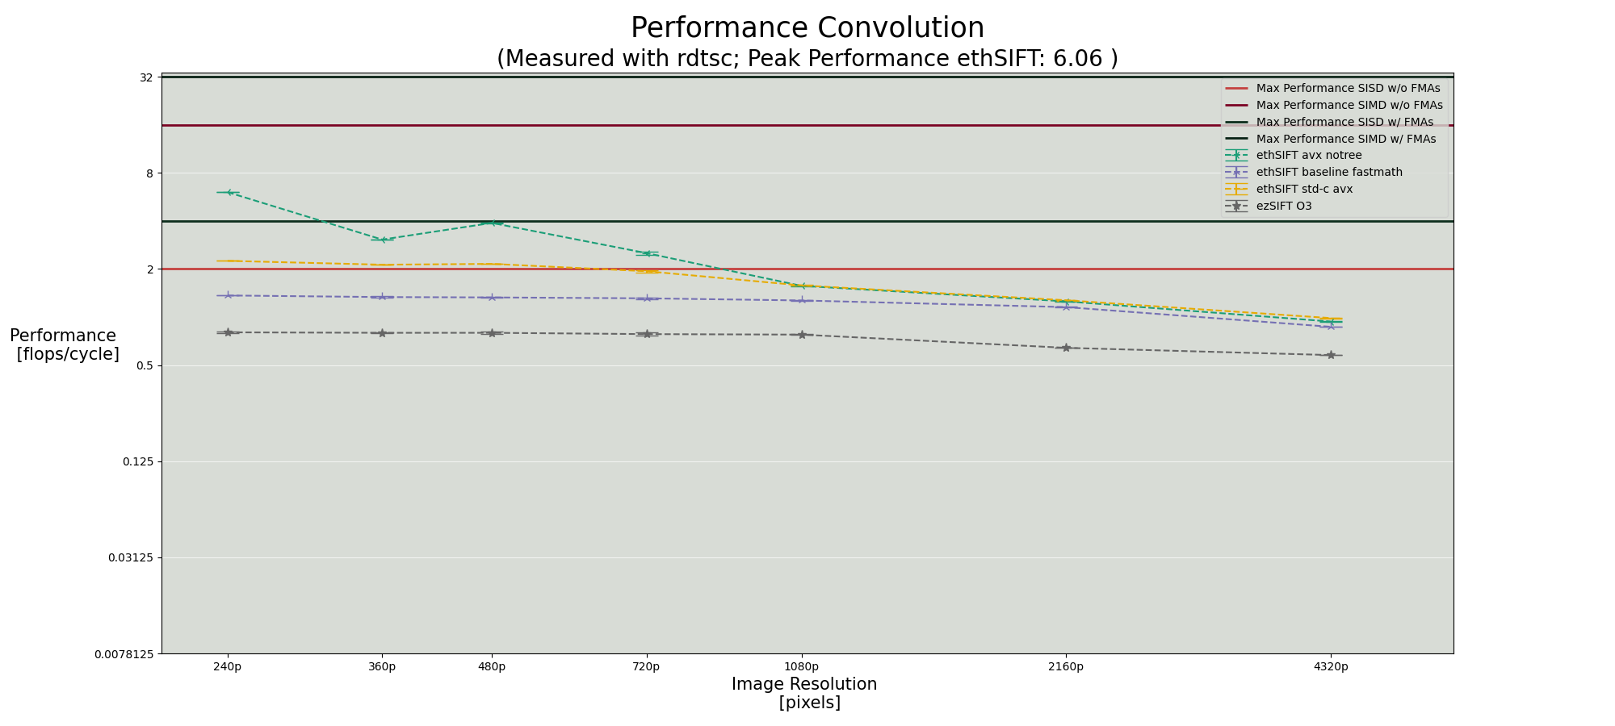
Some interesting plots (Intel i7-8700K @ 4.4GHz with ICC)

Slide 8
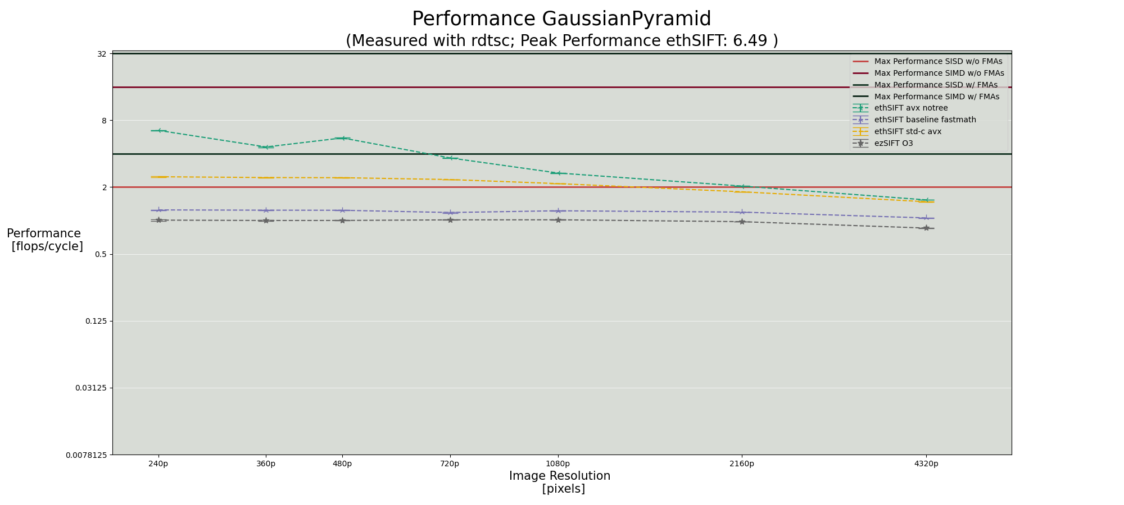
Some interesting plots (Intel i7-8700K @ 4.4GHz with ICC)

Slide 9
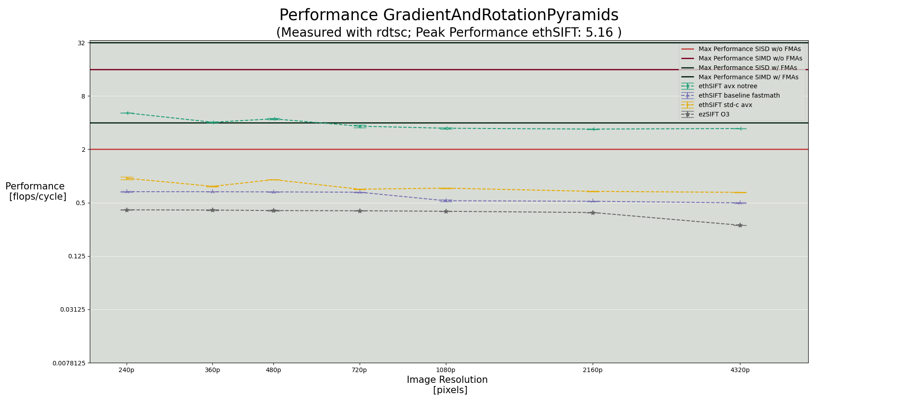
Some interesting plots (Intel i7-8700K @ 4.4GHz with ICC)

Slide 10
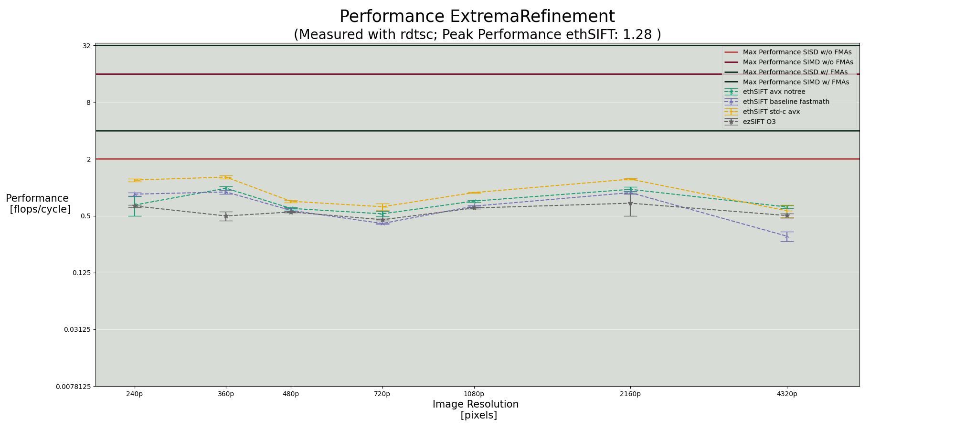
Some interesting plots (Intel i7-8700K @ 4.4GHz with ICC)

Slide 11
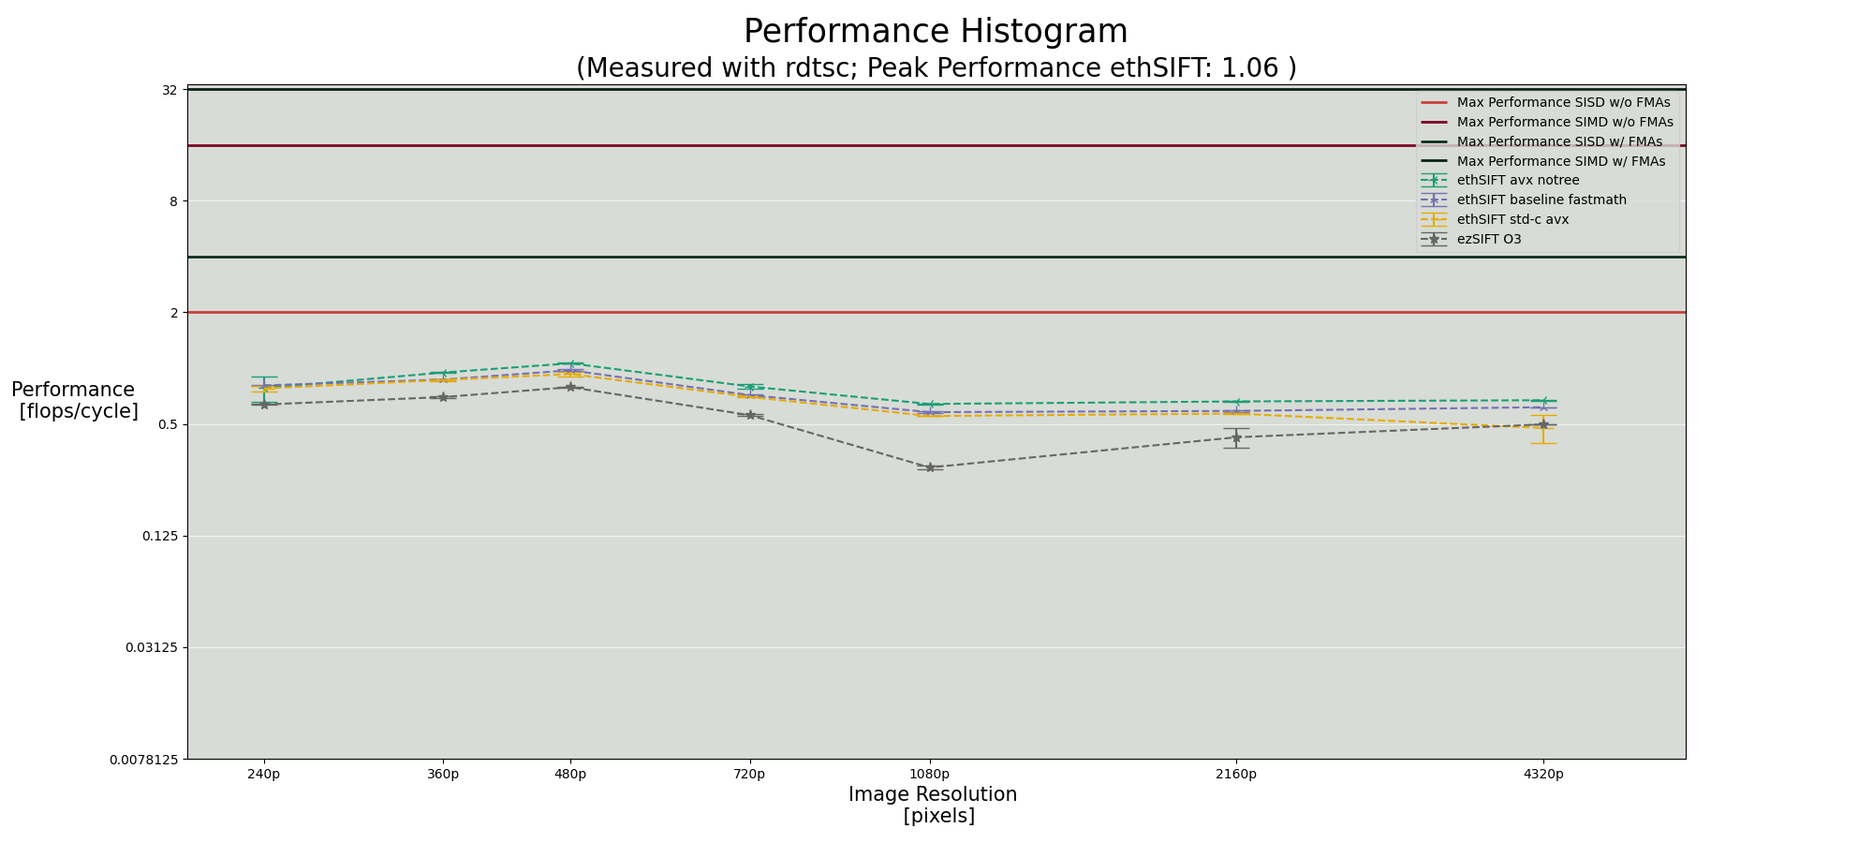
Some interesting plots (Intel i7-8700K @ 4.4GHz with ICC)

Slide 12
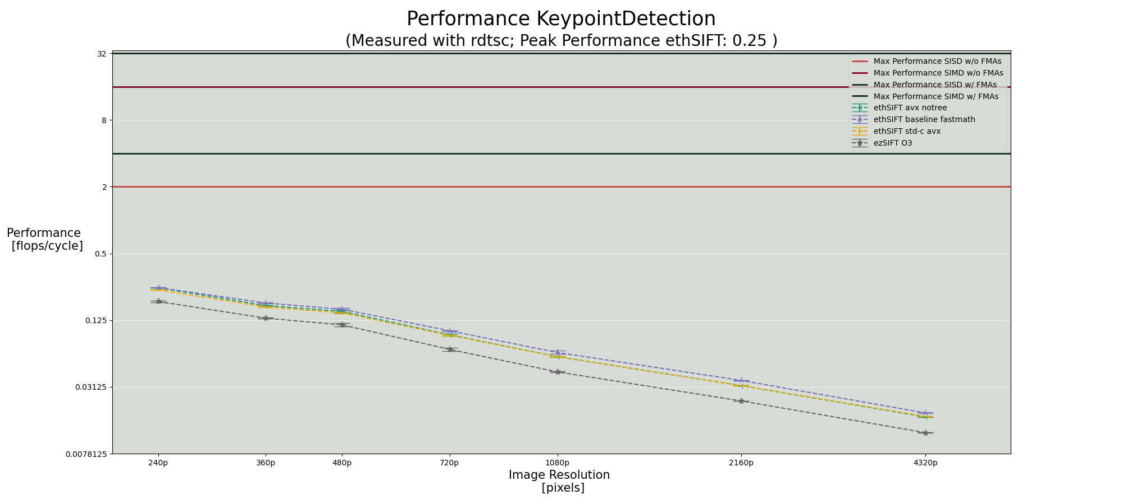
Some interesting plots (Intel i7-8700K @ 4.4GHz with ICC)

Slide 13
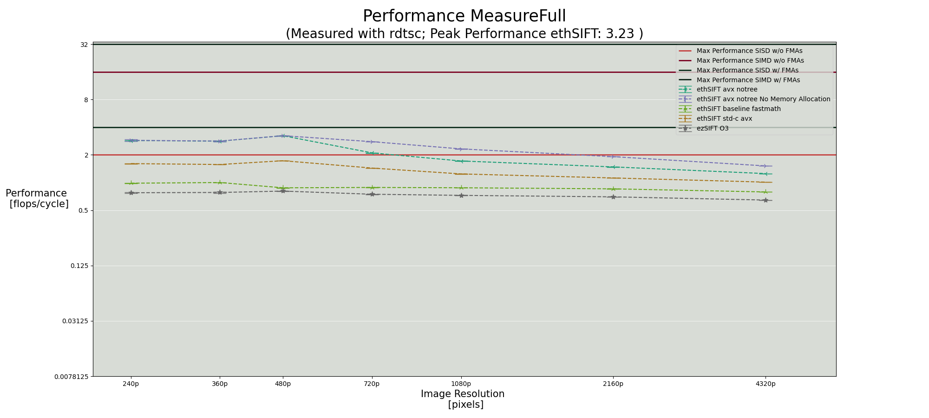
Experimental Results (Intel i7-8700K @ 4.4GHz with ICC)
Overall Speedup:
~3x
Notes:
Experimental setup – platform, compiler
Performance plot over a range of sizes with different code versions
Push input size to the limit in the experiments
Overall Speedup

Slide 14
Interesting Findings
ezSIFT leaks memory by default (manually fixed)
Helped performance:
Variable declarations close to point of use
Declaring const
Worsened performance:
size_t instead of int
Forcing memory to be paged when allocated
Sometimes helped sometimes hurt:
Prefetching memory
Compiler flags
Without optimisations
GCC
Clang
ICC
With optimisations
ICC
Clang
GCC

Slide 15
In Conclusion
SIFT is difficult to optimise
Gaussian kernel convolution quickly becomes the biggest bottleneck
In parts achieved up to 10x speedup over the reference
Overall achieved ~3x speedup

Slide 16
Appendix

Slide 17

Experimental Results (Intel i7-8700K @ 4.4GHz with GCC)
Notes:
Experimental setup – platform, compiler
Performance plot over a range of sizes with different code versions
Push input size to the limit in the experiments
Overall Speedup

Slide 18

Experimental Results (Intel i7-8700K @ 4.4GHz with CLANG)
Notes:
Experimental setup – platform, compiler
Performance plot over a range of sizes with different code versions
Push input size to the limit in the experiments
Overall Speedup

Slide 19
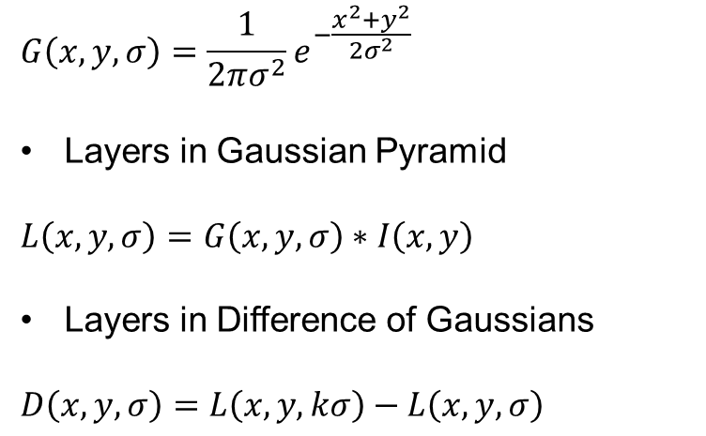
STEP 1: Scale-space Extrema Detection
After each octave, image is downsampled by a factor of 2
Repeatedly convolved with Gaussians
Constant multiplicative factor k

Slide 20
STEP 1: Scale-space Extrema Detection
Find local extrema in DoG pyramid by comparing a pixel to its 8 neighbour pixels in the same scale, as well as to the 9 pixels in each of the adjacent scales.
It is only selected if it is either larger or smaller than all of these other pixel values.

Slide 21
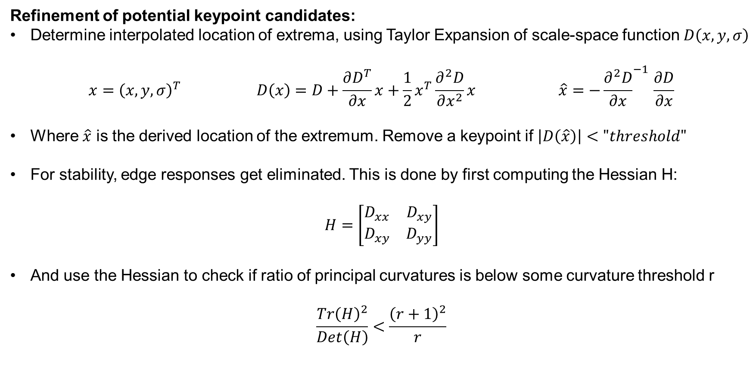
STEP 2: Keypoint Localization

Slide 22
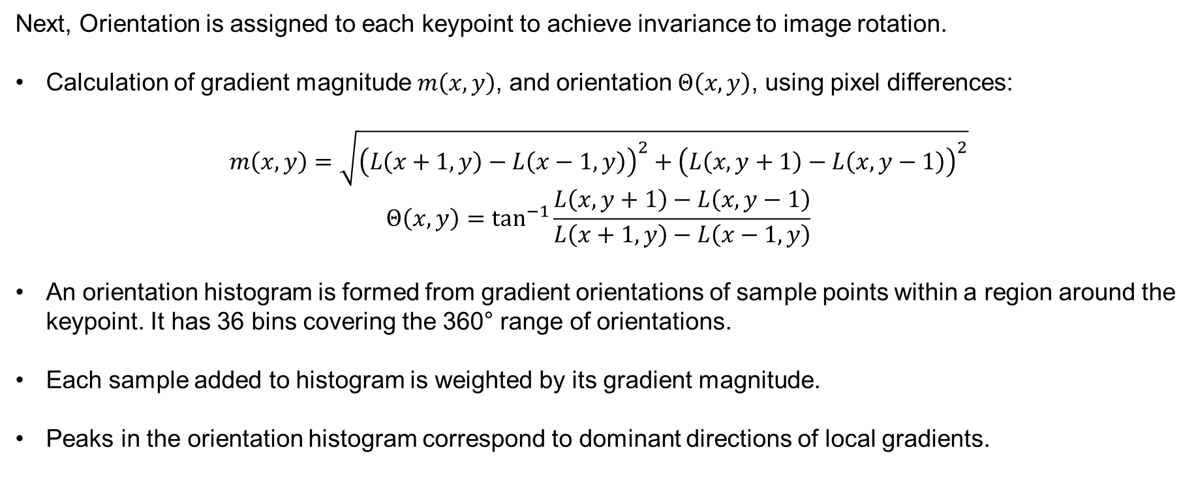
STEP 3: Orientation Assignment

Slide 23
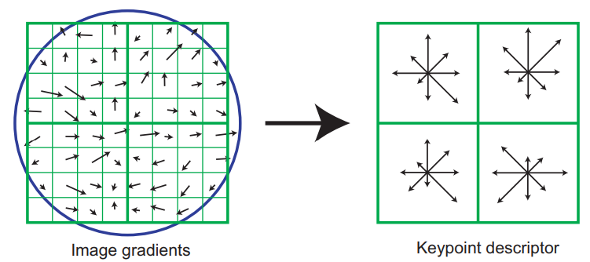
STEP 4: Extraction of Keypoint Descriptor
Last step is to create a descriptor for the local image region:
We consider a 16x16 pixel patch around the keypoint
The patch is subdivided in 16 blocks of size 4x4, for each of these blocks an 8 bin orientation histogram is created
This gives us a total of 128 bin values. These values are represented as a vector to form the keypoint descriptor
Figure: Shows a 2x2 descriptor array computed from an 8x8 set of samples

Slide 24
References
Distinctive Image Features from Scale-Invariant Keypoints [Lowe, 2004]
Guohui Wang, ezSIFT: an easy-to-use standalone SIFT library, 2013

