Slide 1
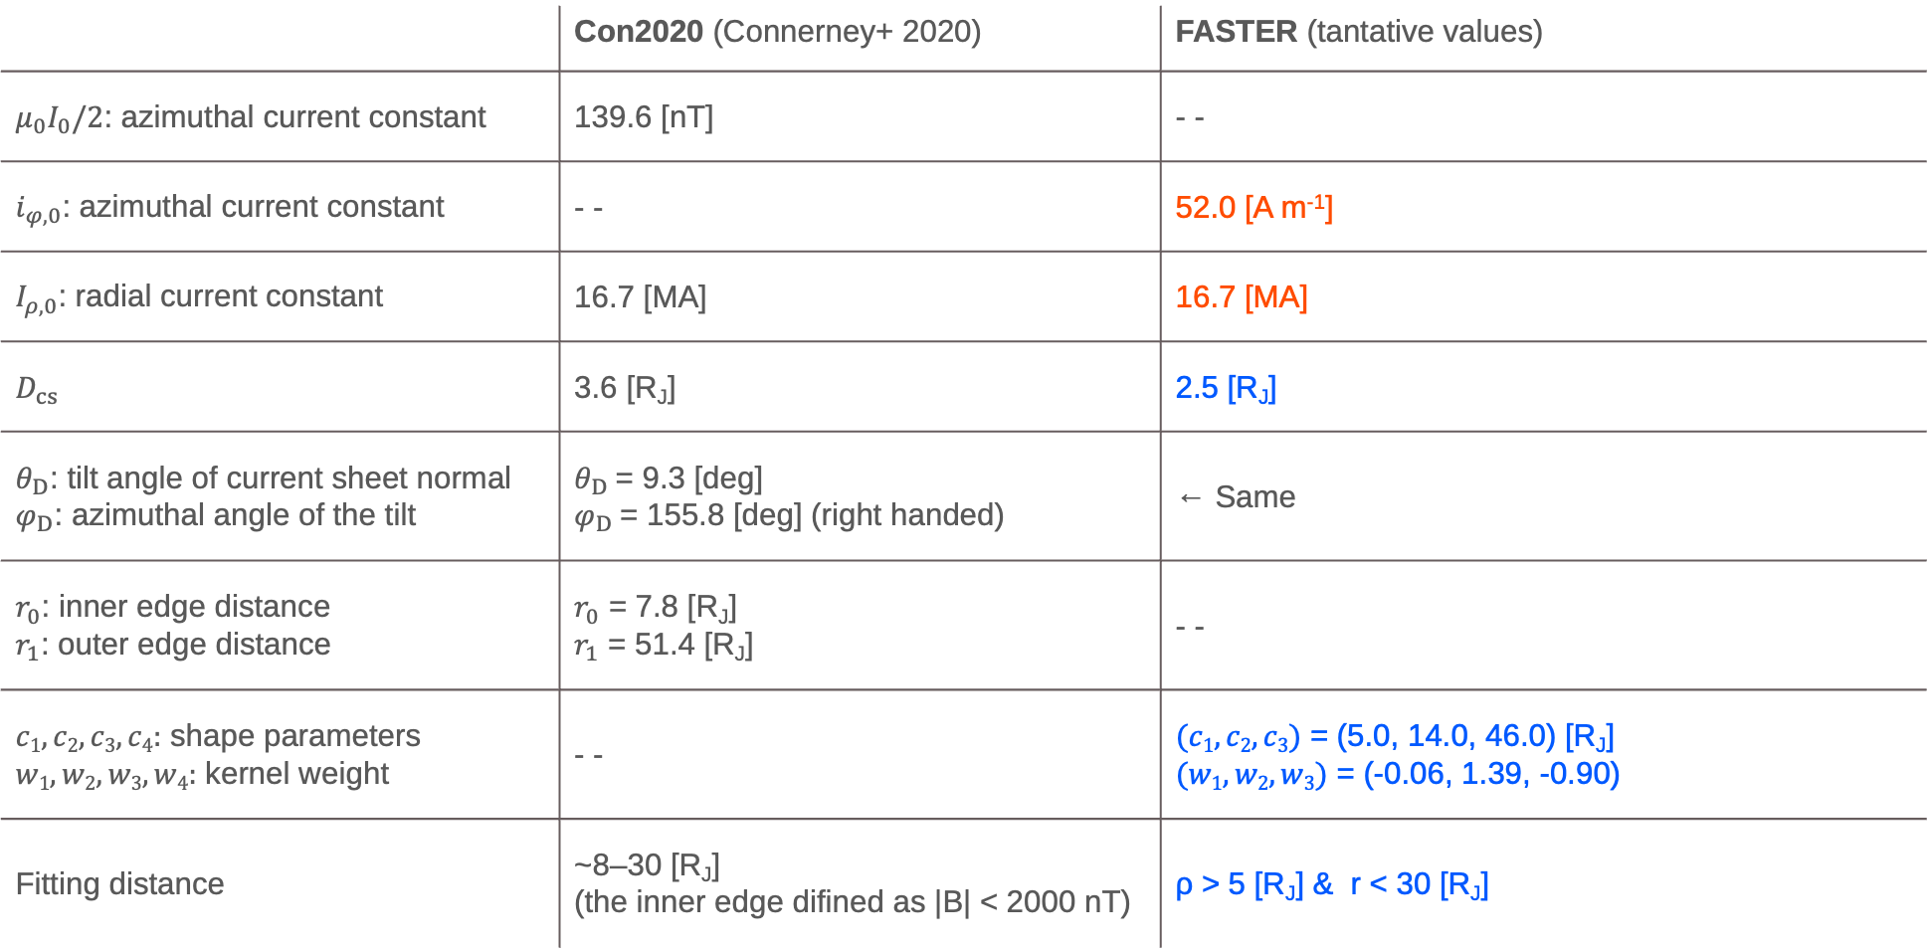
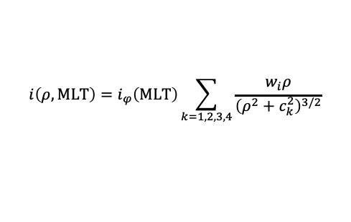
FGM FIT
Blue: Fixed value
Red: Determined for each PJ data
 | Con2020 (Connerney+ 2020) | FASTER (tantative values)
$μ_{0}I_{0}/2$: azimuthal current constant | 139.6 [nT] | - -
$i_{φ,0}$: azimuthal current constant | - - | 52.0 [A m⁻¹]
$I_{ρ,0}$: radial current constant | 16.7 [MA] | 16.7 [MA]
$D_{cs}$ | 3.6 [R_{J}] | 2.5 [R_{J}]
$θ_{D}$: tilt angle of current sheet normal $φ_{D}$: azimuthal angle of the tilt | $θ_{D}$= 9.3 [deg] $φ_{D}$= 155.8 [deg] (right handed) | ← Same
$r_{0}$: inner edge distance $r_{1}$: outer edge distance | $r_{0}$ = 7.8 [R_{J}] $r_{1}$ = 51.4 [R_{J}] | - -
$c1, c2, c3,c4:$ shape parameters $w1, w2, w3,w4:$ kernel weight | - - | $(c1, c2, c3)$ = (5.0, 14.0, 46.0) [R_{J}] $(w1, w2, w3)$ = (-0.06, 1.39, -0.90)
Fitting distance | ~8–30 [R_{J}] (the inner edge difined as |B| < 2000 nT) | ρ > 5 [R_{J}] & r < 30 [R_{J}]
$$i\left(ρ,MLT\right)=i_{φ}\left(MLT\right)\sum_{k=1,2,3,4}{\frac{w_{i}ρ}{{\left(ρ^{2}+c_{k}^{2}\right)}^{3/2}}}$$
1

Slide 2
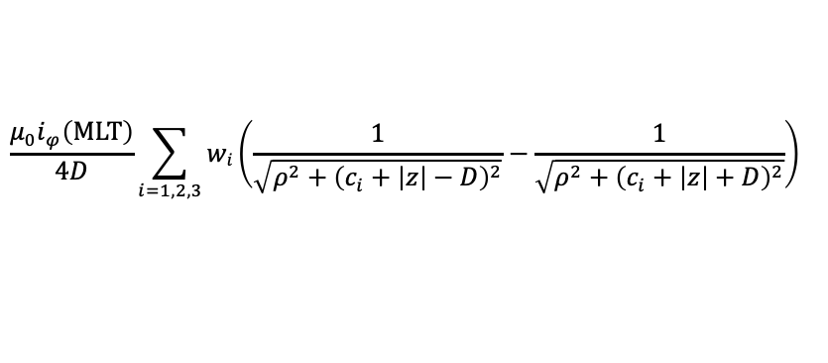
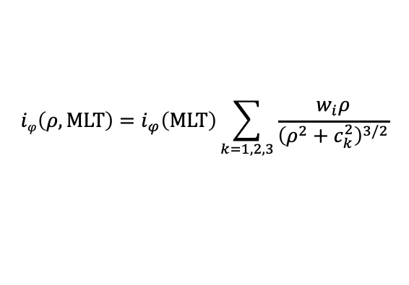

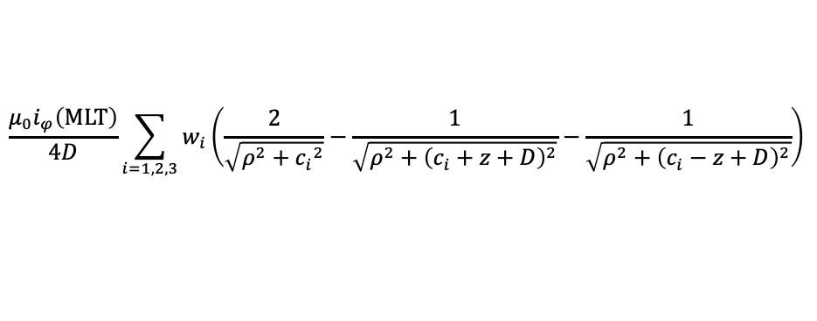



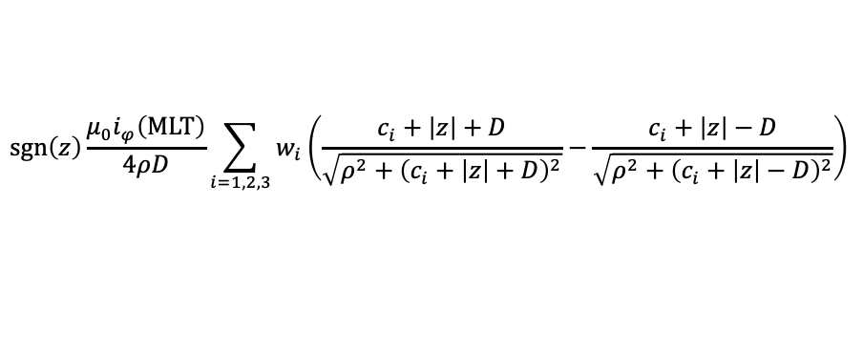

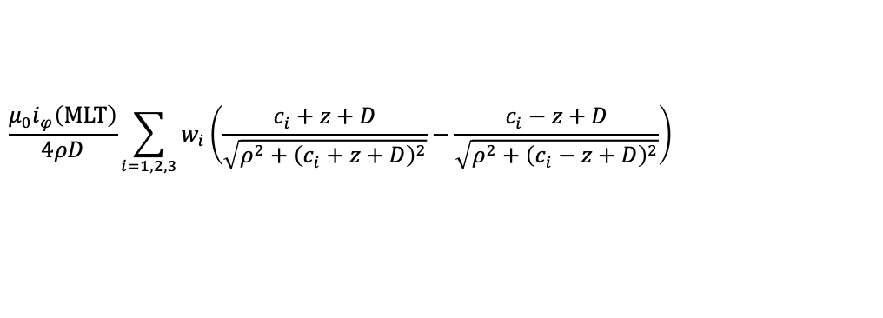

FGM FIT
$$iφ\left(ρ,MLT\right)=i_{φ}\left(MLT\right)\sum_{k=1,2,3}{\frac{w_{i}ρ}{{\left(ρ^{2}+c_{k}^{2}\right)}^{3/2}}}$$
$$I_{ρ}\left(ρ,MLT\right)=\frac{I_{ρ,0}}{2}\left(1+\tanh\left(\frac{ρ−d_{1}}{d_{2}}\right)\right)$$
$$B_{ρ}^{disk}\left(ρ,z,MLT\right)=$$
$$\frac{μ_{0}i_{φ}\left(MLT\right)}{4ρD}\sum_{i=1,2,3}{w_{i}}\left(\frac{c_{i}+z+D}{\sqrt{ρ^{2}+{\left(c_{i}+z+D\right)}^{2}}}−\frac{c_{i}−z+D}{\sqrt{ρ^{2}+{\left(c_{i}−z+D\right)}^{2}}}\right)$$
for |z| ≦ D
$$sgn\left(z\right)\frac{μ_{0}i_{φ}\left(MLT\right)}{4ρD}\sum_{i=1,2,3}{w_{i}}\left(\frac{c_{i}+\left|z\right|+D}{\sqrt{ρ^{2}+{\left(c_{i}+\left|z\right|+D\right)}^{2}}}−\frac{c_{i}+\left|z\right|−D}{\sqrt{ρ^{2}+{\left(c_{i}+\left|z\right|−D\right)}^{2}}}\right)$$
for |z| > D
$$B_{z}^{disk}\left(ρ,z,MLT\right)=$$
$$\frac{μ_{0}i_{φ}\left(MLT\right)}{4D}\sum_{i=1,2,3}{w_{i}}\left(\frac{2}{\sqrt{ρ^{2}+{c_{i}}^{2}}}−\frac{1}{\sqrt{ρ^{2}+{\left(c_{i}+z+D\right)}^{2}}}−\frac{1}{\sqrt{ρ^{2}+{\left(c_{i}−z+D\right)}^{2}}}\right)$$
for |z| ≦ D
$$\frac{μ_{0}i_{φ}\left(MLT\right)}{4D}\sum_{i=1,2,3}{wi\left(\frac{1}{\sqrt{ρ^{2}+{\left(c_{i}+\left|z\right|−D\right)}^{2}}}−\frac{1}{\sqrt{ρ^{2}+{\left(c_{i}+\left|z\right|+D\right)}^{2}}}\right)}$$
for |z| > D
$$B_{φ}^{disk}\left(ρ,z,MLT\right)=$$
$$−\frac{μ_{0}I_{ρ}}{2πρR_{J}}\frac{z}{D}$$
for |z| ≦ D
$$−sgn(z)\frac{μ_{0}I_{ρ}}{2πρR_{J}}$$
for |z| > D
The true analytic solution
2

Slide 3
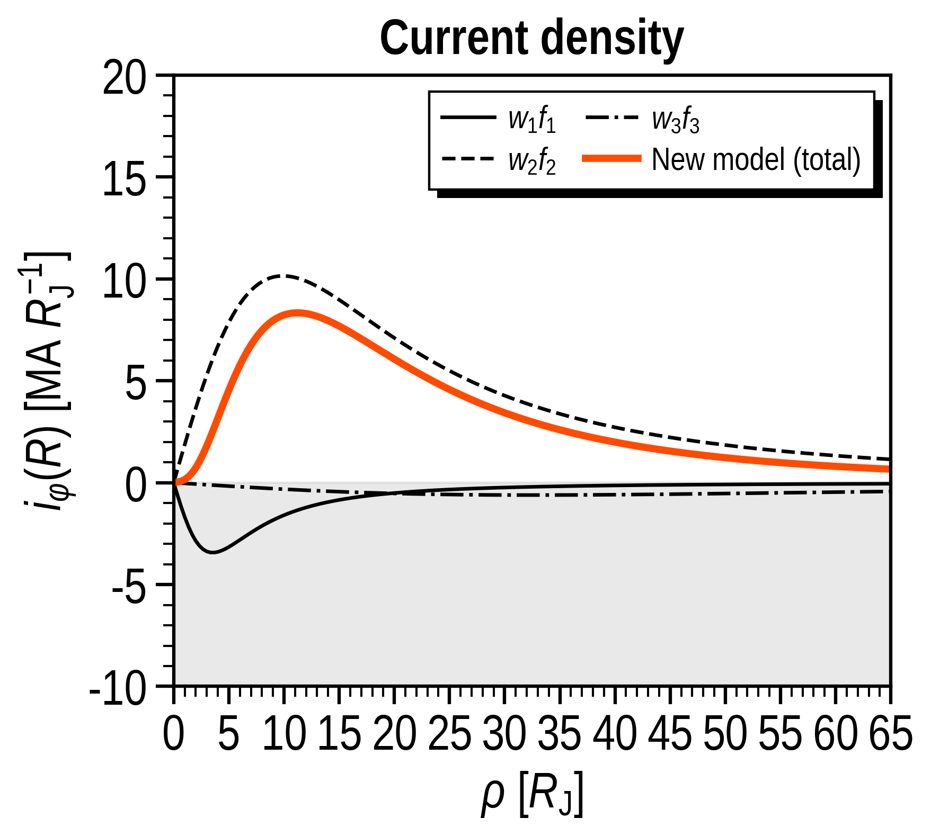
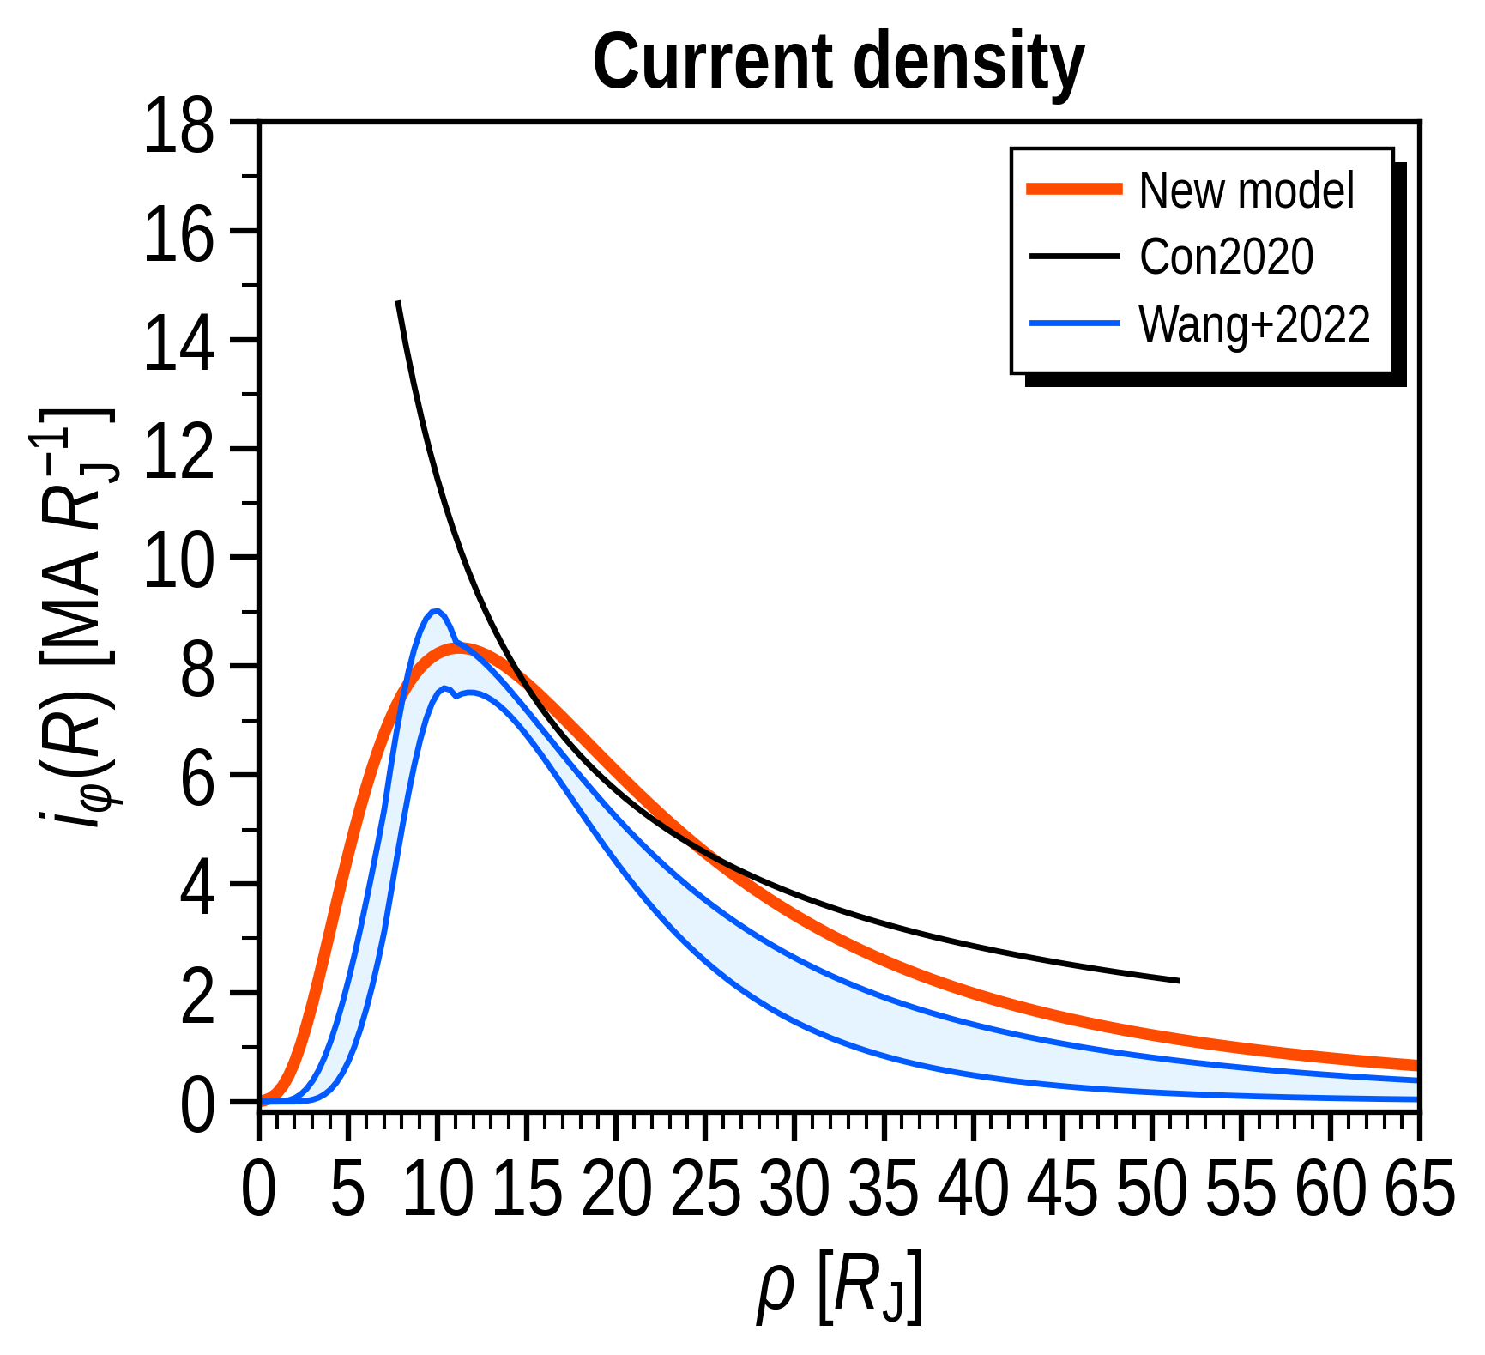
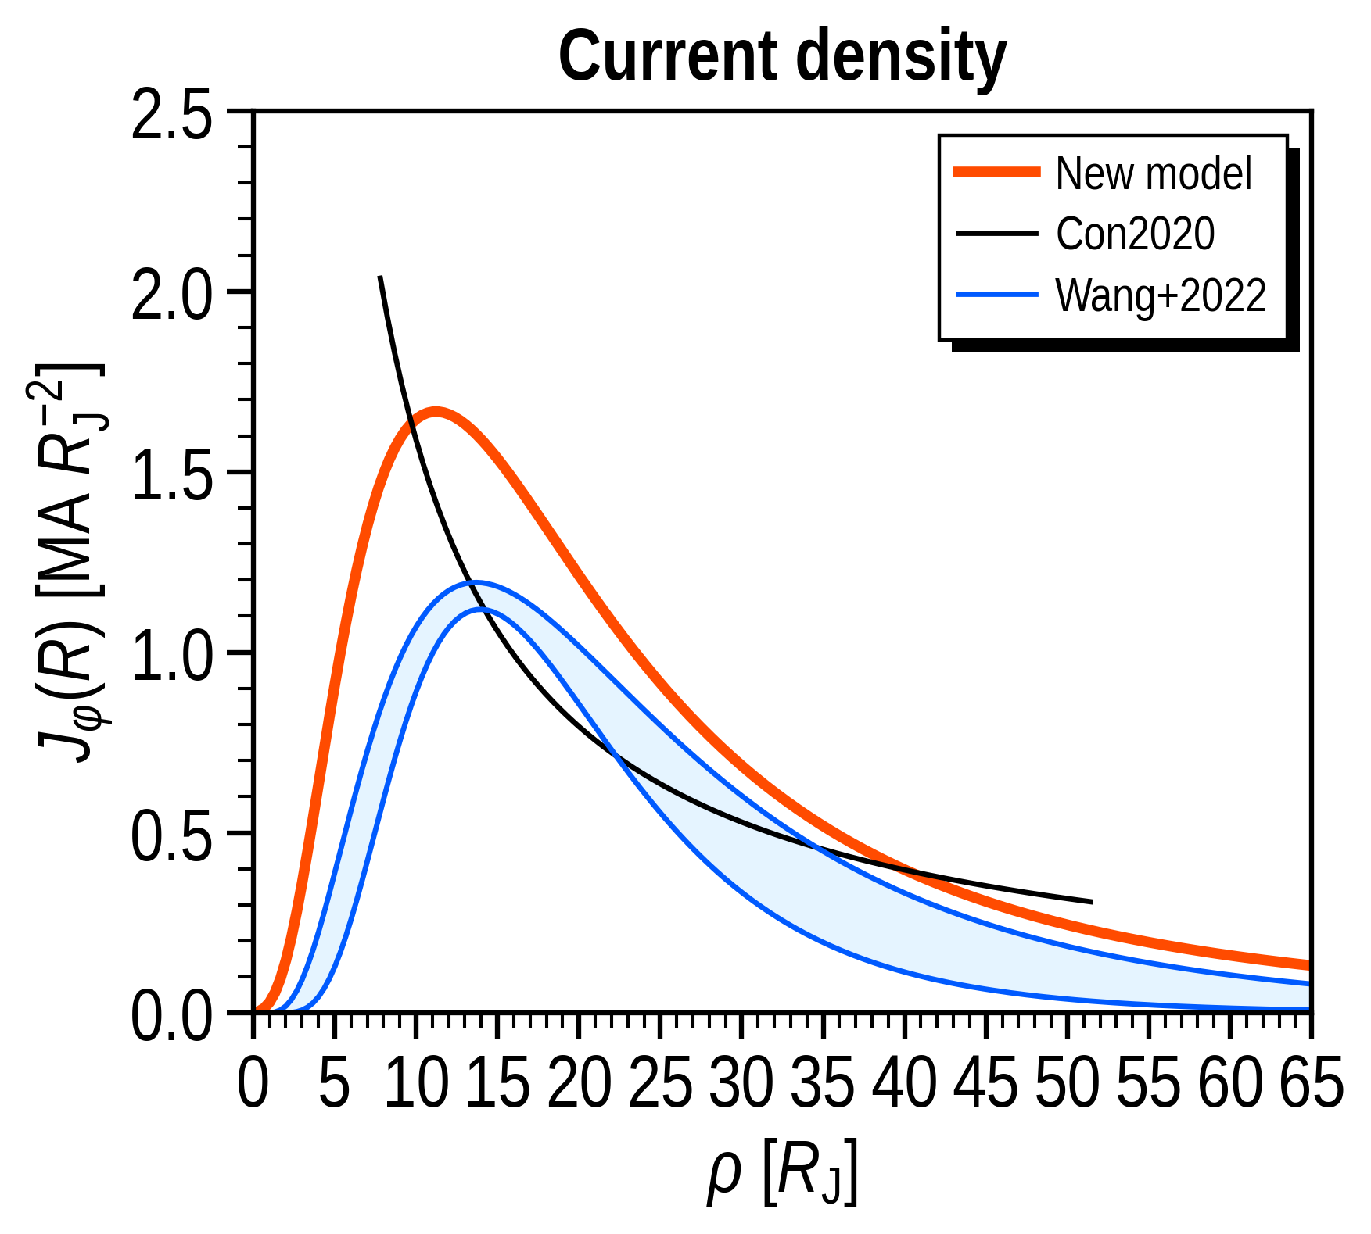
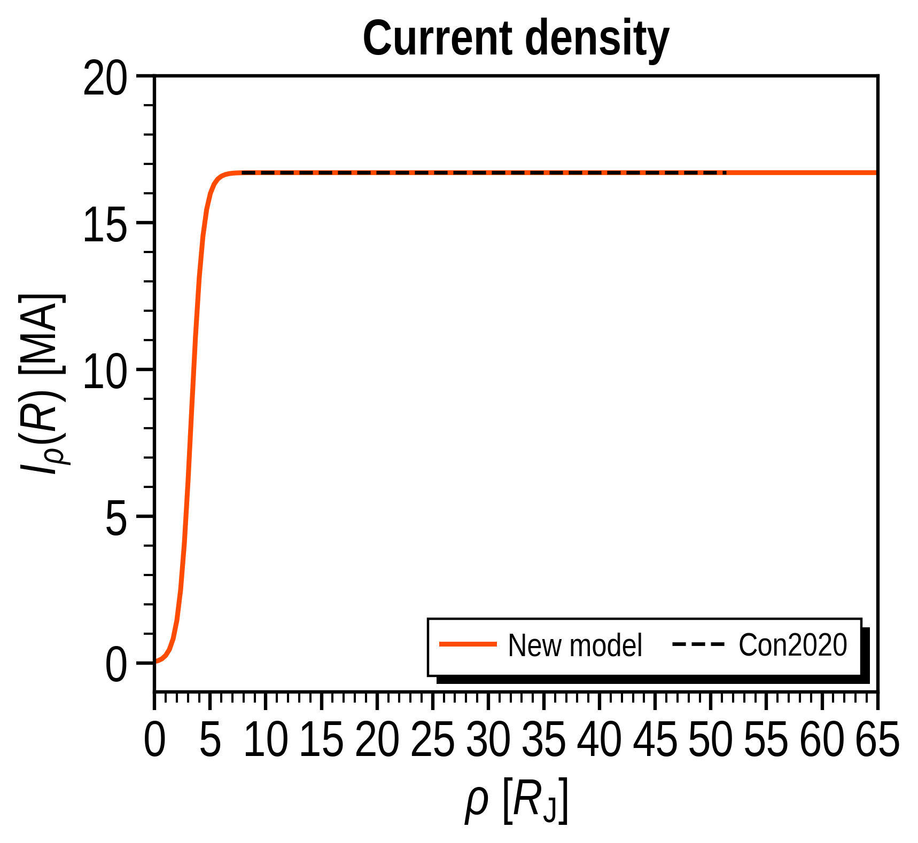
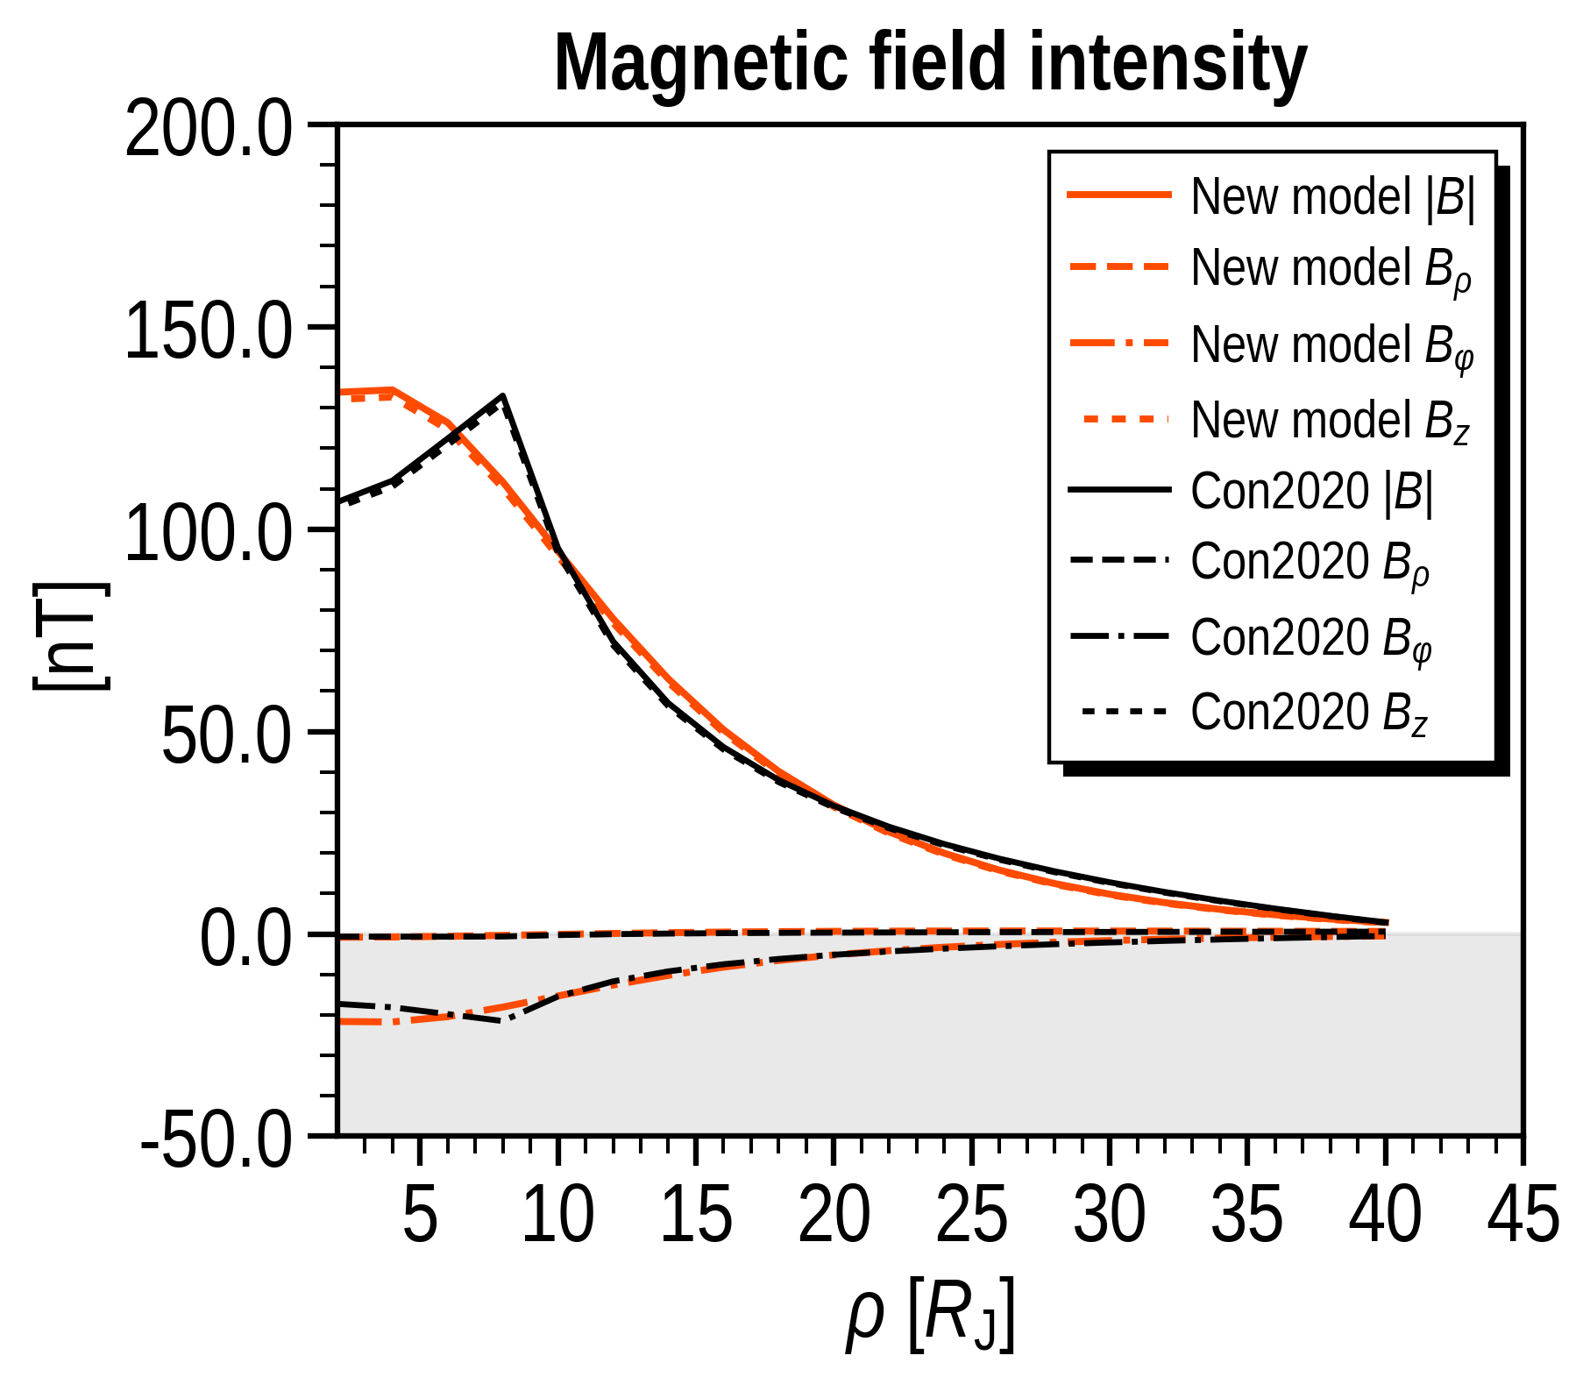
FGM FIT
3

Slide 4
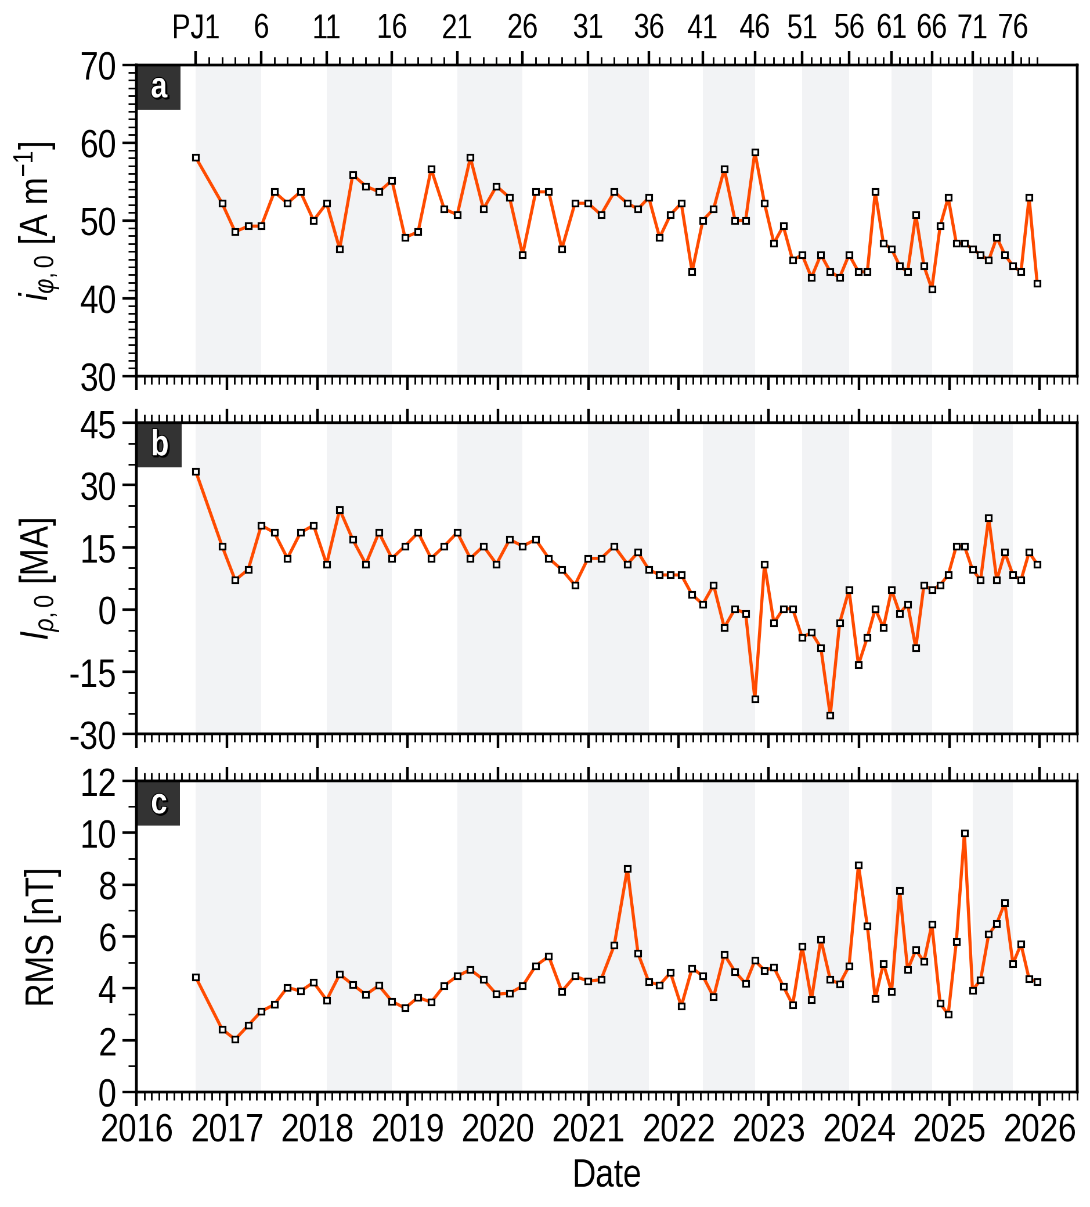
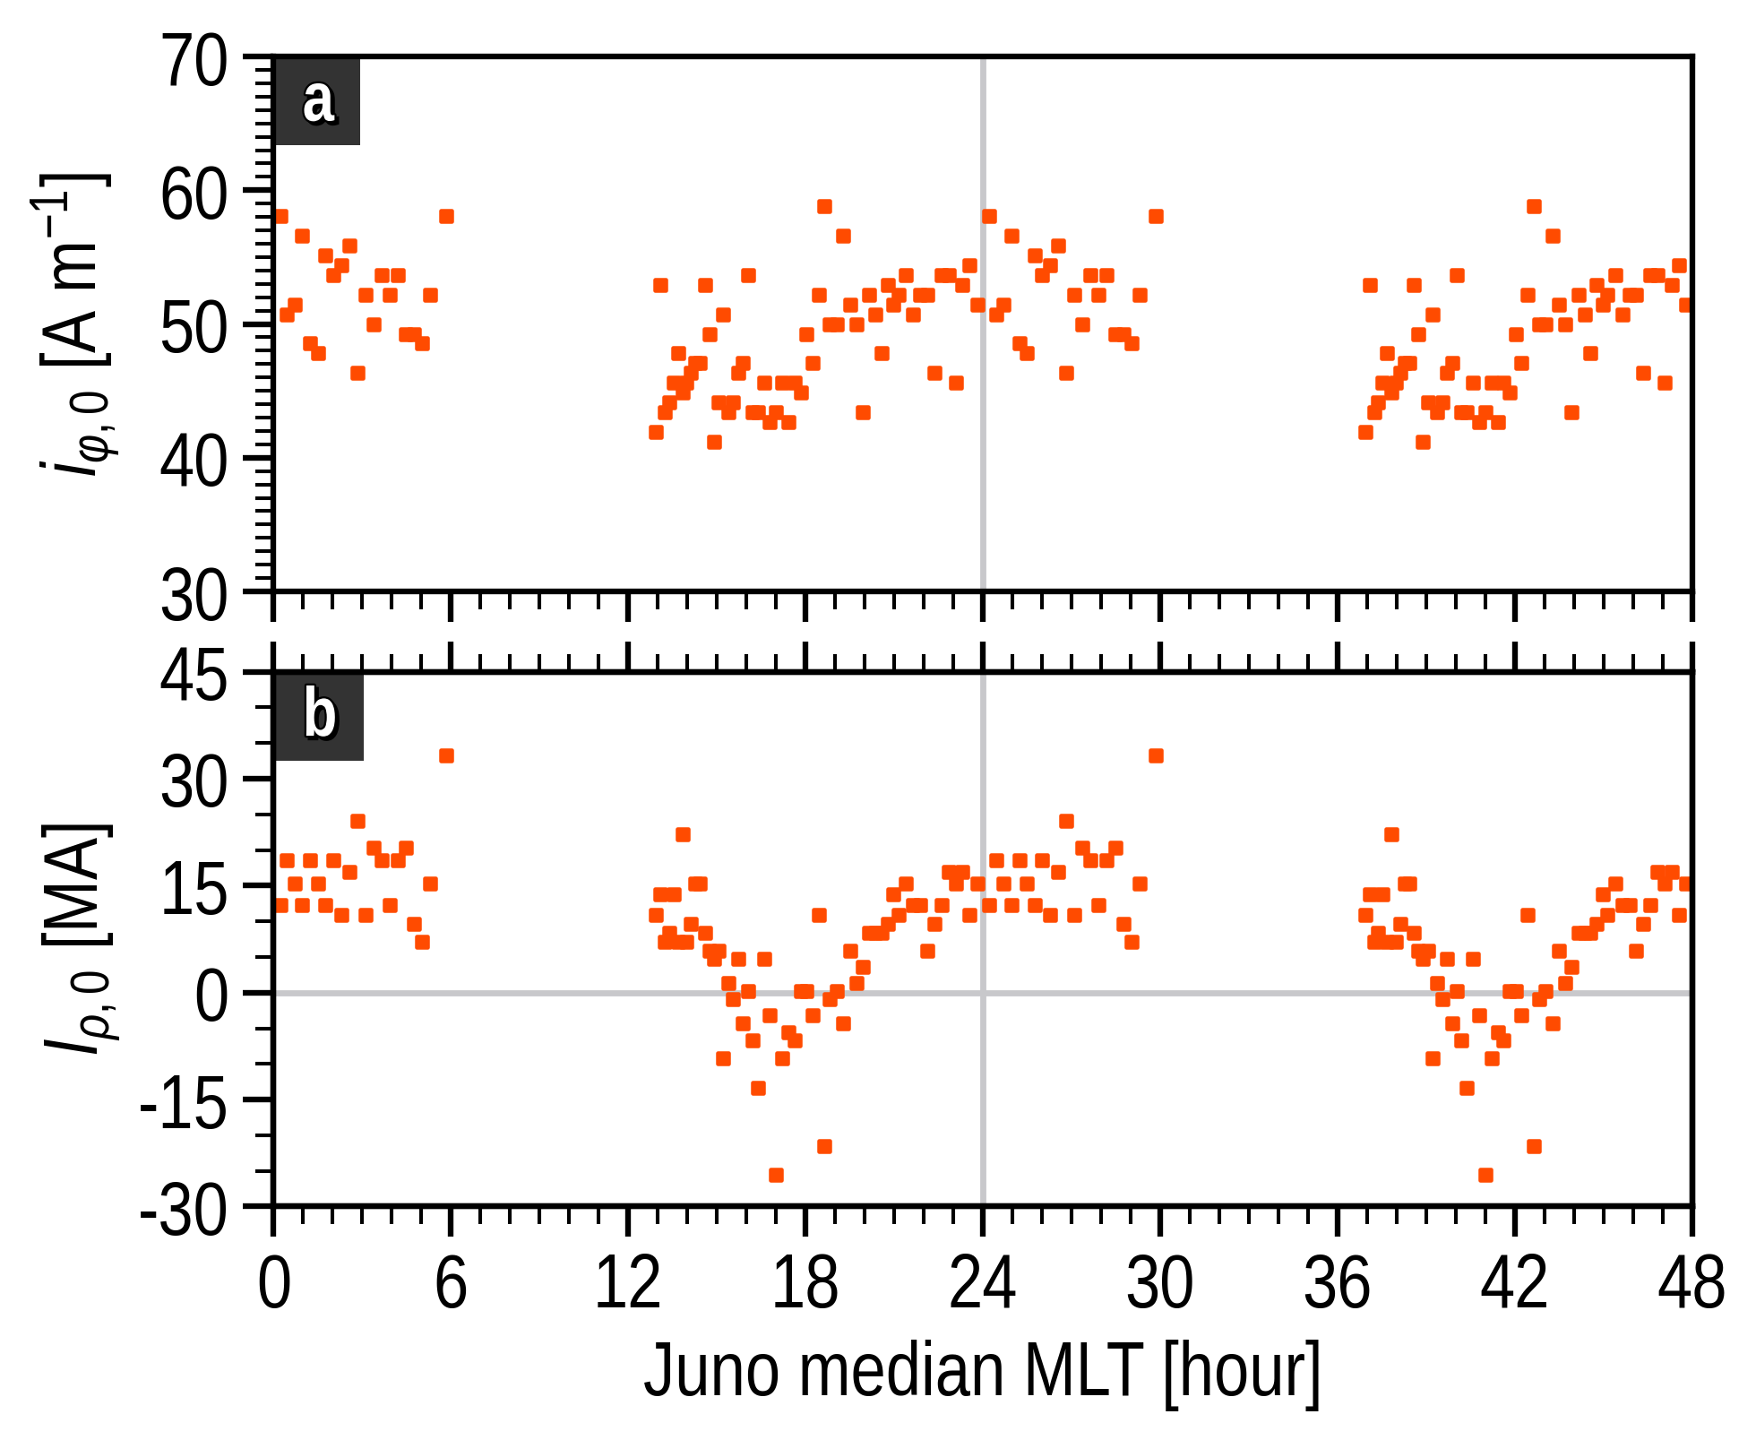
FGM FIT
4

Slide 5
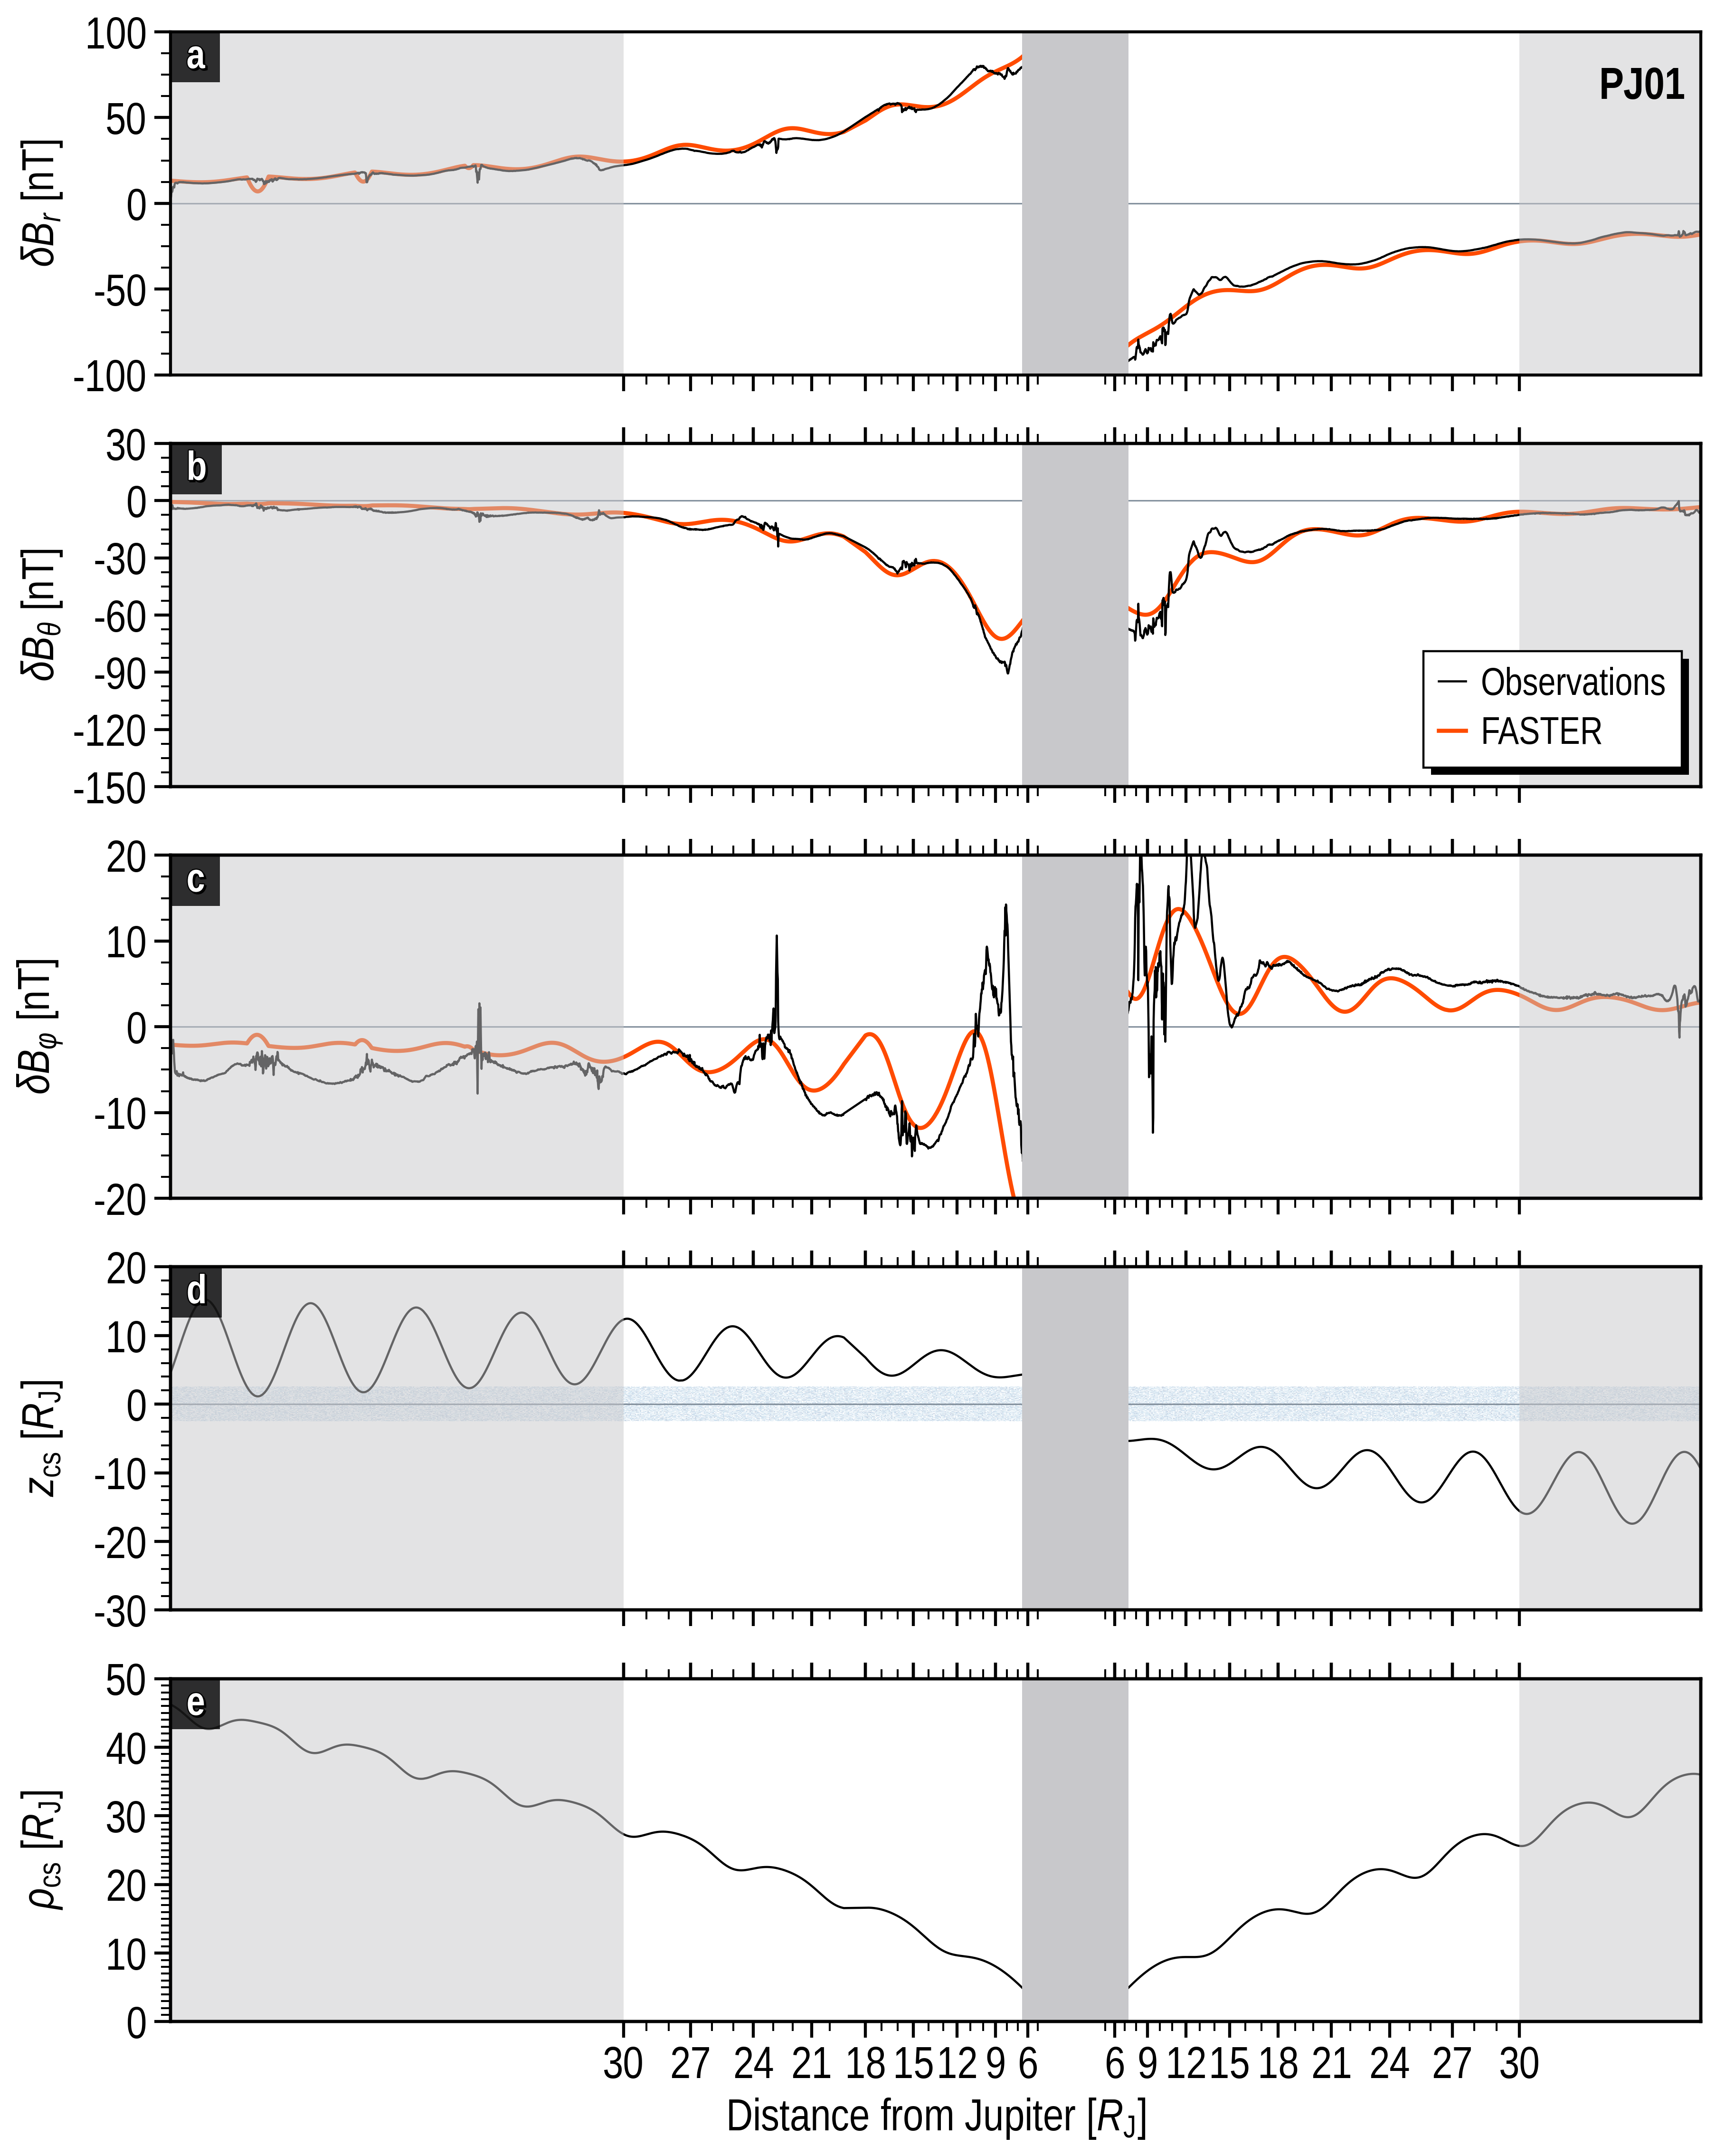
FGM FIT
5

Slide 6
FGM FIT
6

Slide 7
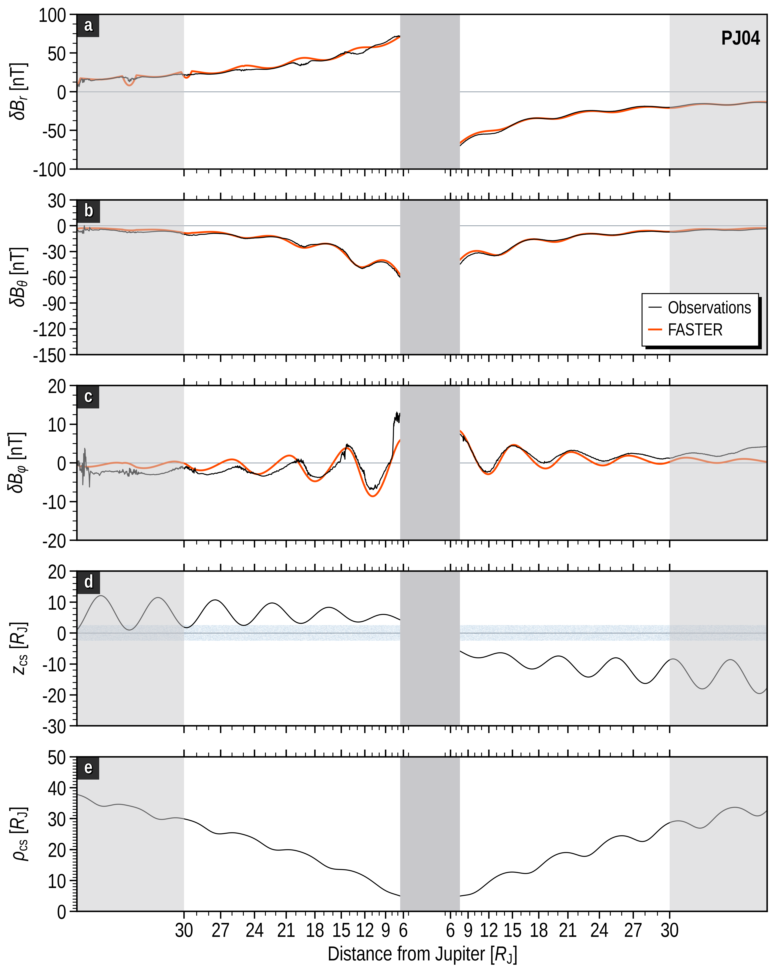
FGM FIT
7

Slide 8
FGM FIT
8

Slide 9
FGM FIT
9

Slide 10
FGM FIT
10

Slide 11
FGM FIT
11

Slide 12
FGM FIT
12

Slide 13
FGM FIT
13

Slide 14
FGM FIT
14

Slide 15
FGM FIT
15

Slide 16
FGM FIT
16

Slide 17
FGM FIT
17

Slide 18
FGM FIT
18

Slide 19
FGM FIT
19

Slide 20
FGM FIT
20

Slide 21
FGM FIT
21

Slide 22
FGM FIT
22

Slide 23
FGM FIT
23

Slide 24
FGM FIT
24

Slide 25
FGM FIT
25

Slide 26
FGM FIT
26

Slide 27
FGM FIT
27

Slide 28
FGM FIT
28

Slide 29
FGM FIT
29

Slide 30
FGM FIT
30

Slide 31
FGM FIT
31

Slide 32
FGM FIT
32

Slide 33
FGM FIT
33

Slide 34
FGM FIT
34

Slide 35
FGM FIT
35

Slide 36
FGM FIT
36

Slide 37
FGM FIT
37

Slide 38
FGM FIT
38

Slide 39
FGM FIT
39

Slide 40
FGM FIT
40

Slide 41
FGM FIT
41

Slide 42
FGM FIT
42

Slide 43
FGM FIT
43

Slide 44
FGM FIT
44

Slide 45
FGM FIT
45

Slide 46
FGM FIT
46

Slide 47
FGM FIT
47

Slide 48
FGM FIT
48

Slide 49
FGM FIT
49

Slide 50
FGM FIT
50

Slide 51
FGM FIT
51

Slide 52
FGM FIT
52

Slide 53
FGM FIT
53

Slide 54
FGM FIT
54

Slide 55
FGM FIT
55

Slide 56
FGM FIT
56

Slide 57
FGM FIT
57

Slide 58
FGM FIT
58

Slide 59
FGM FIT
59

Slide 60
FGM FIT
60

Slide 61
FGM FIT
61

Slide 62
FGM FIT
62

Slide 63
FGM FIT
63

Slide 64
FGM FIT
64

Slide 65
FGM FIT
65

Slide 66
FGM FIT
66

Slide 67
FGM FIT
67

Slide 68
FGM FIT
68

Slide 69
FGM FIT
69

Slide 70
FGM FIT
70

Slide 71
FGM FIT
71

Slide 72
FGM FIT
72

Slide 73
FGM FIT
73

Slide 74
FGM FIT
74

Slide 75
FGM FIT
75

Slide 76
FGM FIT
76

Slide 77
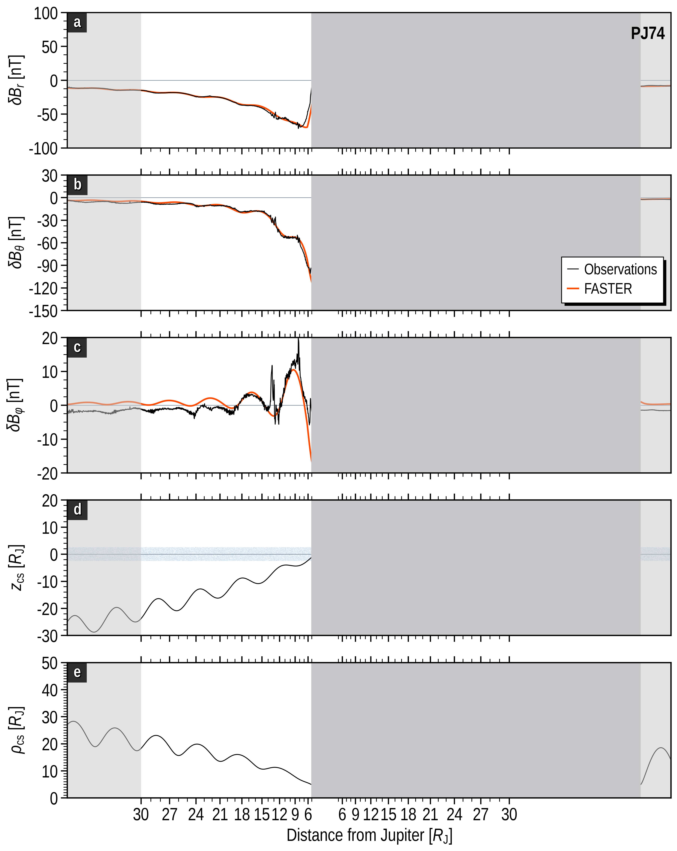
FGM FIT
77

Slide 78
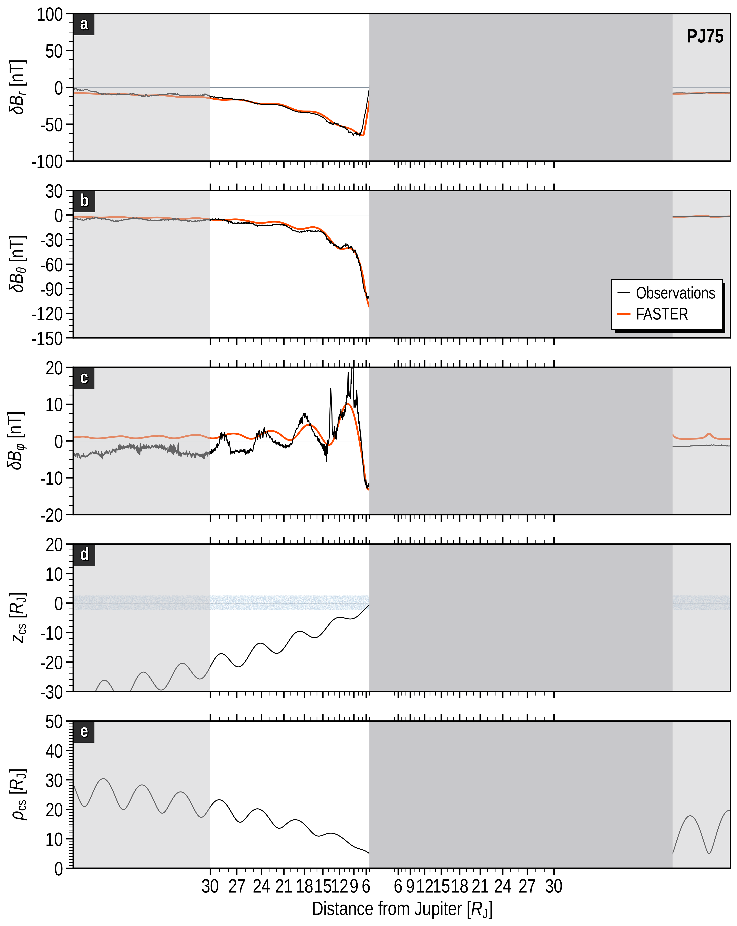
FGM FIT
78

Slide 79
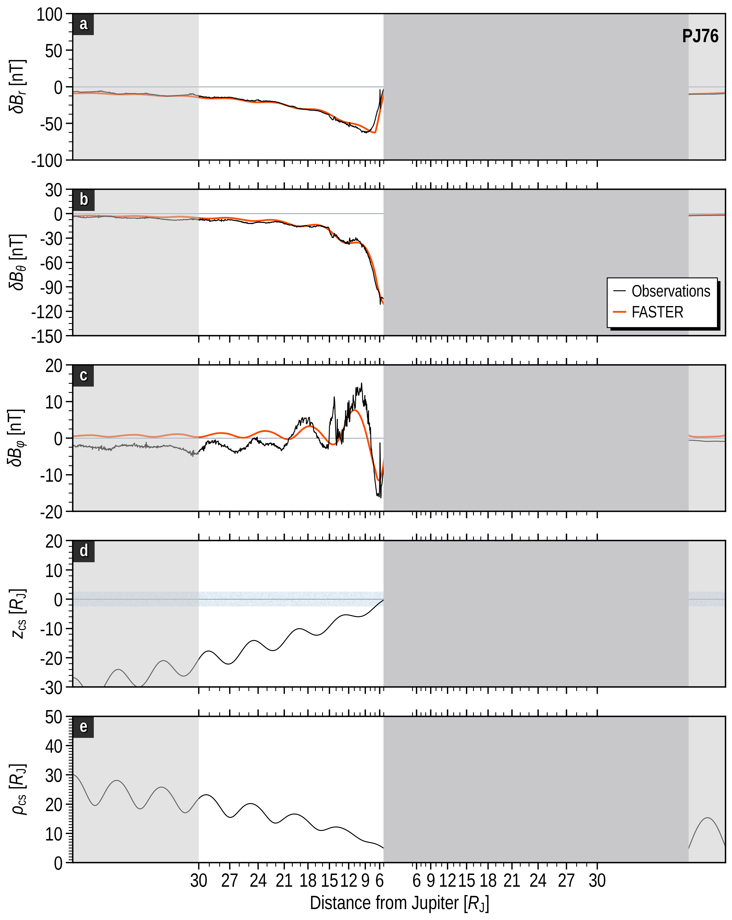
FGM FIT
79

Slide 80
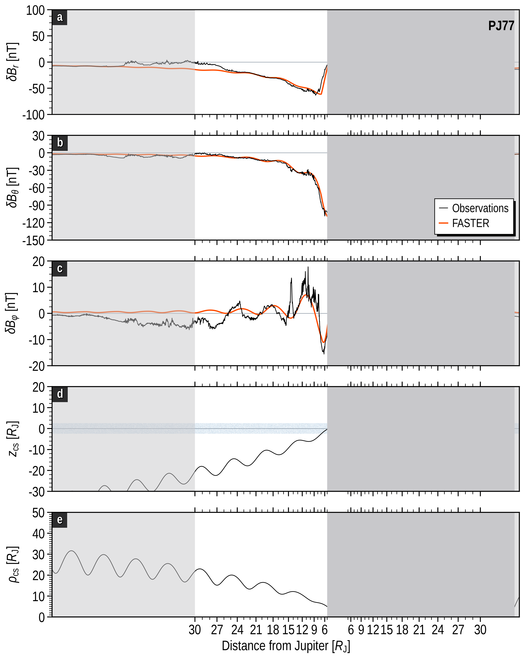
FGM FIT
80

Slide 81
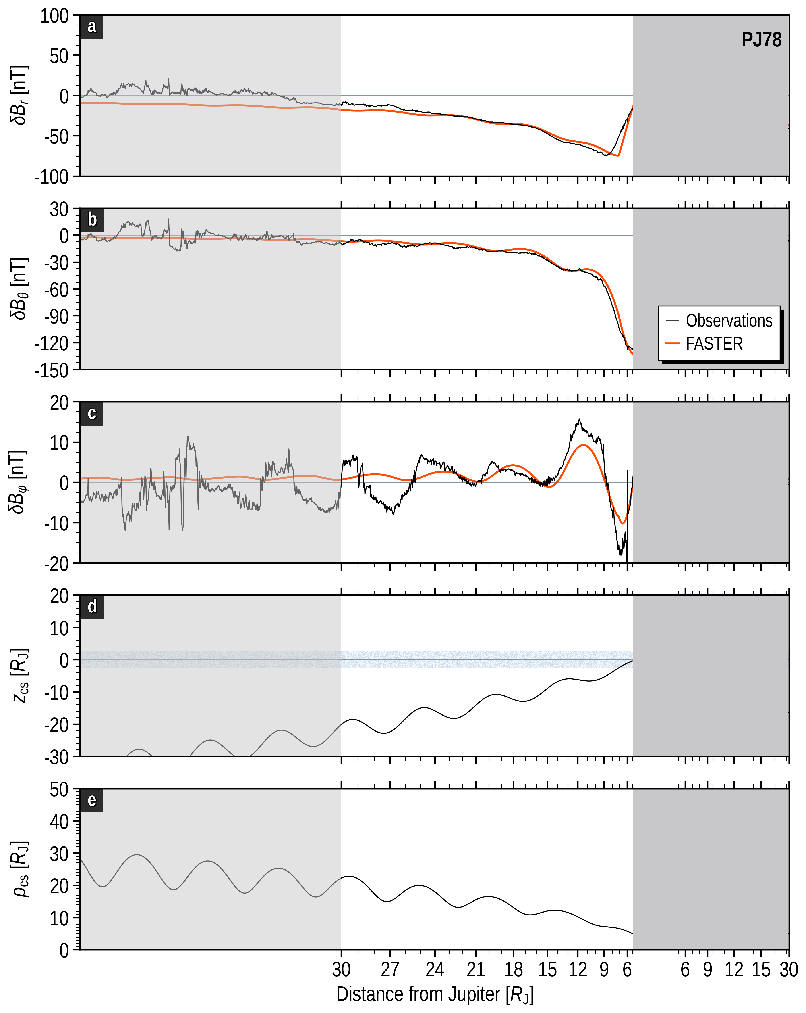
FGM FIT
81

Slide 82
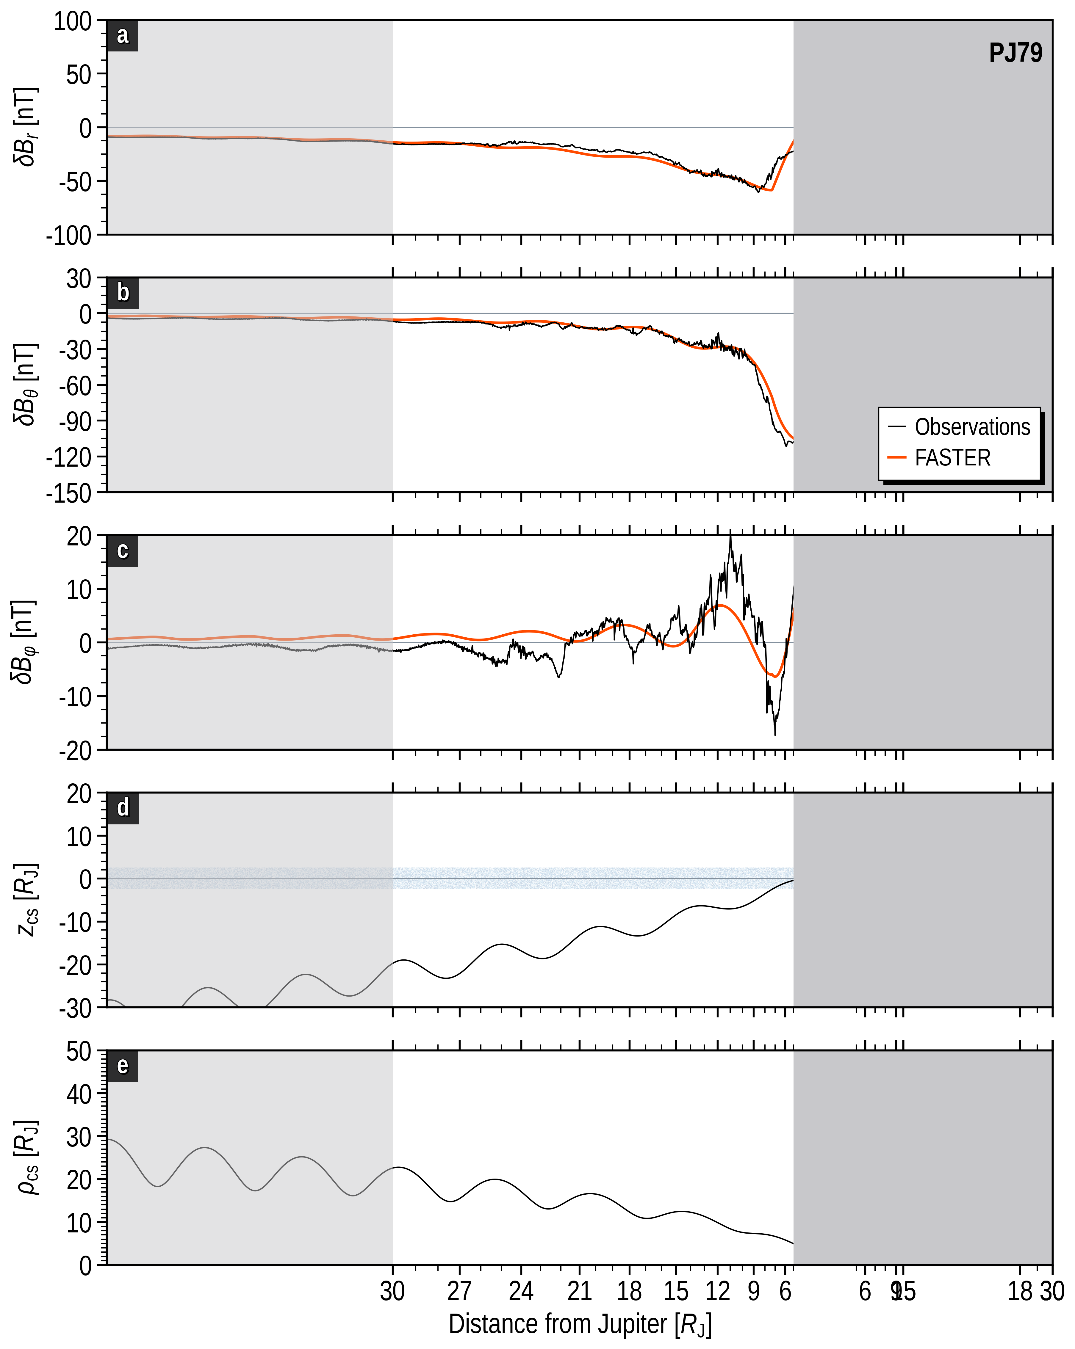
FGM FIT
82

Slide 83
FGM FIT
83

Slide 84
FGM FIT
84

Slide 85


FGM FIT
$$iφ\left(ρ,MLT\right)=i_{φ}\left(MLT\right)\sum_{k=1,2,3}{\frac{w_{i}ρ}{{\left(ρ^{2}+c_{k}^{2}\right)}^{3/2}}}$$
$$I_{ρ}\left(ρ,MLT\right)=\frac{I_{ρ,0}}{2}\left(1+\tanh\left(\frac{ρ−d_{1}}{d_{2}}\right)\right)$$
$$B_{ρ}^{disk}\left(ρ,z,MLT\right)=$$
$$\frac{μ_{0}i_{φ}\left(MLT\right)}{4ρD}\sum_{i=1,2,3}{w_{i}}\left(\frac{c_{i}+z+D}{\sqrt{ρ^{2}+{\left(c_{i}+z+D\right)}^{2}}}−\frac{c_{i}−z+D}{\sqrt{ρ^{2}+{\left(c_{i}−z+D\right)}^{2}}}\right)$$
for |z| ≦ D
$$sgn\left(z\right)\frac{μ_{0}i_{φ}\left(MLT\right)}{4ρD}\sum_{i=1,2,3}{w_{i}}\left(\frac{c_{i}+\left|z\right|+D}{\sqrt{ρ^{2}+{\left(c_{i}+\left|z\right|+D\right)}^{2}}}−\frac{c_{i}+\left|z\right|−D}{\sqrt{ρ^{2}+{\left(c_{i}+\left|z\right|−D\right)}^{2}}}\right)$$
for |z| > D
$$B_{z}^{disk}\left(ρ,z,MLT\right)=$$
$$\frac{μ_{0}i_{φ}\left(MLT\right)}{4D}\sum_{i=1,2,3}{w_{i}}\left(\frac{2}{\sqrt{ρ^{2}+{c_{i}}^{2}}}−\frac{1}{\sqrt{ρ^{2}+{\left(c_{i}+z+D\right)}^{2}}}−\frac{1}{\sqrt{ρ^{2}+{\left(c_{i}−z+D\right)}^{2}}}\right)$$
for |z| ≦ D
$$\frac{μ_{0}i_{φ}\left(MLT\right)}{4D}\sum_{i=1,2,3}{wi\left(\frac{1}{\sqrt{ρ^{2}+{\left(c_{i}+\left|z\right|−D\right)}^{2}}}−\frac{1}{\sqrt{ρ^{2}+{\left(c_{i}+\left|z\right|+D\right)}^{2}}}\right)}$$
for |z| > D
$$B_{φ}^{disk}\left(ρ,z,MLT\right)=$$
$$−\left(\frac{μ_{0}I_{ρ}}{2πρR_{J}}+b_{1}\right)\frac{z}{D}$$
for |z| ≦ D
$$−sgn\left(z\right)\left(\frac{μ_{0}I_{ρ}}{2πρR_{J}}+b_{1}\right)$$
The true analytic solution
for |z| > D
85

Slide 86
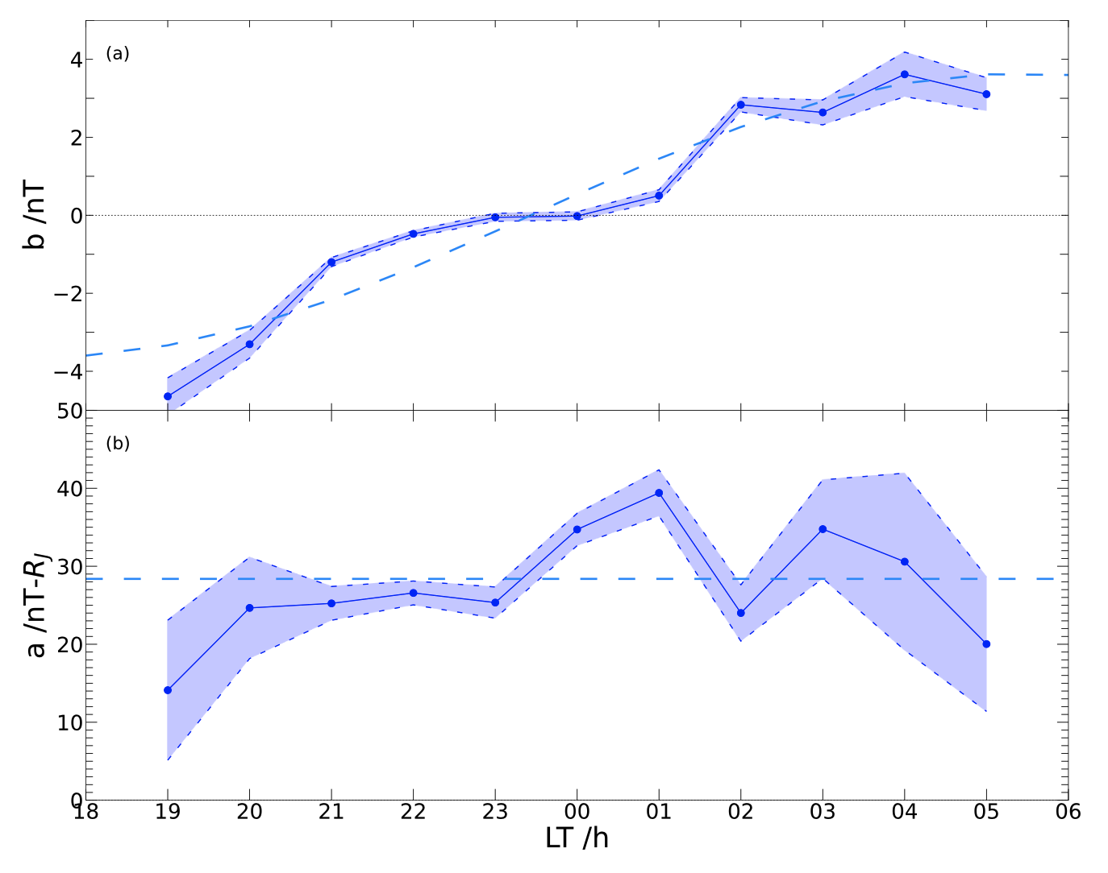

FGM FIT
$$b_{1}=b_{0}\sin\left(2π\left(MLT−{MLT}_{0}\right)/24)\right)$$
86

Slide 87
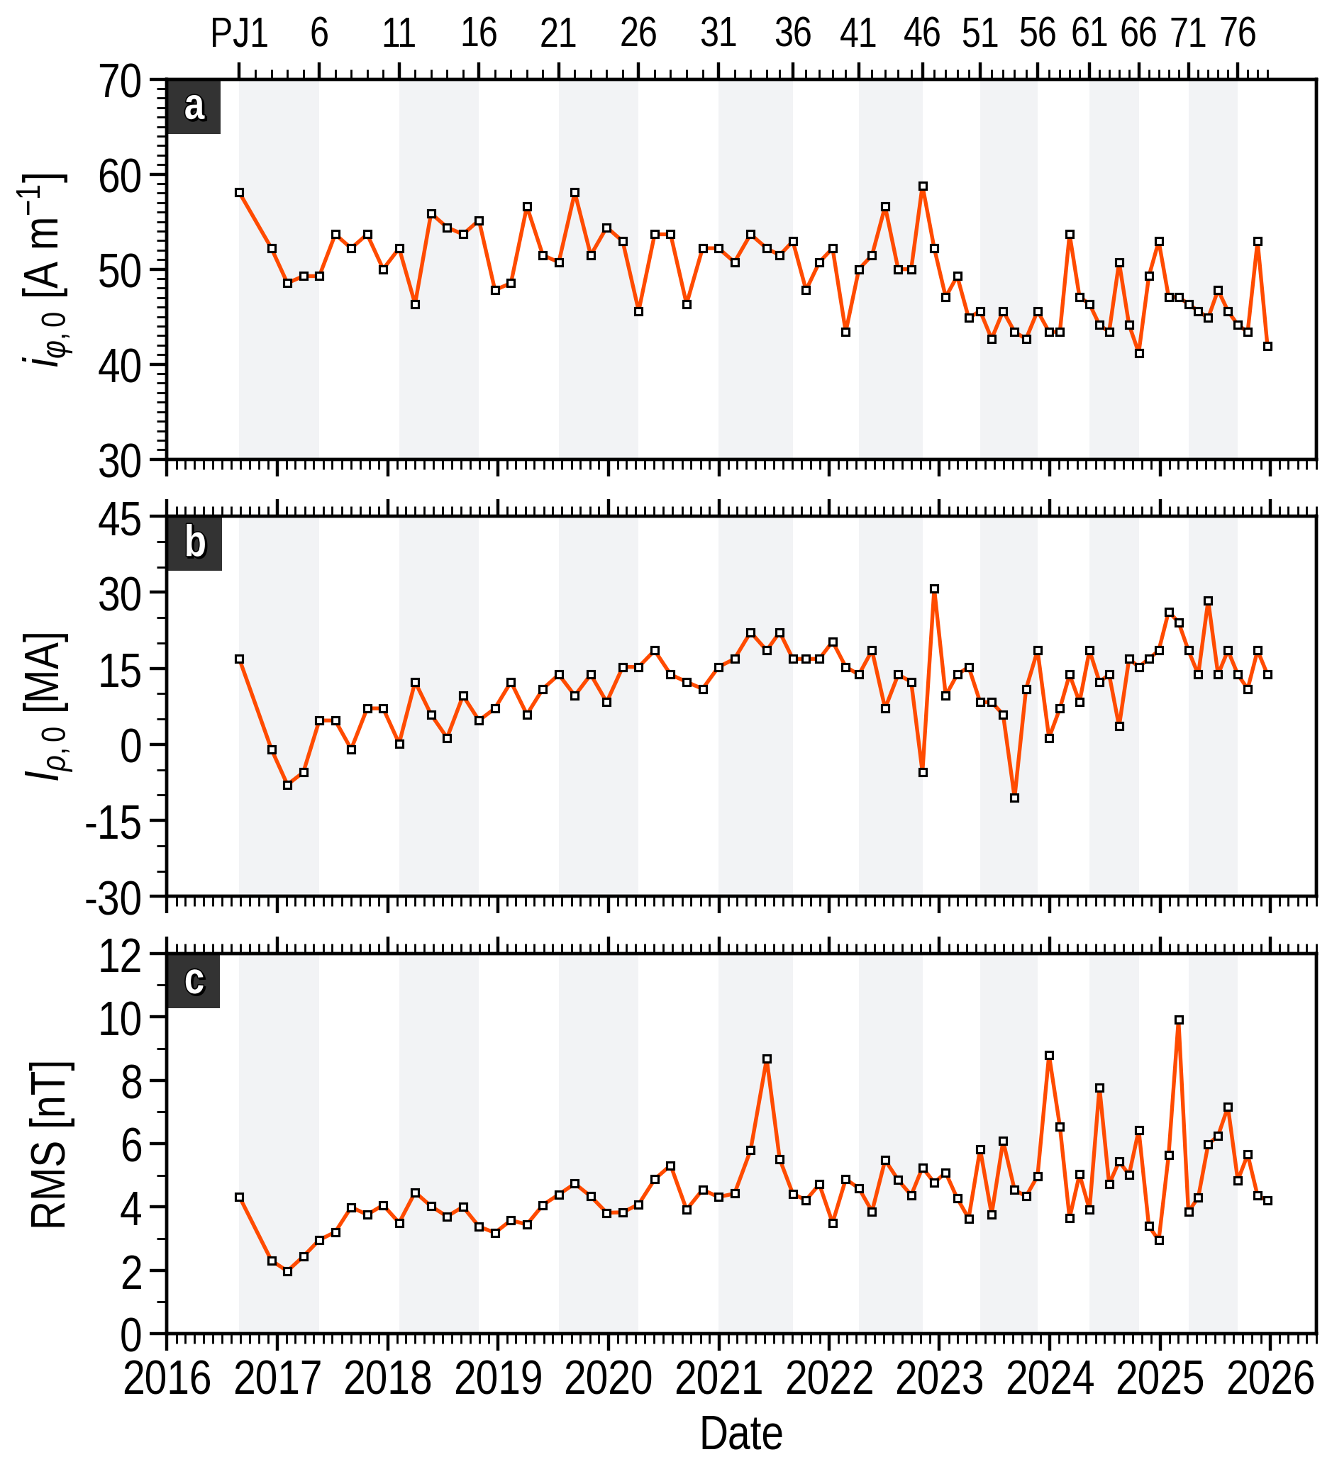
FGM FIT
87

Slide 88
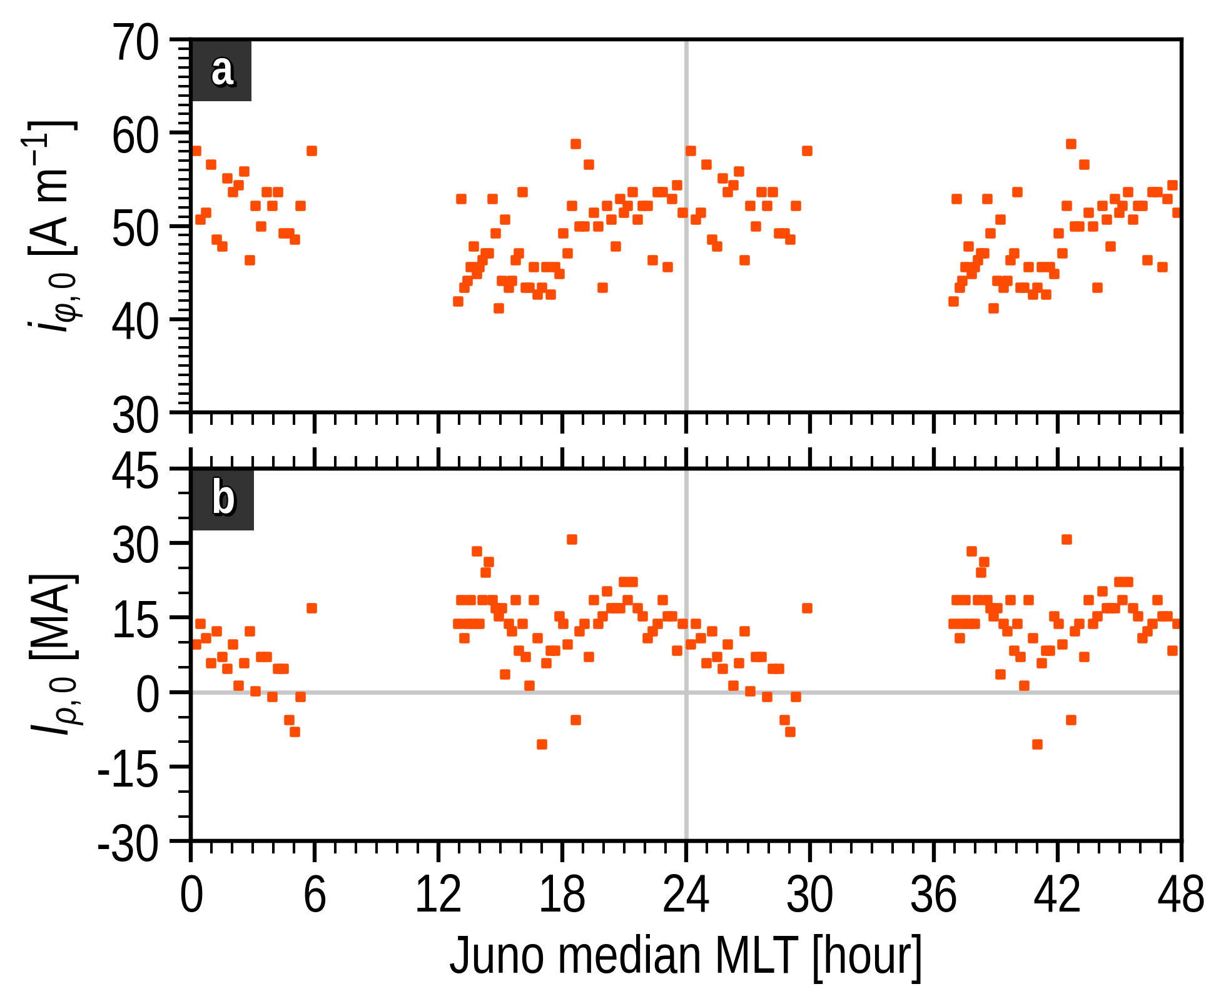
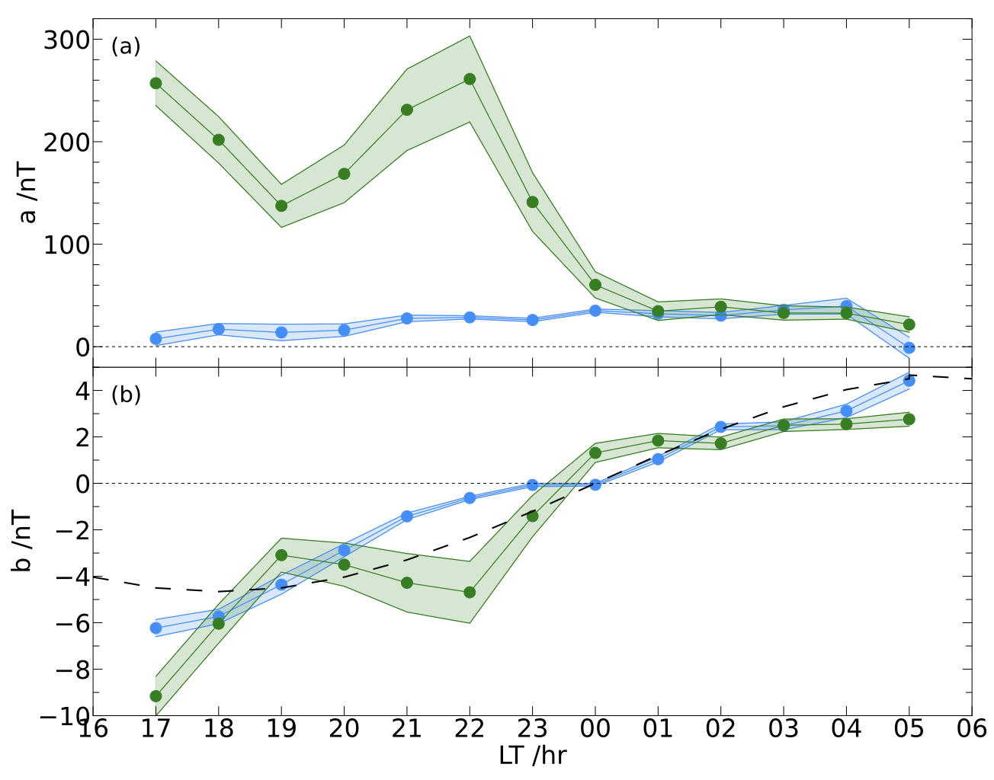
FGM FIT
88

Slide 89

FGM FIT
$$b_{1}=b_{0}\sin\left(2π\left(MLT−{MLT}_{0}\right)/24)\right)$$
89

Slide 90
FGM FIT
90

