Slide 1
History of the Internet and How It Was Developed

Slide 2
The Cold War Origins
In the 1950s
U.S. was worried about a possible Soviet attack.
Decentralized communication network that could survive if destroyed.
https://study.com/academy/lesson/what-is-the-history-of-the-internet-origins-timeline.html

Slide 3
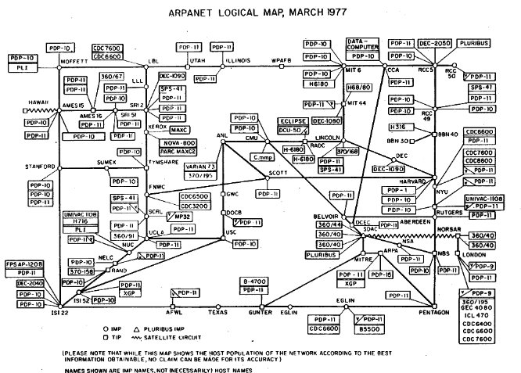
The Birth of ARPANET
1966, Robert Taylor at the Advanced Research Projects Agency (ARPA)
October 29, 1969 first message "login" between UCLA and Stanford Research Institute.
By the end of that year, ARPANET connected 4 universities.
https://en.wikipedia.org/wiki/History_of_the_Internet

Slide 4
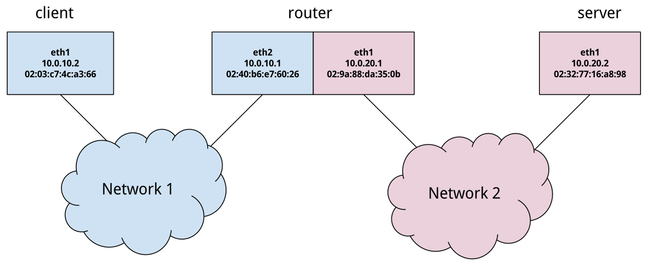
Key Technological Innovations
Packet Switching : breaks data into smaller chunks for transmission
Interface Message Processors (IMPs): routers that directed data between different computers
Host-to-Host Protocols: This allowed computers to communicate directly.
https://www.scienceandmediamuseum.org.uk/objects-and-stories/short-history-internet

Slide 5
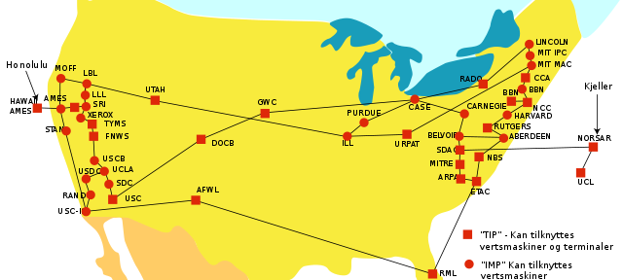
The Expansion of ARPANET
In 1973, 23 computers were connected with ARPANET
First international connections to the UK and Norway
Need for a standardized way to communicate
In 1974, Vint Cerf and Bob Kahn developed the Transmission Control Protocol (TCP) and Internet Protocol (IP).
https://www.scienceandmediamuseum.org.uk/objects-and-stories/short-history-internet

Slide 6

From ARPANET to the Internet
1983, ARPANET adopted the TCP/IP protocol.
Other networks began to emerge
"Networks of networks" : the internet
https://en.wikipedia.org/wiki/History_of_the_Internet

Slide 7
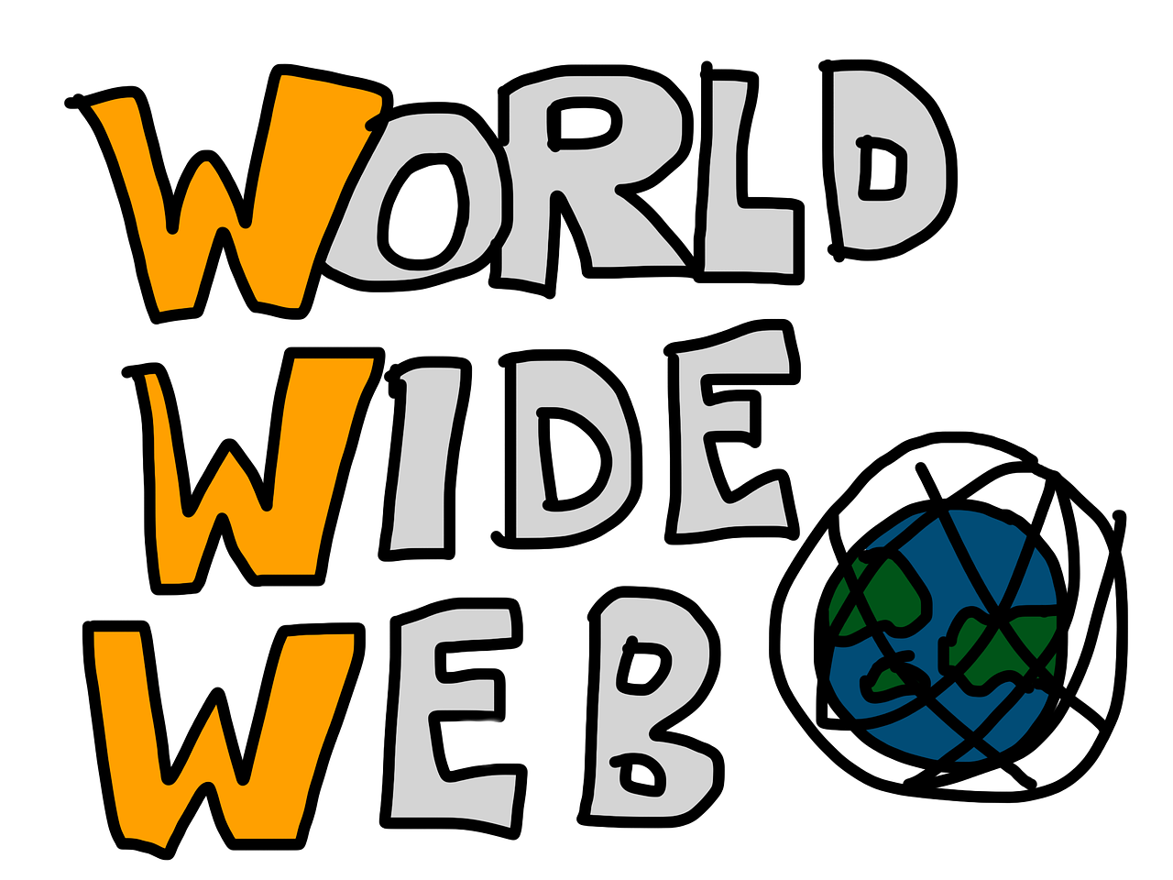
The Creation of the World Wide Web
1989, Tim Berners-Lee, working at CERN, introduced the concept of the World Wide Web.
In 1991, the first web page was created.
In 1993, the first graphical web browser, Mosaic, was released.
https://www.telefonica.com/en/communication-room/blog/history-internet-how-come-being-how-evolved/

Slide 8


The Internet Goes Mainstream
1990s : explosion in internet use.
In 1991, the internet was opened up for commercial use.
In 1995, Amazon and eBay launched their online marketplaces.
In 1998, Google was founded.
https://en.wikipedia.org/wiki/History_of_the_Internet

Slide 9

The Modern Era and Beyond
Internet connects billions of devices.
5G, AI are about to transform the internet even further.
Faster speeds, smarter devices, more integrated global systems.

Slide 10

Sources :
https://en.wikipedia.org/wiki/History_of_the_Internet
https://www.telefonica.com/en/communication-room/blog/history-internet-how-come-being-how-evolved/
https://www.scienceandmediamuseum.org.uk/objects-and-stories/short-history-internet
https://study.com/academy/lesson/what-is-the-history-of-the-internet-origins-timeline.html

