Slide 1
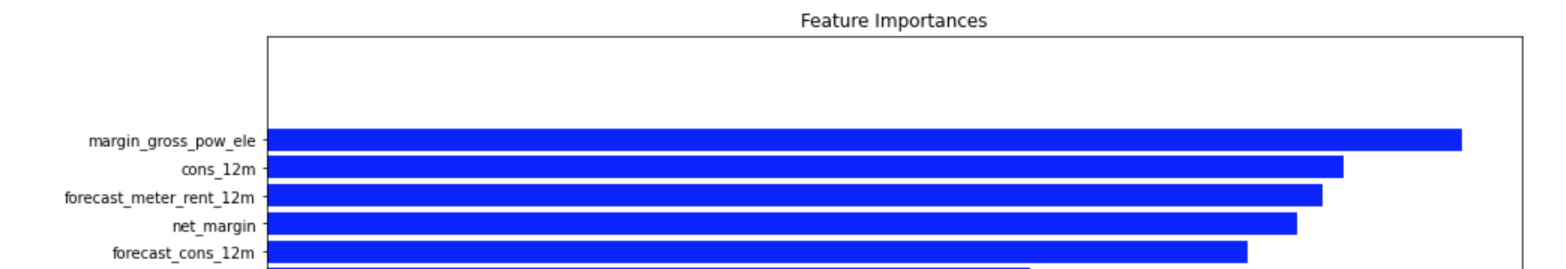
Executive summary
Clients churn are not highly related to price sensitivity
- the top 5 important features are not including price related variables

Slide 2
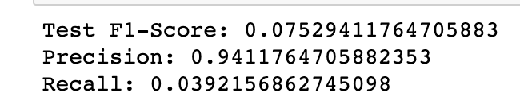
Executive summary
Feature engineering helped increase the precise from 77% to 94%
- the recall and f1 score were still very low

Slide 3
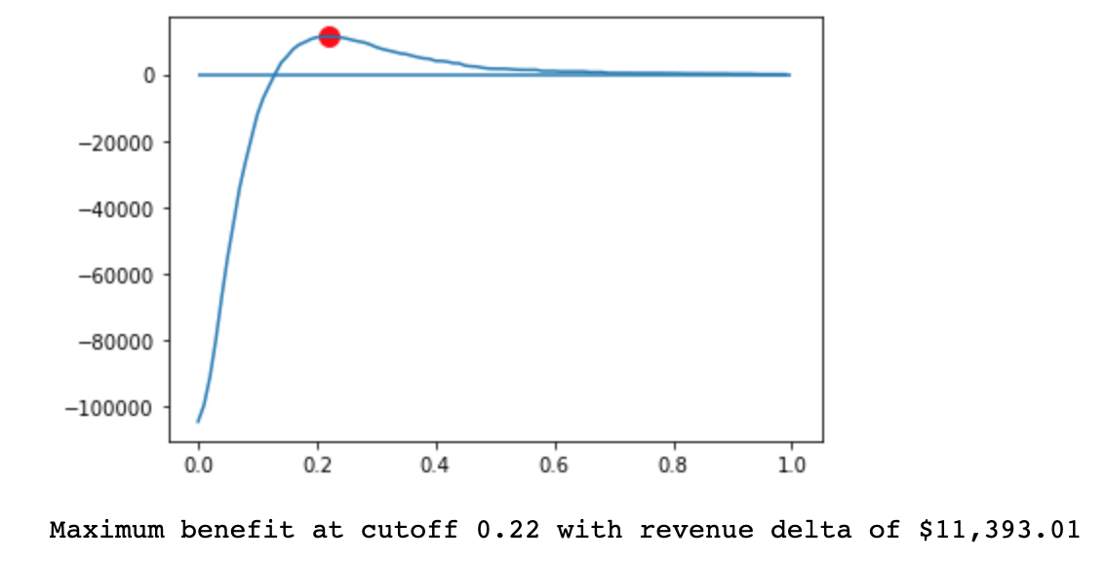
Executive summary
Considering the discounts, when cutoff values equal 0.22 would yield the highest revenue

