Slide 1
ECL - AI in Research Workshop
Shinyen Chiu
08/10/2025
Source: https://www.seascapemodels.org/AI-assistants-for-scientific-coding/

Slide 2
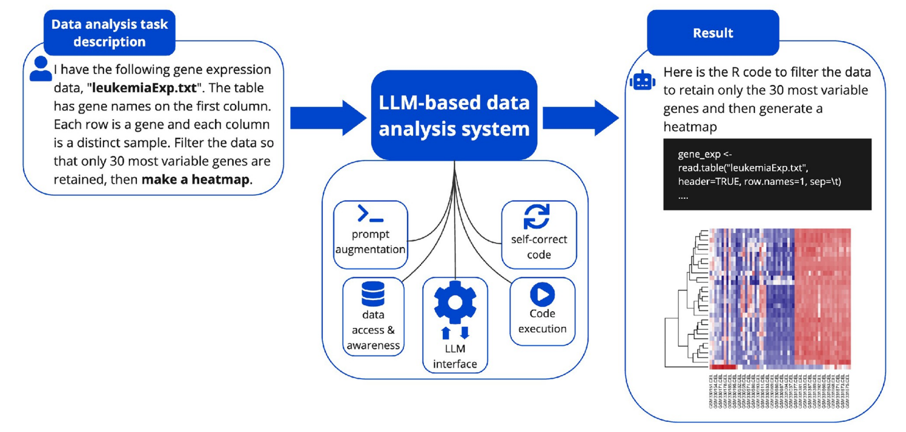
Large Language Model (LLM)
Jansen, J. A., Manukyan, A., Al Khoury, N., & Akalin, A. (2025). Leveraging large language models for data analysis automation. PloS one, 20(2), e0317084.
Notes:
A large language model is a type of advanced AI that excels at processing, understanding, and generating human language. It’s a type of deep learning model, that is trained on massive text datasets to understand, generate, and translate human language.
LLMs were created to write text. But it soon became apparent that they excel at writing programming code in many different languages.
Their progress on math and logic is a bit more controversial. In general LLMs were good at choosing descriptive statistics (accuracy of up to 90% for GPT-4). Whereas when choosing inferential tests accuracy was much less impressive - GPT-4 scored between 20% and 43% accuracy on questions for which a contingency table was the correct answer.
more tasks, more errors
making script that runs > writing logical scripts

Slide 3
Large Language Model (LLM) jargons
token: unit of prediction
context window: LLM’s memory size
AI assistant (reactive) / AI agent (proactive) / tool
User / assistant / system message
Prompt / prompt engineering
Provider prompt
System prompt
User prompt
Notes:
token: LLMs use tokens to break down raw text into smaller, manageable pieces for processing (tokenization)
e.g., GPT5 has ~128,000 tokens (a thesis long)
context window: its maximum short-term memory, limiting the amount of text (in tokens) it can process at once
AI assistant: A reactive AI that responds to your inputs (prompts)
AI agent: A proactive AI that can plan and act autonomously to achieve goals
tool: function the AI can call
prompt: natural language text describing the task that an AI should perform
basic AI chat tools vs. developer-oriented AI frameworks

Slide 4


Build your own chatbot
ellmer: an R package designed to interface with LLMs via the OpenRouter API and enable structured AI-assisted tasks within R
temperature (0-2): controls the randomness of token predictions
top_k (>0): forces the model to choose among a determined set of tokens
Tokens
Cute
0.45
0.25
Smart
0.45
0.25
Shinyen is…
Potato
0.05
0.25
Other tokens
0.05
0.25
Notes:
Why build your own chatbot (e.g., in vscode) rather than open source web AI?
incorporate professional ecology/stats knowledge
share it to your students/clients so everyone get more similar and accurate answers (thru github)
API (application programming interface) key: a unique code used to identify and authenticate an application or user when requesting access to an Application Programming Interface (API), which allows different software to communicate.

Slide 5
Effective prompts
Integrate workflow
Break prompts into small steps
Give long detailed and specific prompts (say them up front and avoid conversations)
Notes:
Prompts matter!
The results also indicate the improvements that can be gained through better prompts (i.e. doubling in accuracy for GPT 4).
Prompting strategy:
integrate workflow
plan statistical approach
organize project and plan workflow
implement workflow → more efficient!
break prompts into small steps
treat each step separately
give long detailed and specific prompts (say them up front and avoid conversations)
be clear about your research question, design, scale, etc
give RICH context to AI
attach domain knowledge
attach data (drag the file from folder into the copilot chat in VScode)
use chain of thought reasoning (now default)
Chris’ workflow:
Folder (be organized): data, outputs, scripts
Create “readme.md” file for text (markdown)
save the context and prompts
Chris’ md structure
Introduction
Aim
Workflow
up to you!
Quarto: render webpage or pdf
Break your problem down into smaller parts (reasoning)
Be clear, specific and give lots of details
Give data structure
Exact dataframe/column names
Put everything up front, rather than engaging in conversation (context poisoning)
Overall… Over-explain what you want and say it all up front LOL
Set up good workflow:
I recommend writing a markdown document with all of this information in it.
LLMs perform differently across these components. They excel at code generation and implementation planning but are less reliable for selecting appropriate statistical approaches or interpreting complex results.
Select statistical approach: Determining appropriate statistical methods for research questions
Include domain knowledge in the prompt
Include data or summary data in the prompt
Combine domain knowledge with CoT (but CoT on its own doesn’t help)
larger and more up-to-date models tend to be better. e.g. try Claude 4.0 or GPT 5
Plan implementation: Designing the analytical workflow and code structure
keep your data analysis code neat and organized!
Organized code is good for your future, it's good for other scientists using your code, it's good for repeatability AND it's good for getting better help from AI assistants.
Create readme file (include directory structure) for the assistant
Write code: Writing the actual code to implement analyses
Start creating the code yourself, using inline editing and copilot edit to help write bits of the code
Instruct an AI agent to complete the tasks in the readme, manually checking in and editing the code as you go
Full ‘vibe-coding’ which means you ask an AI agent to complete the task and just accept all of its suggestions.
Guidance on Interpretation: Understanding and reporting results
Iterating

Slide 6
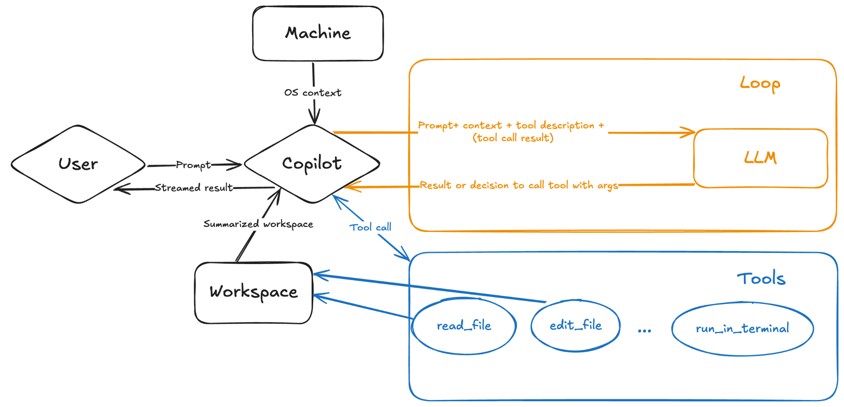
VS Code & GitHub Copilot
https://ellmer.tidyverse.org/index.html
Notes:
In VS Code script: press tab key to accept copilot suggestions (but read it before accepting it!)
You can also ask questions in copilot window

Slide 7
Discussion
Data privacy
Security
Ethics
Environmental issues
Scientific monocultures
monoculture of knowers
monocultures of knowing
Notes:
Data privacy:
no data retention policies… keep your personal data safe!
work with made up data
watch out for codebase referencing (they scan thru your codes and docs)
Security:
beware: access to private data, ability to externally communicate, exposure to untrusted content
Ethics:
Plagiarism
Vibe coding (clicking yes yes yes accept accept accept…)
OK if you’re creating things with low risk
OK if you just need a quick result
not OK for publication (think about your reputation)!
Environmental issues?
Chris’ prompts (just Github copilot over the past year) (or one day of very heavy and intensive use of AI) equate to ~ 15 minute drive… but global cumulative impact?
Scientific monocultures
A monoculture of knowers emerges from prioritizing a particular standpoint and all of the values and assumptions it contains. This influences the research questions that are asked and the way evidence is interpreted. Visions of AI for science reinforce the idea of a singular, authoritative, objective knower with an unbiased ‘view from nowhere’.
Monocultures of knowing emerge from prioritizing one approach to asking research questions and determining when satisfactory understanding has been achieved, marginalizing alternative approaches. In the context of AI-driven research, a monoculture of knowing could arise from prioritizing the quantitative, reductive and predictive approaches that AI tools are designed to optimize.

Slide 8
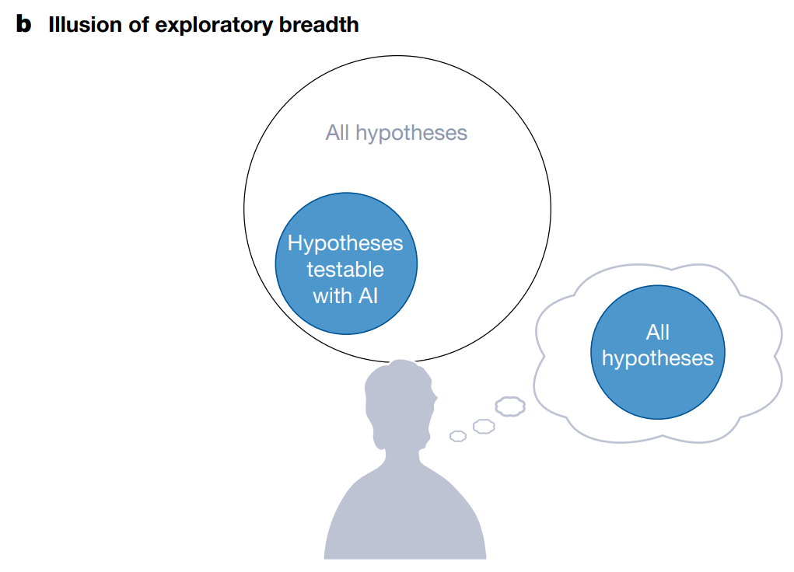
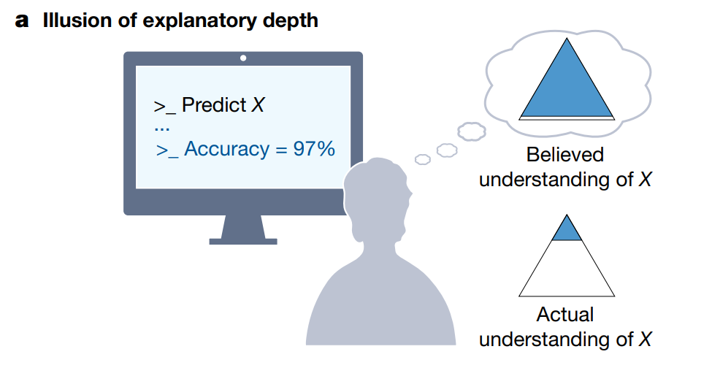
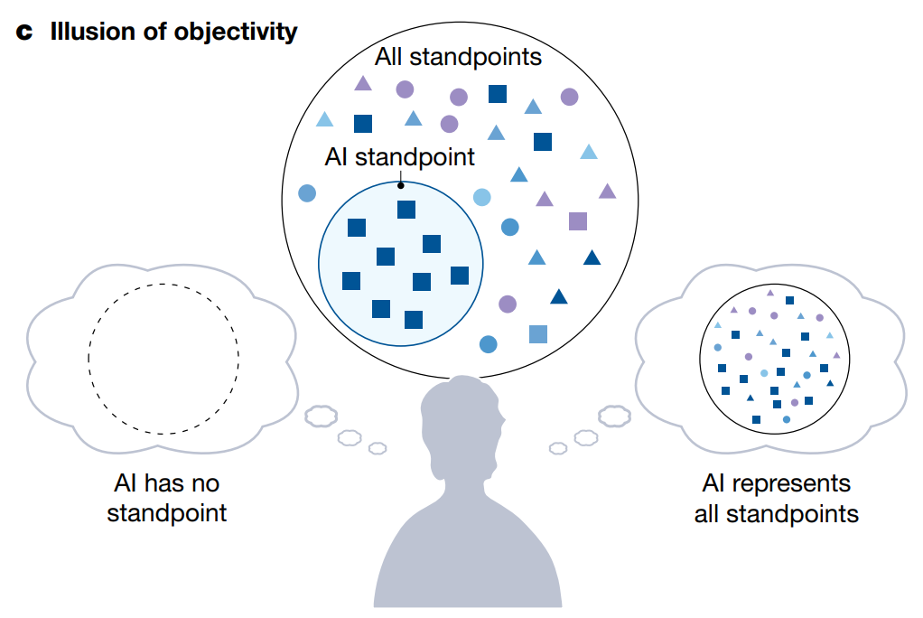
Discussion
Messeri, L., & Crockett, M. J. (2024). Artificial intelligence and illusions of understanding in scientific research. Nature, 627(8002), 49-58.
Notes:
What should the science community do?
define standards for use
define best practices for quality science

Slide 9
References
https://ellmer.tidyverse.org/index.html
Messeri, L., & Crockett, M. J. (2024). Artificial intelligence and illusions of understanding in scientific research. Nature, 627(8002), 49-58.
Jansen, J. A., Manukyan, A., Al Khoury, N., & Akalin, A. (2025). Leveraging large language models for data analysis automation. PloS one, 20(2), e0317084.

