Slide 1


DRY FRUIT STORE
MANAGEMENT SYSTEM
Created by : Pratham Patel,
Rohan Vaghasiya
Guided by : Mr. Vipul Gamit

Slide 2

PROJECT DEFINITION
Dry fruit store management system provides various functionalities which would help local dry fruit seller to make their business available globally and share/sell their product online. This system will provide facilities like customer can buy product online, pay online and get details about physical shop like contact number, location etc... Any person can visit the website to browse and search available product and their details shall be viewed accordingly. Its easier to handle the local business more efficiently. Customer will get regular updates about offers on the system.

Slide 3
PROJECT OBJECTIVE
This will help dry fruit business owners to sell their product online.
It is easier to sell computer-based selling rather than physical contact that is more comfortable in this pandemic era.
This system will improve the work efficiency of the owner and will grow business globally.
This system will simplify customers' effort in dry fruit or grocery buying.
This system will give notification of discounts.
This system will generate internal report.
offers, sales and

Slide 4
PROJECT SCOPE
1.
This system will be useful for any local dry fruit/grocery store owner.
2.
This system will be used only for selling, means only admin can sell the product.
3.
This system can be accessible from any device and from any location.

Slide 5
PRODUCT PERSPECTIVE
This product is aimed toward a person who doesn't want to visit the shop as he might don't get time for that or might not be interested in visiting there and dealing with a lot of formalities. And also in this pandemic era we always use to take safety precaution, so that is also a safe side to buy products online and get delivered to your home.

Slide 6
FUNCTIONAL REQUIREMENTS
FOR ADMIN :
1.
Add, delete, update, view details of staff.
2.
Add, delete details, update product, delivery date, order history.
3.
View customers, update customers, delete customers.
4.
View feedback, Reply Feedbacks.
5.
View feedback, Reply Feedbacks.
6.
Manage payments.

Slide 7
FUNCTIONAL REQUIREMENTS
FOR CUSTOMER :
1.
Customer should be able to View orders and it's details.
2.
3.
Customer Should Be able to add to cart.
Customer should be able to buy product.
4.
5.
6.
Customer should be able to Add/View Feedbacks.
Customer should be able to contact owner.
Customer can pay their bill online.

Slide 8
NON FUNCTIONAL REQUIREMENTS:
1.
The system will respond to the user in approximately 5msec.
2.
The application will be user-friendly and easy to operate.
3.
Users will have to enter correct login Id and password to access the system.
4.
The application will be easily portable to any windows- based system that has internet connectivity.
5.
The application will be able to expand its functionalities without having undesirable side effects.

Slide 9
DATABASE SCHEMAS
TblUser
Uid[pk],username,email,password,roll,date,status.
TblProduct
Pid[pk],pname,category[fk],pimage,price,status,delete_flag,date_updated.
TblSale
Sid[pk],customer,samount,sdate,payment_status,sale_status
TblSaleDetail
MasterId[fk],itemname,packing type,itemqty,itemprice,total.
TblCart
Cid[pk],Uid[fk],camount,cdate.
TblCartDetail
Cdid[pk],Cid[fk],itemname,itemqty,packingtype,itemprice,total.
TblUserDetail
Udid[pk],Uid[fk],contact,house_no,street,city,landmark,date.

Slide 10
TblFeedback
Fid[pk],uname[fk],title,message,date.
TblPayment
Paymentid[pk],ptype,pstatus,contactnum,date.
TblCategory
Ctid[pk],name,status,date.
TblStock
Stid[pk],pid[fk],quantity,date_updated.

Slide 11
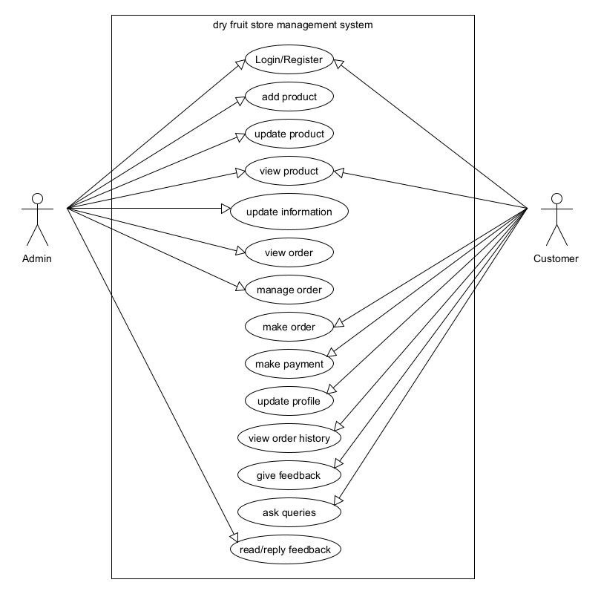
USE CASE DIAGRAM

Slide 12
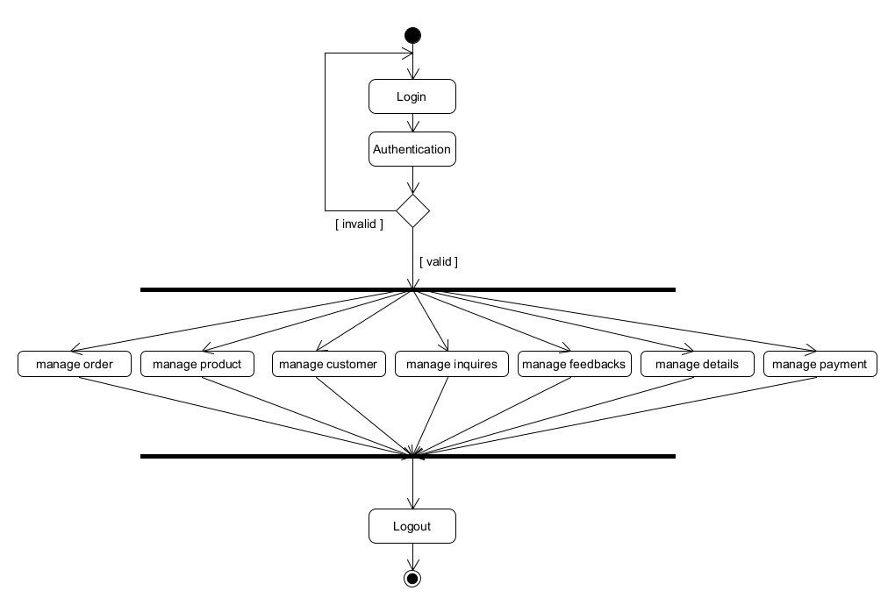
ACTIVITY DIAGRAMS
ACTIVITY DIAGRAM FOR ADMIN

Slide 13
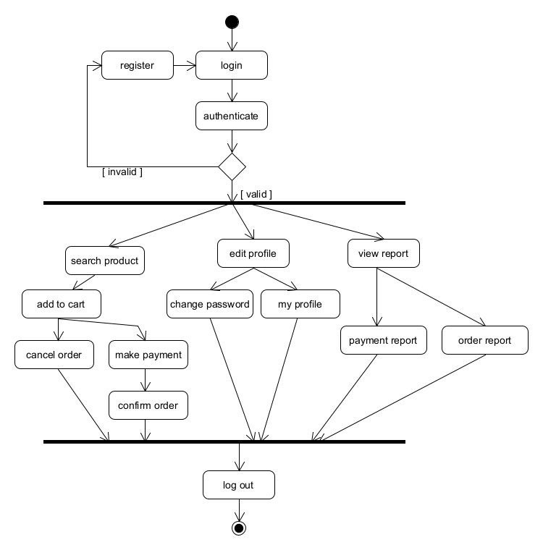
ACTIVITY DIAGRAM FOR CUSTOMER

Slide 14
THANK YOU!

