Slide 1


DRY FRUIT STORE
MANAGEMENT SYSTEM
Created by : Pratham Patel,
Rohan Vaghasiya
Guided by : Dr. Sapan Naik

Slide 2

PROJECT DEFINITION
Dry fruit store management system provides various functionalities which would help local dry fruit seller to make their business available globally and share/sell their product online. This system will provide facilities like customer can buy product online, pay online and get details about physical shop like contact number, location etc... Any person can visit the website to browse and search available product and their details shall be viewed accordingly. Its easier to handle the local business more efficiently. Customer will get regular updates about offers on the system.

Slide 3
PROJECT OBJECTIVE
This will help dry fruit business owners to sell their product online.
It is easier to sell computer-based selling rather than physical contact that is more comfortable in this pandemic era.
This system will improve the work efficiency of the owner and will grow business globally.
This system will simplify customers' effort in dry fruit or grocery buying.
This system will give notification of discounts.
This system will generate internal report.
offers, sales and

Slide 4
PROJECT SCOPE
1.
This system will be useful for any local dry fruit/grocery store owner.
2.
This system will be used only for selling, means only admin can sell the product.
3.
This system can be accessible from any device and from any location.

Slide 5
PRODUCT PERSPECTIVE
This product is aimed toward a person who doesn't want to visit the shop as he might don't get time for that or might not be interested in visiting there and dealing with a lot of formalities. And also in this pandemic era we always use to take safety precaution, so that is also a safe side to buy products online and get delivered to your home. So we have created this system to help that kind of people and seller too.

Slide 6
FUNCTIONAL REQUIREMENTS
FOR ADMIN :
1.
Add, delete, update, view details of staff.
2.
Add, delete details, update product, delivery date, order history.
3.
View customers, Send offers to customer, see their particular orders
4.
View feedback, Reply Feedbacks.
5.
Get Invoice Details
6.
Manage payments.

Slide 7
FUNCTIONAL REQUIREMENTS
FOR CUSTOMER :
1.
Customer should be able to View orders and it's details.
2.
3.
Customer will get invoice pdf directly to their email.
Customer should be able to buy product.
4.
5.
6.
Customer should be able to Add/View Feedbacks.
Customer will get all the updates of placed order.
Customer can pay their bill online.

Slide 8
NON FUNCTIONAL REQUIREMENTS:
1.
The system will respond to the user better if network connectivity is good.
2.
The application will be user-friendly and easy to operate.
3.
Users will have to enter correct login Id and password to access the system.
4.
The application will be easily portable to any system that has internet connectivity.
5.
The application will be able to expand its functionalities without having undesirable side effects.

Slide 9
DATABASE SCHEMAS
TblUser
Uid[pk],username,email,password,roll,date,status.
TblProduct
Pid[pk],pname,category[fk],pimage,price,date.
TblOrder
Sid[pk],customer,address,date,payment_status,delivery_status,date
OrderDetail
MasterId[pk],oid[fk],itemname,packing type,itemqty,total.
TblCart
Cid[pk],Uid[fk],Pid[fk],Pname,Price,Quantity,Date.

Slide 10
TblFeedback
Fid[pk],uname[fk],title,message,date.
TblCategory
Ctid[pk],name,status,date.
TblStock
Stid[pk],pid[fk],quantity,date_updated.
TblImage
Id[pk],imagepath,date

Slide 11
TblUser
Sr.No | Attribute_name | Data Type | Size | Constraint | Description
1 | uid | int | 11 | Primary key | It stores user id
2 | Username | Varchar | 255 | Not Null | It Stores User name
3 | Email | Varchar | 255 | Not Null | It stores Email
4 | Password | Varchar | 255 | Not Null | It stores password
5 | Role | Varchar | 20 | Not Null | It stores designation of admin/customer
6 | Date | Varchar | 255 | Not Null | It stores Date when account is created

Slide 12
TblCart
Sr.No | Attribute_name | Data Type | Size | Constraint | Description
1 | Cid | Int | 10 | Primary Key | It stores cart id
2 | Uid | Int | 10 | Not null | It stores user id.
3 | Pid | Int | 10 | Not Null | It stores product id.
4 | Pname | Varchar | 255 | Not Null | It stores product name
5 | Price | float | 10,2 | Not Null | It stores Price of product
6 | Quantity | Int | 10 | Not Null | It stores quantity of product
7 | Date | Datetime | 255 | Not Null | It stores date.

Slide 13
TblProduct
Sr.No | Attribute_name | Data Type | Size | Constraint | Description
1 | Pid | Int | 11 | Primary Key | It stores Product id.
2 | Pname | Varchar | 50 | Not Null | It store Customer name.
3 | Category | Varchar | 20 | Not Null | It stores Category.
4 | ImagePath | Varchar | 255 | Not Null | It stores path of image.
5 | Price | Float | 10,2 | Not Null | It stores price of product.
6 | Date | Datetime | 255 | Not Null | It stores date.

Slide 14
TblOrder
Sr.No | Attribute_name | Data Type | SIze | Constraint | Description
1 | Oid | Int | 20 | Primary Key | It stores order id
2 | Uid | Int | 40 | Not Null | It stores user id
3 | Pid | Int | 40 | Not Null | It stores product id
4 | Name | varchar | 255 | Not Null | It stores Name of user
5 | Number | Long int | 12 | Not Null | It stores number
6 | Method | Varchar | 20 | Not Null | It stores method

Slide 15
OrderDetail
Sr.No | Attribute_name | Data Type | SIze | Constraint | Description
1 | OdId | Int | 20 | Primary Key | It stores id.
2 | Oid | int | 20 | Not Null | It stores order id.
3 | Pid | Int | 20 | Not Null | It stores product id.
4 | Quantity | Float | 20,2 | Not Null | It stores quantity.
5 | Grand Total | Float | 20,2 | Not Null | It stores grand total.

Slide 16
TblStock
Sr.No | Attribute_name | Data Type | SIze | Constraint | Description
1 | StId | Int | 20 | Primary Key | It stores id.
2 | Pid | Int | 20 | Not Null Foreign key | It stores product id.
3 | Stock | Int | 20 | Not Null | It stores stock.
4 | Date | Datetime | 255 | Not Null | It stores date

Slide 17
TblFeedback
Sr.No | Attribute_name | Data Type | SIze | Constraint | Description
1 | Fid | Int | 20 | Primary Key | It stores id
2 | Name | Varchar | 40 | Not Null | It stores name
3 | Email_Id | Varchar | 40 | Not Null | It stores email
4 | ContactNo | Long int | 20 | Not Null | It stores Mobile number
5 | Message | Varchar | 300 | Not null | It stores message
6 | date | Float | 10 | Not Null | It stores date

Slide 18
TblCategory
Sr.No | Attribute_name | Data Type | SIze | Constraint | Description
1 | Cid | Int | 20 | Primary Key | It stores id
2 | Name | Varchar | 40 | Not Null | It stores name
TblImage
Sr.No | Attribute_name | Data Type | SIze | Constraint | Description
1 | Id | Int | 20 | Primary Key | It stores id
2 | Pimage | Varchar | 256 | Not Null | It stores image path

Slide 19
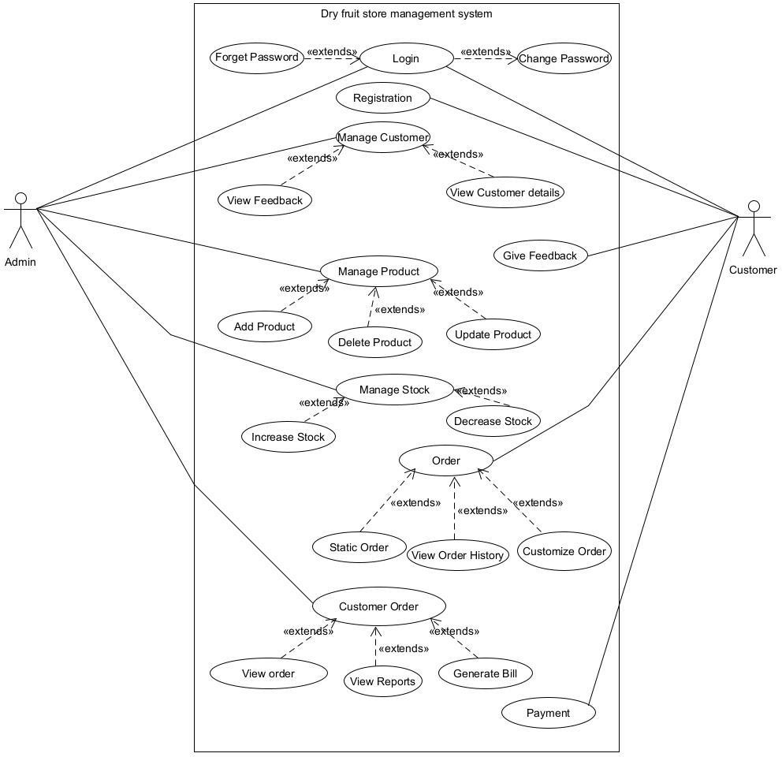
USE CASE DIAGRAM

Slide 20
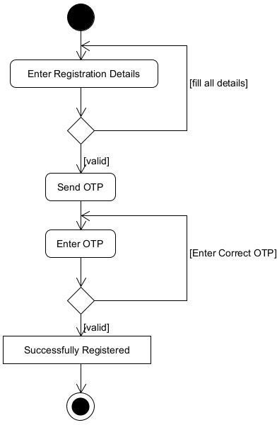
ACTIVITY DIAGRAMS
ACTIVITY DIAGRAM FOR REGISTRATION

Slide 21
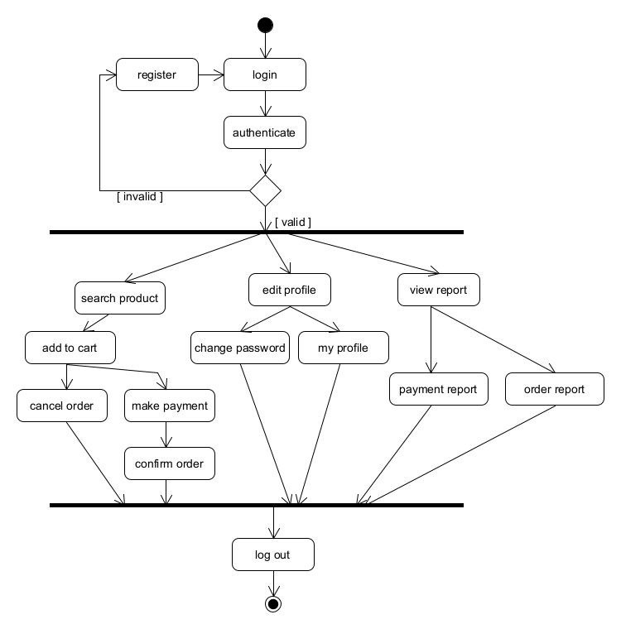
ACTIVITY DIAGRAM FOR MANAGE PRODUCT

Slide 22
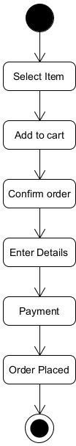
ACTIVITY DIAGRAM FOR MANAGE ORDER

Slide 23
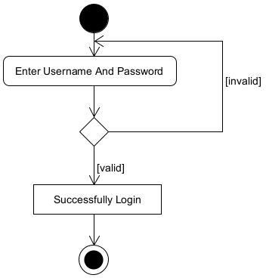
ACTIVITY DIAGRAM FOR LOGIN

Slide 24
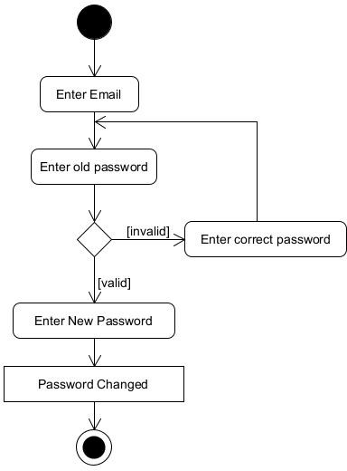
ACTIVITY DIAGRAM FOR CHANGE PASSWORD

Slide 25
THANK YOU!

