Slide 1

Getting credit for peer review
(and help science move on too…!)

Slide 2
Why?
Everything you do as an academic builds your reputation
But your time is precious
So make sure everything you do counts

Slide 3

What’s the one essential tool? (hint, you’ve heard it earlier…)

Slide 4
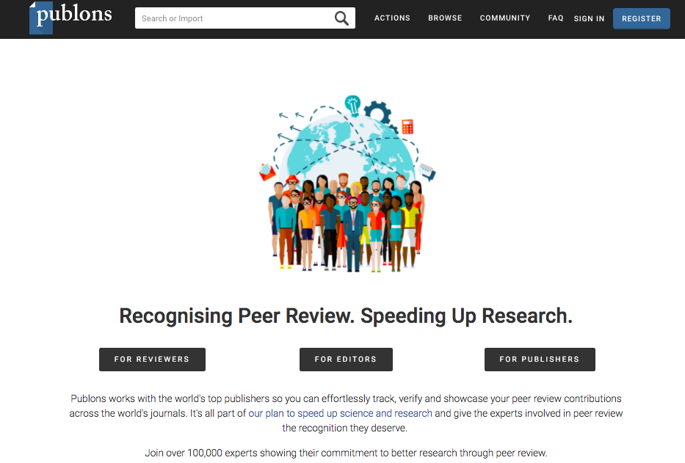
So, what are my options? -traditional peer review

Slide 5
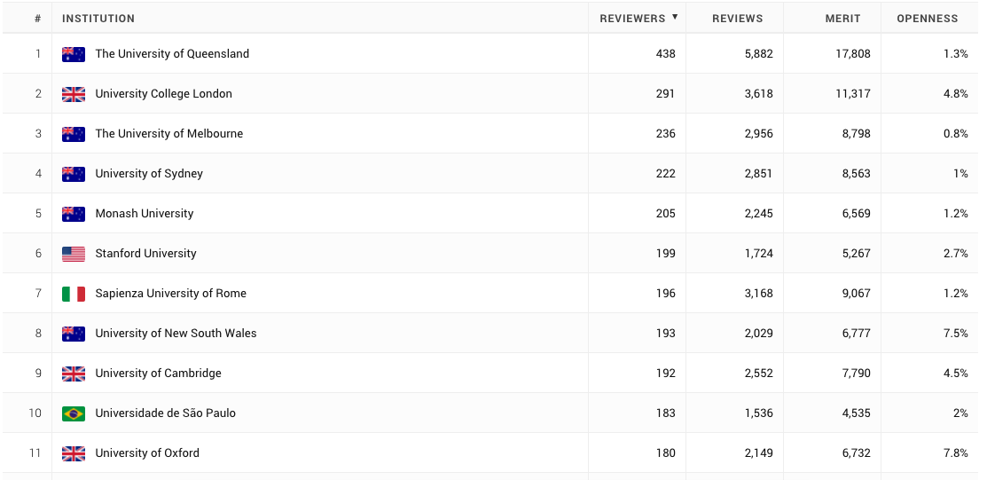
Do universities care?

Slide 6
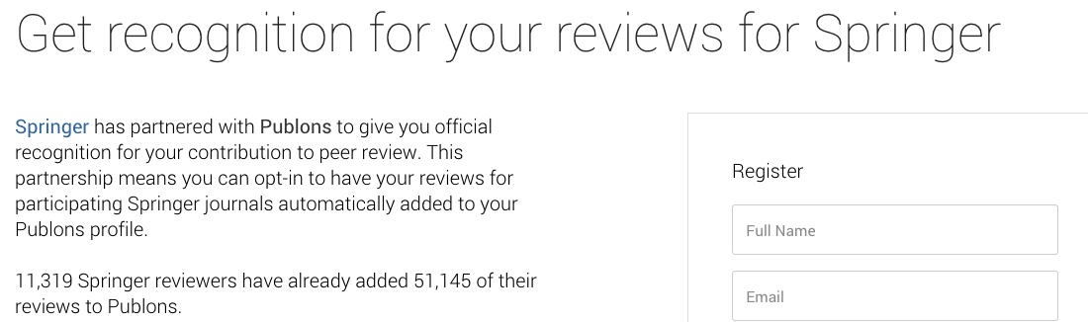
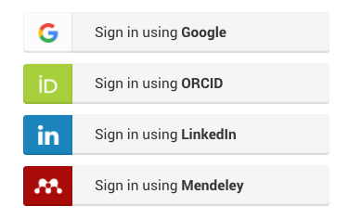
Do publishers care?

Slide 7
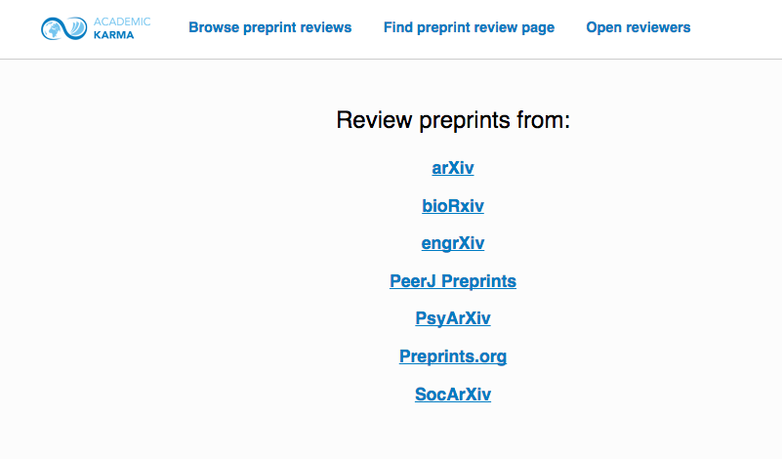
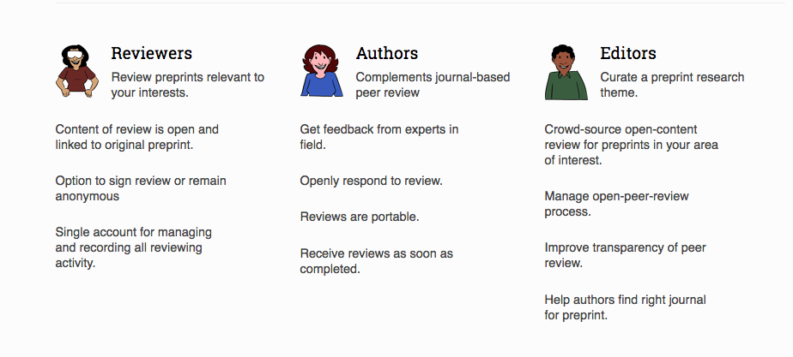
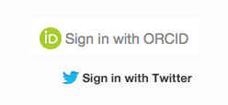
So, what are my options? - peer review of preprints

Slide 8
Actions on peer review
Go to Publons https://publons.com/
Sign in, or sign up
Or explore your institution to see who is reviewing what
Go to Academic Karma http://academickarma.org/
Sign in, or sign up
Browse preprint reviews http://academickarma.org/openreviews
Go to a preprint site and browse preprints
http://asapbio.org/
https://osf.io/preprints

