Slide 1
Meeting on March 28
Takumi Shiota
March 28, 2025
@Maastricht univ.

Slide 2
Edge unfoldings
Definition 1 [E. D. Demaine and J. O’Rourke, 2007]
An edge unfolding of the polyhedron is a flat polygon formed by cutting its edges and unfolding it into a plane.
Cutting along the thick line of each left cube …
(a) Edge unfolding
(b) Not edge unfolding

Slide 3
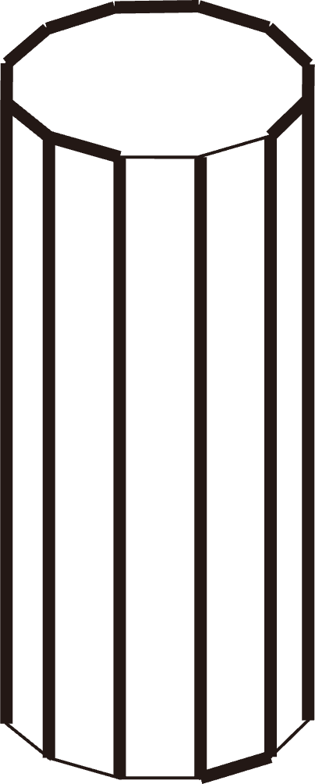
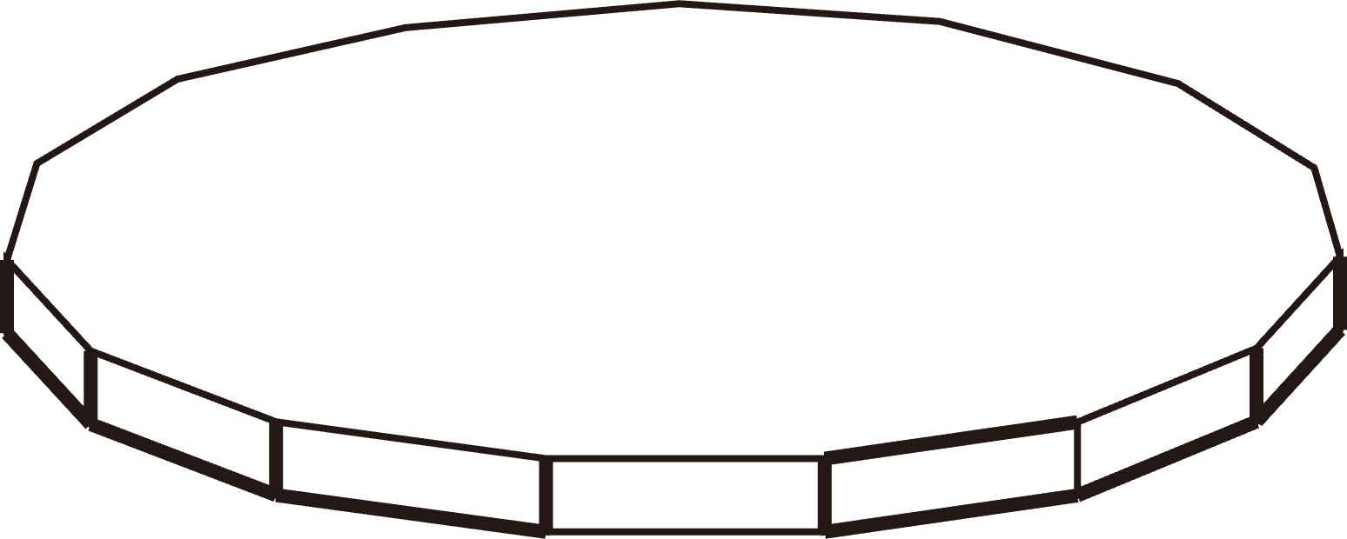

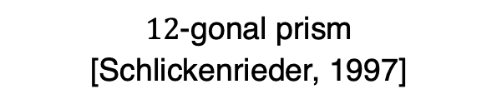
Overlapping edge unfoldings
Overlapping edge unfoldings exist in some convex polyhedra.
Truncated dodecahedron
[T. Horiyama and W. Shoji, 2011]
Truncated icosahedron
[T. Horiyama and W. Shoji, 2011]
$12$-gonal prism
[Schlickenrieder, 1997]
$15$-gonal prism
[Schlickenrieder, 1997]

Slide 4
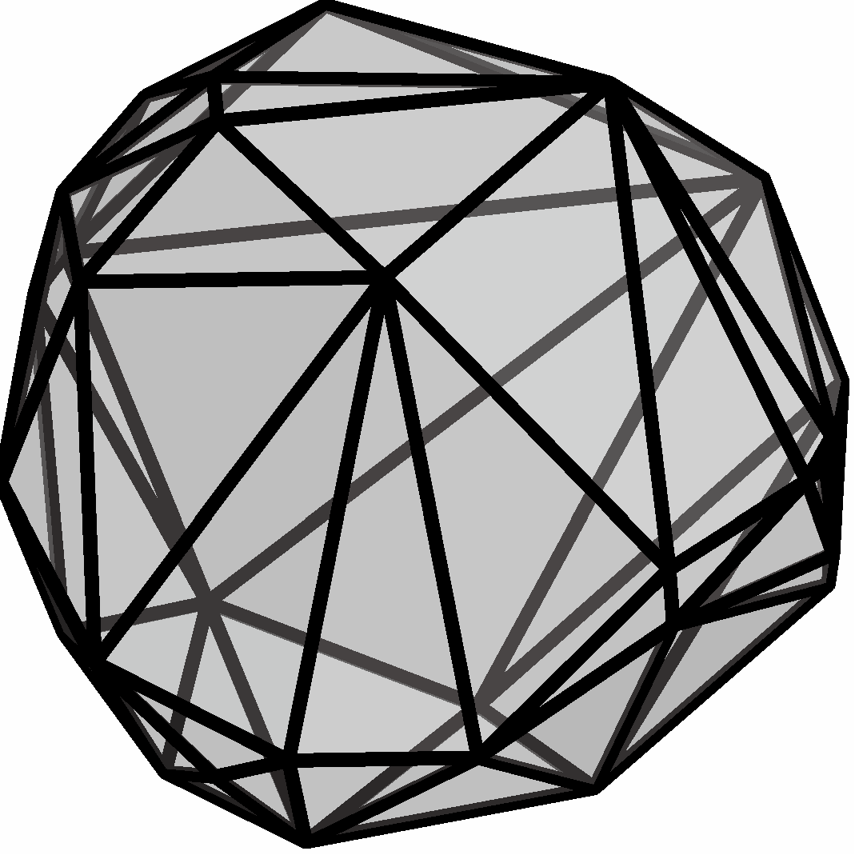
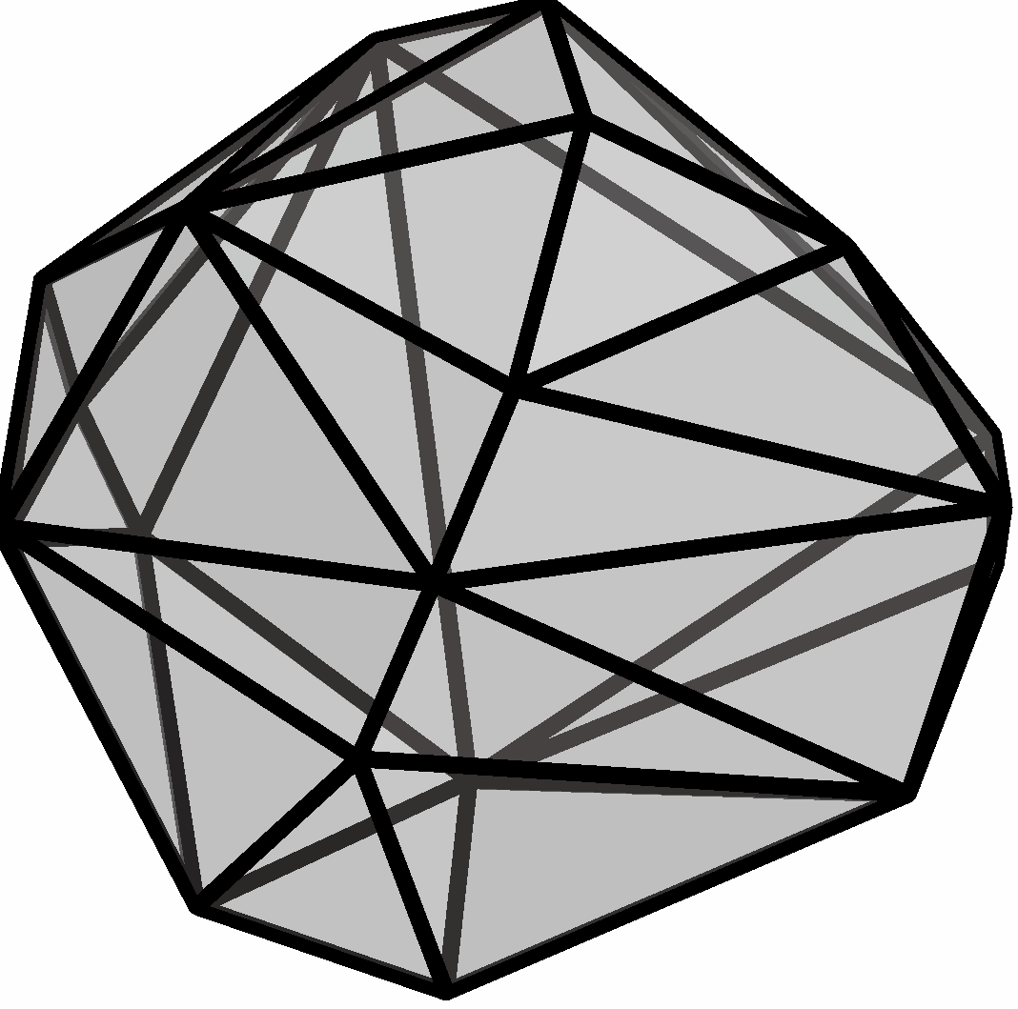
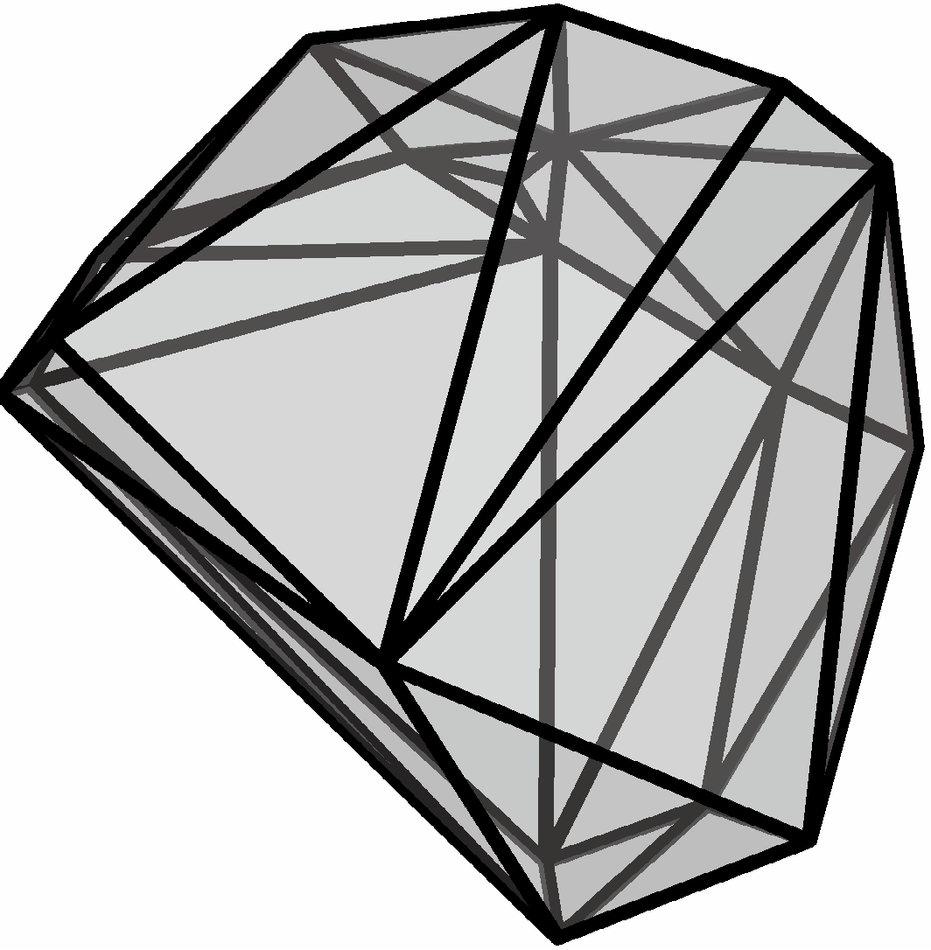
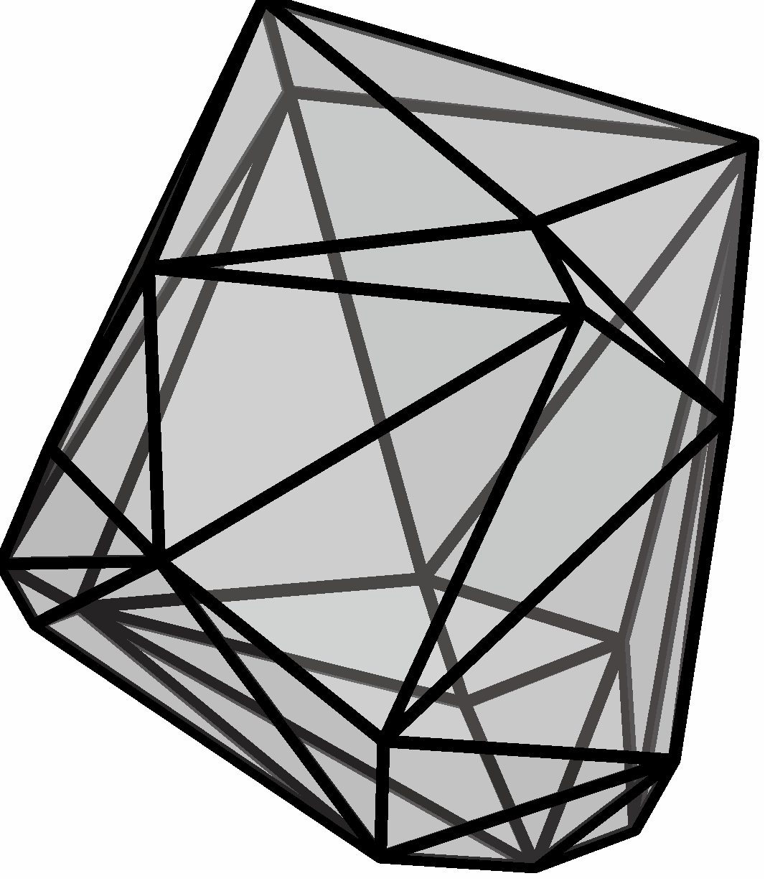
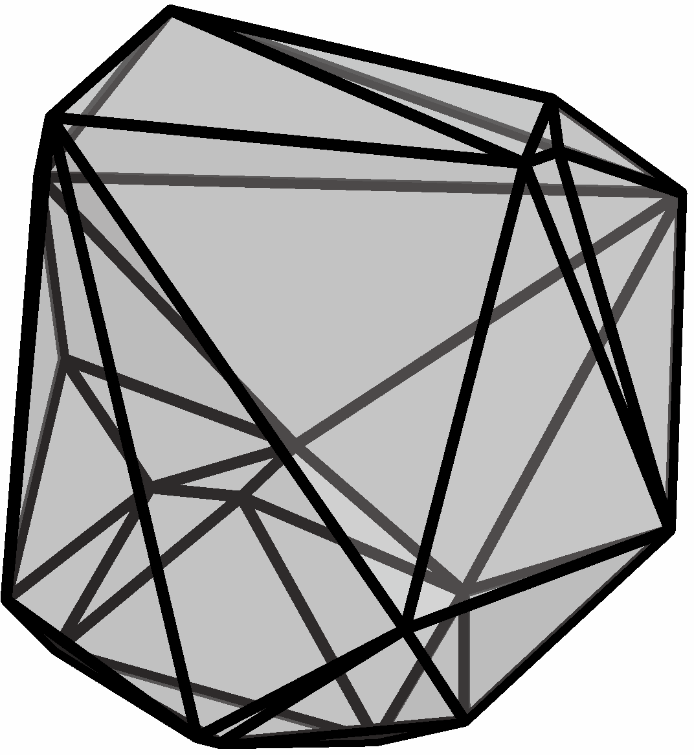
Background
Open problem (Dürer’s problem) [G. C. Shephard, 1975]
Can every convex polyhedron be edge-unfolded without overlaps?
Key points for solve this problem
To find a convex polyhedron that overlaps in any possible edge unfolding.
To present an edge-unfolding algorithm that applies to all convex polyhedra.

Slide 5
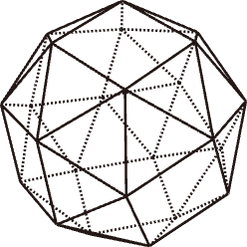
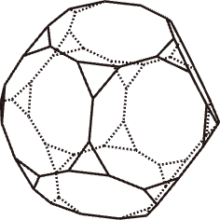
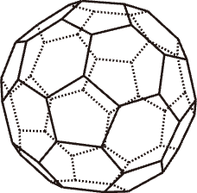
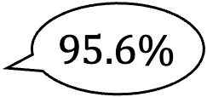

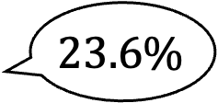
Background [My PhD thesis]
Key points for solve this problem
To find a convex polyhedron that overlaps in any possible edge unfolding.
We developed a method for counting non-overlapping ones.
Archimedean solids | #(Edge unfoldings) [T. Horiyama and W. Shoji., 2013] | #(Non-overlapping edge unfolding)
Snub cube | 89,904,012,853,248 | 85,967,688,920,076
Truncated dodecahedron | 4,982,259,375,000,000,000 | 1,173,681,002,295,455,040
Truncated icosahedron | 375,291,866,372,898,816,000 | 371,723,160,733,469,233,260
$$95.6\%$$
$$23.6\%$$
$$99.1\%$$
Truncated
dodecahedron
Truncated
icosahedron
Snub cube

Slide 6
Background
Key points for solve this problem
To present an edge-unfolding algorithm that applies to all convex polyhedra.
[W. Schlickenrieder, 1997]
Algorithm A
Modify the shape slightly
Useable
Useable
Useable
〜
〜
…
〜
〜
〜
〜
6,000
Useable?
Uncountable Infinity

Slide 7
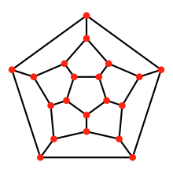
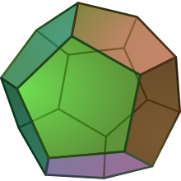
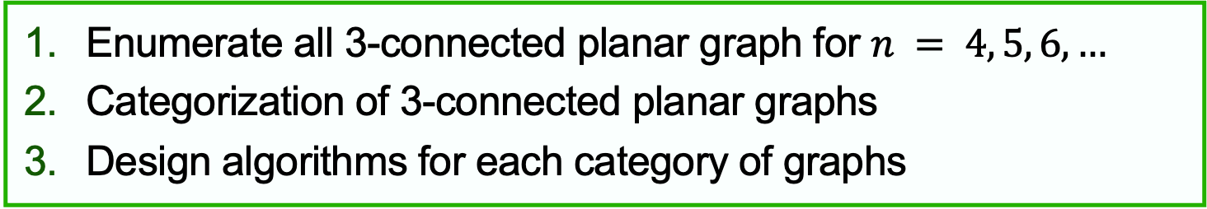
Overview of my idea
Steinitz’s Theorem
*1
*2
Every 3-connected planar graph is the edge-graph of a convex
polyhedron.
Dodecahedron
Planned steps
Enumerate all 3-connected planar graph for $n = 4, 5, 6,…$
Categorization of 3-connected planar graphs
Design algorithms for each category of graphs
I want to work on these during my stay.
*1: https://en.wikipedia.org/wiki/Regular_dodecahedron
*2: https://en.wikipedia.org/wiki/Polyhedral_graph

