Slide 1
Meeting on May 7
Takumi Shiota
May 7, 2025
@Maastricht univ.

Slide 2
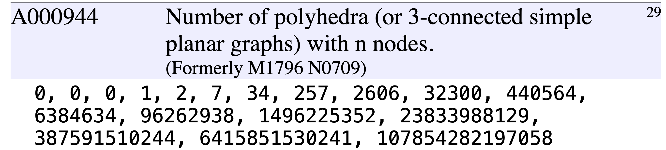
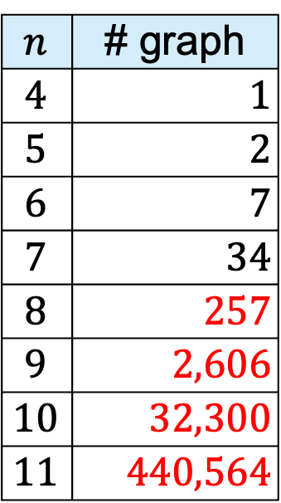
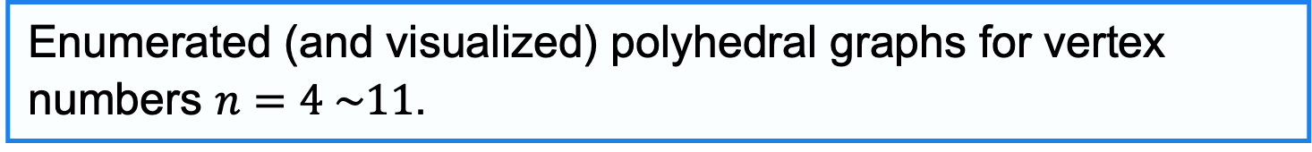
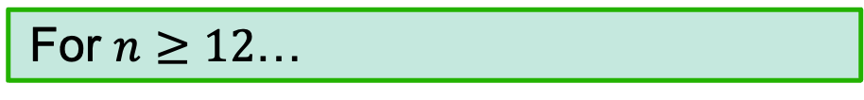
Progress report
Achievements so far
Enumerated (and visualized) polyhedral graphs for vertex numbers $n=4 \sim 11$.
$$n$$ | # graph
$$4$$ | $1$
$$5$$ | $2$
$$6$$ | $7$
$$7$$ | $34$
$$8$$ | $257$
$$9$$ | $2,606$
$$10$$ | $32,300$
$$11$$ | $440,564$
https://oeis.org/A000944
For $n≥12$…
New
My Mac doesn’t have enough storage to handle the computation.

Slide 3
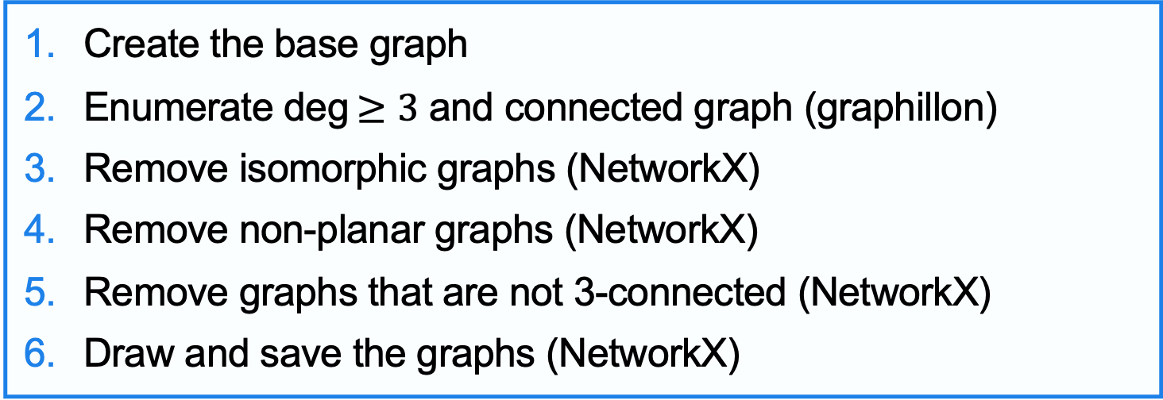
Implementation overview
Previous program flow
Create the base graph
Enumerate deg$≥3$ and connected graph (graphillon)
Remove isomorphic graphs (NetworkX)
Remove non-planar graphs (NetworkX)
Remove graphs that are not 3-connected (NetworkX)
Draw and save the graphs (NetworkX)
Nauty
➡︎ Boost (c++)
Graphs enumerated as a practice with Nauty
Counting the number of simple graphs with $n$ unlabeled nodes.
➡︎ This graph did not need to be implemented in the first place!

Slide 4
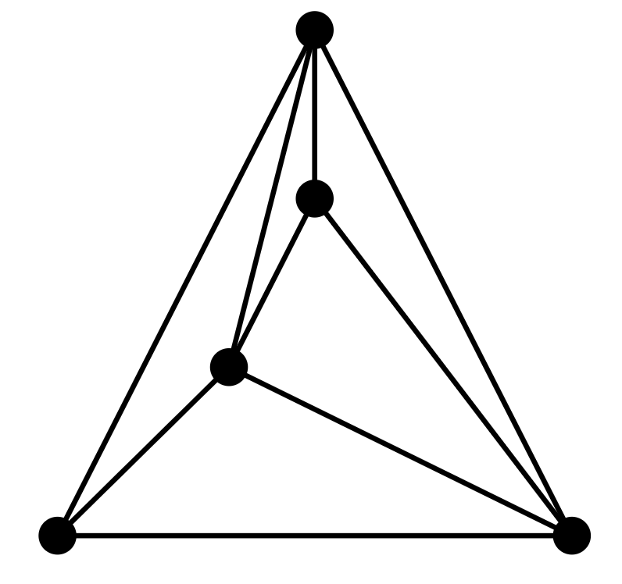


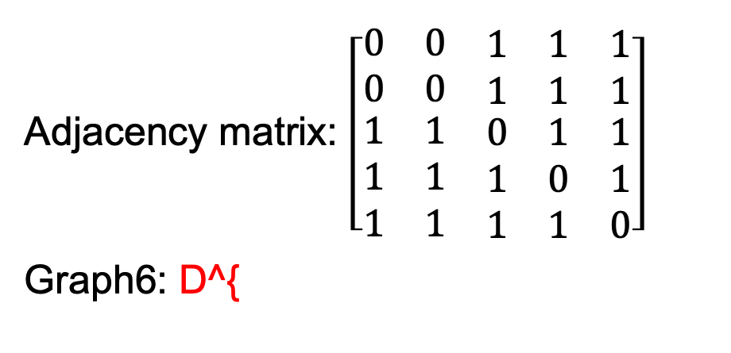



Geng
What is Geng?
A graph generation tool included in nauty
Enumerates all non-isomorphic graphs with specific structural properties that satisfy specified conditions
Outputs graphs in graph6 format (with file extension .g6)
[Ex.]
Adjacency matrix: $\left[\begin{matrix}\begin{matrix}0 & 0 & \begin{matrix}1 & 1 & 1\end{matrix}\end{matrix} \\ \begin{matrix}0 & 0 & \begin{matrix}1 & 1 & 1\end{matrix}\end{matrix} \\ \begin{matrix}\begin{matrix}1 & 1 & \begin{matrix}0 & 1 & 1\end{matrix}\end{matrix} \\ \begin{matrix}1 & 1 & \begin{matrix}1 & 0 & 1\end{matrix}\end{matrix} \\ \begin{matrix}1 & 1 & \begin{matrix}1 & 1 & 0\end{matrix}\end{matrix}\end{matrix}\end{matrix}\right]$
Graph6: D^{
$$5$$
$$2$$
$$3$$
$$1$$
$$4$$
echo 'D^{' | showg -a

Slide 5
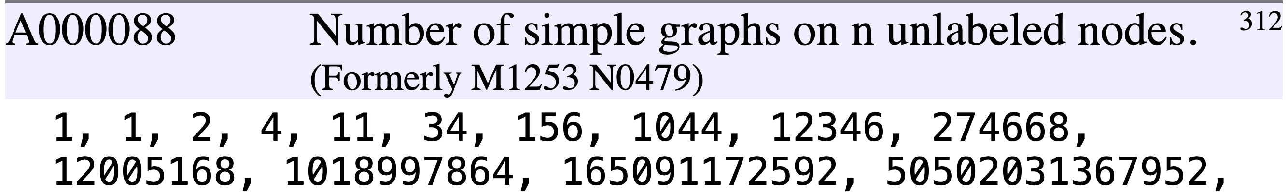
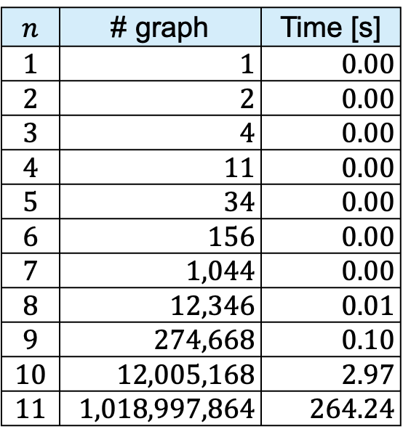
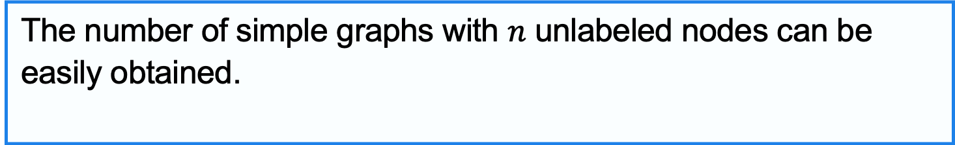
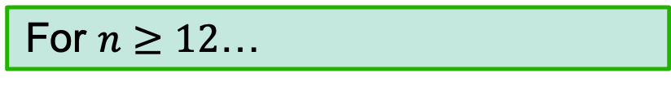
Geng
By using Geng and executing the following command…
The number of simple graphs with $n$ unlabeled nodes can be easily obtained.
$ geng v | wc –l # v: num vertices
$$n$$ | # graph | Time [s]
$$1$$ | $1$ | $0.00$
$$2$$ | $2$ | $0.00$
$$3$$ | $4$ | $0.00$
$$4$$ | $11$ | $0.00$
$$5$$ | $34$ | $0.00$
$$6$$ | $156$ | $0.00$
$$7$$ | $1,044$ | $0.00$
$$8$$ | $12,346$ | $0.01$
$$9$$ | $274,668$ | $0.10$
$$10$$ | $12,005,168$ | $2.97$
$$11$$ | $1,018,997,864$ | $264.24$
https://oeis.org/A000088
For $n≥12$…
By using parallel processing, we can enumerate at high speed.

Slide 6
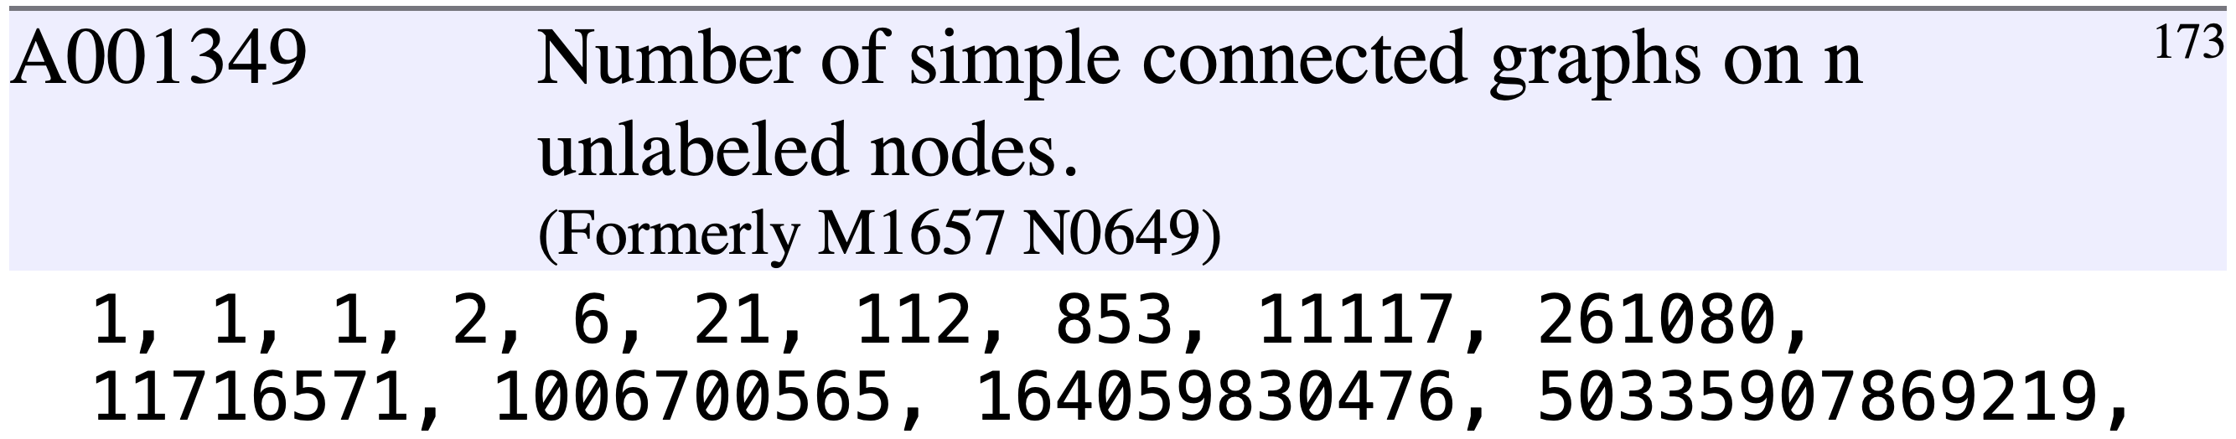
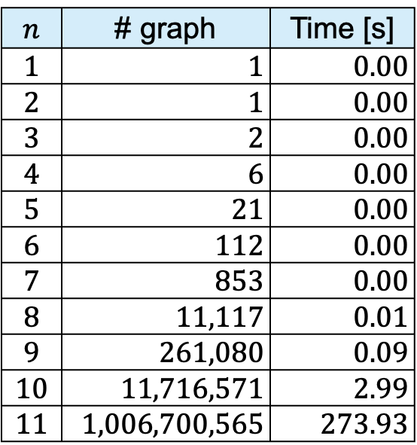
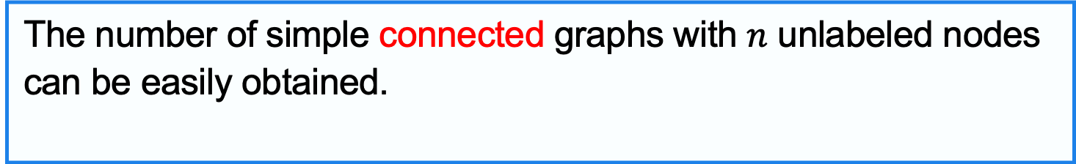
Geng
Geng has a variety of options.
The number of simple connected graphs with $n$ unlabeled nodes can be easily obtained.
$ geng -c v | wc –l # v: num vertices
$$n$$ | # graph | Time [s]
$$1$$ | $1$ | $0.00$
$$2$$ | $1$ | $0.00$
$$3$$ | $2$ | $0.00$
$$4$$ | $6$ | $0.00$
$$5$$ | $21$ | $0.00$
$$6$$ | $112$ | $0.00$
$$7$$ | $853$ | $0.00$
$$8$$ | $11,117$ | $0.01$
$$9$$ | $261,080$ | $0.09$
$$10$$ | $11,716,571$ | $2.99$
$$11$$ | $1,006,700,565$ | $273.93$
https://oeis.org/A001349
By using this option …
Non-isomorphic graphs can be obtained without implementing.

Slide 7
Enumerate polyhedral graphs
Previous program flow
Enumerate non-isomorphic, connected graphs with minimum degree at least 3 using the following command
Remove non-planar graphs (Boost (c++))
Remove graphs that are not 3-connected (NetworkX)
Draw and save the graphs (NetworkX)
$ geng –c -d3 v > nv.g6 # v: num vertices
$ geng --help
...
-c : only write connected graphs
-d# : a lower bound for the minimum degree

Slide 8
To-Do by next week
To-do
Enumerate and visualize graphs with various constraints by combining options.
-c : only write connected graphs
-C : only write biconnected graphs
-t : only generate triangle-free graphs
-f : only generate 4-cycle-free graphs
-p : only generate 5-cycle-free graphs
-k : only generate K4-free graphs
-T : only generate chordal graphs
-S : only generate split graphs
-P : only generate perfect graphs
-F : only generate claw-free graphs
-b : only generate bipartite graphs
I’ll review the definitions since they are unclear.

