Slide 1
Meeting on April 1
Takumi Shiota
April 1, 2025
@Maastricht univ.

Slide 2
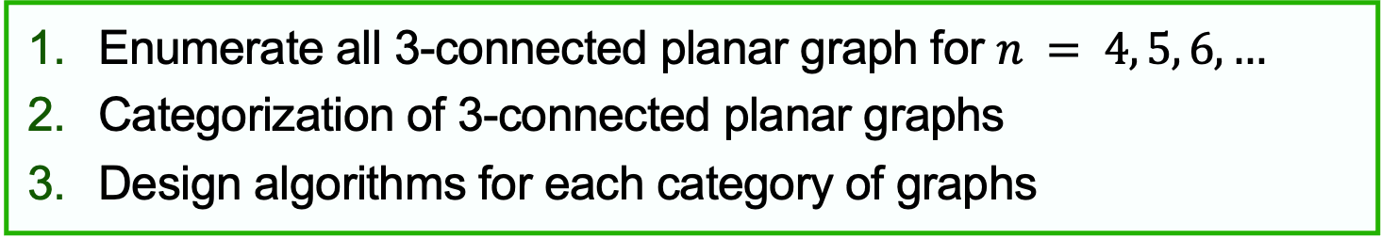
According to the OEIS
Planned steps
Enumerate all 3-connected planar graph for $n = 4, 5, 6,…$
Categorization of 3-connected planar graphs
Design algorithms for each category of graphs
The number of polyhedral graph with 6, 7, 8, ... edges is… 1, 0, 1, 2, 2, 4, 12, 22, 58, 158, 448, 1342, 4199, 13384, 43708, 144810, … https://oeis.org/A002840
The number of polyhedral graph with 4, 5, 6, ... vertices is… 1, 2, 7, 34, 257, 2606, 32300, 440564, 6384634, 96262938, 1496225352, … https://oeis.org/A000944
However…
There doesn’t seem to be any actual visualization of the data.

Slide 3
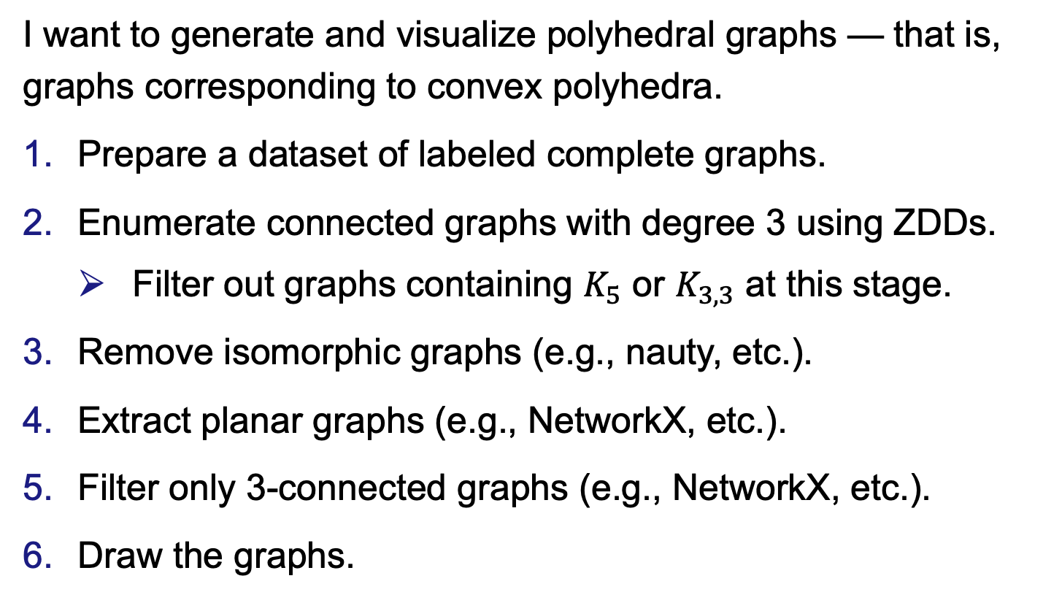
Polyhedral graph
I want to generate and visualize polyhedral graphs — that is, graphs corresponding to convex polyhedra.
Prepare a dataset of labeled complete graphs.
Enumerate connected graphs with degree 3 using ZDDs.
Filter out graphs containing $K_{5}$ or $K_{3,3}$ at this stage.
Remove isomorphic graphs (e.g., nauty, etc.).
Extract planar graphs (e.g., NetworkX, etc.).
Filter only 3-connected graphs (e.g., NetworkX, etc.).
Draw the graphs.
If possible

