Slide 1
Meeting on May 14
Takumi Shiota
May 14, 2025
@Maastricht univ.

Slide 2
Progress report
Program flow
Enumerate non-isomorphic, connected graphs with minimum degree at least 3 using the following command
Remove non-planar graphs (Boost (c++))
Remove graphs that are not 3-connected (NetworkX)
Draw and save the graphs (NetworkX)
$ geng –c -d3 v # v: num vertices
Today’s report
Observations on polyhedral graphs under 7 types of geng options (including 1 combination type)

Slide 3
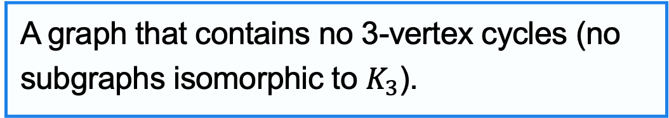
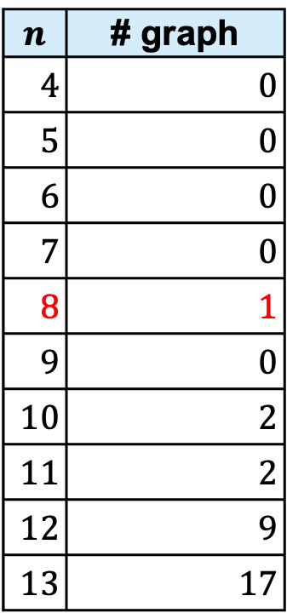
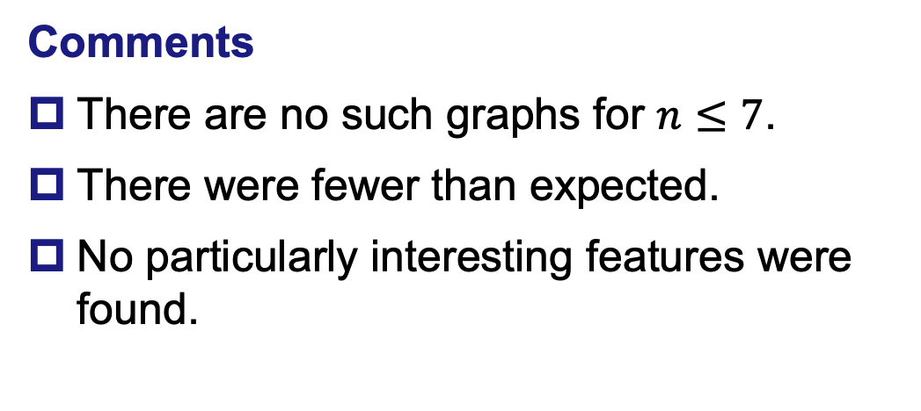
1. + Triangle-free
$ geng –c -d3 -t v # Output: drawing/td3cpt/
Triangle-free graph
$$n$$ | # graph
$4$ | $0$
$5$ | $0$
$6$ | $0$
$7$ | $0$
$8$ | $1$
$9$ | $0$
$10$ | $2$
$11$ | $2$
$12$ | $9$
$13$ | $17$
A graph that contains no 3-vertex cycles (no subgraphs isomorphic to $K_{3}$).
Comments
There are no such graphs for $n≤7$.
There were fewer than expected.
No particularly interesting features were found.

Slide 4
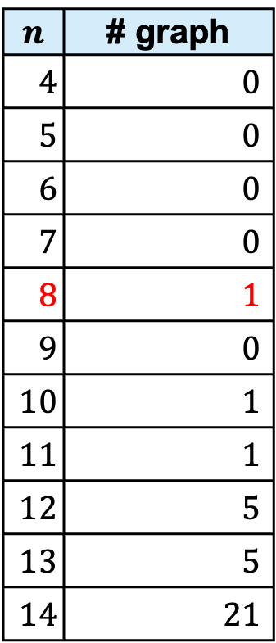
2. + Bipartite
$ geng –c -d3 -b v # Output: drawing/d3cbpt/
Bipartite graph
$$n$$ | # graph
$4$ | $0$
$5$ | $0$
$6$ | $0$
$7$ | $0$
$8$ | $1$
$9$ | $0$
$10$ | $1$
$11$ | $1$
$12$ | $5$
$13$ | $5$
$14$ | $21$
A graph in which vertex set can be divided into two disjoint sets such that no two vertices within the same set are adjacent.
Comments
(Obviously,) all faces consist of even-length cycles.
No particularly interesting features were found.

Slide 5
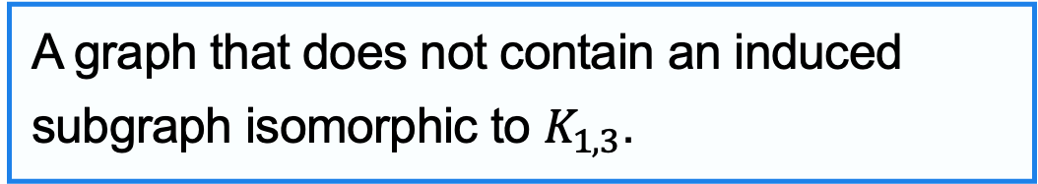
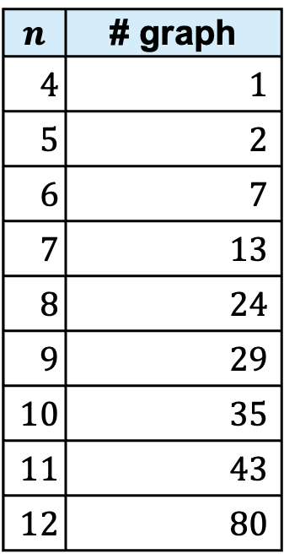
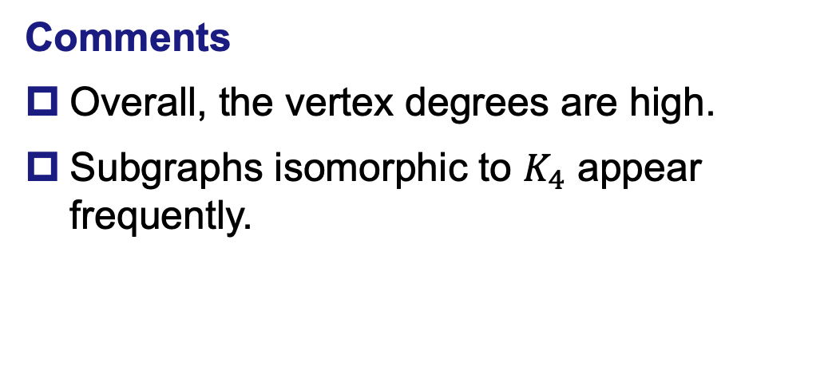
3. + Claw-free
$ geng –c -d3 -F v # Output: drawing/xfd3cpt/
Claw-free graph
$$n$$ | # graph
$4$ | $1$
$5$ | $2$
$6$ | $7$
$7$ | $13$
$8$ | $24$
$9$ | $29$
$10$ | $35$
$11$ | $43$
$12$ | $80$
A graph that does not contain an induced subgraph isomorphic to $K_{1,3}$.
Comments
Overall, the vertex degrees are high.
Subgraphs isomorphic to $K_{4}$ appear frequently.

Slide 6
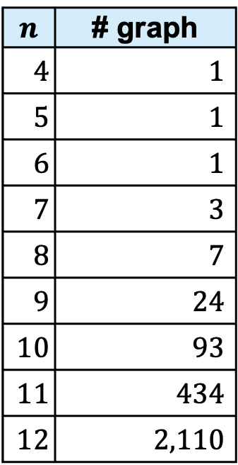
4. + Chordal
$ geng –c -d3 -T v # Output: drawing/xtd3cpt/
Chordal graph
$$n$$ | # graph
$4$ | $1$
$5$ | $1$
$6$ | $1$
$7$ | $3$
$8$ | $7$
$9$ | $24$
$10$ | $93$
$11$ | $434$
$12$ | $2,110$
A graph in which every cycle of four or more vertices has a chord.
Comments
(Obviously,) all faces are triangles.
The graph is very dense, with many tightly packed triangles.

Slide 7
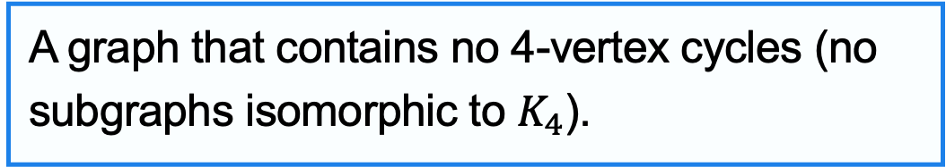
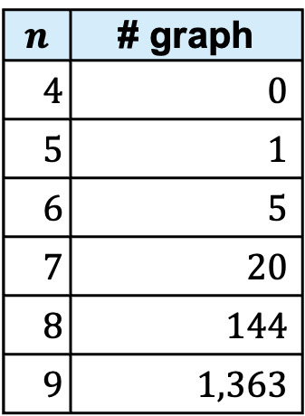
5. + K4-free
$ geng –c -d3 -k v # Output: drawing/kd3cpt/
K4-free graph
$$n$$ | # graph
$4$ | $0$
$5$ | $1$
$6$ | $5$
$7$ | $20$
$8$ | $144$
$9$ | $1,363$
A graph that contains no 4-vertex cycles (no subgraphs isomorphic to $K_{4}$).
Comments
No particularly interesting features were found.

Slide 8
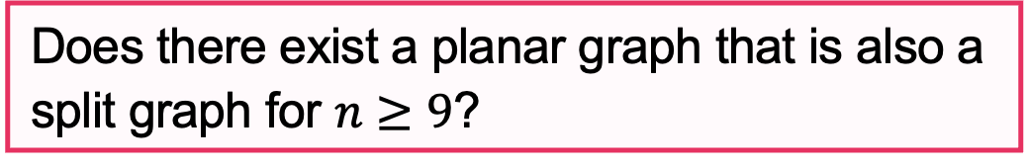
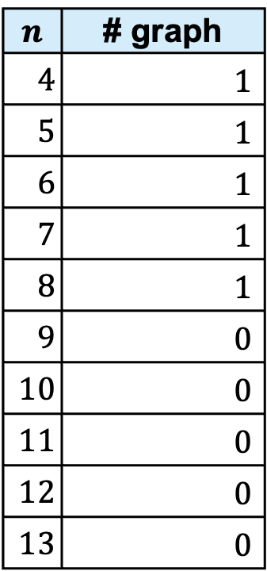
6. + Split
$ geng –c -d3 -S v # Output: drawing/xsd3cpt/
Split graph
$$n$$ | # graph
$4$ | $1$
$5$ | $1$
$6$ | $1$
$7$ | $1$
$8$ | $1$
$9$ | $0$
$10$ | $0$
$11$ | $0$
$12$ | $0$
$13$ | $0$
A graph in which vertex set can be partitioned into a clique and an independent set.
Comments
No examples were found for 9 to 13 vertices.
Question
Does there exist a planar graph that is also a split graph for $n≥9$?

Slide 9

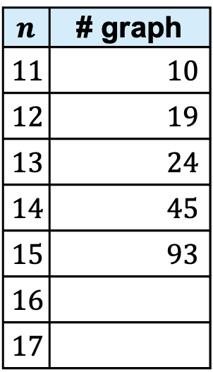

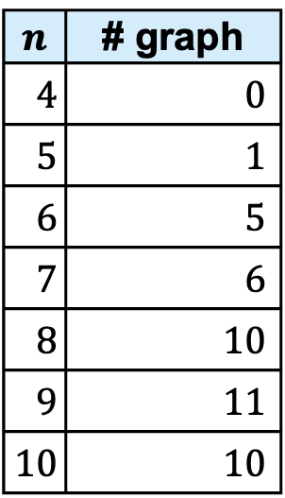

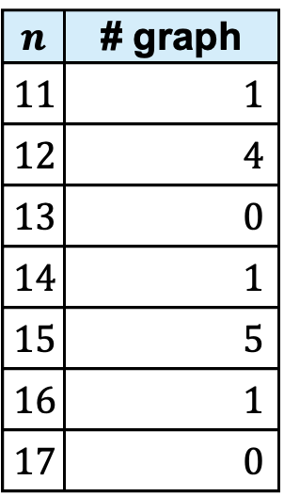
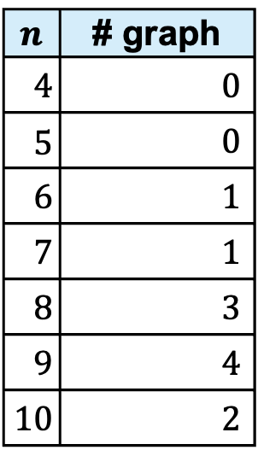
7. + Claw-free + K4-free
$ geng –c -dx –k -F # Output: drawing/xfkd3cpt/ or xfkd4cpt/
$$\deg\left(v\right)≥3$$
$$\deg\left(v\right)≥4$$
$$n$$ | # graph
$4$ | $0$
$5$ | $1$
$6$ | $5$
$7$ | $6$
$8$ | $10$
$9$ | $11$
$10$ | $10$
$$n$$ | # graph
$11$ | $10$
$12$ | $19$
$13$ | $24$
$14$ | $45$
$15$ | $93$
$16$
$17$
$$n$$ | # graph
$4$ | $0$
$5$ | $0$
$6$ | $1$
$7$ | $1$
$8$ | $3$
$9$ | $4$
$10$ | $2$
$$n$$ | # graph
$11$ | $1$
$12$ | $4$
$13$ | $0$
$14$ | $1$
$15$ | $5$
$16$ | $1$
$17$ | $0$
Comments
Graphs with $\deg\left(v\right)≥4$ include the antiprism.

