Slide 1
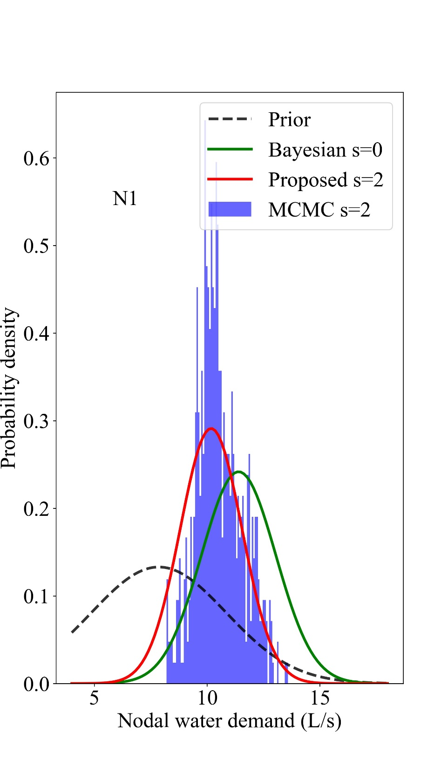
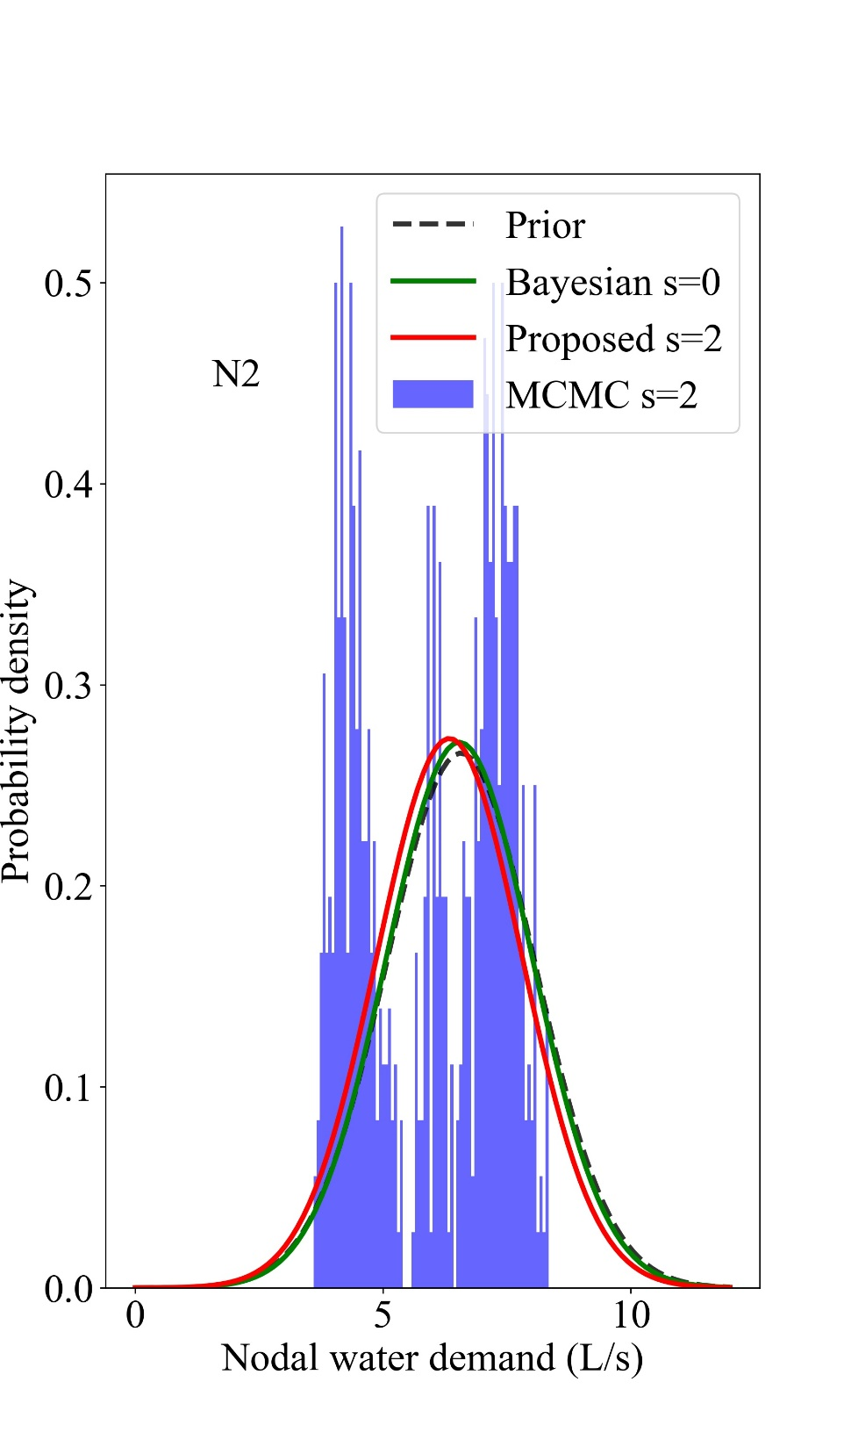
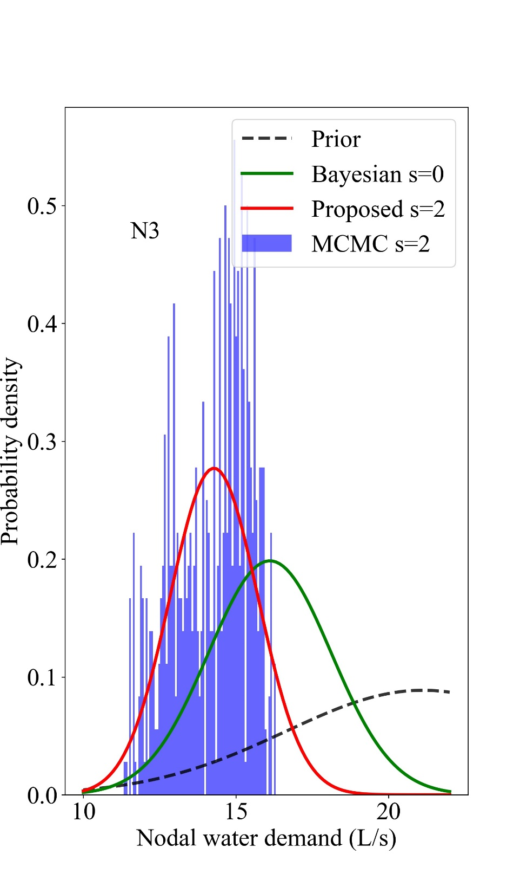
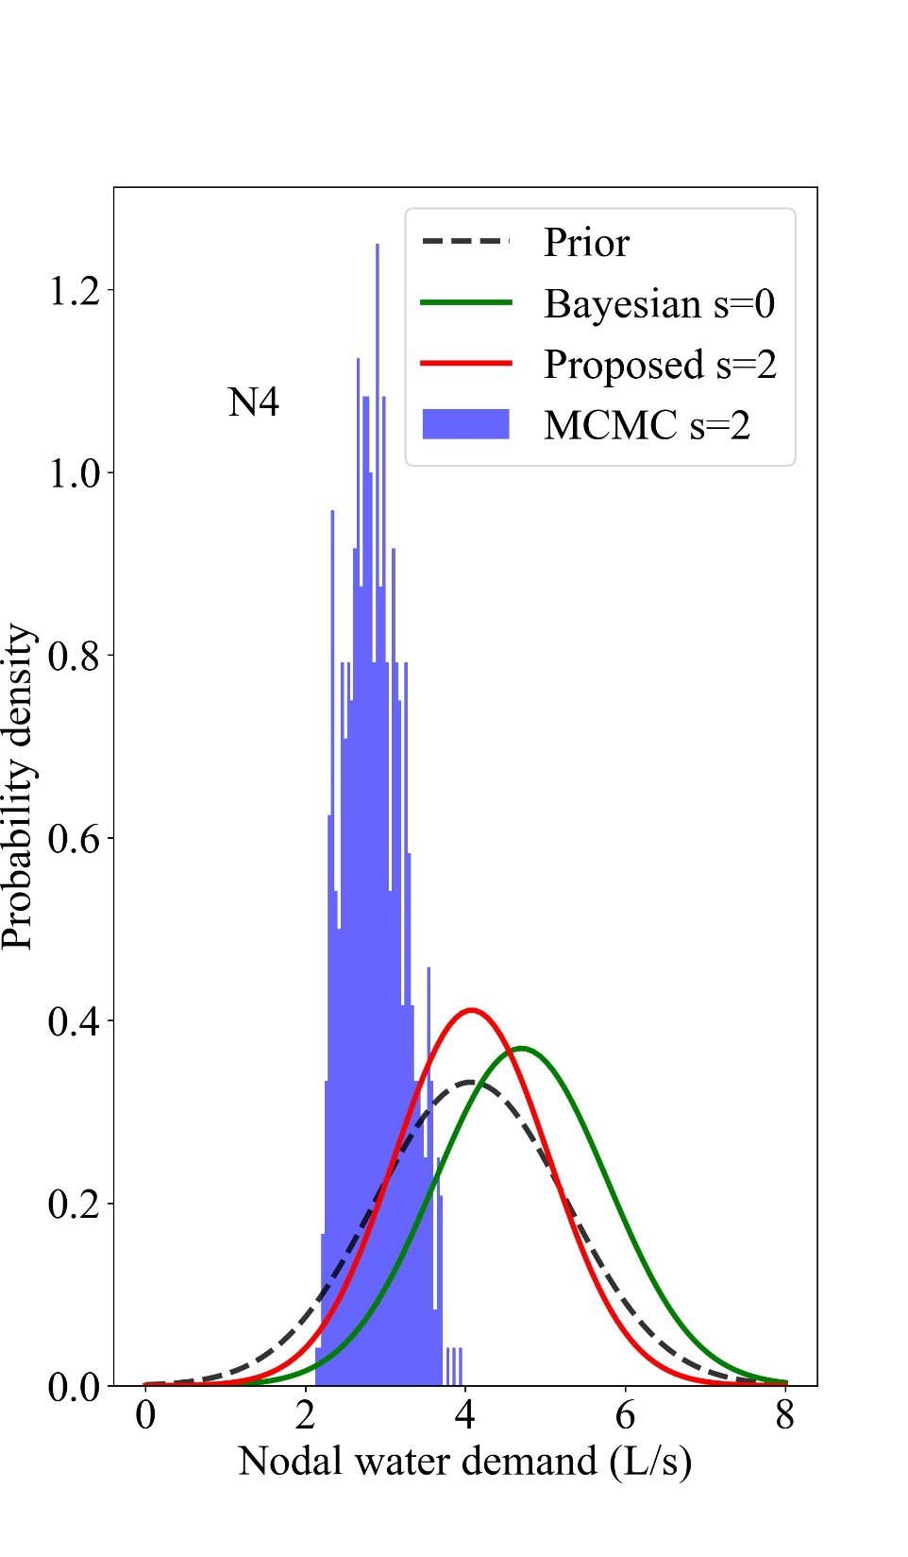
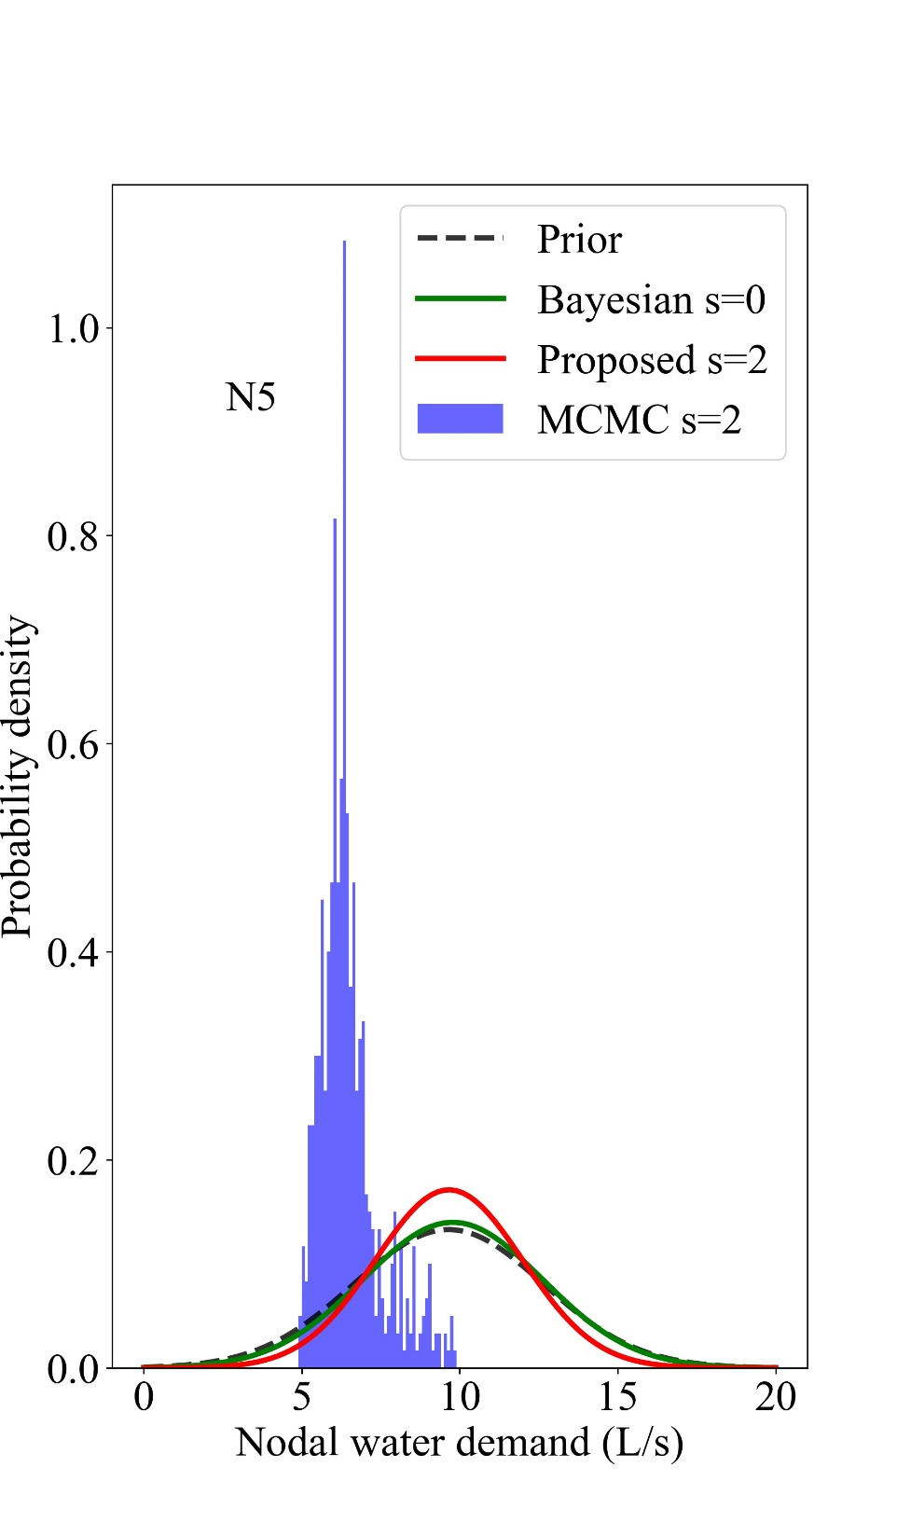
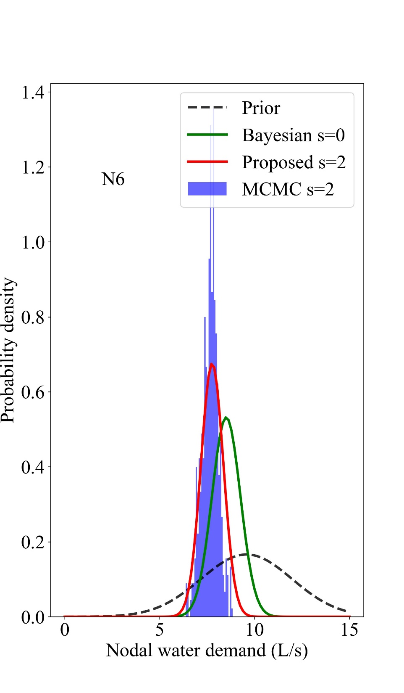
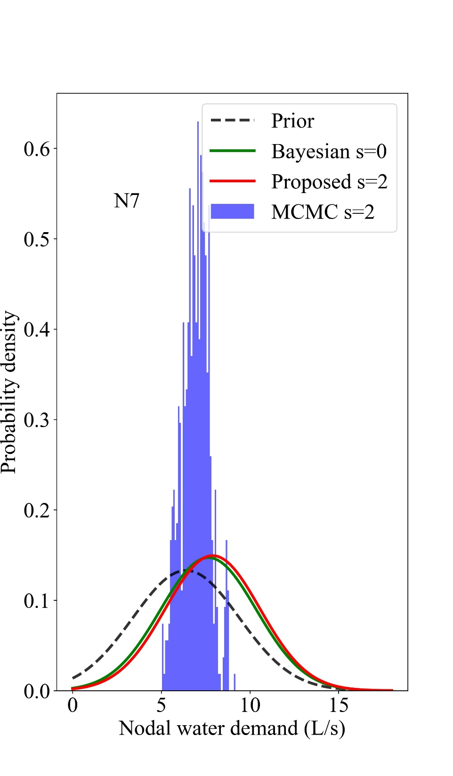
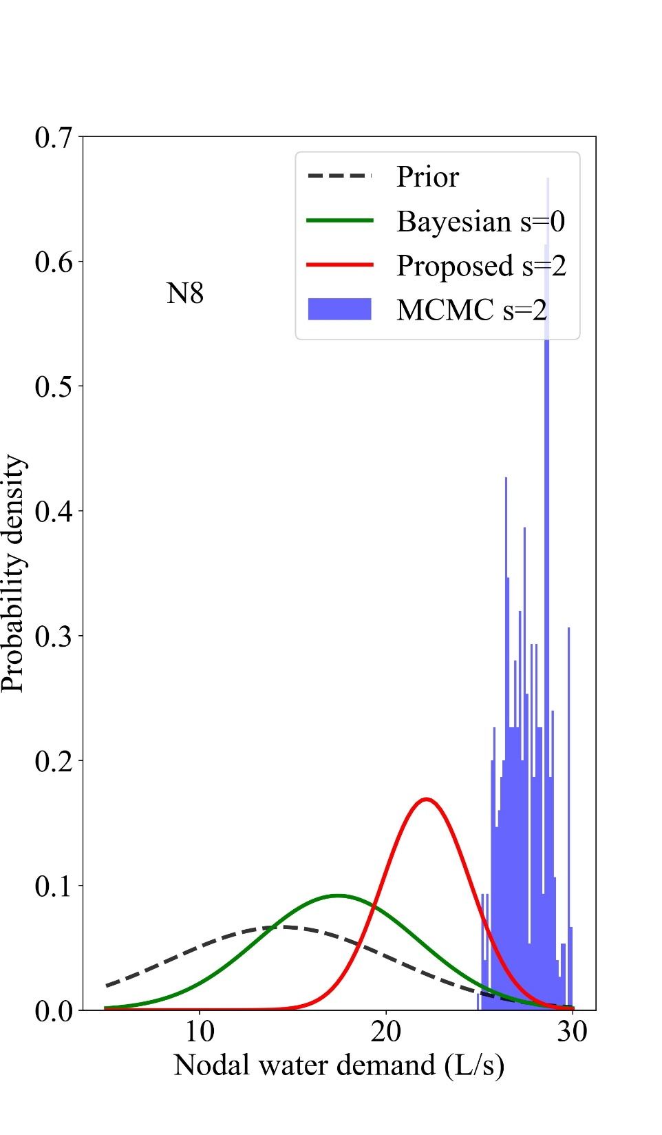
Mean: 10.53
Mean: 5.98
Mean: 14.20
Mean: 2.87
Real value: 10
Real value: 5
Real value: 15
Real value:4
Mean: 6.49
Mean: 7.66
Mean: 6.93
Mean: 27.55
Real value: 10
Real value: 8
Real value: 10
Real value: 20

