Slide 1
Multiple Linear Regression Project-3

Slide 2
Objectives
Using Multiple linear regression:
Prediction of Profit earned in the Startups of different states using R&D, Administrative and Marketing spending
To draw insights by performing EDA on the data
Model building and prediction
Business Impact

Slide 3
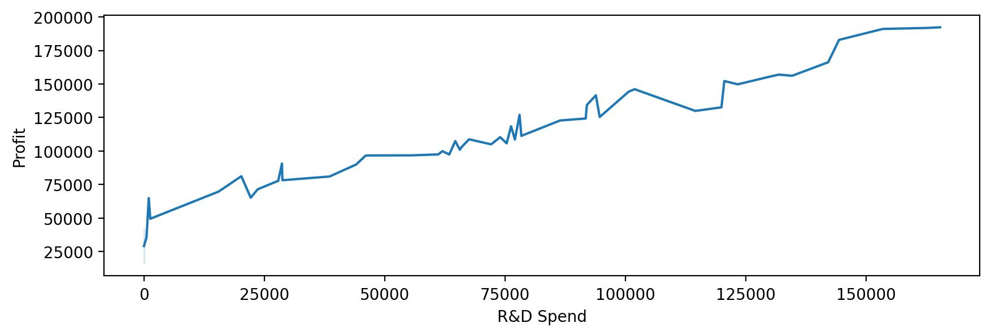
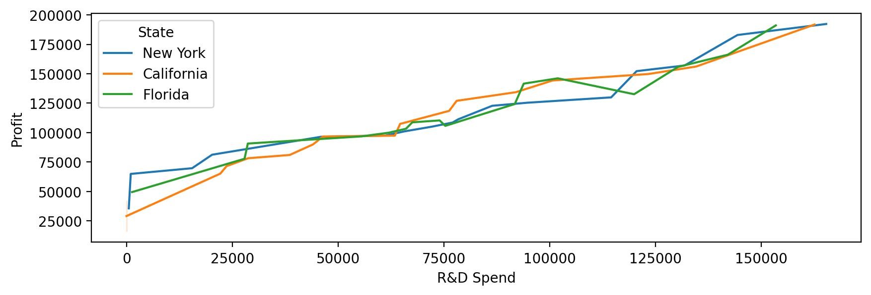
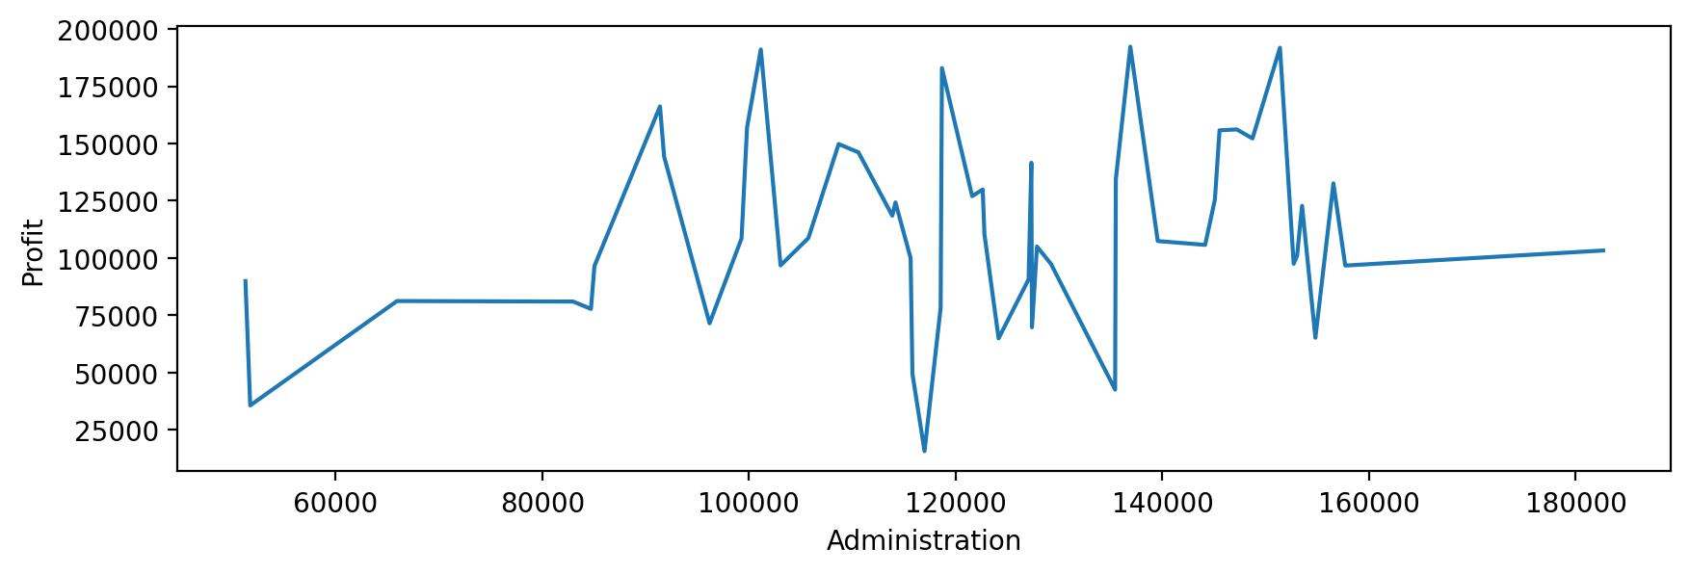
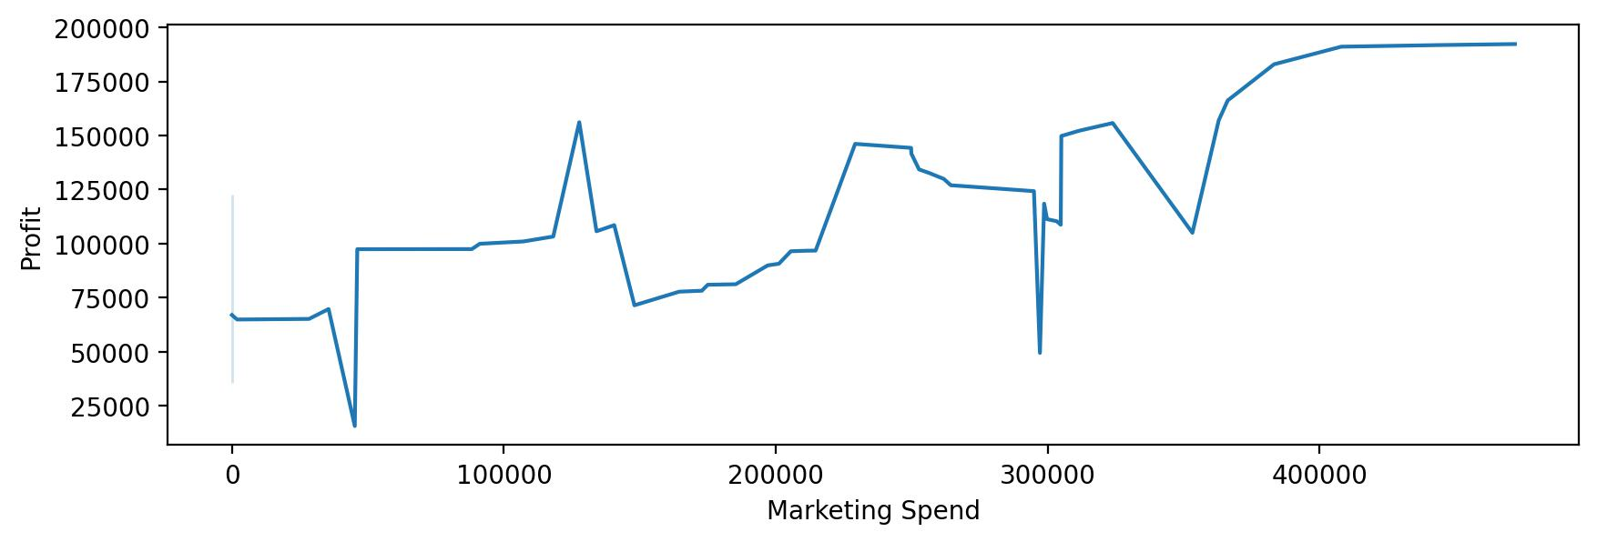
Exploratory Data Analysis on the data
Spending wise total profit earned in the startups of different states
(1)
(2)
(3)
(4)
Figure 1 and 2 depicts that increase in the R&D spending results in a linear increase in the profit earned by the startups from different countries.
Figure 3 does not tells the clearer picture of the relation between profit earned and administration spending that means the profit of the startups does not depends upon the administration spending.
Figure 4 displays that the profit of the startups partially depends upon the Marketing spending as it also depends on other factors.

Slide 4
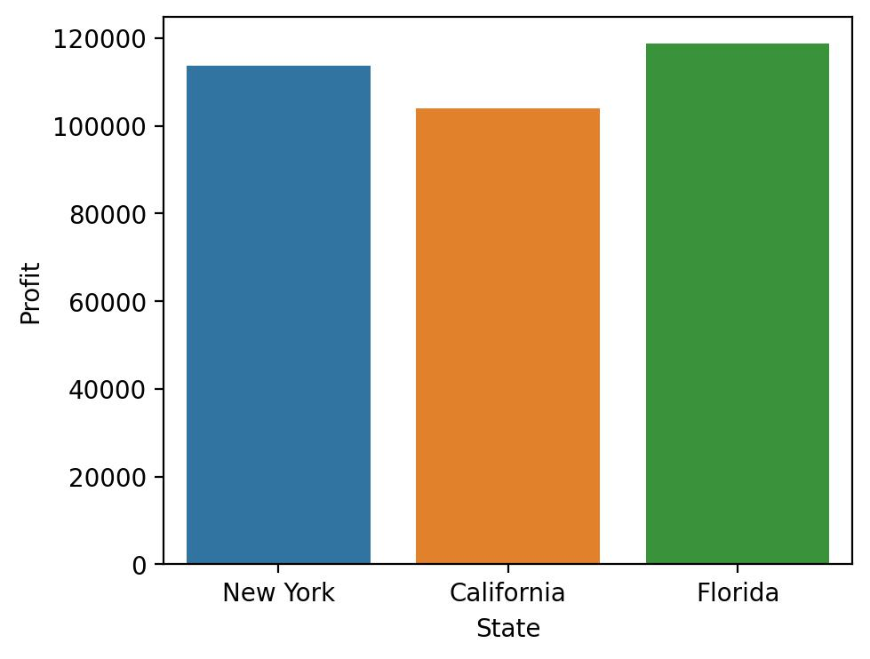
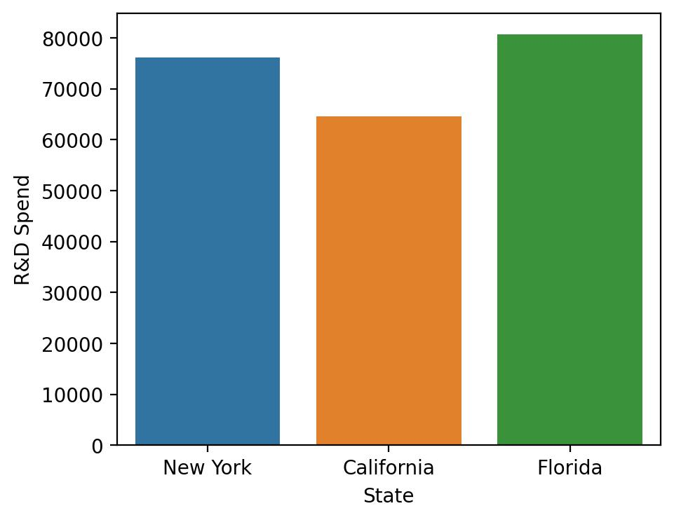
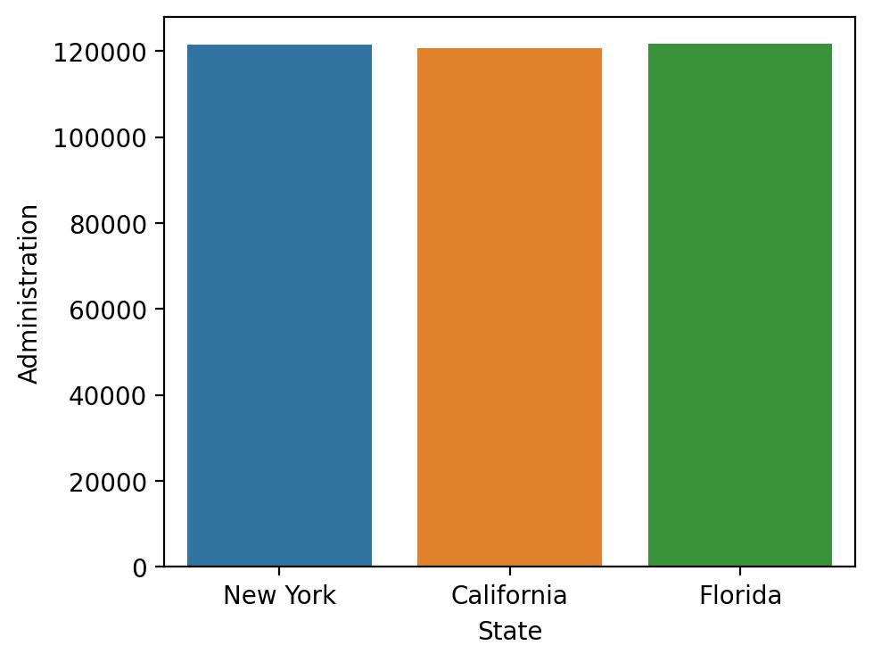
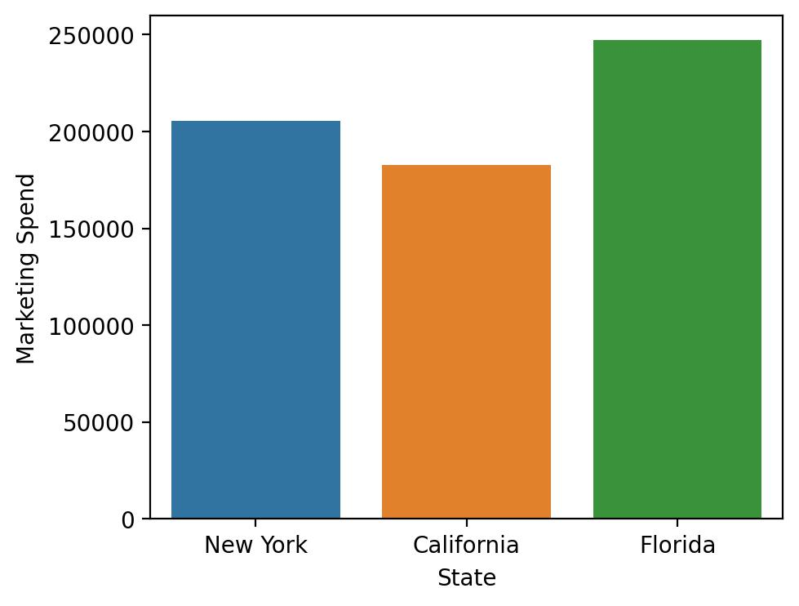
Exploratory Data Analysis on the data
State wise total spending and profit earned in the startups
Florida has earned the maximum profit followed by New York and California. (Figure 5)
Florida has maximum R&D spending followed by New York and California. (Figure 6)
All the three states have almost equal Administration spending so, profit earned is not likely to depend on this data. (Figure 7)
Florida spends maximum on Marketing followed by New York and California. (Figure 8)
It can be concluded that profit earned in the startups is likely to depend upon the R&D and marketing spend.
(5)
(6)
(7)
(8)

Slide 5
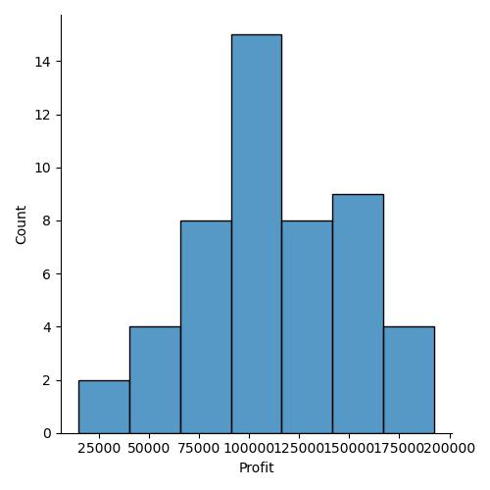
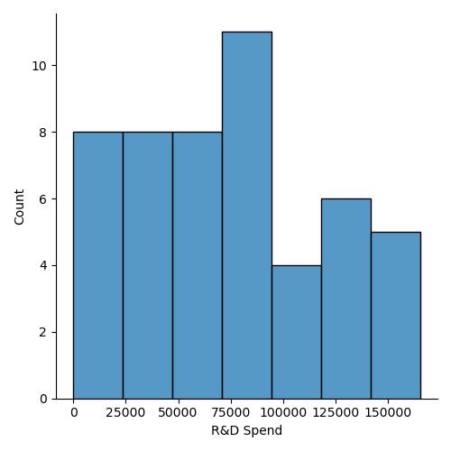
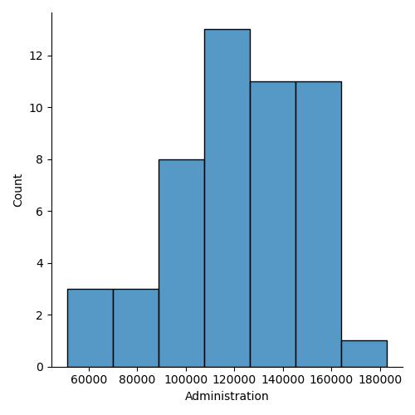
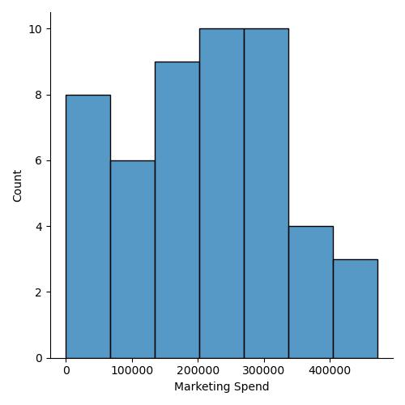
Exploratory Data Analysis on the data
Distribution of total spending and profit earned in the startups
(9)
(10)
(11)
(12)
Fields | Skewness
Profit | 0.20
R&D spending | 0.16
Administration spend | -0.49
Marketing spend | -0.05
The data is normally distributed in all the cases. Figure(9-12)
Since skewness in all the cases lies between -1 and 1 which is for normal distribution.

Slide 6
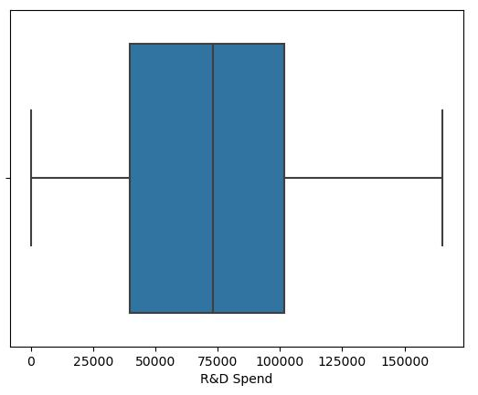
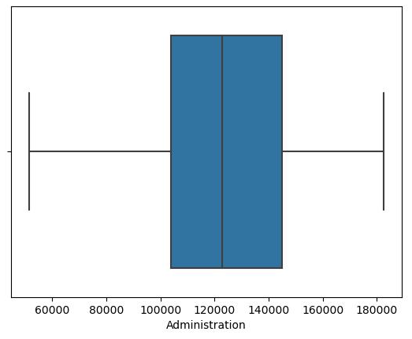
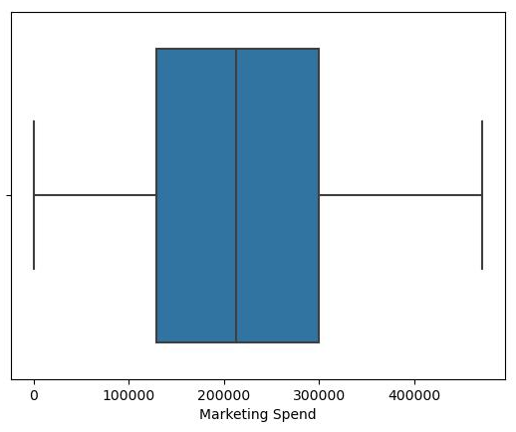
Exploratory Data Analysis on the data
Outliers detection using box plot
(13)
(14)
(15)
There are no outliers present in R&D, administration and marketing spend data. Figure(13-15)

Slide 7
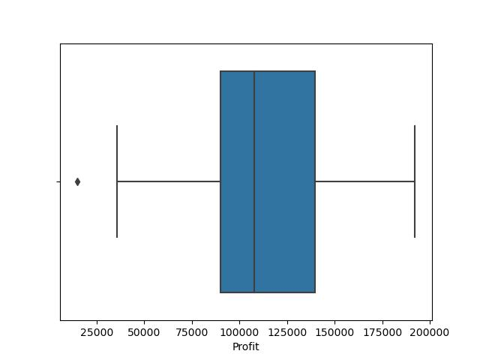

Outliers detection using box plot
Before
After
There is one outlier detected in profit data. It is present in left side. (Figure-Before)
It is adjusted or removed by using quartiles and lower threshold values. (Figure-After)

Slide 8
The dataset is solved by multiple linear regression.
Method-1
Linear regression
Method-2
Ridge or L2 Regression
Method-3
Lasso or L1 Regression
R square value
Model | R square value
Linear Regression | 0.965
Ridge Regression | 0.941
Lasso Regression | 0.954
In all the models R square value lies between 0 and 1.
The model is strongest when approaches 1 and weakest when approaches 0.
All the models are very strong.
Although Linear regression model is the strongest, it means the data is not over fitted.
It is a generalized model.
R square value calculated from Rige and Lasso Regression is slightly less than the valur obtained using Linear Regression fitting.

Slide 9
Business Impact
Improved Decision-Making: Accurate profit predictions based on R&D and marketing spending enable the company to make informed and strategic decisions. Budget allocation, resource planning, and marketing strategies for maximum profitability can be optimized.
Cost Optimization: Data-driven insights from regression models help in optimizing spending on R&D, administration and marketing. Areas for most effective budget allocation can be identified and unnecessary expenses can be reduced.
Increased Profitability: The precision of the regression models results in increased profitability. Efficient spending and resource allocation lead to higher profit margins and overall financial success.
Strategic Resource Allocation: Accurate profit predictions guide the allocation of resources and personnel. We can deploy teams and budgets more strategically, ensuring that they are aligned with profit-generating activities.

Slide 10
Business Impact
Resource Efficiency: Efficient spending, guided by the regression models, leads to resource efficiency. This means the startup company can achieve more with fewer resources, reducing waste and overhead costs.
Risk Mitigation: Accurate profit predictions help in identifying and mitigating financial risks. Proactive adjustments can be made to avoid potential losses.
Shareholder and Investor Confidence: Strong profitability driven by data-backed spending strategies fosters confidence among shareholders and investors. They are more likely to support the business, contributing to its financial health and growth.
Business Growth: Increased profitability and efficient spending lead to business growth opportunities.

