Slide 1
Multiple Linear Regression Project-4

Slide 2
Objectives
Using Multiple linear regression:
Prediction of Toyota Corrolla Car’s Price based on various parameters like KM,CC,HP etc
To draw insights by performing EDA on the data
Model building and prediction
Business Impact

Slide 3
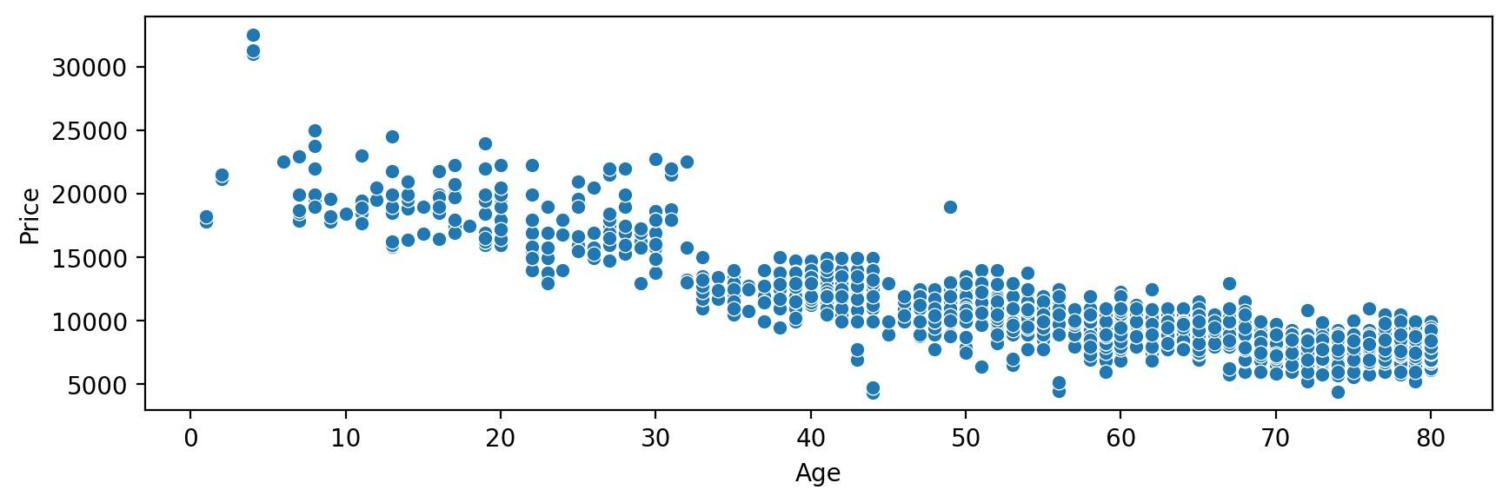
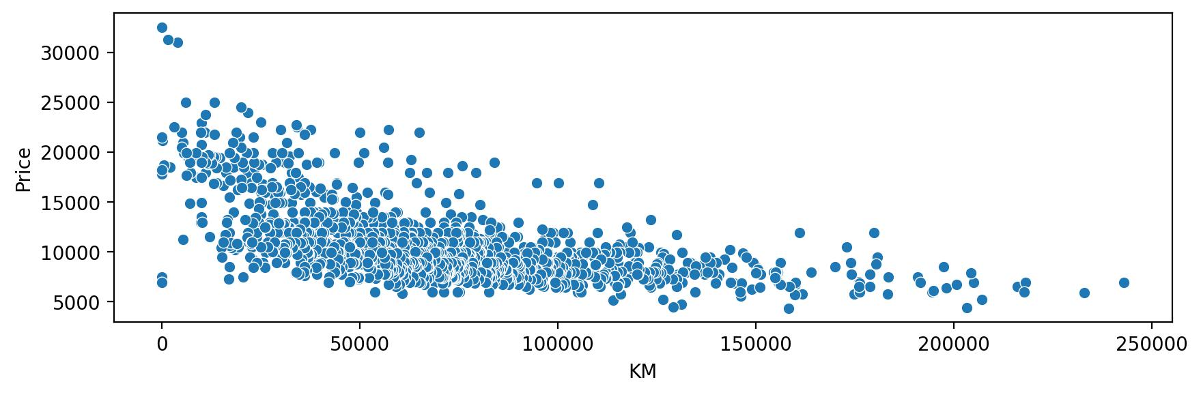
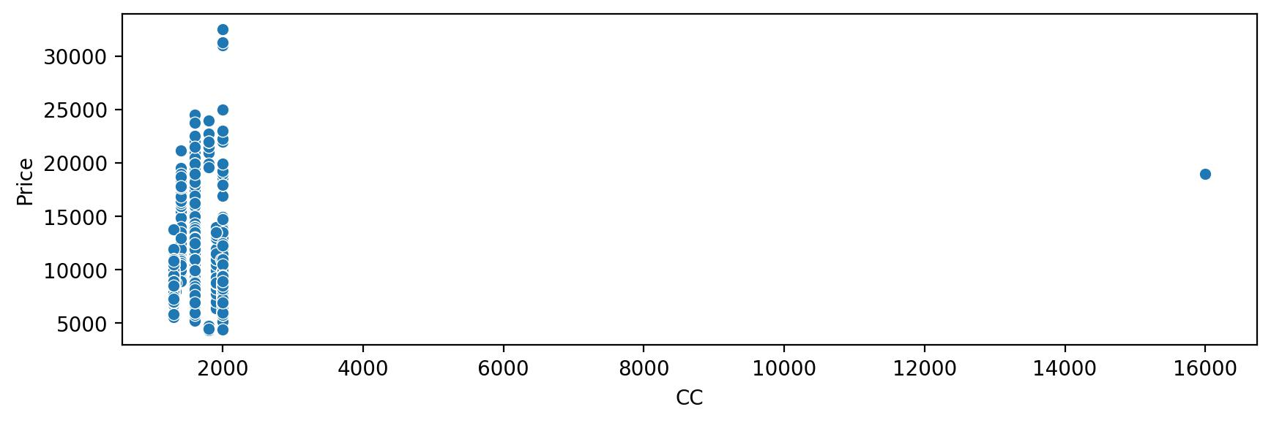
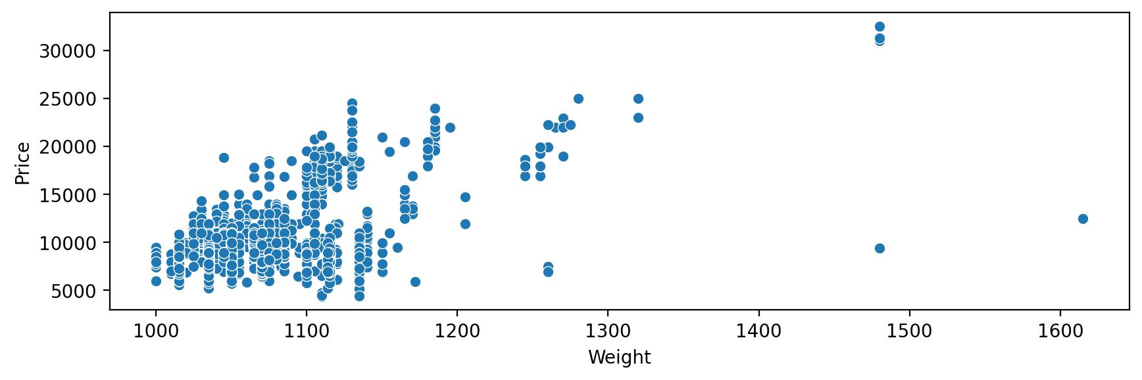
Exploratory Data Analysis on the data
Age, KM, CC and Weight wise variation in Toyota Corolla car Price
(1)
(2)
(3)
(4)
Figure 1 and 2 depicts that increase in Age and Kilometers travelled by car results in the decrease in the car prices.
Figure 3 does not tells the clearer picture of the relation between CC and Price of the car, implying the CC and price are not correlated.
Figure 4 displays that the price of the car partially depends upon its weight and does not have much affect on prices due to the car’s weight.

Slide 4
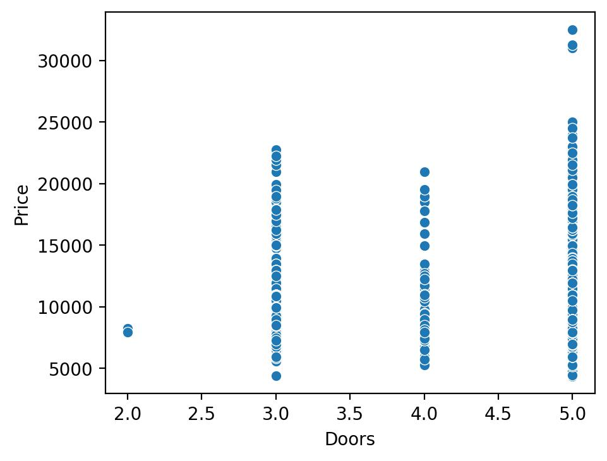
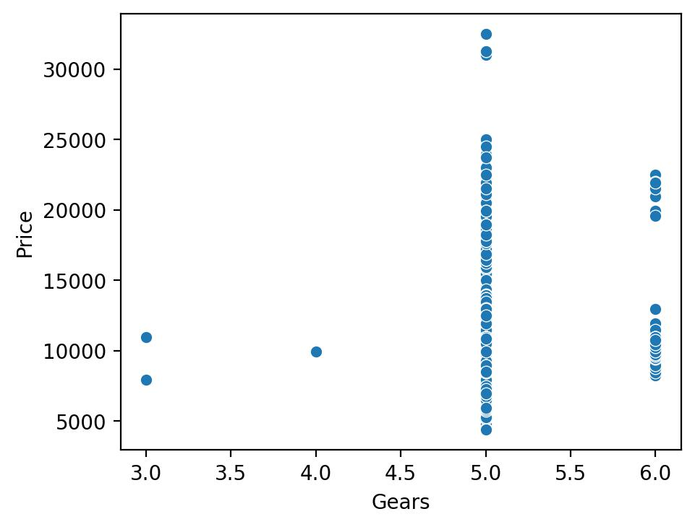
Exploratory Data Analysis on the data
# of car doors and gears wise variation in Toyota Corolla car Price
Toyota Corolla car comes under all price range in case of 5 and 6 gears.
Variations in car price are maximum in case of 5 gears.
The expensive car falls in the category of 5 gears.
Toyota Corolla car comes under all price range with same set of doors.
Although, the most expensive car falls in the category of five doors

Slide 5
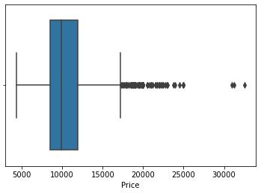
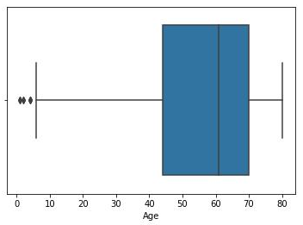
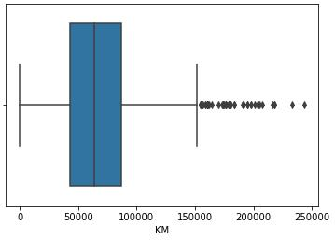
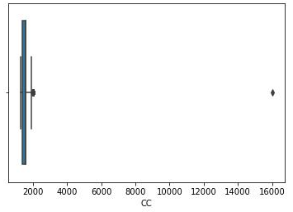
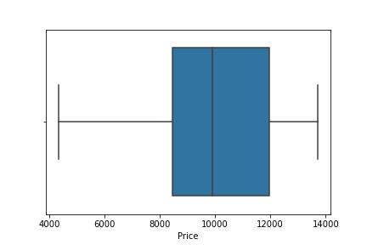
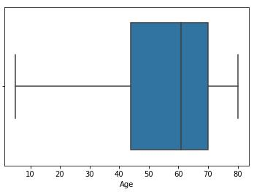
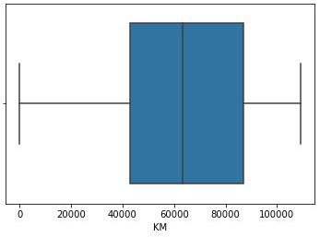
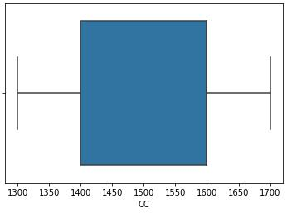
Exploratory Data Analysis on the data
Outliers detection using box plot
(5)
(6)
(7)
(8)
(9)
(10)
(11)
(12)
Outliers are present in Price, Age, KM and CC data as shown in Figure 5-8.
Outliers have been rectified from Price, Age, KM and CC data as shown in Figure 9-12.

Slide 6
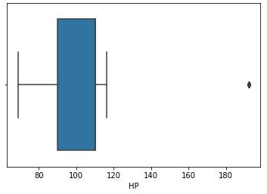
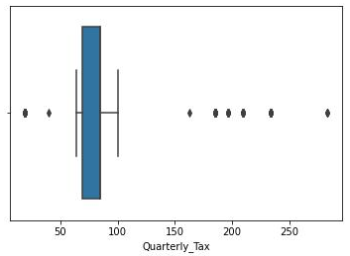
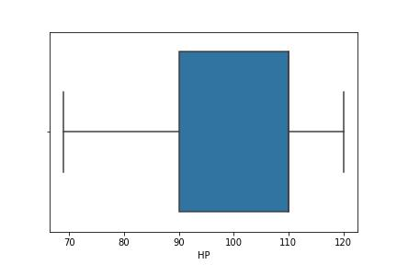
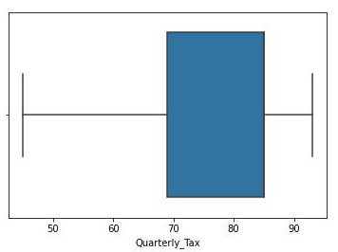
Exploratory Data Analysis on the data
Outliers detection using box plot
(13)
(14)
(15)
(16)
Outliers are present in HP and Quaterly_tax data as shown in Figure 13, 14.
Outliers have been rectified from HP and Quaterly_tax data as shown in Figure 15, 16.

Slide 7
The dataset is solved by multiple linear regression.
Method-1
Linear regression
Method-2
Ridge or L2 Regression
Method-3
Lasso or L1 Regression
Method-4
Polynomial Regression
R square value
Model | R square value
Linear Regression | 0.773
Ridge Regression | 0.718
Lasso Regression | 0.718
Polynomial Regression | 0.755
In all the models R square value lies between 0 and 1.
The model is strongest when approaches 1 and weakest when approaches 0.
All the models are strong.
Although Linear and polynomial regression model is the strongest, it means the data is not over fitted.
It is a generalized model.
R square value calculated from Ridge and Lasso Regression is slightly less than the value obtained using other two fitted models.

Slide 8
Business Impact
Pricing Strategy Optimization:
Leverage accurate price predictions to refine Toyota Corolla's pricing strategy, ensuring competitiveness in the market.
Align pricing decisions with the value derived from parameters such as Age of car, HP, Kilometers, CC, Quaterly tax, and Weight of the car.
Market Positioning:
Tailor pricing strategies to reflect the Corolla's strengths in comparison to competitors.
Use data-driven insights to position the Toyota Corolla strategically in the market, capturing value and maintaining a competitive edge.
Customer Satisfaction:
Provide transparency and fairness in pricing, enhancing customer trust and satisfaction.
Ensure that pricing aligns with the perceived value of the car, considering factors like Age, HP, Kilometers, CC, Quaterly tax, and Weight.
Profitability Enhancement:
Maximize profitability by setting optimal prices based on a comprehensive analysis of relevant parameters.
Identify opportunities to increase margins without compromising market share.

Slide 9
Business Impact
Targeted Marketing Campaigns:
Craft targeted marketing initiatives based on the insights derived from price prediction data.
Tailor promotional efforts to highlight specific features (e.g., HP, low Kilometers) that contribute to the perceived value of the Toyota Corolla.
Resale Value Considerations:
Anticipate how different parameters influence the resale value of the Toyota Corolla.
Provide customers with insights into the long-term value of their investment, considering factors like Age, Kilometers, and overall condition.
Competitive Advantage:
Gain a competitive advantage by staying ahead of market trends and adjusting pricing strategies in real-time.
Leverage data to respond promptly to changes in consumer behavior, economic conditions, or industry dynamics.

