Slide 1
Linear Regression Project-1

Slide 2
Objectives
Using simple linear regression:
Prediction of Delivery time using Sorting time
To draw insights by performing EDA on the data
Model building and prediction
Business Impact

Slide 3
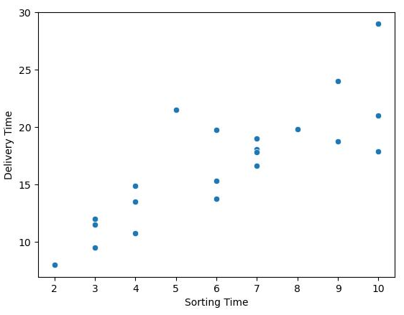
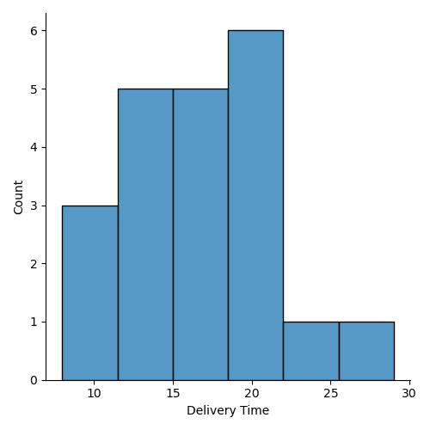
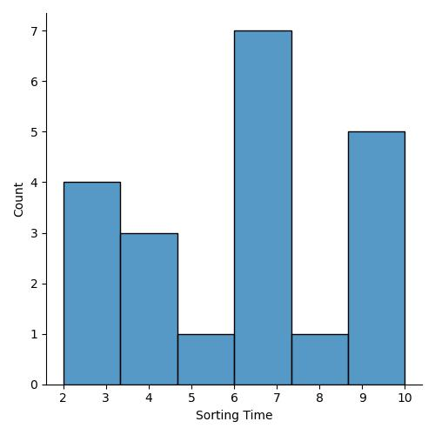
Project 1: Prediction of Delivery time using Sorting time
Exploratory Data Analysis on the data
(1)
(2)
(3)
Scatter plot in Figure 1, shows that Delivery time does depend on sorting time but only to certain extent, since for the same sorting time there are different delivery time that means it also depend on other parameters
Figure 2 and 3 depicts that the distribution of delivery time and sorting time is normally distributed and the skewness lies between -1 and 1
Skewness (Delivery time): 0.35
Skewness (Sorting time):0.05

Slide 4
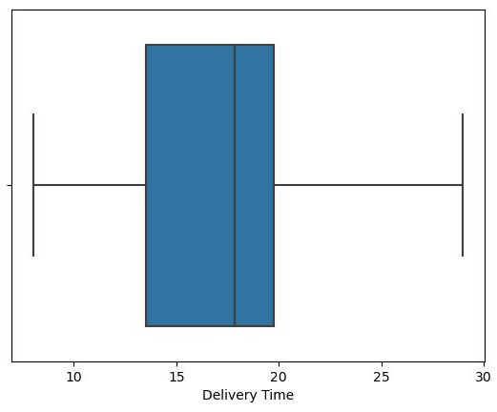
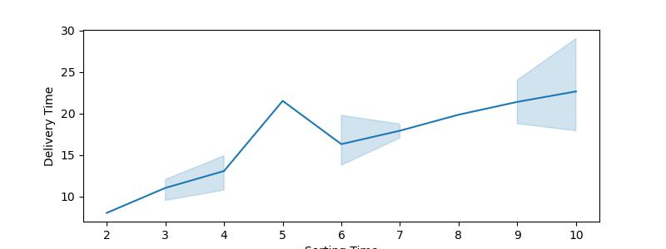
(4)
(5)
Box plot in Figure 4 depicts that there are no outliers present in the data.
Figure 5 is the line plot between delivery time and sorting time and shows that increase in sorting time causes an increase in delivery time as well.

Slide 5
Correlation
Both delivery time and sorting time are ~83% correlated, which is a moderate correlation.
(correlation > 85%, is a strong correlation)
Co-efficient (m)
The co-efficient of the equation of fitted data came out to be 1.6707
Intercept (c)
The intercept of the equation of fitted data came out to be 6.2557
R square value
R_square value: 0.697
The strength of the model is strong since R square value lies between 0 and 1.
The model is strongest when approaches 1 and weakest when approaches 0.
The predicted values are fine and the fitted model is strong.

Slide 6
Business Impact
Enhanced Operational Efficiency: The ability to accurately predict delivery times based on sorting time enables to streamline the logistics and supply chain operations. Routes, schedules, and resource allocations can be optimized resulting in reduced operational costs and increased efficiency.
Improved Customer Satisfaction: Reliable delivery time predictions lead to more precise scheduling and timely deliveries. This significantly enhances the customer experience, contributing to higher satisfaction rates and improved customer retention.
Cost Reduction: Accurate predictions help minimize excess labor costs, fuel expenses, and other operational overheads. This cost reduction directly contributes to improved profitability.
Supply Chain Resilience: The ability to anticipate delivery times with precision enhances the supply chain resilience. The company can proactively address disruptions, ensuring business continuity and reducing the impact of unforeseen events.

Slide 7
Business Impact
Customer Loyalty and Word-of-Mouth Marketing: Timely deliveries and accurate predictions foster customer loyalty. Satisfied customers are more likely to recommend the services to others, contributing to organic growth through word-of-mouth marketing.
Brand Reputation: The reliability and accuracy of the delivery predictions enhance brand's reputation, instilling trust and confidence in the services. This can lead to a larger customer base and more repeat business.
Sustainability: Efficient delivery schedules reduce fuel consumption and environmental impact, contributing to the sustainability goals and corporate responsibility.

